Slide 1

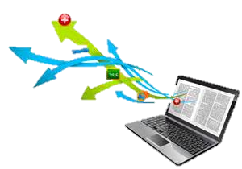
EMERGING STANDARDS IN E-LEARNING: how to start
Presentation by:
OWOJUYIGBE Ayodeji. A
ICT Librarian,
YabaTech.
aowojuyigbe@gmail.com

Slide 2

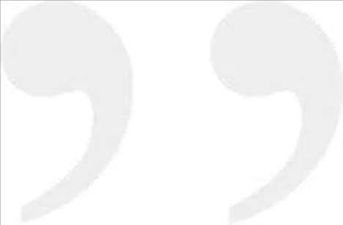
“If you wait for a perfect condition, you will never get anything done” – Ecclesiastes 11:4
“Great achievement is usually born of great sacrifices and is never the result of selfishness” – Napoleon Hill
“If Nigeria fails, it is because education has failed; and if education fails, it is because teachers have failed to deliver their mandate” – Owojuyigbe Ayodeji. A

Slide 3
Our focus:
Digital Library known as e-Library
The e-Future Challenges
Experiences with e-Learning in Academic Education

Slide 4
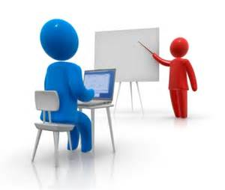


Introduction
Digital
Electronic
Virtual
Automated
The New Concepts of ICT in Librarianships are set up for the following goals:

Slide 5
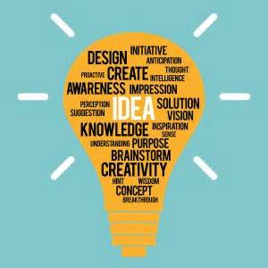
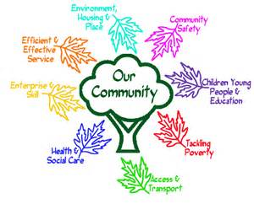
Introduction Contd.
Digital library base on:
converting print-on-paper resources
to digital form, usually by Scanning
a managed and organized collection of
information resources, preserved for a long
time, with associated user services, where the information

Slide 6


Introduction Contd.
Electronic library base on:
converting print-on-paper resources (hard copy)
to soft copy format,
a place where electronic materials such as video tapes and CD-ROM can be accessed using video machine and computer.

Slide 7
Introduction Contd.
Virtual library base on:
Library without wall.
Consist of both digital and electronic libraries.
Library that is everywhere.

Slide 8
Introduction Contd.
Automated library base on:
Consists of Library software's such as:
  - NewGenLib. Software (New Generation Library Software)
Consists of the following:
- digital library - electronic library.
- virtual library - online library
Library in which all the activities within library are linked together to efficiency and effectiveness.

Slide 9
Introduction Contd.
Librarians are expected to grow their leadership competencies and skills to manage the emerging changes in libraries.
The extent to which libraries will adapt to technologies and mainstream to global standards would be a reflection of its leadership.
Widening digital divide, resistance to change, declining culture of reading and assimilation as well as poor skills are traceable to leadership deficit in the libraries and the parent institutions.

Slide 10
Introduction
Technological Innovations
Shift from PRINT era to DIGITAL era
The change
New librarian landscape in terms of services and activities
These innovations have affected the roles, competencies, skills and knowledge of library and information science professionals

Slide 11
Quote
“We are no longer just the guardians of books. We are information providers in an environment that is constantly changing and where the information needs to be gathered quickly and effectively. Today, our mission is to promote services for the ever increasing amount of information. And even if we don’t like it, information technology has changed our jobs.”
As stated in the paper of Erlendsdóttir(1998)

Slide 12
Categories of Competencies
Professional Skills –IT Skills
-Hardware/ software and networking Skills
-MS-Office suite
-Presentation
-software’s e.g. power point etc.
-Library automation
-Database creation

Slide 13
-Internet e.g. E-Mail management, Intricacies of internet search tools
-Intranet skill
-Scanning techniques
-Networking skills
. On-line search engines
. On-line databases search
-Desktop publishing
-Content development
-Digitization
-Web based services
-Virtual learning

Slide 14
Focus 1:
e-Library

Slide 15
Introduction
Online catalogues began 1990s
Not Web based & Required Software to run Interactively across the Internet
World Wide Web and hypertext-based catalogues came 2000
Access to collection by LAN and WAN
the Web facilitated universal Access

Slide 16
Key concepts in e-library
Born Digital, created as digital, used as digital, remains in digital form ever
Scanned created Digital and so packaged
Electronic / Digital Library Content created Digital by process of digitization and re-packaged as digital resource

Slide 17
E-Libraries & Digitization
Digitization is converting print-on-paper resources to digital form, usually by Scanning
Digital libraries are Electronic libraries
Virtual libraries
Libraries without walls
Paperless Libraries
A managed collection of Information resources preserved in digital format

Slide 18
Components common to e-library
organized information collections;
electronic or digital format
preserved information
online access via computer

Slide 19
hybrid libraries
Most libraries today are hybrid libraries
have both physical and digital collections
provide services both digital and Print
Within physical library space
available mainly in educational Institutions
and multinational corporations

Slide 20
Digital Related Terminologies
Library Portal
Digital Repository
Institutional Repository
Digital Library Management
Digital Preservation
Access Rights
Metadata

Slide 21
METADATA
Metadata is data about data
Information about information resources
physical description of items - format, size subject, topic
author, title, publisher, date of publication
preservation or archiving information
access information and copyright

Slide 22
E-library in Africa/Nigeria
e- Book -: eGranary
        Myilibrary
e- Journal -: EBSCO-HOST,
AGORA
JSTOR
SCIENCE DIRECT
Africa Online Digital Library - full access online to Multilingual, Multimedia Repository materials

Slide 23
WHY e-library?
Ensure Standardization Metadata format in libraries
Widen Access to Information (OA)
Facilitate Collaboration/Cooperation
Encourage Resource Sharing
Longevity/durability of Library Materials

Slide 24

Elements OF e-library
Users friendly
Display screen Tip name
Suit each organization in term of their activities
All features must be present
Must meet up with system requirements
Must be able to linked the user to the interface

Slide 25
Focus 2:
The Challenges of e-library

Slide 26
The Challenges of e-library
According to OCLC) & L of C ( 2015 Surveys):
Rights issues (copyright, privacy)
Born Digital, web harvesting
Issues with digital asset management systems (DAMS) or institutional repositories (IR)
Storage and preservation

Slide 27
E-library Challenges (survey)
Selection – prioritizing users over curators and funders
Audio/Visual materials
Access: are we putting things where scholars can find them?
Cost – Machines - Human Resources

Slide 28
Other Peculiar Challenges to e-library
Poor Facility Infrastructure
Inadequate Technical Expertise –
Staffing Retention Training
Poor understanding of Digitization Issues by supposed stakeholders
Copyright
Fast Changing Technologies

Slide 29
Challenges of e-library
Poor Facility Infrastructure
Inadequate Technical Expertise –
Staffing Retention Training
Poor understanding of Digitisation Issues by supposed stakeholders
Copyright
Fast Changing Technologies

Slide 30
Challenges of e-library
Integrating Access to both physical and digital materials for Effective Access
Intellectual Property Rights – access, dissemination of physical of digital materials, copying
Process management / workflow / shift from projects to programmes

Slide 31
Challenges of e-library
Integrating Access to both physical and digital materials for Effective Access
Intellectual Property Rights – access, dissemination of physical of digital materials, copying
Process management / workflow / shift from projects to programmes

Slide 32
Focus 3:
Way Forward for e-library

Slide 33
Way Forward for e-library
Digital Copy for preservation Not Replacement for Original piece
Collaboration –Resource Sharing
More User Orientation and Stakeholders Education
Training and Retraining of Library personnel
Improve Information Infrastructure Country wide
Continuation of Digital Efforts Institutional and otherwise to preserve the nations Intellectual and Historical Resources

Slide 34
E-library Principle
The e-library principle is captured in the spirit of Chinese proverb:
  What I hear, I forget
  What I see, I remember
  What I do, I understand
It involves blending of a variety of methods considered appropriate for delivery of learning contents

Slide 35
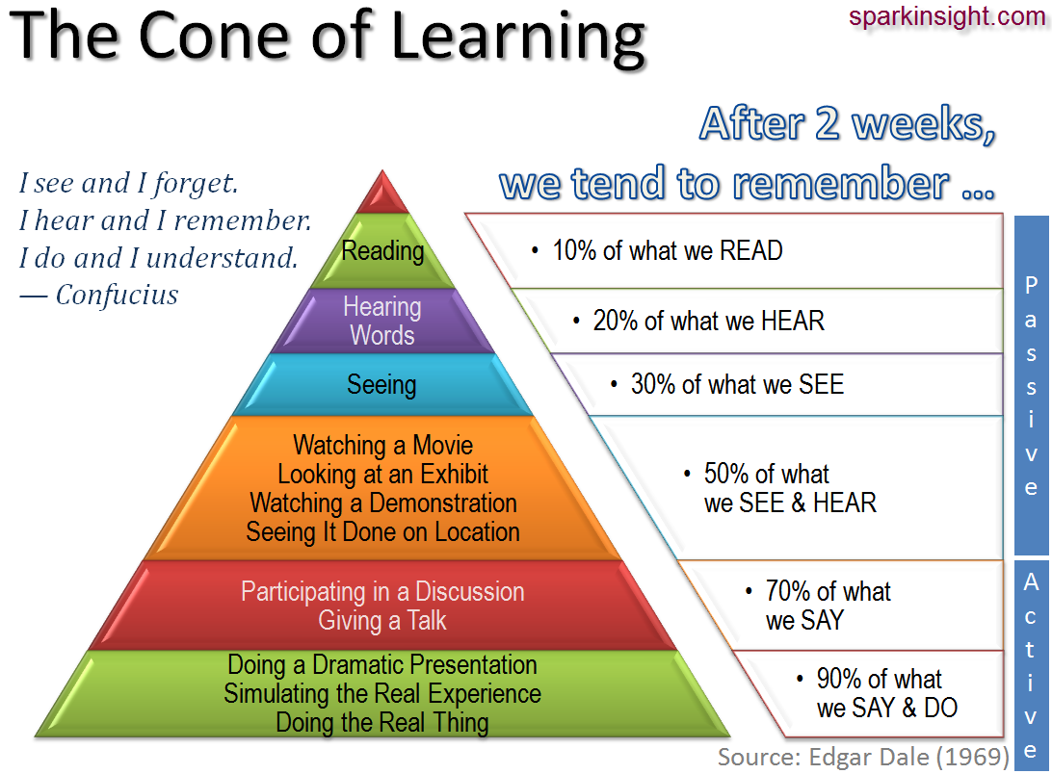

Slide 36
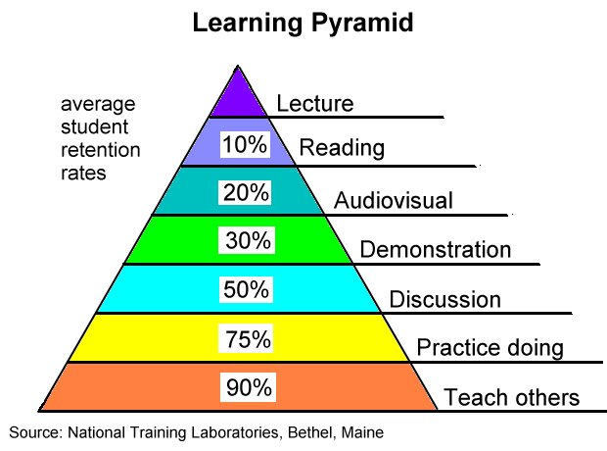

Slide 37
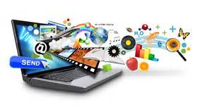

Conclusion
The Librarian should be willing to follow suit for us to succeed in finding local solutions to our national challenged.

Slide 38




