Slide 1

Presentation to Nigeria Governors’ Forum
27th August 2024
Presentation by: Kemi Adekanye, Chief Volunteer

Slide 2
Brief History
2017
Started supporting children fighting cancer in National Hospital Abuja under the name ‘Friends for a Cause’
2019
Registered with the CAC as Okapi Children Cancer Foundation
2020
Included children being treated for cancer at the University of Abuja Teaching Hospital, Gwagwalada
2023
Included children being managed for cancer at Federal Medical Centre Abuja

Slide 3
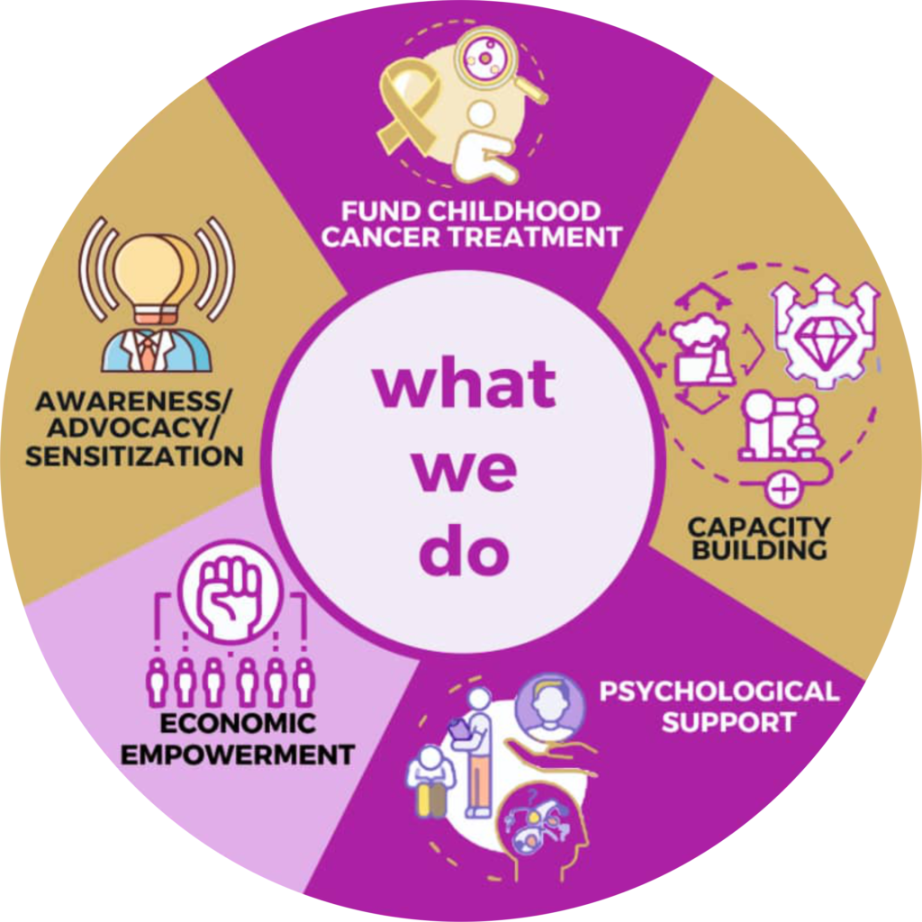
Our Core Competence
Fund Childhood Cancer Treatment
Capacity Building
Psychological Support
Economic Empowerment
Awareness/Advocacy Sensitization

Slide 4

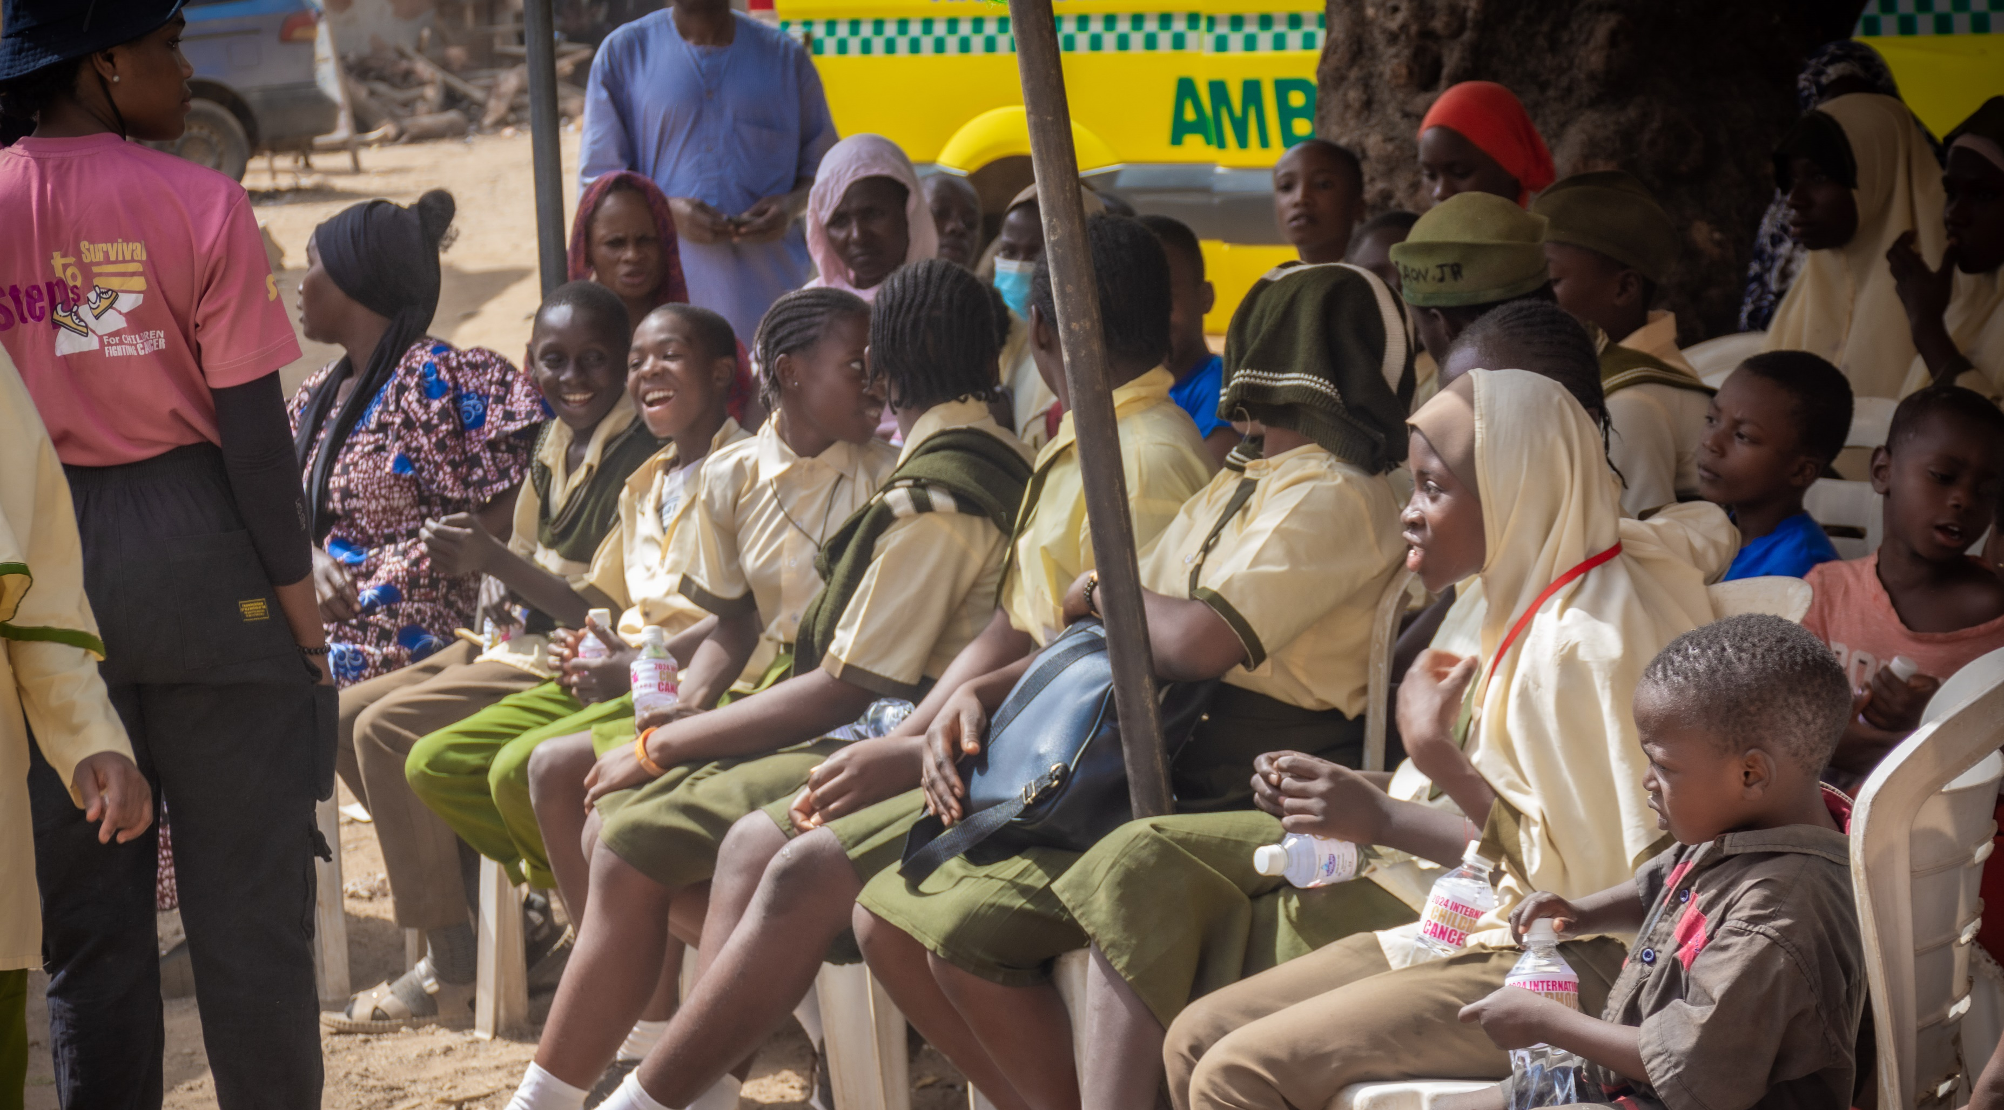
OKAPICCF Impact
Reduction in treatment abandonment
Improvement in treatment outcomes
Early presentation of cases to the hospital
Reduction in morbidity and mortality
Elimination of barriers to care

Slide 5
Intervention Avenues
1
Annual thanksgiving celebrations with children in all three hospitals
2
Annual Children’s Day celebrations
3
Annual International Childhood Cancer Day with medical outreaches
4
School sensitization program and awareness creation for school children and teachers
5
Annual Childhood Cancer Awareness Walk and fundraising
6
Weekly awareness and annual webinar

Slide 6
Direct Childhood Cancer Interventions
NATIONAL HOSPITAL ABUJA (FROM 2017)
UNIVERSITY OF ABUJA TEACHING HOSPITAL
(FROM 2020)
FEDERAL MEDICAL CENTER, JABI (FROM 2023)
137
PATIENTS
11
PATIENTS
40
PATIENTS

Slide 7
Secondary School Ambassadorial Program
S/N
School
Students
1
Tundun Wada Government Secondary School, Wuse Zone 4
373
120% average percentage increase in awareness post sensitization exercise
2
Regent Primary School, Maitama
85
3
Government Secondary School, Gwarinpa
320
4
Government Day Secondary School, Nyanya
157
5
Starville School, Jahi
128
6
Euston British School, Gwarinpa
85
7
Knosk N100 a day School, Kuje
62
Over 2500 school aged children trained on the basics of childhood cancer awareness
8
Holy Child Educational Home, Lugbe
109
9
Anglican Comprehensive Secondary School, Kubwa
148
10
Bwari Government Secondary School
400
11
Daisies Academy
170
12
Karshi Government Secondary School
230
13
Aduvie International School
100
14
Government Secondary School, Kubwa
120
15
Total Child School, Dutse
100

Slide 8
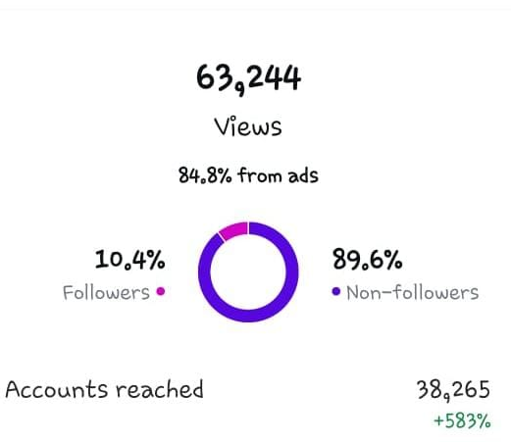
Awareness & Advocacy
Community sensitization outreaches with free medical consultations for over 1,000 community members in various communities and IDP camps.
Online awareness webinars reaching over 1,000 individuals annually.
Social media campaigns reaching over 60,000 monthly

Slide 9
Year-On-Year Fund Raising
Year
Amount Raised (NGN)
2017
765,000.00
2018
1,300,000.00
2019
2,150,000.00
2020
3,200,000.00
2021
6,000,000.00
2022
9,600,000.00
2023
15,300,000.00

Slide 10
Fund Raising Initiatives
Monthly Donor Schemes
Charity Shop Initiatives
Crowd Funding Efforts

Slide 11




The Future
Alignment and partnership with the Nigeria Governors Forum (NGF) on core intervention areas of childhood cancer i.e. community and school awareness, training of health care workers and economic empowerment for parents
Partnership with the NGF secretariat towards the upcoming childhood cancer awareness walk holding on the 28th of September 2024 and the esteemed presence of the DG as the SPECIAL GUEST OF HONOR
Support of the NGF in the expansion of OCCF reach and impact to other states i.e., presence of OCCF in at least 1 state in every geo-political zone
Collaboration with the health department of NGF secretariat on the implementation of childhood cancer advocacy and awareness in the FCT and other parts of the country

Slide 12
Thank You!

