Slide 1
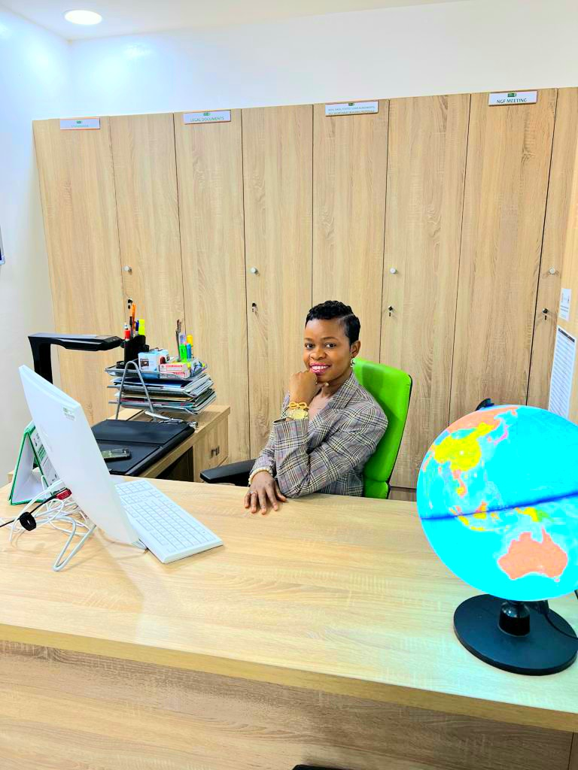
Sharing Experiences in Setting Up a Library: A Case Study of the Nigeria Governors’ Forum Special Library Setup from Scratch.
Lighting Talk Session Presentation at the Shrewsbury and Telford Health Libraries NHS Trust, Midlands United Kingdom.
NAOMI UBOGU 26/10/2023

Slide 2
Content
Overview
What you must consider before starting a library project
How it started
The second library set up :Planning the Process
The library 3D layout
The current NGF library in pictures
Sustainability of the library after setting up
General Challenges of setting up a library

Slide 3
Overview
One aspect of the library that any library staff should not overlook is how libraries are set up. Setting up a library requires careful planning, research, and the expertise of a librarian. The Nigeria Governors’ Forum Special Library project was executed with careful consideration of the needs of the library patrons and ensuring that all aspects of the library set up aligned with the core values of the organization.
The project commenced in August 2018 with the very first library in a small space with a few bookshelves and a reader's section. As library collections and patron usage continued to grow, there was a need to transform the library into a bigger and more modern library. This led to the transformation of the library in 2022.

Slide 4
What you must consider before starting a library project!
1. Needs of the patrons
2. Budget
3.Location & Infrastructure
4. Collection Development
5. Technology Integration
6. Staffing
7. Policies & Procedures

Slide 5
How it started

Slide 6
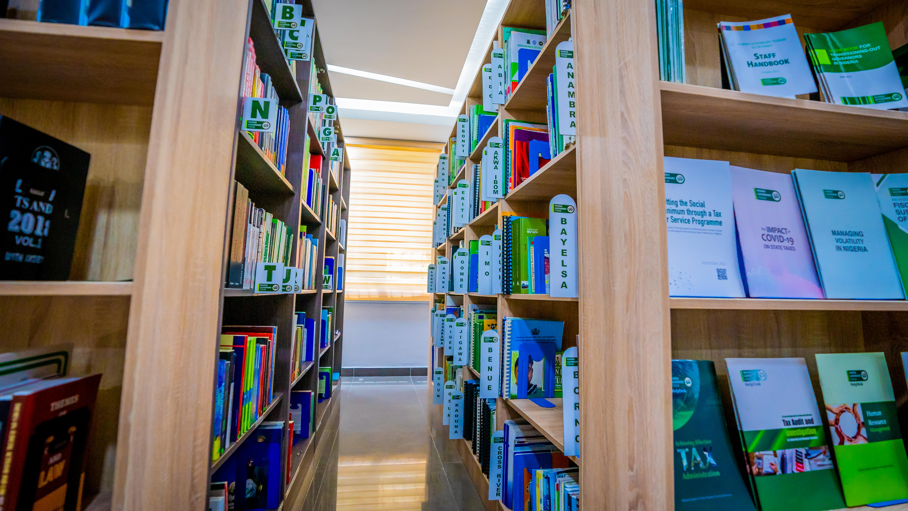
The second Library set up :Planning the Process
Developing the Concept Note
Transforming the Concept Note into 3D Design
Getting Approval for the Project
Sourcing for Vendors & Procurement Process
Project Execution
Work Plan

Slide 8
The current NGF Library in Pictures

Slide 21
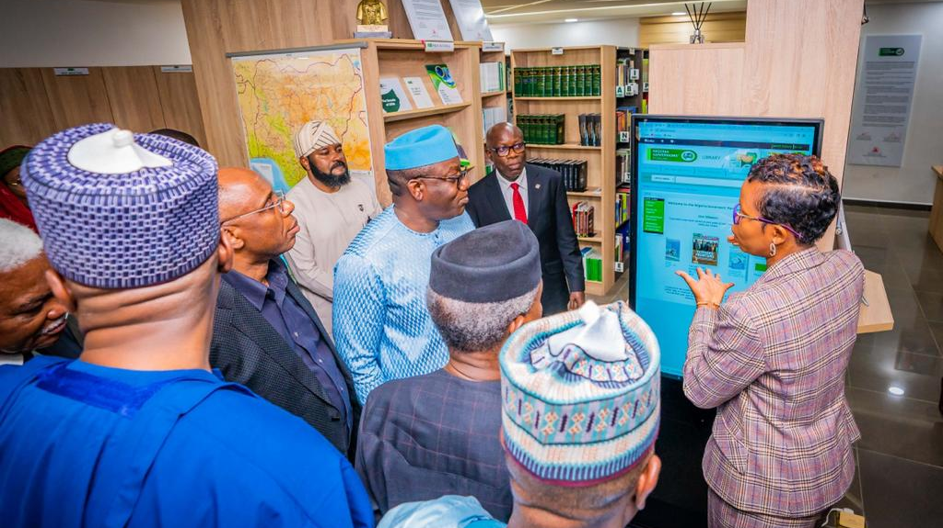
Sustainability of the library after setting up
Outreach, Advocacy & Engaging with Stakeholders
Keeping up with current library trends
Evaluations & Continuous Improvements
Monitoring & Reporting

Slide 22
General Challenges of setting up a library
Setting up a library from scratch can be a challenging task, but it can also be a rewarding experience. Here are some of the challenges that one may face when setting up a library from scratch:
Not having a plan: Working with no plan will lead to project failure.
Building a collection: Building a collection from scratch requires a lot of effort and planning. It involves creating an acquisitions plan, determining the costs of building the collection, and considering the role of book donations
Funding: Establishing a new library requires a funding plan and determining the sustainability of that plan.
Marketing: Connecting the new library with the community can be a challenge, and marketing plays a crucial role in getting the word out.
Policies and procedures: Developing policies and procedures can be a challenging task, especially when starting from scratch. It requires careful planning and adaptation as the library grows and evolves.
Working with limited resources: Starting a library from scratch often means working with limited resources, which can be a challenge. It requires creativity and resourcefulness to make the most of what is available.

Slide 23
Thank you!
Questions

