Slide 1
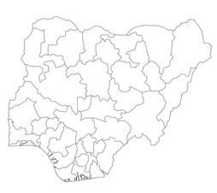
Capacity Building Workshop for Honourable Commissioners of Education in Nigeria
December 7, 2023

Slide 2
Background
Nigeria remains the most populous country in Africa with approximately 213 million people.
The country’s population growth is rapid with attendant pressure on the delivery of social services including education
Capacity building workshop for Commissioners of Education in Nigeria. December 7, 2023

Slide 3
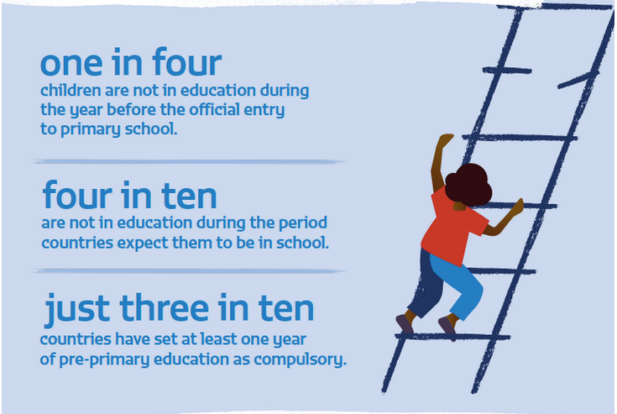
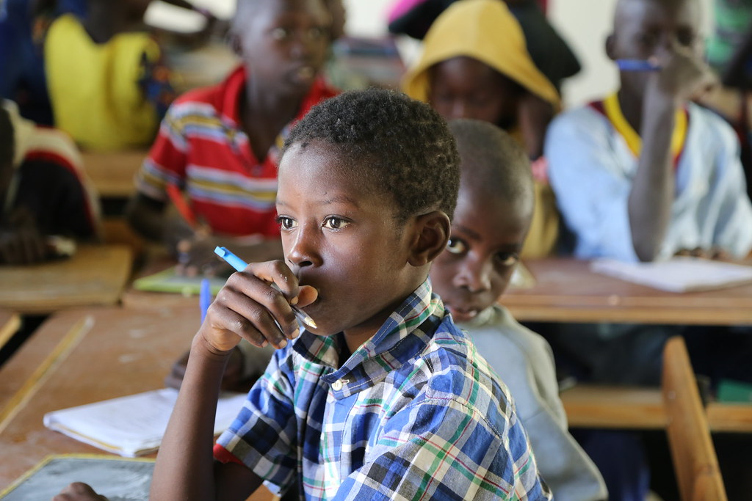
Evidence are:
Learning and out of school crises,
Access to inclusive and equitable quality education, and;
Skills development
Capacity building workshop for Commissioners of Education in Nigeria. December 7, 2023

Slide 4
As the UN, we are committed to driving this agenda with the government at the federal and state levels by working to
Increase percentage of children a) in grade 3; b) at the end of primary education; and c) at the end of lower secondary education achieving minimum proficiency levels in reading and mathematics. (SGD 4.1.1) from 20.90%(G3); 20.30%(G5); 65.90%(G9) to 23.40% G3; 33.90% G5; 73.80% G9
Capacity building workshop for Commissioners of Education in Nigeria. December 7, 2023
Notes:
Note:
Grade 5 is used as some private schools do not have grade 6
2027 target is 12% increase from baseline
Data Source: MICS

Slide 5
As the UN, we are committed to driving this agenda with the government at the federal and state levels by working to
To reduce out-of-school rate for children of primary and lower secondary school age:(SDG 4.1.4) from 41%(Total); 32%(Primary); 50%(Secondary)
to
32%(Total); 25%(Primary) and 45%(Secondary)
Capacity building workshop for Commissioners of Education in Nigeria. December 7, 2023

Slide 6
As the UN, we are committed to driving this agenda with the government at the federal and state levels by working to
To increase the proportion of teachers who have received at least the minimum organized teacher training (e.g. pedagogical training) pre-service, or in-service required for teaching at the relevant level, by sex and education level (%) (SDG 4.c.1 from 66%(Total); 71.7%(Female); 61%(Male) to 80%(Total); 80%(Female); 80%(Male)
Capacity building workshop for Commissioners of Education in Nigeria. December 7, 2023

Slide 7
United Nations Sustainable Development Cooperation Framework
UNSDCF
Useful Info on Education Outcome:
P. 51 By 2027, people in Nigeria enjoy equitable access and use of quality education system that delivers an inclusive education for learning and transferable
Accessible: https://nigeria.un.org/en/214596-united-nations-sustainable-development-cooperation-framework-unsdcf-2023-2027
The UN support will be coordinated within the framework of the UN-Nigeria partnership agreement (UNSDCF 2023 – 2027)
National and State peculiarities will be taken into consideration while intervening
Capacity building workshop for Commissioners of Education in Nigeria. December 7, 2023

Slide 8
Overarching intervention by output areas are:
Key interventions
Support Federal and State governments to review and align ESP to SDG4 to increase and expand access, inclusion, equity, and quality of learning outcomes.
Strengthen systemic capacity to manage and use EMIS, Lurits, TMIS and Learning Assessment.
Output 1:
System strengthening to plan, implement and monitor the delivery of basic quality inclusive education for knowledge and skills acquisition
Capacity building workshop for Commissioners of Education in Nigeria. December 7, 2023

Slide 9
Overarching intervention by output areas are:
Output 2:
Government, communities, and their partners demonstrate increased capacities to expand access to quality inclusive formal (pre-primary to secondary) and non-formal education, including in humanitarian and fragile contexts, and reduce the number of out-of-school children.
Key interventions
Provide technical support to improve access to quality and inclusive education and skills development for out of school children and young people including in refugee-hosting areas.
Strengthen youth and adult literacy including the development and institutionalization of accredited and flexible learning pathways and digital technologies
Provide technical assistance in implementation and monitoring of safe schools' framework.
Capacity building workshop for Commissioners of Education in Nigeria. December 7, 2023

Slide 10
Overarching intervention by output areas are:
Key interventions
Expand the rollout of foundational literacy and numeracy approaches in both formal schools and non-formal learning centers.
Expand, Integrate and Strengthen Systems (EISS) to build teachers’ capacity and resilience.
Promote inclusive and equitable education, health and wellbeing for thriving adolescent and young persons.
Equip learners with relevant skills to meet individual, labor market and societal demands through TVET, transferable and employability skills
Output 3:
The education eco-system is better able to transform the delivery of quality inclusive education that rapidly improves learning outcomes and skills development, including in humanitarian and fragile contexts.
Capacity building workshop for Commissioners of Education in Nigeria. December 7, 2023

Slide 11
Conclusion
The UN will remain committed to supporting Nigeria in the achievement of its goals by facilitating and supporting a multi-sectoral coordination platform for Education response.
Thank you!

