Slide 1
Efforts at Strengthening Fiscal Transparency, Accountability and the Ease of Doing Business at State-Level
THE JOURNEY SO FAR

Slide 2
A CASE OF THE $1.5 BILLION STATES FISCAL TRANSPARENCY, ACCOUNTABILITY AND SUSTAINABILITY (SFTAS)
The Program Development Objective (PDO) is to strengthen fiscal transparency, accountability and sustainability in the participating States, including in the context of COVID-19
Component One (Program for Results):
Performance-based Grants to States
ORIGINAL US$700 million
ADDITIONAL FINANCING US$750 million
Original Program approved in June 2018. Additional Financing approved December 2020. The PforR provides annual performance-based grants to States over four years: 2018 to 2021. Government Programs supported: The Fiscal Sustainability Plan and Open Government Partnership National Action Plan (and the National Economic Council COVID-19 Plan through Additional Financing) Ex-ante open to all 36 Nigerian States to participate, but States have to achieve the annual Eligibility Criteria to receive grants: the timely publication of annual budgets and audited financial statements. Common set of disbursement-linked indicators (DLI): DLIs strengthen States’ fiscal transparency and accountability, domestic revenue mobilization, efficiency in public expenditures, and debt management and sustainability. DLIs have basic and stretch targets to enable “lagging” States to participate while incentivizing States with stronger capacity to begin with to do more Individual State’s grants depend on number of DLIs achieved each year.
Component Two
(IPF): Technical Assistance
US$50 million
In-kind capacity building to States to help them achieve the DLIs – available to all States Support to the Program Coordination Unit in the Federal Ministry of Finance Support for the independent verification of result by the Office of the Auditor-General for the Federation and an external audit firm
For more information:
Original Financing: https://projects.worldbank.org/en/projects-operations/project-detail/P162009?lang=en
Additional Financing: https://projects.worldbank.org/en/projects-operations/project-detail/P174042

Slide 3
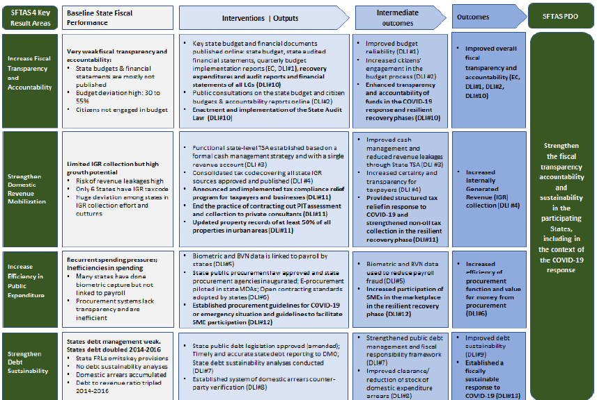
SFTAS RESULT CHAIN

Slide 4
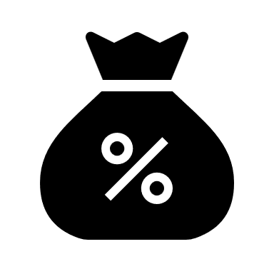
REFORM OUTCOMES
Representative Budget (DLI 2): Increased citizens engagement during budget formulation and reflection of citizens input in final appropriation.
Increased Transparency (EC, DLI 1 – 2): Citizens can now access and assess government budgets as well as final statements (including quarterly budget performance reports and annual audited financial statements inline with global reporting standards such as NCoA and IPSAS). This is expected to increase government accountability to the people. Government also makes citizens versions of the budget and financial statement available online (citizens budget and accountability report)
Follow the Money (DLI 6.2): The increased deployment and adoption of an e-procurement system by States ensures increased transparency, accountability and deliver better value for money in government expenditure.
The Adoption of NCOA in 2021 - 2024 enables Data Aggregation and Comparison: The aggregation of data that has come by way of SFTAS DLRs has availed everyone the much-needed data for national development expenditure planning. If sustained, deliberate and targeted expenditures can be planned for consensus interventions as was done for COVID-19 response.
Responsive and Transparent Tax Administration System: The passage of Consolidated Revenue Codes across States establishes a foundation for the harmonization of taxes, levies and fees paid to government. It also avails citizens a central reference legal framework for tax laws and connected rate schedules. This has built transparency and will ease periodic reviews to align with current realities of the economy. Other reforms like prohibiting contracted-out collection of PIT reduces the opportunities for double and illegal taxation by persons who are not the tax authority. Overall, these reduce the cost of compliance; encouraging improved tax compliance and consequently, raise government revenue.

Slide 5
REFORM OUTCOMES
Transparency on Debt Stock (including domestic expenditure arrears) (DLI 7 - 9): Greater transparency around what the true debt position of State governments are. This has impacts on liquidity and solvency positions of government accounts. However, what is more important is the increased response of State governments to develop and execute an Arrears Clearance Framework (ACF). Keeping the debt stock within limits has an impact on a State’s Credit and consequently, access to credit e.g., capital market, etc.
Independence of the Offices of the Auditor General for State and Local Government (DLI 10.3) : This avails the offices the required autonomy has advised in the provision of Sections 125 – 127 of the 1999 Constitution of the Federal Republic of Nigeria and the ISSAI - The 10 Mexico Declaration on the Independence of Supreme Audit Institutions. Over 29 Offices of State and Local Government Auditors-General have been supported to conduct an institutional diagnostic assessment which provides each audit office with a road map for reforms.
Improving Land Administration (DLI 11.3): Increased deployment of Geographic Information System (GIS) to strengthen land administration and property enumeration. This will positively impact social development planning and create opportunities for effective property tax administration, which will improve government revenues for development expenditure.

Slide 6
STATE-LEVEL PERFORMANCES UNDER SFTAS
OVERALL PERFORMANCE: OVER ENTIRE PERIOD AND ALL DLRS
VERY GOOD PERFORMERS: TOP 25% OF STATES
GOMBE SOKOTO DELTA BORNO NIGER
EXCELLENT PERFORMERS: TOP 10% OF STATES
JIGAWA KEBBI EBONYI
TOP PERFORMER
YOBE

Slide 7
FISCAL DATA | PUBLICATION DEADLINE
NCOA compliant Annual Budget | By January 31
IPSAS compliant Audited Financial Statements | By July 31
Quarterly Budget Implementation Reports | Within 4 weeks of quarter end
Citizens Budget | By April 30
Citizen Accountability Report | By September 30
Procurement data in OCDS format | On monthly basis
Domestic Arrears Clearance Framework | By June 30
Domestic Expenditure Arrears Database | By December 31
Annual Debt Sustainability Report | By December 31
Medium Term Debt Management Strategy | By December 31
TRANSPARENCY CHECKLIST
The following documents should be published and remain accessible online
7

Slide 8
NGF’S EFFORT AT SUSTAINABILITY
Active engagement with Civil Society Organizations such as BudgIT and Paradigm Leadership Support Initiative (PLSI).
Collaboration with sister and partner organizations/programs at State-level such as FCDO PERL, USAID State-2-State, World Bank SABER to integrate some of the reforms as eligibility criteria for future support/programs as well as adoption of reform tools for consistency in reform domestication.
Developed and launched the NGF eLearning Management system - https://elms.ngf.org.ng/ - https://ngf.org.ng/index.php/73-featured-news/2804-ngf-launches-e-learning-management-system-to-support-capacity-building-in-states
Developed and launched the NGF Public Finance Database - https://www.publicfinance.ngf.org.ng/
Continuous sensitization and engagement with the State executives – Governors and relevant commissioners, emphasizing the win-win of reforms advocated for.
Deepening reform adoption through post-program support e.g., adoption of the program segment of the NCoA.

Slide 9
STATE ACTION ON BUSINESS ENABLING REFORMS (SABER)
Key Program Information:
Development Objective: to improve (1) the efficiency of land administration, (2) the regulatory framework for private investment in fiber optic infrastructure, (3) services provided by investment promotion agencies and public-private partnership units, and (4) the efficiency and transparency of government-to-business services in participating states
US$ 750 million Operation comprising:
$730 million Program-for-Results (PforR) component
$20 million TA Investment Project Financing (IPF) component
1
4
Program Status:
NEC approval: August 18, 2022
IDA Board approval: 29 September 2022
FEC approval: December 14, 2022
FA signing: January 6, 2023
Effectiveness: June 14, 2023
Prior Results Verification: November 2023
Program sensitization: Ongoing since June 2023.
External Borrowing Plan Approval: Still with NASS
Key
Program
Information
On-lending of the loan to the States on same terms (in contrast to SFTAS, which was a grant from the FGN)
2
5
Duration: 3 years (Jan 2023- Dec 2025)
Prior Results period:
June 1, 2022 – January 5, 2023
3
6
30 states submitted evidence for the Prior Results (PRs) Verification, which could lead to $1M-$4M/state disbursement. A total of $13.5M/state can be achieved IF all Year 1 DLIs and ECs are met by December 31, 2023
For more information: https://projects.worldbank.org/en/projects-operations/project-detail/P177442?lang=en

Slide 10
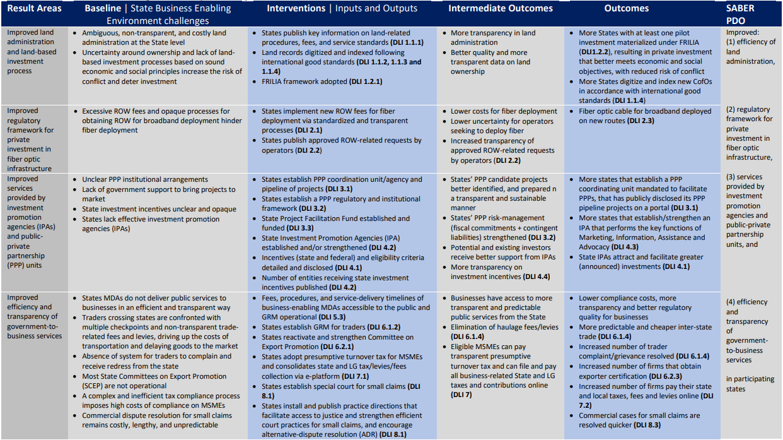
SABER THEORY OF CHANGE

Slide 11
PROGRAM DISBURSEMENT LINKED INDICATORS (DLIS) & ANCHOR STATES MDAS
Results Area 1: Improved Land Administration and Land-based Investment Process
DLI 1: Improved efficiency in property registration and sustainability of the land-based investment
Results Area 2: Improved regulatory framework for private investment in fiber optic infrastructure
DLI 2: Improved regulatory framework for private investment in fiber optic infrastructure.
Results Area 3: Improved services provided by investment promotion agencies (IPA)s and public-private partnership (PPP) units.
DLI 3: Development of an effective PPP framework
DLI 4: Improved investment promotion environment
Results Area 4: Improved efficiency and transparency of government-to-business services.
DLI 5: Increased transparency of official fees and procedures
DLI 6: Increased transparency of fees and levies for inter-state trade and increased exporter certification.
DLI 7: Simplified state and local business tax regimes
DLI 8: Quick determination of commercial disputes
Key State MDAs for Expenditure Framework
Ministries of Finance, Budget and Economic Planning, State Internal Revenue Service (DLI 3*) (DLI 4) (DLI 7*)
Governor's offices, Investment Promotion Agency or Public Private Partnership Agency or Equivalent (DLI 2*) (DLI 3*) (DLI 5*)
Ministries of Trade and Investment / Commerce and Industry, or equivalent (DLI 4*) (DLI 6*)
Ministries of Land and Urban Planning, Telecommunication Infrastructure Regulatory Agency or equivalent (DLI 1*) (DLI 2)
Investment Promotion Offices/Agencies (DLI 2) (DLI 4) (DLI 3*) (DLI 4) (DLI 6)
Judiciary (DLI 8*)
*Key State MDAs will have to collaborate with other state MDAs to achieve the results

Slide 12
ROLE OF THE NGF ON SABER
The Nigeria Governors’ Forum (NGF) is a Technical Assistance Partner on SABER, engaged to provide support to States on domesticating reforms relating to EC (NCoA & IPSAS), DLI 1, DLI 2, DLI 3 and DLI 7
Development of Reform Toolkits Containing Sample Templates, Guidelines, Etc.
Sensitization Sessions
Technical Walkthrough Sessions
Peer Learning Sessions
Bilateral Advisory
Remote Desk Review
Exchange Visits
Online Courses on Selected Subjects

Slide 13
QUESTIONS & ANSWERS

