Slide 2
Battling Fake News and Media Manipulation: Fact Checking and Verification

Slide 3
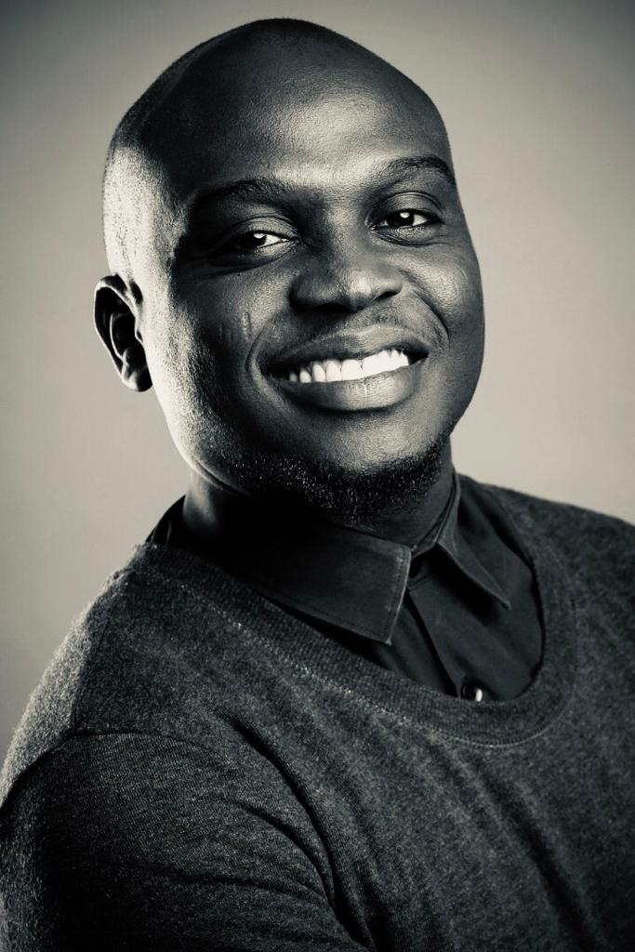
David Ajikobi
NIGERIA EDITOR, AFRICA CHECK
08023562213
David@africacheck.org

Slide 4
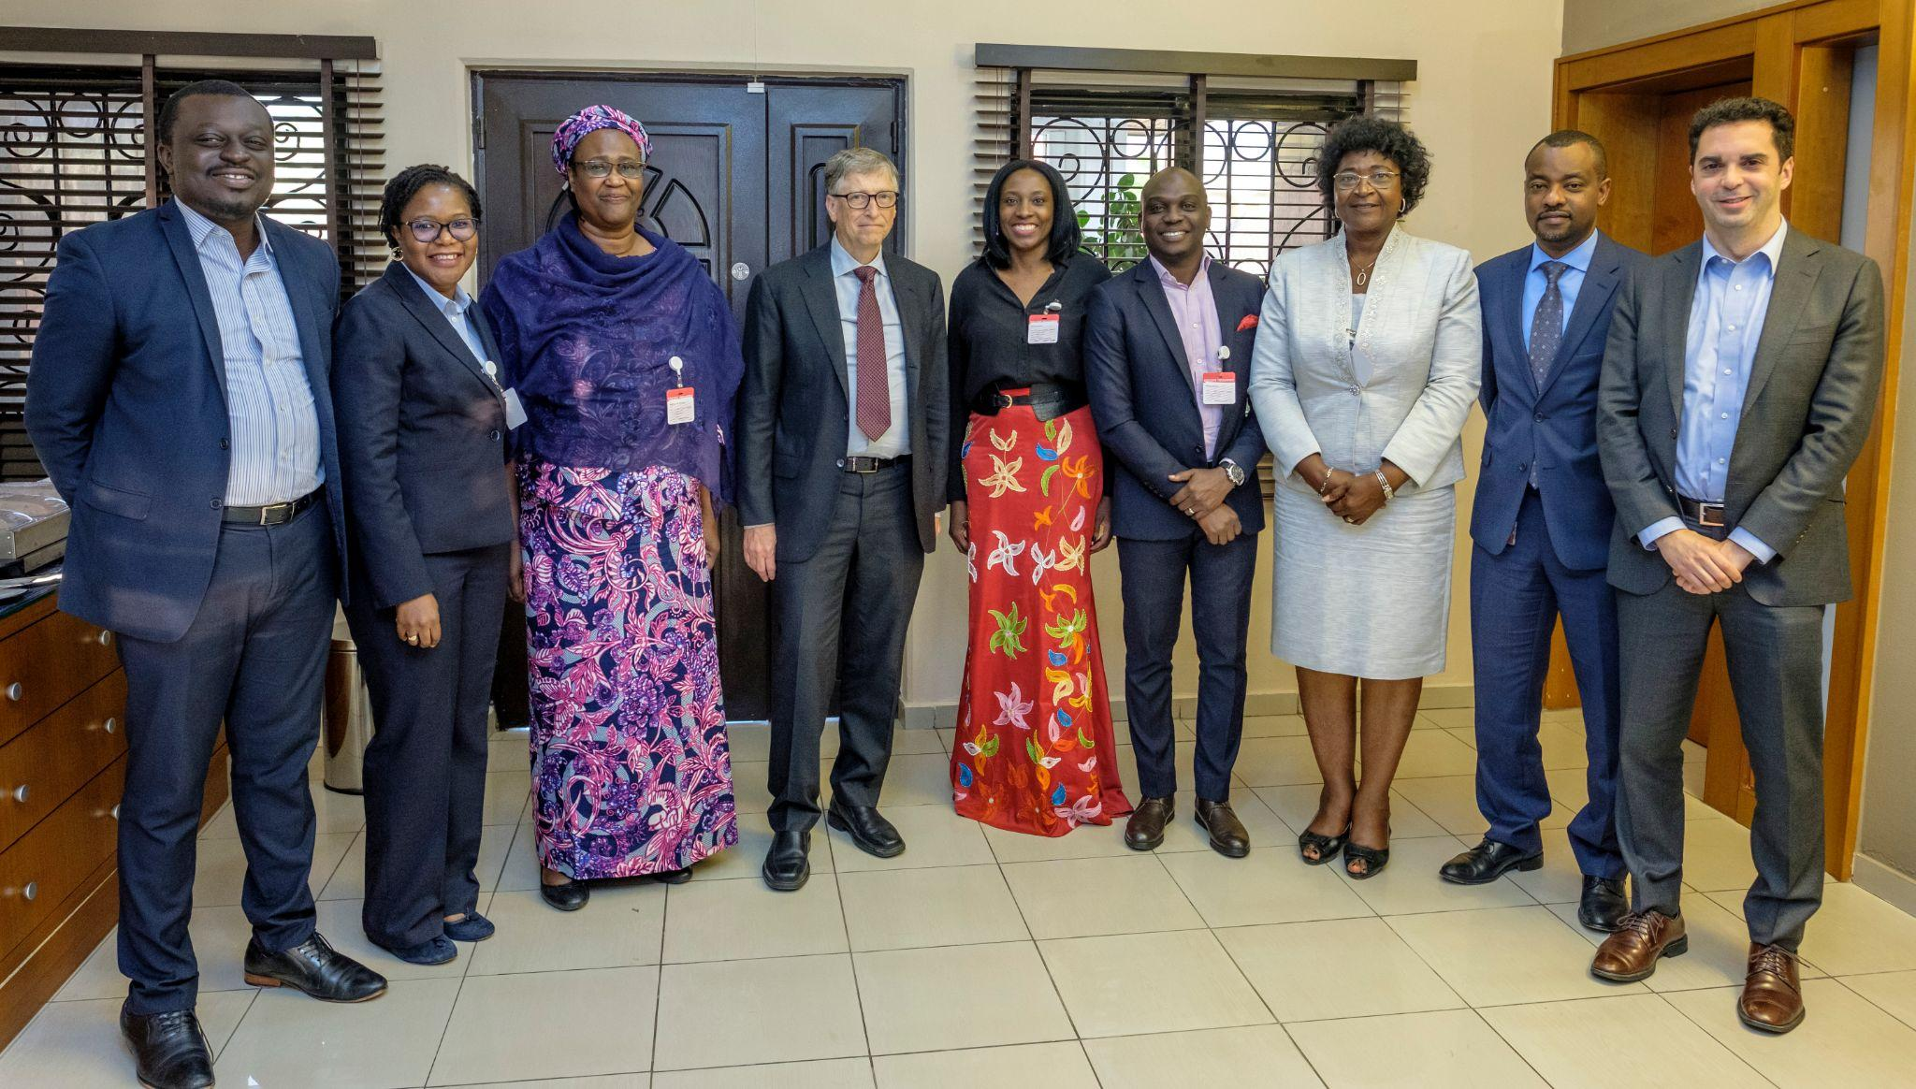

Slide 5
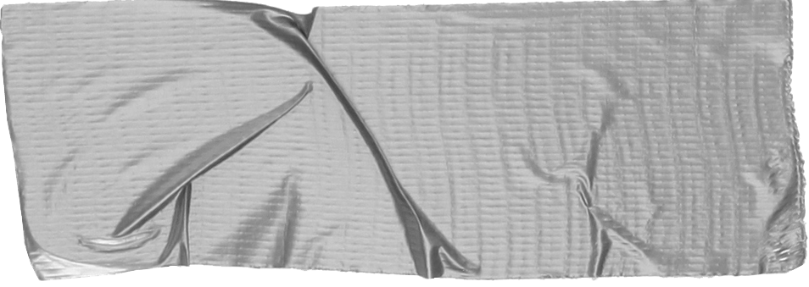
What is Fact-checking?

Slide 6
What is fact-checking?
Used to refer mainly to sub-editing in newsrooms before publishing an article in a newspaper or broadcasting a story on radio or TV
Now, in the case of independent fact-checking organisations, it’s verifying information that’s already in the public domain
We verify the accuracy of claims by public figures, organisations and the media, and on social media, by using publicly available data
SOURCE: Fact-Checking as Idea and Practice in Journalism, Lucas Graves and Michelle A. Amazeen (OUP,Feb 2019), Africa Check April 2019
Notes:
Before giving away the answer, ask participants to explain what they understand when you refer to the term “fact-checking”.
(In online training allow them to unmute themselves if the group is not too big or talkative, or let them answer using the chat function on Zoom)
Go through their answers and give appropriate feedback. Then explain what we can refer to as the “evolution of fact-checking”
Explain how internal fact-checking in newsrooms is different to what independent fact-checking organisations do.
Speak to bullet point 1:
“Twenty, or even 15 or 10 years ago when journalists spoke about fact-checking they were likely to be referring to internal fact-checking or what we know as subediting before publishing an article in a newspaper or broadcasting a story on radio or TV. This would include checking for grammar and spelling errors, making sure there aren’t any inconsistencies in a news story, making sure that the dates of historical events or other information that reporters might refer to are correct, and so on.
Speak to bullet point 2:
“These days when we talk about fact-checking, it’s very likely that we are referring to independent fact-checking, also sometimes referred to as ‘dedicated fact-checking’, as practised by fact-checking organisations like Africa Check. Dedicated fact-checking refers to verifying information that’s already in the public domain – this means we’re looking at the accuracy of something that has already been published, something that has already been said by public figures like politicians, for example.
Speak to bullet point 3:
“We therefore verify the accuracy of claims by public figures, organisations and the media, and also on social media on platforms such as Facebook and WhatsApp. And very importantly, we do this by using publicly available information and data.
“When we refer to publicly available data, we are talking about information that anyone can access IF they know where to find it – something that we’ll share several tips on during this training.”

Slide 7
Why fact-check?
People need access to accurate information to make well-informed decisions
“He said, she said reporting” can be life-threatening
Notes:
07/2022: ADAPT THE SECOND EXAMPLE YOU WILL BE REFERRING TO A MORE RECENT ONE (IF POSSIBLE, RELATED TO ELECTIONS) AND UPDATE THE NUMBER OF YEARS BETWEEN THE TWO EXAMPLES Before giving away the answer, ask participants to explain why fact-checking is important. “Why do we at Africa Check do what we do? Why are we having this training session? …”
(They are likely to answer that providing accurate information is important, that it’s the only way for them to remain credible – especially if they are journalists. BUT then let them dig deeper by asking why access to accurate information is so important.)
“Why do the public, the people out there, need accurate information?”
If, by this time, nobody has answered that they need accurate information to make well-informed decisions, show them the first bullet point and speak to it:
“People make decisions every day – some of them almost automatically – like looking for oncoming traffic before crossing the road. Others require more effort and access to accurate information. We have to decide, for example, who we’re going to vote for in the next election, what we are going to spend our money on, how to ensure our children get the best possible education, whether I’m going to get the Covid-19 vaccination (when it becomes available), and so on. And this is why we do what we do – to help people sort fact from fiction and base their decisions on accurate information.”
Second bullet point:
“He said, she said reporting” refers to journalists correctly quoting sources but actually not verifying whether what the sources say is factually correct. Most journalists do this at some point. We go to press conferences and quote someone on what they said and then we talk to other people to get their point of view, and so forth. BUT IF you quote claims with no scientific basis – and you don’t include accurate information based on credible research, the information provided to your audience is not only misleading and possibly damaging, it can actually be life-threatening.”
Then speak to the last statement at the bottom:
“False information is not new. It’s been around for years and has always had the potential to be very dangerous so let’s look at two examples … 17 years and two continents apart”

Slide 8
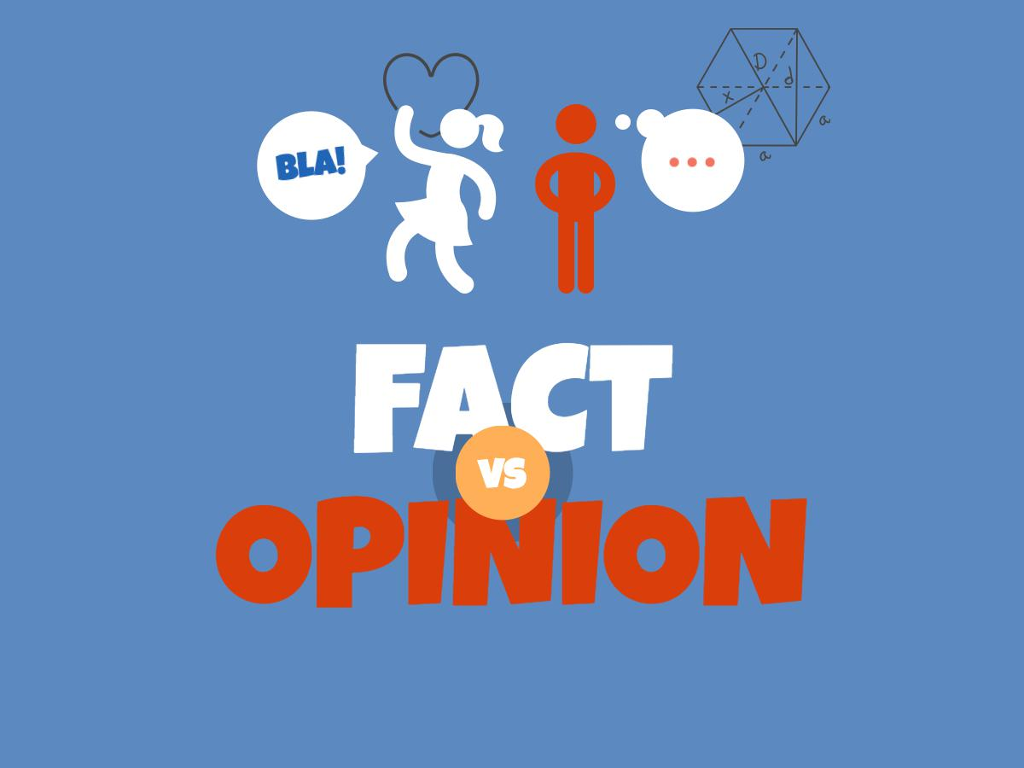

Slide 9
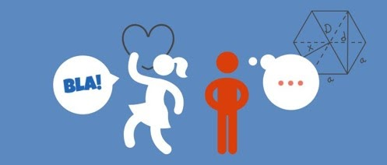
Fact vs opinion
Opinion
Subjective
Not based on evidence that can be checked
Often biased as it’s based on someone’s experiences, worldview and belief system
Fact
Backed up by evidence
Can be checked or verified
Notes:
Explain the difference between fact and opinion referring to the slides, and also why it’s so important to be able to distinguish between the two as a fact-checker.

Slide 10
What is not fact-checkable?
Opinions
Claims about the future
Notes:
Further explain that establishing whether a statement is fact-checkable, is the first thing to do even before starting the fact-checking process.
Explain why opinions and predictions can’t be fact-checked:
“Public figures, like politicians, often make promises – especially in the lead-up to elections – for example, ‘We will build 5 000 houses in [add specific region/country] over the next three years.’ When these promises are made we can’t fact-check them as they still have to be fulfilled, BUT what you can do at that point is to make a note of the promise and then verify whether it did indeed happen three years down the line.
“At Africa Check we do this through a tool we call the Promise Tracker.”

Slide 11
Example
The weather is fine today.
It will be 27°C in Lagos tomorrow.
It is 27°C in Lagos.
Notes:
05/2022: Feel free to use a different example.
Display these statements one by one and ask participants whether each statement is fact-checkable, discuss their feedback and clarify why/why not.
Update city and the day’s temperature in line with the country/s your audience are from.

Slide 12
Fact-checkable or not? And why?
Tinubu: My administration will have at least 35% female representation.
❎
Covid-19 is caused by a strain of the coronavirus.
✅
Buhari: My administration has done the best it can to fight insurgency.
❎
Notes:
05/22: Replace with relevant elections-related or your preferred examples.
Ask the participants if the following statements are fact-checkable or not, and why.
(The slide is animated so the first statement will show and only once you click, the answer and so on.)
Let participants look at each statement, answer and then discuss each answer (depending on time).
PLEASE NOTE: This could be confusing especially to journalists who have to distinguish between what one can report on vs. what one can fact-check. Explain to them that as a journalist you could, for example, report on the first and third statement but as a fact-checker you can’t verify the accuracy of those statements per se.
If the minister of health says that government is aiming to have a certain number of citizens vaccinated by a specific time, as a journalist you can report on that. You can also speak to medical experts or people involved in the vaccine rollout to assess how likely it is that this target can be reached.
The same goes for the third statement. If someone is saying that the WHO is “doing the best it can” in the fight against the Covid-19 pandemic

Slide 13
When deciding what to fact-check, ask yourself:
First and most important, what will the overall impact be if the statement or claim is not fact-checked? Also:
Will it put people’s lives at risk?
Will it have an impact on important decisions the public have to make?
How prominent is the person or organisation who shared the information?
Is the false information widely spread or might your fact-checking report amplify it?
Does the claim spread unnecessary fear?
Is it fact-checkable?
Notes:
Talk through each of these questions, giving examples as often as possible.
Notes re. possible examples and talking points:
Vaccine-related false information or false information that encourages violence/spread anger
Here you can keep in mind the important decisions we have to make, for example, who we’re going to vote for in the election or how we’re going to protect ourselves and our children against Covid-19 and other diseases
The more prominent and trusted a person or organisation, the more likely it is that the public will trust the information they’re supplied with and share it with others (people would often believe religious leaders when it comes to health-related issues so if a prominent religious leader says Covid-19 doesn’t exist it could have serious consequences)
If a social media post, for example, has been online for a few days but the person who shared it has a small following and the post hasn’t gained a lot of traction, consider whether by fact-checking it you might not actually amplify the information.
False claims related to violence (violent protests, police brutality, xenophobic attacks, etc.) often spreads unnecessary fear and distrust and it’s important to stop it in its track.
This brings us back to the first discussion we had in this session. It’s important to determine whether something is fact-checkable or at least possibly fact-checkable before attempting to fact-check it.

Slide 14
Disinformation is false or misleading information that is created and spread deliberately to deceive

Slide 15
The spread of false information could be unintentional. The term misinformation is often used in this sense.

Slide 16
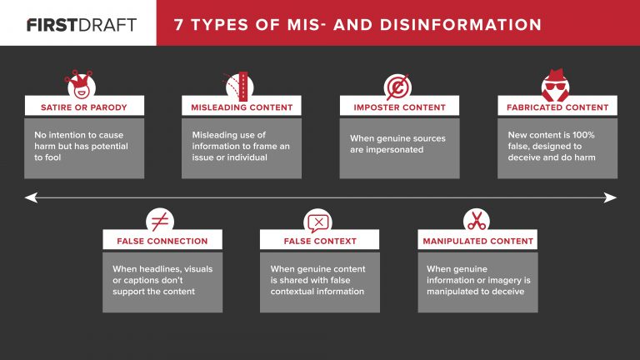

Slide 17
Tips on identifying disinformation
Develop a critical mindset
Check the source: the author, the publication
Determine whether others are reporting the same news
Sensational headlines are red flags

Slide 18
Tips on identifying disinformation (cont’d)
Ask yourself why was this created
Don’t take online photos and videos at face value
Check the facts, examine the evidence
Ask the experts

Slide 19
Strategies for spotting disinfo
schemes

Slide 20
Creators of fake news try to think like journalists.
While journalists hunt for new angles to major breaking news, producers of fake news simply create them.
Any gap in a big story is a potential tool for disinformation.
Predict the next fake news angle

Slide 21
Governments/politicians seek popularity
Anti-government groups seek sympathy
Fraudsters seek money
Bloggers seek online traffic
Everyone who creates & shares information has an agenda
Watch motives

Slide 22
Conspiracy theories are usually complex narratives created to make a point or points
Find the points
Questions to start with:
Who is accused of what?
Why?
Conspiracy theories breed disinformation, which in turn strengthen the conspiracy theories. It’s vicious cycle.
Find the root of conspiracy theories

Slide 23
Those who hold opinions in line with conspiracy theory are likely to create or shares disinformation related to those conspiracy theories.
For example, it is not difficult to identify the major influencers in conspiracy theories. They are usually quite vocal.
Identify the actors

Slide 24
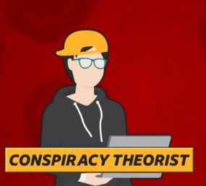
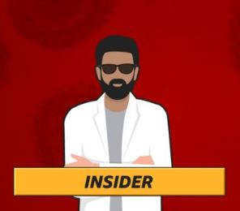
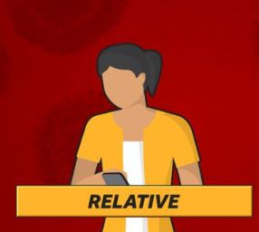
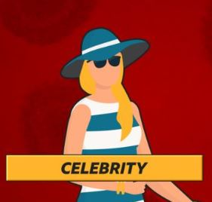
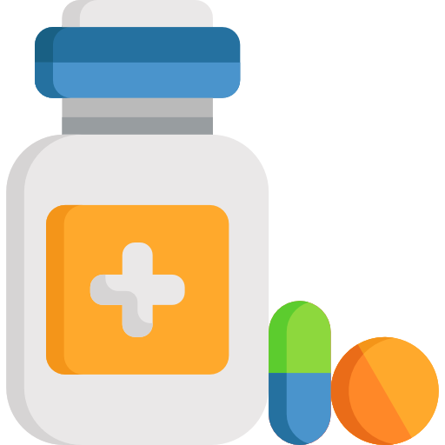
Vector source: BBC

Slide 25
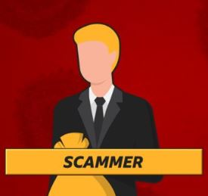
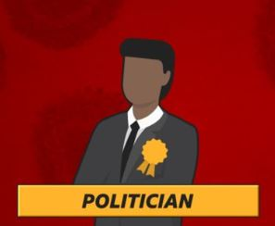
Vector source: BBC

Slide 26
Africa Check’s 5-step fact-checking process

Slide 27
Tips for addressing your own bias
Push beyond your own bias when evaluating information by asking yourself:
Am I objective?
Am I giving all sides of the story?
Have I checked all the facts – whether I personally agree with them or not?
Notes:
Quickly touch on these tips/questions and add anything you think would be valuable to share with participants.
“It’s not easy to get rid of bias, but it certainly helps to be aware of it and ask yourself these questions:
Am I objective?
Am I giving all sides of the story?
Have I checked all the facts – whether I personally agree with them or not?”

Slide 28
Start with the question:
Can I fact-check this?

Slide 29
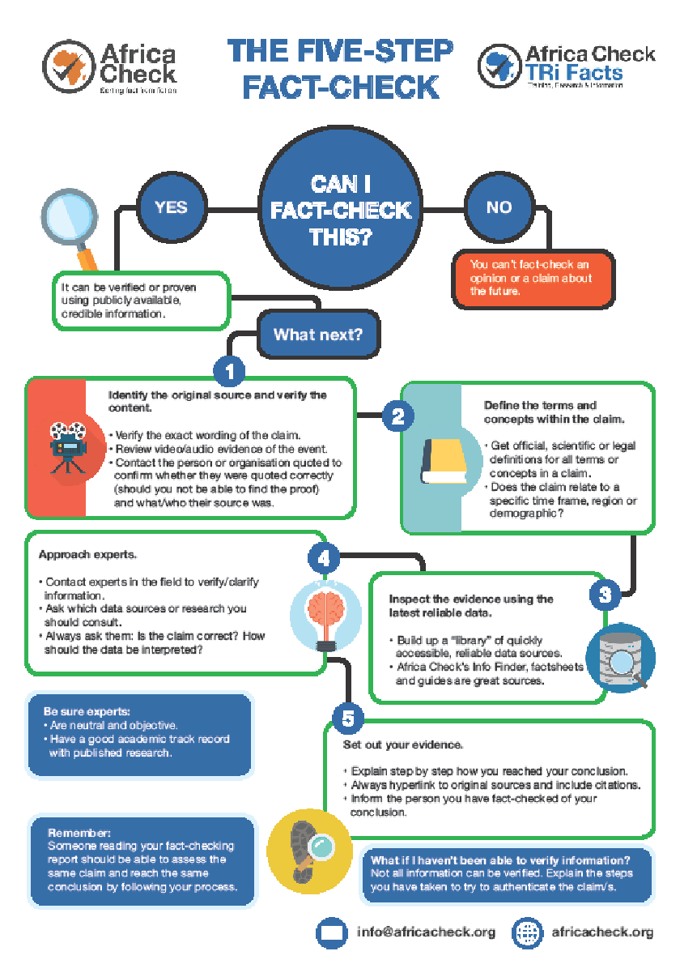
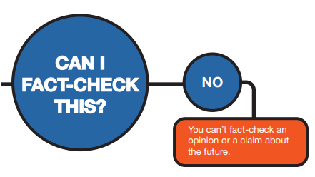

Slide 30
Step 1:
Identify the original source and verify the content
Confirm the exact wording
Find audio/video clips
Contact person – were they quoted correctly?
What was their source?
Notes:
Make sure of exact wording
Find audio/video clips
Contact person – were they quoted correctly?
What was their source?
MIGHT BE CHALLENGING

Slide 31
Step 3:
Inspect the evidence using the latest reliable data
Notes:
Build up a library of the latest reliable data – Vincent will discuss this in detail a bit later. We collect data in the countries we work in and put it together and make available on our website. – start building a database, starting with your contacts, reliable online sources and then adding experts as you go along

Slide 32
Notes:
05/2022: The explanations at the bottom of the notes are applicable to the fact-checking examples that were used for last year’s Covid/health-focused training. You can explain this step by referring to the data sources you consulted in the example that you are using.
“Build up a library of the latest reliable data. At Africa Check, we collect data in the countries we work in and put it together and make available on our website. – start building a database, starting with your contacts, reliable online sources and then adding experts as you go along.”
In the Magufuli case, we have previously fact-checked similar inhalation claims and not found any evidence that it is a viable treatment for Covid-19. Other fact-checkers including Reuters, France24 and the BBC have also found no evidence to back up this resilient claim.
Also consulted the World Health Organization site, which stated clearly that there’s no cure for Covid-19 yet.
Explain the data that was used in the Madonsela example by referring to the fact-check: africacheck.org/fact-checks/reports/do-one-four-women-africa-suffer-depression-we-checked

Slide 33
Step 4:
Ask the experts
ASK: Who would you consider an expert?
Contact experts in the field to verify/clarify information – good academic track record
Ask which data sources or research you should consult.
Always ask them: Is the claim correct? How should the data be interpreted? MAKE SURE YOU UNDERSTAND. Never assume.
Notes:
ASK: Who would you consider an expert?
Contact experts in the field to verify/clarify information – good academic track record
Ask which data sources or research you should consult.
Always ask them: Is the claim correct? How should the data be interpreted? MAKE SURE YOU UNDERSTAND. Never assume.
Prevalence refers to the share of a population with an illness or condition. In 2017, the World Health Organization (WHO) estimated that 5.9% of women in its Africa region (one in 17) suffered from depressive disorders. This covers 47 African countries. The rate was based on modelled prevalence estimates from the 2015 Global Burden of Disease Study (GBD), led by the Institute for Health Metrics and Evaluation (IHME) at the University of Washington in the US. Asked why the WHO regarded the GBD as the best available source of data for this estimate, WHO communications officer Alison Brunier said the study is “unique in its comprehensiveness and the methodological approach used to deal with inconsistencies in data”. Dr Alize Ferrari, leads the mental disorders component of the Global Burden of Disease Study on behalf of the IHME. She said its prevalence estimates are based on a review of existing data. The study’s researchers look for survey data that is representative of the population and that has estimates of measures such as prevalence and incidence (new cases of an illness). They apply the criteria for mental disorders provided in the Diagnostic and Statistical Manual of Mental Disorders or the International Classification of Diseases. Data from individual studies is pooled to arrive at a weighted average. The study was last updated in 2017. The latest age-standardised estimate for the prevalence of depression in sub-Saharan Africa is 4.3% (one in 23). “Estimates from sub-Saharan Africa represent our modelled results for the whole of Africa,” Ferrari explained.

Slide 34
Step 5:
Set out your evidence
1.Explain evidence step by step
2.Always hyperlink to sources
3. Inform the person you’ve fact-checked of your conclusion
4. Someone reading your report needs to be able to reach the same conclusion following your process
REMEMBER: peer review, more than one person must get the same finding
Notes:
Explain evidence step by step 2. Always hyperlink to sources 3. Inform the person you’ve fact-checked of your conclusion 4. Someone reading your report needs to be able to reach the same conclusion following your process REMEMBER: peer review, more than one person must get the same finding

Slide 35
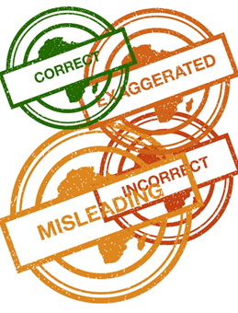
Verdicts
Correct
Mostly correct
Unproven
Misleading
Exaggerated
Understated
Incorrect
Notes:
Quickly touch on: we can’t always categorise something as correct or incorrect. These are the ratings Africa Check uses. If time allows you can refer to what some of them means.

Slide 36
Verdicts
Correct
The claim is accurate, according to the best evidence publicly available at this time, and leaves out nothing significant.
Mostly correct
The claim contains elements of truth but is either not entirely accurate, according to the best evidence publicly available at this time, or needs clarification.
Notes:
Only discuss the different types of verdicts if there’s enough time.

Slide 37
Incorrect
The claim is inaccurate according to the best evidence publicly available at this time.
Unproven
Evidence publicly available at this time neither proves nor disproves the statement. More research is needed.
Misleading
Elements of the claim are accurate but presented in a way that it is misleading.
Exaggerated/understated
The claim exaggerates the facts/understates the facts.
Notes:
Only discuss this if there’s enough time.

Slide 38
Using the fact-checking process in your day-to-day reporting
Notes:
The next few slides are from a different presentation. You can either use your own tips on ways in which journalists can apply fact-checking in their day-to-day work or use some of the information in these slides and delete the rest.
Start by explaining that we realise journalists are working against tighter deadlines, which is why we look at ways in which they can apply fact-checking steps/processes in their daily work.

Slide 39
General tips
Mark facts to check as you write (underline or highlight)
Or list facts
Pay particular attention to:
Numbers/percentages
Names & titles
Places
Quotes (direct and paraphrased)
Comparison

Slide 40
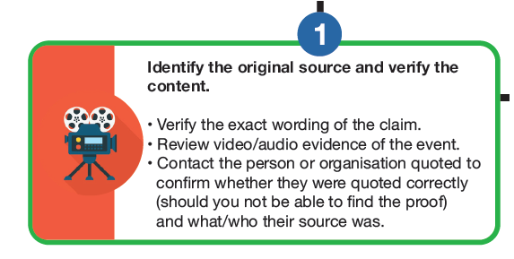
Identify the original source + verify

Slide 41
How would this apply?
Don’t take information from a secondary source (e.g. a newspaper) without verifying
Compare the text version of a speech with its video/audio version
A press release is only a starting point
🡺 Ask: How do you know that?

Slide 42
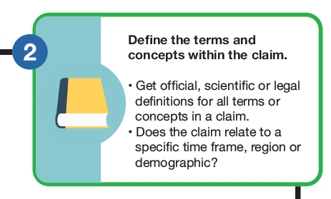
Define terms & concepts

Slide 43
How would this apply?
Don’t allow a source/interviewee to hide behind technical language
Explain jargon & technical terms to your audience

Slide 44
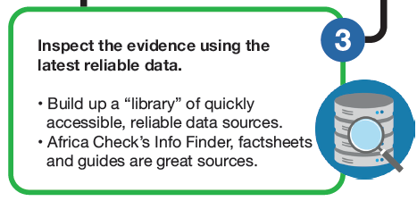
Find the latest, reliable data

Slide 45
How would this apply?
Don’t simply repeat a statistic. Determine if the person you’re quoting has used the latest data and if it’s reliable.
Make sure a source/expert has direct knowledge of the information they are providing. If they don’t, go to the original source.

Slide 46
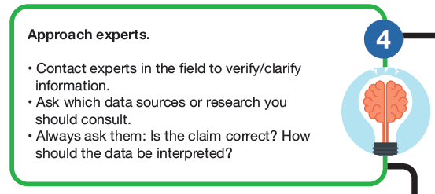
Ask the experts

Slide 47
How would this apply?
Ask experts to provide clarity/context; to help you find data or to determine if the data you have found is reliable.

Slide 48
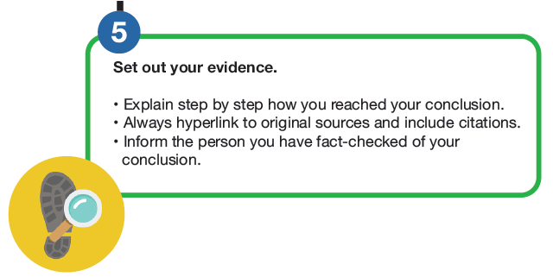
Set out the evidence

Slide 49
How would this apply?
Include links to original sources
Anticipate audience questions

Slide 50
Finding credible online data
Notes:
07/2022
These slides are very much Covid- and health-focused. Please adapt in line with the election-focus where possible and also include sources for elections-related information such as the sources on page 8 in the toolkit.
“Finding information online and knowing what is credible and what not can be very challenging. In this session, I’ll give you some advice on this topic.”

Slide 51
Possible sources of data
National Institutes of Statistics
International organisations such as the United Nations
Leading universities and research institutions
Central banks
Government reports
Reports tabled in parliaments
Reputable peer-reviewed journals
Experts
Fact-checking organisations like Africa Check (note that fact-checkers aren’t primary sources)
Notes:
Please adapt the list if necessary
Tell participants they can use the listed sources as a starting point to find data and talk a bit to each point highlighting those you think are most valuable.
BUT also mention: “Even if a source is listed here, you can’t merely take any statement or fact and assume it’s the best and latest data about a topic. These sources can serve as a good start for trying to find the best data though.
“When we find online data at Africa Check on, for example, Statistics ‘South Africa’s website, we will contact them to find out if new research has been done in the meantime to make sure we’re looking at the latest reliable data.”
“Important to remember is that although fact-checking organisations can often lead you to valuable information and they often allow and encourage third parties to publish and link to their work, fact-checking reports aren’t the primary sources of the information.”

Slide 52
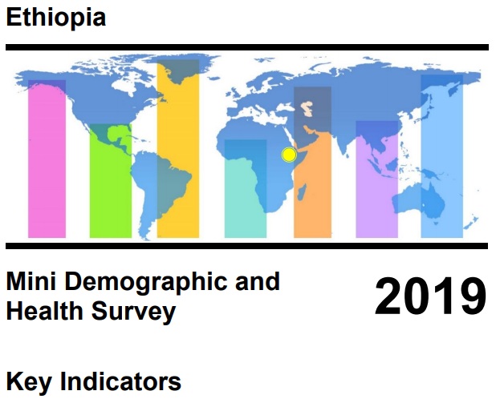
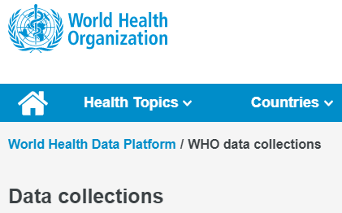
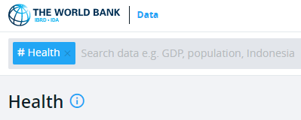
Sources of health data
Institute for Health Metrics and Evaluation: burden of disease
World Health Organization
World Bank
Unicef
Demographic and Health Survey
Notes:
Briefly talk to these examples and the kind of information you can find on these sites.

Slide 53
How to judge the reliability of data
When was the data gathered?
What timeframe are you looking at and what did the picture look like before and after?
An old research study may no longer be applicable
How was the data collected?
Can you follow the methodology – where did the researcher get their data and how did they analyse it?
Notes:
Some examples you can touch on to explain the questions/points on the slide (feel free to add your own examples):
“When a minister of finance claims that a country’s unemployment has dropped by 15%, ask over what period? There’s a big difference between 15% over one year or over a decade.
“Also look at the figures before and after the period mentioned. It might have decreased by 15% over the past year, but when you look at the figures over the past five years, you might see that unemployment numbers actually increased.”
“Always make sure you’re looking at the latest research.
“When reading through the research, is it clear what steps the researcher took to get to their results – where did they get their data and how did they analyse it?”

Slide 54
How to judge the reliability of data
Can the findings be generalised?
What’s the sample size?
Is the sample representative of the population? (Gender, age, etc.)
Is there a conflict of interest?
Is the research funded and by who?
Could the researcher benefit from the results of the study?
Notes:
“The larger the sample, the better.
“What does the sample size look like in terms of demographics – is the sample balanced in terms of gender, age, etc?
“If the researcher can benefit from the results of the study, that should immediately be considered a red flag.”
“Taking these points into account, let’s look at a study that was published in the 1990s, despite several red flags, which still has serious consequences today …

Slide 55
OSINT Essentials
https://www.osintessentials.com/
Notes:
07/2022
These slides are very much Covid- and health-focused. Please adapt in line with the election-focus where possible and also include sources for elections-related information such as the sources on page 8 in the toolkit.
“Finding information online and knowing what is credible and what not can be very challenging. In this session, I’ll give you some advice on this topic.”

Slide 57
David Ajikobi
Nigeria Editor
david@africacheck.org
08023562213
@Pantaphobious
africacheck.org
@AfricaCheck
@AfricaCheck
Notes:
Trainer to replace with their details

