Slide 1
UNICEF
in Nigeria
Presentation at the Induction Programme for Governors
17 May 2023

Slide 2
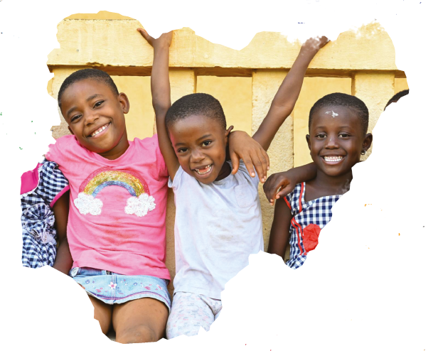
MAJOR CONTRIBUTIONS TO LIVES OF CHILDREN IN THE LAST 5 YEARS
30 MILLION CHILDREN
vaccinated through integrated campaigns against life-threatening diseases
58 MILLION
Children vaccinated against Polio
ZERO-DOSE STRATEGY in 100 LGAs
For reaching undeserved children across 18 states
23 MILLION CHILDREN
received two doses of Vitamin A in 2022.
1.5 MILLION GIRLS
Entered school, using a new evidence-based approach
5 MILLION CHILDREN
Continued learning during COVID-19, using radio, TV and home-based material
7.4 MILLION CHILDREN
under the age of five today have birth registration
34 STATES WITH CHILDREN ACT
These states have adopted the act.
2.8 MILLION CHILDREN
Living in conflict affected areas received psychosocial support
4 MILLION IDP
and host communities, accessing primary health care
600,000 CHILDREN
Aged 6 – 59 months with severe acute malnutrition admitted for treatment
1.3 MILLION CHILDREN
Living in conflict affected areas accessed formal and non-formal education
25 MILLION CHILDREN
covered in the National Social Register
20 MILLION PEOPLE
living in certified free of open defecation communities
2.4 MILLION PEOPLE
accessed life-saving water, sanitation and hygiene services

Slide 3
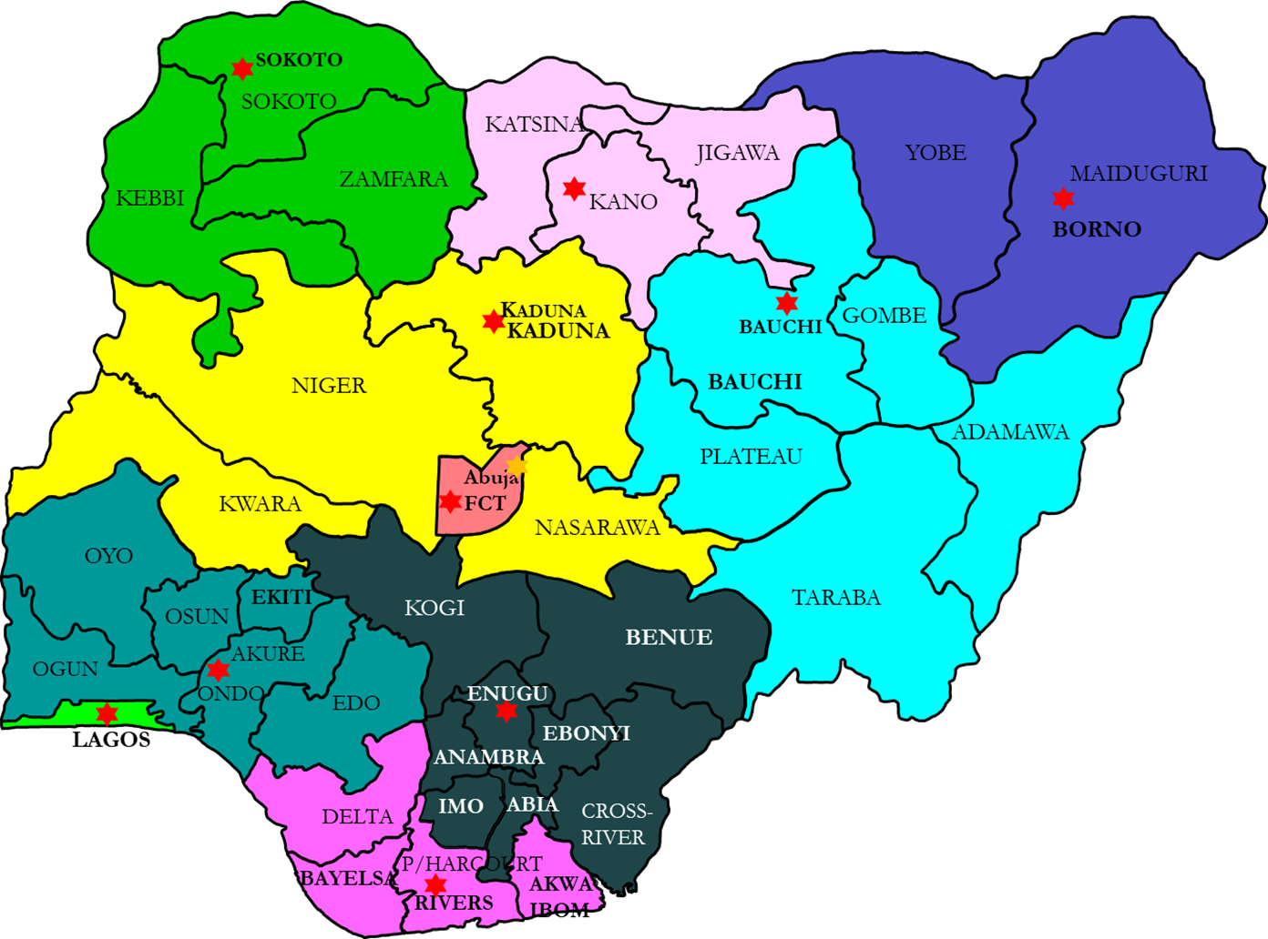
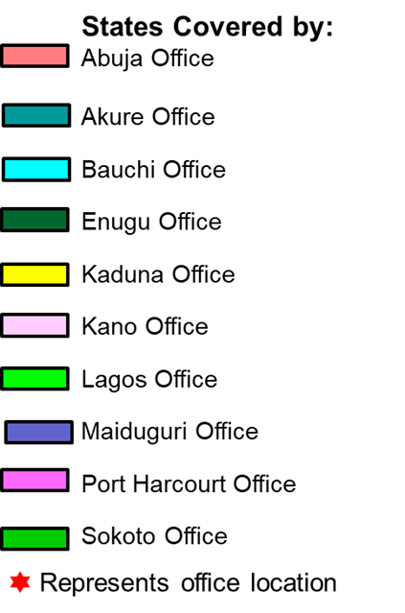
Where we work
Geographic scope:
All geopolitical zones with focus in 20 states
2 nation-wide programmes
Eight field offices
Programmes:
Health, Nutrition, Education, Child Protection, WASH and Social Policy
3 | Nigeria Country Programme 2023-2027

Slide 4
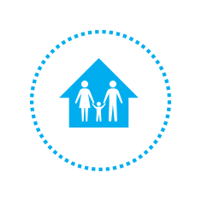
OUR TARGETS BY 2027
 | OVER 1 MILLION ADDITIONAL CHILDREN immunized (zero-dose) |  | OVER 1,700 PHC FACILITIES in 14 States meet PHC minimum standards |  | 50 MILLION CHILDREN (aged 6-59 months) receive vitamin A twice a year
 | 10 MILLION CHILDREN access formal or non-formal education |  | 4.8 MILLION CHILDREN access learning materials and 21 states scale up foundational learning |  | 40 MILLION CHILDREN with birth registration
 | 5 MILLION PEOPLE access to basic sanitation services |  | 2 MILLION PEOPLE access to basic water supply services |  | 1.5 MILLION GIRLS AND WOMEN access prevention and protections services on FGM
4 | Nigeria Country Programme 2023-2027

Slide 5
THANK YOU

