Slide 1
A BRIEF ON NGF’S TECHNICAL ASSISTANCE ON:
STATES FISCAL TRANSPARENCY, ACCOUNTABILITY AND SUSTAINABILITY (SFTAS)
&
STATE ACTION ON BUSINESS ENABLING REFORMS (SABER)
PROGRAMMES-FOR-RESULT
Presented by:
Olanrewaju Ajogbasile
Senior Programme Manager
Date: 17th May 2023

Slide 2






OVERVIEW OF NGF SFTAS TECHNICAL ASSISTANCE
  STATES FISCAL TRANSPARENCY, ACCOUNTABILITY AND SUSTAINABILITY (SFTAS)
  We offer technical assistance (TA) to States on budgeting, financial reporting, cash management strategy, revenue mobilization, audit and public procurement (including e-procurement), all of which relate to the Eligibility Criteria (EC) and Disbursement Linked Results (DLRs) 1, 3, 4, 5, 6, 10 and 11.
  Although the PforR component has ended, the TA component is being extended till December 2023 to support the sustainability of SFTAS reforms and early towards SABER PforR.
  STATE ACTION ON BUSINESS ENABLING REFORMS (SABER)
  We offer technical assistance (TA) to States on improving efficiency in property registration and sustainability of the land-based investment process; Improved regulatory framework for private investment in fiber optic infrastructure; Development of an effective Public Private Partnership (PPP) framework; Simplification of State and local business tax regimes.
SABER

Slide 3













HOW WE SUPPORT YOUR STATES
Development & Dissemination of Toolkits
Knowledge Guides, Templates, Self-Help videos Available Online.
*Plan to deploy a Learning Management System.
Peer Learning Events
Experience/Knowledge Sharing Workshops to Distil Good Practice & Share Reform Lessons among States
Just-in-time Support
Desk Reviews/Technical Advisories/Walkthrough Sessions Based on Demand
State Reform Experience Studies
To Distill Good Practices and Major Reform Lessons from the 36 States of Nigeria with the Aim of Promoting State to State Learning
Executive Briefings & Advisory
On urgent reform actions in resolving bottlenecks and facilitating reform delivery
Exchange Visits
To facilitate On-The-Job Training and First-Hand Learning for State Officials

Slide 4
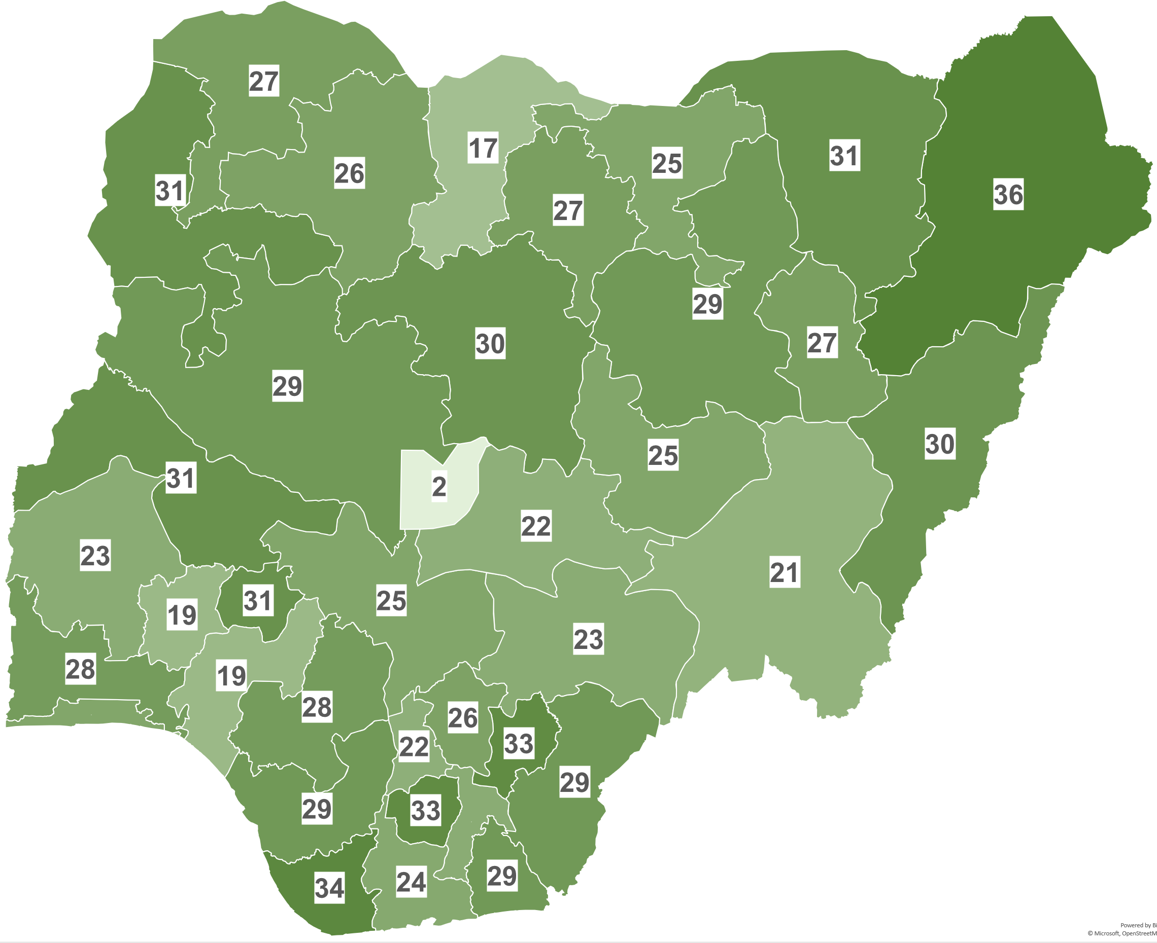

NGF SFTAS AND SABER TECHNICAL ASSISTANCE PROGRAMME BENEFICIARIES
SFTAS (Jan 2020 – Dec 2022)
Over 7,400 Government officials at various levels (Legislators, Commissioners, Permanent Secretaries, Directors, Deputy/Assistant Directors, Operational officers, etc.) across the 36 States and FCT benefitted/attended NGF’s capacity building activities.
SABER (Jul – Dec 2022)
161 Government officials have also benefited from NGF’s TA.
25
25
#
NGF TA beneficiary
SABER TA beneficiary
Notes:
FY 2020 = 2,672
FY 2021 Q1-Q4 - 2432
FY 22 Q1 –Q4= 2347
TOOLKIT DOWNLOADS
FY 2020 - 3037
FY 2021 - 2916
FY 202- 2600

Slide 5

NOTABLE SFTAS-SABER TA MILESTONES (JAN. 2020 – DEC. 2022)
SFTAS
14 Toolkits (PFM knowledge guides & templates) developed & a total of 8553 Downloads of SFTAS Toolkits has been recorded on NGF Website.
969 Just-time Technical Assistance (bilateral engagements, advisories, remote desk reviews) delivered to states and FCT.
4 State Exchange visits and 10 Peer Learning Events organised for state officials to share knowledge and distil lessons.
115 Sensitisation/consultative/Briefing sessions held with state governors, key state officials & programme implementing partners
NGF proactively supported all 36 States on preparation of FY2022 Budget Implementation Reports (BIR) for quarters 1, 2 & 3. This ensured that for the first time All States published their respective BIRs using the NCoA template Post-SFTAS performance years.
A ‘SFTAS Charter’ developed in collaboration with the sustainability committee and officially endorsed by the forum leadership on the 17th of August 2022.
Development of NGF eLearning Management Platform and Piloting of a course module on ‘Introduction to Public Financial Management’ in January 2023.
SABER
30 States provided with TA to achieve SABER programme Prior Results for DLI 1.

Slide 6
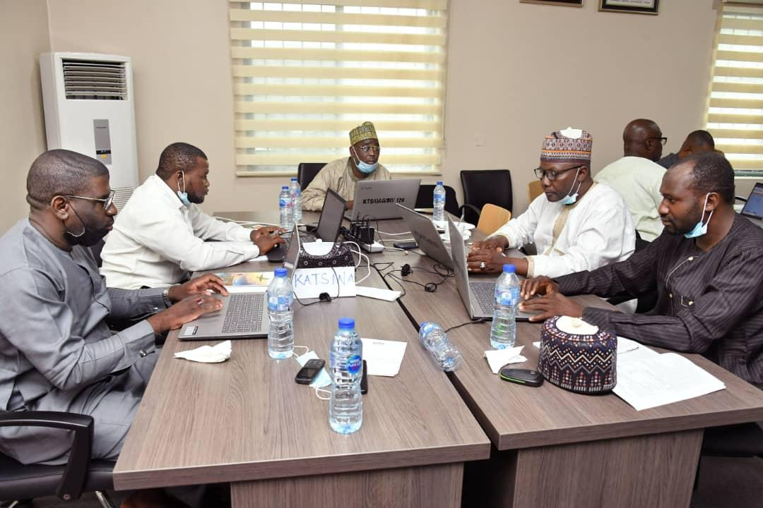
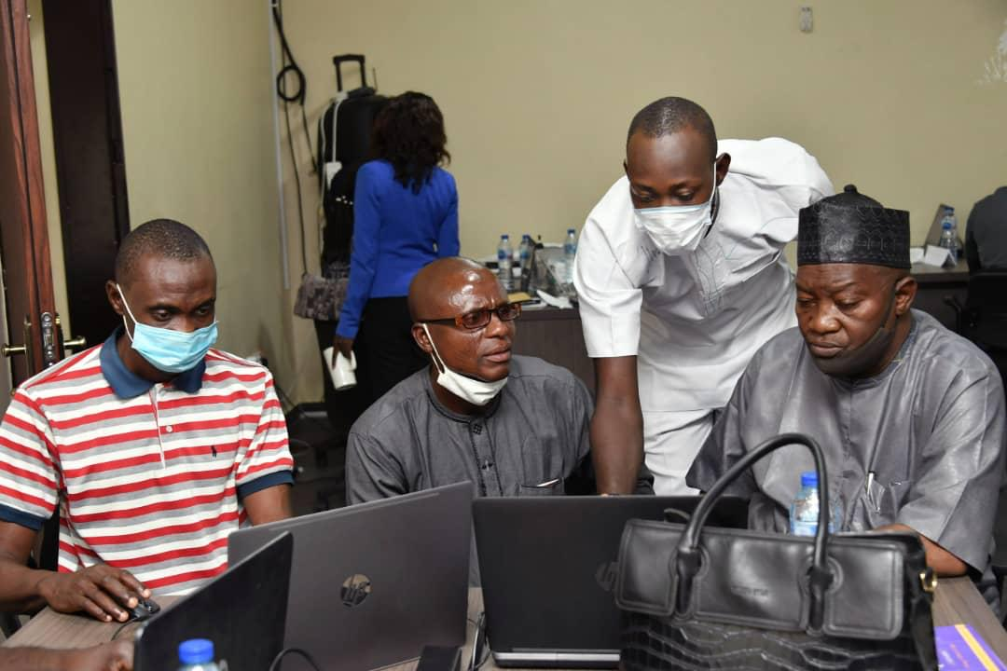
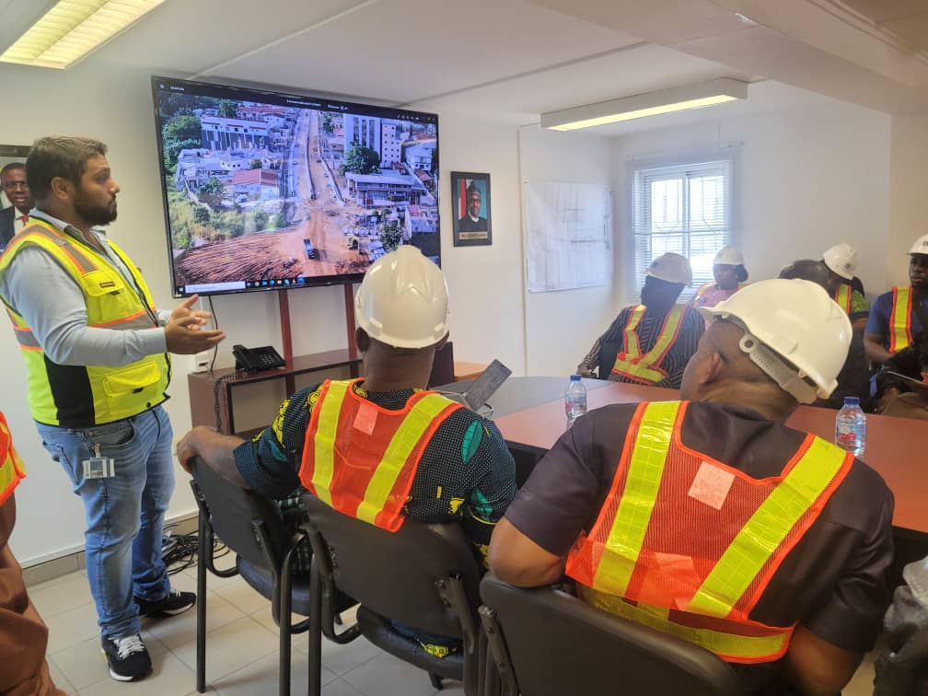
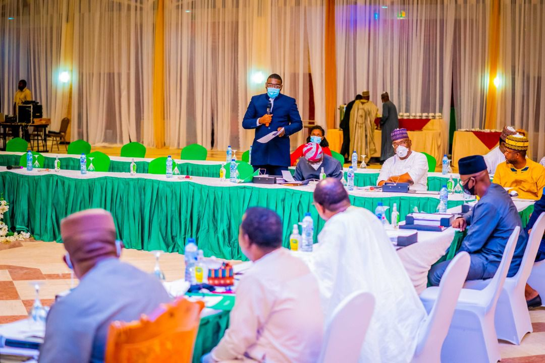
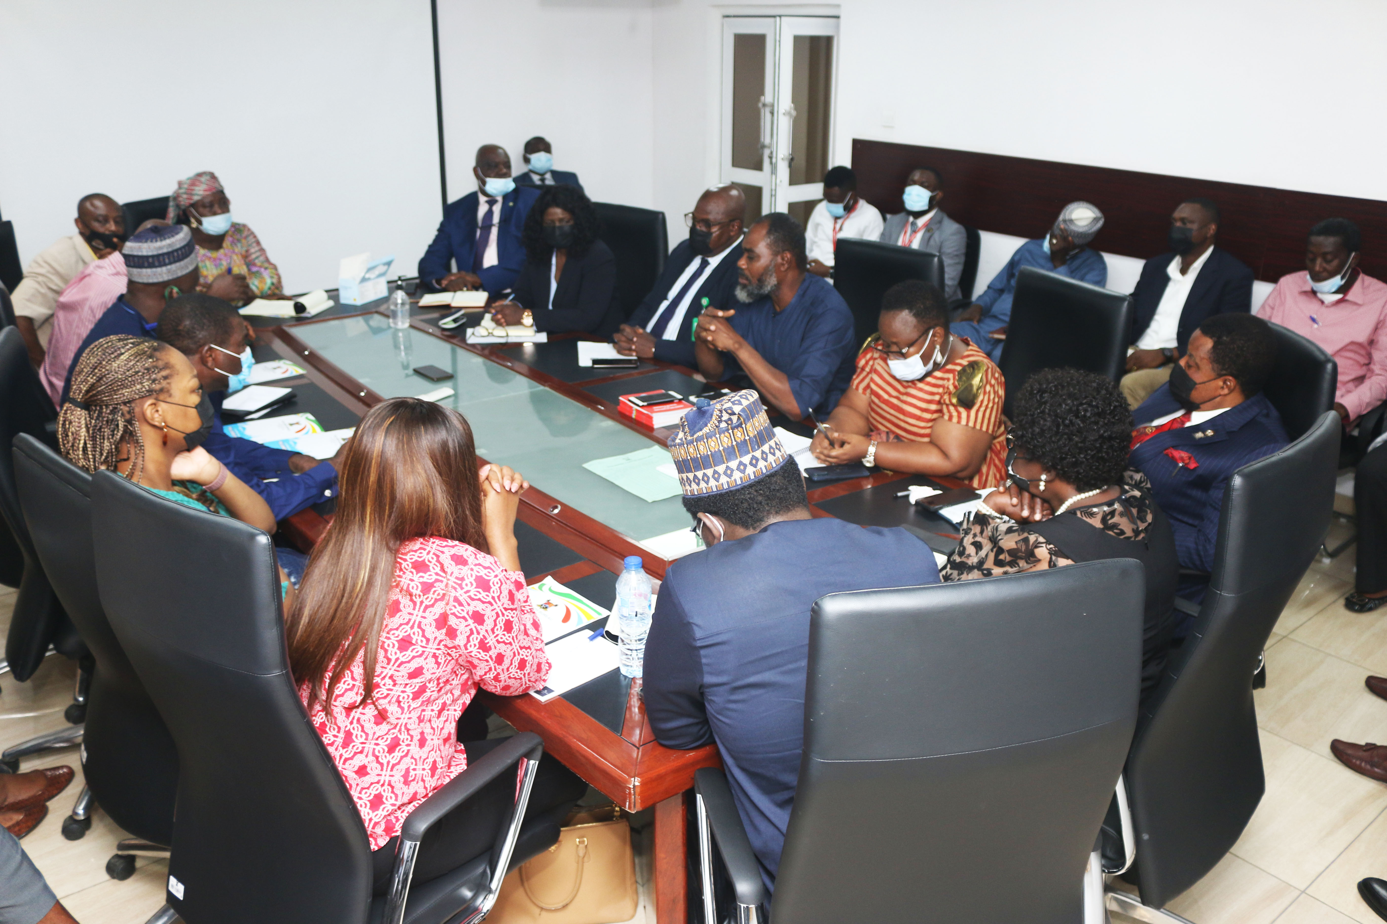
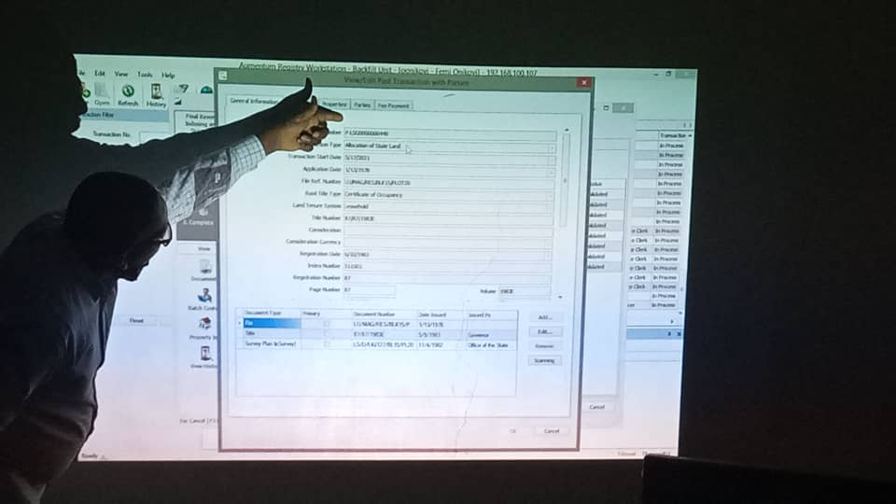
PICTURES FROM CAPACITY BUILDING TRAININGS, LEARNING SESSION, AND STATES EXCHANGE VISITS

Slide 7
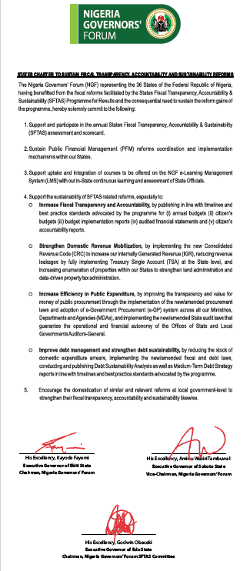
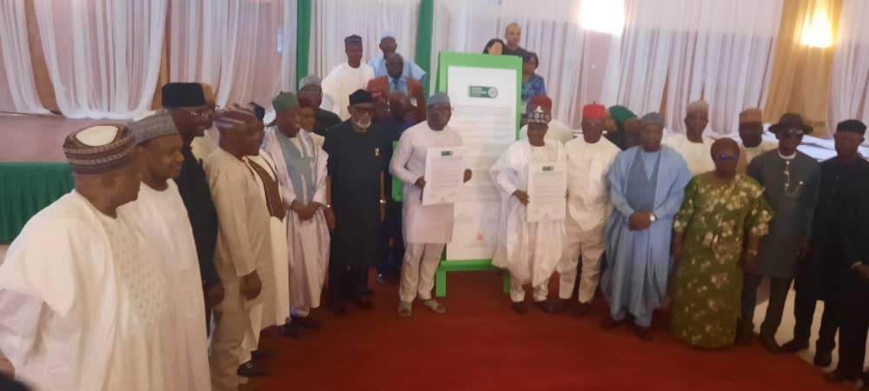
SFTAS REFORM SUSTAINABILITY CHARTER WAS ENDORSED BY THE FORUM AND SIGNED BY ITS LEADERSHIP ON 17TH AUGUST 2022
First Non-Disbursement SFTAS Annual Performance Assessment (APA) is ongoing, and results will be published….
Beta version of the NGF eLMS (https://elms.ngf.org.ng ) is ready and will be launched officially soon.

Slide 8
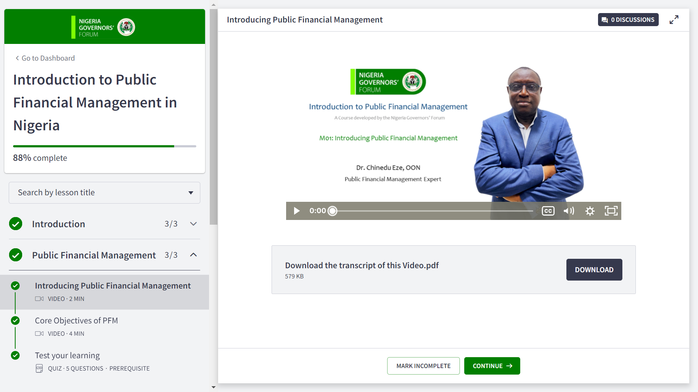
PILOTING The NGF e-LEARNING MANAGEMENT PLATFORM – https://elms.ngf.org.ng

Slide 9
Contacts
Olanrewaju Ajogbasile
Senior Programme Manager (SPM)
Mobile:+2349083411461, Email: oajogbasile@ngf.org.ng

