Slide 1

Nigeria Covid-19 Action Recovery Economic Stimulus (NG-CARES) Programme for Results
N G – C A R E S
Presented at the
2023 NGF Governors Induction for New and Returning Governors
17/05/2023

Slide 2

N G – C A R E S
Outline
About NG-CARES
Success Story’s
Impact of Flood on the States
Request for Restructuring
Next Steps/Key Ask

Slide 3

Introduction
N G – C A R E S
NG-CARES – an emergency USD750million program to support all 36 states and FCT efforts to respond to and to recover from the Covid-19 induced socio-economic crisis. (USD735m On-Lent – USD15m federal TA).
Program Development Objective (PDO) - to expand access to livelihood support and food security services, and grants for poor and vulnerable households and firms.
Disbursements are RESULTS-based linked to 11 DLIs in three RESULTS AREAS (RA):
  RA1 – Increased Social Transfers, Basic Services, and Livelihood Support to Poor and Vulnerable Households
  RA2 – Increasing Food Security and Safe Functioning of Food Supply Chains
  RA3 – Facilitating the Recovery and Enhancing Capabilities of Micro and small enterprises

Slide 4
N G – C A R E S
The Role of the NGF Secretariat – To provide Peer Learning and Experience Sharing among the 36 States and the FCT.
Support the capacity building efforts of the FCSU to the States through:
I. Knowledge material development
II. Facilitate exchange visits, and;
III. National peer-learning & experience sharing events.

Slide 5
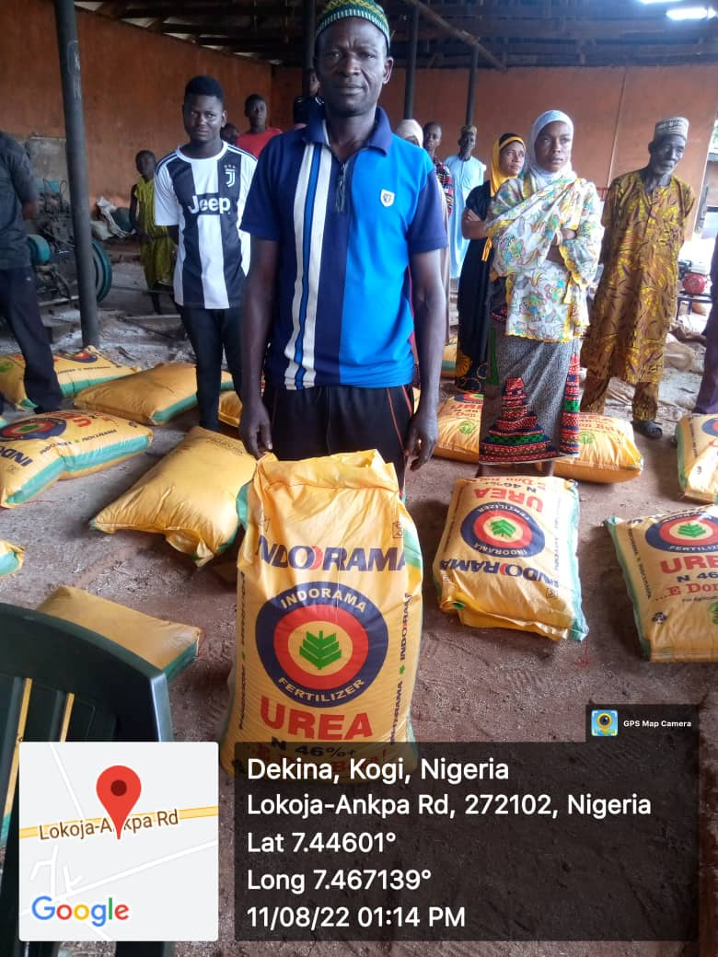
N G – C A R E S
Success Story’s
Over 2 million direct & indirect beneficiaries
165 wet markets upgraded
About 20,000 MSME’s supported
Over N77billion ($168million) earned by 35 States & FCT:
  Zamfara – N5.273billion (70,835 beneficiaries)
  Bauchi – N4.232billion (43,069 beneficiaries)
  Ondo – N3.838billion (56,161 beneficiaries)

Slide 6
N G – C A R E S
Impact of Flood on the State
4,476,867 | 665 | 2,437,411 | 676,945 | 174,281
Persons Affected | Deaths | Displaced Persons | Hecters of Damaged Farmlands | Houses Damaged
I. Over 4.4 million people have been affected by the flooding, with over 2.4million of them in need of immediate human assistance. Bayelsa (1.7million) and Anambra (2million) equals 77% of total number of displace person.
II. The floods have also resulted in the destruction of critical infrastructure, and the loss of crops and livestock affecting the main sources of livelihoods and food security of poor and vulnerable families.
Source: NEMA
The States response to the floods have been restricted – because of inflation and other economic disruptions.
NG-CARES provides service systems that meet human basic needs like drinking water, sanitation, energy, and safe functioning of food supply chains.

Slide 7

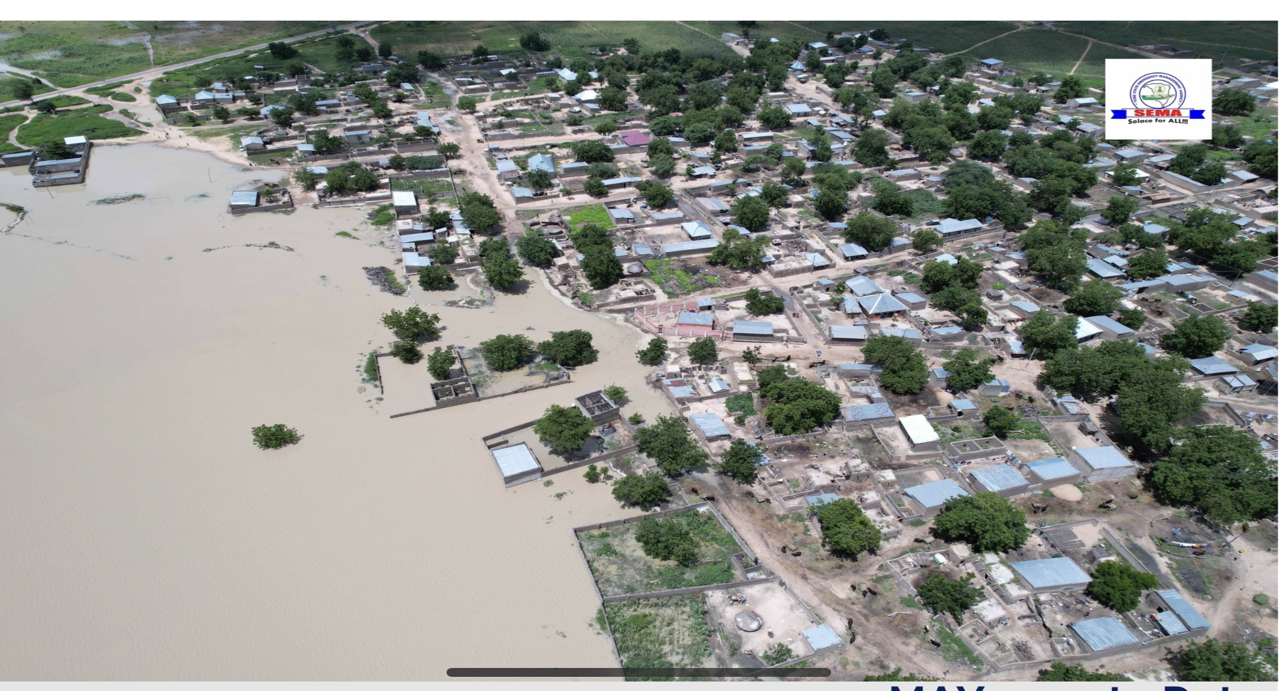
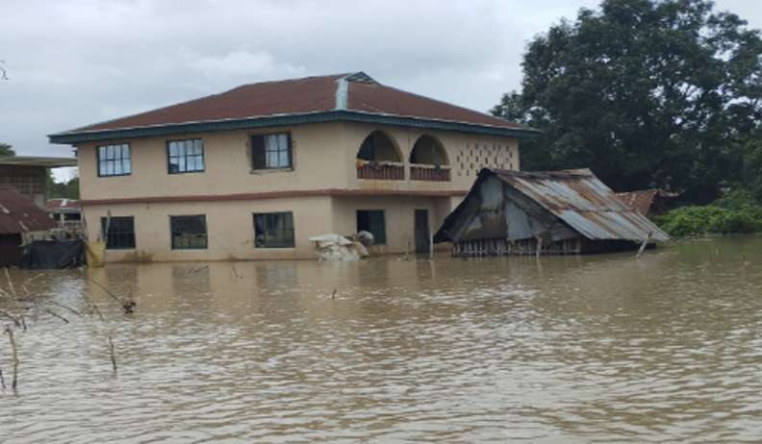
N G – C A R E S
The restructuring will support the States flood management/response strategy, by reallocating the funds to priority Disbursement Linked Indicators (DLIs) related to flood impact responses.
Other Reasons for Restructuring NG CARES
Review of Performance and changes in State Priorities
Changes to reflect response to other shocks – such as conflicts and insecurity.
Changes to reflect economic realities – DLI Pricing and Targets
  Changes due to implementation delays and governance structure and system imperatives– Operation modalities and challenges.
  Changes to address Funds flow and Financial Management issues
Source: Yobe State Emergency Management Authority (SEMA)
Source: Anambra State

Slide 8
Prayers /Next Steps
N G – C A R E S
Improved Adherence to Fund Release Policy and Welfare of NG-CARES Staff
World Bank Approval of Restructuring –May 2023
Special Planning Meeting with SCSC Chairmen – May 31 – June 1
2nd Advance Disbursement – June 2023
2nd IVA assessment in June 2023 – 3rd & 4th Assessment in Dec ’23 & Jun ‘24 respectively.

Slide 9
N G – C A R E S
Thank You

