Slide 1
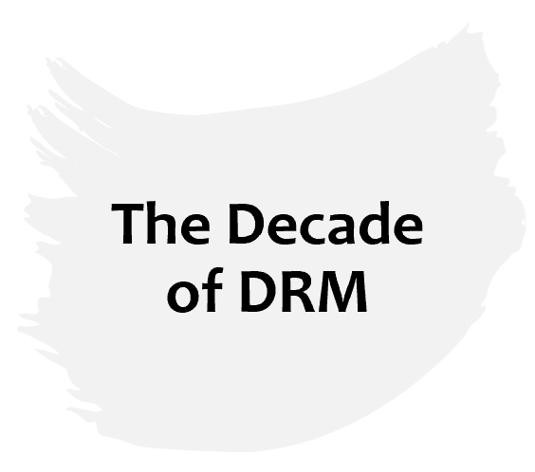
2023 Induction Programme for Governors Wednesday, 17th May 2023
David Nabena

Slide 2
Increasing role of DRM
Tax reform at the State-level received significant attention in the last decade, spurred by the mid-2014 – 2016 oil crisis which saw government revenues (% of GDP) fall by nearly half from 11% in 2014 to 6% in 2016.
The sharp revenue slump during the period revealed a previously overlooked risk – oil receipts were more volatile than oil prices.
What tax reforms mean for States
Better tax administration practices
Increased funding for government administration, infrastructure provision, and social service delivery
Fair and competitive business environment for private sector growth
Enhanced state-society relations
Reduced dependence on aid and federation revenues.
Inflection point for tax reforms

Slide 3
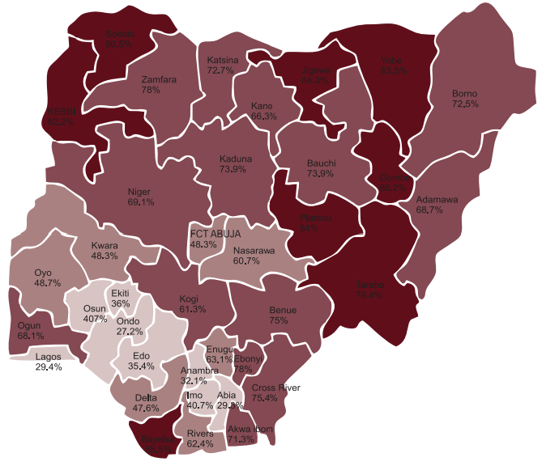
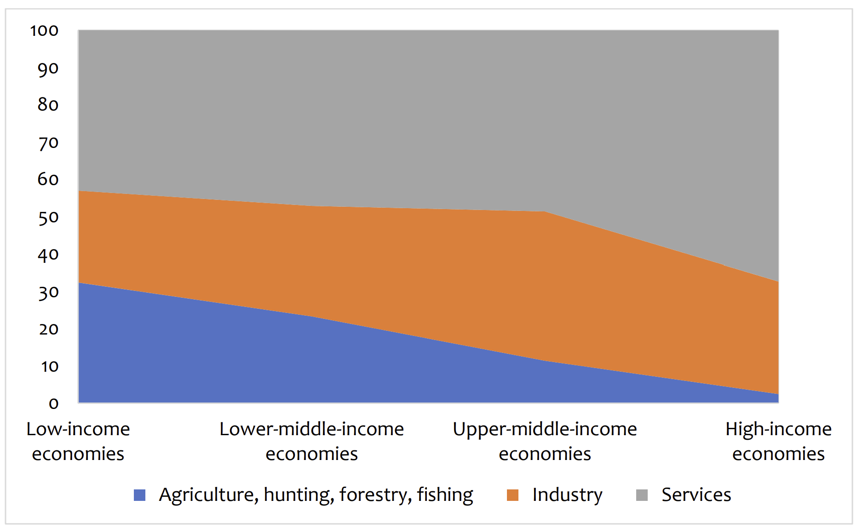
Can low income economies generate high domestic revenues?
Tertiarisation of the Nigerian economy
Multidimensional Poverty in Nigeria, headcount (%)
Industrial transformation
Low productivity, low income, high unemployment, high poverty……..

Slide 4
Repositioning State economies
An aggressive manufacturing agenda will reduce the burden on high unemployment and poverty by creating a sustainable pool of high-skilled, high-paying jobs. Targeted infrastructure, skills development, harmonising regulations, making quality connections with the private sector, and preparing for a more digital future are important conditions to accelerate this process. Special economic zones (SEZs) such as free-trade zones, export-processing zones, industrial parks, economic and technology-development zones, high-tech zones, science and technology parks, free ports, enterprise zones have become the most common vehicles to deliver a competitive advantage.
Attract large scale investments through regional cooperation for projects, policies, and regulations. Integration creates a business case for large-scale investments because it provides a predictable risk profile for a large section of the country rather than dealing with multiple jurisdictions, with multiple regulations and supply chain arrangements.
Public financial management (PFM) remains central to the steerage of development and the provision of public and private services. In this bucket, an effective tax reform can anchor the government’s long-term strategy to finance development, support private sector growth and strengthen public legitimacy.

Slide 5
NGF’s DRM Programme, 2017 - 2023
Capacity Building | Trust Building Services | Digital Transformation
The Intelligent Tax Authority (TITA) initiative - a digitalised end-to-end taxpayer management and revenue administration system.
eLMS - online training platform for State government officials.
EoI will help catalyse the development of a rules engine for information exchange amongst States.
Research – independent and collaborative research to generate evidence for advocacy and action.
Data creation, analysis and sharing – through an IGR Dashboard we assess the tax environment of all States.
Capacity building – the HelpDesk provides demand-based advice and technical support to States through direct technical assistance, workshops, and knowledge transfer.
High-level advocacy (engagement with Governors, JTB, SIRS, FGN, Development Partners etc)
Tax for Service - in which informal sector workers pay taxes in exchange for free minimum healthcare is a policy innovation that rides on the capacity to raise revenues from the informal sector for a core domain of human development.
Public finance database – Nigeria’s first open source State-level public finance database
Risks of taxation, 2019
Impact of COVID lockdown on state taxes, 2020
Key conditions for effective tax reforms:
Administrative & financial autonomy for tax authorities.
Simplified, harmonised and consolidated revenue code
Effective service delivery to build public trust and taxpayer compliance.
Whole-of-government approach to tax reforms.
Digital transformation of tax administration and government processes.

Slide 6
DRM in Figures
States’ Capacity to Administer Taxes, 2017 - 2022
Total IGR for the 36 States, 2011 - 2022

Slide 7
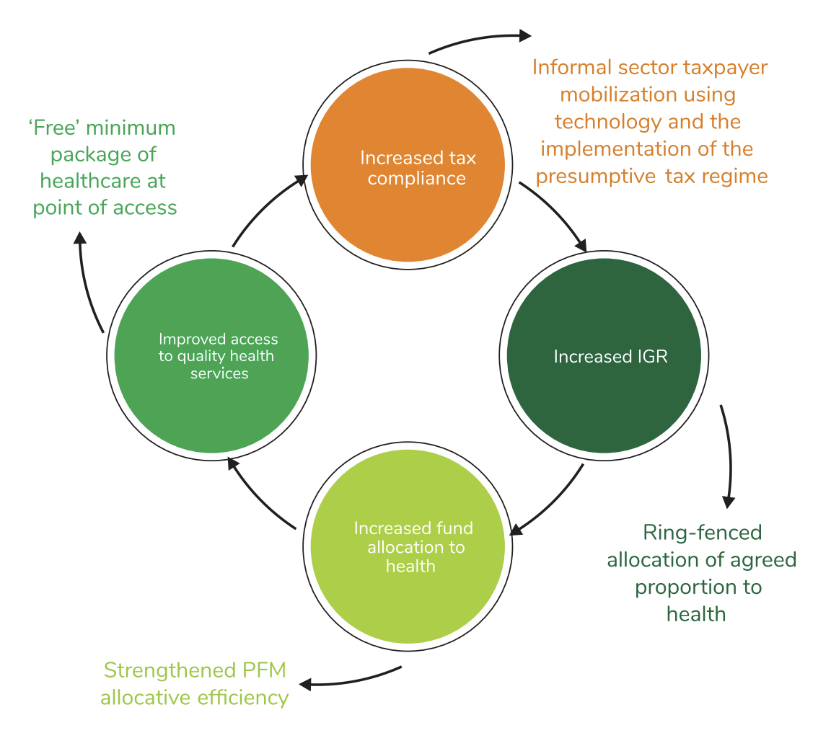
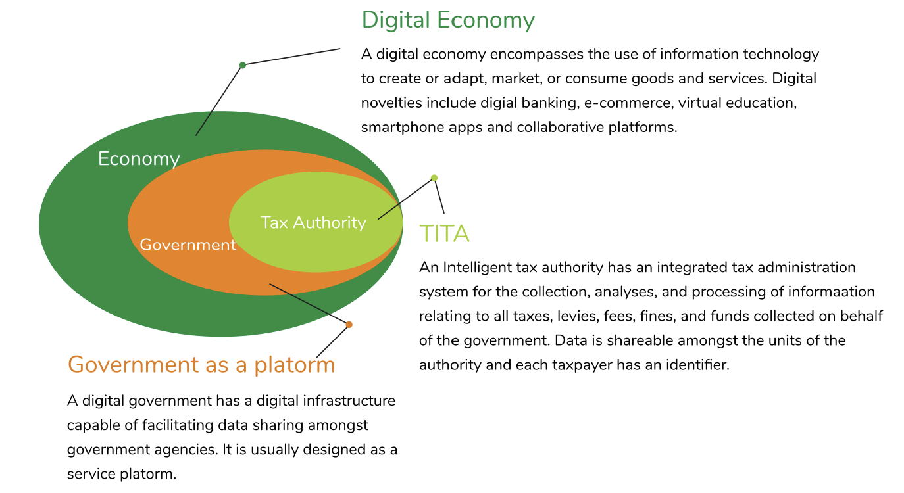
RESEARCH
MODEL
INTERVENE
MONITOR & LEARN
Tax for Service
Digital DRM

