Slide 1
Achieving Realistic Budgets for Development Planning
Ben Akabueze
Director-General, Budget Office of the Federation
Federal Government of Nigeria
16th May, 2023

Slide 2
Outline
Introduction
Conceptual Framework
Achieving a Realistic Budget: Key Considerations
Critical Issues
Recommendations

Slide 3
Introduction

Slide 4
Introduction
No nation/state can develop sustainably without an effective planning framework, which includes development plans and annual budgets that give life to the priorities of the plan, as well as the institutional arrangements to enable implementation of the plans and budgets. A good implementation framework will include monitoring & evaluation and legislative oversight.
Achieving realistic budgets for development will take more than designing a credible budget framework.
The Executive and Legislature must play their respective roles in the Budget process.

Slide 5
Introduction …/2
Poor development outcomes are often rooted in the weak links between policymaking, planning and budgeting.
All the states in the country are faced with binding resource constraints as well as other structural constraints that prevent them from realising their development aspirations.
Most governments in Nigeria do not measure well in the evaluation of budget realism, as evidenced mainly by the gap between actual performance and budgets

Slide 6
Conceptual Framework
Development Plan
A development plan should be a carefully crafted framework with a long-term scope.
It provides a comprehensive overview of the economy, sets policy direction for economic growth; also identifies strategies, programmes and projects to accomplish the set goals.
A development plan is usually made up of five components: Vision, Mission, Goals, Strategies, and Actions. In other words, the Plan is basically about deciding in advance what to do, how to do it, when to do it and who to do it.
The development plan is a blueprint for action; Actions are the life-wire of any plan; Without actions or actionable activities, a development plan is useless.

Slide 7
Conceptual Framework …/2
Development Plan (2)
Development planning in Nigeria dates back to the early 1960s; however, we can argue that it has not been as successful as desirable.
It is important to underscore that development planning is not easy since it deals with many complex and futuristic events.
Development planning entails deliberately pursuing short-term activities that are geared to the achievement of the long-term development plan

Slide 8
Conceptual Framework …/3
Annual Budget
Annual Budgets are essentially bite-sizes of the development plan that target development objectives achievable within a year.
A budget is not just a set of revenue & expenditure plans by the Government, but a culmination of government’s strategic economic and fiscal policies, plans and priorities for actualising its development agenda in a fiscal year.
Budgeting entails choice among competing alternatives; the purpose being to achieve the optimal allocation of available funds.
Resource constraints vis a vis competing economic needs underscore the need for Budgeting.

Slide 9
Conceptual Framework …/4
Annual Budget (2)
Public sector budgeting is eclectic; it is multidimensional in coverage:
Political: it allocates the scarce resources of a country among multiple, competing and sometimes conflicting interests.
Economic: it serves as the primary fiscal instrument for stimulating economic growth and development, promoting full employment, combating inflation, and maintaining economic stability.
Accounting: it provides a ceiling on government spending and makes it legally binding for it to operate within the allocated funds.
Administrative: it specifies the ways and means by which public services are provided, and establishes criteria by which they are monitored, measured, and evaluated.
Moral: it is also a moral document; you can tell what a country values by looking at its budget.

Slide 10
Conceptual Framework …/5
What Makes For Effective Planning, Budgeting and Budget Monitoring Framework
CLARITY
A strategic economic development plan can be complex, but it is important to keep things as simple and straightforward as possible.
Source: https://www.sehinc.com/news/how-develop-strategic-economic-development-plan

Slide 11
Conceptual Framework …/6
What Makes For Effective Planning, Budgeting and Budget Monitoring Framework
REALISM
The Plan should be ambitious but realistic
This would require balancing the gap between Needs vs. Availability
and revenue
Source: https://www.sehinc.com/news/how-develop-strategic-economic-development-plan

Slide 12
Conceptual Framework: The Plan-Strategy-Budget Linkage
Public Resources
Resource Framework
Private Resources
Strong M & E Framework
Budget Implementation

Slide 13
Achieving a realistic budget:
Key considerations

Slide 14
Key Considerations for Achieving a Realistic Budget
(1) Recognizing the usefulness of budget principles
Comprehensiveness
Is the coverage of government operations complete?
Are estimates gross or does netting take place?
Transparency
How useful is the budget classification? Are there separate economic and functional classifications that meet international standards?
Is it easy to connect policies and expenditures through a program structure?

Slide 15
Key Considerations for Achieving a Realistic Budget …/2
(1) Recognizing the usefulness of budget principles …/2
Realism
Is the budget based on a realistic macroeconomic framework?
Are estimates based on reasonable revenue projections? How are these made, and by whom?
Are the financing provisions realistic?
Is there a realistic costing of policies and programs and hence expenditures (e.g., assumptions about inflation, exchange rates, etc.)
How are future cost implications taken into account?
Is there a clear separation between present and new policies?
How far are spending priorities determined and agreed under the budget process?

Slide 16
Key Considerations for Achieving a Realistic Budget …/3
(2) Keeping to the rules
The constitution
This is the highest in the legal hierarchy. Although it deals only with broad principles, the Constitution clarifies three important aspects:
(1) the relative powers of the executive and legislative branches with respect to public finances;
(2) the definition of the financial relations between national and subnational levels of government; and
(3) the requirement that all public funds be paid into designated accounts and that these funds be spent only under the authority of a law.

Slide 17
Key Considerations for Achieving a Realistic Budget …/4
(2) Keeping to the rules …/2
The organic budget law
This is usually the main vehicle for establishing principles of public financial management, and represents best practice.
The organic budget law guides budget preparation, approval, execution, control, and auditing.
It is called "organic" because it relates to organizational matters and systems, and does not therefore require annual re-enactment.
It can often be modified only under certain conditions, such as qualified parliamentary majority.
The organic budget law also gives to the government, or the minister responsible for public finance, the authority to issue detailed regulations and instructions

Slide 18
Key Considerations for Achieving a Realistic Budget …/5
(3) Identifying the responsibilities of stakeholders within the budget system
Operating within the powers assigned to the legislative and executive branches, and, within the executive branch is important to achieving a realistic budget.
When considering expenditure changes at the budget preparation stage, countries vary in the extent to which the legislature can change the budget, once it is submitted for their consideration.
Many countries, for example, allow for the composition of the expenditure or revenue plans to be changed but not the global total.
In some others, particularly in a number of transition economies, new expenditure proposals- often poorly costed - can be put forward, approved by the Legislature, and thus enter into the budget. Most often, this undermines the realism of the budget
The Executive must ultimately negotiate the budget with the Legislature

Slide 19
Key Considerations for Achieving a Realistic Budget …/6
(4) Budgetary Controls
There are a number of budget controls that must be adhered to for a realistic budget:
Establishing fiscal rules, eg, deficit limits
Maintaining expenditure limits, especially on costs
No extra-budgetary expenditures

Slide 20
CRITICAL ISSUES

Slide 21
Public Debts
External Debt (N’M)
Persistent deficit financing has resulted in the total States domestic debt has risen significantly from N1.69 trillion in June 2015 to N5.34 trillion in December 2022.
This largely reflects the states’ critical revenue problem, which could lead to a debt sustainability problem if not urgently addressed.
Domestic Debt (N’M)

Slide 22
Domestic vs External Debt by States
Domestic debt was highest in Lagos, Delta, Ogun, and Rivers, at N807 billion, N304 billion, N270 billion and N225 billion, respectively in December 2022.
It was lowest in Jigawa, Kebbi, and Katsina at under N70 billion in December 2022.

Slide 23
States still depend largely on Federation Allocation
In 2021, FAAC allocation accounted for more than 50% of States Revenue.
Internally Generated Revenue (IGR) is rising but at a slow pace because:
Most states ignore or fail to report the collection of many tax revenues such as Property tax, CGT and WHT.
Aid/Grants forms the bulk of other revenues for some states.
61%
55%
54%
48%

Slide 24
The increasing burden of Petrol Subsidy…
…is undermining fiscal space
2011-14:
Subsidy. N3.2tr
2015-18:
Subsidy. N3.0tr
2019-22:
Subsidy. N5.2tr
A provision of N3.36 was made for subsidy up to June 2023.
The States collectively bear about N940bn of the subsidy cost

Slide 25
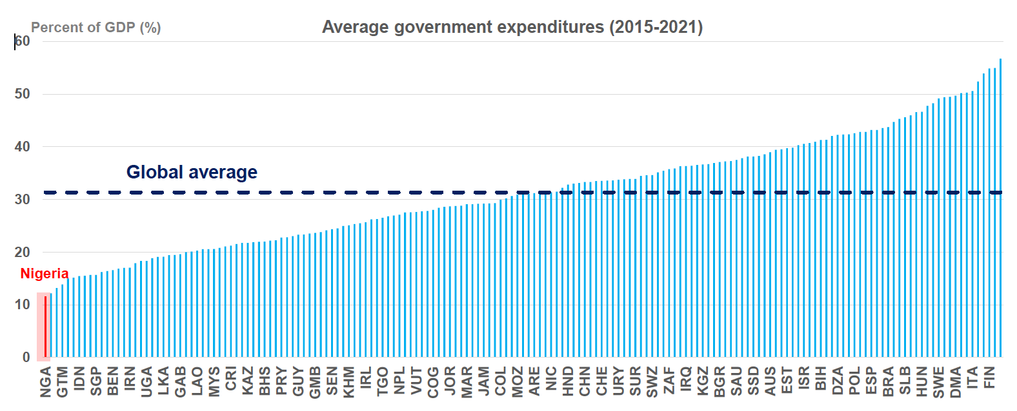
Nigeria’s General Government Spending…
…is about the lowest globally
Source: World Bank, Nigeria PER 2022

Slide 26
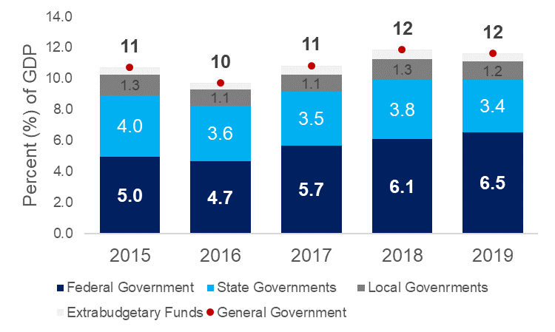
Nigeria’s government spending by tier of government (% GDP)
Federal Government accounts more than half of the general government spending.
State governments collectively account for about a third of government expenditures but are at the forefront of basic service delivery.
In 2020 and 2021, State governments’ spending was 2.8% and 3.1% of GDP, respectively, lower than in the pre-pandemic era.
Data relating to the contributions of local government spending remains a problem.
Source: World Bank – NiPPER, calculations are based on State Audited Financial Statements, OAGF, DMO, and NBS data

Slide 27
Large Variation of Spending Across the States
In 2021 State Governments collectively spent N5.67 billion Naira (excl. debt service), about 68% of the budgeted amount.
With a large population, this translates to a low level of per capita public expenditure
On average, States spent about US$70 per person in 2021.
Added to the low expenditure level is the problem of spending efficiency.

Slide 28
Across the States, allocation to basic service delivery is low
Function | States Average (% of Total 2021 Budget) | Avge State budget allocation per capita (US$)
General Public Service | 37% | 34.5
Economic Affairs | 24% | 21.7
Education | 16% | 14.6
Health | 9% | 8.0
Housing and Community Amenities | 7% | 6.2
Public Order and Safety | 3% | 2.5
Environmental Protection | 2% | 2.0
Recreation, Culture and Religion | 2% | 1.5
Social Protection | 1% | 0.6
Total Budgeted Expenditure 2021 | 100% | 92
Source: World Bank, NiPPER: calculations are based on State 2021 Budgets, NBS and CBN data

Slide 29
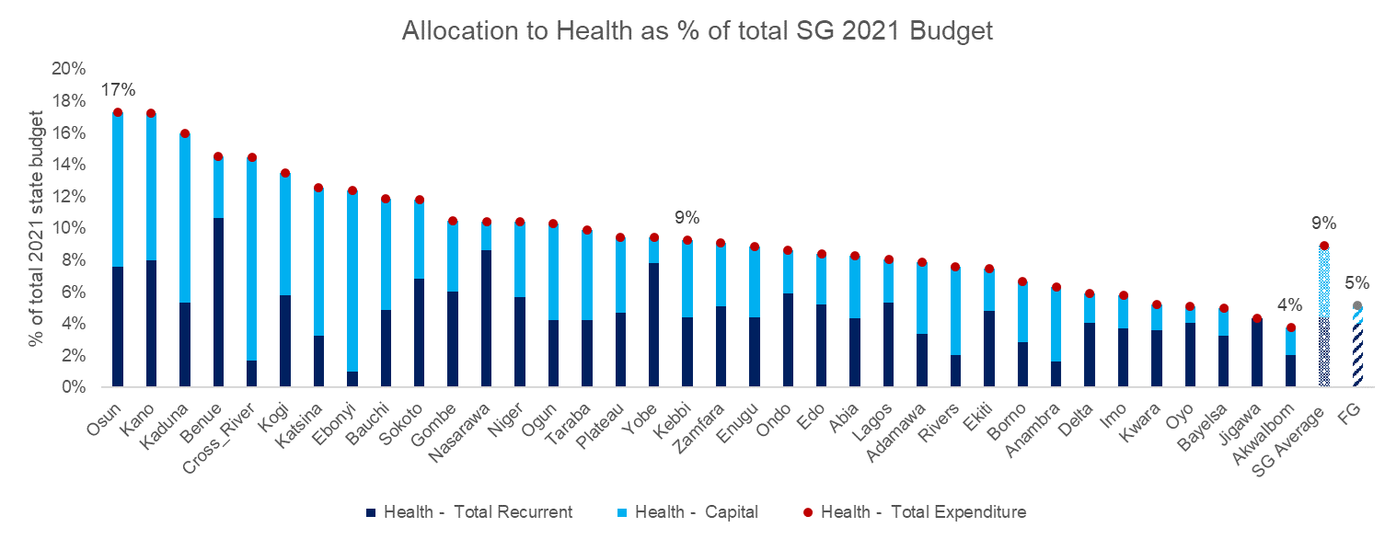
States’ low priority for HEALTH is of great concern
On average, States allocate less than 10% of their budgets for HEALTH
In 2021 the 36 Nigerian states collectively allocated N731 billion for health compared to FG health allocation of N630 billion
In per capita terms, this translates to an average state allocation of US$ 8 dollars of health spending per capita a year (about US$ 6 dollars per person from the Federal Government Budget)
With an average states budget implementation of 68%, the actual annual spending on health from state budgets may be as low as $4 dollars per person.
Source: World Bank, NiPPER: calculations are based on State 2021 Budgets, NBS and CBN data

Slide 30
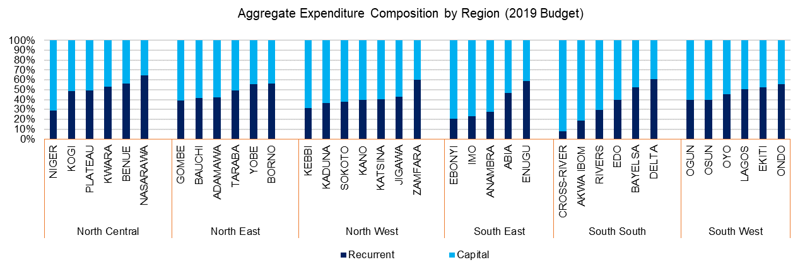
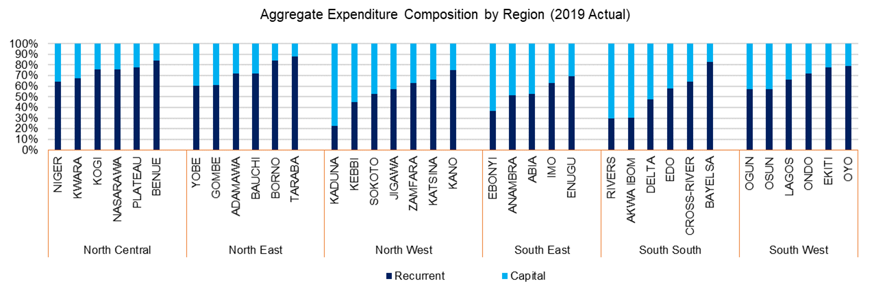
States’ spending is skewed towards recurrent expenditure
SG on average allocate 60% of budget for capital…
Although more allocation is made for capital investments during budget formulation, actual state spending is skewed towards recurrent.
But in the actual spending the ratio is reversed (40% of actual spending is on capital)
In 2021, while 68% of the States Budget is implemented (up from 50% in 2019), about 50% of the capital budget is executed (up from only 40% in 2019).
Source: World Bank, NiPPER

Slide 31
Recommendations

Slide 32
Some Recommendations
State governments should consider:
Setting up institutional structures to formalise the collection of all tax and non-tax revenues;
This may require pushing for a strong legislative framework to legitimise the drive for increased non-tax revenue collections; and
Strengthening the State Inland Revenue Service
Public orientation programmes to educate and motivate people to pay taxes. However, this will only be effective if the government can communicate transparency and accountability in the use of public funds.
Stimulate private sector investments and entrepreneurial innovations by creating business hubs and creating a conducive business environment.

Slide 33
Some Recommendations …/2
State governments should also consider:
Establishing fiscal rules, e.g., deficit limits
Increasing spending efficiency by creating a price list, and spending caps for certain non-essential expenditures.
Tagging some critical expenditures (especially those with long-term and multiplier effects) to certain revenue lines.
Choosing to focus on a list of priorities and needs of the State rather than spread resources thinly across various expenditure lines.

Slide 34
Some Recommendations …/3
Set up and/or adequately resource critical fiscal management institutions like Budget Office, Debt Management Office and Planning Department
Professionalise and strengthen critical agencies that play roles in budget implementation like Office of Accountant General and Public Procurement and Office of Auditor General
Institutionalise a framework for regular measurement and reporting of budget performance
Institutionalise mid-year budget reviews

Slide 35
THANK you!
www.budgetoffice.gov.ng

