Slide 1
Achieving Impact

Slide 2
INTRODUCTION
What is impact?
A powerful, significant or major effect that something, has on a situation or person
Tokenism is IMPACTLESS.

Slide 3
OBJECTIVE:
Appreciating the God given platform as Governor's wives to support our spouses' work as governors in bringing about impactful outcomes in our work with our people, particularly women, girls and vulnerable persons.

Slide 4
POWER OF FIRST LADIES
First Ladies have the power to drive change in their States
Use the platform to raise awareness and mobilize resources to address issues such as maternal and child health, education, gender-based violence and empowerment
Deploy expertise and wealth of experience for development of your State
Collaborate with arms and agencies of government, civil society, the private sector, and development partners to achieve goals

Slide 5
STRATEGIC APPROACH
1
Identify key issues that affect your state and prioritize based on impact on women, girls, and vulnerable groups
2
Identify stakeholders who can support efforts and develop partnerships with such
3
Leverage their expertise, resources, and networks to achieve goals
Be innovative and explore new approaches to addressing problems
Experiment and take calculated risks. e.g start with a pilot program and expand when successful.
4
5

Slide 6
INGREDIENT FOR IMPACT
PASSION

Slide 7
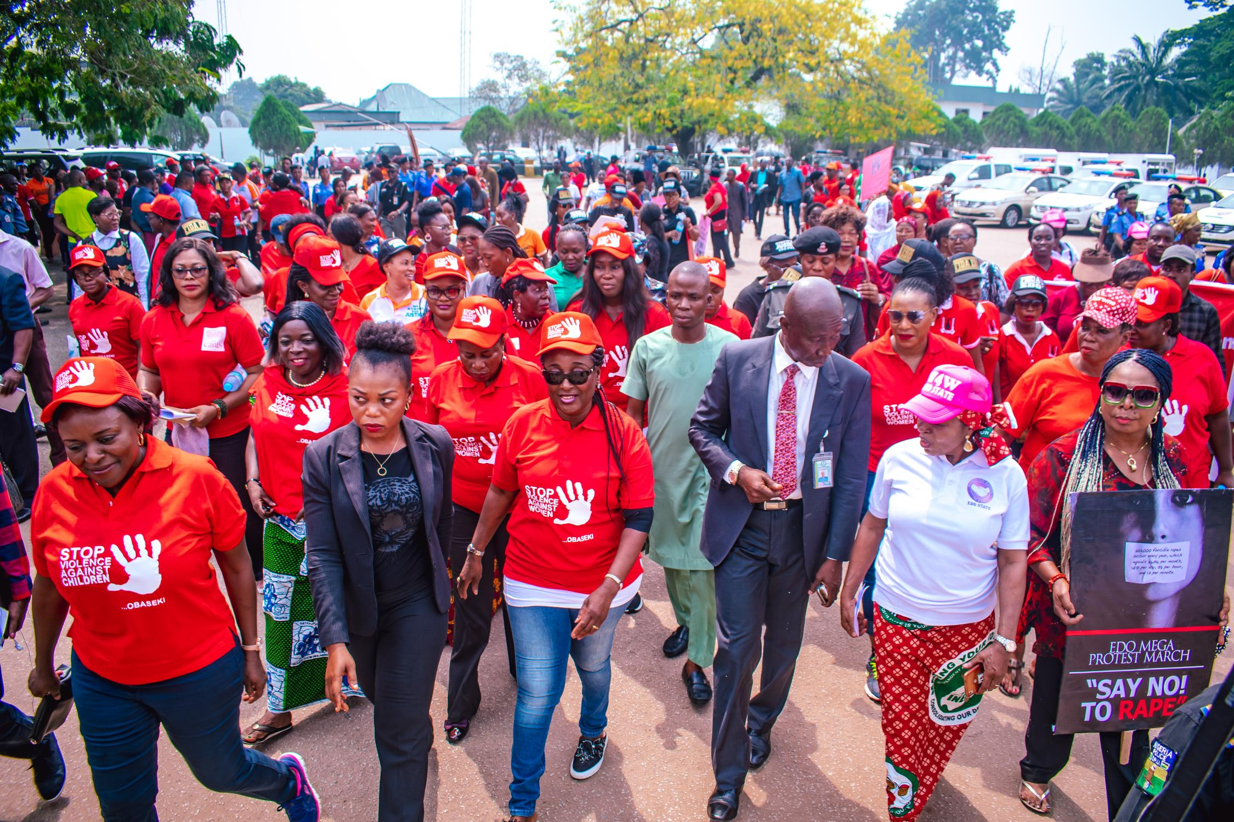
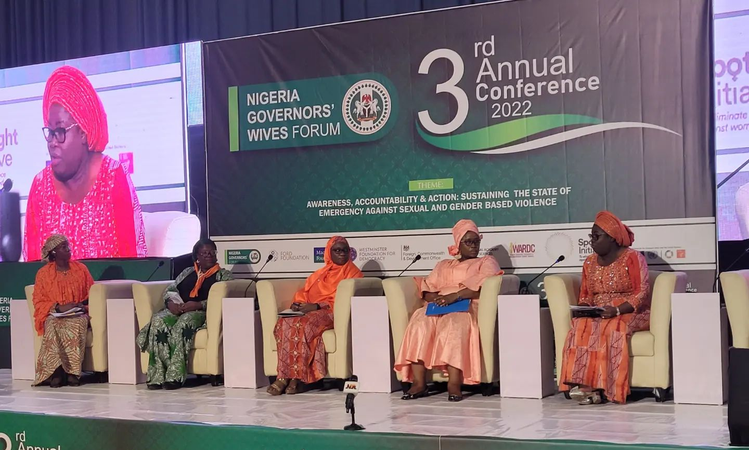
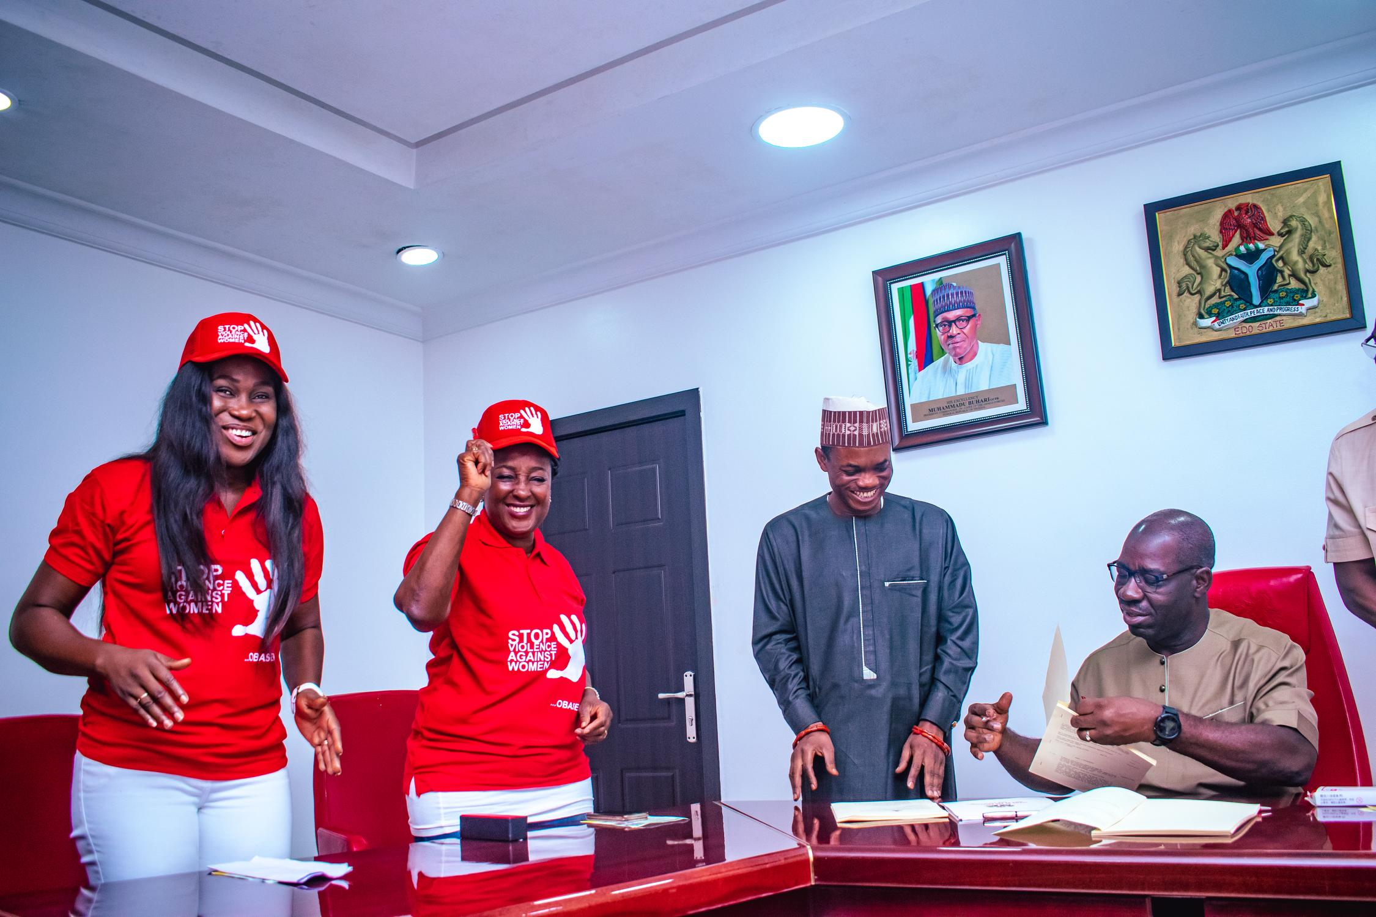
SOME IMPACTFUL ACHIEVEMENTS
Domesticating the Violence Against Persons Prohibition Law (VAPP LAW) in 34 States from 16 States within the space of thirty months

Slide 8
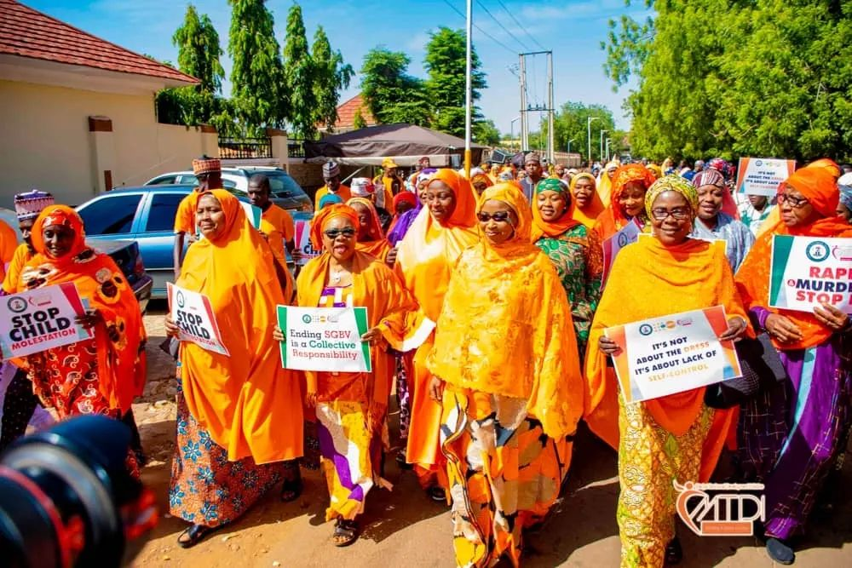
SOME IMPACTFUL ACHIEVEMENTS
Sokoto State First Lady leading a march against gender based violence as part of sixteen days of activism

Slide 9
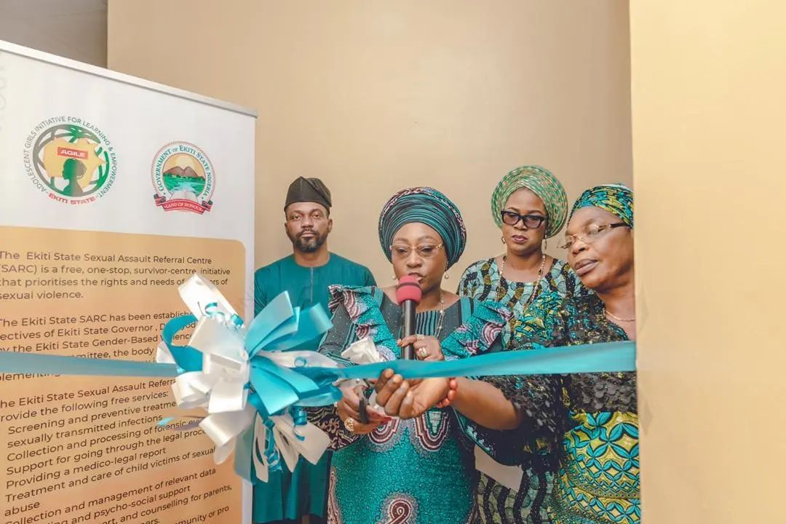
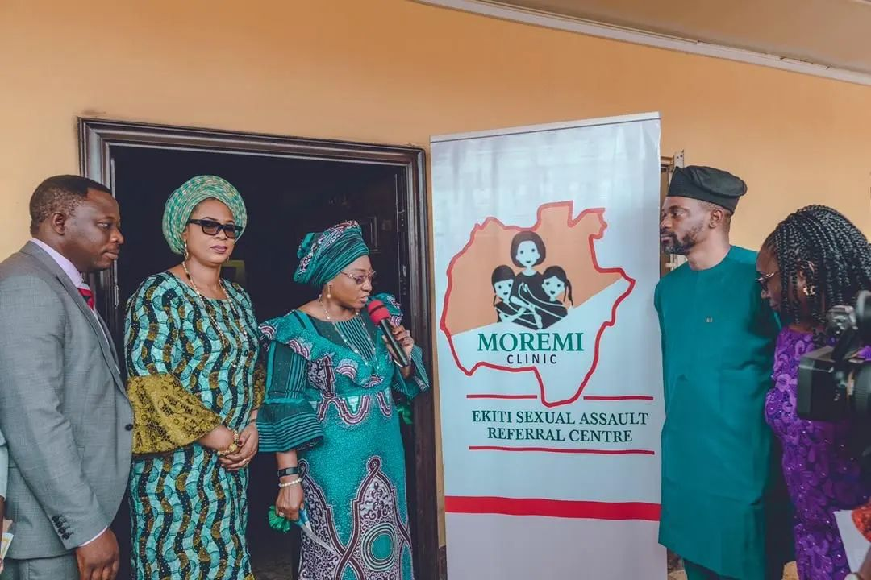
SOME IMPACTFUL ACHIEVEMENTS
Ekiti First Lady Commissions two more Sexual Assault referral Centres in her State

Slide 10
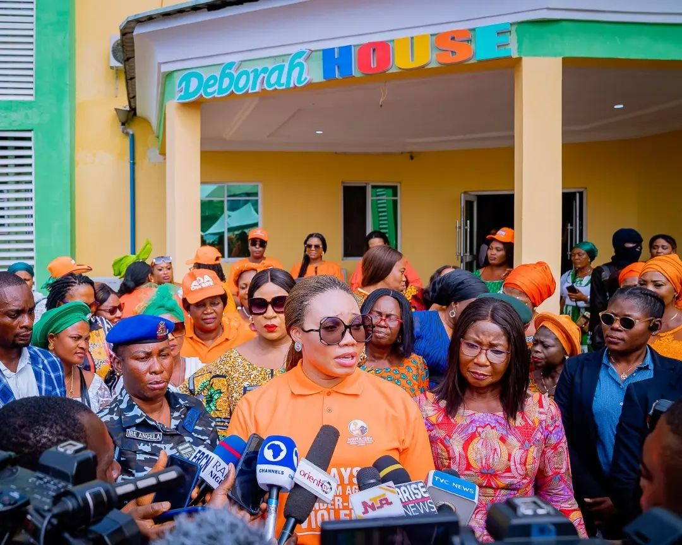
SOME IMPACTFUL ACHIEVEMENTS
Imo First Lady Commissions Deborah House, which is the Imo State Sexual Assault referral Centre

Slide 11
ADVOCACY AND AWARENESS
Power of advocacy in driving positive change and amplifying the voices of the marginalized.
First Ladies of Ekiti State, Akwa Ibom State and myself during Occupy the National Assembly, in protest over their refusal to pass the gender bill

Slide 12
ADVOCACY AND AWARENESS
Power of advocacy in driving positive change and amplifying the voices of the marginalized.
First Lady of Akwa Ibom State advocates against rape

Slide 13
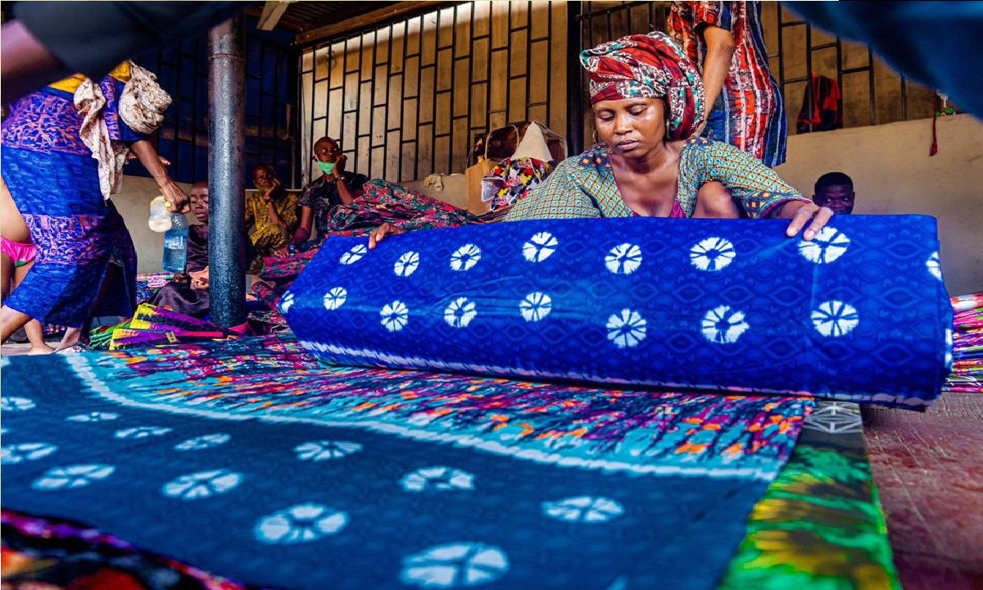
ADVOCACY AND AWARENESS
Power of advocacy in driving positive change and amplifying the voices of the marginalized.
Ogun State First Lady used her office to promote the manufacture and use of Adire in the State by organising the First Lady Adire Market Week

Slide 14
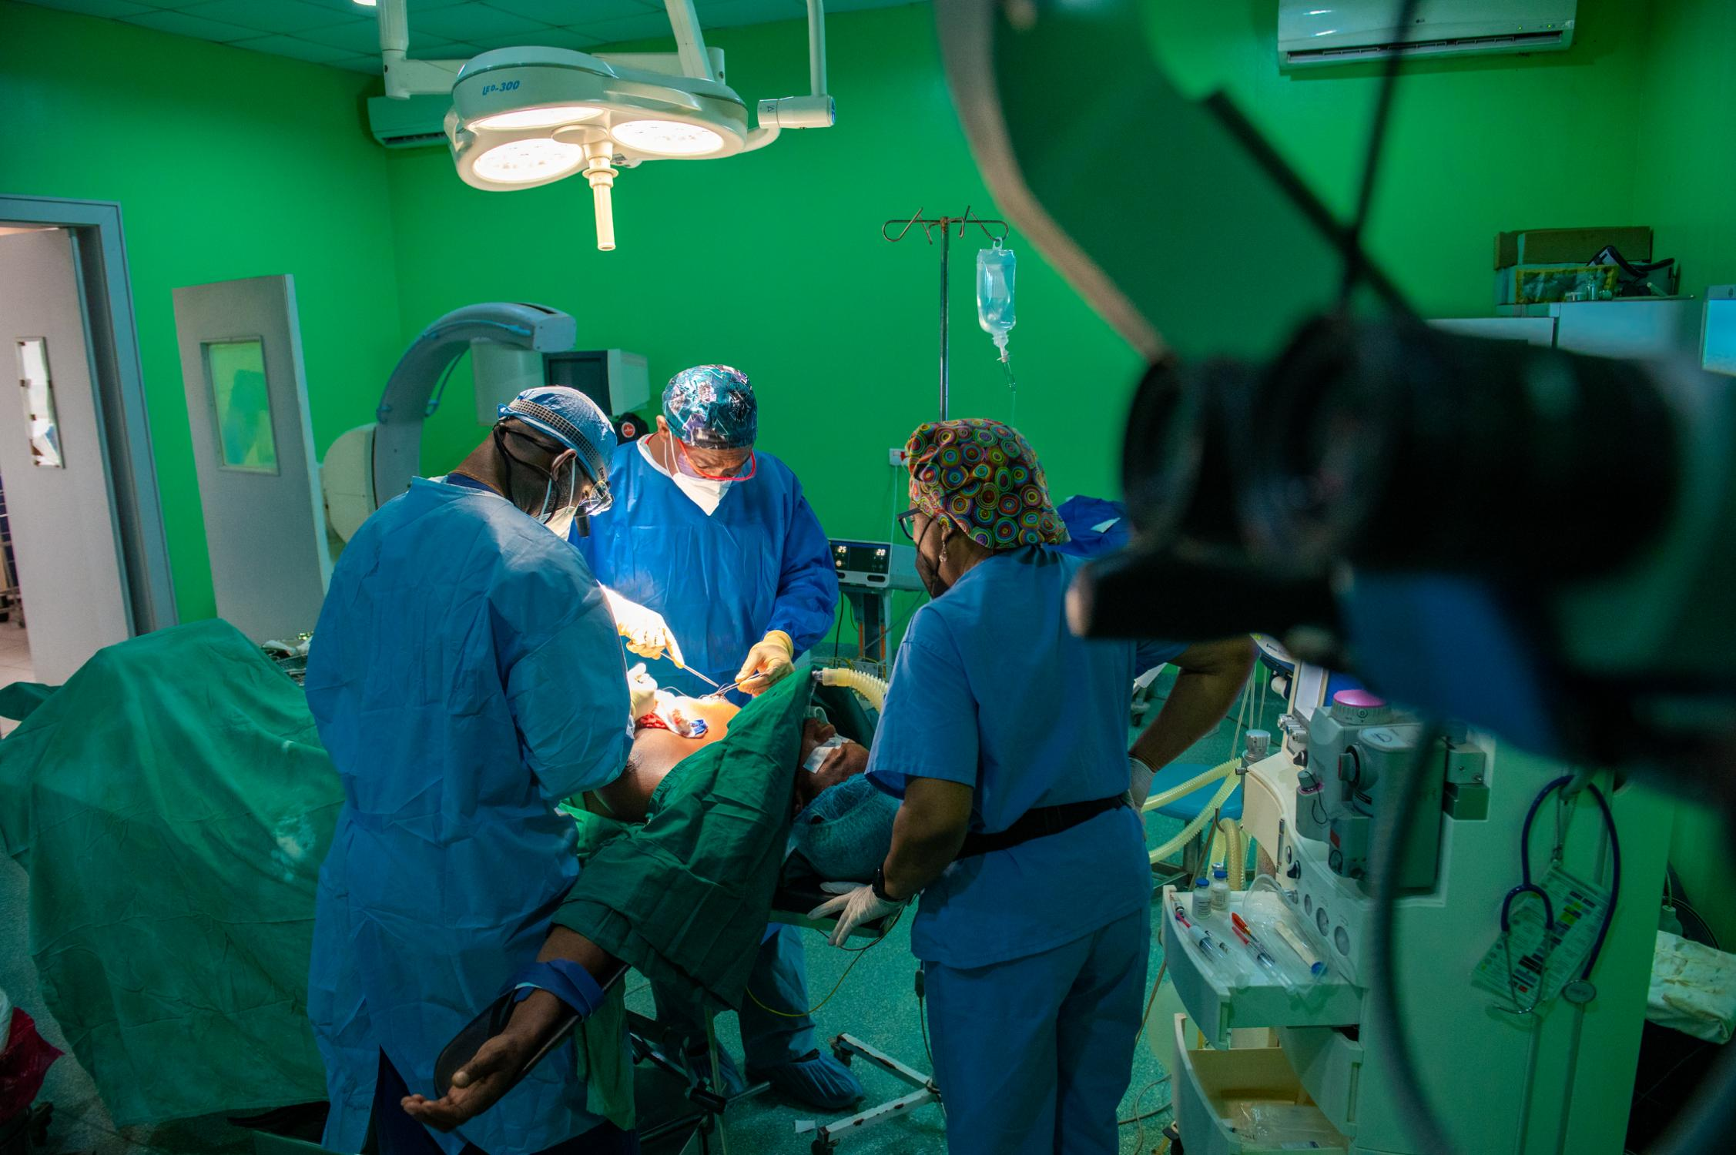
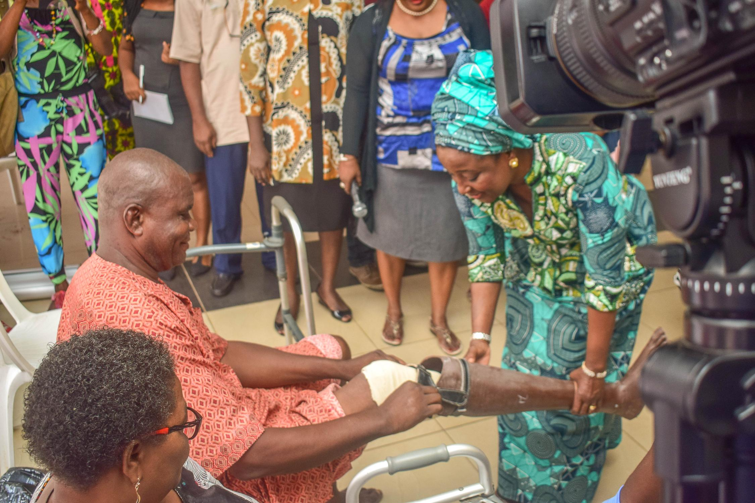
The Power of Collaboration
Collaborated with Association of Nigerian Physicians in the Americas (ANPA) for the Medical Outreach that reached over 10,000 persons
Collaborated with TOLARAM FOUNDATION for prosthesis for 300 persons

Slide 15
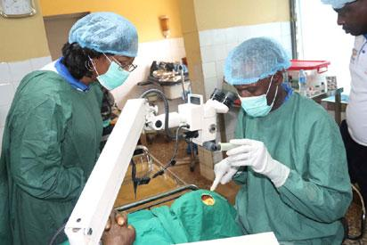
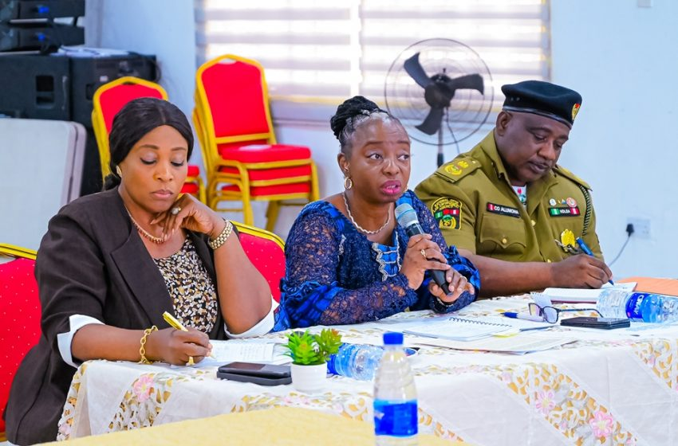
The Power of Collaboration
Delta State First Lady launched State wide free medical outreach and reached over 40,000 persons
Lagos First Lady collaborates NDLEA to fight drug abuse in Schools and communities

Slide 16
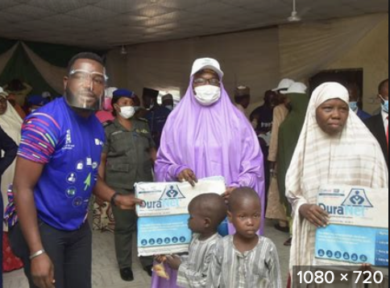
The Power of Collaboration
Gombe First Lady launched free medical outreach for vulnerable groups

Slide 17
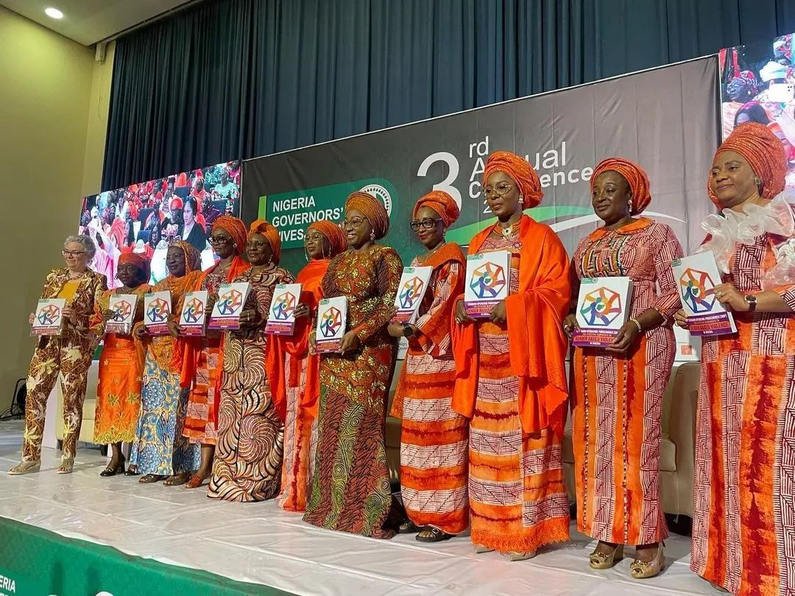
The Power of Collaboration (Internal Collaborations)
Nigerian Governors Wives Against Gender Based Violence

Slide 18
The Power of Collaboration (Internal Collaborations)
FLAC, First Ladies Against Cancer

Slide 19
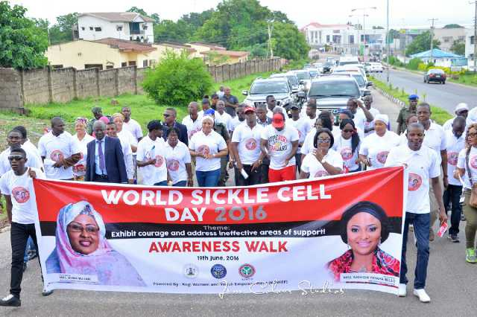
Some Impactful Achievements
Deploy expertise and wealth of experience for development of your State
Kebbi State First Lady bringing her professional expertise to bear in her State

Slide 20
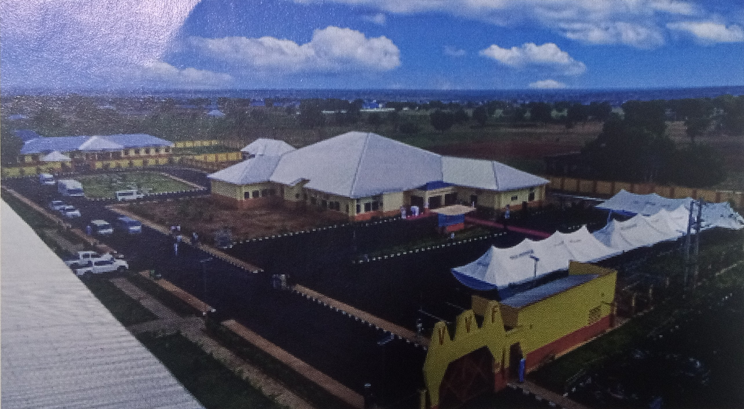
Some Impactful Achievements
Deploy expertise and wealth of experience for development of your State
Niger State First Lady built the Women Health centre, a free VVF hospital with theatre facilities to cater for women in her State

Slide 21
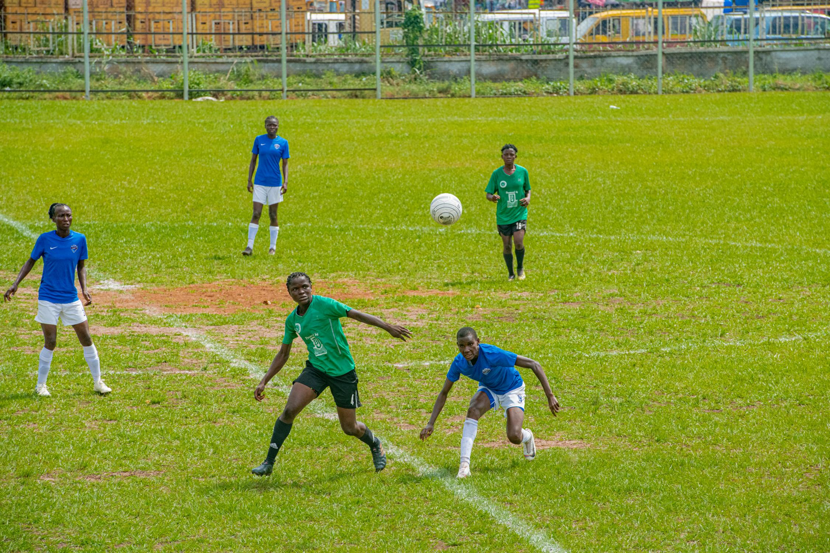
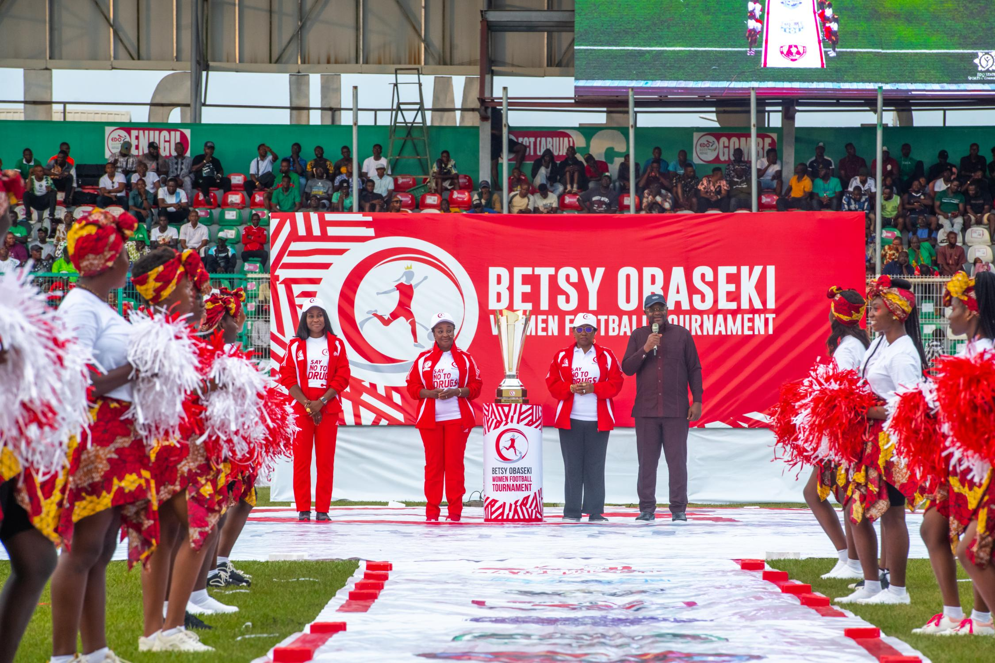
Some Impactful Achievements
The Betsy Obaseki Women Football Tournament which is the only female pre-season tournament in the country and has been applauded by FIFA for its impact in the development of women football.

Slide 22
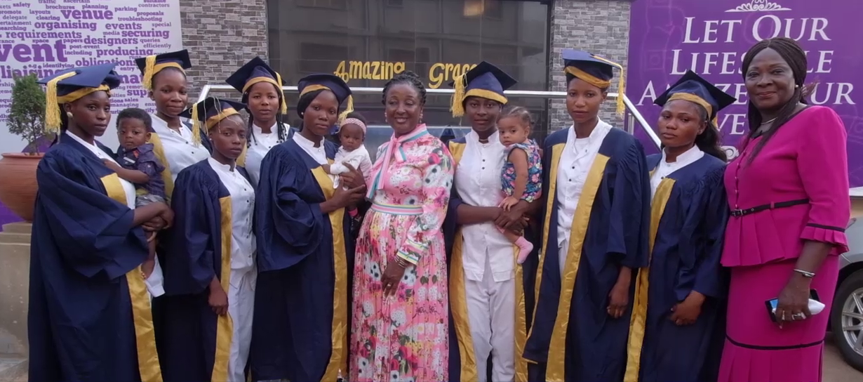
EMPOWERING WOMEN AND GIRLS
Significance: Education, Gender Equality, Economic development, breaking the cycle of poverty, Social and political participation, building resilient communities.
Edo Youth Academy Graduation Ceremony

Slide 23
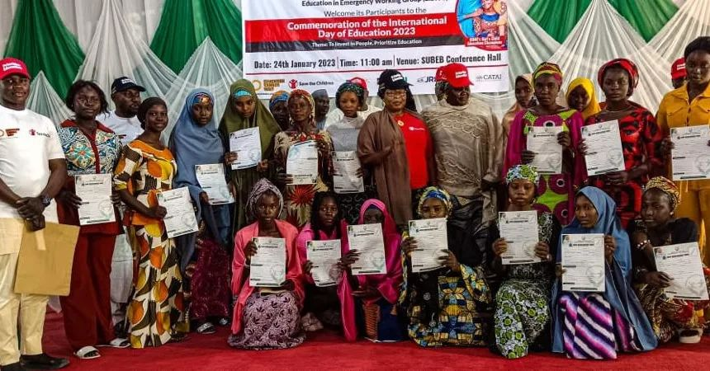
EMPOWERING WOMEN AND GIRLS
Significance: Education, Gender Equality, Economic development, breaking the cycle of poverty, Social and political participation, building resilient communities.
Adamawa First Lady gives scholarships to best WAEC students

Slide 24
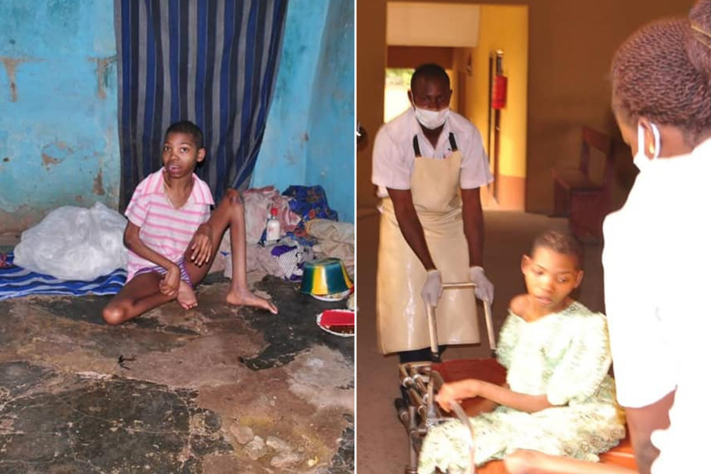
ADDRESSING VULNERABILITY
Significance: Education, Gender Equality, Economic development, breaking the cycle of poverty, Social and political participation, building resilient communities.
Osun First Lady rescues Physically Challenged person locked up for five years

Slide 25
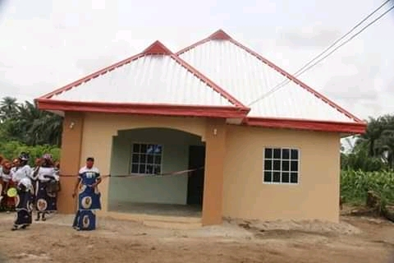
ADDRESSING VULNERABILITY
Significance: Education, Gender Equality, Economic development, breaking the cycle of poverty, Social and political participation, building resilient communities.
Abia First Lady donates buildings to widows and indigents persons

Slide 26
MOTHERLY ROLE
Perception as Mother of State and you must play that role to the people.
VISIT OF UWAILA'S PARENTS

Slide 27
PITFALLS TO AVOID
Learn to sift through requests. Not every collaboration is impactful, some want to ride on your platform for personal gain or aggrandizement.
Fight for Focus: You will constantly be pulled by other things that go with the office, e.g ceremonies etc. And you can spend 4 years or even 8 years doing just that.
Wastage: White elephant projects that are not commensurate with the result. Check the budget first and compare with expected final result before you begin.

Slide 28
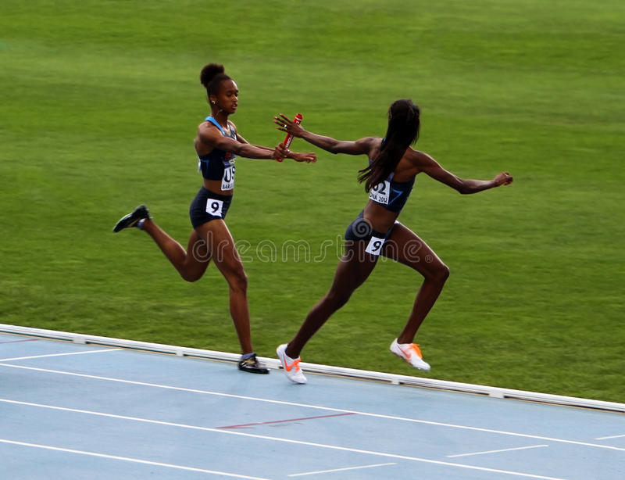
CHARGE
Rise above tokenism, for impact.
Build on what other First Ladies have done. See it as a relay, take the baton and run with all your might until you pass it on with greater impact.

Slide 29
Development Partners

Slide 30
CONCLUSION
Embrace the opportunity to make a positive impact on the lives of your people.
Use your power to drive change and make a difference
Impact can also be noiseless
Best wishes in your endeavors

Slide 31
Question and Answers

Slide 32
THANK YOU

