Slide 1
Driven by:
PRESIDENTIAL
ENABLING BUSINESS
ENVIRONMENT
COUNCIL (PEBEC)
NIGERIA’S SUBNATIONAL EASE OF DOING BUSINESS REFORMS IMPLEMENTATION HIGHLIGHTS
Presentation at the NGF Induction Session
May 2023

Slide 2
01
Subnational Agenda
CONTENT
03
State Action for Business Enabling Reforms (SABER)
02
Subnational Ease of Doing Business Report
PAGE 2

Slide 3
A snapshot of the business environment
15 months of Russian invasion of Ukraine
AfCFTA and the promise of greater access to African markets
2.6% population growth rate
402m people, 3rd largest population by 2050
PAGE 3

Slide 4
COMPETITIVENESS AGENDA
PEBEC was established in 2016 to remove bureaucratic bottlenecks in Nigeria’s business environment through extensive collaboration across 7 main areas:
01
The National Assembly
P
EB
E
C
02
6
The Judiciary
P
EB
E
C
5
P
03
EB
E
C
State Governments
4
P
EB
E
C
04
FGN regulators in key sectors
3
P
EB
E
C
05
Ministries, Departments and Agencies (MDAs)
P
2
EB
E
C
1
06
Private sector and stakeholders
07
AfCFTA Implementation Readiness
PAGE 4

Slide 5
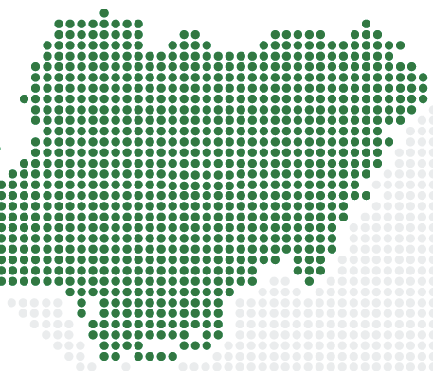
Subnational Reforms - Taking Ease of Doing Business to all Nigerians
Since 2017, the PEBEC framework was cascade to Subnational level. No State left behind.
Rationale
Enlightened Self-interest | Reform effort aligns with best interest of each state and support economic growth and development aspirations
Jobs creation | Improvements in the business environment enable MSMEs to flourish and will result in high levels of job creation
Quick tangible impact | Reforms aim to deliver results with quick tangible impact for Nigerian leading to better living standards and positive perceptions
Attracting FDI | Reform progress serve as a tool for investors to measure viability of proposed investments in a state
Healthy Competition | Some states are already implementing reforms; other states have to do the same to remain competitive
Effective change management | A lot can be achieved with limited resources by applying best practices – “Efficiency”, “Transparency”, “Performance Management”, and “Key Performance Indicators (KPIs)
PAGE 5

Slide 6
STATE EoDB INITIATIVE STRUCTURE
2nd SUBNATIONAL TECHNICAL WORKING GROUP 2019-2023
Chair
PEBEC Secretary
State ExCo
Regional representatives
Edo (S.S)
Ekiti (S.W)
Abia (S.E)
Gombe (N.E)
Jigawa (N.W)
Nasarawa (N.C)
Quarterly Reporting
Organised Private
Sector / Private
Sector Representatives
Nigeria Economic Summit Group (NESG)
National Competitiveness Council of Nigeria (NCCN)
OLAM Nigeria
EoDB Council
Public Sector
Representatives
NEC Secretariat
Governors’ Forum
National Bureau of Statistics (NBS)
Nigeria Investment Promotion Commission (NIPC)
Nigeria Export Promotion Commission
EBES (Subnational TWG Secretariat)
Monthly reporting
Co-ordinating Officer
PAGE 6

Slide 7
Operating model for states is similar to the PEBEC model
National Steering Committee to serve as a key oversight /governance arrangement.
Chaired by governor or deputy or any other ranking official
Includes commissioners of key MDAs
Meet monthly to provide coordination across ministry and remove challenges
States should implement business climate reform recommendations from the Subnational Ease of Doing Business Report
Customers
State ExCo
MSMEs across 6 priority sectors
Organised Private Sector
Private sector associations e.g. manufacturers, traders, farmers, transporters, etc.
MSMEs
Multinationals
General Public
Quarterly reporting
State EoDB Council
Monthly reporting
Co-ordinating Office
Implementing and monitoring entity led by State Reform Champion
Full time members seconded/recruited
Support from external stakeholders
PAGE 7
Notes:
7

Slide 8
EoDB Council Structure and Objectives
State EoDB Councils
The EoDB structure in the State provides an oversight for reforms approval, implementation and tracking
State Reform Champions
The key focal person for reforms within the State
To coordinate all subnational efforts on behalf of the State
EoDB workshops
Workshops in collaboration with PEBEC Secretariat and World Bank to promote the subnational reform project with the States
PAGE 8

Slide 9
EoDB at Subnational Level
Roadmap for the development and implementation of the reforms
Setup state Councils and Secretariats
1
Initial Phase
Assign action owners and reform champions
Prioritise reforms initiatives (limit to 3-5 per indicator)
Implement first set of priority reforms
Implement second set of priority reforms
Implement third set of priority reforms
2
Reform Implementation
Engage stakeholders and general public to raise awareness of reforms and increase accountability
Develop and roll-out monitoring and evaluation plans
3
Tracking and Feedback
Implement M&E Plans, anchored by monthly SteerCo meetings, monthly peer review reports, engagement with international rankers and reports cards on implementation sprints
PAGE 9

Slide 10
01
Subnational Agenda
CONTENT
03
State Action for Business Enabling Reforms (SABER)
02
Subnational Ease of Doing Business Report
PAGE 10

Slide 11
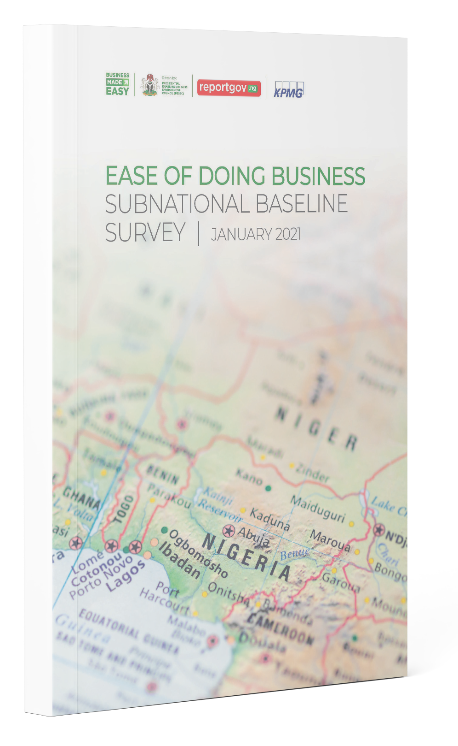
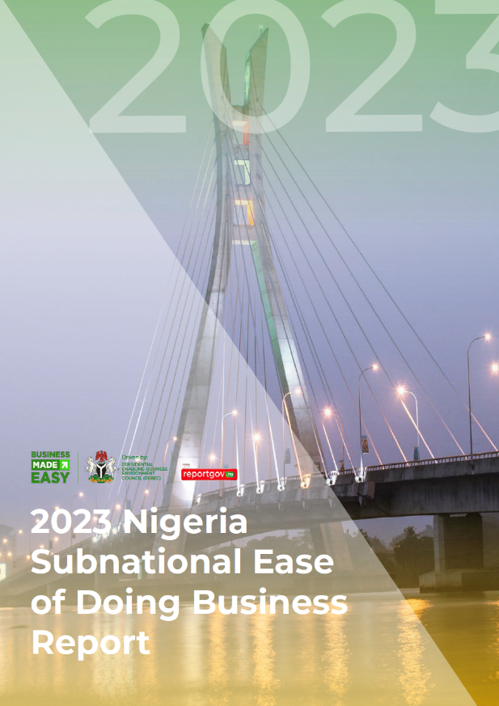
Subnational EoDB Baseline Survey
In May 2018, the NEC approved use of a subnational survey methodology framework developed by the Subnational Technical Working Group
Provide a status report on the attractiveness of states attractiveness in terms of business climate reforms as a reference resource for micro, small and medium sized enterprises (MSMEs) and the general business community.
Support State Ease of Doing Business Councils to craft their reform agendas and implementation roadmaps based on empirical data and feedback from a cross-section of MSMEs across the 36 States and the FCT.
Subnational Ease of Doing Business Baseline Survey, released March 2021
2nd Subnational Ease of Doing Business Survey Report, released March 2023
PAGE 11

Slide 12
The 2nd Subnational EoDB Report is an improvement on the 2021 Baseline Report
6 indicators with 16 sub-indicators
Transparency and Accessibility to Information
Infrastructure
Skills and Labour
Electricity: Availability, cost, and experience
Transportation: Availability and quality
Logistics: Availability, cost, and quality
Telecoms and Internet: Cost and quality
Investment promotion: Availability and experience
Information structures: Availability and awareness
Skills and Labour: Availability
Secure and stable environment
Regulatory Environment
Economic Opportunity
Secure and stable environment: Availability and experience
Registering a business: Availability, cost, and experience
Process around renewing licenses: Availability, cost, and experience
Enforcing contracts: Availability and accessibility
Land & property acquisition & development: Availability, cost, and experience
Paying taxes: Availability, cost, and experience
Access to funding: Availability, cost, and experience
Access to forex: Availability and experience
Access to new/range of customers: Accessibility
Source: 2023 Subnational Ease of Doing Business in Nigeria Survey

Slide 13
The 2023 Subnational EoDB Report is an improvement on the 2021 Baseline Report
Subnationals represented
Total respondents
Industries represented
Duration
36+1
2852
10
17
Total respondents from the National Bureau of Statistics
Industries represented
Subnationals¹ represented
Weeks to collate responses
Agriculture
Transport
Construction
Trade
Manufacturing
IT & Comms
Prof. services
Health
Entertainment
Tourism
60%
Small and micro enterprises
35%
Mid-size companies
5%
Large companies
1. including Abuja FCT
Source: 2023 Subnational Ease of Doing Business in Nigeria Survey
Notes:
13

Slide 14
There has been a marginal improvement in the satisfaction with the ease of doing business in Nigeria from the 2021 baseline with the 2023 EoDB weighted score increasing to 5.69 (against 5.45 in the baseline)
Infrastructure and Secure and stable environment are the key drivers of satisfaction both accounting for 41.1 % (22.8% and 18.3% respectively) of satisfaction
Key findings
While there is marginal variation in satisfaction across business sizes, there is noticeable dispersion in satisfaction across sectors. Businesses in Agriculture (6.21), Transportation (6.21), and Construction (6.13) have the highest satisfaction scores while those in Health (5.43), Entertainment (5.43), and Tourism (5.25) are the least satisfied
Satisfaction with electricity has a great correlation with the overall satisfaction with the ease of doing business. A 5 hour increase in daily power supply could result in 1.5 – 2 points increase in satisfaction
Implementing the right reforms and communicating these reforms to the MSMEs is necessary to improve satisfaction. 6 out of the 11 subnationals that implemented reforms experienced an increase in satisfaction score
Source: 2023 Subnational Ease of Doing Business in Nigeria Survey Result Analysis, 2021 Ease of Doing Business Subnational Baseline Survey
Notes:
14

Slide 15
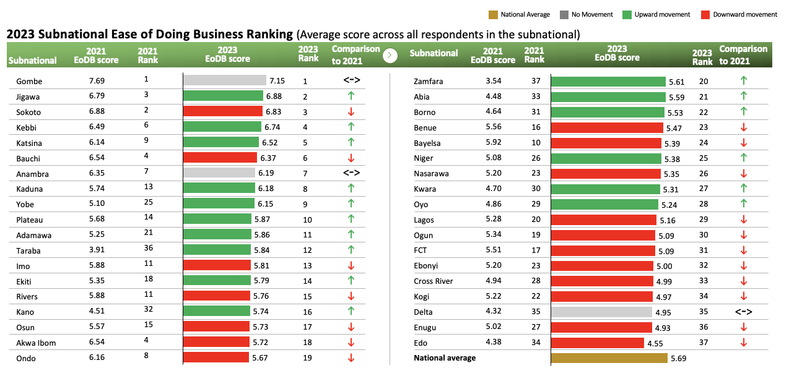
Overview of the 2023 ranking – By scores
Source: 2023 Subnational Ease of Doing Business in Nigeria Survey Result Analysis, 2021 Ease of Doing Business Subnational Baseline Survey

Slide 16
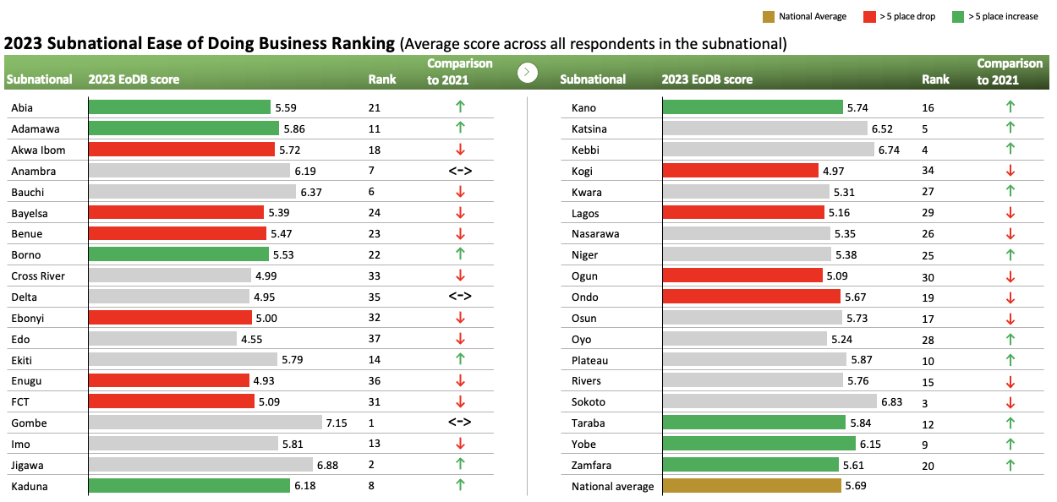
Overview of the 2023 ranking – showing EoDB score movements
Source: 2023 Subnational Ease of Doing Business in Nigeria Survey Result Analysis, 2021 Ease of Doing Business Subnational Baseline Survey

Slide 17
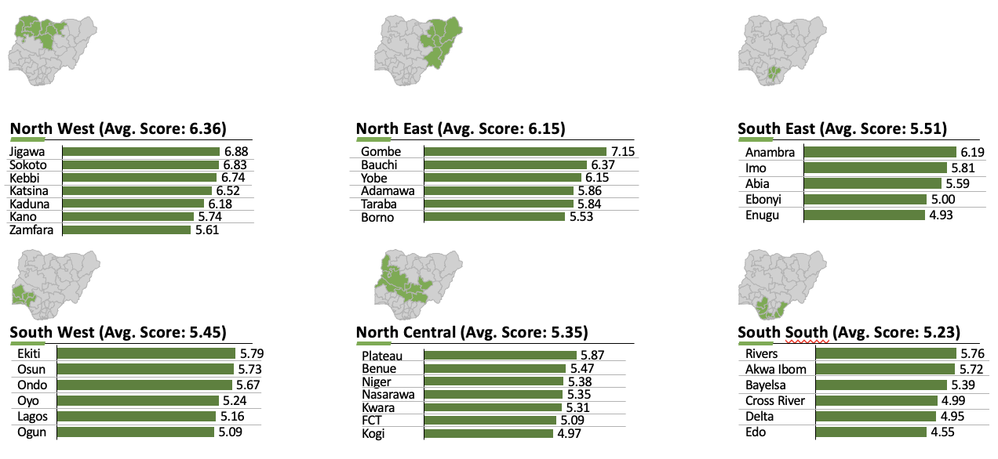
Overview of the 2023 Scores – Geopolitical zones
2023 Subnational Ease of Doing Business Ranking (Average score across all respondents in the subnational)
Source: 2023 Subnational Ease of Doing Business in Nigeria Survey Result Analysis

Slide 18
Implementing relevant reforms, targeted communication and continuous improvement are essential to ensuring that subnationals are successful in improving their business climates
Relevance & Communication
Continuous improvement
Implementing reforms is a step in the right direction to improve the ease of doing business. However, subnationals need to ensure that MSMEs are aware of the reforms and that the reforms being implemented are relevant to the pain points of the respondents:
Anambra and Delta states moved 0 places despite implementing reforms because the respondents believe the reforms do not address their pain points
Edo, Nasarawa, Enugu, Ogun and Oyo states dropped despite implementing reforms because the respondents are mostly not aware of the reforms implemented
Subnationals needs to consistently build on their efforts for MSMEs to continue to see them as providing an enabling business environment:
The top 3 droppers in this survey; Akwa Ibom state (14 place drop; # 4 to #18), Bayelsa state (14 place drop; #10 to #24), and FCT (14 place drop; #17 to #31) all did not implement reforms
Gombe state maintained its #1 position, Jigawa state improved by 1 place and Plateau state improved by 4 places. These 3 subnationals implemented reforms
Source: 2023 Subnational Ease of Doing Business in Nigeria Survey Result Analysis, 2021 Ease of Doing Business Subnational Baseline Survey
Notes:
18

Slide 19
01
Subnational Agenda
CONTENT
03
State Action for Business Enabling Reforms (SABER)
02
Subnational Ease of Doing Business Report
PAGE 19

Slide 20
Rationale for the SABER program
Provide opportunities for structural development and institutionalisation of reforms across the country leveraging the PEBEC-NEC implementation structure
1
3
Consolidate and deepen gains from EoDB reforms implemented across the country.
2
4
Facilitate crowding in private investment at scale, which is needed to achieve Nigeria’s development priorities
Deepen subnational business-enabling reforms through SABER program incentives, using results-based financing targeted at improving the business environment.
PAGE 20

Slide 21
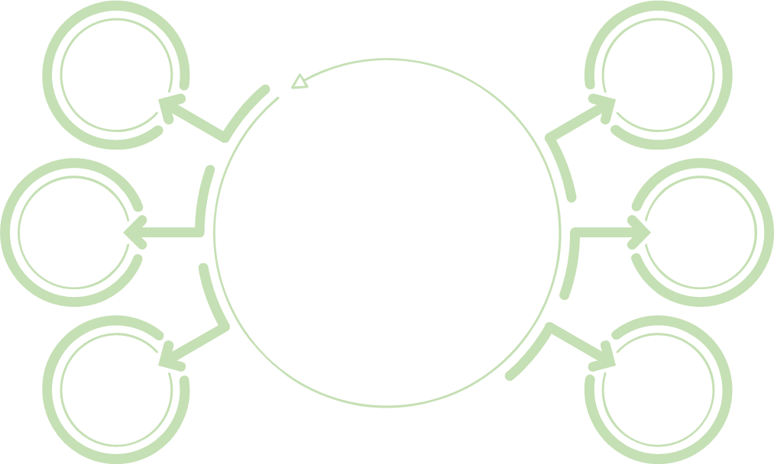
Introduction – Key Program Information
US$ 750 million Operation comprising:
$730 million PforR component
$20 million TA Investment Project Financing (IPF) component
Each State could potentially receive a
total disbursement of USD 52.5 million
Development Objective:
To improve the business enabling environment in participating states and the FCT
1
4
On-lending of the loan to the States on same terms (in contrast to SFTAS, which was a grant from the FGN)
Key
Program
Information
2
5
Board approval date: 29 September 2022
Use of Prior Results galvernize full participation was adopted with a December 31, 2022 deadline.
Duration: 3 years (January 2023- December 2025)
Prior Results period: May 31, 2022 - December 31, 2022
3
6
PAGE 21
Notes:
21

Slide 22
The SABER Partners
The ethos of the PEBEC Reforms are - Collaboration and Co-designing. These key concepts have formed the core of the PEBEC design strategy and thought process
+
Nigeria reforms experience
Global best practice
THE SABER PROGRAM
Private sector
State Governments
PAGE 22

Slide 23
SABER Institutional Arrangements
NGF SABER Ad-Hoc Committee
The NGF has set up an Ad-hoc Committee similar to the NGF SFTAS Committee, Chaired by Gov of Gombe, His Excellency, Governor Muhammad Yahaya
This will be the PEBEC with NGF SABER Adhoc Committee Chair/members. The NSC will be chaired by the His Excellency, the Vice President
National Steering Committee (NSC)
SABER Technical Working Group (TWG)
The TWG consists of representatives from the 6 geopolitical zones, World Bank, PEBEC Secretariat, Home Finance Department FMFBNP, NGF Secretariat and NESG (private sector reps).
Program Coordination Unit (PCU)
The PCU will be domiciled in the Home Finance Department of Federal Ministry of Finance, Budget & National Planning (FMFBNP).
PAGE 23
Notes:
23

Slide 24
Next Steps
Meeting of the NGF SABER ad-hoc committee
Approval of the National Borrowing Plan by the National Assembly to allow for disbursements
SABER PRESENTATION | AUGUST 2022
PAGE 24

Slide 25
The underlying key objectives of the Intervention remain constant
Build the capacity of the Agencies to deliver
Strengthen the capabilities of the Agencies for the long-term, to sustain the improvements on an on-going basis
Strong political will and determination by the government to effect changes and improvement
Institutionalization
Foster cooperation between the ministries, Agencies and also across States, National Assembly and Private Sector
Effective coordination between all the relevant agencies to provide a unified view of implications and improvements
Proper planning to eliminate the critical binding constraints
Collaboration
Continuous Improvement
Be a “moving-target” to make Nigeria a progressively easier place to do business
Means to constantly measure and monitor the improvements
Effect a hands-on implementation support for the changes and improvements
PAGE 25

Slide 26
THANK YOU
PEBEC/EBES Ofﬁce: 4th Floor, Nigeria Investment Promotion Commission (NIPC), Plot No. 1181 Aguiyi Ironsi Street, Maitama, Abuja
T: +234 803 208 2832 | Email: info@ebes.gov.ng | www.businessmadeeasy.ng | @EBESnigeria facebook.com/EBESnigeria

