Slide 1
Implementing
Sustainable
Development Goals
(SDGs)
In Nigeria
The place of road safety and transport in the implementation
Dr. Boboye Oyeyemi
Kano State, Nigeria
24.08.16
MFR,mni,NPoM
Corps Marshal- FRSC

Slide 2
INTRODUCTION
MDGs
SDGs
Already Concluded
Transforming our world: the 2030 Agenda for Sustainable Development
An intergovernmental set of 17 aspiration Goals with 169 targets

Slide 3
INTRODUCTION…ii

Slide 4
THE SDGs: What are they?

Slide 5
THE SDGs: Where Road Safety Counts
Goal 3: Ensure healthy lives and promote well being for all at all ages
By 2020, halve the number of global deaths and injuries from road traffic accidents
Target 6:

Slide 6
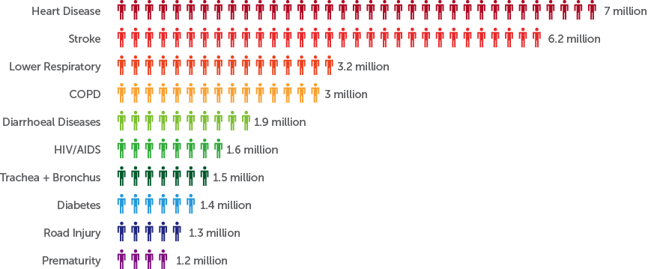
THE SDGs: Where Road Safety Counts…ii

Slide 7
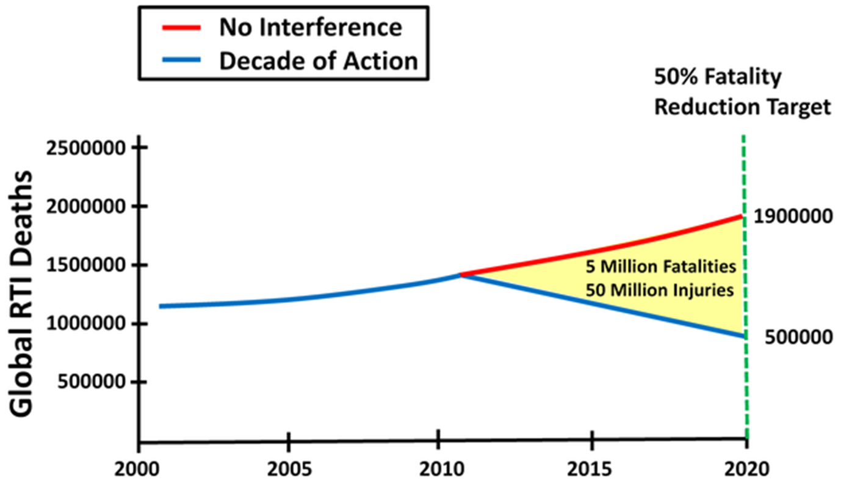
THE SDGs: Where Road Safety Counts…iii
Majority of the persons involved are in the 15-41 years age group
There has been a concerted global effort to reduce Road Traffic Injuries (RTIs) and fatality by half by year 2020 through the UN Decade of Action for Road Safety: 2011-2020
RTIs places an immense burden on health care system, diverting financial and human resources from other priorities
The Age Group most affected
By RTI constitutes Nigeria’s
active work force

Slide 8
THE SDGs: Where Transport and Safety Counts..i
Goal 11:Make cities and human settlements inclusive, safe, resilient and sustainable
By 2030, provide access to safe, affordable, accessible and sustainable transport systems for all, improving road safety, notably by expanding public transport, with special attention to the needs of those in vulnerable situations, women, children, persons with disabilities and older persons
Target: 2

Slide 9
THE SDGs: Where Transport and Safety Counts..ii
Coordination between Health and Transport is essential because millions of Nigerians are at health risk due to:
Ambient Air Pollution from Green House Gases
Noise pollution with adverse health implications

Slide 10
Enabling Actions
Transport and safety are central to the effectiveness of the SDGs.
Implementing the strategies outlined in the UN Decade of Action for Road Safety 2011-2020 is crucial
Support and finance the Lead Agency concepts of Road Safety in Nigeria through the NRSS
Bench mark safety infrastructures and invest >0.1% of GDP
Create consumer and industry demand for safer vehicles
Collaborate to increase responsiveness to Post Crash emergencies in Nigeria
Establishment of effective crash data system and analysis for informed policies
Promote the use alternative transport through cycling and walking

Slide 11
Enabling Actions ii
Ensure the development of the rail system to boost mass transportation and reduce the over dependence on road transportation
Create livable cities that promotes clean energy use
Make conscious budgetary allocation for infrastructural development that supports safe transportation
Promote polices that abhors discriminations against gender and persons with disabilities
Promote effective intermodal transportation system

Slide 12
MONITORING & ACCOUNTABILTY
Timeliness is crucial for indicators to inform decision making
Data to be carefully disaggregated to track equity in achievements
Oversight function of accountability by OSSAP on funds allotted for projects and programmes are carried out
There is need for improved collaboration and monitoring of progress on each of the targets between the FRSC and the office of the
SSAP-SDG

Slide 13
BY YEAR 2030….
5,440
………..
< 2,720
….2020………2025……..2030

Slide 14
Attaining the SGDs 3⁶ and 11² in Nigeria Starts with
you

Slide 15
THANK YOU
Phone Only
SMS Only
Call toll free on: 122
0700 – CALL - FRSC
0700 – 2255 – 3772
080 7769 0362
www.frsc.gov.ng

