Slide 1
NGF HEALTH UPDATE
19TH JUNE, 2019

Slide 2
NGF Priority Areas
POLIO ERADICATION INITIATIVE
Ensure Nigeria is declared polio free by 2019
NUTRITION
Make progress towards Global Nutrition Targets 2025
….because health is a human right

Slide 3
The Commitments
UHC
SSHIS for Financial Protection
SPHCB for increase access to quality care
Nutrition
Set up State food and Nutrition committee
Promote 6-months maternity leave
PEI
Eradication of polio
Abuja commitment
DMA – for availability of drugs
Multisectoral nutrition plan
Creches in MDAs
Strengthening of routine immunization

Slide 4
Updates on Priorities
Polio
Campaign
Nigeria 33 months WPV polio free
On the verge of being certified polio free,
Circulating vaccines derived Polio still prevalent in some States
Required Actions- Sustenance of political commitment
Routine Immunization
National Average – 57% (compared to 49% in 2015 i.e. IMPROVED)
Eleven States have a coverage of above 80% (Lagos, Ekiti, Osun, Imo, Abia, Enugu, Rivers, Edo, Cross Rivers, Anambra and FCT) compared to only 5 states (Edo, Ekiti, Enugu, Imo and Lagos) in 2015.
Highest Coverage was in Lagos with 93% lowest in Zamfara (12%), Katsina (12%), Kebbi (19%) and Sokoto (22%)
Required Actions- Provision of operational funds for last mile vaccines distribution, supervision and outreach services

Slide 5
Updates on Priorities
Basic Health Provision Fund
Scheme launched nationally
Federal Government has released xxx (25% of its contribution)
28 States have expressed interest in the scheme
13 States have opened the required TSA account
Required Actions- States yet to expressed interest to do so urgently; and all states to strive to meet all the criteria
State Social Health Insurance Scheme
28 States now have a SSHIS law
Enrollees already accessing care in Anambra, Bayelsa, Delta, Kano, Lagos, Ogun and Oyo States.
Required Actions- Remaining States (in RED) to accelerate the establishment of SSHIS and commence enrollment

Slide 6
Updates on Priorities
Nutrition
Lagos and Kaduna states have implemented the six month maternity leave
Required Actions- Remaining States to implement the 6-month maternity leave

Slide 7
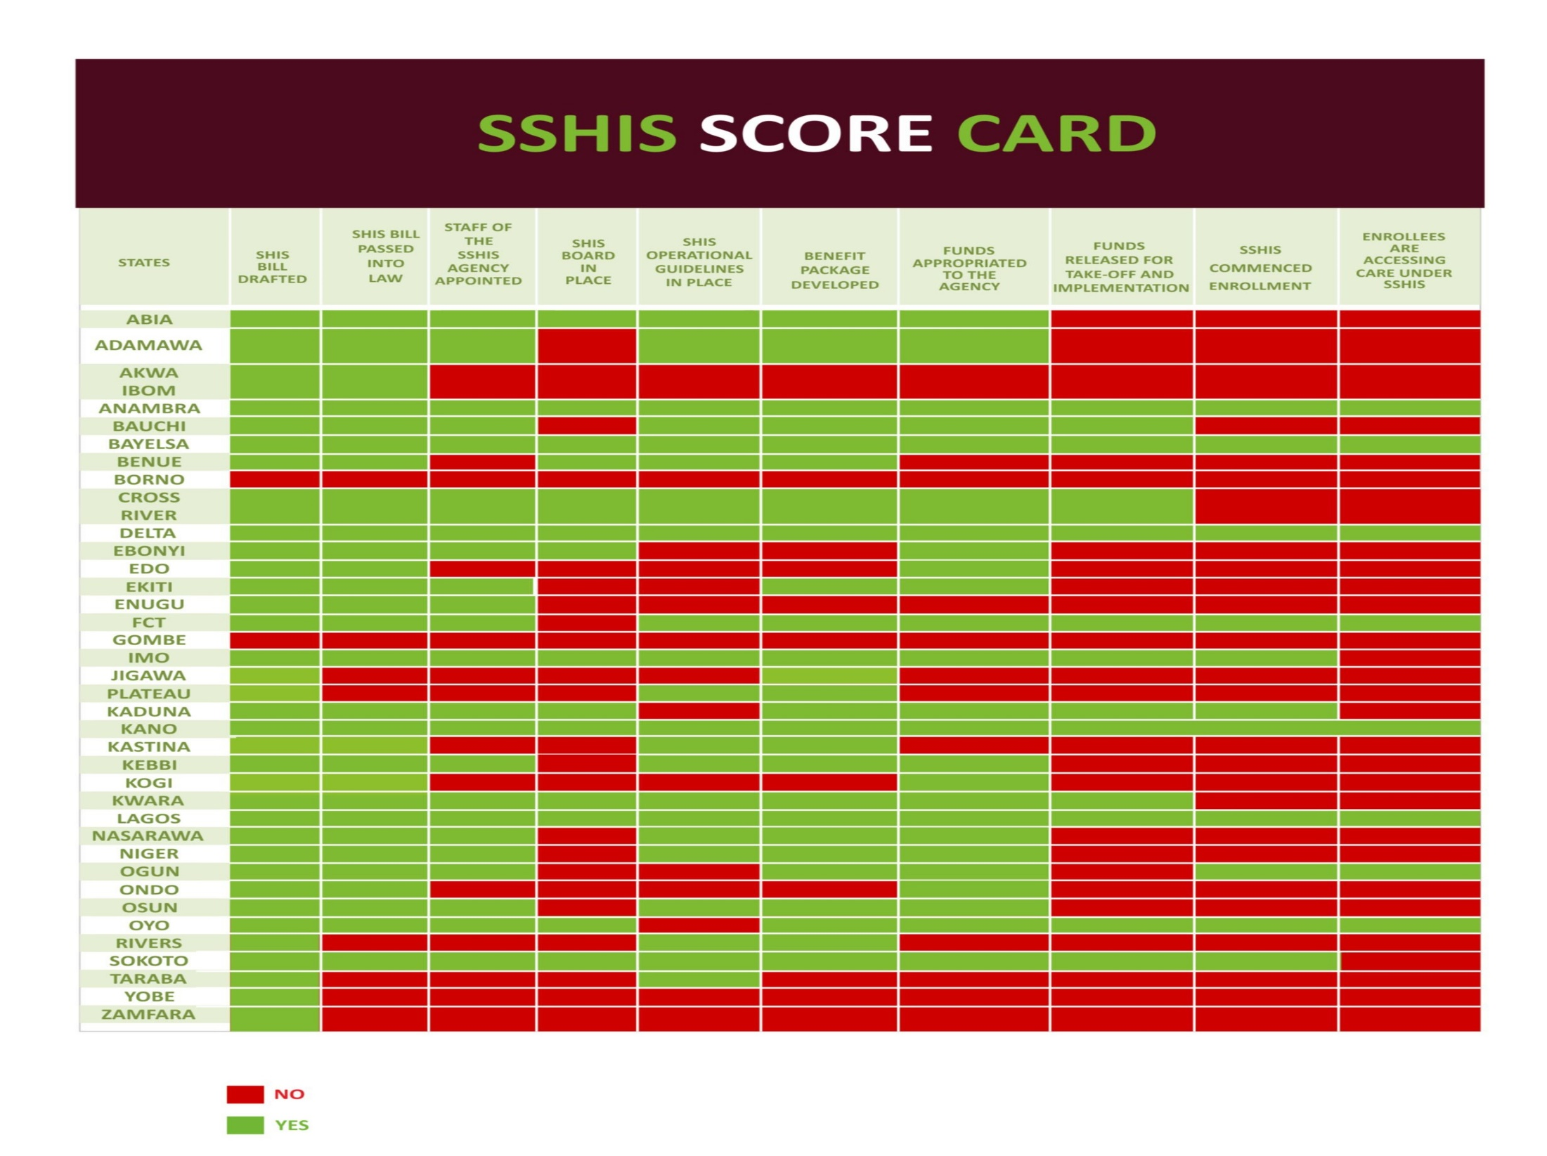

Slide 8
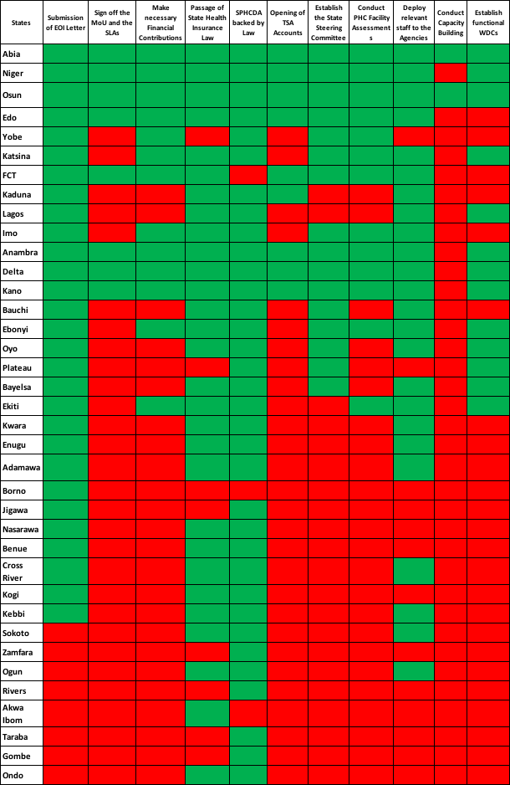
Updates on Priorities

Slide 9
Thank you for Listening

