Slide 1
NIGERIA GOVERNORS’ FORUM (NGF)
STATES FISCAL TRANSPARENCY, ACCOUNTABILITY AND SUSTAINABILITY(SFTAS) TECHNICAL ASSISTANCE PROJECT
Date: 15th December 2021
Presented by:
Olanrewaju Ajogbasile
Senior Programme Manager,
NGF HelpDesk & SFTAS TA
oajogbasile@ngf.org.ng
+2349083411461

Slide 2
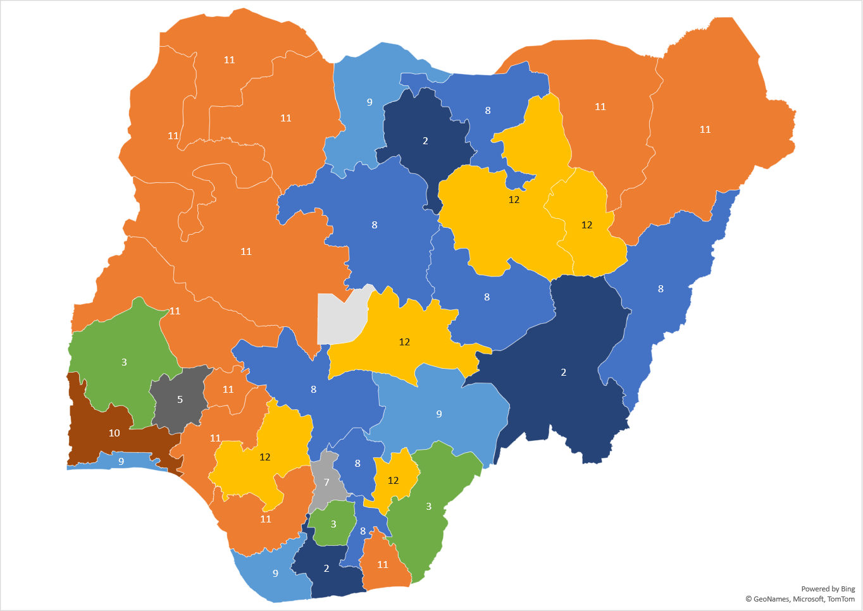
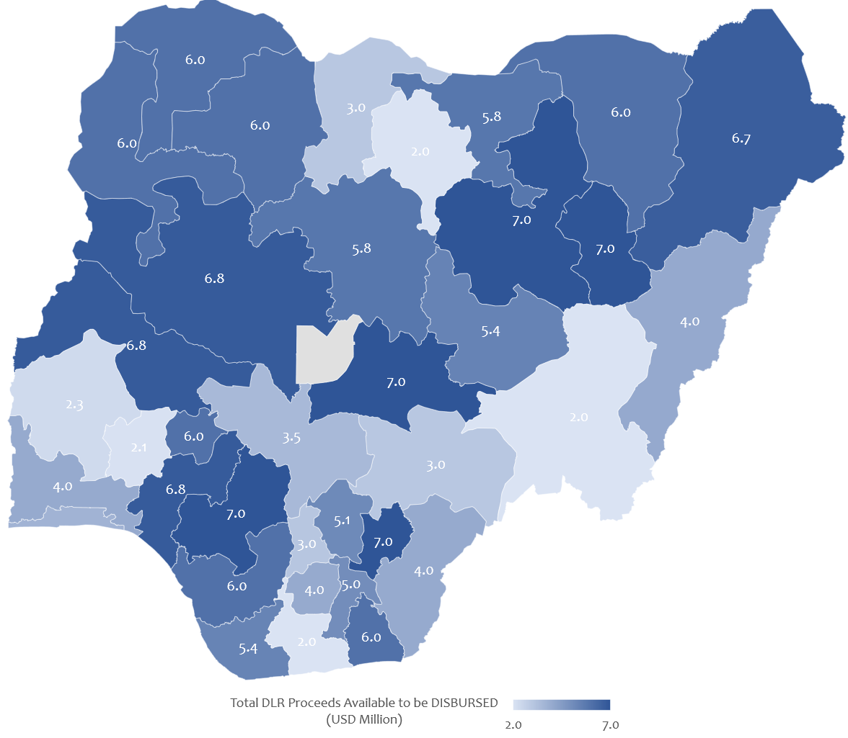
SFTAS
Annual PERFORMANCE ASSESSMENT (APA)
DEC 2020-JUNE 2021 RESULTS
HIGHLIGHTS
ALL States met the Eligibility Criteria
Every State met at least one DLR DLR between 10.1, 10.2, 10.3, 11.2 AND 13.2.
Top performers in this round of APA include Bauchi, Ebonyi, Edo, Gombe, Nasarawa, Borno, Ekiti, Kebbi, Kwara, Niger, Ondo, Sokoto, Yobe and Zamfara State.
12 States (Adamawa, Anambra, Benue, Kano, Katsina, Kogi, Lagos, Ogun, Osun, Oyo, Rivers, and Taraba State) still have until 31st December 2021 to meet DLI 10.3 (Audit Law enactment and implementation) – US$2 million.
Number of DLRs achieved by States
Disbursement Distribution by States (USD Million)

Slide 3
S/N | STATES | EC | DLR 10.1 (2020) | 10.2 (ia) August 2020 BER | 10.2 (ib) Sept 2020 BER | 10.2 (ic) Oct 2020 BER | 10.2 (id) Nov 2020 BER | 10.2 (ie) Dec 2020 BER | 10.2 (ii a) Q3 2020 Audit report | 10.2 (ii b) Q4 2020 Audit report | 10.2 (ii c) Q1 2021 Audit report | DLR 10.3 | DLR 11.2 | DLR 13.2 | Total DLR Proceeds Available to be DISBURSED (USD Million)
1 | ABIA | Y | A | A | A | A | A | A | NA | NA | NA | A | A | NA | 5.025
2 | ADAMAWA | Y | A | A | A | A | A | A | NA | NA | NA | NA | A | A | 4.025
3 | AKWA IBOM | Y | A | A | A | A | A | A | A | A | A | A | A | NA | 6
4 | ANAMBRA | Y | A | A | A | A | A | A | NA | NA | NA | NA | A | NA | 3.025
5 | BAUCHI | Y | A | A | A | A | A | A | A | A | A | A | A | A | 7
6 | BAYELSA | Y | A | A | A | A | A | A | NA | NA | A | A | A | NA | 5.35
7 | BENUE | Y | NA | A | A | A | A | A | A | A | A | NA | A | NA | 3
8 | BORNO | Y | A | A | A | A | A | A | NA | A | A | A | A | A | 6.675
9 | CROSS RIVER | Y | A | NA | NA | NA | NA | NA | NA | NA | NA | A | A | NA | 4
10 | DELTA | Y | A | A | A | A | A | A | A | A | A | A | A | NA | 6
11 | EBONYI | Y | A | A | A | A | A | A | A | A | A | A | A | A | 7
12 | EDO | Y | A | A | A | A | A | A | A | A | A | A | A | A | 7
13 | EKITI | Y | A | A | A | A | A | A | A | A | A | A | A | NA | 6
14 | ENUGU | Y | A | A | A | A | NA | A | A | NA | NA | A | A | NA | 5.145
15 | GOMBE | Y | A | A | A | A | A | A | A | A | A | A | A | A | 7
16 | IMO | Y | A | NA | NA | NA | NA | NA | NA | NA | NA | A | A | NA | 4
17 | JIGAWA | Y | A | NA | A | A | A | A | NA | NA | NA | A | A | A | 5.82
18 | KADUNA | Y | A | A | A | NA | A | A | NA | NA | NA | A | A | A | 5.82
19 | KANO | Y | A | NA | NA | NA | NA | NA | NA | NA | NA | NA | A | NA | 2
20 | KATSINA | Y | NA | A | A | A | A | A | A | A | A | NA | A | NA | 3
21 | KEBBI | Y | A | A | A | A | A | A | A | A | A | A | A | NA | 6
22 | KOGI | Y | A | A | A | NA | A | A | A | NA | A | NA | A | NA | 3.47
23 | KWARA | Y | A | A | A | NA | A | A | A | A | A | A | A | A | 6.795
24 | LAGOS | Y | A | A | A | A | A | A | A | A | NA | NA | A | NA | 3.675
25 | NASARAWA | Y | A | A | A | A | A | A | A | A | A | A | A | A | 7
26 | NIGER | Y | A | A | A | NA | A | A | A | A | A | A | A | A | 6.795
27 | OGUN | Y | A | A | A | A | A | A | A | A | A | NA | A | NA | 4
28 | ONDO | Y | A | NA | A | A | A | A | A | A | A | A | A | A | 6.795
29 | OSUN | Y | NA | NA | A | A | NA | NA | A | A | NA | NA | A | NA | 2.06
30 | OYO | Y | A | NA | NA | NA | NA | NA | NA | NA | A | NA | A | NA | 2.325
31 | PLATEAU | Y | A | NA | A | A | NA | NA | A | A | A | A | A | NA | 5.385
32 | RIVERS | Y | NA | NA | NA | NA | NA | NA | NA | NA | NA | NA | A | A | 2
33 | SOKOTO | Y | A | A | A | A | A | A | A | A | A | A | A | NA | 6
34 | TARABA | Y | A | NA | NA | NA | NA | NA | NA | NA | NA | NA | A | NA | 2
35 | YOBE | Y | A | A | A | A | A | A | A | A | A | A | A | NA | 6
36 | ZAMFARA | Y | A | A | A | A | A | A | A | A | A | A | A | NA | 6
 |  |  |  |  |  |  |  |  |  |  |  |  | Total Disbursement Due: |  | US$179.185 Million

Slide 4
NEXT STEPS
S/N | Steps to disbursement | Target Date | Notes
1. | PCU submits a withdrawal application through client connection for the agreed credit proceeds. | Monday 13th Dec 2021 | Done.
2. | WB Treasury transfer USD funds to PCU. | Tuesday 14th Dec 2021 | Done.
3. | PCU to request CBN to convert funds into Naira and received funds in Naira AND PCU to have approval from HMF for onward payments to States. | Start Wednesday 15th Dec 2021 Complete Tuesday 21st Dec 2021 | Note that PCU already has the States’ bank account details. Also ALL States should have signed the revised SGAs.
4. | PCU to make onward transfers to States | Thursday 23rd Dec 2021
WHAT MUST HAPPEN FOR STATES TO GET DISBURSEMENT THIS YEAR

Slide 5
Key DLR REMINDERS
States action to meet DLRs requiring enactment of a legal framework before 31st December 2021 Deadline
DLR | TA Status | Notes for Action
DLR 10.3 Audit Law Enactment and Implementation | 12 States did not meet the DLR as at 2020 APA: Adamawa, Kano, Katsina, Kogi, Osun and Oyo State have received NGF technical advisory on necessary amendments. Anambra, Lagos, Taraba, Benue, Ogun and Rivers State are yet to leverage NGF technical assistance. | Adamawa, Kano, Katsina, Kogi, Osun and Oyo should reflect NGF technical advisory, enact the amendment and reissue the implementation instruction before 31st Dec 2021. Other States should endeavor to address gaps identified with their laws, enact an amendment and reissue the implementation instruction before 31st Dec 2021.
DLR 4.1 Enactment, publication and implementation of a Consolidated State Revenue Code. | 17 States did not meet the DLR as at 2019 APA: Bayelsa, Borno, Gombe, Kano, Kebbi, Niger, Yobe and Zamfara State have leveraged and implemented NGF technical advisory. Akwa Ibom, Lagos, Ogun, Imo and Rivers State have received NGF technical advisory and are yet to implement or are in the process of implementing recommendations. Anambra, Enugu, Katsina and Nasarawa State are yet to leverage NGF’s technical assistance. | Bayelsa, Borno, Gombe, Kano, Kebbi, Niger, Yobe, Akwa Ibom, Lagos, Ogun, Imo, Rivers and Zamfara State should ensure they enact and implement the version that reflects NGF’s technical advisory before 31st Dec 2021.

Slide 6
Key DLR REMINDERS
States action to meet DLRs requiring enactment of a legal framework before 31st December 2021 Deadline
DLR | TA Status | Notes for Action
DLR 6.1 Enactment and implementation of a public procurement law (in line with UNCITRAL Model Law) | 15 States did not meet the DLR as at 2019 APA: Ebonyi, Kano, Kebbi, Kwara, Lagos, Nasarawa, Ogun, Yobe, Zamfara, Enugu and Imo State have leveraged and implemented NGF technical advisory. Adamawa, Bayelsa, Borno and Rivers State have received NGF technical advisory and are yet to implement or are in the process of implementing recommendations. | Ebonyi, Kano, Kebbi, Kwara, Lagos, Nasarawa, Ogun, Yobe, Zamfara, Enugu, Imo, Adamawa, Bayelsa, Borno and Rivers State should ensure they enact and implement the version that reflects NGF’s technical advisory before 31st Dec 2021.
DLR 7.1 Enactment of a State-level debt legislation | 13 States did not meet the DLR as at 2019 APA: Akwa Ibom, Bayelsa, Imo, Nasarawa and Rivers State have leveraged and implemented DMO’s technical advisory. Abia, Anambra, Borno, Delta, Kano, Katsina, Kebbi and Zamfara State have leveraged DMO’s technical advisory but yet to revert with a revised law. | Abia, Anambra, Borno, Delta, Kano, Katsina, Kebbi and Zamfara State should endeavor to reflect DMO’s recommended amendments before 31st December 2021.

Slide 7
E_PROCUREMENT (DLI6.2)
Progress and MATTERS ARISING
DLR 6.1 Definition: Implement e-procurement in at least 4 MDAs (incl. Education, Health and Public Works) publish all contract award information in OCDS format on the online portal for the 4 MDAs AND For those MDAs without e-procurement: Publish contract award information above a threshold set out in the State’s procurement law/regulation on a monthly basis in OCDS format on the state website or online portal if available
DLR Value: US$ 2 Million
Framework Agreement States’ Deployment and Change Management Status:
State | Kaduna | Edo | Jigawa | Niger | Akwa Ibom | Kogi | Borno | Gombe | Kano | Ondo | Zamfara | Kebbi | Sokoto | Yobe | Ekiti | Bayelsa
Go-Live Status | Live | Live | Live | Live | Live | Live | Live | Live | Live | Live | On Track | On Track | On Track | Live | Live | Live
Change Mgt Status
Non-Framework States Deployment and Change Management Status:
State | Delta | Abia | Ebonyi | Kwara | Lagos | Adamawa | Benue | Ogun | Plateau | Nassarawa | Bauchi | Osun | Oyo | Enugu
Go-Live Status | Live | Live | Live | Live | Live | Live | Live | Live | Live | Live | On Track | On Track | On Track | Live
Change Mgt Status
Legend | Slipped/ Significantly Behind Plan | At Risk/ Marginally Behind Plan | On Track | Live

Slide 8
E_PROCUREMENT (DLI6.2)
Progress and MATTERS ARISING
Payment Issues:
Kaduna, Edo and Jigawa State have made some payments but have one or two outstanding milestone payment
Kano, Niger and Sokoto State have only paid for one milestone out of at least 3 due for payment.
Akwa Ibom, Bayelsa, Borno, Ekiti, Gombe, Kebbi, Kogi, Ondo, Yobe and Zamfara State are yet to make any milestone payment to the vendor.
The vendor has written to all States concerned and these issues have been brought to the notice of the Honourable Commissioners of Finance of the various States.
Vendor has began charging interest on delayed payments and may resort to withdrawing service where payment continue to delay. This could jeopardise the chances of these framework agreement States in meeting the revised DLI timeline of June FY2022.

