Slide 1



THE NATIONAL SOCIAL REGISTER &
COVID-19 RAPID RESPONSE REGISTER
NATIONAL SOCIAL SAFETY NETS COORDINATING OFFICE
Federal Ministry of Humanitarian Affairs, Disaster Management and Social Development
Iorwa Apera
National Coordinator
November 2021

Slide 2

Social Register
The Social Register is a tool to
identify and register
the poor & vulnerable and is developed by the states Ministries of Planning through the State Coordination and Operations Unit (SOCU)

Slide 3

Community Driven
Adoption of bottom-up approach
Transparency
Accountability
Inclusiveness

Slide 4






Summary of NSR as at 30th Nov. 2021
737 LGAs
8,000+ Federal Electoral Wards
104,55 Communities
10,571,776 Households
44,330,514 Individuals
National Social Safety-Nets Coordinating Office (NASSCO)

Slide 5
NSR by State
S/N | State | Households | Individuals
1 | ABIA | 77,211 | 298,561
2 | ADAMAWA | 109,536 | 388,941
3 | AKWA IBOM | 279,566 | 1,293,147
4 | ANAMBRA | 232,013 | 1,223,478
5 | BAUCHI | 209,959 | 898,628
6 | BAYELSA | 156,979 | 600,574
7 | BENUE | 309,317 | 1,321,044
8 | BORNO | 84,885 | 412,936
9 | CROSS RIVER | 94,435 | 475,263
10 | DELTA | 143,981 | 387,845
11 | EBONYI | 278,844 | 804,117
12 | EDO | 218,514 | 869,041
13 | EKITI | 49,914 | 193,413
14 | ENUGU | 91,653 | 329,882
15 | FCT | 179,619 | 687,525
16 | GOMBE | 117,364 | 542,045
17 | IMO | 139,192 | 641,293
18 | JIGAWA | 590,196 | 2,328,750
19 | KADUNA | 680,888 | 2,656,993
20 | KANO | 767,475 | 3,548,922
21 | KATSINA | 458,246 | 2,367,521
22 | KEBBI | 909,296 | 4,217,308
23 | KOGI | 325,828 | 1,420,575
24 | KWARA | 173,100 | 791,465
25 | LAGOS | 556,881 | 2,222,875
26 | NASARAWA | 499,081 | 1,868,037
27 | NIGER | 195,158 | 915,366
28 | OGUN | 140,711 | 458,990
29 | ONDO | 64,886 | 225,143
30 | OSUN | 155,227 | 518,112
31 | OYO | 65,973 | 247,243
32 | PLATEAU | 280,055 | 1,071,925
33 | RIVERS | 359,010 | 1,491,247
34 | SOKOTO | 358,698 | 1,338,397
35 | TARABA | 104,238 | 351,339
36 | YOBE | 135,680 | 650,351
37 | ZAMFARA | 978,167 | 4,272,222
 | Total | 10,571,776 | 44,330,514
Status of NSR as at 30th Nov. 2021

Slide 6
COVID-19 RAPID RESPONSE REGISTER

Slide 7
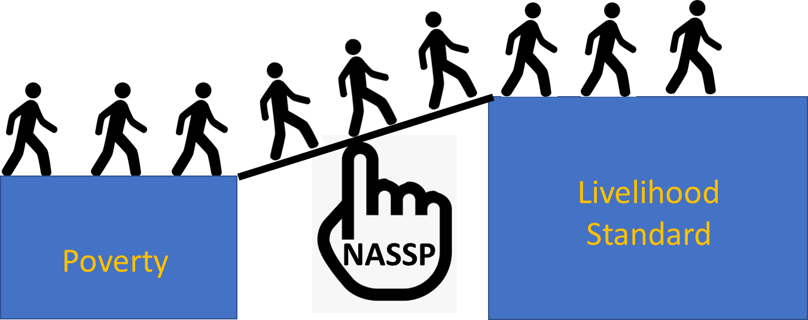
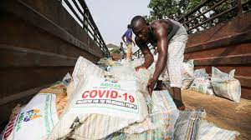
THE RAPID RESPONSE REGISTER FOR COVID 19 CASH TRANSFER
The “Rapid Response Register” – RRR
A shock response framework
Designed in collaboration with the World Bank to provide Emergency Social Interventions to poor and vulnerable households in challenging circumstances (Natural disaster, epidemic, pandemic, economic downturn, etc)

Slide 8
TARGET GROUP
01 - Self-employed
02 - Wage employed
03 - Urban poor
Small businesses, street vendors and petty traders
Low wage employed individuals and families, daily laborers earning wages by engaging in construction and other forms of daily wage-based activities, employees of businesses involved in services, workers in different industries and manufacturing firms, taxi drivers
Street dwellers, orphans and vulnerable children, PWDs, vulnerable families living in slum areas
Notes:
© Copyright PresentationGo.com – The free PowerPoint template library

Slide 9
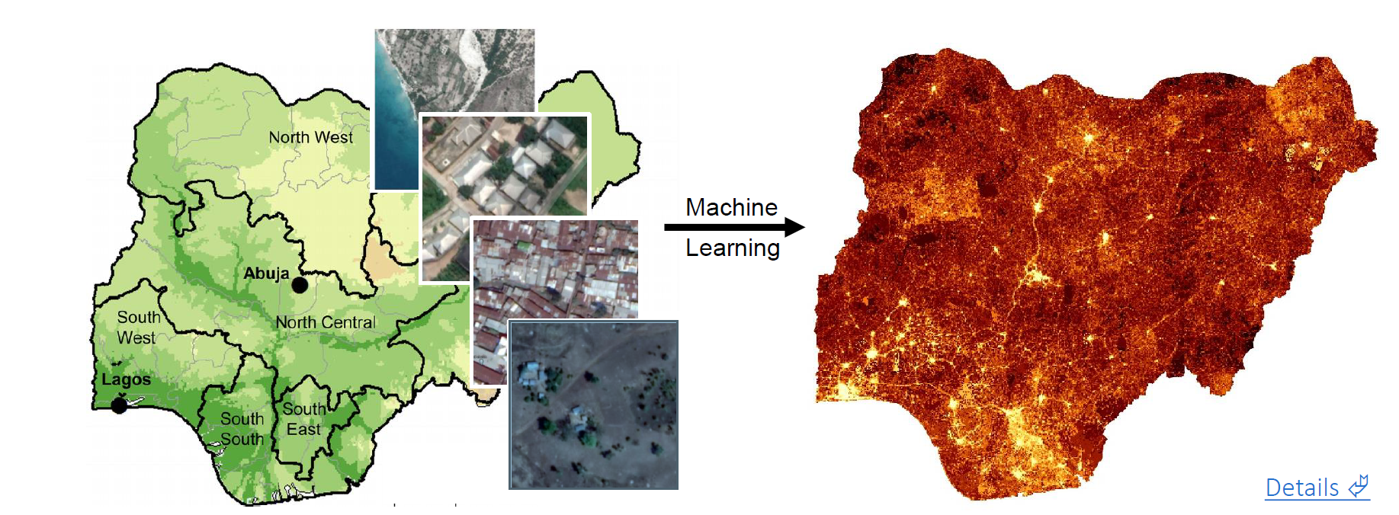
SATELLITE TECHNOLOGY POVERTY MAPPING

Slide 10
RESULTS
The SMS/USSD deployment started on 29th May 2021 up till 9th Sept 2021. The exercise was implemented in three batches covering the entire states.
All 36 states and the FCT in the federation have been reached, with a total coverage of 1,753,956 individuals registered through the USSD out of this 500,000 are mined and paid as part of the 1 million COVID 19 Cash Transfer of ESP

Slide 11
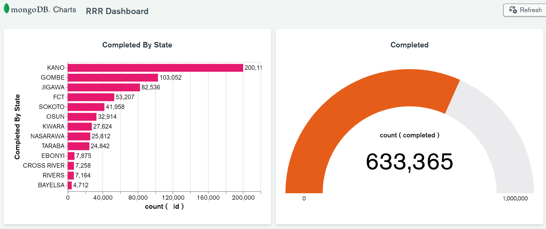

Slide 12
NASSP Scale-Up
NASSP SU
10.2 million HH
ESR-CT
8.2 million HH
ESR-CT (Rural)
3.2 million HH
ESR-CT (Urban)
5.0 million HH
Expanded RCT
2 million HH
R-CT
2 million HH

Slide 13
PRAYER
Institutionalize the State Operations Coordinating Unit (SOCU) into a Department under the State Ministry of Planning and Budget.
  The Social Register is first a State Asset and a National Asset
    Some States are way ahead in the registration of their poor and vulnerable
    State Governments will need to support their States beyond the life of the Project (30th June, 2021)
    Cost of registering one household is 1,543.78 Naira
    E.g. Abia State has been unable to cover the initial projection of 30% of its poor.
      Abia has registered about 298,566 people (72,211 PVHH) thus far, out of a total expected of 1,178,324 ( PVHH)
      To cover the rest of its poor, Abia would need to invest 283 million Naira to identify the remaining 879,758 people (183,283 PVHH)
      So the State will need to invest to accelerate the pace of the identification of its poor

Slide 14
PRAYER
Take advantage of the second wave of the capture of urban poor into the Rapid Response Register which started Friday Friday 10 December with 14 states and Friday 17th December for the rest of the states.
  We urge the State to support their SOCU with additional logistics to mobilise their urban poor massively. On average each State will need about N 5 million.
  Again the response rate differ across states for various reasons.
  State Governments may need to give their State Coordinators a little nudge to act fast
States need to take ownership of the database.
  Establish Steering Committee for the NASSP Scale-Up and personally Chair the SC, with SOCU as the Secretariat.
  Mandate the use of the social register for all social development programmes.
    It is an asset with no equivalent
    It will aid the equitable spread of social development
    Investing (health, education and social growth) in the people on the social register will ensure you achieve human capital development

Slide 15

Thank you!
Any questions?

