Slide 1
The African Enterprise Initiative repositioning African Business for the Global Market Place

Slide 2
ABOUT NICKY OKOYE FOUNDATION
The Nicky Okoye Organization is head quartered in Washington DC, United States and is dedicated to the aggregation of capital for projects, entrepreneurs and businesses in Africa and the Caribbean. The Organization also supports Nation States, Regional Authorities, Institutions, Conglomerates and Entrepreneurs with strategic business development, expansion, investment and global market penetration strategies.
The Nicky Okoye Foundation is dedicated to Africa Content Strategy, the development of Entrepreneurship, National Development and building structures that will create sustainable economic value chains using the most cutting edge 21st century technologies and systems. The Nicky Okoye Organization includes the ANABEL GROUP of Companies which has interests in hospitality, telecommunications, technology, education and training.

Slide 3
ABOUT NICKY OKOYE
Dr. Nicky Okoye is a serial entrepreneur, a global leader, global strategist and investment advisor. He supports Conglomerates, National and Sub National states with strategy, advise and wealth creation pathways that stimulates sustainable economic growth models and guarantees national development. Dr Okoye is passionate about aggregating investment capital for 21st century ideas which repositions the growing Nations of Africa and the Caribbean in the global marketplace. Dr Okoye is a global expert on strategy, market penetration, business development and national development. He has gained extensive experience in raising global capital and he co-founded what grew to become one of the largest companies in Africa after leading the capital raise of over $1 billion in less than 12 months. A feat considered one of the most outstanding capital raising exercises in the history of Africa’s capital markets.

Slide 4
Nigeria’s Youth integration Challenges
Nigerian Youths feel left out and are leaving the country
Nigerian SMEs and Nigerian Youths need to get 21st Century guidance on business startup and business sustainability
Nigerian SMEs and Youths need access to opportunities in various industries, especially in a post COVID-19 environment
Nigerian Institutions need to communicate in the language of the 21st century digital generation especially SOCIAL MEDIA, Podcasts, Youtube etc.

Slide 5
AfEI Menu of Interventions
The Accreditation and Verification of SMEs cross Country to form data base for incentives
The SME Eco-system and Job immediate Creation starting with Certified Business Advisors, Content Creators, Global Speakers, Global Developers, Business apprentices
The Community Enterprise Clinic Centers and Community economic eco-system
Project Triple E, STRATEGY for Youth Development: Employment, Empowerment and Entrepreneurship and a community economic ecosystem
AfEI INVESTMENT FUND strategy for capital aggregation
The Champions Bootcamp strategy for African markets penetration
The Global Market Access strategy
The Global Strategy Enterprise Initiative ( the Unicorn G 250 program)
Enterprise Development Strategy sustainability for State Government Officials

Slide 6
Jobs created in first twelve months
1000 Certified Business Advisors
5000 Certified Content Creators
1000 Certified Global Speakers
2000 Accredited Global Developers
50,000 Accredited Global Business Apprenticeship
10,000 Certified African Merchants
500 NOGBA
1000 Champions of the Universe
1000 Blockchain experts
1000 Data experts

Slide 7
The African Enterprise Fund
The AEF is a Capital Aggregator and it will identify and mobilize local Nigeria capital by aggregating Nigeria’s wealthy successful enterprises, entrepreneurs, retired, serving political and public servants, Nigeria’s wealthy families, Nigerian corporates, and Nigeria’s Diaspora communities to invest in an early stage fund designed investment in Nigerian entrepreneurship ventures. Our strategic focus areas will include energy, micro manufacturing, services, technology and the creative industries of fashion, beauty, music, movies, media and entertainment.

Slide 8
African Enterprise Institute

Slide 9
Nigerian Enterprises must transition in a new approach for Youth and MSME development
A transition into the 21st century: systems, markets & industries
A digital approach to support and engagement: connectivity, building communities and creating new MSME influencers
A drive to expand markets nationally, continentally and globally: cross boarder transactions, selling in Lagos, selling in Joburg, selling in New York and Los Angles
AfEI supporting digital, video, material and study content that MSMEs can consume and use to reestablishment their businesses

Slide 10
Project Triple E ENTREPRENEURSHIP Business Apprenticeship Program: certify and accredit 50,000 a year, business, trade and commercial apprentices across the Continent. A five-year program which produces fully funded, fully trained and fully engaged new businesspeople. Some recent new entrepreneurs and new businesspeople can be integrated in the program by taking the certification course.

Slide 11
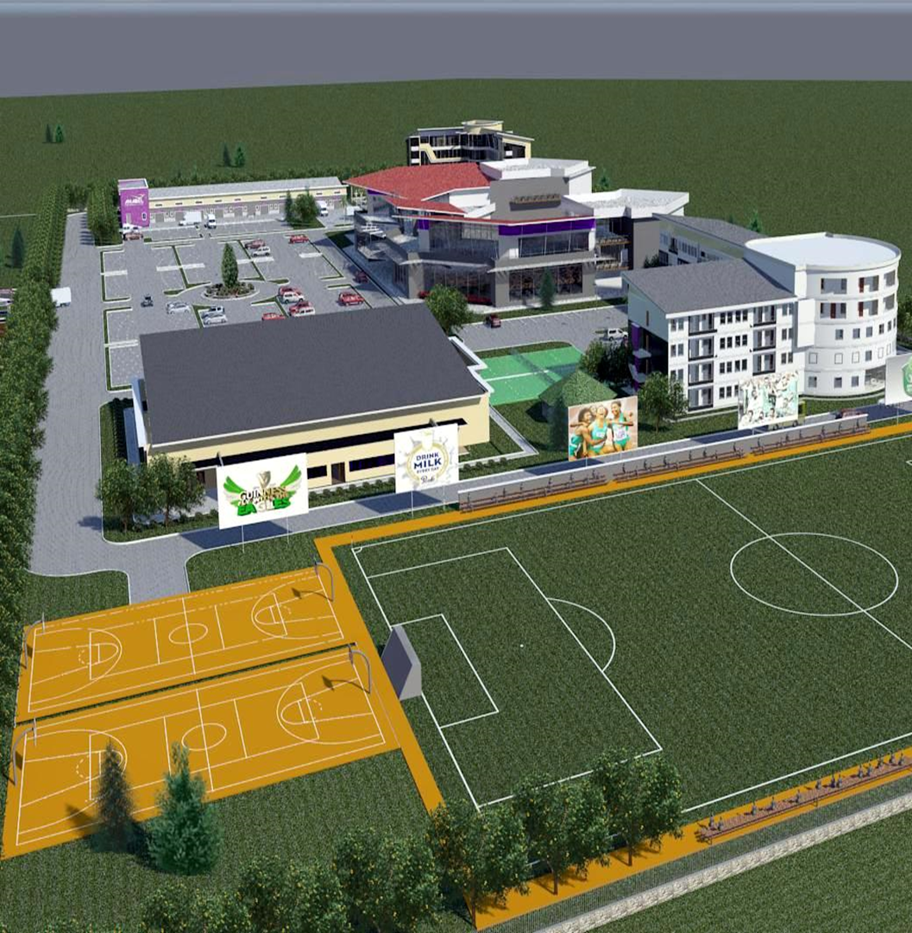
The African Enterprise Innovation Campus
HIGHLIGHS…
FMITI Collaboration in SME development in Strategic Interventions…
The African Enterprise Innovation Campus is designed to be a work hub innovation environment and co-workspace that will provide affordable business premises to one thousand entrepreneurship ventures in their early stage of business development.
Enterprise Development strategies for Federal and State Govts
Verification and accreditation of SMEs in the States
Enterprise Development Centers at the grass roots
Enterprise sustainable Funding and an AEI VENTURE FUND
Enterprise Bootcamps, studies, awards, certifications and accreditations

Slide 12
Global Enterprise Strategy Initiative (GESI) POWERED BY
G 250 (global UNICORN program)
E 1000 (elite millennials’ Entrepreneurship program)
Access to Technology
Access to Global Capital
Access to Global Markets
Access to Strategic Partnerships
Access to Global Opportunities
Access to Global Talent

Slide 13
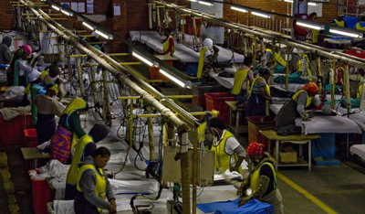
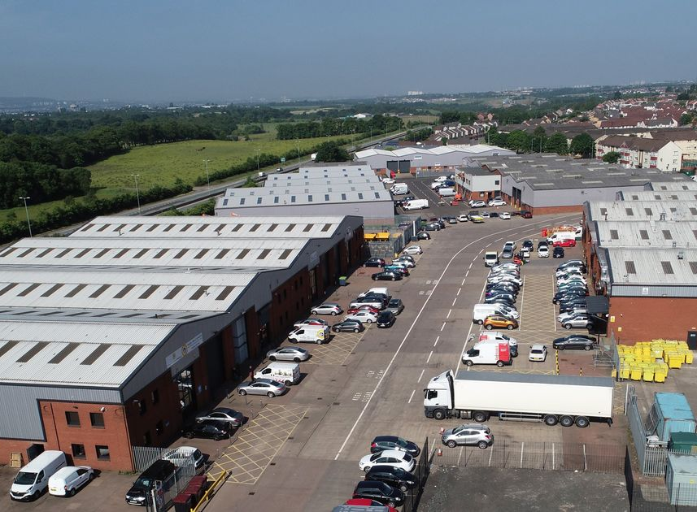
Community Enterprise Development Centers with Co-Work spaces and Mini Industrial Estates
Each LGA African Enterprise Clinic will be affiliated to a mini-industrial estate to provide co-work, co-location and shared services for new and existing entrepreneurs, SMEs and micro businesses.
Mini-industrial Estates will be of five types…
Creative (fashion, movies, music, beauty, sports, media, entertainment)
Technology ( fintech, edtech, Logitech, medtech, regtech)
Micro Manufacturing ( toothpicks, school bags, school shoes, spare parts, buttons, pencils, chuck, agric-processing, food processing)
Energy ( renewable batteries, renewable technology )
Services ( legal, accounting, technical, home & building maintenance, grooming, wedding, events, consulting, life coaches, public speaking)

Slide 14
Enterprise Development Strategy
70% of SME loans are turned down, 80% of winners are defaulting: CAPACITY is Lacking
State Officials accreditation for local and international business support and advisory, in each agency of the State Government
Community Enterprise Centers
Integrate Enterprise Development Officials with Value chains: education, energy, real estate, automobile, hospitality, pharmaceuticals, healthcare, transportation (land, sea & air)

Slide 15
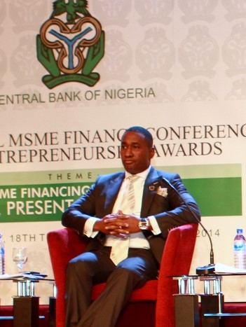
Over the Years, the interventions in Entrepreneurship designed and implemented by Dr Nicky Okoye and the Anabel Group has impacted the following..…
400,000 entrepreneurs trained in various skills using an aggregation strategy and partnership with training centers across Nigeria.
Supported Government Policy driving the development and supporting the design of additional Federal and State Government interventions for Entrepreneurs in creative Industries, micro manufacturing, leather and textiles, wielding, engineering, construction, services.
Supported Central Bank policy by assisting with the Central Bank of Nigeria Entrepreneurship Clinic strategy which has impacted thousands of entrepreneurs.
Supported Central Bank policy for development finance to extend funding to SMEs.
Supported the Nigerian Oil and Gas industry by getting the Nigeria Content Development and Monitoring Board to initiate a special intervention for the funding and support of local entrepreneurs including women.

Slide 16
Road Map
SME verifications and accreditations, Champions of the UNIVERSE Entrepreneurship Boot Camp, Digital Content Strategy unveiled
Community Enterprise Development Centers: Integrated Strategy with co-work spaces and StartUP HUBs
The Africa Enterprise Fund
The Innovation Campus and Startup Nigeria HUBs
The Enterprise Strategy

Slide 17
NIGERIA is the First African Government to endorse the African Enterprise Initiative
Dr Nicky Okoye signs the MOU as the African Enterprise Initiative takes off in association with the Federal Ministry of Industries, Trade and Investment

Slide 18
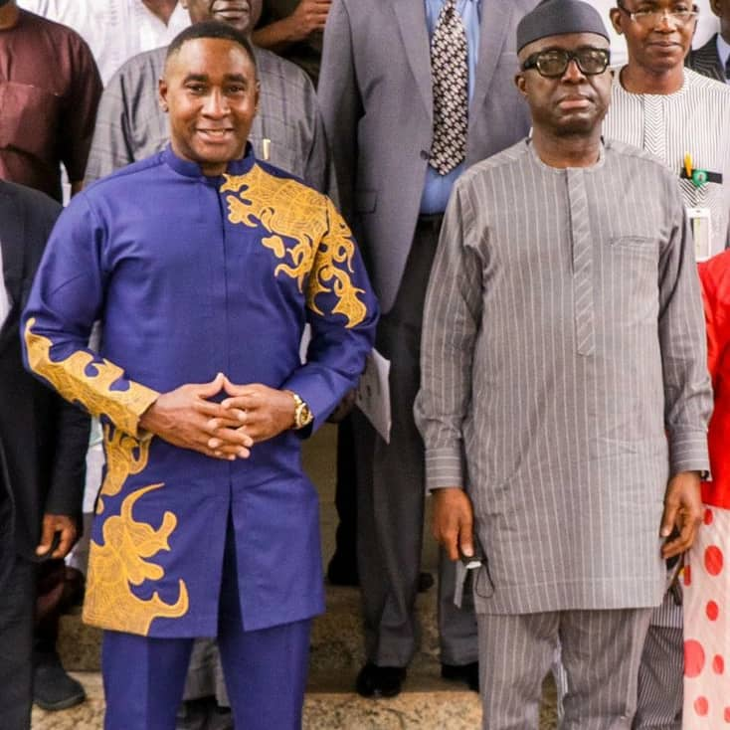
NIGERIA’s Federal Ministry of Industries, Trade and Investment signs Landmark Memorandum for Implementation of the African Enterprise Initiative with the NICKY OKOYE FOUNDATION

Slide 19
Strategic Options
Accreditation and Verification of State SMEs including immediate jobs for verifying agents
Special Sponsorship/ Grant for design and development of Community Enterprise Development Centers in select communities, tied to specific communities.
Special Sponsorship / grant for set up of the digital content creation, bootcamp, accreditation and verification of SMEs across Nigeria and subsequently Africa.
Investment, Grant and sponsorship for State participants in the Champions of the Universe Entrepreneurship BOOTCAMP
Sponsorship of Scholarships for certifications to fund strategic interventions and Job creation across Nigeria and subsequently Africa. Tied to Sates or special students

Slide 20
The Strategic Partners
A Global Collation is being built

Slide 21
THANK YOU
Nicky Okoye
Founder,
African Enterprise Institute
President@africanenterprise.institute

