Slide 1
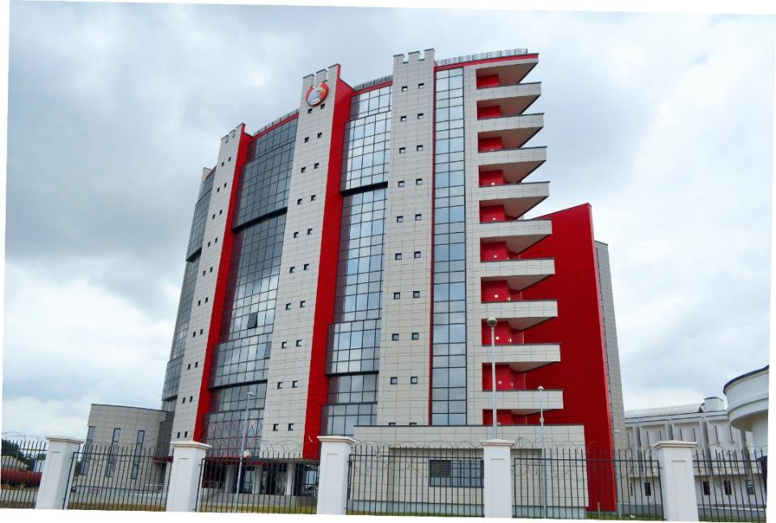
Economic and Financial Crimes Commission (EFCC) as an Organization
Presented by the Executive Chairman,
Economic and Financial Crimes Commission
ABDULRASHEED BAWA
Executive Chairman
To the
Executive Governors
19th January, 2022

Slide 2
Table of Content
Overview of the EFCC (Establishment) Act, 2004
Current Zonal Commands
Staff strength
Progress report
Achievements
Convictions (January, 2021 – December, 2021)
Recoveries (January, 2021 – December, 2021)
The Economic and
Financial Crimes Commission

Slide 3
Establishment
The Economic and Financial Crimes Commission (Establishment) Act was first enacted in 2002
The Economic and Financial Crimes Commission (Establishment) Act, 2004 repealed the Act of 2002
The Commission was set up on the 13th of April, 2003
The Economic and
Financial Crimes Commission

Slide 4
The Economic and Financial Crimes Commission (Establishment) Act, 2004
The Commission shall be a body with perpetual succession and a common seal.
The Commission may sue or be sued in its corporate name and may for the purpose of its function acquire, hold or dispose of property (whether movable or immovable)
Immunities : Subject to the provisions of Section 41 of the Act, an officer of the Commission when investigating or prosecuting a case under this Act, shall have all the powers and immunities of a Police Officer under the Police Act and any other law conferring power on the police or empowering and protecting law enforcement agencies.
The Economic and
Financial Crimes Commission

Slide 5
Composition of the Commission (Section 2 (1))
Chairman, EFCC
Governor of the Central Bank
or his representative
Representative,
Federal Ministry of Foreign Affairs
Representative,
Federal Ministry of Finance
Representative,
Federal Ministry of Justice
Chairman, National Drug Law Enforcement Agency
or his representative
Director-General, National Intelligence Agency
or his representative
Director-General, Department of State Security Services
or his representative
Registrar-General
of the Corporate Affairs Commission
or his representative
Director-General, Securities and Exchange Commission
or his representative
Managing Director, Nigeria Deposit Insurance Corporation
or his representative
Commissioner for Insurance
or his representative
Postmaster-General of the Nigerian Postal Services
or his representative
Chairman,
Nigerian Communications Commission
or his representative
Comptroller-General, Nigeria Customs Services
or his representative
Comptroller-General, Nigeria Immigration Services
or his representative
Inspector General
of Police
or his representative
Four (4) eminent Nigerians with cognate experience in finance, banking or accounting
Secretary to the Commission
The Economic and
Financial Crimes Commission

Slide 6
Functions of the Commission (Section 6)
The enforcement and the due administration of the provisions of the Act; (EFCC)
The investigation of all financial crimes including advance fee fraud, money laundering, counterfeiting, illegal charge transfers, futures market fraud, fraudulent encashment of negotiable instruments, computer credit card fraud, contract scam, etc.;
The co-ordination and enforcement of all economic and financial crimes laws and enforcement functions conferred on any other person or authority;
The adoption of measures to identify, trace, freeze, confiscate or seize proceeds derived from terrorist activities, economic and financial crimes related offences or the properties the value of which corresponds to such proceeds;
:
The Economic and
Financial Crimes Commission

Slide 7
Functions of the Commission (Section 6)
The adoption of measures to identify, trace, freeze, confiscate or seize proceeds derived from terrorist activities, economic and financial crimes related offences or the properties the value of which corresponds to such proceeds;
The facilitation of rapid exchange of scientific and technical information and the conduct of joint operations geared towards the eradication of economic and financial crimes;
The examination and investigation of all reported cases of economic and financial crimes with a view to identifying individuals, corporate bodies or groups involved;
The determination of the extent of financial loss and such other losses by government, private individuals or organizations;
The Economic and
Financial Crimes Commission

Slide 8
Functions of the Commission (Section 6)
Collaborating with government bodies both within and outside Nigeria carrying on functions wholly or in part analogous with those of the Commission concerning :
(i) the identification, determination, of the whereabouts and activities of persons suspected of being involved in economic and financial crimes,
(ii) the movement of proceeds or properties derived from the commission of economic and financial and other related crimes;
(iii) the exchange of personnel or other experts, (iv) the establishment and maintenance of a system for monitoring international economic and financial crimes in order to identify suspicious transactions and persons involved,
(v) maintaining data, statistics, records and reports on person, organizations, proceeds, properties, documents or other items or assets involved in economic and financial crimes;
(vi) undertaking research and similar works with a view to determining the manifestation, extent, magnitude, and effects of economic and financial crimes and advising government on appropriate intervention measures for combating
The Economic and
Financial Crimes Commission

Slide 9
Functions of the Commission (Section 6)
Dealing with matters connected with the extradition, deportation and mutual legal or other assistance between Nigeria and any other country involving Economic and Financial Crimes;
The collection of all reports relating suspicious financial transactions, analyse and disseminate to all relevant Government agencies;
Taking charge of, supervising, controlling, coordinating all the responsibilities, functions and activities relating to the current investigation and prosecution of all offenses connected with or relating to economic and financial crimes;
:
The coordination of all existing economic and financial crimes, investigating units in Nigeria;

Slide 10
Functions of the Commission (Section 6)
Maintaining a liaison with office of the Attorney-General of the Federation, the Nigerian Customs Service, the Immigration and Prison Service Board, the Central Bank of Nigeria, the Nigeria Deposit Insurance Corporation, the National Drug Law Enforcement Agency, all government security and law enforcement agencies and such other financial supervisory institutions in the eradication of economic and financial crimes;
Carrying out and sustaining rigorous public and enlightenment campaign against economic and financial crimes within and outside Nigeria and;
Carrying out such other activities as are necessary or expedient for the full discharge of all or any of the functions conferred on it under this Act.
The Economic and
Financial Crimes Commission

Slide 11
Special Powers of the Commission (Section 7 (1))
The Commission has the power to:
Cause investigations to be conducted as to whether any person, corporate Commission body or organization has committed any offence under this Act or other law relating to economic and financial crimes.
Cause investigations to be conducted into the properties of any person if it appears to the commission that the person’s lifestyle and extent of the properties are not justified by his source of income;
*Note: NDLEA, FIRS, NSCDC all have the above special powers as well.
The Economic and
Financial Crimes Commission

Slide 12
Special Powers of the Commission
The Commission is charged with the responsibility of enforcing the provisions of –
The Money Laundering (Prohibition) Act 2011 as amended;
The Advance Fee Fraud and Other Fraud Related Offences Act, 2006;
The Failed Banks (Recovery of Debts) and Financial Malpractices in Banks Act 1997, as amended;
The Banks and other Financial Institutions Act, 2020, as amended;- and
Miscellaneous Offences Act, 1983
Cybercrimes Act, 2015
Any other law or regulations relating to economic and financial crimes, including the Criminal Code and Penal Code.
The Economic and
Financial Crimes Commission

Slide 13
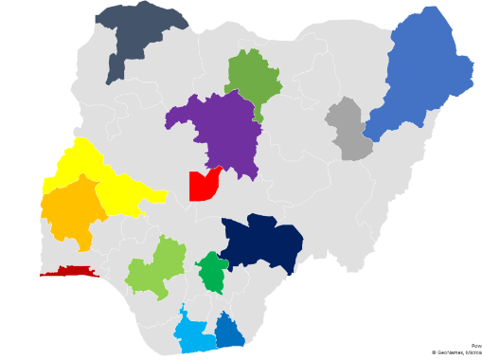
EFCC Zonal Commands
The Commission has the following Commands, which service the various zones where they are located:
Abuja Command: FCT and Nassarawa
Benin Command: Edo, Delta and Ondo
Enugu Command: Enugu, Ebonyi, Anambra and Imo
Gombe Command: Gombe, Adamawa and Bauchi
Ibadan Command: Oyo, Osun and Ekiti
Ilorin Command: Kwara and Kogi
Kaduna Command: Kaduna and Niger
Kano Command: Kano, Jigawa and Katsina
Lagos Command: Lagos and Ogun
Maiduguri Command: Borno and Yobe
Makurdi Command: Benue, Taraba and Plateau
Port Harcourt Command: Rivers, Bayelsa and Abia
Sokoto Command: Sokoto, Kebbi and Zamfara
Uyo Command: Akwa Ibom and Cross River
Notes:
In this slide there is a background placeholder. Click to the small icon on the center of the slide and choose an image from computer. When add an image, you must sent it to back with Right Click on Image -> Send to Back -> Send to Back.

Slide 14
Staff Strength
S/N | STATUS | NUMBER OF OFFICERS
1 | APPOINTED | 2
2 | REGULAR | 2817
3 | SECONDED | 976
4 | CONTRACT | 4
 | TOTAL | 3799
The Economic and
Financial Crimes Commission
Notes:
In this slide there is a background placeholder. Click to the small icon on the center of the slide and choose an image from computer. When add an image, you must sent it to back with Right Click on Image -> Send to Back -> Send to Back.

Slide 15
Staff distribution as per State of Origin
S/N | STATE | APPOINTED | CONTRACT | SECONDED | REGULAR | TOTAL
1 | ABIA | 0 | 0 | 7 | 62 | 69
2 | ADAMAWA | 0 | 0 | 77 | 89 | 166
3 | AKWA IBOM | 0 | 0 | 21 | 72 | 93
4 | ANAMBRA | 0 | 0 | 5 | 81 | 86
5 | BAUCHI | 0 | 0 | 39 | 69 | 108
6 | BAYELSA | 0 | 0 | 2 | 70 | 72
7 | BENUE | 0 | 0 | 73 | 92 | 165
8 | BORNO | 0 | 0 | 50 | 102 | 152
9 | CROSS RIVER | 1 | 1 | 14 | 83 | 99
10 | DELTA | 0 | 1 | 7 | 69 | 77
11 | EBONYI | 0 | 0 | 3 | 68 | 71
12 | EDO | 0 | 0 | 41 | 76 | 117
13 | EKITI | 0 | 0 | 10 | 70 | 80
14 | ENUGU | 0 | 0 | 11 | 78 | 89
15 | FCT | 0 | 0 | 6 | 53 | 59
16 | GOMBE | 0 | 0 | 37 | 79 | 116
17 | IMO | 0 | 0 | 14 | 83 | 97
18 | JIGAWA | 0 | 0 | 22 | 71 | 93
19 | KADUNA | 0 | 1 | 69 | 92 | 162
20 | KANO | 0 | 0 | 41 | 93 | 134
21 | KATSINA | 0 | 0 | 41 | 94 | 135
22 | KEBBI | 1 | 1 | 25 | 57 | 84
23 | KOGI | 0 | 0 | 48 | 93 | 141
24 | KWARA | 0 | 0 | 30 | 92 | 122
25 | LAGOS | 0 | 0 | 11 | 67 | 78
26 | NASARAWA | 0 | 0 | 67 | 75 | 142
27 | NIGER | 0 | 0 | 43 | 72 | 115
28 | OGUN | 0 | 0 | 9 | 80 | 89
29 | ONDO | 0 | 0 | 20 | 76 | 96
30 | OSUN | 0 | 0 | 20 | 75 | 95
31 | OYO | 0 | 0 | 3 | 73 | 76
32 | PLATEAU | 0 | 0 | 36 | 73 | 109
33 | RIVERS | 0 | 0 | 6 | 57 | 63
34 | TARABA | 0 | 0 | 20 | 84 | 104
35 | SOKOTO | 0 | 0 | 19 | 62 | 81
36 | YOBE | 0 | 0 | 13 | 73 | 86
37 | ZAMFARA | 0 | 0 | 16 | 62 | 78
 |  |  |  |  | TOTAL | 3799
The Economic and
Financial Crimes Commission
Notes:
In this slide there is a background placeholder. Click to the small icon on the center of the slide and choose an image from computer. When add an image, you must sent it to back with Right Click on Image -> Send to Back -> Send to Back.

Slide 16
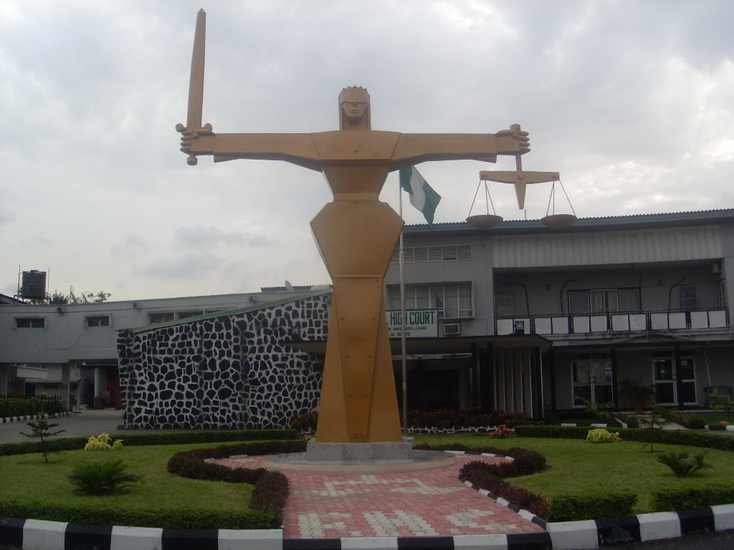
Progress Report: Achievements
Development of strategic advisories for informed policy decisions that will enhance transparency and accountability in public expenditure
Launching of the EFCC Strategic Plan and Action Plan 2021-2025
Launching of the Eagle eye app for seamless and easy reporting of information by the public
Development of Standard Operating Procedures (SOPs) for 2 Offices, 16 departments and 8 Units
Development of 21 Policy documents and manuals
Creation of the Department of Intelligence
Upgrade of the Information & Communication technology (ICT) Internal Audit and Procurement Units to full-fledged Departments
Restructuring of the Department Operations by the expansion of its Organogram
Provision of Specialized tool to the Department of Forensics & Crimes Laboratory Services
Restructuring of the Legal and Prosecution Department
Digitization of the Commission’s work flow process by the launch of the EFCC Case file Management software
Strengthened cooperation and collaboration with local and International partners by way of renewals of MOUs, gathering informal communication and exchange of information and intelligence
Provision of the Law Pavilion on tablets for all lawyers in the Legal & Prosecution Department of the Commission
Provision of operational tools and infrastructure including operational vehicles
Training and retraining of staff (Foreign and local)
The Economic and
Financial Crimes Commission

Slide 17
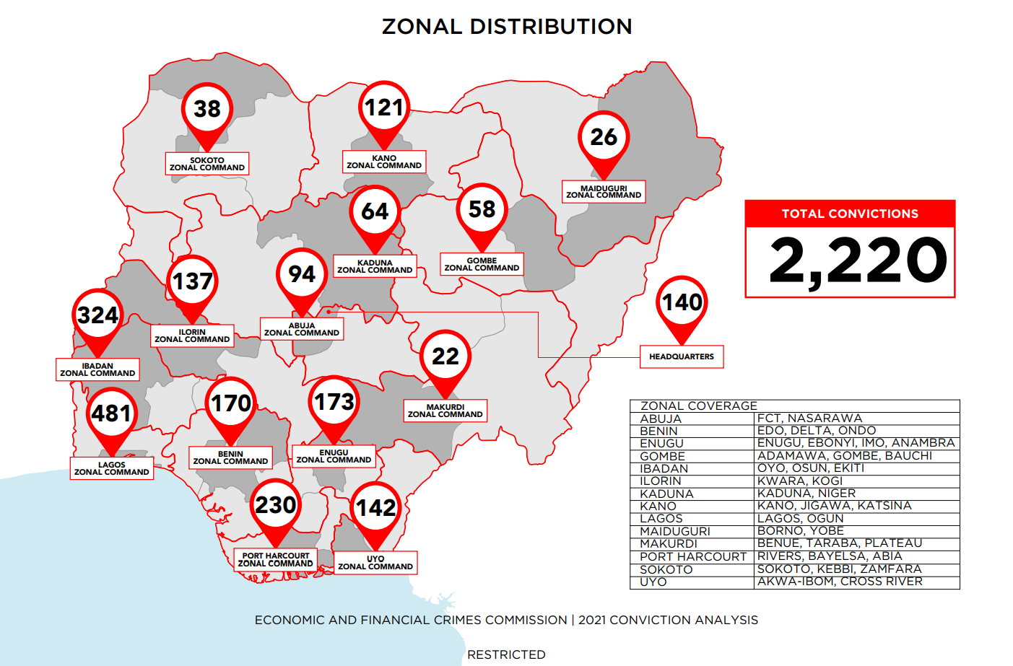
Convictions
2nd January – 29th December, 2021
The Economic and
Financial Crimes Commission
Notes:
In this slide there is a background placeholder. Click to the small icon on the center of the slide and choose an image from computer. When add an image, you must sent it to back with Right Click on Image -> Send to Back -> Send to Back.

Slide 18
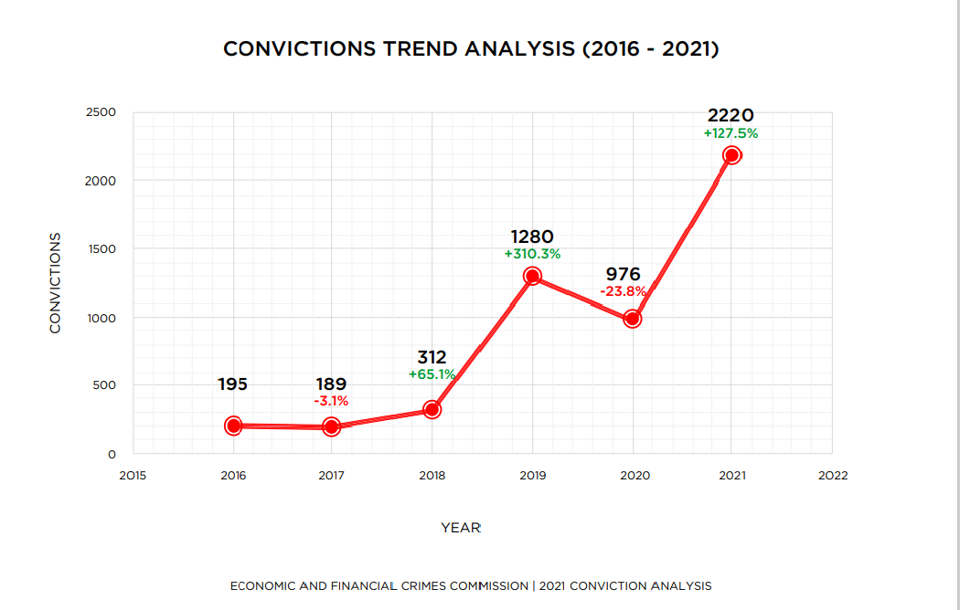
CONVICTIONS TREND ANALYSIS
The Economic and
Financial Crimes Commission
Notes:
In this slide there is a background placeholder. Click to the small icon on the center of the slide and choose an image from computer. When add an image, you must sent it to back with Right Click on Image -> Send to Back -> Send to Back.

Slide 19
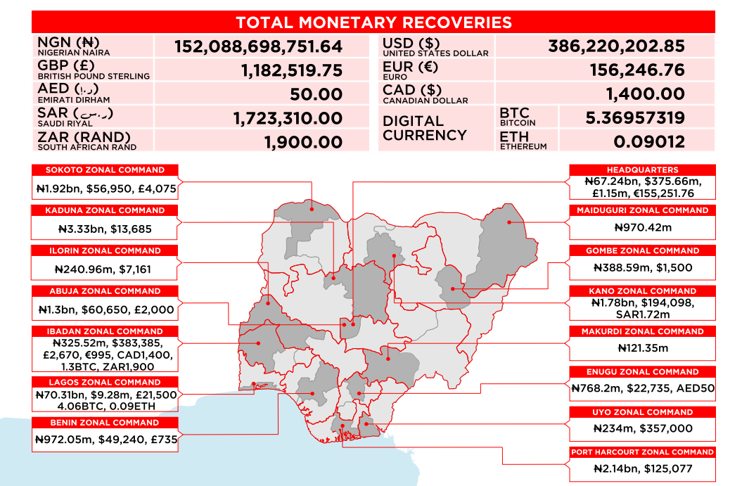
Recoveries
2nd January – 29th December, 2021
The Economic and
Financial Crimes Commission
Notes:
In this slide there is a background placeholder. Click to the small icon on the center of the slide and choose an image from computer. When add an image, you must sent it to back with Right Click on Image -> Send to Back -> Send to Back.

Slide 20
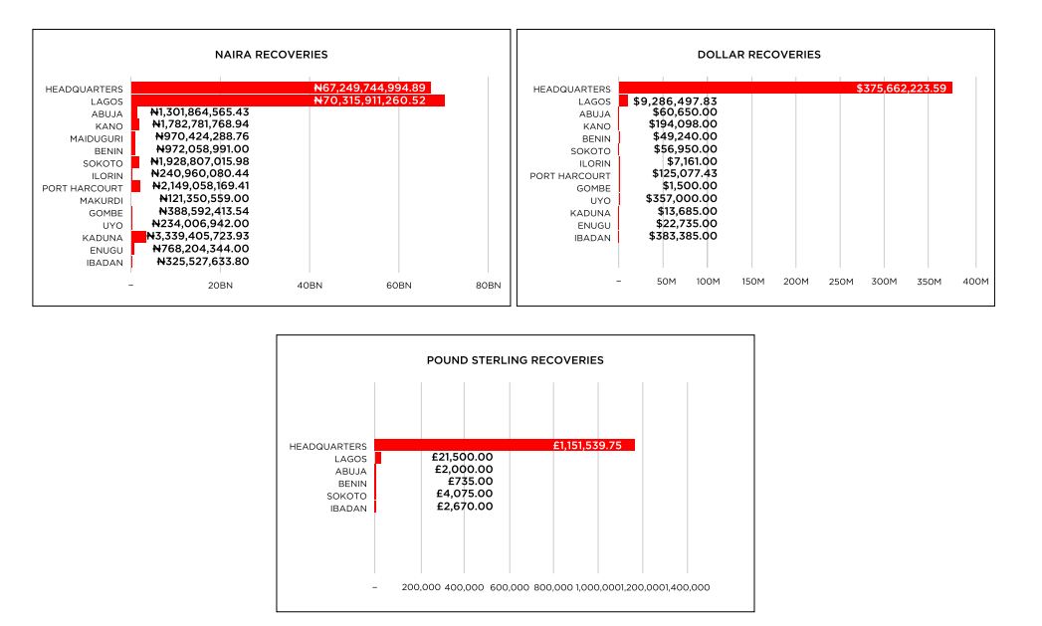
Recoveries
2nd January – 29th December, 2021
The Economic and
Financial Crimes Commission
Notes:
In this slide there is a background placeholder. Click to the small icon on the center of the slide and choose an image from computer. When add an image, you must sent it to back with Right Click on Image -> Send to Back -> Send to Back.

Slide 21
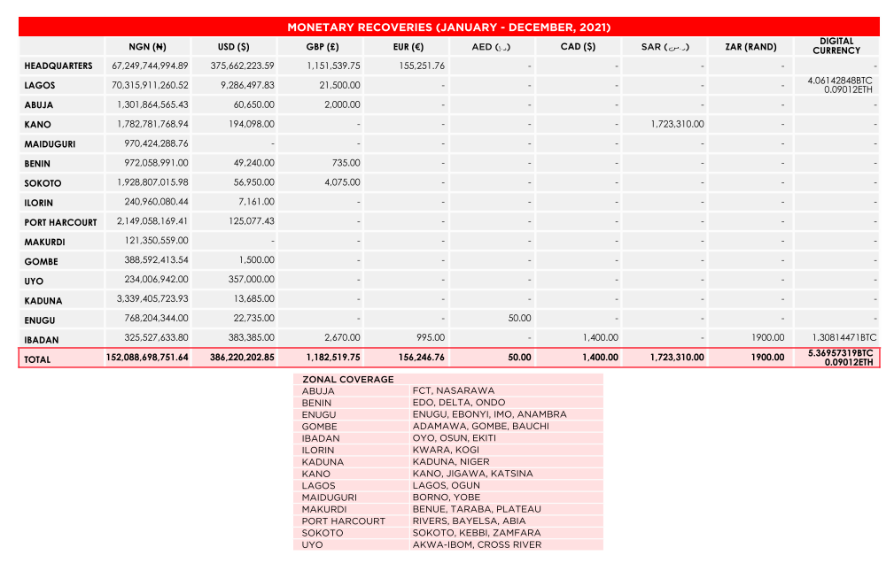
Recoveries
The Economic and
Financial Crimes Commission
Notes:
In this slide there is a background placeholder. Click to the small icon on the center of the slide and choose an image from computer. When add an image, you must sent it to back with Right Click on Image -> Send to Back -> Send to Back.

Slide 22
Strategic Objectives: Going forward
The five (5) STRATEGIC OBJECTIVES are:
To increase public engagement in the fight against economic and financial crimes;
To improve systems and processes for the prevention of economic and financial crimes;
To improve intelligence driven investigation, prosecution and asset recovery;
To improve law enforcement coordination and collaboration with relevant stakeholders;
To enhance institutional capacity and human capital development.
* Each strategic objective has the outcomes, outputs, and activities designed achieve the Strategic Objectives as well as key performance indicators(KPIs ) to assess the level of achievement.
The Economic and
Financial Crimes Commission
Notes:
In this slide there is a background placeholder. Click to the small icon on the center of the slide and choose an image from computer. When add an image, you must sent it to back with Right Click on Image -> Send to Back -> Send to Back.

Slide 23
Monitoring and Evaluation (M&E) Framework
The Strategic Plan has a monitoring and evaluation component at the Input, Output, Outcome and Objective levels to ensure effective implementation
The Economic and
Financial Crimes Commission
Notes:
In this slide there is a background placeholder. Click to the small icon on the center of the slide and choose an image from computer. When add an image, you must sent it to back with Right Click on Image -> Send to Back -> Send to Back.

Slide 24
VISION
A Nigeria free of Economic and Financial Crimes
MISSION
To Eradicate Economic and Financial Crimes Through Prevention, Enforcement and Coordination
The Economic and
Financial Crimes Commission

Slide 25
CORE VALUES
Integrity, Courage, Professionalism and Collaboration
The Economic and
Financial Crimes Commission

Slide 26
Issues to discuss
Security Vote
Cash withdrawals
Relationship with EFCC
Human rights
Federation vs. Federal Government: Recoveries
The Economic and
Financial Crimes Commission
Notes:
In this slide there is a background placeholder. Click to the small icon on the center of the slide and choose an image from computer. When add an image, you must sent it to back with Right Click on Image -> Send to Back -> Send to Back.

Slide 27
Issues to discuss
Cybercrime
Geographic Information System
Procurement Processes
Interfaith dialogue
National Identification Number (NIMC)
State Health Insurance Scheme
E-Governance structure
The Economic and
Financial Crimes Commission
Notes:
In this slide there is a background placeholder. Click to the small icon on the center of the slide and choose an image from computer. When add an image, you must sent it to back with Right Click on Image -> Send to Back -> Send to Back.

Slide 28
AND
Remember, EFCC will get you anywhere, anytime.
Thank you
The Economic and
Financial Crimes Commission

