Slide 1
REPORT OF THE NATIONAL ECONOMIC COUNCIL (NEC) AD-HOC COMMITTEE INTERFACING WITH NIGERIA NATIONAL PETROLEUM CORPORATION (NNPC) ON THE APPROPRIATE PRICING OF PREMIUM MOTOR SPIRIT (PMS) IN NIGERIA
PRESENTED TO THE NATIONAL ECONOMIC COUNCIL
BY THE CHAIRMAN (GOVERNOR OF KADUNA STATE)
MARCH 2021

Slide 2
Introduction
2
Following the Group Managing Director of NNPC presentation on PMS price, increasing cost under-recoveries, value shortfall to Federation and the imperative of PMS deregulation at the 113th (2nd in 2021) National Economic council (NEC) Hybrid Meeting of Thursday, 18th February 2021, Banquet Hall, State House, a NEC Committee under the leadership of His Excellency the Governor of Kaduna State, Malam Nasir El-Rufai was mandated by the Chairman NEC, His Excellency the Vice President to interface with NNPC and find a way out of the subsidy conundrum
2

Slide 3
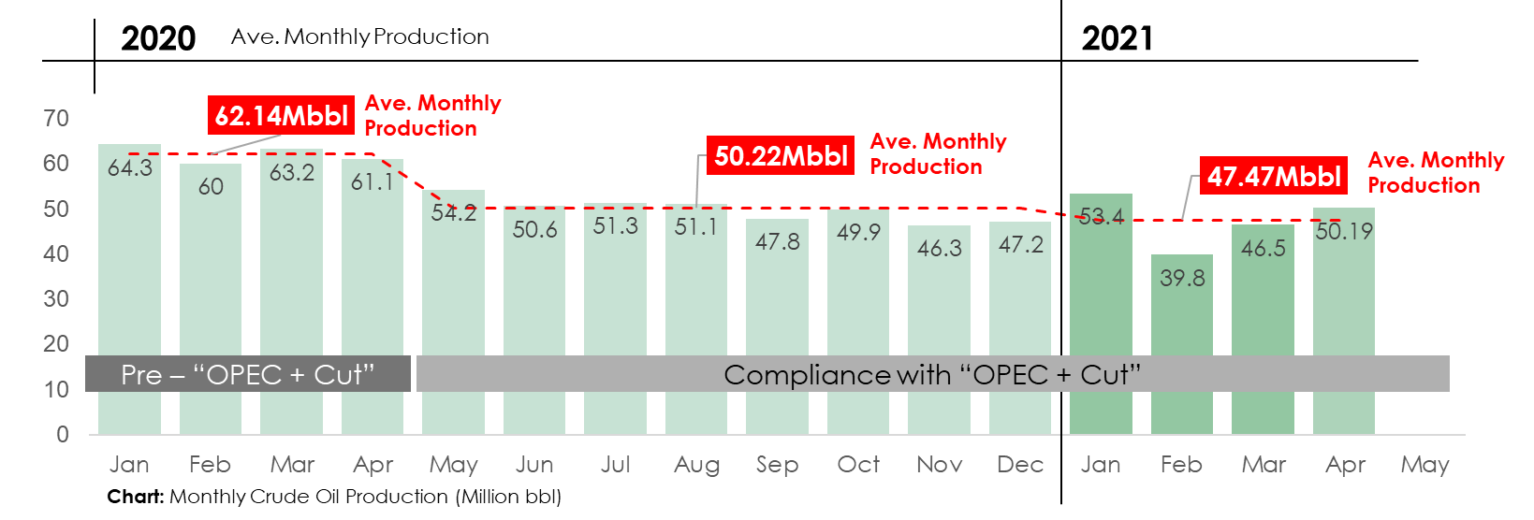
Nigeria’s crude oil production and revenues have been impacted by the daily cut of about 500,000bbl due to compliance with OPEC + since May 2020 and a soaring value shortfall due to under pricing of PMS against cost of supply
3
Crude oil production has dropped by about 12Million Barrels/Month since May 2020 due to compliance with OPEC+ cut
Average daily production is down by about 500,000bbl/day (from Ave. of 2.1 Million bbl/day to 1.6 Million bbl/day)

Slide 4
Consequently, …
4
The Federation will continue to bear the shortfall due to differentials between the current PMS retail price and actual open market price, unless PMS is fully deregulated
Remittances to Federation Account Allocation Committee (FAAC) would continue to shrink as NNPC recovers shortfall the Federation’s oil revenue
Between N70billion and N210 billion is estimated to be spent every month to keep PMS price at N162/litre (below cost), and remittance to FAAC would shrink down to less than N50 billion per month or even zero if trends pesist.
4

Slide 5
Engagement with Trade Unions on Deregulation and the way forward
5
Tripartite meetings between the FGN and two Trade Unions ended with a suspension of the planned nationwide industrial action while progress was being made on the implementation of the mutually agreed terms and conditions
Crude oil market would continue to improve as the world recovers from the impact of Covid-19, PMS landing cost would escalate as well, leaving no option than to fully deregulate and save the estimated value shortfall of between N70 billion/month up to N210billion/month to the Federation Account.
5

Slide 6
Comments from the Chairman of the Council - 1
6
That there were no issues or disagreement on deregulation, but the issue was how to manage the fallout of deregulation on Nigerians.
That the Government had agreed with the Unions to give Nigerians a choice by providing auto gas conversion kits as well as CNG/LPG mass transit buses as alternatives to gasoline. He however, noted that the programme was yet to be implemented fully.
He equally noted that inflation was close to 17%, adding that another fuel price increase would worsen the hardship on Nigerians without provision of adequate palliative measures to cushion the effects.
6

Slide 7
Comments from the Chairman of the Council - 2
7
Consequently, NEC mandated its Ad-hoc Committee on Excess Crude and Other Special Accounts of the Federation, chaired by the Governor of Kaduna State to interface with NNPC with a view to coming up with recommendations on an appropriate pricing of PMS, as well as actions/initiatives to address the impact of the deregulation on Nigerians.
7

Slide 8
Membership of the NEC Ad-hoc Committee include:
8
Governor of Kaduna State - Chairman
Governor of Edo State - Member
Governor of Jigawa State - Member
Governor of Ebonyi State - Member
Governor of Akwa-Ibom State - Member
Governor of Ekiti State - Member
Governor of CBN - Member
Hon. Minister of Finance, Budget & National. Planning - Member
Accountant General of the Federation - Member
Group Managing Director, NNPC - Member
Permanent Secretary, MBNP - Secretary
8

Slide 9
Terms of Reference (ToR) for the Ad-hoc Committee
9
Interface with NNPC to determine the appropriate pricing of PMS in Nigeria taking into consideration the elements of subsidy, forex differentials and smuggling of PMS across neighbouring countries.
Come up with recommendations that would address the impact of fuel price deregulation on Nigerians.
provide policy guidelines that would aggressively drive the roll out of gas-based alternatives to PMS.
co-opt and /or invite any individual or corporate body deemed appropriate to facilitate the work of a committee; and
update Council of regular intervals
9

Slide 10
Inaugural meeting of the NEC Ad-Hoc Committee
10
The inaugural meeting committee was chaired by His Excellency Malam Nasir Ahmad El-Rufai, the Governor of Kaduna State on Thursday 25th February 2021.
The inaugural meeting attendance included:
Governors of Ekiti, Jigawa, Edo, and Ebonyi States,
The GMD, NNPC,
DG BOF representing Hon Minister of Finance, Budget and National Planning
Others include officials from DPR, NNPC, NGF and the Secretariat
The committee has subsequently held three (3) more meetings on the 3rd, 10th, and 11th March 2021 during which it received presentations from NNPC, Department of Petroleum Resource (DPR) and representatives of the Independent Petroleum Marketers Association of Nigeria (IPMAN)
10

Slide 11
Methodology
11
The committee adopted a variety of approaches in executing its assignment, including physical meetings, review of presentations and other submissions by relevant stakeholders
11

Slide 12
Findings
12
The Committee has considered the following:
Crude oil price movement and PMS open market retail pump price at different FX regimes
Projected revenue inflow to the government of the Federation
NNPC value shortfall and declining remittances to FAAC
Gasoline prices and pricing framework across some West African countries including some other major economies and
finally, the Autogas transport switch framework.
12

Slide 13
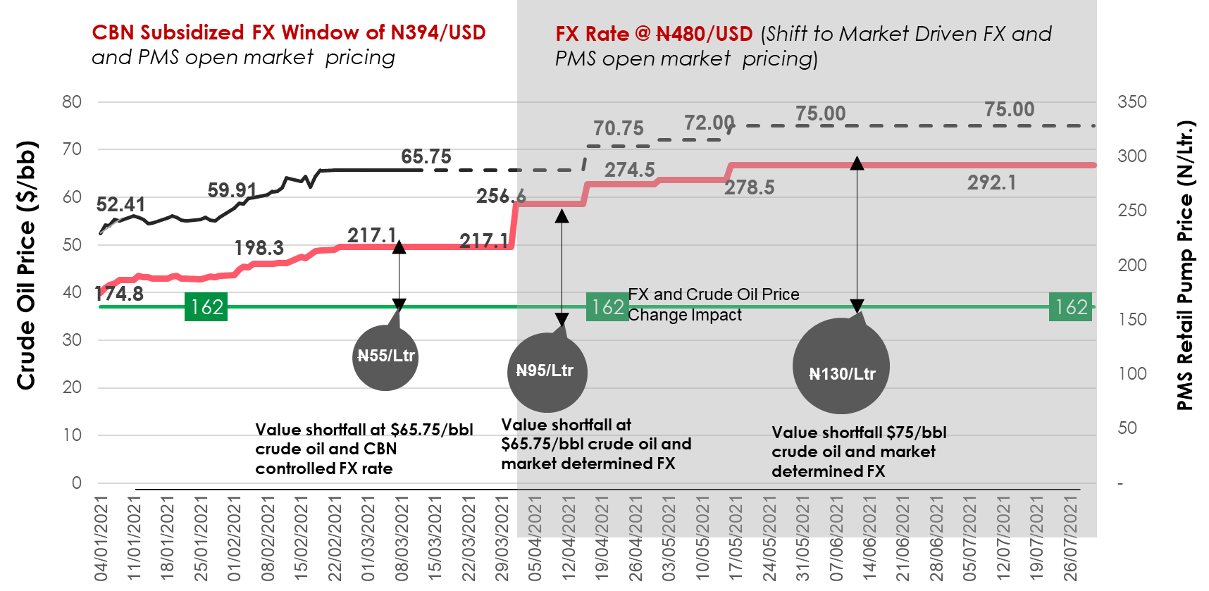
Impact of Crude Oil Price Movement on PMS Retail Pump Price at Different FX Regimes
13
Current PMS Retail Pump Price (N/Ltr)
Deregulated PMS Retail Pump Price (N/Ltr)
Dated Brent Crude Oil Price ($/bbl)
13

Slide 14
Nigeria National Petroleum Corporation Presentation - 1
14
AS PMS cost continues to respond to crude oil price recovery thus pushing PMS retail pump price upward, the current PMS pump price of N162/litre benchmark will continue to expose the Federation to growing value shortfall.
At CBN subsidized FX window of N394/USD and crude oil price of $65.75/bbl, the estimated value shortfall will be around N55/litre on PMS
At market driven FX rate of N480/USD and crude oil price of $65.75/bbl, the estimated value shortfall will be around N95/litre on PMS
Lastly, at market driven FX rate of N480/USD and an increase in price of crude oil to $75/bbl the shortfall rises to N130/litre.
14

Slide 15
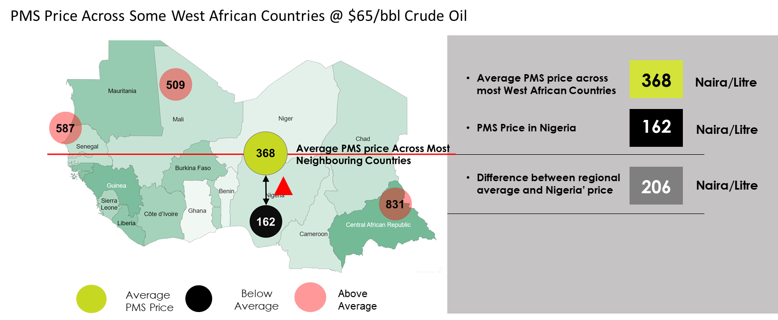
Crude oil price recovery has necessitated PMS price increase across the world with a wide gap between Nigeria’s price and the deregulated West African market
15
15

Slide 16
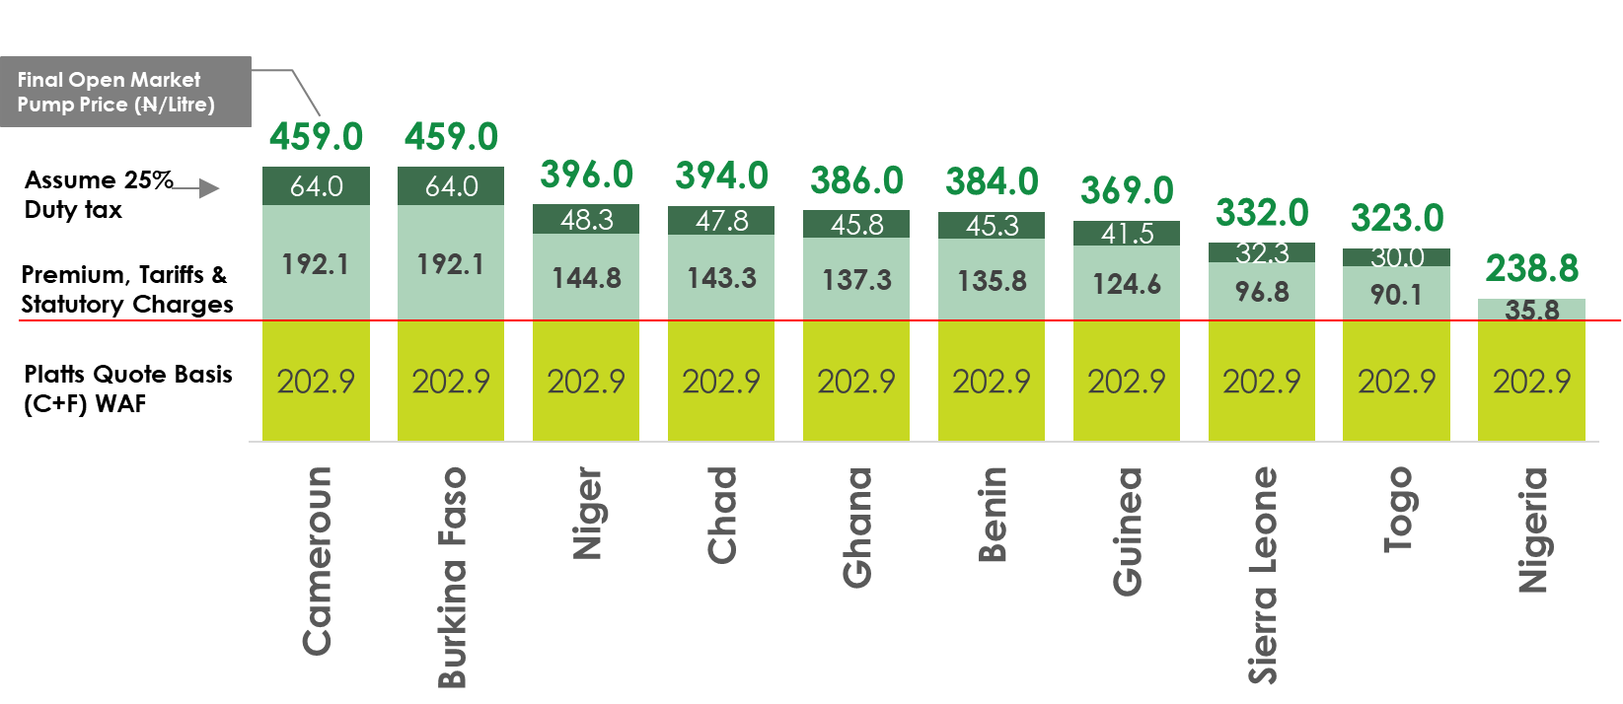
PMS open market pricing structure and price outlook at $65/bbl crude oil across 10 West African countries
16
Referenced FX Rate: N410/USD
Prices in Neighbouring countries reflects quality of gasoline, logistics costs & the tax system administered by each country
Petrol Tax in other Jurisdictions:
UK, France and Germany all levy taxes of at least 60%
US imposes 13%
Malaysia offers subsidies of 30% on petrol and 40% on diesel with annual exposure of about $14 billion

Slide 17
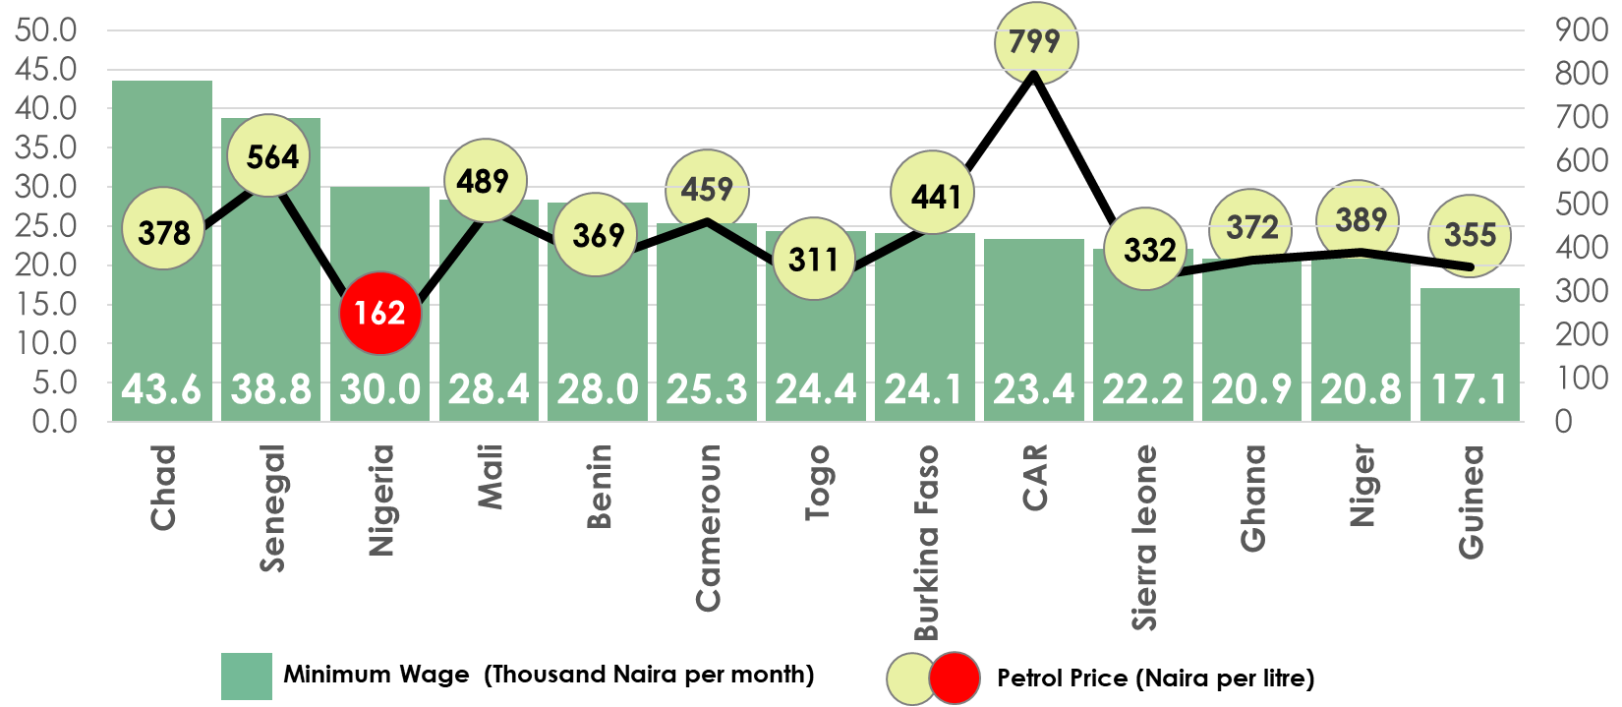
Monthly Minimum Wage and Gasoline Prices Across Some West Africa Countries
17
Note: Prices in Neighbouring countries reflects quality of gasoline, logistics costs & the tax system administered by each country
www.globalpetrolprices.com 1st March 2021
New prices are reported monthly or bi-weekly
www.ilo.org 2019
Applicable Exchange rates adjusted to: N410/USD

Slide 18
Nigeria National Petroleum Corporation Presentation - 2
18
NNPC outlined a gasoline pricing framework of some West Africa Countries, based on N410/USD FX regime as follows: Nigeria – N162; Ghana – N323; Mali – N509; Chad – N394; Niger – N396; Benin – N384; Cameroon – N459; Central Africa Republic – N831; Liberia – N587. It should be noted that, irrespective of the tax regime in all the sampled countries, a portion of the proceeds from the sale of PMS in these countries go to the government coffers, unlike in Nigeria.
The Committee found that there is no correlation between the minimum wage and PMS retail price in Nigeria and comparable countries. The analysis provided by NNPC showed the minimum wage across comparable countries using N410/USD exchange rate: Nigeria – N30,000; Chad – N43,600; Senegal – N38,800; Mali – 28,400; Benin – N27,900; Cameroon – N25,300; Togo – N24,400; Ghana – N20,900; Niger – N20,800; and Guinea – N17,100.
18

Slide 19
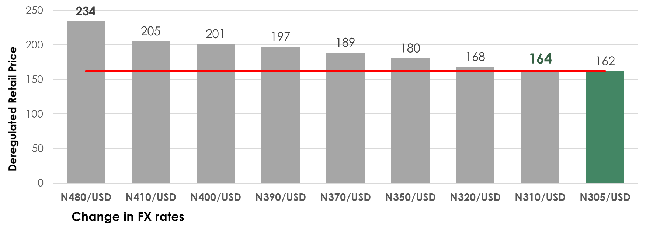
Impact of FX Rates Changes on PMS Open Market Price at Average Crude Oil Price of $60/bbl
19
19
In order to keep PMS retail pump price at N162 per litre without value shortfall, the applicable FX rate for PMS supply has to be around N305 per USD
When official rate is above N305 per USD, the subsidy is essentially transferred from PMS to FX

Slide 20
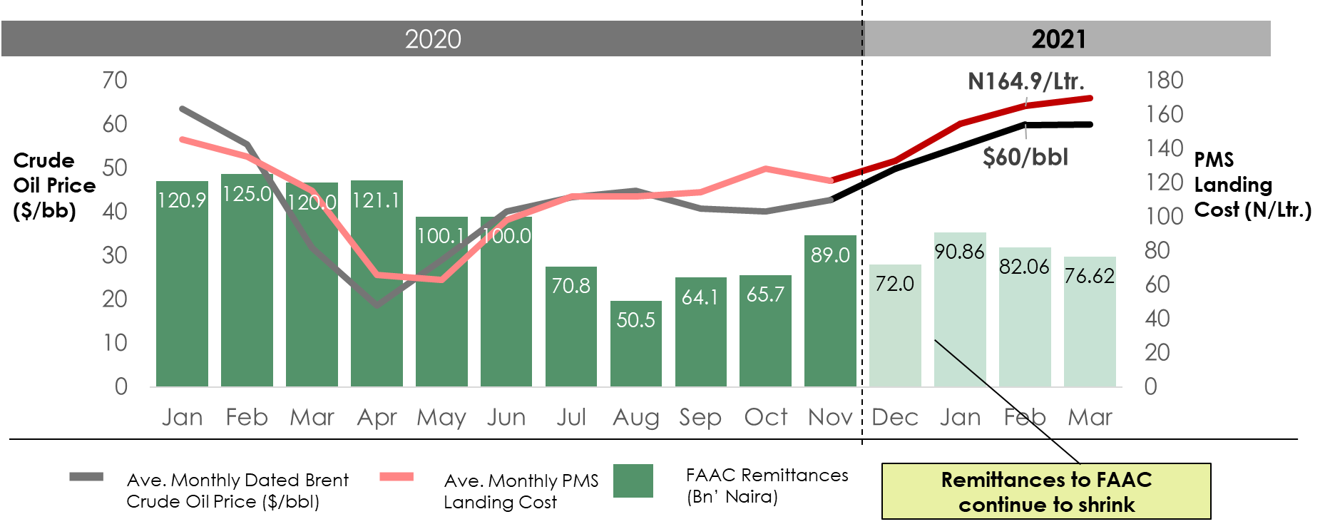
Crude Oil Price Movement, PMS Landing Cost and the Impact on Net Remittances to FAAC
20
Without full deregulation of PMS, remittances to FAAC will continue to fade away as NNPC recovers shortfall from the Federation

Slide 21
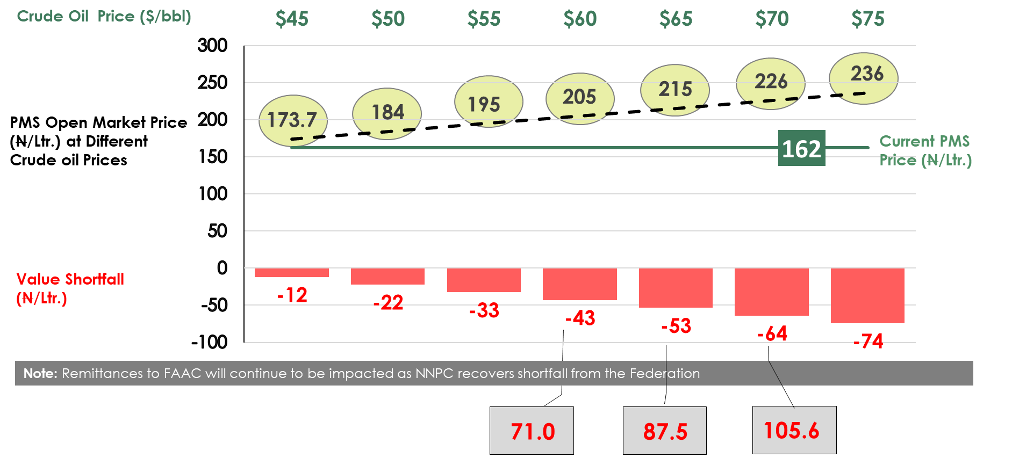
With PMS retail price fixed at N162/litre and open market price trailing crude oil price recovery, value shortfall against the Federation oil revenue will continue erode remittance to FAAC
21
Estimated Monthly shortfall to FAAC Remittances (Billion Naira) at daily consumption of 55Million litres

Slide 22
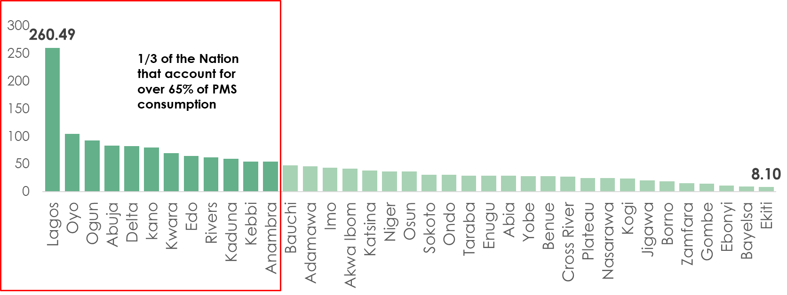
Average Monthly PMS Consumption (Million Litres) by State
22
22
N70 Billion is estimated to be washed away every month due to differentials between PMS landing cost and the Ex-coastal price being offered marketers as crude oil price appreciate
Remittances to FAAC will be depressed down to about N50Billion/Month as NNPC recovers about N70Billion/Month shortfall from the Federation

Slide 23
Nigeria National Petroleum Corporation Presentation - 3
23
Remittances to FAAC would continue to shrink as NNPC recovers shortfall from the Federation as a result of crude oil price recovery without commensurate increase in PMS retail price. The projected monthly shortfall due to PMS price differentials at CBN subsidized FX window of N394/USD is N70 billion, while the projected shortfall due to PMS price differentials at market driven forex rate at N480/USD is N100billion. According to BusinessDay, we spent N7 billion daily on PMS subsidy.
The analysis of average monthly PMS consumption by States showed that 1/3 of the Nation accounts for over 65% consumption of PMS. The analysis showed that the following States of Lagos, Oyo, Ogun, Abuja, Delta, Kano, Kwara, Edo, Rivers, Kaduna, Kebbi and Adamawa accounted for 65% of PMS consumption in the Country. Most States with high PMS consumption either have borders with neighbouring countries or are in close proximity, this has been an avenue for smugglers to benefit from profitable arbitrage opportunities.
23

Slide 24
Department of Petroleum Resources Presentation -1
24
Transportation and gas-based industries are critical economic development enablers that must be powered by our gas resource. Dual fuel system of transportation and the use of gas for the industrial sector holds great opportunity in Nigeria for driving sustainable economic development.
In adopting gas-based alternatives to PMS, the Autogas penetration will primarily focus initially on the commercial transport segment, including big urban metros, interstate travels including the conversion of State mass transits and national deployment across LGAs.
24

Slide 25
Department of Petroleum Resources Presentation -2
25
The committee agreed that CNG is more efficient compared to PMS or LPG. Noting that CNG efficiency/km and cost/litre delivers >33% efficiency factor compared to LPG. Unlike CNG, LPG’s use as a transportation fuel will impact price and availability of LPG for domestic use, and LPG requirements will have to be supplemented with imports to meet domestic demand and this will have an adverse effect on foreign exchange liquidity.
The Gas Expansion Framework includes regulatory enablement, extensive sensitization and energy availability. Its focus on Gas Based Industries will be to ensure improved gas availability through enhanced DSO administration, enhanced gas transportation regime by implementing the NGTNC and enabling the use of virtual pipelines and by the creation of business and investment opportunities through improved regulatory instruments and enhanced business support.
25

Slide 26
Department of Petroleum Resources Presentation -3
26
DPR has approved licenses for the construction of 9,000 Autogas infrastructure across the country, and over 30,000 vehicles are currently running on dual fuel coupled with the commencement of in-country production of dual fuel vehicles. Plans are underway to supply about 1 million conversion kits to support easier switching from PMS to Autogas
26

Slide 27
Recommendations - 1
27
The Committee recommends immediate implementation of complete deregulation of the downstream sub sector of the industry, and to adopt a PMS pricing structure that addresses regional arbitrage and smuggling of PMS and also provides additional revenue to the Federation Account.
The Committee recommends PMS pump price increment from the current N162/Litre as follows:
N408.5/Litre (negotiation price with Organised Labour Unions)
N380/Litre (Settlement Price with Organised Labour Unions)
Average PMS price across most West Africa countries is N368/litre compared to Nigeria’s N162/Litre. This huge price differential (N206/Litre) within a sub-region has been the major incentive that drive the smuggling of Nigeria’s cheaper PMS to neighboring West African countries
27

Slide 28
Recommendations - 2
28
If the above proposal is accepted, it is expected that about N1.3 trillion to N2.3 trillion would accrue to the Federation within a year based on a price of N346.3/Litre and consumption of 30million litres per day and N346.2/Litre or at consumption rate of 60million litres per day
A portion of the additional windfall should be set aside to finance the conversion of mass transit vehicles to CNG/LGP and pay for the installation of conversion outlets in as many Petrol fuel stations across the country. It is envisaged that a timeline of 3 to 6 months is required to implement the Autogas conversion. However, the impact will be felt substantially within 6 to 12 months.
28

Slide 29
Transition to Autogas (CNG) Cheaper than PMS & More Available than LPG
29
29
*CNG price based on US$2.5/mscf gas price

Slide 30
Recommendations - 3
30
There is the need for the deregulation to commence immediately in order to provide the resources to finance the palliative programmes of both the Federal and State governments, to support the poor and vulnerable groups/households across the country through Conditional Cash Transfers (CCT), grants and credits.
To encourage and ensure that petroleum products marketers remain in business after the deregulation. NNPC would be expected to grant marketers a minimum of 30 days credit facility backed by a bank bond or existing credit policy of NNPC.
30

Slide 31
Recommendations - 4
31
Privatisation of the three (3) government refineries after their full rehabilitation and expedite the licensing procedure for modular refineries to reduce recurring government expenditure on refinery maintenance and increase the country’s refining capacity.
Increase the scope of the Social Investment Programme across all States by providing additional financial resources to poor households especially the country’s 80 million poor population living on less than 1USD/per day.
31

Slide 32
Recommendations - 5
32
ix. Autogas Conversion kits: Federal government and its agencies to ensure delivery of 1 million CNG/LPG Autogas conversion kits, storage skids and dispensing units under the Nigeria Gas Expansion Programme by December 2021 to enable delivery of cheaper transportation and power fuel.
x. CNG/LPG Mass Transit Buses: FG to make available 113 CNG/LPG mass transit buses immediately and provide to the major cities across the country on a scale up basis thereafter to all states and local governments before December 2021.
32

Slide 33
33
Thank You
33

