Slide 1
Overview of Performance Scorecard

Slide 2
Overview of the Mid Year Performance Review
Focuses on providing methodology, budget performance and summary of deliverables
Summary of Priority Area Score Cards
Focuses on deep dive into the Priority Areas and drivers of performance
Recommendations to Accelerate Delivery
Focuses on providing recommendations across all the Priority Areas

Slide 3
2.
3.
Ensure Energy Sufficiency in Power & Petroleum Products
1.
Stabilize the Macroeconomy
Achieve Agriculture
& Food Security
Improve Health. Education & Productivity of Nigerians
4.
Improve Transportation & Other Infrastructure
5.
Drive Industrialization
Focusing on SMEs
6.
7.
Enhance Social Inclusion and Reduce Poverty
8.
Fight Corruption and Improve Governance
9.
Provide Security for All Citizens

Slide 4
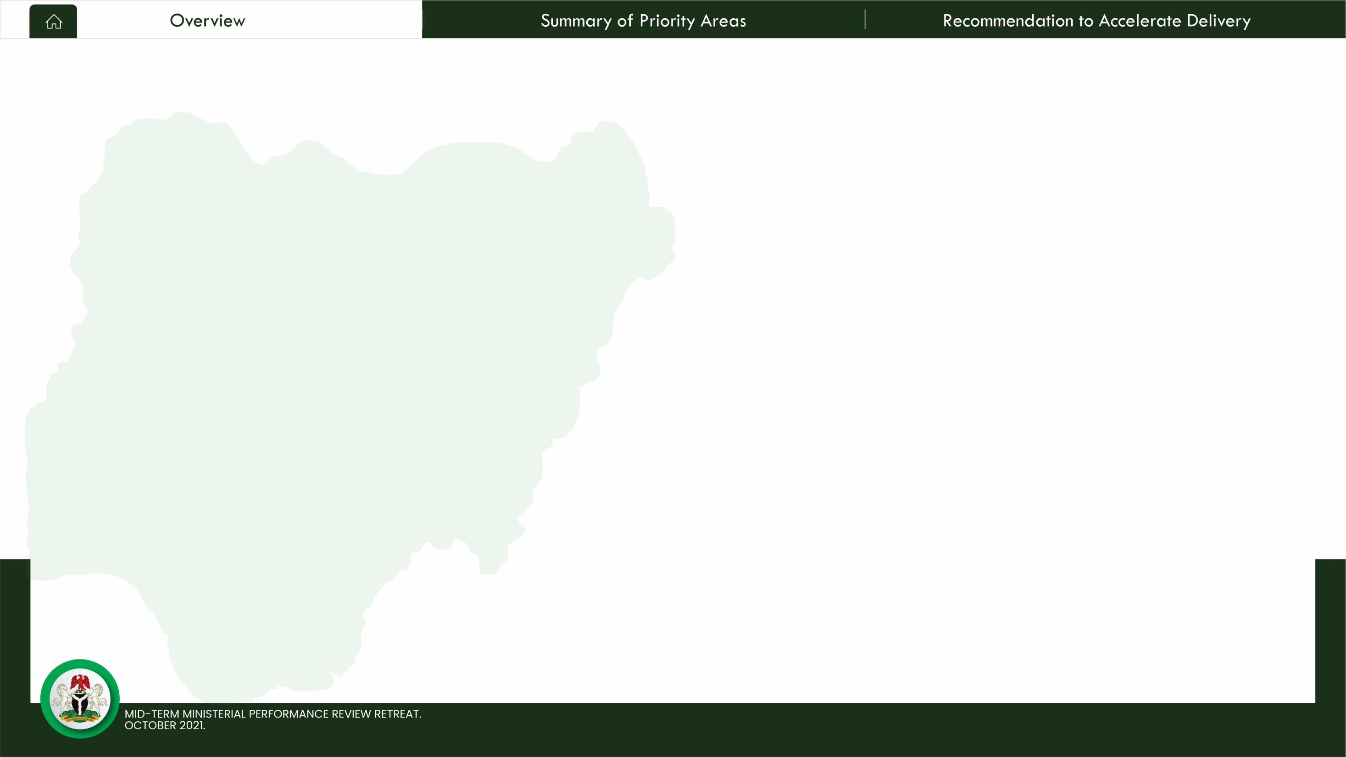
Methodology
01
02
03
04
05
DEVELOP COLLABORATIVE RESULTS FRAMEWORK
BILATERAL SESSIONS WITH MINISTERS & PERM SECS
MINISTERIAL SELF ASSESSMENT
SECTOR ANALYSIS & VALIDATION
SYNTHESIS OF FINDINGS
A collaborative results framework developed to drive collaboration and deliver joint accountability for results
Bilateral Session engagement with Ministers & PS to negotiate results and agree on Indicators for tracking progress
Ministries were provided with self reporting template on results and projects to determine progress
Engagement of Sector Experts to provide analysis of reporting and validate submissions based on further engagement with Ministries
Findings were collated and analyzed to provide key challenges and recommendations
PERFORMANCE MANAGEMENT SYSTEM & EXECUTIVE DASHBOARD
Digitizing the tracking of Projects, Programmes and Policies powering delivery of the 9 Priority Areas.
Integrating Citizen Engagement Mechanism to track citizen’s perception of impact
Creates a knowledge management system on what works and why?

Slide 5
Overall Performance of the Priority Areas
Progress towards achieving Mandate, status of ministerial deliverables contributing to priority area
Number of
deliverables
Key Takeaways
The 9 Priority Areas are being delivered through 302 deliverables in 29 Ministries and OHCSF
4 of the 9 priorities (2, 6, 7 & 8) have more than 70% of their deliverables on track
2 of the 9 priorities (4 & 9) have between 50% to 70% of their constituent deliverables on track
3 of the 9 priorities (1, 3 & 5) have less than 50% of their constituent deliverables on track
Progress on a number of deliverables unrated are due to lack of data

Slide 6
Approximately 58% Ministerial Deliverables appear to be on track
The Journey So Far as at Mid Term
Key Takeaways
58% of deliverables are on track - a 5% increase from 2020 performance (53%). There is a need to ramp up implementation on the deliverables.
18% of all Ministerial deliverables are at risk / not on track to achieve their 2023 targets
24% of all Ministerial deliverables were not assessed in 2021 Q2 due to lack of data

Slide 7
Budget Performance as at Q2, 2021
Recurrent & Capital Budget Performance
Key Takeaways
Graphs show MDAs expenditure only (Debt Services, Statutory Transfers etc. are excluded). This only represents around 60% of Total FGN Expenditure (excluding GOEs).
As with 2020, recurrent expenditure performance is strong whereas Capital Expenditure utilisation lags significantly behind releases
Improved Ex Ante cash planning – matching bottom-up capital work plans with top-down cash flow forecasts would help improve predictability in budget execution. This should close the gap between capital expenditure releases and utilisation

Slide 8
Progress of Ministerial Deliverables: 2020 – Q2 2021
Breakdown of Ministries Progress on the 9 Priority Areas
Key Takeaways
2021 Q2 performance is an improvement on 2020
17 of the 29 Ministries are now on track to deliver 70% or more of their deliverables.
On the average, budget performance by 2021 Q2 is lower than in 2020
Ministries with majority of their deliverables rated green have 62% budget performance
Increasing the fiscal space for MDA expenditure (by increasing revenues and/or reducing debt service burden) may help accelerate delivery of Ministerial Mandates and Priority Area Outcomes

Slide 10
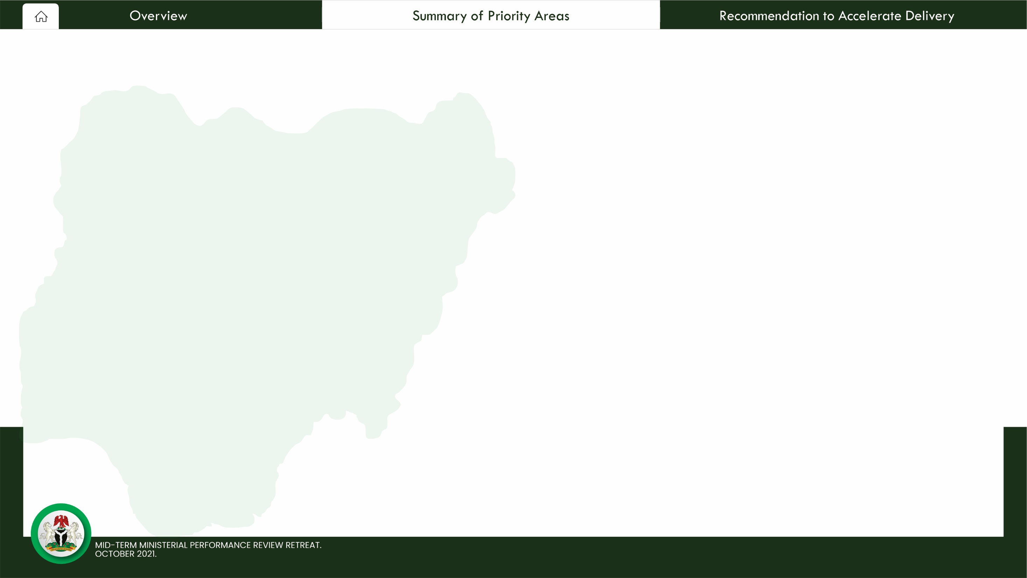
Leading
Contributing
Federal Ministry of Finance, Budget & National Planning
Contributing Ministries to Priority 1: Stabilize the Macroeconomy
Federal Ministry of Petroleum Resources
Federal Ministry of Communication & Digital Economy
Federal Ministry of Environment
Federal Ministry of Aviation
Federal Ministry of Information & Culture
Federal Ministry of Interior

Slide 11
Priority 1 Scorecard
Priority 1
Priority 2
Priority 3
Priority 4
Priority 5
Priority 6
Priority 7
Priority 8 Priority 9
On track / Completed
At risk
Not started / Behind schedule
Key indicators
Selected key deliverables
2019
Baseline
2021
Actuals
2023
Targets
2023 Deliverables
Progress
Rationale
Macro economic Indicators
Increase Revenue by implementing the (Strategic Revenue Growth Initiatives) Program
The coordination framework to achieve set targets and other internal factors identified within the SRGI framework itself, has not been resolved.
GDP growth rate (%) | 2.27 | 5.01² | 3.86
Inflation rate (%) | 11.98 | 17.01 | <10
Revenue/GDP (%) | 5.6 | 8.6 | 10.16
Domestic/Total Debt (%) | 67.1 | 61 | 60
Oil production (mbpd) | 2.3 | 1.24 | 3
Oil revenue/ Federal Revenue (%) | 39 | 37.3 | 40 - 45
Exchange rate (N/$) | 306.5 | 404.19 | N/A
Level of Completion (PIB) | Ongoing | Passed & Assented by President | N/A
Raise Revenue Collection Efficiency Levels (Cost of Collection)
Revenue collection efficiency has improved but there is need to enhance the operational capacity of revenue agencies as well as employing appropriate technology
Prioritize the implementation of the National (Single Window) Project
Low evidence of prioritization of the single window project. Even the lead agency is yet to be appointed.
Develop and Implement the Digital Economic Strategy
Reasonable progress has been made in the areas of digital platforms, digital infrastructure and digital financial services and skills.
Optimize fiscal incentives to boost productivity in critical sectors including Agriculture, Solid Minerals and Manufacturing
There exist evidence of remarkable progress towards achieving this deliverable.
Aggresively promote passage of Petroleum Industry Bill
PIB is now an ACT as assented by the President with potential impact on diversifying the economy

Slide 13
Leading
Contributing
Federal Ministry of Agriculture & Rural Development
Contributing Ministries to Priority 2: Achieve Agriculture & Food Security
Federal Ministry of Defence
Federal Ministry of Environment
Federal Ministry of Finance, Budget & National Planning
Federal Ministry of Industry, Trade & Investment
Federal Ministry of Science, Technology & Innovation
Federal Ministry of Transportation
Federal Ministry of Water Resources

Slide 14
Priority 2 Scorecard
Priority 1
Priority 2
Priority 3
Priority 4
Priority 5
Priority 6
Priority 7
Priority 8 Priority 9
On track / Completed
At risk
Not started / Behind schedule
indicators
Selected key deliverables
2019
Baseline
Q2, 2021
Actuals
2023
Targets
Indicators
Deliverables
Progress
Rationale
Annual Production of Stable Food(MT) | 162.1 M | 392 M | 883.6 M
Annual Production of Meat (MT) | 3.5 M | 8.2 M | 18.5 M
Annal Production of Diary (Liters) | 1.2 M | 3.1 M | 6.3 M
Agric Contribution to GDP (US$ B) | 99.12 B | 22.1 B | n/a
 | 14.7% | 21.8% | 10%
Consumer Food Price Index (%)
Global Hunger Index Score (%) | 27.9% | 29.2% | 19.9%
Engage with State Governments and Private Entities to scale-up the production of Cattle, Sheep, Goat, Dairy, Poultry, Maize, Sorghum, Rice, Tomato, Yam, Cowpea, Acha, Millet, Groundnut and Fish
Already achieved 44.4% of 2023 target set by FMARD but the 2021 yearly target of 523.7 million MT (which would have moved achievement to 59.3%) is threatened by insecurity. The 2023 target may not be met if insecurity is not resolved.
Implement a Rural Transformation Plan, including the Green Imperative on Public-Private Partnership Mechanisation Program under the Agricultural Equipment Hiring Enterprise (AEHE) Centres and Animal Traction Program
The Nigeria/ Brazil cooperation mechanization programme has not taken off as planned. FMFBNP needs to fast track the take-off process.
Implement the National Livestock Transformation Plan along with the program on Animal Breeding and Conservation, Grazing Reserve Development, Dairy Value Chain Development and Small Ruminants Development
This programme has not taken-off as planned. It has been marred in controversy and the implementation of pilot sites in northern states is slow.
Complete all priority on-going dam and irrigation projects
Already achieved 58.3% by Q2 2021 but low public sector investment in water sector and non passage of National Water Resources Bill is slowing down this programme.
Reduce Post Harvest Losses of Agricultural Produce
Post harvest losses still high. Processing programmes too slow.
Support Food and Nutrition program to enhance the quality and safety of food production consumption
Nutrition sensitive practices are still not part of most agricultural interventions. It is important to mainstream nutrition into all interventions to reduce malnutrition.
14

Slide 16
Leading
Contributing
Contributing Ministries to
Priority 3: Ensure Energy Sufficiency in Power & Petroleum Products
Federal Ministry of Petroleum Resources
Federal Ministry of Power
Federal Ministry of Environment

Slide 17
Priority 3 Scorecard
Priority 1
Priority 2
Priority 3
Priority 4
Priority 5
Priority 6
Priority 7
Priority 8 Priority 9
On track / Completed
At risk
Not started / Behind schedule
Key indicators
Selected key deliverables
2019
Baseline
2020
Actuals
Q2, 2021
Actuals
2023
Targets
Indicators
Deliverables
Progress
Rationale
Volume of crude oil production per day (mbpd)
Increase crude oil production to 3 Million bpd (crude oil + condensate)
Current productivity is 1.86 mbpd, an increase from the current OPEC quota of 1.4 mbpd. Without an increase in the current OPEC quota, this deliverable is at risk of achieving the target 3 mbpd , even with the Marginal Field bid rounds.
1.7
1.5
1,86
3.00
Eradicate smuggling of PMS across Nigerian borders
While the number of PMS trucks equalized increased and number of Diverted Trucked Out decreased by over 100%, the volume of PMS consumed has increased. So is the amount of subsidy paid by the government on the increase
Number of Diverted Trucked Out
1,149
1,560
337
398
Transmission and distribution capacity (MW)
8,100
5,059
4091.4
11,000
Implement the Siemens Grid and Distribution Enhancement Project
Information on the exact status of execution was not accessible. It is therefore difficult to know whether the project is on track, at risk of non-execution or would require external support to overcome challenges.
Annual additional
generation capacity (MW)
5,801.6
-742.4
-532
9,801.6
Increase Generation Capacity by at least 1,000MW Annually
The delivery on this target is at serious state of non-execution, symptomatic of the existence of potential issues and would need assistance in the future

Slide 19
Leading
Contributing
Federal Ministry of Works & Housing
Contributing Ministries to
Priority 4: Improve Transportation & Other Infrastructure
Federal Ministry of Transportation
Federal Capital Territory Administration (FCTA)
Federal Ministry of Aviation
Federal Ministry of Niger Delta
Office of the Head of Service of the Federation
Federal Ministry of Finance, Budget & National Planning

Slide 20
Priority 4: Scorecard
Priority 1
Priority 2
Priority 3
Priority 4
Priority 5
Priority 6
Priority 7
Priority 8 Priority 9
On track / Completed
At risk
Not started / Behind schedule
Key indicators
Selected key deliverables
2019
Baseline
2021 Q2 Actuals
2023 Targets
2023 Deliverables
Indicators
Progress Rationale
% Completion of MMIA | 0% | 35% | 100%
Value of housing loans (Mortgages) advanced (N) Number of Affordable Houses Constructed | N/A 2,720 | N/A 3,591 | N/A 27,896
Length of SUKUK Bond Road Constructed (km) | 1,258 | 1,517 | 3,498
Length of rail track constructed (KM) Number of stations building completed Length of Rail Track Rehabilitated (km) Number of station Building Rehabilitated | 575 1 6 245 9 | 670 32 326 11 | 669.5 31 326 11
Perfect Plans for intermodal transport system for efficient and seamless movement across the country and engage state governments on their respective roles
Targets have been met for construction of rail tracks. To maximise the value of these investments, inter-connectivity of transport modes would need to be accelerated.
Conclude the concessioning of Murtala Mohammed International airport Lagos, Nnamdi Azikiwe International Airport, Abuja, Aminu Kano International Airport, Kano and Port Harcourt International Airport
The concessioning process is stalled due to labor union and court issues. This issue has been long pending almost since the inception of this Administration. Further delays would hamper revenue-generation and Nigeria's overall aspirations of being a hub in the sub-region
Implement Mortgage-based Affordable Housing scheme
Based on the targets set by the ministry for affordable housing, performance reflects 63% in Q2 2021. However, the accessibility of mortgage-based affordable housing is still work-in-progress.
Collaborate with research institutions and the public sector to build quality houses for Nigerians at lowest possible cost.(PPP)
There is an improvement in the number of houses constructed; from 57% in 2020, 94% in Q1 2021 and 98% in Q2 2021 (in relation to targets). However, affordability i.e. lower-cost housing for the average citizen, is still work-in-progress.
Ensure completion of the 2nd Niger Bridge, Abuja – Kaduna – Kano expressway, Obajana – Kabba Road
This project is on track.. The performance is up to 97% in Q2 2021. This will open up new cities for development thereby easing cost of transportation
Monitor and accelerate the completion of all ongoing rail projects.
This activity/deliverable is on track. The performance was 99% in 2020, 100% in Q1 2021 and 101% in Q2 2021.

Slide 22
Leading
Contributing
Federal Ministry of Industry, Trade & Investment
Federal Ministry of Communication & Digital Economy
Contributing Ministries to Priority 5: Drive Industrialization
Federal Ministry of Mines & Steel Development
Federal Ministry of Finance,Budget & Planning
Federal Ministry of Power
Federal Ministry of Information & Culture
Office of the Head of Service of the Federation
Federal Ministry of Science, Technology & Innovation
Federal Capital Territory Administration (FCTA)

Slide 23
Priority 5: Scorecard
Priority 1
Priority 2
Priority 3
Priority 4
Priority 5
Priority 6
Priority 7
Priority 8 Priority 9
Key indicators
Selected key deliverables
Indicators
2019 Baseline
2020 Actuals
Q2 2021 Actuals
2023 Targets
2023
Deliverables
Progress
Rationale
Manufacturing contribution to GDP
12.34%
12.71%
14.18%¹
20%
Fully activate the private sector led six (6) Special Economic Zones (SEZs)
Brown fields - Calabar & Kano FTZ: developed a project delivery model, inaugurated the Transaction Implementation Committee, appointed a Transaction Adviser and obtained FEC approval for the renovation/development of the Kano FTZ. The Green Fields : Lekki, Enyimba, Ibom, Funtua and Benue are still at the level of review of land assets; need to develop model for project structure, appoint Transaction adviser by Q2 2021 and include cost in 2021 budget and advertise for bidders to invest/concession the SEZs. Katsina State Gov has provided land for the Funtua FTZ; determined the structure of the delivery team, model and process to be adopted still being reviewed
Value of non-oil exports (per annum)
$8.2bn
$1.85bn
$2bn
Disbursements to MSMEs (per annum)
N53.5 bn
N12.4 bn*
n/a
N87.1 bn
Ensure credit access to 10 Million MSMEs at single digit rate
Disbursed ₦12.4bn to 978 MSMEs year-to-date across several sectors (behind 2020 target of N68.2bn). Secured approval to implement a N100bn MSME Intervention Fund, as part of the Economic Sustainability Plan. BOI needs to access the N50 billion de- risking facility to be able to disburse funds when released by the CBN. More collaboration with CBN is required and verification/prequalification of MSMEs needs to be done before disbursement.
Contribution of ICT to GDP (%)
11.34%
14.07%
17.92%¹
n/a
Complete implementation of broadband connectivity for all by 2023
Broadband penetration is 41.27% with 78.7 million subscribers. New Broadband Plan for 2020 - 2025 developed and unveiled. In 2020, some states reduced/eliminated Right of Way charges Kaduna, Anambra, Kwara, Ekiti and Imo. No data on progress on this plan in 2021
Broadband coverage across the country (%)
33.72%
41.27%
39.97%²
70%
4G coverage across the country (%)
22%
37%
n/a
65%
Execute a plan to deploy 4G across the country
4G coverage is at 37.8% nationwide. Opening up of the 60 GHz spectrum to aid in expanding 4G coverage. Continuous monitoring of the 4G spectrum to ensure effective and efficient utilization. Enforcement of the “Use-It-Trade-It-OR-Lose-It” regulation for assigned spectrum. Licensing of 5GHz spectrum.
Revenue generated from mining
N5bn
N2.32bn
n/a
N80bn
Implement a policy for the orderly and efficient mining of the 7 priority minerals in the Mining Roadmap
Since 2019, an implementation committee to drive the policy on efficient mining of 7 strategic minerals was set up. There is no data to determine if any more progress has been made.
% increase in contribution of Science, Technology and Innovation to GDP
2.23%
3.3%
3.09%¹
6.6%
Establish Science and Technology Parks across the country
Negotiating with private investors towards establishing S & T Park on PPP basis. Unable to commence this project due to unavailability of funds. However, a technology incubation center has been established in Nassarawa
Digitize all government processes by 2023
More than 70% of MDAs have been engaged on this project but actual implementation is yet very low. Stronger collaboration and commitment from all MDAS is required.

Slide 25
Leading
Federal Ministry of Health
Contributing
Federal Ministry of Education
Federal Ministry of Labour & Employment
Contributing Ministries to
Priority 6: Improve Health, Education & Productivity of Nigerians
Federal Ministry of Power
Federal Ministry of Water Resources
Ministry of Defence
Federal Ministry of Women Affairs
Ministry of Niger Delta
Federal Ministry Special Duties and Intergovernmental Affairs
Federal Ministry of Finance, Budget and National Planning
Federal Ministry of Youths and Sports Development
Federal Ministry of Science, Technology and Innovation

Slide 26
Priority 6 Scorecard
Priority 1
Priority 2
Priority 3
Priority 4
Priority 5
Priority 6
Priority 7
Priority 8 Priority 9
On track / Completed
At risk
Not started / Behind schedule
Key indicators
Selected key deliverables
Indicators
2019
Baseline
2021 Q2
Actuals
2023
Targets
Progress
Rationale
2023 Deliverables
Number of Nigerians covered by any form of approved health insurance | 3.19 M | 12.1 M | 51 M
Number of PHC's operating the BHCPF | 0 | 4,425 | 9,205
Number of high quality hospitals established in collaboration with Private Sector investors. | 0 | 0 | 0
Number of states benefitting from UBEC Funds | 37 | 37 | 37
Primary School Enrolment Rate (%) | 83% | 66% | 78%
Primary School Completion Rate (%) | 68% | 71% | 80%
Pass rate in Standardized WASSCE NECO NABTEB UTME | 73.5% | 58.9% (2020) | 67.1%
Mandatory and Universal Health Insurance across all states and the FCT
On track to meet the target. However, there is a need to firm up with a proper legal framework through relevant revisions in the extant laws
Operational BHCPF in collaboration with relevant agencies and partners
At risk of not been delivered due to lack of appropriation in the last 2 years. Few states do not have adequate technical support to be able to access disbursed funds
High quality hospitals established in collaboration with the private sector.
It is at risk of not been achieved due to uncertain policy framework, poor investment climate and lack of direct engagement
Implement advocacies and prioritized funding to increase enrolment and completion rates in Primary & Secondary Schools
FME is on track to achieving their low target with minimal outcomes
Ensure country wide compliance with the June 12 Declaration on the enforcement of free and compulsory education
This is on track based on the Ministry. However, the target of the Ministry is proportionately low compared to the number of students out of school
Review the operation of specialized education funds and implement reforms to optimize their benefit to the sector
37 states are already implementing the reforms to operationalize the specialized education fund.

Slide 28
Leading
Contributing
Federal Ministry of Humanitarian Affairs, Disaster Management & Social Development
Contributing Ministries to
Priority 7: Ensure Social Inclusion & Reduce Poverty
Federal Ministry of Labour & Employment
Federal Ministry of Special Duties & Intergovernmental Affairs
Federal Ministry of Women Affairs
Federal Ministry of Youths & Sports Development
All other 23 Ministries
+
Office of the Head of Service of the Federation

Slide 29
Priority 7 Scorecard
Priority 1
Priority 2
Priority 3
Priority 4
Priority 5
Priority 6
Priority 7
Priority 8 Priority 9
On track / Completed
At risk
Not started / Behind schedule
Key indicators
Selected key deliverables
2019
Baseline
2020
Actuals
2021 Q2
Actuals
2023
Targets
Indicators
2023 Deliverables
Progress
Rationale
# of Poor and Vulnerable Households in the National Social Register (millions)
3.76
5.73
8.30
5
Advocate for the domestication of the Childs Right Act by all states of the Federation (Women Affairs)
26 (72%) of states + FCT have domesticated the CRA. For the Target to be achieved by 2023, the remaining 10 states need to domesticate CRA.
# of Individual in National Social Register (millions)
N/A
24.31
32.68
35.28
Formulate and Implement social policies for improved living standard for the elderly, vulnerable, socially disadvantaged and victims of human trafficking
Formulation of policies is on track as 6 national policies (Ageing, Migration, Disaster Risk Management, Disability, Internally Displaced Persons and Social Protection) have been achieved. However, policy implementation needs to be at the pace of policy formulation.
# of states with CRA Domesticated
24 +FCT
25 +FCT
26 +FCT
36 +FCT
# of Jobs created
(N-Power)
549,193
550,693
1,081,116
1,350,000
A number of MoUs have been signed & funds are being raised for Sports Initiative to establish private sector-driven sports. However, more still needs to be done in order to attract desired investment into sports development.
Develop and establish a private sector driven sports development fund to support and invest in various programmes and sports facilities
# of women benefitted from Economic Empowerment Funding
15,702
492,000
80,000
60,198
242,064
253,358
274,266
300,000
Conduct a review and propose amendments to legislation to ensure gender equality and end all forms of discrimination against girls and women
The National Gender Policy is being reviewed. VAPP Act is being domesticated in 30 states. Gender and Equal Opportunities Bill needs to be fast-tracked at the National Assembly and domesticated in all states of the federation.
Number of Improved Athletes in Priority Sports

Slide 31
Leading
Contributing
Federal Ministry of Finance, Budget & National Planning
Federal Ministry of Foreign Affairs
Contributing Ministries to Priority 8: Fight Corruption & Improve Governance
Federal Ministry of Justice
Office of the Head of Service of the Federation
Federal Ministry of Communication & Digital Economy
Federal Ministry of Information & Culture
Federal Ministry of Interior
Federal Ministry of Police Affairs

Slide 32
Priority 8: Outcomes – Scorecard
Priority 1
Priority 2
Priority 3
Priority 4
Priority 5
Priority 6
Priority 7
Priority 8 Priority 9
On track / Completed
At risk
Not started / Behind schedule
Key indicators
Selected key deliverables
Indicators
2019 Baseline
Q2 2021 Actuals
2023 Targets
2023 Deliverables
Progress
Rationale
Number of criminal cases concluded.
256
600
1,706
Establish anti-corruption courts and special divisions
This deliverable is on track, but full achievement is dependent on the alteration of the constitution by the National Assembly to allow for the establishment of special courts and divisions
Number of Disposed Assets
17
97
272
Collaborate with the Presidential Committee on Asset Recovery (PCAR) to build better coordination of the anti-corruption effort and disposal of recovered assets
Efforts are on track but the lack of synergy between the various Agencies responsible for Assets Recovery and some cases lack of data on recovered assets is hampering progress
Number of Presidential Cohort Trained
N/A
N/A
300
% of Digitization on Existing Government Records
25%
50%
100%
Coordinate all prosecuting agencies to streamline efforts, standardise practices, as well as improve speed and efficiency in the criminal trial process
Efforts are ongoing towards achieving the deliverable. However, the lack of synergy between the investigating and prosecuting Agencies to achieve speedy dispensation of justice.
Number of Leadership Positions secured in UN, AU, ECOWAS and other major bodies
450
503
N/A
Secure leadership positions for Nigerians in the UN, AU, ECOWAS and other major international bodies
Nigerians are gaining leadership positions across bilateral and multilateral institutions
Digitized Government Correspondence and Records (OHCSF)
Only HR records at the OHCSF have so far been digitized.

Slide 34
Leading
Contributing
Federal Ministry of Defence
Federal Capital Territory Administration (FCTA)
Federal Ministry of Interior
Contributing Ministries to
Priority 9: Improve Security for All
Federal Ministry of Justice
Federal Ministry Police Affairs
Federal Ministry of Transport
Federal Ministry of Communication & Digital Economy
Federal Ministry of Mines & Steel
Federal Ministry of Niger Delta

Slide 35
Priority 9: Outcomes – Scorecard
Priority 1
Priority 2
Priority 3
Priority 4
Priority 5
Priority 6
Priority 7
Priority 8 Priority 9
On track / Completed
At risk
Not started / Behind schedule
Key Indicators
Selected key deliverables
Indicators | Baseline (2019) | Actual (2020) | Actual (2021) | Target (2023)
Number of violent conflicts recorded | N/A | N/A | N/A | N/A
Number of Corruption Cases Detected/Reported | N/A | N/A | N/A | N/A
Reduction in the number of repeat offenders re-arrested for fresh crimes (% Recidivism) | N/A | N/A | N/A | N/A
Proportion of successful criminal prosecutions | N/A | N/A | N/A | N/A
2023 Deliverables
Progress
Rationale
End insurgency in the North- East, banditry in the North- West and other forms of insecurity in Nigeria.
Increased effectiveness of new Formations and Units established in 2020; Procurement of critical equipment for the Armed Forces of Nigeria (AFN); Recovery of some territories that were under the control of insurgents.
Commence a fully automated visa on arrival (VoA) process and maintain a premium website for its implementation
There was partial automation of VoA before August 2019. Now, it is fully operational as existing VoA IT system are upgraded; Improve the Internet Speed; Enhance the payment process; Introduce a dedicated website for VoA and e-Visa at www.immigration.gov.ng
Fully implement with the Nigeria Police, the community Policing Policy
Community Policing Unit established in the Nigerian Police, and Community Police Committee established in all 774 LGAs. Community Policing policy will aid intelligence gathering at the community levels
Implement structures for effective security information/intelligence gathering from the grassroots, across the various States of the Federation.
i. Shortage of Manpower; ii. Logistics problem; (iii) Apathy among the citizenship to divulge intelligence information
Develop and maintain Central Security Database between all security agencies
No data to assess this deliverable but it is critical in building coordinated efforts to end insurgency and all forms of insecurity in the country

Slide 36
Contributing Ministries to Priority 1: Stabilize the Macroeconomy
Accelerating Delivery

Slide 37
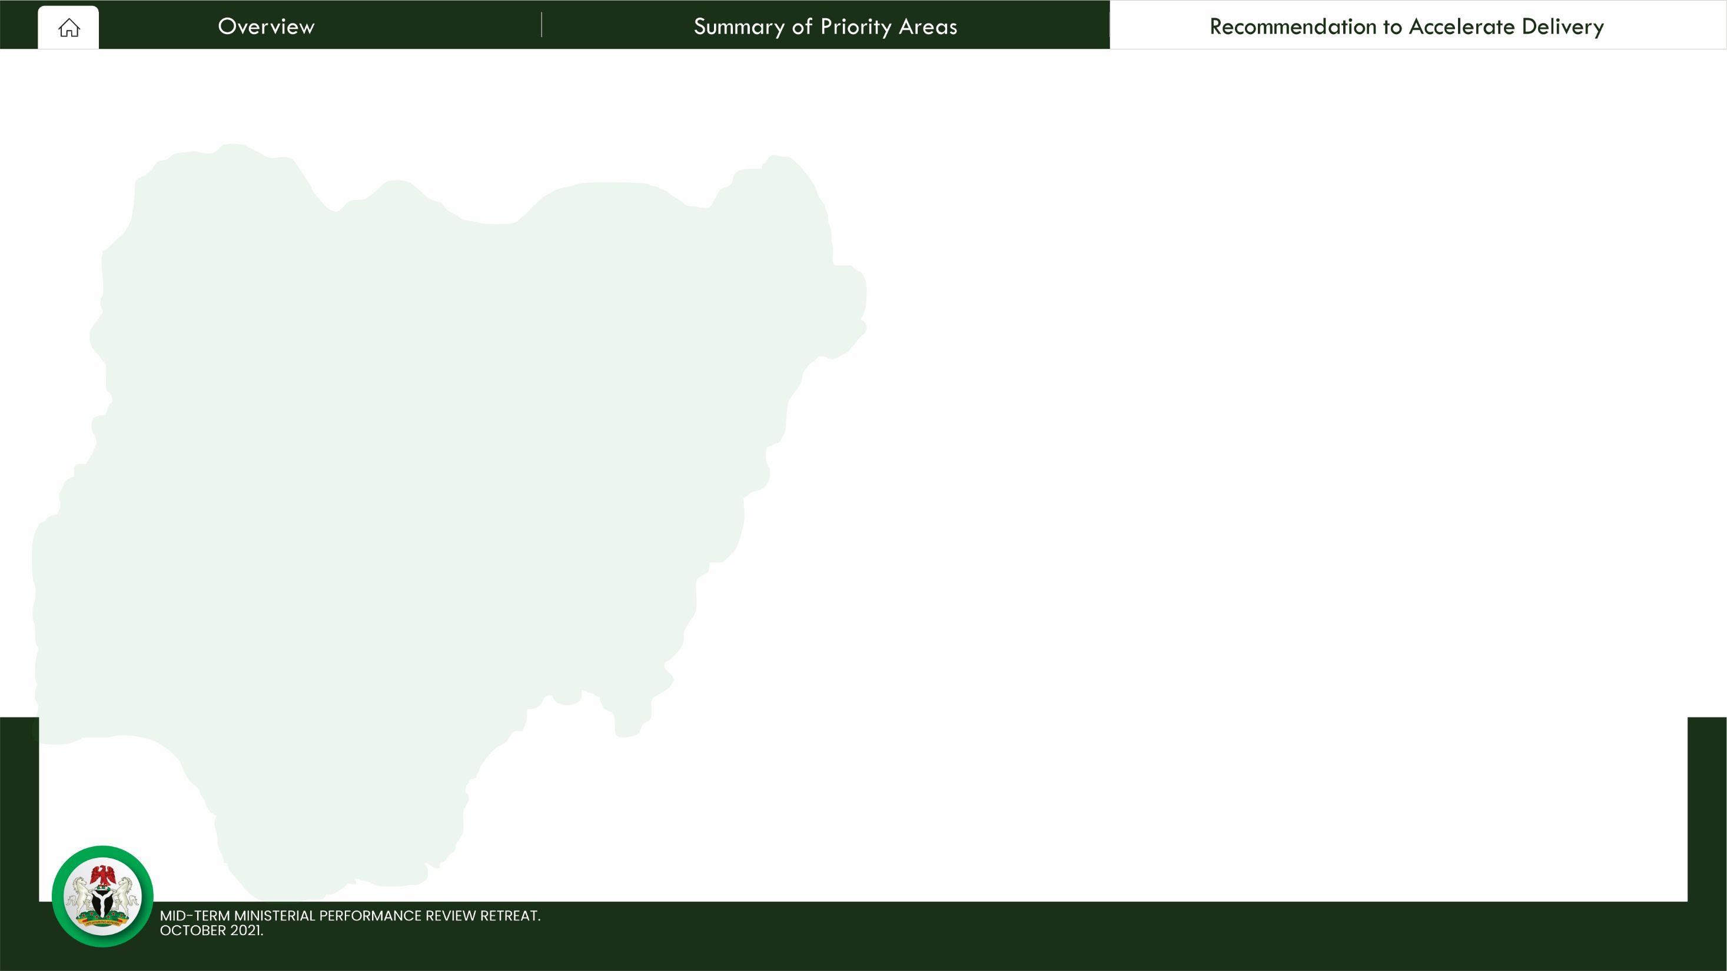
Key Enablers for Accelerating Delivery
DEEPEN DELIVERY & PERFORMANCE MANAGEMENT CAPABILITY OF MDAs TO COMPLETE KEY LEGACY PROJECTS, PROGRAMMES AND POLICIES OF GOVERNMENT
Ministries should reprioritize and focus more on those deliverables that have the highest impact on respective priority areas and can be delivered by 2023.
The capacity strengthening of the PRS department in MDAs should be intensified, focusing on Target setting, Tracking and Reporting.
National Bureau of Statistics should expand their scope to include key outcome metrics that measure the impact of the nine priority areas.
Ministries and their Agencies are encouraged to set up mini delivery units to improve systems and process of tracking and reporting on their deliverables.

Slide 38
Key Enablers for Accelerating Delivery
2. EXECUTIVE-LEGISLATIVE SYNERGY IS KEY TO ACHIEVING DELIVERY
▪ The harmonious working relationship between executive & legislative arms of government needs to be sustained to drive government’s agenda
▪ Leverage on the joint executive-legislature engagements to agree on adequate funding for key projects and programmes that need to be completed by 2023.
3. INNOVATIVE FINANCING FRAMEWORK IS A KEY ALTERNATIVE TO BRIDGING THE
INFRASTRUCTURE GAP
▪ Broaden/fasten the operationalization of innovative financing vehicles like the Road Tax Credit, PPP, InfraCo as alternative options for bridging the infrastructure gap.

Slide 39
Key Enablers for Accelerating Delivery
4. EFFECTIVE COLLABORATION BETWEEN PARENT MINISTRIES & THEIR AGENCIES IS A CRITICAL SUCCESS FACTOR FOR ACHIEVING THE 9 PRIORITY AREAS
▪ Ministries are encouraged to set up intra-ministerial task teams for effective data management.
▪ Building on the existing collaborative Results Framework, Ministers, Permanent Secretaries and Chief Executives are encouraged to have periodic stock take engagements geared towards achieving their deliverables.
5. DEPLOY A STRATEGIC COMMUNICATION PLAN TO COMMUNICATE THE PLANS & ACHIEVEMENTS OF THE 9 PRIORITY AREAS.
▪ There is a need for government to deepen its engagement with citizens particularly around the nine priority areas.

Slide 40
END

