Slide 1
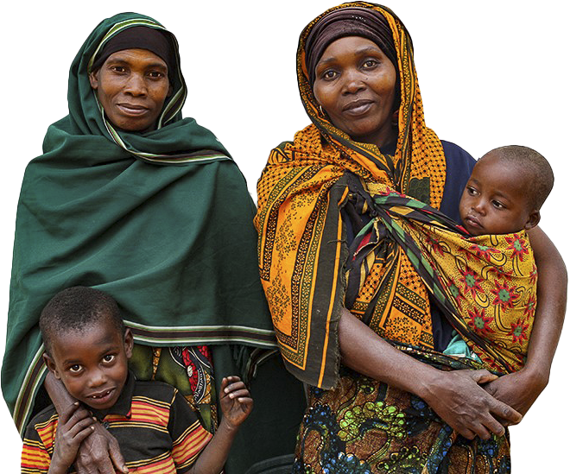

Slide 2
WHO WE ARE
Nigeria Health Watch is a not-for-profit organisation offering communication and advocacy expertise in the health sector.
Our dual strength in health and communication enables us to provide perfect solutions for communication and advocacy for key health issues

Slide 3
WHAT WE DO
Amplify some of the great work happening in the health sector
Hold decision makers accountable for the implementation of health policy
Create opportunities for positive ideas and action
Advocate for better health and access to healthcare in Nigeria

Slide 4
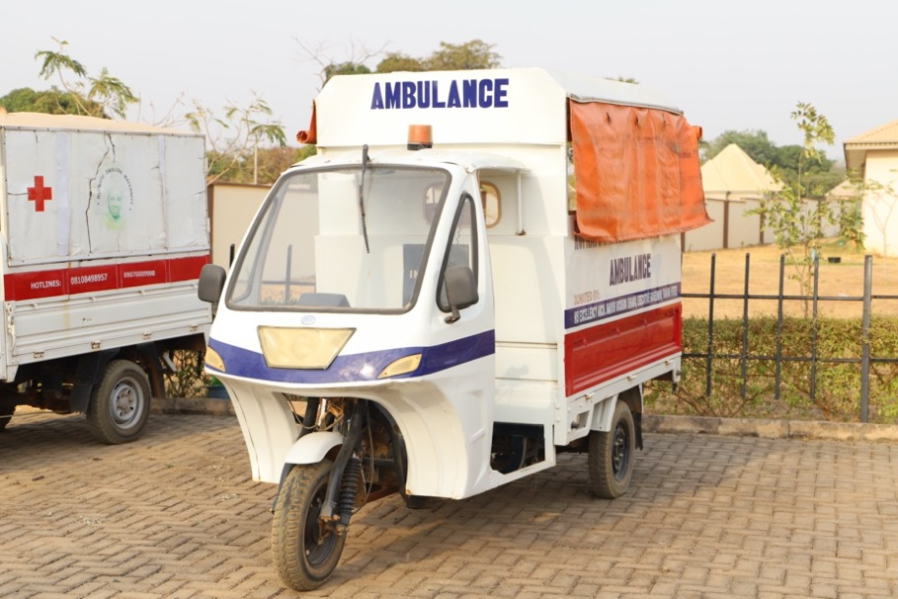
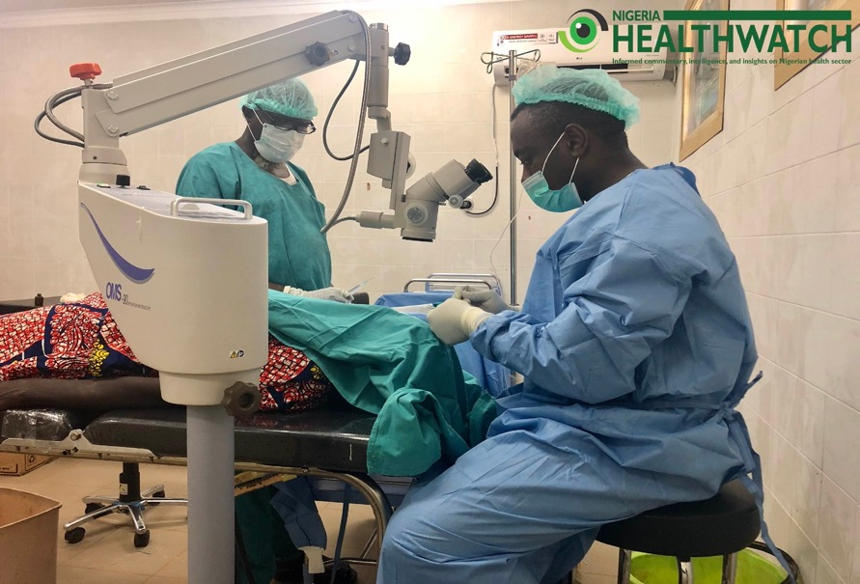

Slide 5
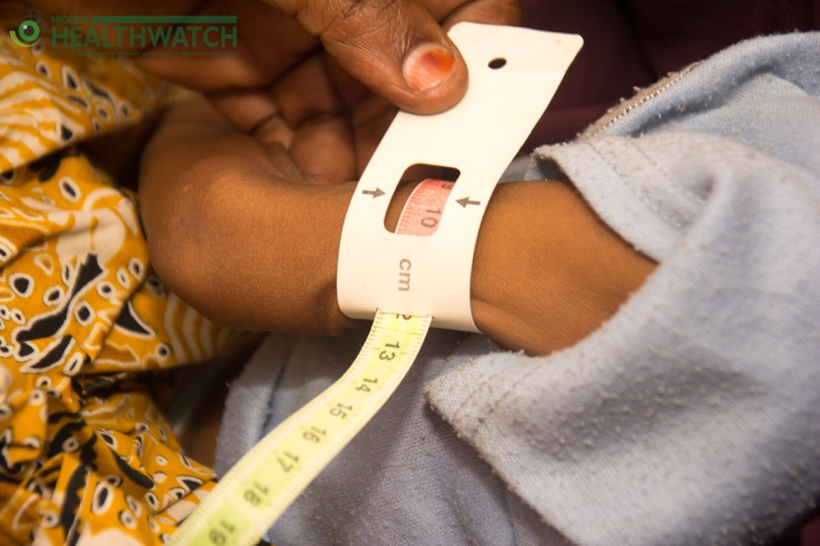

Slide 6
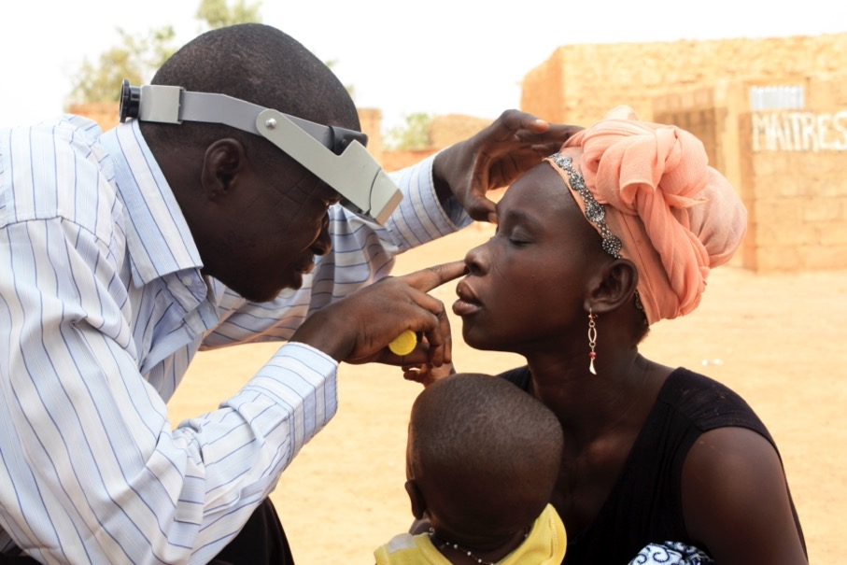
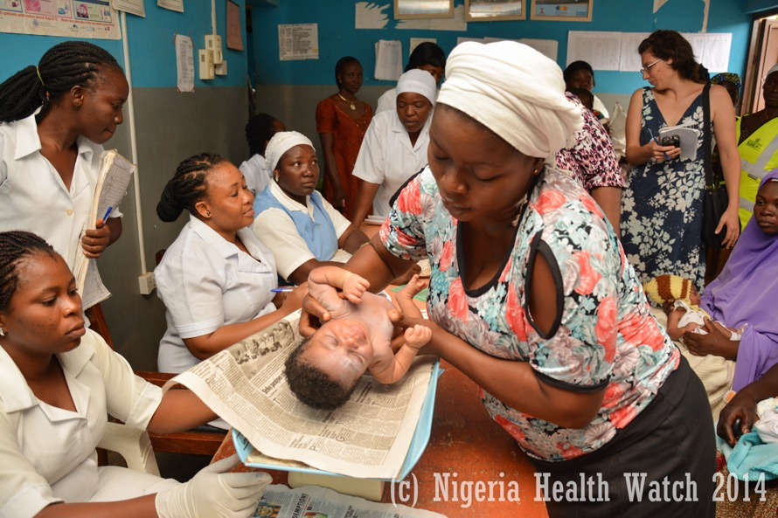

Slide 7
HOW DO WE WORK?
Editorial – solutions focus and thought leadership articles
Developing strategic communication plans
Convening health events – policy dialogues and forums
Documentation of health interventions
Assessment of health services
Advocacy using multiple platforms – social media, print, TV

Slide 8
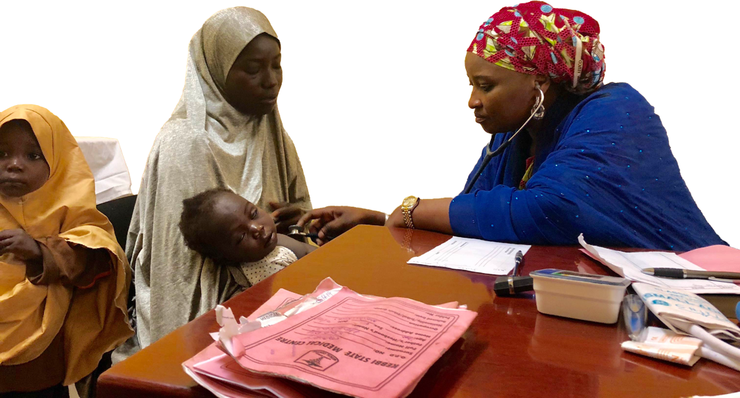
OUR WORK ACROSS STATES

Slide 9
OUR WORK ACROSS STATES
OVERARCHING AIM
Improve formulation of health policies.
Advocate for the allocation of more resources to healthcare
Collaborate with health authorities and key stakeholders to conduct health assessments

Slide 10
ADVOCACY EFFORTS GEARED AT:
Improved engagement on health issues in Nigeria with emphasis on:
• Primary health care
• Maternal, Newborn & Child Health (MNCH)
• Routine immunisation
• Nutrition
• Sexual and Reproductive Health and Rights (SRHR)
• Universal Health Coverage (UHC)
• Gender equality
• Noncommunicable diseases (NCDs)
• Epidemic preparedness

Slide 11
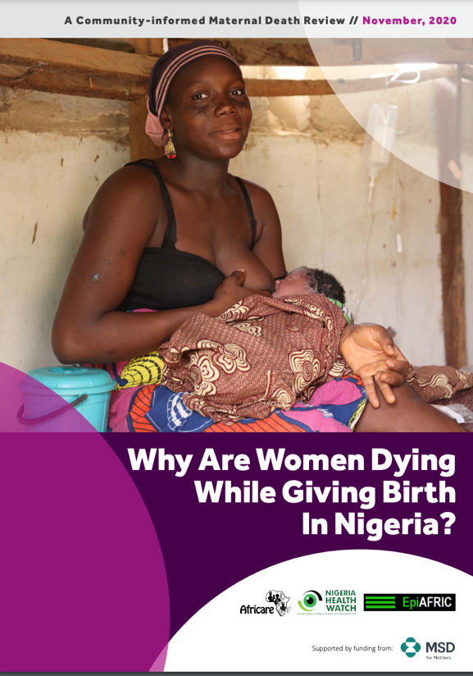
Case Study

Slide 13
COMMUNITY INFORMED MATERNAL DEATH REVIEW
The study aimed to understand the leading causes of maternal death and inform advocacy efforts at the national, state and local levels and ensure accountability and use lessons learnt to drive improvements in maternal health care
Understand the health literacy and beliefs around pregnancies and how they affect health-seeking behaviours around pregnancy and maternal death

Slide 14
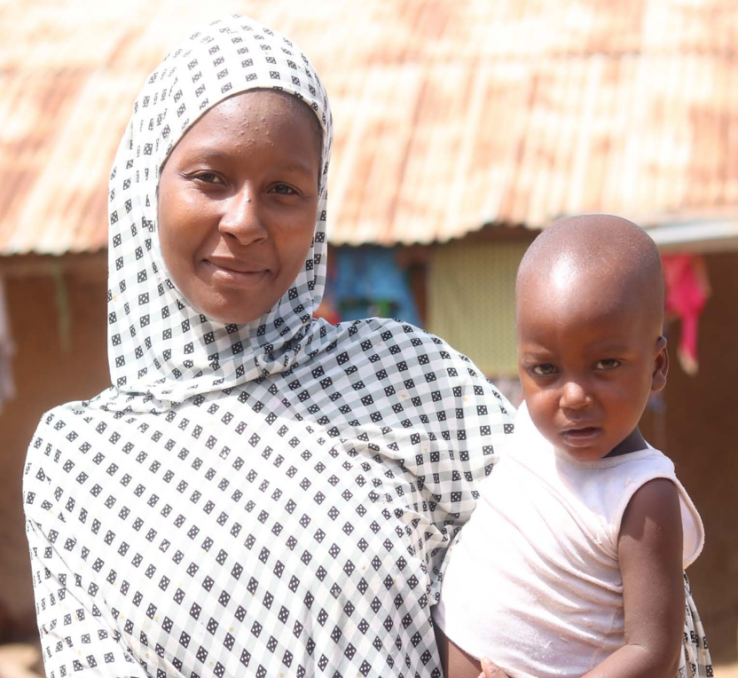
KEY FINDINGS
Local cultural beliefs play a significant role in the health-seeking behaviors of younger women, impeding ability to seek facility-based births
High level of trust between Traditional Birth Attendants and expectant mothers due to the poor interaction of women with the formal healthcare system.
Influence of husbands making healthcare decisions on behalf of their wives, disempowering women to act
During pregnancy, women are faced with high levels of anxiety and no support mechanisms
Women lack information on the causes of maternal death and how it can be prevented

Slide 15
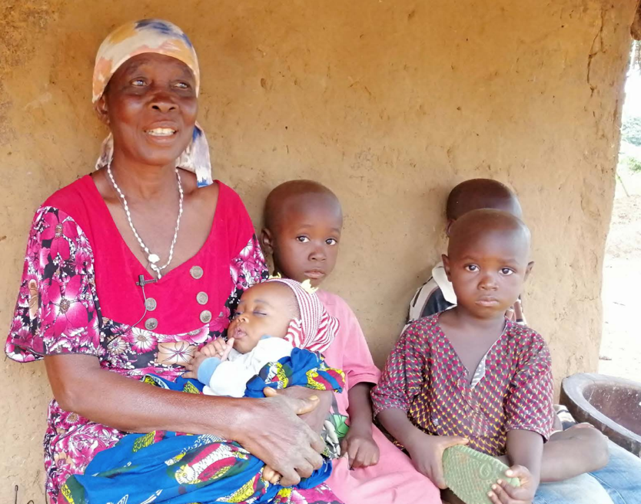
KEY RECOMMENDATIONS
Multi-stakeholder approach involving the federal, state and local governments, and traditional and community leaders to facilitate effective community Maternal and Perinatal Death Surveillance and response (MPDSR)
Traditional birth assistants must be better equipped and trained to identify dangers in pregnancy, referring women to health facilities
Better availability and access to quality Primary Healthcare Centres in local communities
Health education must take place at the community level with the involvement of multiple stakeholders

Slide 16
Opportunities for Collaboration

Slide 17
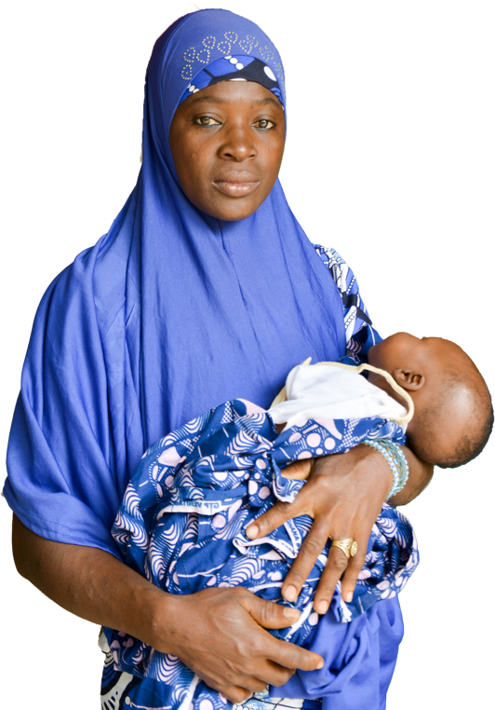
Nigeria Health Watch’s
Expansive and Unique Audience
Collaborate with state health leadership to share and amplify the work that you are doing
Nigeria Health Watch’s editorial expertise - write articles highlighting stories of interventions and solutions that have led to positive change at the state level
Harnessing our HCF/NHW convening power to support you in organising events and forums to share outputs from community interventions

Slide 18
ASSESSMENT OF WATER, SANITATION & HYGIENCE FACILITIES
Align with states’ plan to improve WASH and PHC services
Spur action and community awareness in the area of WASH services in primary healthcare centres
Currently conducting WASH assessment in PHCs in Kaduna State

Slide 19
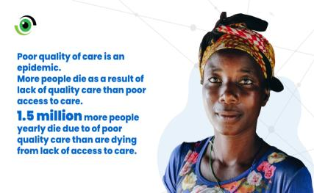
QUALITY OF MATERNAL MEDICINES ADVOCACY
Elevate evidence on the impact of poor-quality maternal health medicines on maternal outcomes.
Improve engagement at state government level to achieve leadership on issues of quality maternal medicines.
Create and strengthen accountability mechanisms for the procurement and distribution of quality maternal health medicines.

Slide 20
THANK YOU

Slide 21
www.nigeriahealthwatch.com
info@nigeriahealthwatch.com

