Slide 1
UNICEF Health Systems Strengthening
UNICEF Nigeria Country Office
© UNICEF/UN0123456

Slide 2
SOKOTO
YOBE
KATSINA
JIGAWA
KEBBI
ZAMFARA
KANO
BORNO
KADUNA
BAUCHI
Akure Field Office
Bauchi Field Office
Enugu Field Office
Kaduna Field Office
Kano Field Office
Lagos Field Office
Maiduguri Field Office
Port Harcourt Field Office
Sokoto Field Office
Country Office
NIGER
GOMBE
ADAMAWA
KWARA
ABUJA
PLATEAU
OYO
NASARAWA
TARABA
OSUN
EKITI
KOGI
BENUE
OGUN
ONDO
EDO
ENUGU
LAGOS
ANAMBRA
EBONYI
IMO
CROSS RIVER
DELTA
ABIA
RIVERS
AKWA IBOM
BAYELSA

Slide 3
PHC System
PARTNERSHIPS FOR PHC
GOVERNANCE + SUSTAINABLE FINANCING
IMPROVED HEALTH AND WELLBEING, ECONOMIC GROWTH AND SECURITY
PRIMARY HEALTH CARE
HEALTH WORKFORCE
ESSENTIAL MEDICINES
HEALTHCARE MANAGEMENT
COMMUNITY ENGAGEMENT

Slide 4
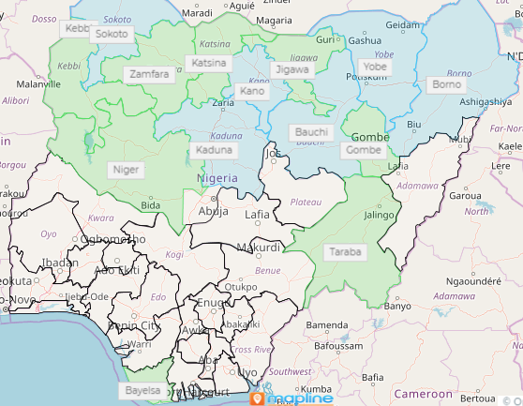
Pivot/leverage the three main PHC System Strengthening initiatives in country
PHC MoU-6: funding pool, gov incremental share – sustainability, government ownership.
PHC State HSS Fund-8: + zero dose, financial assurance, MoU Fed/State
PHC Challenge Fund-36: common PHC performance FW, EG leadership, governance and accountability.

Slide 5
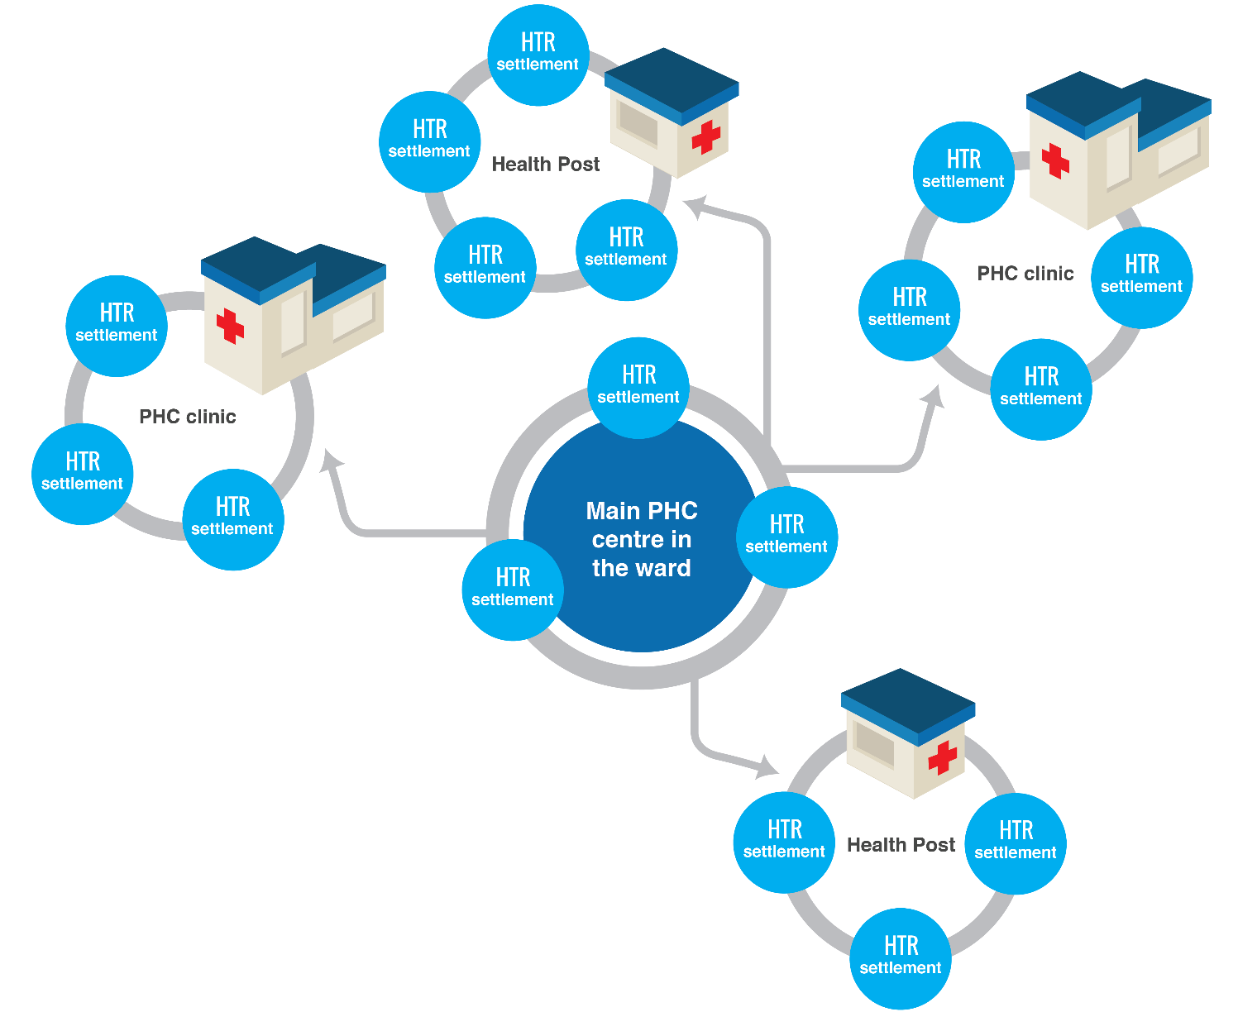
Delivery of integrated PHC services
Functional ward/1 PHC 24 hr services with strong equity lens (zero dose) – with WASH, Nut, BR,
Closely engaged with community
INTEGRATED services!!!
Use of quality data/evidence
Building on COVID19 (EOC, oxygen, vaccination…)
COMMUNITY

Slide 6
Vision: By 2027 in Nigeria, all children including adolescents, and women realize their right to survive and thrive with a focus on the most excluded.
More children and women have access to a more effective and accountable PHC system for UHC
Available adolescent-responsive and gender-transformational functional PHC per ward providing 24hr services including health, nutrition and WASH, closely engaged with the community
Effective leadership, partnerships, coordination, governance, and accountability mechanisms established for PHC at federal and state level
Integrated life-saving PHC services are available and effective in humanitarian context and for the most deprived
Service providers at PHC and community level have increased knowledge and skills and are motivated to deliver quality, respectful and equitable PHC and community services
Supply chain of essential and lifesaving commodities are planned for, effective and maintained to deliver at PHC and community to the end users
Health managers and service providers at district levels are capacitated to institutionalize improved management, supervision, delivery and monitoring of PHC services
Health managers and service providers are capacitated to analyze and increase use of data from HMIS for evidence-based planning, decision-making and action, and tracking results for effective coverage of integrated PHC services
State and federal governments including technical agencies have increased capacities and commitment for integrated and comprehensive PHC and evidence-based planning, prioritization, budgeting, and financing
Communities have increased awareness to demand for and utilize optimum quality PHC services supported by appropriate referral linkages
Partners and coordination platforms are improved with assurance mechanisms that contribute to accountability of decision-makers at all levels, including the private sector
PHC systems are capacitated for emergency preparedness, responsiveness and are resilient to future shocks and pandemics
Zero-dose communities have available effective, comprehensive, quality PHC systems that are resilient and responsive
Adequate HRH personnel, information system, distribution, incentive mechanisms, and capacity
Health facilities, communities and outreach sites forecast and receive regular supply of PHC commodities without stock-outs for equitable and inclusive access
Improved health manager capacity for integrated planning, decision-making, supervision and monitoring
Communities, families and care givers have knowledge and skills to demand and utilize quality integrated PHC services
Available quality data including performance monitoring; findings from investment cases and fiscal space analysis; and global best practices are used for decision making, adequate financing and resource mob for sustainable PHC optimization
Streamlined policies and legislations that delineate clear roles and responsibilities of each stakeholder in the PHC scene
RIP, contingency planning and emergency response capacity including coordination for humanitarian response is strengthened to deliver at PHC level, contributing to strengthen the humanitarian-development nexus
Zero-dose communities are identified, reached, closely monitored and measured for multideprivation and other vulnerabilities, and advocated for.
All stakeholders in the PHC space align and build synergies to fully and sustainably implement current multiple PHC revitalization policies, strategies and plans
Current situation: fragmented and inefficient health system not able to deliver integrated essential PHC services to improve RMNCAH+N outcomes in Nigeria
Notes:
By 2027, Government and Stakeholders at national and sub-national levels will have increased capacity to sustain quality, efficient and resilient primary health care systems in development and humanitarian settings

Slide 7
PHC Leadership challenge
Make high quality PHC services accessible and affordable to women/girls and children by strengthening the PHC service delivery platform through improved leadership, oversight, management, and delivery of essential health services at the sub-national level, influencing improvement in overall health outcomes.
Seattle Declaration and with the renewed political commitment to improve PHC delivery, under the leadership of Nigeria’s 36 Executive Governors and Fed government (NPHCDA).
To challenge states to do better recognizing states that demonstrate a dramatic impact in building strong resilient and innovative PHC systems.
State awards for best performing states assessed against a common performance framework.
7 | PHC Leadership Challenge Fund
Notes:
make high quality PHC services accessible and affordable to women/girls and children . This
will be achieved by strengthening the primary health care service delivery platform through improved leadership, oversight,
management, and delivery of essential health services at the sub-national level and thereby influencing improvement in overall health
outcomes. Building on the momentum of the Seattle Declaration, there is an opportunity to rapidly accelerate progress, with the
renewed political commitment to improve PHC delivery, under the leadership of Nigeria’s 36 Executive Governors. Leadership and
governance are critical to improving health outcomes, and governors play an important role in the political oversight for all socioeconomic
sectors at the state level.
To challenge states to do better, the PHC Leadership Challenge Fund will recognize the work of Nigeria’s Executive Governors and
State teams whose states demonstrate a dramatic impact in building strong resilient PHC systems. This will also give an opportunity
for innovative interventions to be recognized and scaled up including peer learning and exchange.
The PHC Leadership Challenge Award would result in direct and residual benefits, such as:
1. Motivate Governors to increase investments towards actualization of Seattle Declaration and full implementation of Primary
Health Care Under One Roof (PHCUOR) strategy, with a particular focus on Governors leading in closing the gender gaps
and barriers relevant to their States.
2. Contribute to building strong, equitable, protective, sustainable PHC systems through improving human resources,
addressing both the critical shortages, maldistribution, performance management, gender and other inequities, with a focus
on gender equitable representation at all levels of the health system, and improving capacities at sub national levels through
skills enhancement and continued stakeholder engagement that deliver a gender response and age sensitive Minimum
Services Package (MSP) of PHC.
3. Generate and increase access to accurate and timely PHC performance data linked to health outcomes for decision making
and accountability through training, oversight as well as instituting reward and sanctions mechanisms.
4. Strengthen the institutional capacity of the Secretariat (NGF) and capacities to provide technical support (NPHCDA) to
increase accountability and transparency on data for program and financials linked with improving performance management
at state and LGA and PHC levels.
5. Strengthen effective partnerships at federal and state levels towards improving evidence-based PHC service delivery and
overall health outcomes.

Slide 8
Performance Framework – 15 Oct / 15 Dec
SC Governance, Leadership; social accountability; service delivery; financing; and performance → PHC output indicators demonstrated to lead to the improvement of programme outcomes. Yearly national/state targets
Common dashboard
Standardized indicators; data quality, accuracy and use; address current HMIS challenges.
+ focus on disparities across and within States; equity vulnerable and hard to reach
Governors/health commissioners/SPHCDA/LGA buy-in & ownership
Inputs: NGF Metadashboard, MSDAT, DHIS2 program scorecards, PHCUOR scorecard, RI SC, RMNCAH SC
Selected w NPHCDA; w inputs from SPHCDAs + FMOH → Challenge: improve leadership and performance of the PHC system strongly linked to results
8 | PHC Challenge Fund
Notes:
Performance and results tracking
The project will develop a performance measurement framework, including sex and gender disaggregated data, for
tracking, managing, and reporting implementation of the Challenge. The indicator domains will address the key areas
of the of the Seattle commitments: governance and leadership; social accountability; service delivery; financing; and
performance. They will be selected on the five MAMMS principles of meaningfulness, availability, movability,
measurability and simplicity. The performance framework will be developed during the first 6 months of the
programme and will leverage on yearly national targets set in sectoral policy reference documents for Health and
Nutrition outcome indicators as per the monitoring table in Section D for the whole duration of the programme. If
progressive yearly national targets for specific outcome indicators are not currently available, the technical lead of
the project will facilitate the setting of such targets working closely with NPHCDA and DPRS based on the most
robust and updated data. The performance framework will also address PHC output indicators demonstrated to lead
to the improvement of programme outcomes, as well as assess impact and success. The performance framework
will be clear, results oriented, easy to understand and track – including the sources of data. By leveraging on data
as the backbone of the performance framework for programme implementation, data quality, accuracy and its use
for maximizing impact become an integral part of this proposal which will require synergic efforts to address the
challenges that current HMIS are facing in Nigeria, including DHIS2, at several levels. The NGF’s Meta-dashboard
currently under development and supported through ongoing NGF data grant, will also be reviewed for linkages with
the overall performance tracking. The program specific score cards linked with DHIS 2, namely RMNCAHN, routine
immunization, etc. to also be aligned so as to link PHC performance to health outcome results including
improvements in service delivery, access, coverage and quality and ultimately to impact towards understanding the
progress for sustainable and resilient PHC systems. There will be specific focus towards areas like reproductive
health including family planning, maternal and newborn health, child and adolescent health that face wide disparities
across and within States specifically with an equity lens and ensuring that averages do not mask the reality of
inequities for the most vulnerable and hard to reach populations.

Slide 9
Stakeholder engagement
Federal Ministry of Health – quarterly
World Health Organization – TBD
The World Bank – TBD
UNFPA
Other BMGF grantees
Bill and Melinda Gates Foundation – bimonthly
Federal/State Ministry of Finance and Budget - TBD
July 2021
30 Aug.
June 2021
15 Aug. 2021
30 Sep.
Nigeria Governors Forum - monthly
National Primary Health Care Development Agency – monthly
Nigeria Health Commissioners Forum - quarterly
Association of Chief Executives of State PHC Development Agencies/Boards - quarterly

