Slide 1
THE NIGERIAN
MINT
NIGERIAN SECURITY PRINTING
AND MINTING PLC

Slide 2
About NSPM
The Nigerian Security Printing and Minting PLC apart from being the foremost in Africa, is the only full-fledged security printing organization in the whole of African sub-region.
Since 1965 when The MINT, as we are known, began full operation, we have been producing currency notes and coins for the Central Bank of Nigeria as well as a wide range of security documents for federal, state and local government establishments, commercial banks, blue chip companies amongst others.
With a Staff strength of over 1,000, the Mint is positioned to meeting the currency production of the Nigerian Government as well as demands of the West African sub region with superior currency products that meets world standards.
NSPMC Building, Abuja

Slide 3
About NSPM
58
YEARS
EXCELLENCE
of

Slide 4
About NSPM
NSPM PLC PRESENT OWNERSHIP STRUCTURE
BPE
9.95%
Central Bank of Nigeria 90%
Thomas De La Rue (UK)
0.5%

Slide 5
About NSPM
Our Commitment
The Nigerian Security Printing and Minting Plc is committed to providing innovative and superior security print and mint products that meets regulatory requirements and are continually improved to ensure they meet and exceed customer expectations.
The company has two ultra-modern factory complexes in Abuja and Lagos with adequate capacity and technologically up-to-date machineries.
The Nigerian Security Printing and Minting is well positioned to meet the needs of its customers with highly secure and quality currency and Security document.
Abuja Factory
Lagos Factory

Slide 6
About NSPM
Nothing Short of the Top-most Quality
Our high-tech electronically controlled machines, sophisticated inks and highly skilled personnel all go to show that we keep pace with the most current trend in the industry world-wide.
The Mint’s quest for superior quality influenced our pursuit of the ISO9001 Certification.
Our focus is to continually Improve the efficiency of our processes as well as the quality of our products.
06

Slide 7
What We do
Currency Production
Security Documents
Since 1965 when The MINT, as we are known, began full operation, we have been producing currency notes and coins for the Central Bank of Nigeria as well as a wide range of Security Documents for Federal, State and Local Government establishments

Slide 8
CURRENCY
PRODUCTION
The mint has been a trusted partner to the Central Bank of Nigeria in the production of the Naira.
Consistently we have successfully produced 100% of the Nigerian Naira locally.
The Mint is expanding its currency production outside the shores of Nigeria; ongoing talks with Gambia and Liberia.

Slide 9
SECURITY
DOCUMENT
The main goal of security printing is to prevent counterfeiting, forgery, and tampering.
For decades, The mint has been producing highly secured security documents for various levels of Government.
Beyond the printing of the conventional security documents, we have a wide array of digital security products for Governments, MDAs, Higher Institutions, Manufacturing and FMCGs.

Slide 10
OUR SERVICES
Conventional
Products
Ballot Papers & Result Sheets
Property Documents
Certificates & Licenses
Revenue Receipts
The Mint produces High Quality, secured Ballot papers
Secure Land titles (C of O and R of O) for your state that is foolproof
The mint produces both blank and personalized, High quality and secure certificates and licenses
We understand that states are sustained through Internally generated revenue hence the importance of a secure receipt
Digital
Solutions
Product Authentication & Verification
Track and Trace Solution
Electronic Document Management
Our Product Authentication & verification System is aimed at providing the functionalities to verify and authenticate any certificate, licenses, property documents to eliminate forgery
Our Track and Trace solution allows for Government to track products or documents to reduce or eliminate counterfeits
The Mint provides a seamless and intuitive Document management system to enable Government institutions digitize (Scan, Store, & Retrieve) their paper documents in a secure environment

Slide 11
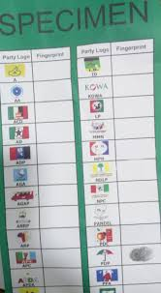
Electoral Materials
We Make High Quality Ballot Papers for Electoral Bodies
Ballot papers are an important part of the electoral process. They bear the mandate that citizens of the country give to their preferred candidate for public office.
Secure ballot papers increase trust in the electoral system. But when they are compromised, the integrity of the ballot process is put in doubt. This is why countries across the world want to ensure that these papers are designed and managed with the highest degree of security possible.
At the MINT, we have developed the capacity to handle this process efficiently. Our decades-long experience in security printing equips us with the know-how required to produce ballot papers to specification.
This solution will boost voters confidence in the electoral process and boost free and fair election in Nigeria

Slide 12
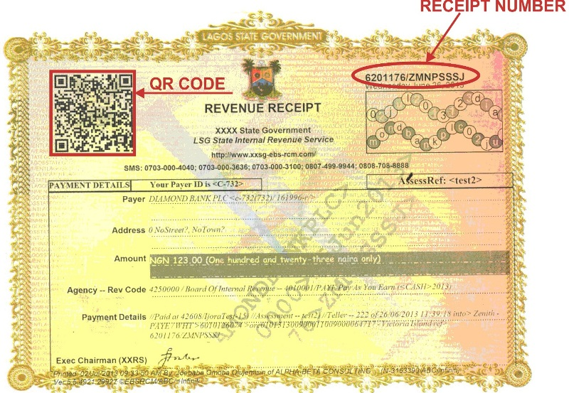
Revenue Receipts
Government revenue receipts are very important documents. They serve as evidence that a residents have made remittance for the use of the public utilities they use. Without them, it would be difficult to ascertain that people have made these payments.
Unfortunately, swindlers impersonating officers of various revenue collection bodies may make attempts to defraud residents by issuing them with forged receipts. A large number of people are cheated of their money by ill-intentioned actors posing as revenue collectors who use counterfeit receipts to perpetuate their fraudulent acts
The MINT has taken adequate measures to forestall the forgery of receipts by utilizing various security traits in the production of these receipts. These features are at par with global best practices in security printing.
Revenue collected can be well accounted for as there will be little or no counterfeit receipts

Slide 13
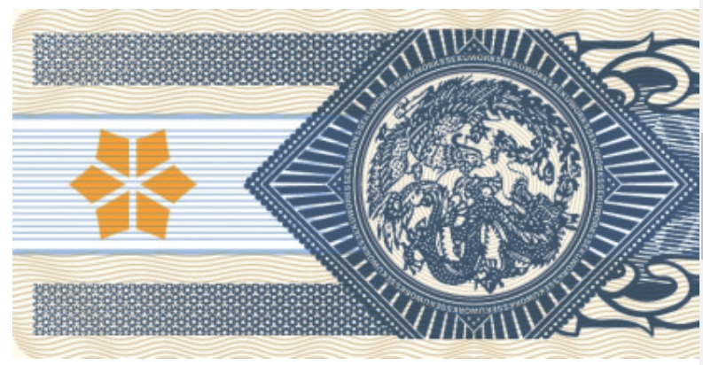
Stamps
Governments around the world enforce these taxes on a variety of legally recorded documents. Governments have placed stamp taxes on the transfer of homes, buildings, copyrights, land, patents, and securities.
Stamp duties are a major source of Government revenue for both Federal and state Governments alike
Our tax stamp solutions offer improved security features and prevents forgery

Slide 14
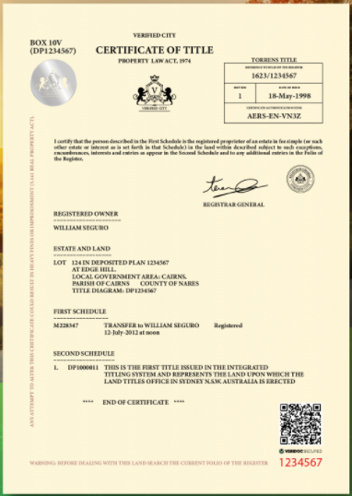
Secured Land Documents
Fake land titles have increasingly become a major challenge at all levels of Government.
Fraudsters have devised several ways of forging genuine land titles or even selling original land titles to several buyers.
It is estimated that States loose billions in revenue every year to these fraudulent land dealings
NSPMC can work with States at all levels to reduce this menace and block this revenue loss by:
Printing Secured Land Document Certificates that cannot be forged or tampered with
NSPM can also digitize these certificates so that the title document can be easily Verified and the ownership Authenticated before any sales. This is done by embedding a QR code on a land title.
Land documents can be verified conveniently by anyone for a fee.
Government can generate revenue by charging an official fee for the Verification service

Slide 15
DIGITIZATION: ELECTRONIC DOCUMENT MANAGEMENT SYSTEM
The average government agency spends a minimum of 800M on paper every year
Government workers spend about 35% of their time searching for or managing physical records and files
NSPM offers a seamless and convenient way of Digitizing your paper documents and converting them to electronic documents, capturing important information and saving the document in a central repository for easy retrieval later.
Benefits include:
Cost reduction by reducing the need for paper
Improved efficiency o
Prevent loss of records
Ease of information processing and retrieval
Improve security of important records by controlling access to documents
NSPM provides a Document Management solution that is not only Secured but that is Simple, Easy to Use and can be deployed in phases

Slide 16
Digitised Vehicle Documents
States can digitize any critical document for the purpose of Verification and Authentication
Many techniques are used today to verify traffic documents. One is the traditional method wherein a driver is asked to show their documents such as driving license and insurance.
A lot of time of both the driver and the traffic police is consumed during the verification process.
A QR Codes in vehicle verification aims at reducing traffic police (VIO) work. They are not capital intensive and hence will prove to be a cost-effective solution.
016

Slide 17
Track and Trace Solution
The Track and Trace solution allows Governments to provide visibility and traceability in various aspects of its business. Government products can be digitally Tagged and Traced to ensure efficiency in service delivery and to curb the challenges of revenue loss due to product counterfeiting.
Applications:
Supply Chain
Monitor revenue generated and collected as taxes from registered products in the state
Manage/Resolve the issue around Ghost workers
Government asset can be tagged and tracked using our Track and Trace Solution
Government can monitor and enforce revenue generation from taxes

Slide 18
Government As a Platform
Government as a Platform is a common core infrastructure of shared digital systems, technology and processes on which it’s easy to build brilliant, user-centric government services.
This will be a route to better public services; the breaking down of organizational silos; as a toolkit for civil servants; an open platform to build upon; as new public infrastructure
NSPM will build and host a SECURED, INTEGRATED platform for the Ministry to host all other parastatals and a one stop platform for Government resources
A single window for all Government Resources

Slide 19
Why NSPM?
State-of-the-art machines and equipment to produce highly secured documents
Years of experience as Nigeria’s Number one Security Printing House
Experience and dedicated staff
Attention to detail and excellent service delivery
A good track of satisfied customers

Slide 20
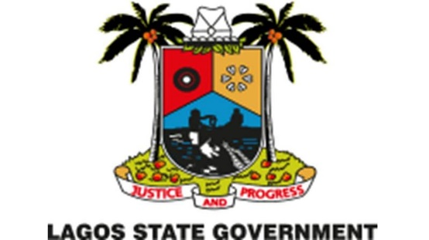
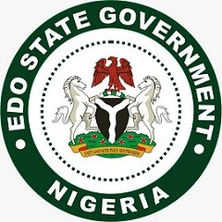
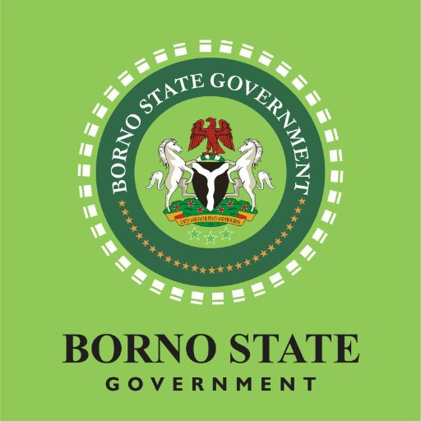
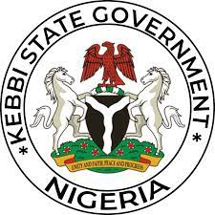
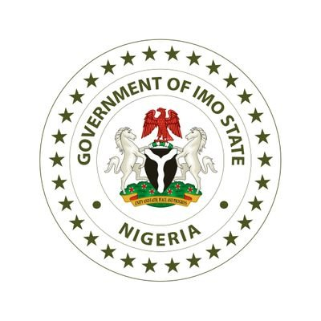
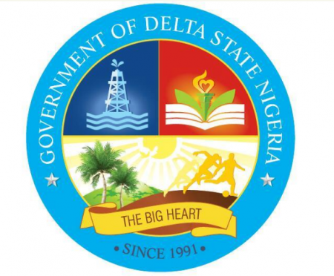
OUR CUSTOMERS, OUR PRIORITY
Over the years, we have partnered with Federal, State and Local Governments to deliver world-class security documents and solutions. We take pride in going above and beyond for our customers.
Some of our customers include:

Slide 21
Contact US
Email: Tunji.Kazeem@mintnigeria.com
Phone Number: +234 90 3000 2378
Website: www.mintnigeria.com

Slide 22
THANK YOU
FOR YOR
ATTENTION
Let us partner with you!

