Slide 1
You are welcome to the
Nutrition Scorecard Workshop
Date: Thursday, 24 June 2021
Time: 10:00am – 12:00pm
Venue: Zoom

Slide 2
Agenda
Sessions
Welcome Address - NGF General Introductions - All
Remarks / Workshop objectives - Mrs. Nelson Chito, Head Nutrition Division, Federal Ministry of Finance, Budget & National Planning
Nutrition Scorecard Presentation / Feedback - Dr Ahmad Abdulwahab, Senior Health Adviser, NGF Secretariat
Reviewing data collection tools - Gbenga Sadik, Nutrition Analyst, NGF Secretariat
Presentation on framework for prioritization of multi-sectoral nutrition plans – Dr Ahmad Abdulwahab
Wrap-up & closing remarks.

Slide 3
Remarks / Workshop Objective
By:
Mrs. Nelson Chito
Head, Nutrition Division,
Federal Ministry of Finance, Budget and National Planning

Slide 4
Meeting Objectives
To review lessons from the first phase of the scorecard.
To review data collection tool for the second phase.
To discuss resource tracking framework and prioritization of multi-sectoral nutrition plans.

Slide 5
Nutrition Scorecard Presentation
By:
Dr Ahmad Abdulwahab
Senior Health Advisor,
Nigeria Governors’ Forum Secretariat

Slide 6
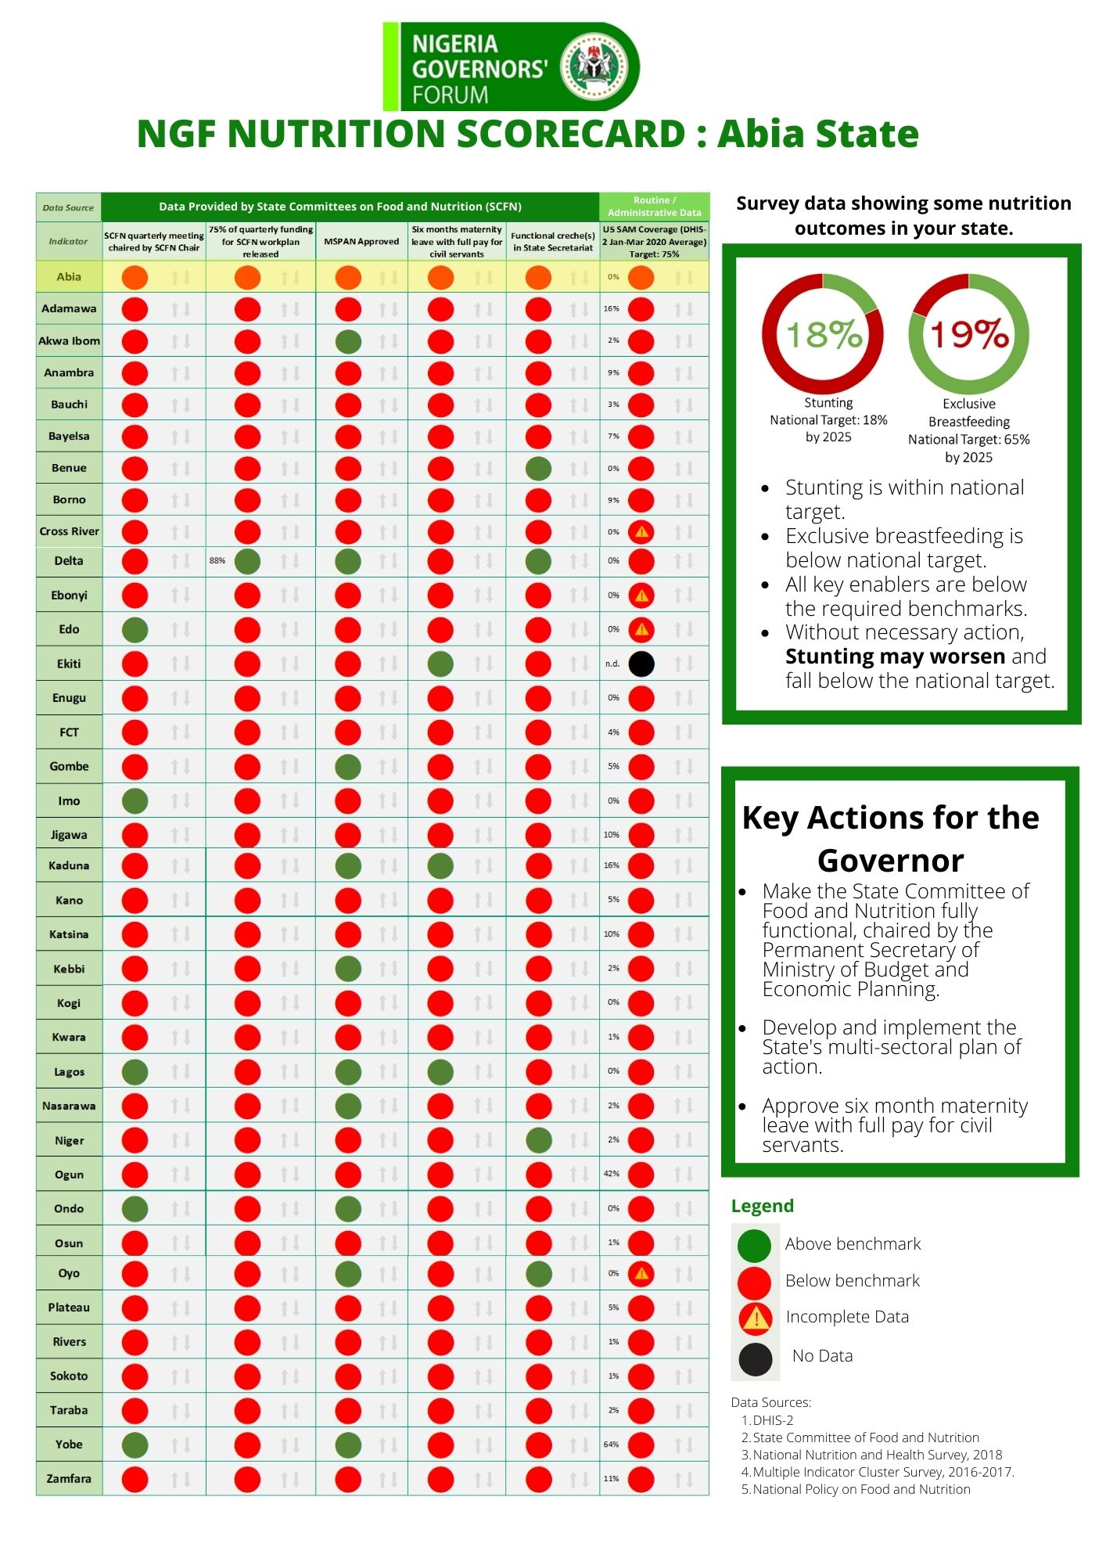
Background 1/2
The NGF Nutrition Scorecard is a data visualization tool designed to hold the state Governors accountable to key nutrition commitments and
motivate them to act.
The Scorecard was developed by the NGF in collaboration with DataDENT and other nutrition stakeholders including the Ministry of Budget and Planning, Alive and Thrive, UNICEF, Save the Children and CS-SUNN.

Slide 7
Background 2/2
Four key nutrition commitments were identified that will shape the enabling environment for nutrition in Nigeria.
The scorecard was presented to all 36 State Governors in a physical meeting held Wednesday, 14 April 2021 and it was well-received.
The scorecard presented was state-specific, with relevant recommendations to each State Governor.

Slide 8
Key Nutrition commitments being tracked
Commitment 1
Commitment 2
Commitment 3
Commitment 4
To set up or revitalize State Committees on Food and Nutrition (SCFN)
To establish multisectoral plan of action on nutrition (MSPAN)
To increase spending on nutrition interventions
To promote maternity protections for civil servants
SCFN Quarterly meeting chaired by the SCFN chair.
75% of quarterly funding for SCFN workplan released.
Multisectoral plan (MSPAN) approved.
?
Six months maternity leave with full pay for civil servants.
Functional creches in state secretariats.
Indicators

Slide 9
NGF SCORECARD PROCESS FLOW
Improved Nutrition Outcomes
Evidence-based Action
NGF /
Partners
NGF / Partners/
SCFN
NGF
SCFN
Data Collation
Data Analysis
Mock-up Scorecard
Validation
Final Scorecard
NGF
Data Collection
Dissemination
State Governors
State Commissioners of Health, Budget and National Planning, Agriculture and
SCFN
Nutrition Stakeholders
Notes:
This chart describes the key processes involved in developing the scorecard.

Slide 10
Feedback on the scorecard has been very encouraging.
State Governors have committed to follow-up with their Commissioners to ensure the State’s nutrition situation is improved
Positive feedback from the Office of the Vice President, Federal Ministry of Health and Nutrition Partners, with ongoing talks about adopting the scorecard nationally.
Some States have reached out to showcase improvement since the last data collection.

Slide 11
Challenges / Key Lessons Learnt
Challenges | Lessons Learnt
Data collection process was cumbersome, with delayed response from some states. | An online form will be used for data collection, to make it easier to fill and collate.
Absence of indicator for budget / resource tracking. | A new framework is being developed.
Inadequate validation or vetting from the SCFN chairperson | A signed endorsement from the PS Budget and Economic Planning / Chairperson of SCFN. All validation documents should be sent or uploaded as required.

Slide 12
Next steps for the Scorecard
Quarterly scorecards to be developed, starting from 2nd quarter of 2021.
Developing a proxy indicator for resource tracking.
Data collection and collation for 2nd quarter of 2021.
Review of scorecard every quarter.
Scorecard presentation to the State Governors every 6 months. Next presentation to be October 2021.

Slide 13
The timeline for the next round of the Scorecard is as follows:
Two Weeks of Data collection by SCFN
Four Weeks of Data collation and analysis by NGF
Two Weeks of Data review / partners by NGF
Workshop with SCFN
24 June 2021
Form submission
8 July 2021
Draft Scorecard Validation with SCFN
5 August 2021
Final Scorecard Dissemination
Week 3, August 2021

Slide 14
Discussion, Questions, and Answers

Slide 15
Review of Data Collection Tool
By:
Gbenga Sadik
Nutrition Analyst,
Nigeria Governors’ Forum Secretariat

Slide 16
Slight adjustments were made to the data collection tool for this round:
An online form is being used for easy dissemination and analysis.
The Chairperson of the State Committee on Food and Nutrition / Permanent Secretary, Ministry of Budget and Economic Planning is required to endorse the form.
A new set of questions have been introduced in the budget/resource tracking section:
“20. Does your state have a prioritized list of nutrition programs (either from the MSPAN or agreed-upon by the SCFN)?”
“22. Does your state currently track allocations, releases, and/or expenditures to nutrition activities?”

Slide 17
Online form demo

Slide 18
Discussion, Questions, and Answers

Slide 19
Creating a List of Prioritized Programs for Nutrition Resource Tracking

Slide 20
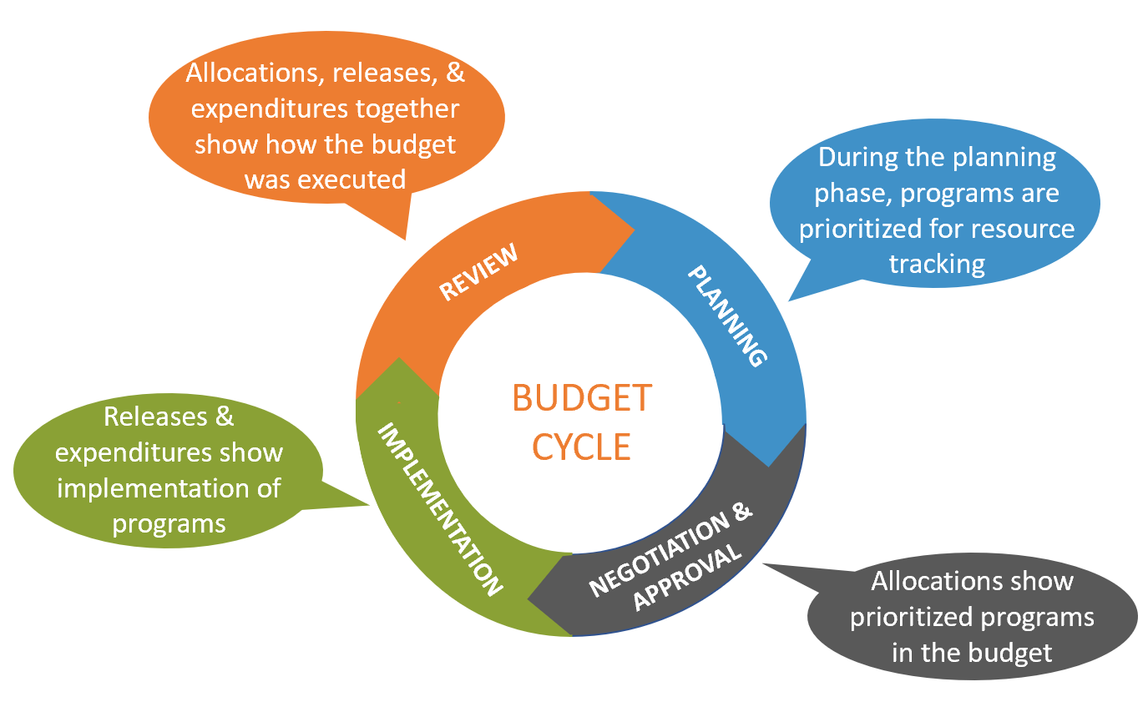
Why is tracking resources to nutrition important?
To achieve the targets set out in the National Policy on Food and Nutrition, there is a need to track resources to nutrition so that monies are allocated and appropriately spent to support nutrition programs
Graphic adapted from Strengthening Partnerships, Results, and Innovation in Nutrition Globally (SPRING) budget cycle

Slide 21
In the next round of data collection for the nutrition scorecard, the following indicators:
State list of prioritized nutrition programs for resource tracking (either from the MSPAN or approved by the SCFN)
Whether the state has a system to routinely track allocations, releases, and/or expenditures to nutrition

Slide 22
Proposed step-by-step framework for prioritization and tracking nutrition spending
Step 1
National Plan Review
Step 2
State Prioritization
Step 3
MDA Allocation
Step 4
Workplan Incorporation
Step 5
Budget Review
Step 6
Annual Budget Computation
Step 7
Quarterly Implementation Plan
Step 8
Budget Analysis and Advocacy
Step 9
Formal Funding Request.
Step 10
Spending Analysis and Advocacy
SCFN reviews the National plan.
SCFN develops state priority plan from the MSPAN in alignment with the national plan.
SCFN allocates activities in the plan to responsible MDAs.
The DPRS in MDAs will incorporate the plans into their work plan and budget.
SCFN Chair reviews the budget from all MDAs to ensure nutrition is adequately captured
SCFN computes approved total annual nutrition budget from the information in step 5.
Nutrition divisions in the MDAs will develop quarterly implementation plans based on the approved priority programs
Total annual budget computed is used for advocacy by the NGF, NCN and other stakeholders.
Nutrition division in the MDAs make formal request for the release of approved funds every month / quarter.
Amount released to MDAs for nutrition activities is computed as State’s Actual Nutrition Spending.

Slide 23
To prepare the prioritized list of programs, the SCFN should aim to follow these steps:
Convene all nutrition-relevant MDAs
Review the state-level MSPAN or relevant MDA workplans to identify which programs are nutrition-relevant and should be prioritized for resource tracking
Obtain the approval of the Chairperson of the SCFN on the list of prioritized programs

Slide 24
Discussion, Next Steps

Slide 25
Thank you for your time.

