Slide 1
Subnational Fiscal Data in Nigeria
An Update and Preliminary Findings
May 7, 2021

Slide 2
Outline of the presentation
NIGERIA’S SUBNATIONAL DATA: SO MUCH PROGRESS SHARING IDEAS ABOUT USING DATA FOR ANALYSIS OPTIONS FOR EFFICIENT COLLABORATION AND EXPANDING ACCESS TO DATA, TOOLS, AND ANALYSIS

Slide 3
1. NIGERIA’S SUBNATIONAL DATA
A lot of progress

Slide 4
State data availability has increased significantly…
Subnational Data Boom
Timely publication online by all 36 States as part of the World Bank assisted States Fiscal Transparency, Accountability and Sustainability Program for Results Eligibility Criteria and Disbursement-linked Indicators
Fiscal - Budgets
Fiscal – Actuals
State Annual Audited Financial Statements (2018-2019, 2020 by end July 2021)
Fiscal – Debt
State Debt Stock (annual 2018-2020)
State Debt Sustainability Assessment Reports (2020)
Macro
Micro
Quarterly Budget Implementation Reports (2018-2020, Aligned with NCOA in 2021)
Aligned with NCOA (2021)
S-GDP (21 states +FCT, 2013-2017)
S-Inflation (monthly)
S-Unemployment
NLSS 2018/2019
DHS 2018
FAAC transfers (SG and LG 2018-2020)
S-Population
SG Budgets 2018 – 2021

Slide 5
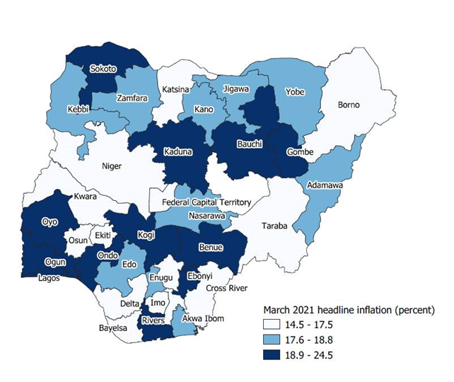
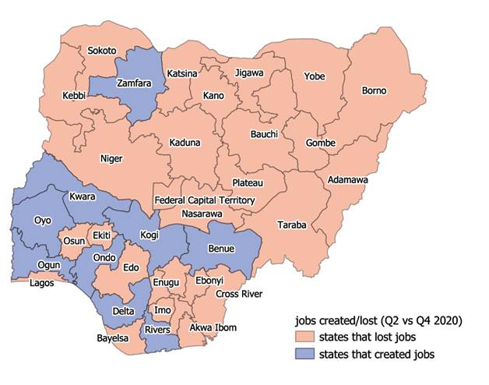
… enabling establishing facts about States
Which states have the highest inflation?
Which states created jobs since the peak of the pandemic?
Source: World Bank calculations using NBS data
Source: World Bank calculations using NBS data

Slide 6
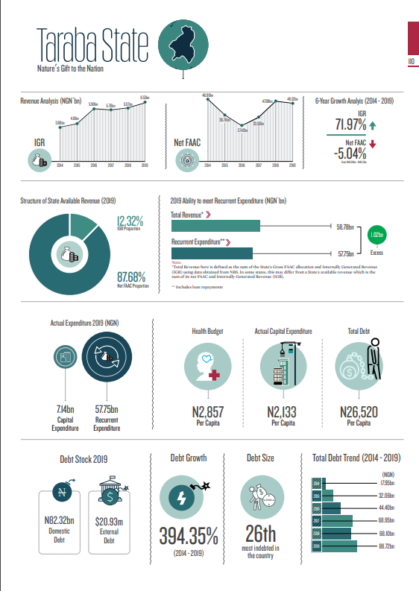
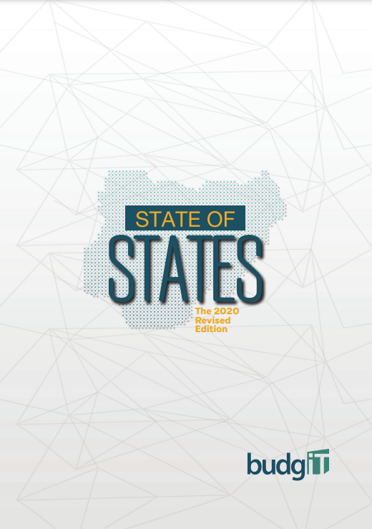
BudgIT State of States is a great example of fiscal reporting
BudgIT State of States

Slide 7
2. SOME TOOLS and DATASETS
Sharing some preliminary analysis

Slide 8
Subnational Fiscal Datasets
State Governments: what were looking at and why
A. 36 State Budget and Actual data from 2018-2019 Audited State Financial Statements
Spending overview across all 36 states (high-level economic classification)
State budget implementation assessment across all 36 states
B. 2020 Amended Budget
State Expenditure Prioritization during COVID-19
C. 2021 NCOA-aligned SG Budget Analytical Tool
State Budget allocations for key functions/ MDAs across all 36 states

Slide 9
2.A SFS 2018-2019 data
Actual Spending Comparisons across States

Slide 10
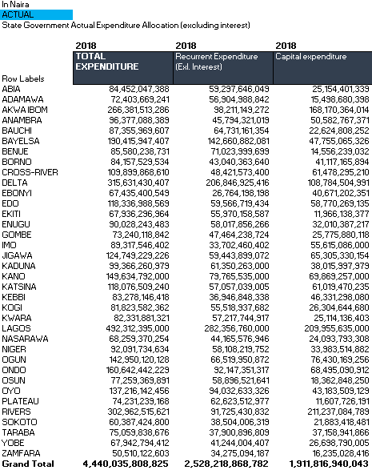
A. SG 2018-2019 SFS Data
Snapshot of 2018 Actual Spending Data
Since 2018, States have been incentivized (by SFTAS) to publish their Audited Financial Statements We all collected State Audited Financial Statements High level - economic classification – SG data available for all 36 states BUDGETED and ACTUAL spending values For 2018 and 2019 Allows insights into overall spending across states … and do per capita comparisons … as well as budget performance (how much of the budgeted amount was actually spent).

Slide 11
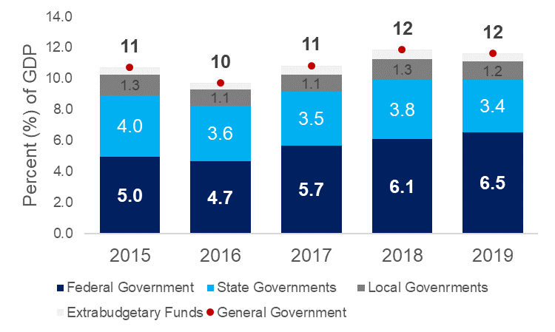
A. Sample Analysis (1) of 2018-2019 SFS
States account for about third of the general government spending
Federal Government accounts for over a half of the general government spending in Nigeria
State governments collectively:
account for about a third of government expenditures
present a second largest tier of government
Are the forefront of the basic service delivery
The share of federal government spending has been increasing over time, following revenue shocks and federal government’s higher ability to finance larger deficits
There remains significant data gaps about spending at the local government level
Nigeria’s government spending by tier of government (% GDP)
Source: World Bank calculations using State Audited Financial Statements, OAGF, DMO, and NBS data

Slide 12
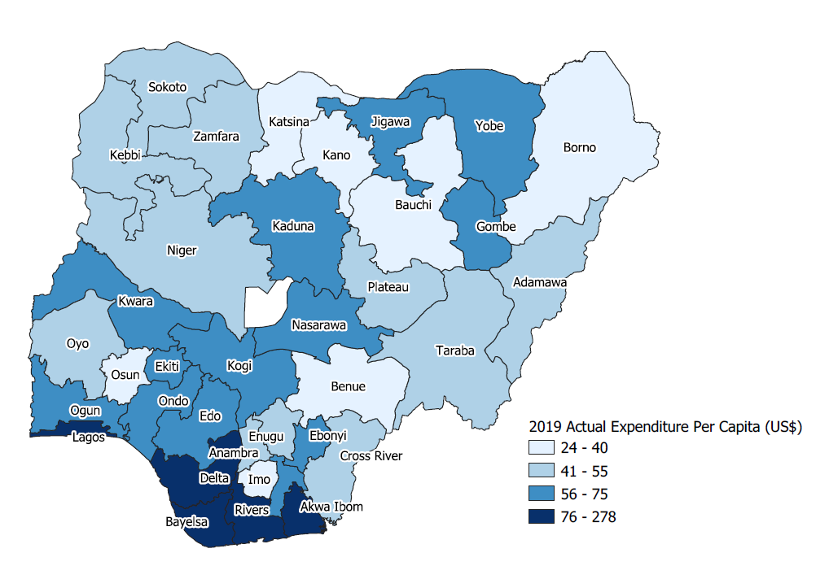
A. Sample Analysis (2) of 2018-2019 SFS
State Spending levels are low per person and there is large variation across states
Actual per capita spending across states in 2019 (US$)
In 2019, State Governments collectively spent N 4,500 billion Naira (excl. debt service)
With large population, this translates to low level of per capita spending
On average, SG spent about US$59 per person (in 2019, at IEFX)
There’s large variation across states: with many Northern states having lowest per capita public expenditures
Source: World Bank calculations using State Audited Financial Statements, NBS and CBN data

Slide 13
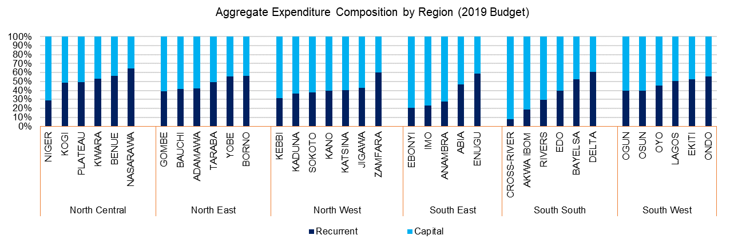
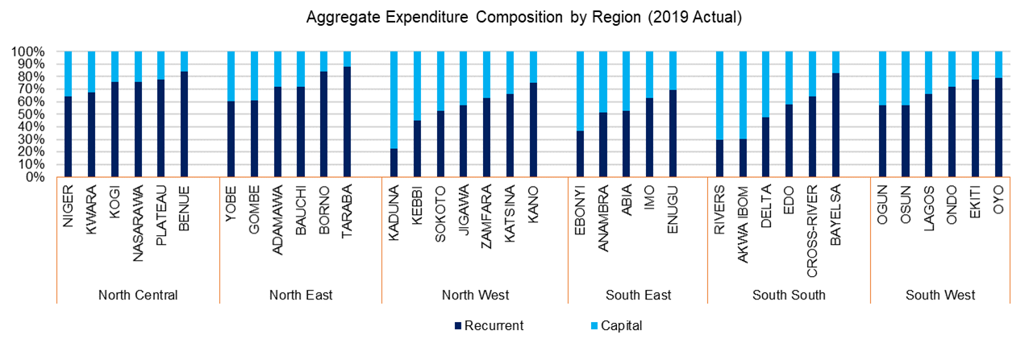
A. Sample Analysis (3) of 2018-2019 SFS
Subnational spending is skewed towards recurrent expenditure
Although budgets prioritize capital investments….
SG on average allocate 60% of budget for capital…
…actual state spending is skewed towards recurrent
But in the actual spending the ratio is reversed (40% of actual spending is on capital)

Slide 14
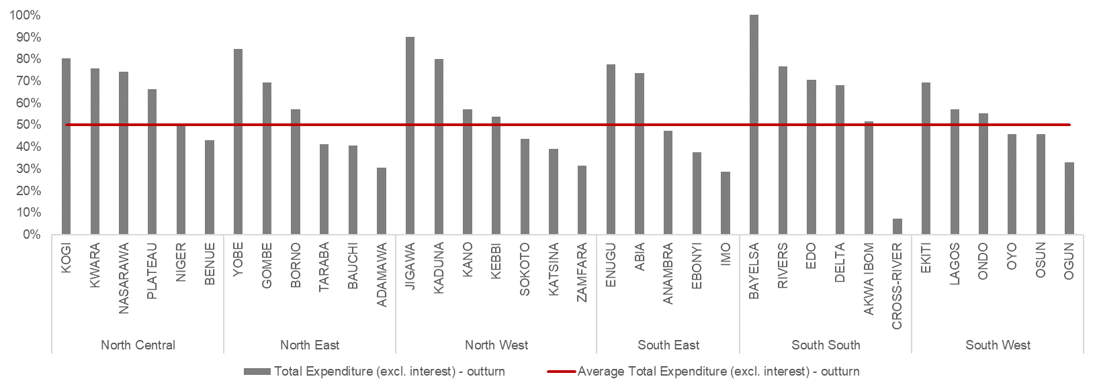
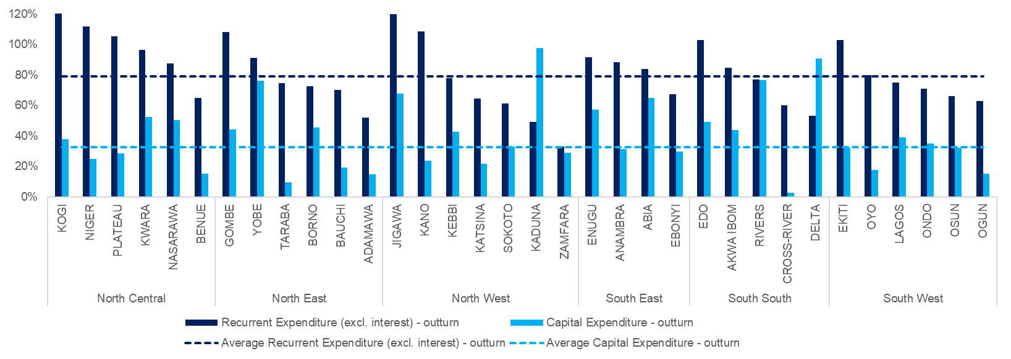
A. Sample Analysis (4) of 2018-2019 SFS
Budget implementation is low – particularly for capital - and there is large variation across states
Average budget implementation at SG level is only about 50% in 2018 and 2019
Only about 50% of state budget is implemented
…with only 30% of budgeted capital expenditures executed
Recurrent implementation rate (80%) far exceeding capital implementation (30%)

Slide 15
2.B 2020 Original and Amended Budgets
What did States Prioritize in the face of COVID shock?

Slide 16
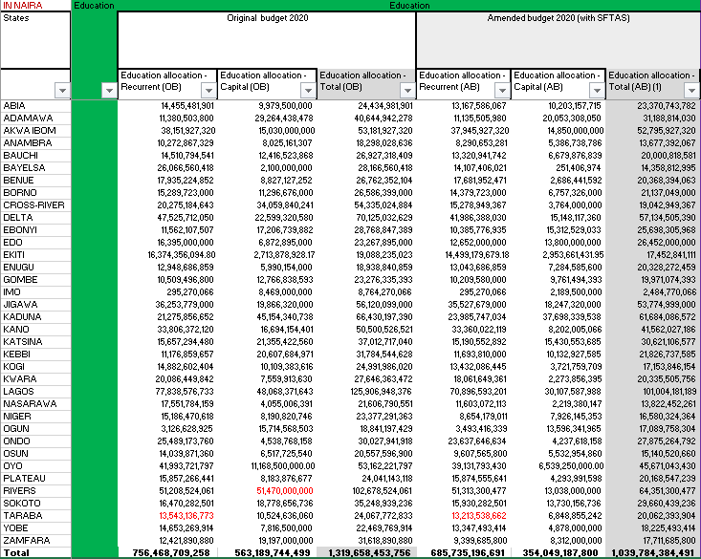
B. SG 2020 COVID-Responsive Budgets
Snapshot of 2020 Amended Budget Data - Education
Thanks to NGF for excellent TA! All states passed 2020 Amended COVID-responsive budgets We wanted to see whether social sectors prioritized after the COVID shock We collected data for health, education, social, WASH, agriculture, and MSMEs sectors from the FY2020 amended budget… …for each of the 36 states Sector budget allocation was captured broadly based on MDAs/Organizations (documented) We captured both the 2020 original budget (OB) and amended budget (AB)

Slide 17
B. Sample Analysis (1) of 2020 COVID-responsive Budgets
States prioritized spending in social sectors in the face of COVID shock
Health and Education sectors, too, faced cuts. But does this mean they were not prioritized?
All sectors faced cuts – as total budgets were cuts by 35%
Sector | Sector Allocation in the original budget (N bn) | Sector Allocation in the Amended Budget (N bn) | % change between Amended and Original Budget
Health | 859 | 704 | -18.0%
Education | 1320 | 1040 | -21.2%
Total Budget | 9,454 | 6,175 | -34.7%
…but key sectors were cut by less
Health and education were allocated higher shares of total resources after COVID shock than in the original budget – no salami slicing
Sector | Sector Allocation in the original budget (N bn) | Sector Allocation in the original budget (%) | Sector Allocation in the Amended Budget (N bn) | Sector Allocation in the Amended Budget (%)
Health | 859 | 9.1% | 704 | 11.4%
Education | 1320 | 14.0% | 1040 | 16.8%

Slide 18
2.C 2021 NCOA-Aligned Budgets
A whole new game

Slide 19
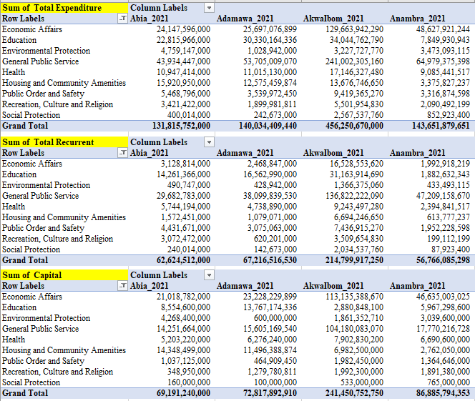
C. NCOA-Aligned 2021 Budgets
Excellent TA from NGF to all states!
We pulled it all to one excel-based tool to analyze all 36 state government budgets…
…mapping MDAs to functions
2021 NCOA-aligned SG Budget Analytical Tool allows analyzing SG budget compositions:
Across key functions
MDAs
Recurrent/capital allocations
Snapshot of the 2021 NCOA-aligned SG Budget Analytical Tool

Slide 20
C. Sample Analysis (1) of 2021 SG Budgets
We get the overall picture of spending at the key tier of service delivery
Function | SG Average (% of Total 2021 Budget) | Average SG budget allocation per capita (US$)
General Public Service | 37% | 34.5
Economic Affairs | 24% | 21.7
Education | 16% | 14.6
Health | 9% | 8.0
Housing and Community Amenities | 7% | 6.2
Public Order and Safety | 3% | 2.5
Environmental Protection | 2% | 2.0
Recreation, Culture and Religion | 2% | 1.5
Social Protection | 1% | 0.6
Total SG Budgeted Expenditure 2021 | 100% | 92
Source: World Bank calculations using State 2021 Budgets, NBS and CBN data

Slide 21
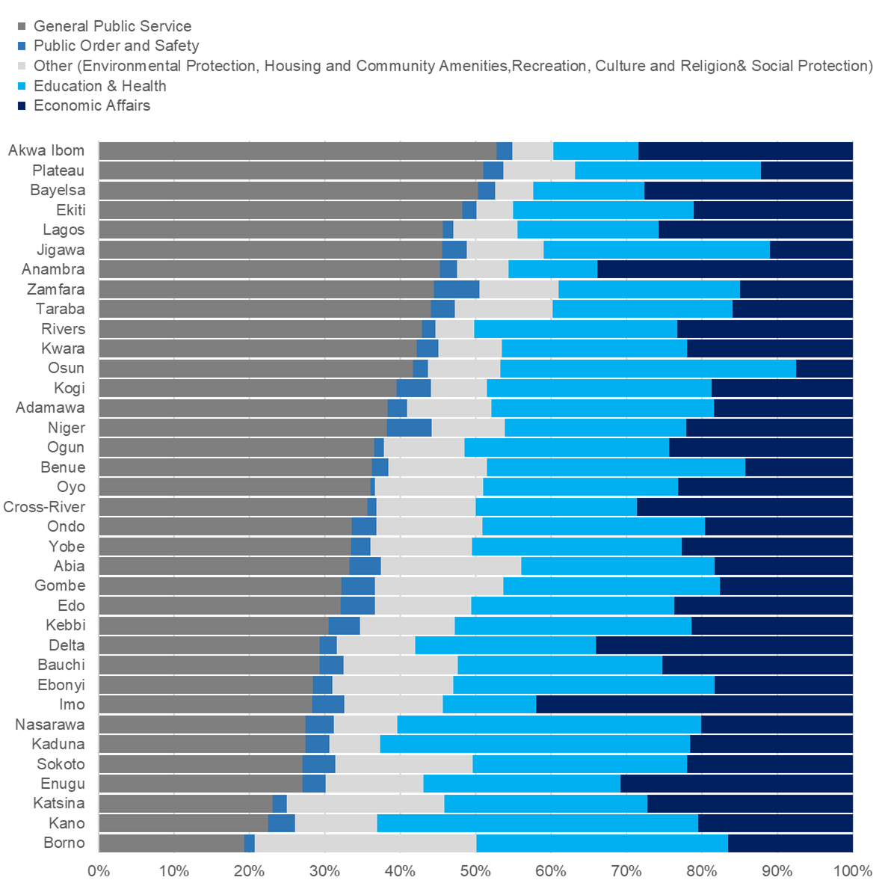
C. Sample Analysis (2) of 2021 SG Budgets
We can see how differently states allocate their budgets across functions
Source: World Bank calculations using State 2021 Budgets, NBS and CBN data

Slide 22
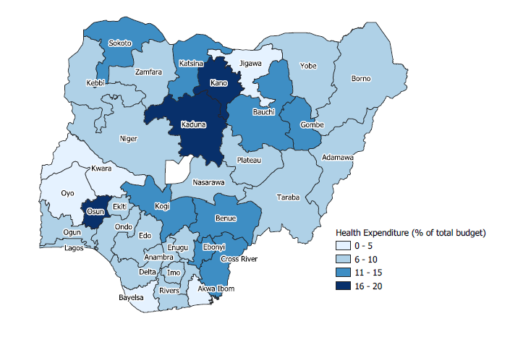
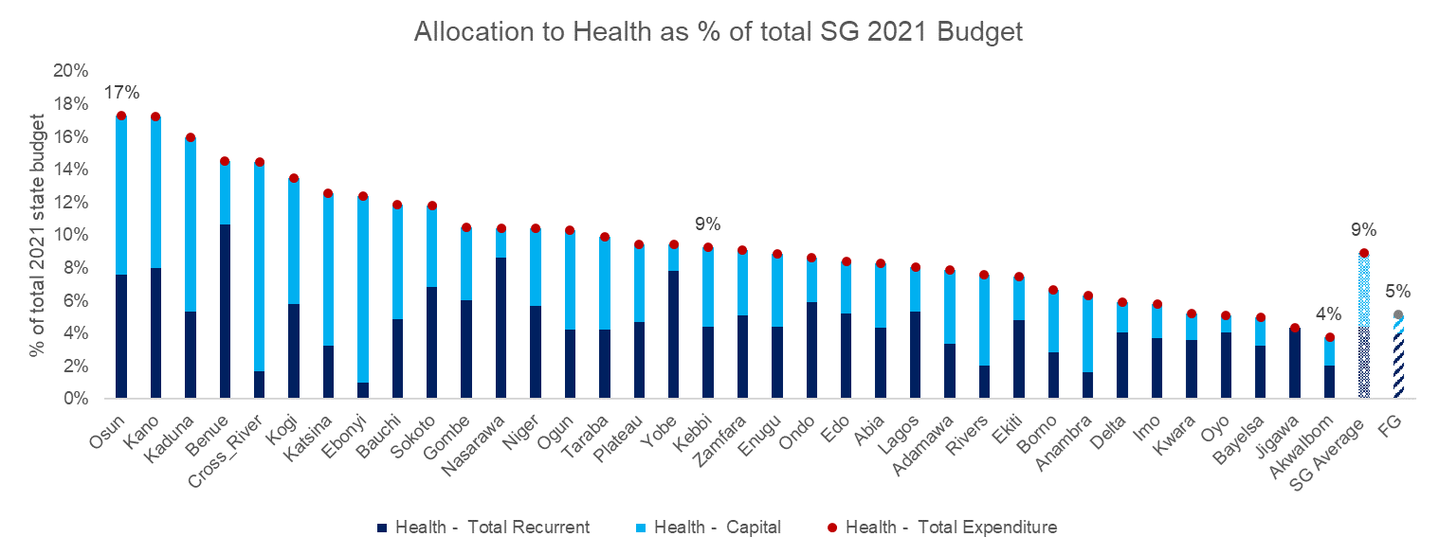
C. Sample Analysis (3) of 2021 SG Budgets
And zoom in to a specific function (and its composition) and see comparisons across states
In 2021 budgets, collectively the 36 Nigerian states allocated N 731 billion for health (compared to FG health allocation of N 610 billion)
States allocate less than 10% of their budgets for HEALTH - even in the face of the pandemic
In per capita terms, this translates to an average state allocation US$ 8 dollars of health spending per person a year (with up to US$ 6 dollars per person from the Federal Government Budget)
With average SG budget implementation of 50%, the actual annual spending on health from state budgets may be as low as $ 4 dollars per person
There’s a large variation across states
Source: World Bank calculations using State 2021 Budgets, NBS and CBN data

Slide 23
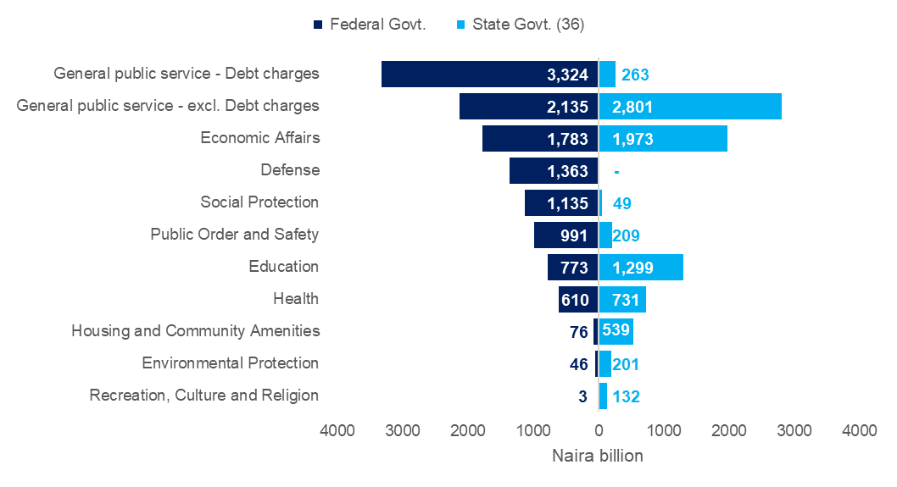
C. Sample Analysis (4) of 2021 SG Budgets
We can compare 36 State budgets with the Federal government budget
Source: World Bank estimates using Federal Government and 36 State Government Budget 2021

Slide 24
Just-in: 2021 Quarterly Budget Performance Reports are also NCOA-aligned
A picture of Actual Spending across functions across states!

Slide 25
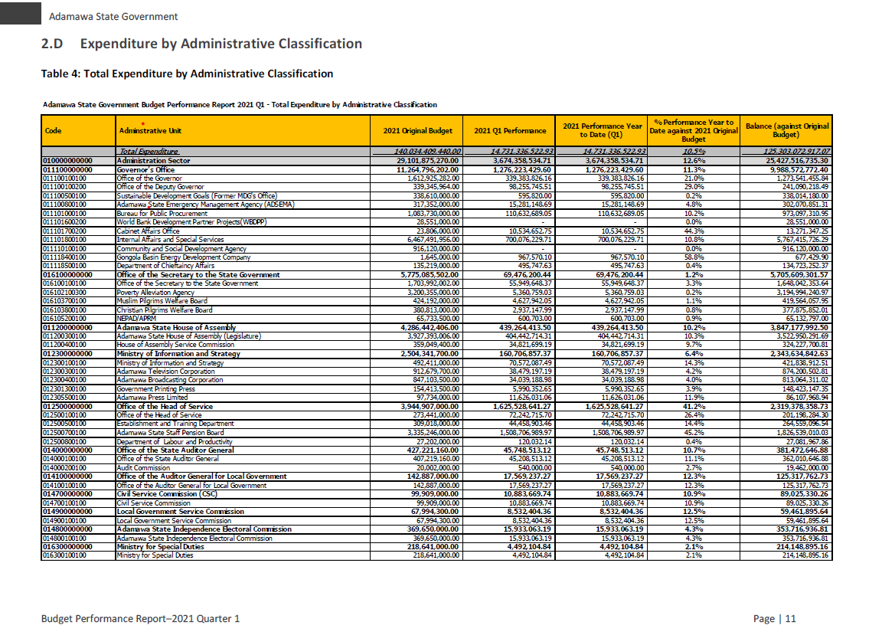
2021 Quarterly BIRs are aligned with NCOA (1)
So have actual spending data in real time by administrative classification….

Slide 26
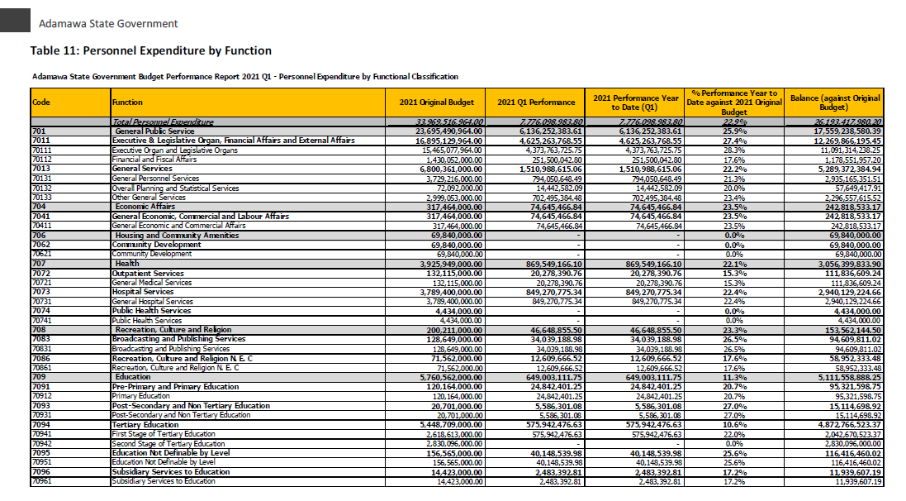
2021 Quarterly BIRs are aligned with NCOA (2)
…and functional classification: for instance, can see state education expenditures by level of education
We are yet to process the BIRs as the Q1 BIR have *just* been published

Slide 27
2.D Fiscal Inputs vs Citizens’ Outcomes
Do inputs translate to outcomes?

Slide 28
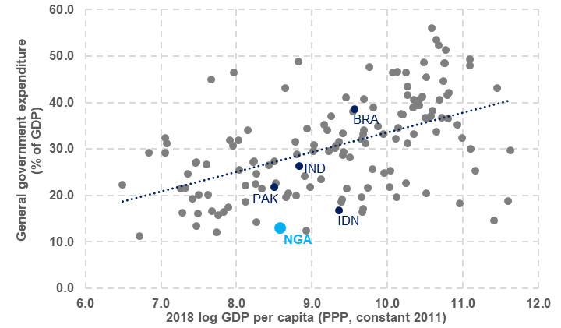
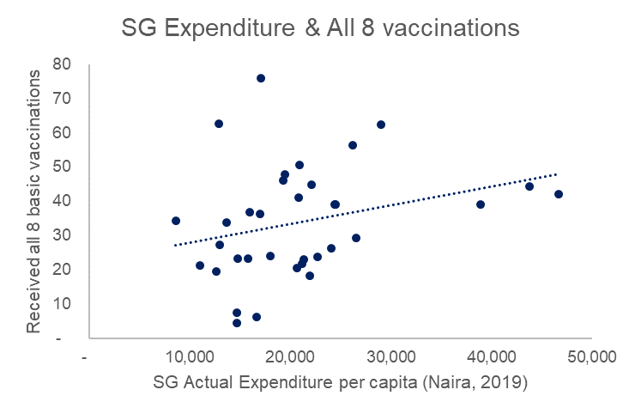
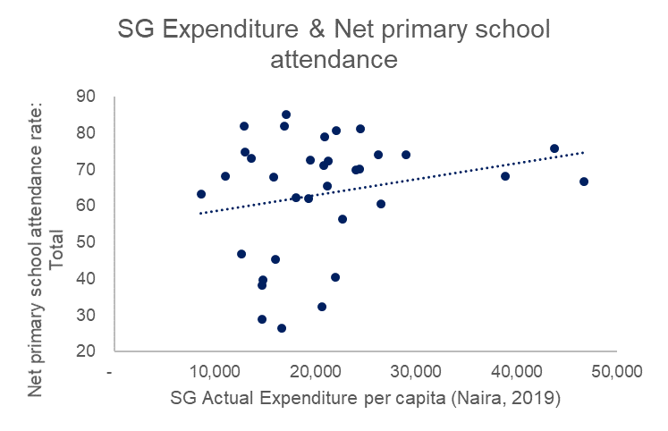
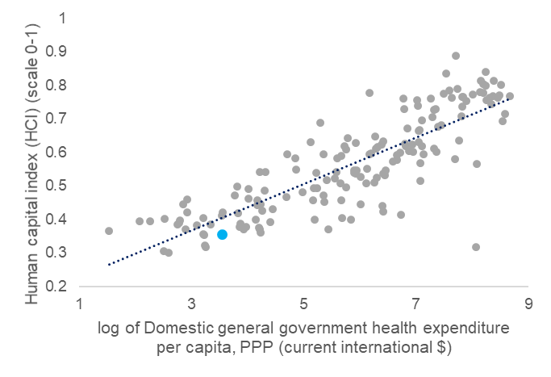
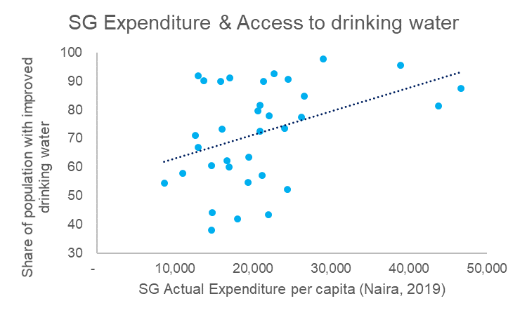
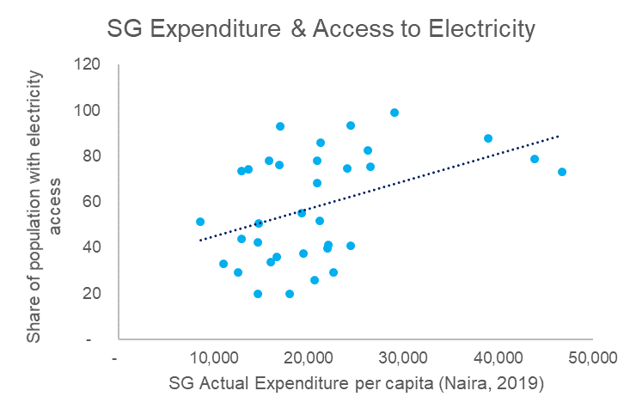
Spending levels matter: Towards efficiency analysis
Positioning Nigeria globally, and looking at variation across states
We know Nigeria’s spending is low (and so its efficiency)
Similar results emerge within Nigeria
States that spend more (per capita) have better outcomes: human capital...
…translating into poor outcomes compared to peers
…and for access to core infrastructure
But the level of spending is not the only thing that matters (more analysis on the way)
Source: World Bank calculations using State Audited Financial Statements, NLSS, NBS and CBN data

Slide 29
3. OPTIONS FOR EFFICIENT COLLABORATION
Expanding Access to Data, Tools, and Analysis

Slide 30
Discussion
Collaborating more closely may yield benefits
Data processing
Data publication
Analysis

