Slide 1
Tech for Tax: A new tax system and tax administration for XXI century? How disruptive technologies are changing the way tax systems are administered
April 19, 2021
Rajul Awasthi,
The World Bank
Notes:
This short presentation is about technologies, and the way forward for tax administrations in the 21st century. Country examples are provided in the annex, but we won’t have time to go over them today. For those who are interested, they can check them later on

Slide 2
Covid-19 has made digital transformation a matter of necessity!
One key lesson from Covid-19: The criticality of internet-based compliance and payment platforms for revenue administrations
Where such platforms existed, the negative impact of Covid-19 on revenues was not mainly a function of administrative factors but restricted to economic factors
The ability of revenue administrations to maintain business continuity in a pandemic emerged as a critical element of success
Countries had different starting points and hence, varying levels of readiness to face the Covid-19 pandemic.
Low-capacity environments faced difficulties in keeping revenue administrations fully functional and suffered the most in terms of revenue declines
Higher capacity administrations minimized the disruption of revenue collection efforts
Please see: “Covid-19: Revenue Administration Implications, The World Bank Group, April 2020”
Key Takeaway: Accelerate the move to a digital tax administration!
Notes:
One thing that Covid taught us, and I mean tax administrations and taxpayers, is how critical it is to have an internet-based compliance and payment platform. Some administrations have learned it the hard way.
Where such platforms were operating well, the impact on revenues due to Covid was largely due to the economic slowdown. For the rest, there was a drop in revenues also attributed to low collection, under assessment, and other admin challenges.
Indeed, countries that had low capacity and did not have these platforms operational faced difficulties in business continuity
So the key takeaway is to simply accelerate the process toward a digital tax administration

Slide 3
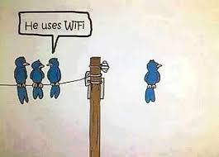
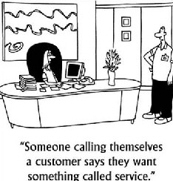
Disruptive Technologies and Tax Administrations
Information technologies in the 20th century allowed tax administrations to automate the processes and become more efficient. Today, we just need to utilize the same automated processes, but only make adjustments to render them faster and more convenient
WRONG!
Right
A tax administration in the 21st century should use the new wave of technology to radically transform how business is done
Notes:
In today’s world, the issue is not about just tweaking a process or speeding up automation. We need to embrace new (disruptive) technologies and change the way we operate

Slide 4
Road to a High-Tech Digital Tax Administration
Basic e-tax administration
Use of data for enforcement strengthened; e-services expanded
Data analytics based risk profiling; real-time horizontal monitoring
The future: “Digital by default” tax administration
High speed internet available
E-filing, e-payment
Other basic e-services
Rudimentary risk assessment
Tax administration has data warehouse
Third party structured data available
E-services expanded, include e-submission of tax relevant source data
Widespread use of e-platform
Tax administration is rich in data resources
Data analytics (Big Data) successfully used.
E-auditing: analyzing data in digital format
Full gamut of e services available
Horizontal monitoring programs for Large taxpayers (e.g., regular interactions with T/P replacing rigorous audits)
Tax administration is “digital by default”
High quality taxpayer user experience
E-assessment, algorithm based.
Predictive data analytics, AI
User-centric design, tailored engagement
Smart portal solutions, mobile apps Blockchain solutions, Cloud services ..
Notes:
Most administrations, especially in the countries we operate, aspire to roll-out e-filing and e-payment and maybe a risk management framework. However, this is the beginning of the journey.
Along the way, administrations need to have data warehouses and a full-fledged e-platform.
The next big thing is data analytics, e-auditing, and horizontal monitoring (this is when we engage at first large taxpayers on a regular basis in lieu of the comprehensive and expensive end-of-year audit).
The end point is an administration that is digital by default with predictive data analytics, smart portal solutions, etc.

Slide 5
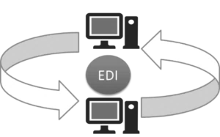
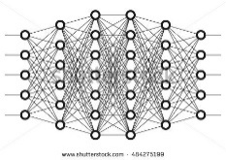
Tech Trends that Change a Tax Administration
Digital by Default
Electronic Data Interchange
Electronic Notifications
Accurate Self Assessments
Intelligent Virtual Assistants
Big Data
New technological advancements and tools can bring capabilities to tax administrations in key areas such as:
Digital Invoicing
Tax Payments
Digital Fiscalization
Advanced Data Analytics
Value Chains / Factoring
Etc.
Transparency
No Secrets
Pre-Filling Tax Returns
Deep Neural Networks
Audit Case Selection
Analytics
Notes:
I won’t stop at this slide … self explanatory

Slide 6
The digitalization of the tax administration
Key Takeaway:
Beyond the adoption of new tools and technologies, a successful digitalization of a Tax Administration involves a comprehensive institutional transformation
This encompasses required adjustments to traditional operational models with the purpose of (1) developing new capabilities, (2) achieving long-term and sustainable efficiencies, and (3) offering new and improved taxpayer services
Notes:
However, technology is not in itself THE answer. It has to be part of a comprehensive institutional transformation.
This entails developing new capabilities, BPR and streamlining, generating efficiency, and offering new and improved services where a taxpayer is considered a client and not a target for audit

Slide 7
Key Considerations
Regardless of the particular technology or tool, the following general guidelines must be observed.
Establish high standards of security shared on all systems and process in use by the institutions
Focus on institutional goals and objectives and
Establish efficient operational processes to support them
Combine the high-level strategic vision with an adaptable operational structure
Prioritize collaboration efforts across different departments and/or institutions
Notes:
Some final thoughts to leave you with …
First, when it comes to disruptive technologies with data floating around, establishing high standard of security is critical..
Second, the focus should be on the tax admin’s goals (IT should not drive the agenda), and then setting up processes that support these goals
Third, we need to have flexible and adaptable operations that allow to achieve the high-level strategic vision of the admin (cannot afford to be rigid)
Finally, and this may sound like a cliché, but collaboration within and with external parties is key. Data is not owned by one team and disruptive technologies is all about data and the management of data flows. Without collaboration, the whole process is undermined.

Slide 8
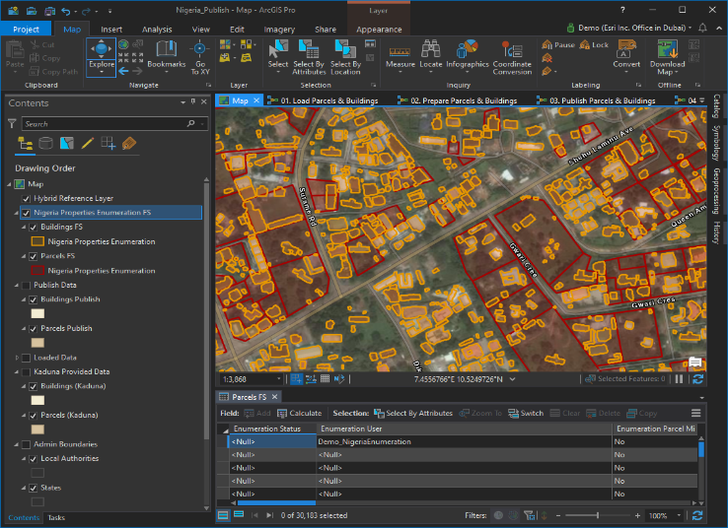
Property Tax: Cutting-edge Technology Helps Overcome the Revenue Challenge

Slide 9
Technology in property tax administration
Property Mapping
Property Registers
Property Valuation
Property Tax Operations
Taxpayer Service

Slide 10
A key factor in revenue mobilization is the Coverage Ratio
Policy Variables
Administrative Variables
Revenues
$$$
=
Tax
Base
*
TR
*
*
CR
VR
CLR
TLAR
*
*
1
3
5
TLAR: Tax Liability Assessment Ratio (billing)
CLR: Collection Ratio (billing, collecting, enforcing)
CR: Coverage Ratio (property identification, cadastre)
VR: Valuation Ratio (property valuation)
2
4

Slide 11
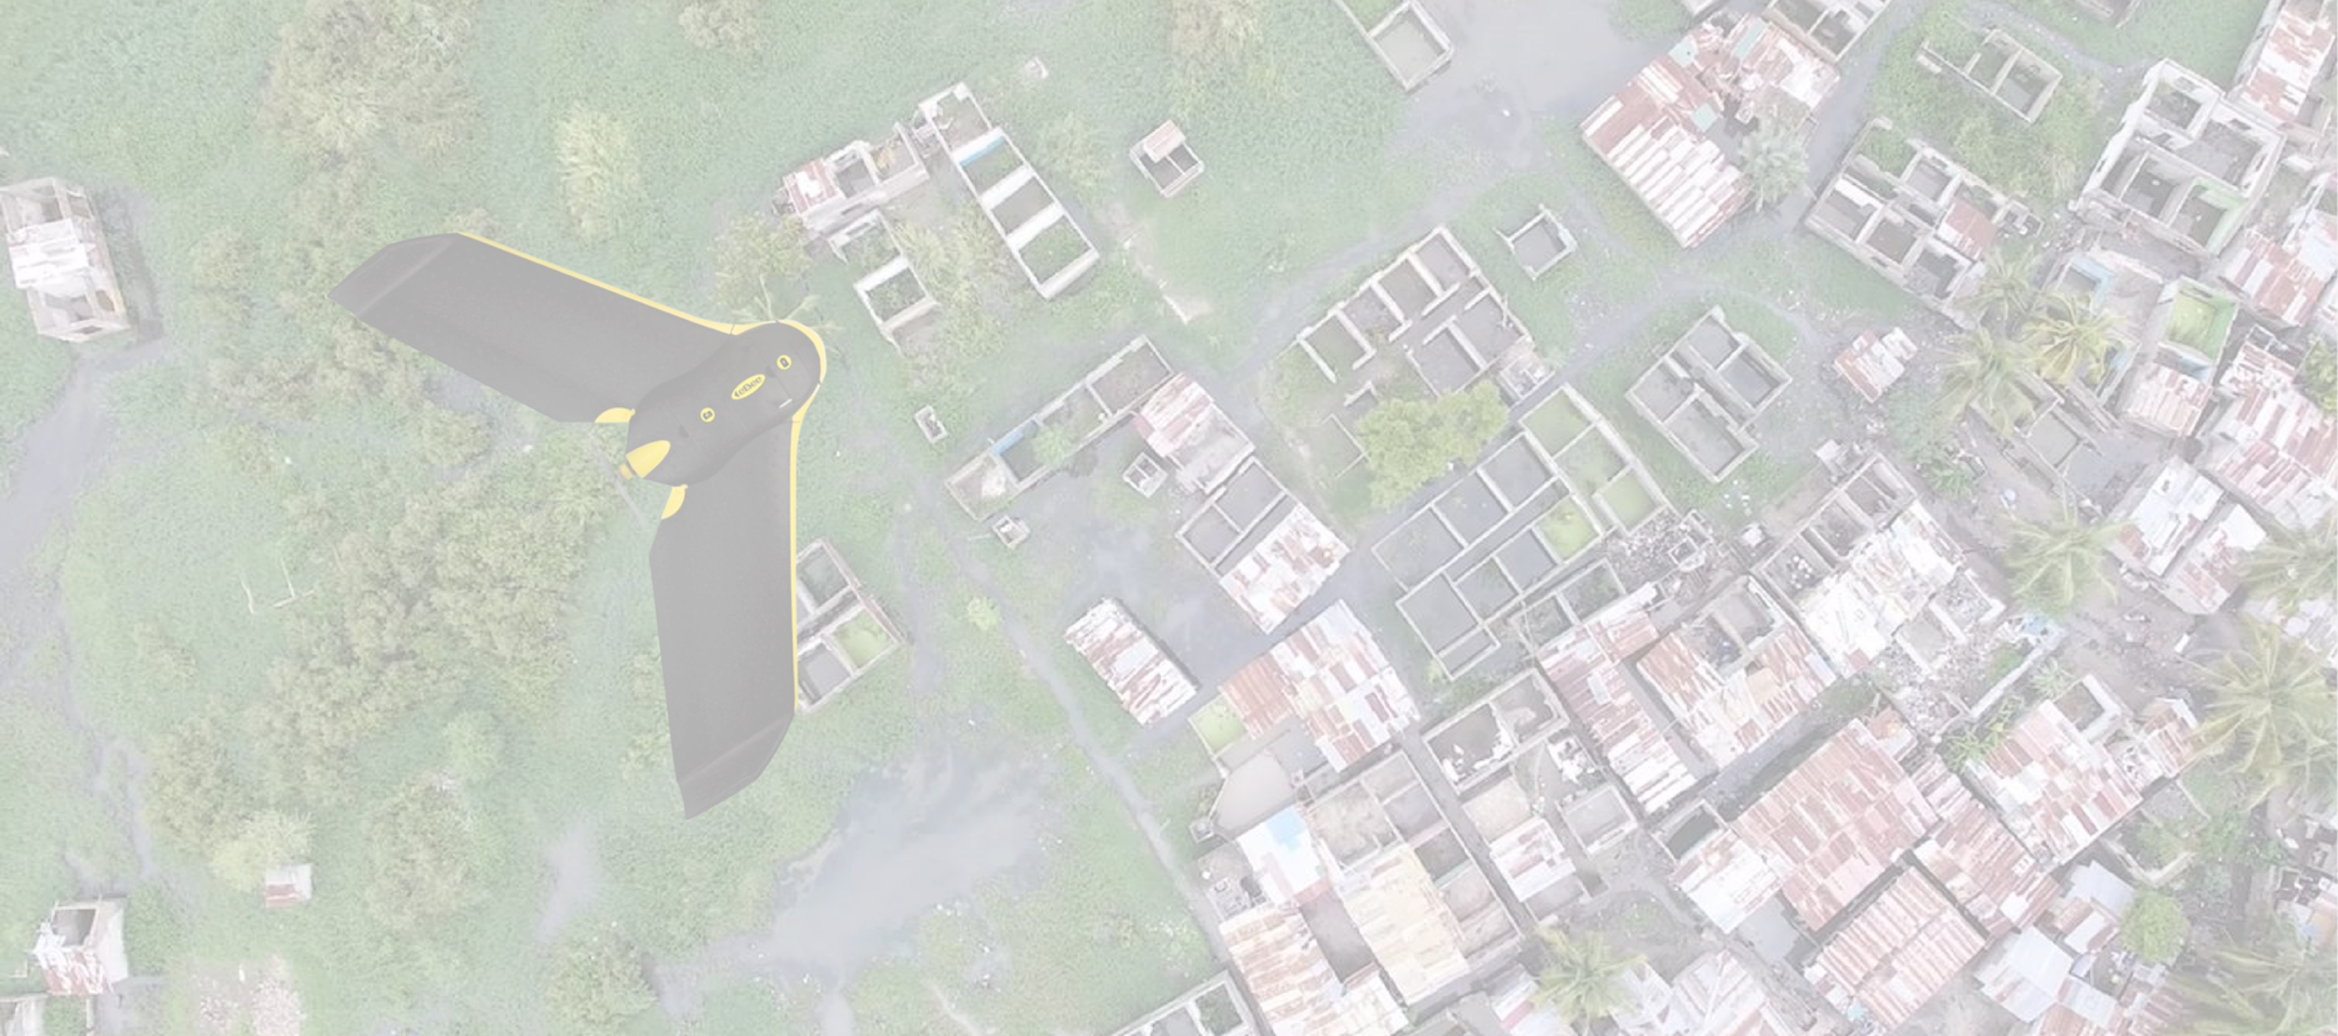
Satellite Imagery data for property footprints and 3D vectors
Application of Unmanned Aerial Vehicles (Drones) for mapping
Software for enumeration and identification of buildings
Geo-location of each property possible
Property Mapping for
Improving coverage

Slide 12
Cutting-edge technology applications
1
3
5
Data to identify universe of structures
2
4
5
1
3
2
4
6
Imagery Acquisition: Satellites-speed, scale, ability to update regularly; Drones –great detail but complexity and scalability, regulation
.
Footprints and heights of all buildings (i.e. get height & built area) in urban areas
.
Vector data of infrastructure (roads, rail, air) & landcover (forest, water)
.
Coverage with orthophoto derived from satellite imagery
Digital surface and terrain models
Data can be updated in future at low cost to capture urban expansion
5
Software solution to support field enumeration
2
4
2
4
Allows co position visible on the mapllection of necessary attributes by teams using tablets Enumerator’s
Automatic geo-tagging; parcel boundaries can be marked directly & pictures taken
.
House to House enumeration likely (with tablets)
.
Links to existing land records
.
Analysis of tax gap can draw on existing footprints followed by house-to-house enumeration with tablets.

Slide 13
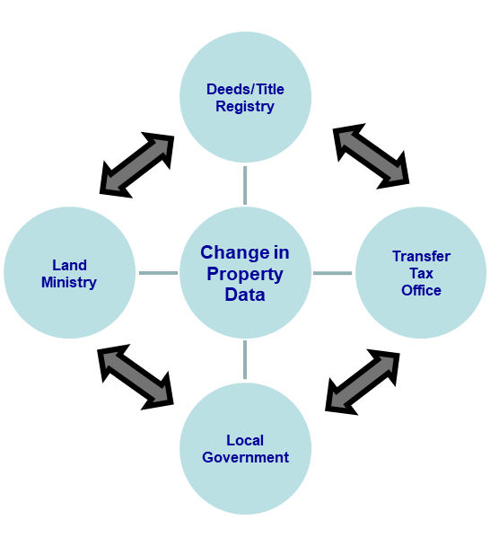
Intergovernmental Co-operation for Property Registry Updating through technology
3
5
4

Slide 14
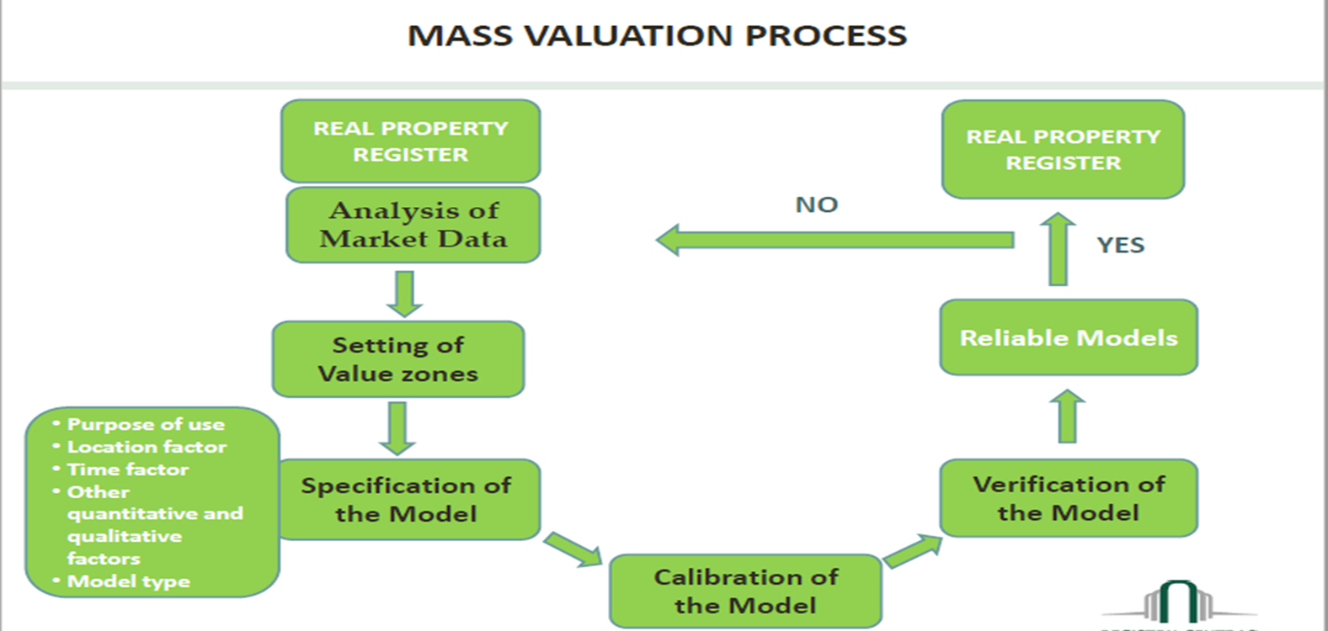
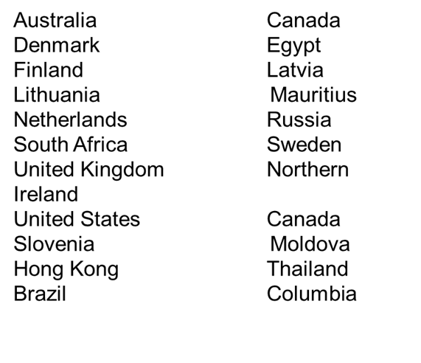
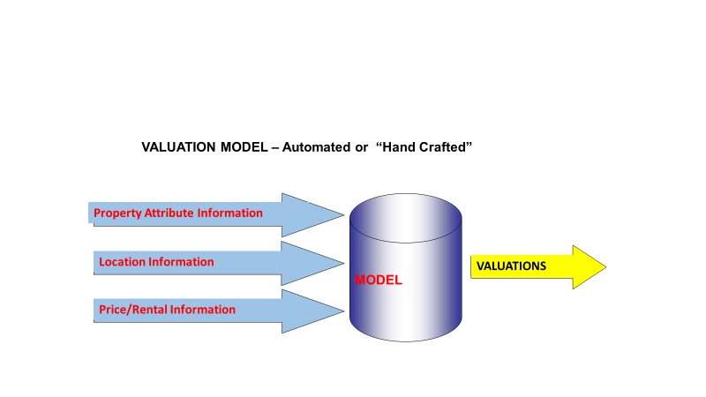
Computer Assisted
Mass Valuation
3
5
4

Slide 15
Property Tax Operations Management System
Tax Liability Assessment
3
5
15
Source: Kelly, 2013, p. 144
4
Source: Kelly 2013 pg. 144

Slide 16
Proper billing and collection, payment options
Low compliance cost
Good data on taxpayers
IT Services Facilitate Compliance
Taxpayer Communication (property tax bills, receipts, reminders)
Professional service
Easy access
One-stop shops
idea goes here.
Effective credit control and debt collection systems
Acceptable Service level delivery i.e. Value for money
Information for enforcement

Slide 17
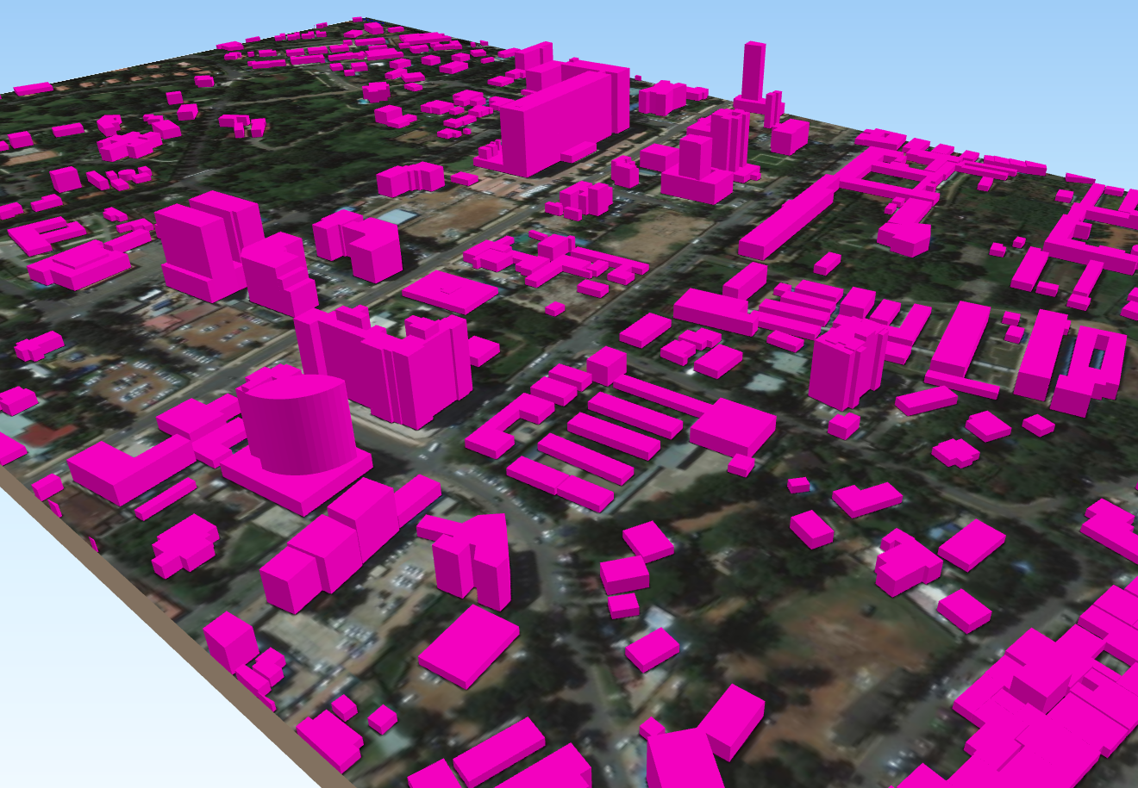
World Bank’s support to property tax reform in Nigeria: SFTAS project + TA helping states in updating property records, reforming legislation, laying the foundation for improved property taxation
Firm to provide GIS data and orthophotos to map every building
Software for States to conduct field enumeration
Technical/Project Management support
GIS data and orthophotos to map every building
3
ArcGIS Pro plus survey123 to conduct enumeration) - a desktop software that allows for the creation and management of geospatial data
Several states are already using this software
5
17
4
Executive Governors have approved the State work plan and budget for updating property records for inclusion in the FY21 State Budget.

Slide 18
Annex: Use Cases and Examples

Slide 19
BIG DATA
The goal is to obtain useful and actionable information from large amounts of collected data.
Collect: Data need be collected as close to the source and as close to real time as possible.
Process: Data will need to be transformed, aggregated or processed in some way to be useful.
Store: Data, or a transformation of it, will need to be stored for a certain period of time.
Analyze: Specialized tools like Business Intelligence Software may be used to generate reports and user-friendly visualizations and aggregations from the processed data.
Some areas where this practice can be applied include:
Sensor data, Internet-of-Things, Supply chain monitoring and automation, Collect and analyze a vast number of digital documents (like digital invoices, declarations, etc)

Slide 20
Using big data in a tax administration
Vehicle Registration
Family Records
Remittances
Tax Returns
Taxpayer Assistance
Audits
Risk Management / Control
360 View of Taxpayer
Payroll
Company Registry
Trade Operations
Property Records
Taxpayer Assistance

Slide 21
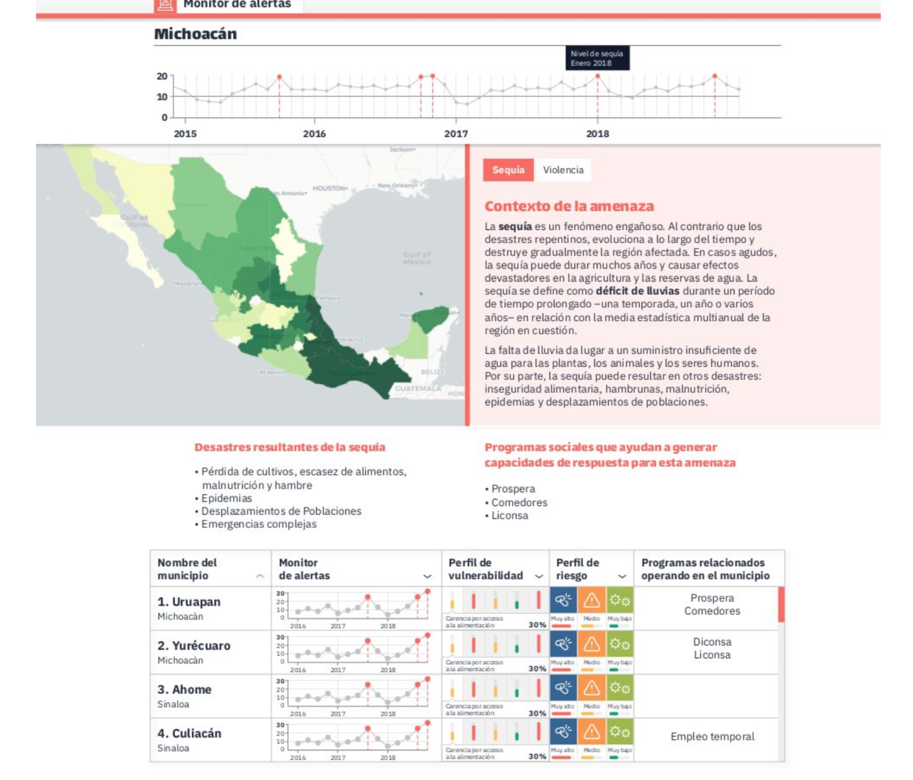
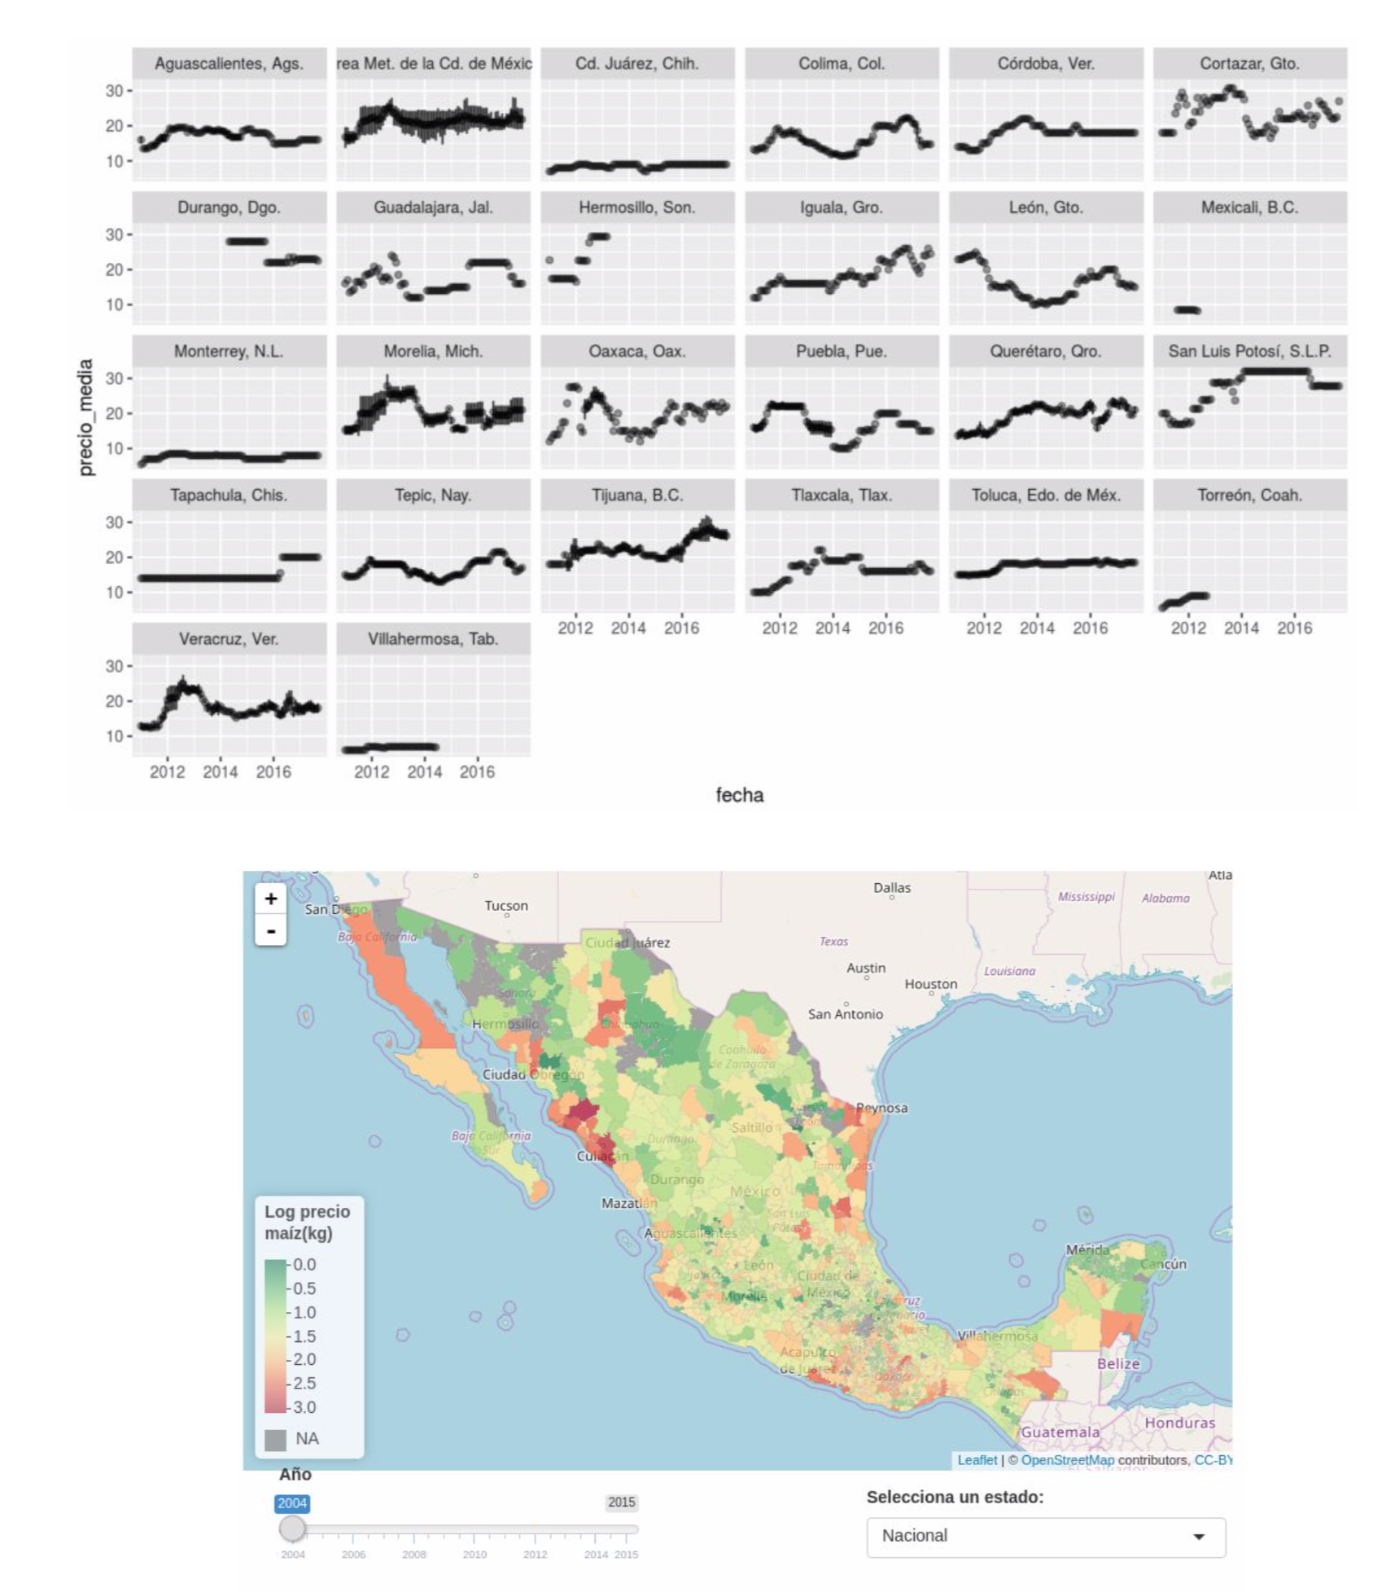
EXAMPLES OF DIGITALISATION EFFORTS
Mexico; by officially integrating a Data Lab for government purposes different agencies are able to integrate and analysis different data sources to obtain valuable and actionable information.

Slide 22
DISTRIBUTED LEDGER TECHNOLOGY/BLOCKCHAIN
Some of the key considerations to identify scenarios where DLT can be considered and applied are:
The managed information is sensitive or related to valuable assets.
The related activity involves the coordination of multiple entities and/or a complex chain of intermediaries.
Real-time visibility of occurring events is required or important to the related activity.
Maintaining an immutable record of the data and operations is important to the related activity.
Distributed Ledger Technology, normally referred to simply as “blockchain”, provides a mechanism that allows a group of peers to collaboratively maintain a secure, ordered and consistent ledger of records without the additional requirement of a trusted third party.

Slide 23
BLOCKCHAIN: USE CASES
WORLD ECONOMIC FORUM Davos, Switzerland 2016; 816 technology experts predict their governments will employ “blockchain” technology for tax collection between 2023-2025. [WEF - Blockchain Beyond the Hype]
World Customs Organization (WCO) June 2018; pilot programs and field tests begin for applications of DLT in customs and releted agencies, the main objectives are fraud detection and simplification of regulatory compliance. [WCO - Research Paper 45]
Shenzhen, China - State Tax Administration August 2018, as part of a pilot program with the private company Tencent, “blockchain” is used to generate and store official electronic invoices. [EEO]

Slide 24
Blockchain case study: Australian Taxation Office
ATO ran a Hackathon to see if they could create a prototype to help increase transparency around LCT (Luxury Car Tax) compliance and assist other government authorities and car dealerships in helping in tracking vehicle ownership details.
Blockchain was used to ensure data entered by car dealers was not later tampered with. Also they used it as a shared data-store so that car dealerships, state road authorities and customs can track ownership of a luxury vehicle throughout its lifespan.
Caveat: Solving a problem using a blockchain will involve fundamental business change, coupled with the challenge associated with the state of its technology maturity. Other external factors to contend with are: privacy, lack of governing principles, standards, and other change management issues
ATO: “We … recommend maintaining a healthy dose of skepticism regarding any claims of future revolutionary impact…”

Slide 25
MACHINE LEARNING
Most advanced data processing technique available today, designed around the general idea of pattern recognition.
Base evaluation or classification model adequate to our particular use case.
Generate a large initial dataset to be used as training material for the selected model. The larger (and better) the dataset the better the resulting model will be.
In the case of “supervised” models, a feedback mechanism on model iterations in order to improve its accuracy level over time.
Some relevant applications of this technology include:
Fraud Detection, Identification of Irregular Activity Patterns, Products Classification, Advanced Statistical Analysis

Slide 26
BIG DATA / MACHINE LEARNING: USE CASES
OECD - Technologies for Better Tax Administration Big data analytics allows the Tax Administration to obtain valuable information from existing data sources, in order to improve services offered to taxpayers as well as its capabilities on risk management; particularly in the cases of detecting fraud and evasion. [Technologies for Better Tax Administration]
Intra-European Organisation of Tax Administrations With the collaboration of 30 countries, IOTA publish a comprehensive guide of experiences, case studies and best practices identified on the fields of: Data Management, Predictive Models, Social Network data analysis, Data visualizations, Debt administration. [IOTA - Good Practice Guide]

Slide 27
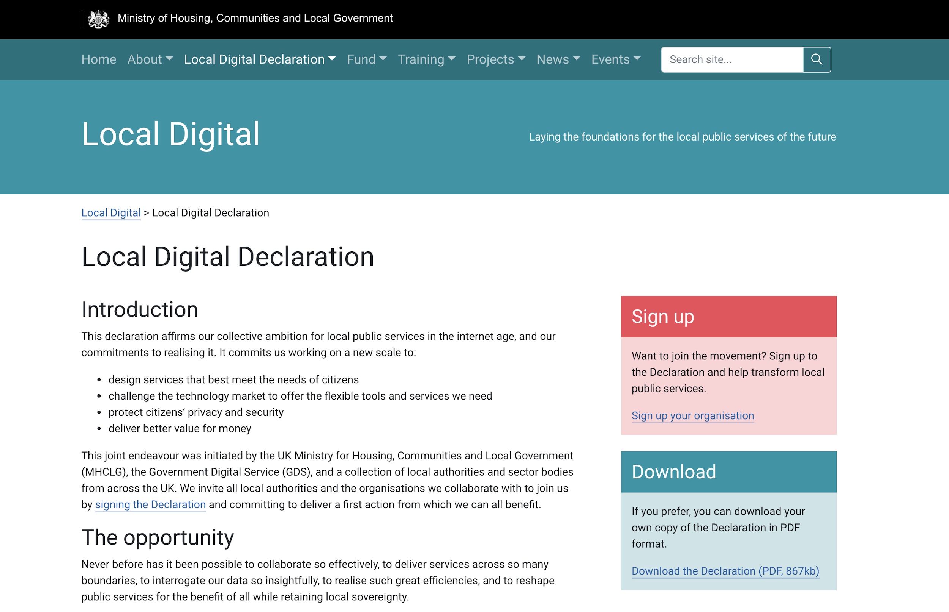
EXAMPLES OF DIGITALISATION EFFORTS
UK; as part of the “Making Tax Digital” program, simplify regulatory compliance for taxpayers presenting personal income and VA tax declarations.

Slide 28
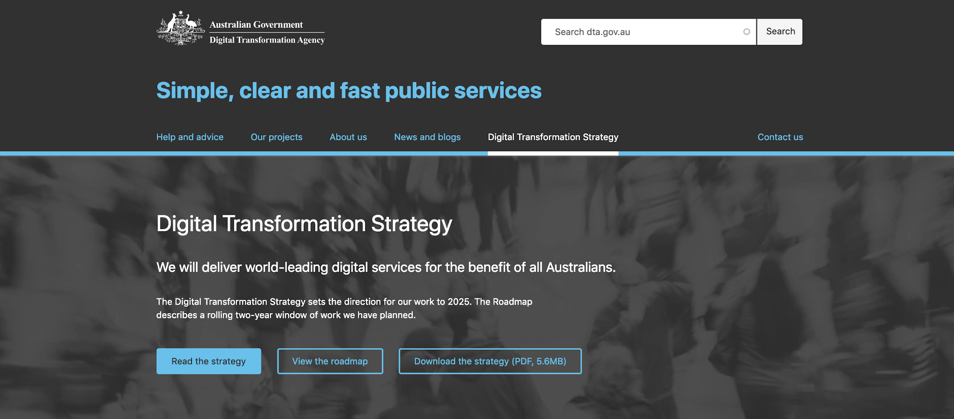
EXAMPLES OF DIGITALISATION EFFORTS
The Australian government launches a comprehensive e-government innovation program: Digital Management Agenda.

Slide 29
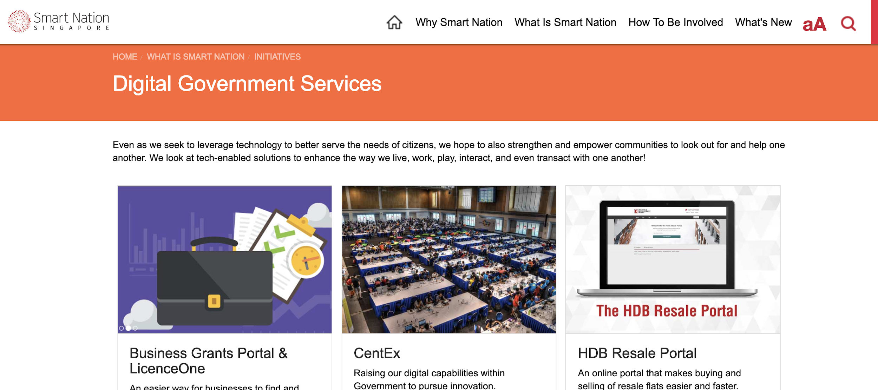
EXAMPLES OF DIGITALISATION EFFORTS
Singapore’s government launches its Smart Nation initiative with the purpose of offering a completely online official services channel.

Slide 30
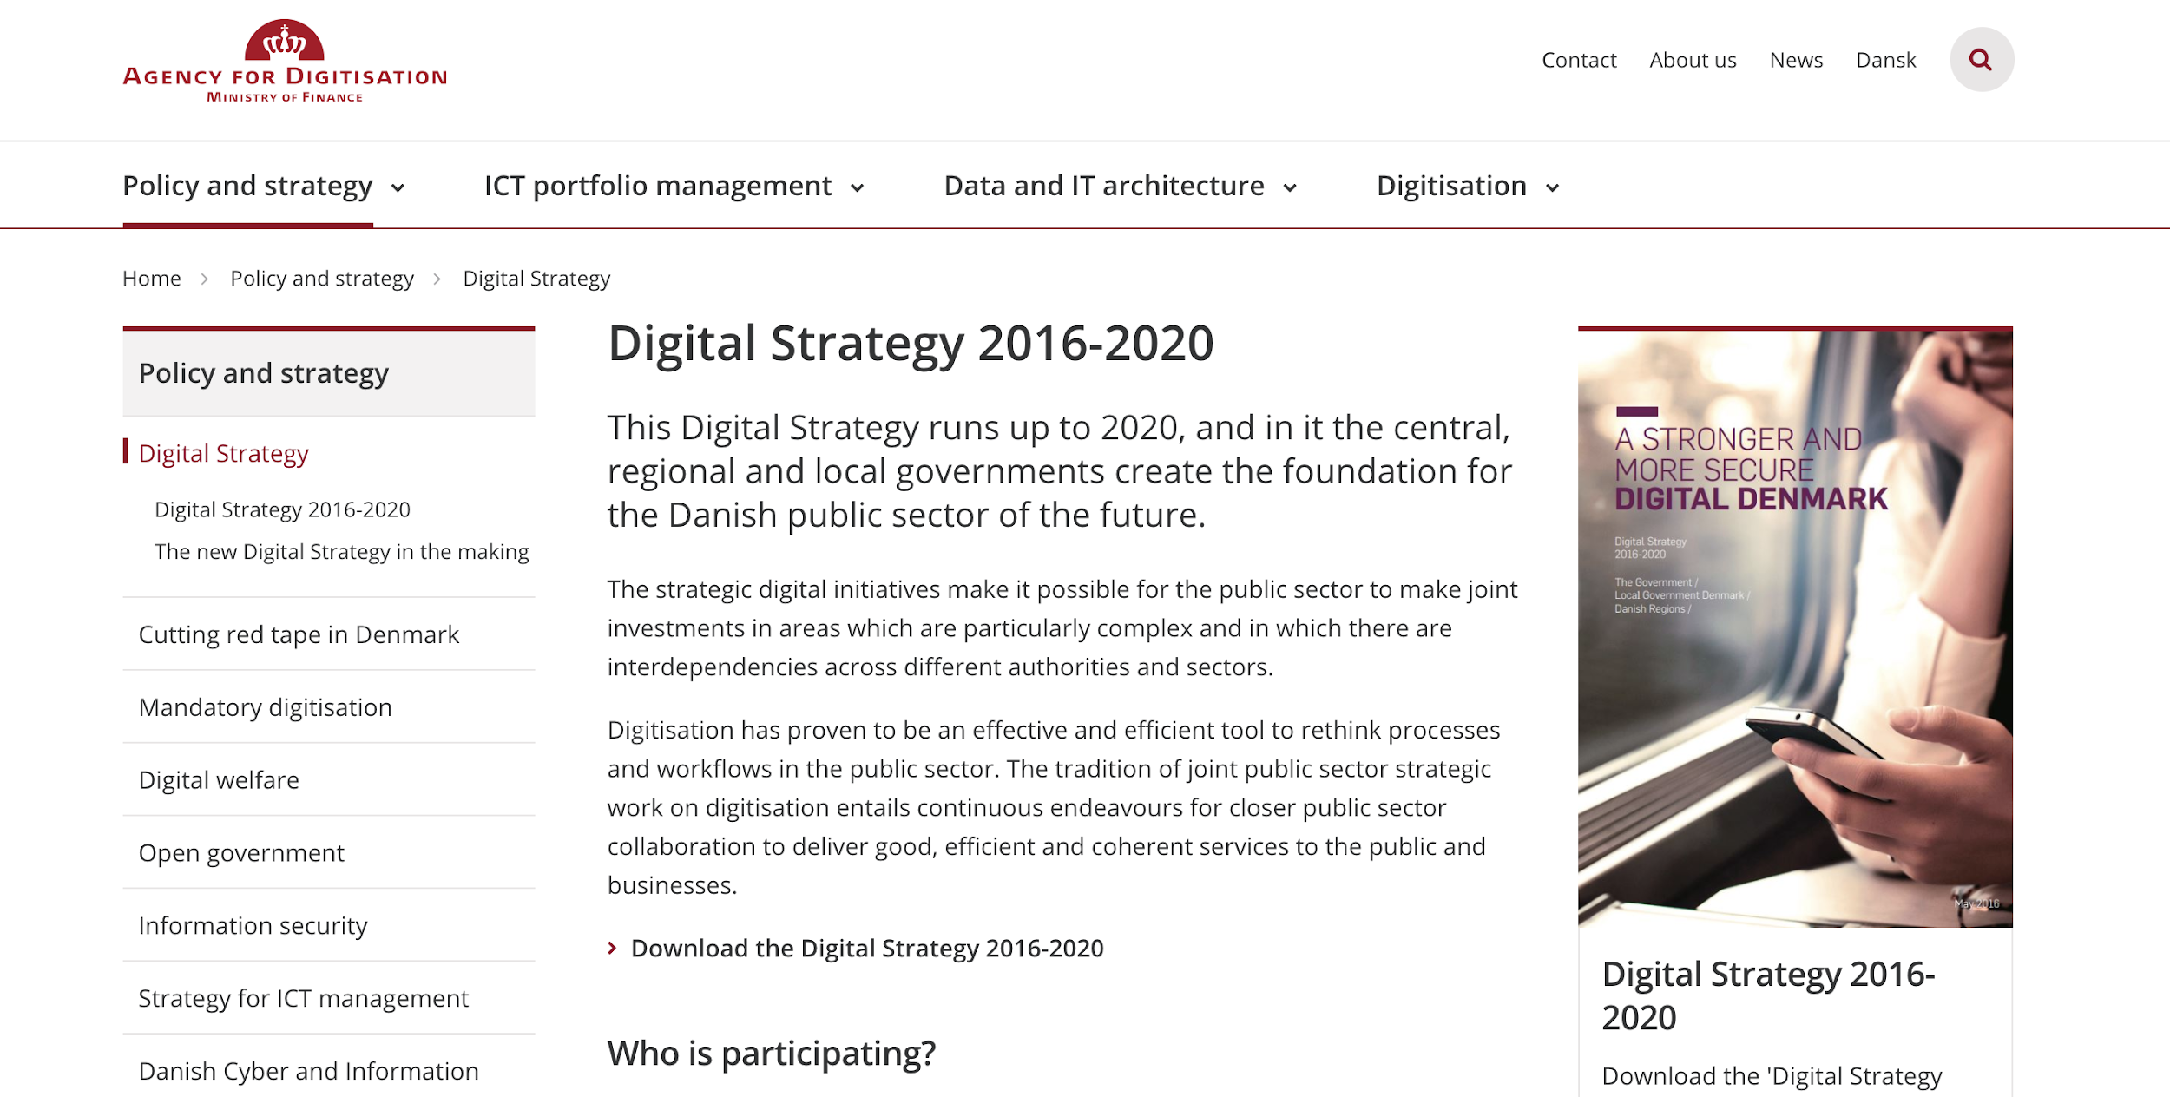
EXAMPLES OF DIGITALISATION EFFORTS
One-Touch program in Denmark, as part of a National Digital Strategy, aims to eliminate the requirement to present personal income forms for the majority of taxpayers. Denmark is the most advanced Digital Economy in Europe, according to the DESI Index.

Slide 31
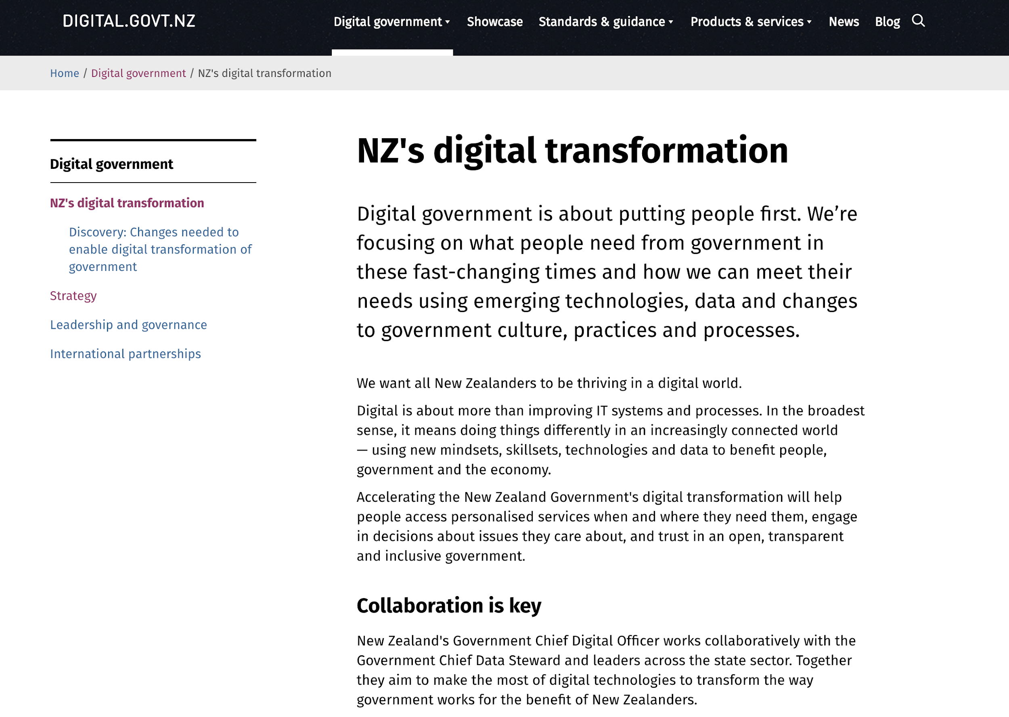
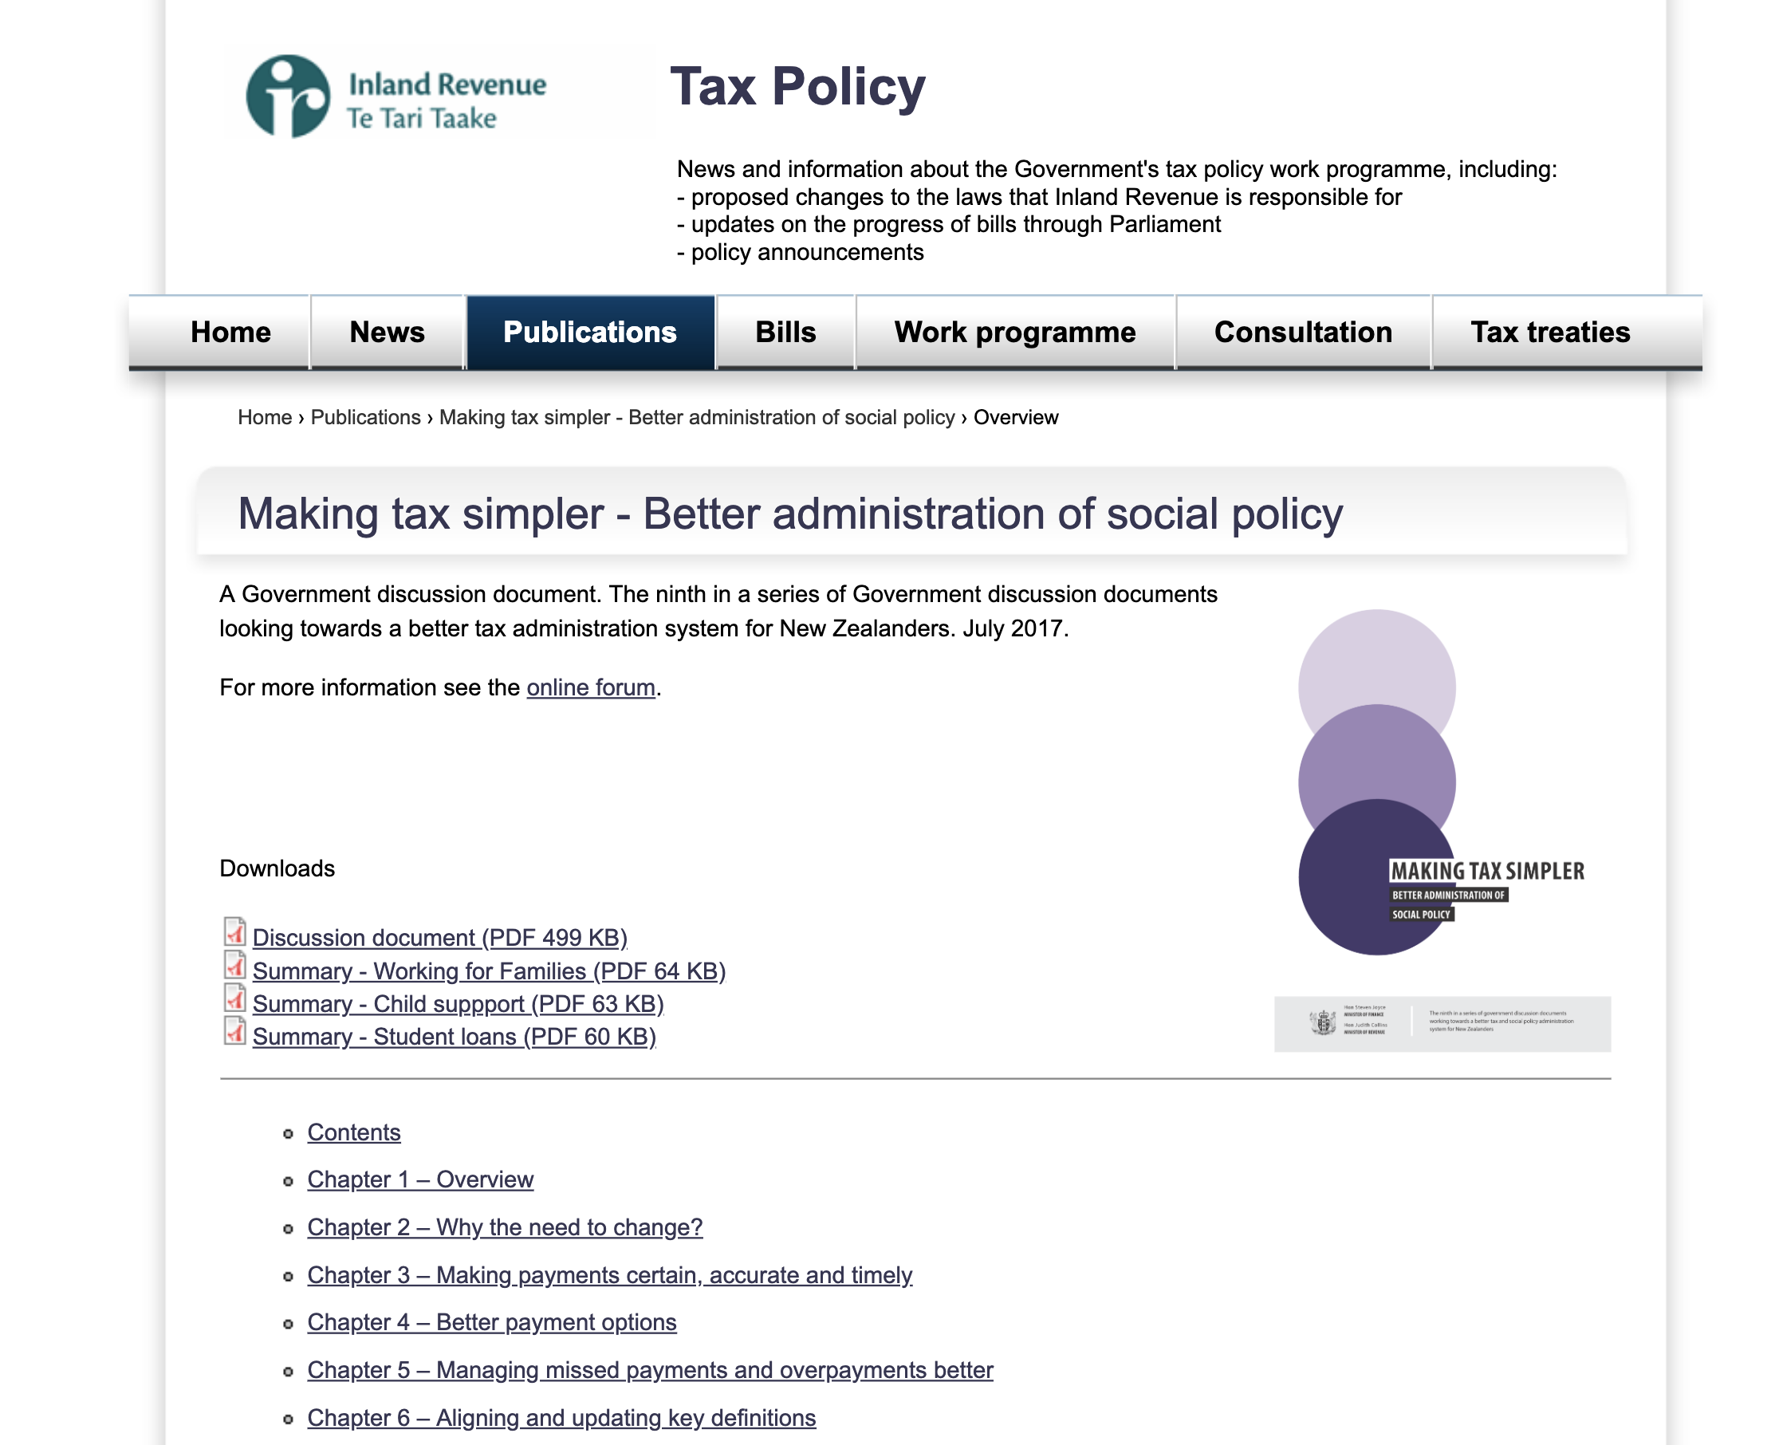
EXAMPLES OF DIGITALISATION EFFORTS
New Zealand; as part of a robust national innovation program, the government launched Making Tax Simpler, its main objective is to simplify regulatory compliance for the taxpayer and apply technological advancements to reduce the associated costs and complexities.

Slide 32
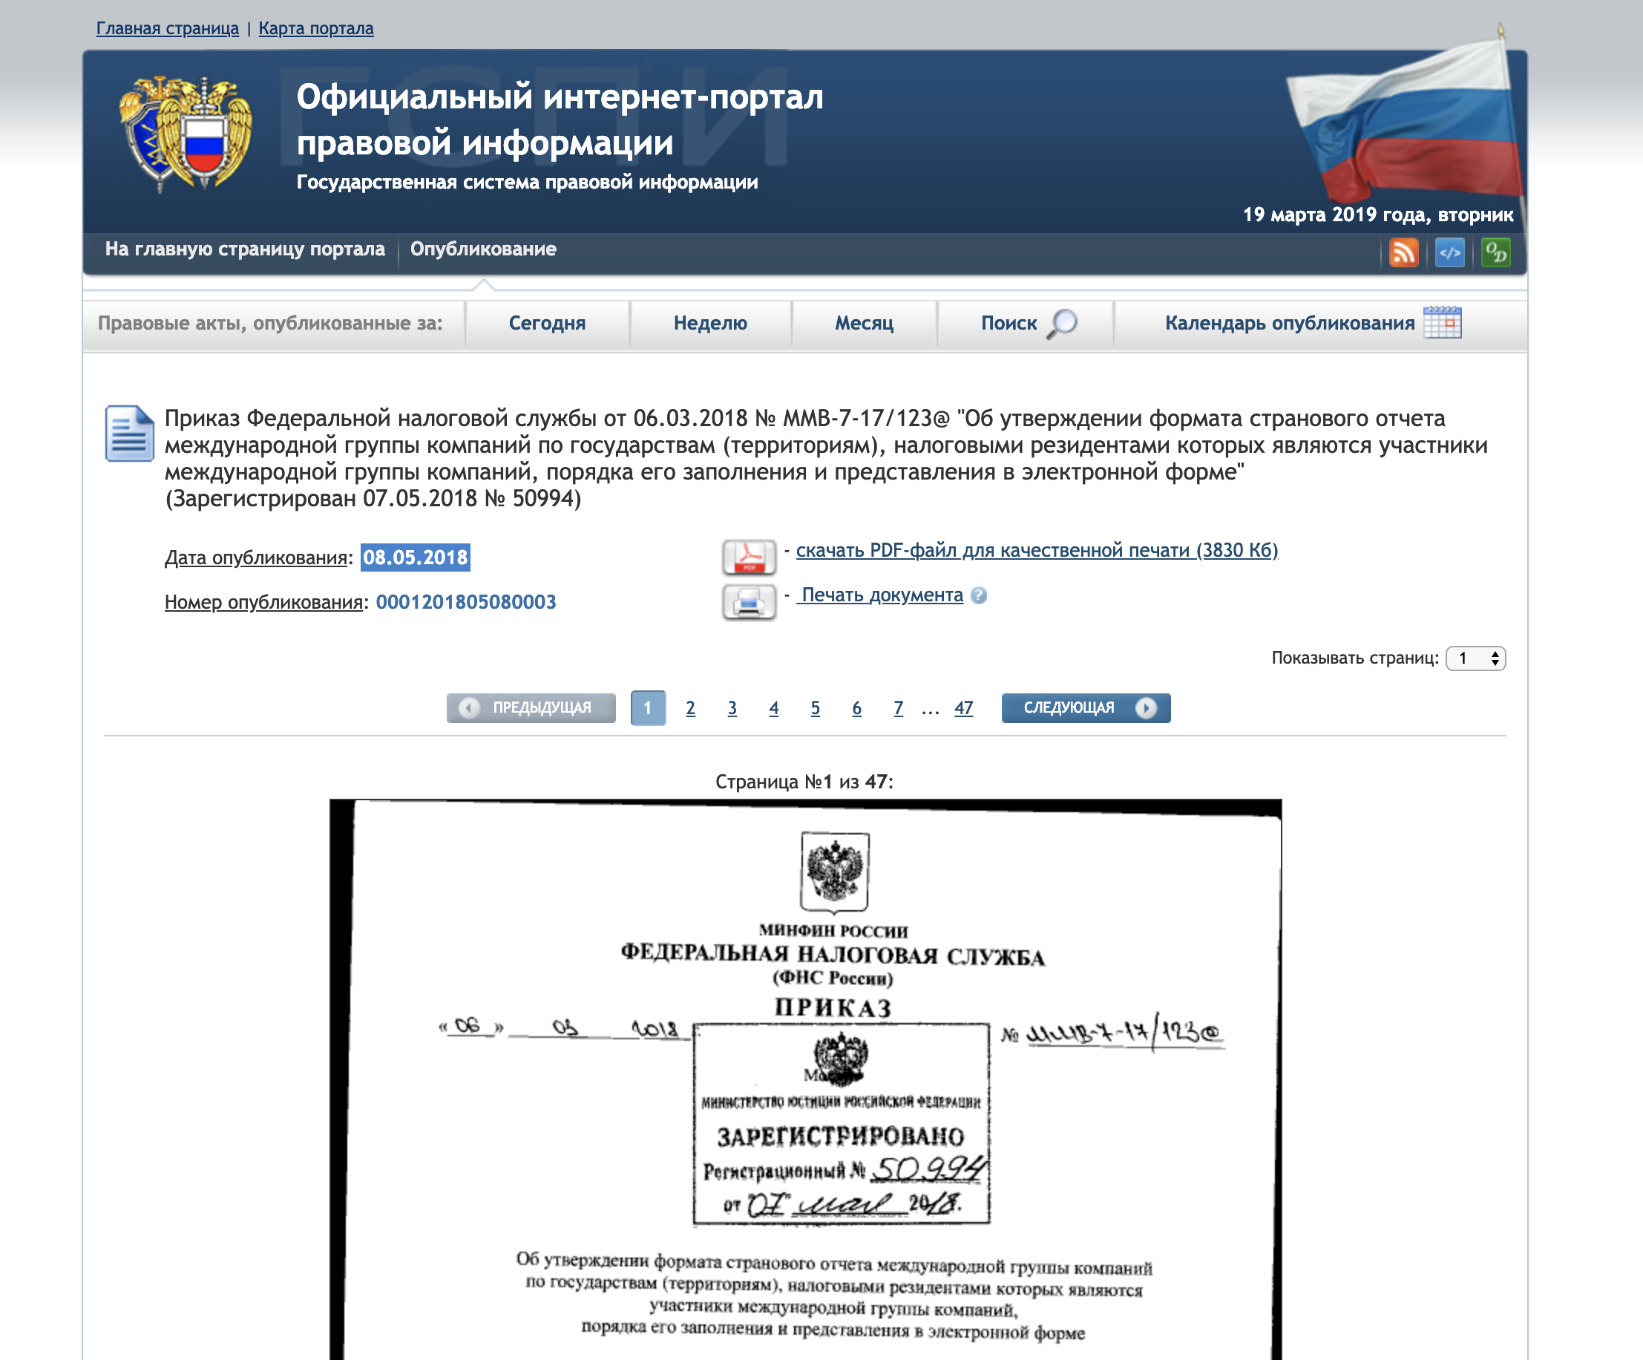
EXAMPLES OF DIGITALISATION EFFORTS
Russia; to improve its analytical and monitoring capabilities for international commerce, establish the requirement for exchange “CbC” information on digital format. [*]

Slide 33
EXAMPLES OF DIGITALISATION EFFORTS

Slide 34
EXAMPLES OF DIGITALISATION EFFORTS

Slide 36
Country Examples: Property Tax Coverage
India
Nigeria
Rwanda
Zanzibar

Slide 37
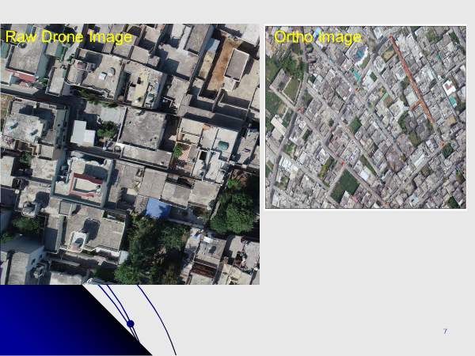
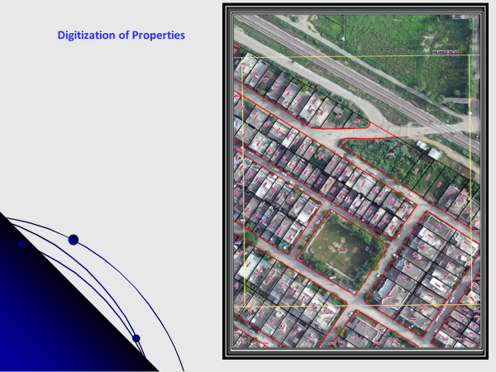
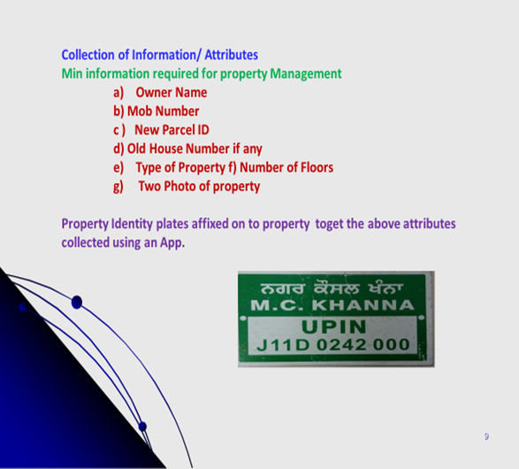
Punjab, India:
Property Mapping

Slide 38
Kigali, Rwanda

Slide 39
Zanzibar, Tanzania

