Slide 1
TAX & TECHNOLOGY EVENT
TECHNOLOGY TRANSFORMATION OF TAX AUTHORITIES - THE INTELLIGIENT REVENUE AUTHORITY
^{Monday 19th April 2021}

Slide 2
CONTENT
Taxpayer Administration and Automation
Common Challenges with Manual Taxpayer Management
Tax Administration Management Information System (TAMIS)
Typical Tamis Concept Models
Benefits of TAMIS Adoption
Common Errors/Issues
Types of TAMIS Solutions
Approaches to Deployment
Integration Opportunities for TAMIS In Nigeria
Key Messages for Tax Authorities

Slide 3
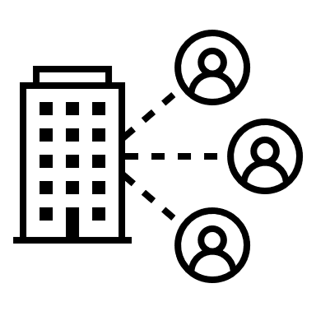
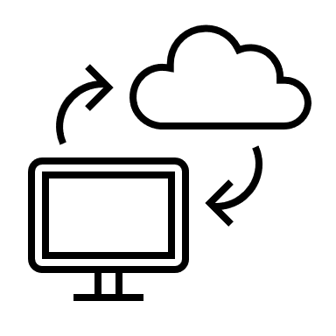
TAXPAYER ADMINISTRATION AND AUTOMATION
Taxpayer management comprises of a set of systematic administrative activities ranging from taxpayer enumeration, assessment, filling to payment.
For a long time, State Internal Revenue Services (SIRSs) have run tax administration through manual processes with very limited automation to support tax processes e.g., enumeration, assessment, and records filing were only posted into a database management system (DBMS) after manually collecting taxpayer information/data.
Automation and technology adoption is gaining momentum amongst SIRSs
Automation of workflow management
Online tools to support self- assessment e.g., Tax calculator, interactive chat bot.
Online payment and receipting function.
Online Revenue Collection Monitoring System
3

Slide 4
COMMON CHALLENGES WITH MANUAL TAXPAYER MANAGEMENT
Inaccurate taxpayer records due to human error during data entry/information transfer.
Limited capacity to generate a unique taxpayer ID.
Inadequate data control/access protocol to ensure data integrity.
Inadequate coverage of taxpayer base.
Limited capacity to leverage collaboration opportunities e.g., leveraging partner databases such as Customs, Immigration, Banks, FIRS, etc.
Significant administrative burden and inefficient processes that cause longer processing times.
Increased compliance cost and inconvenience for the taxpayer e.g., enumeration, filing and payment.
Fraud and mismanagement such as collusion between tax officers and taxpayers to aid under-reporting of tax liabilities and payment.
4

Slide 5
TAX ADMINISTRATION MANAGEMENT INFORMATION SYSTEM (TAMIS)
TAMIS is a system of programmed modules designed to intelligently allow users enter, build, query, process, analyse taxpayer data and information relating to functions such as registration, self-assessment, filling returns, payment, receipting, issuance of clearance certificate and appeals management, enforcement and collection (through integration with other agencies’ database).
5

Slide 6
TAMIS MODELS…
Registration &
Cancellation
Returns
Generation
Assessment
Walk In
Taxpayer
Services center
Payments
Refunds
Appeals &
Objections
External Interfaces
Collections
Clearance
Directions
Call In
Tax Functions
Taxpayer
Call Center
Workflow
Accounting
Audit
Rules Engine
Notification
E-Service
Correspondence
Management
Reporting
Services
Support Functions
Information &
Transactional
Services
RAMIS Data Store
Source: Mahesh Ranawaka (2018), Sri Lanka Revenue Administration Management Information System (RAMIS)
6

Slide 7
TAMIS MODELS…
Typical TAMIS Concept Models
Source: Asian Development Bank (2014), Tool Kit for Tax Administration Management Information System
7

Slide 8
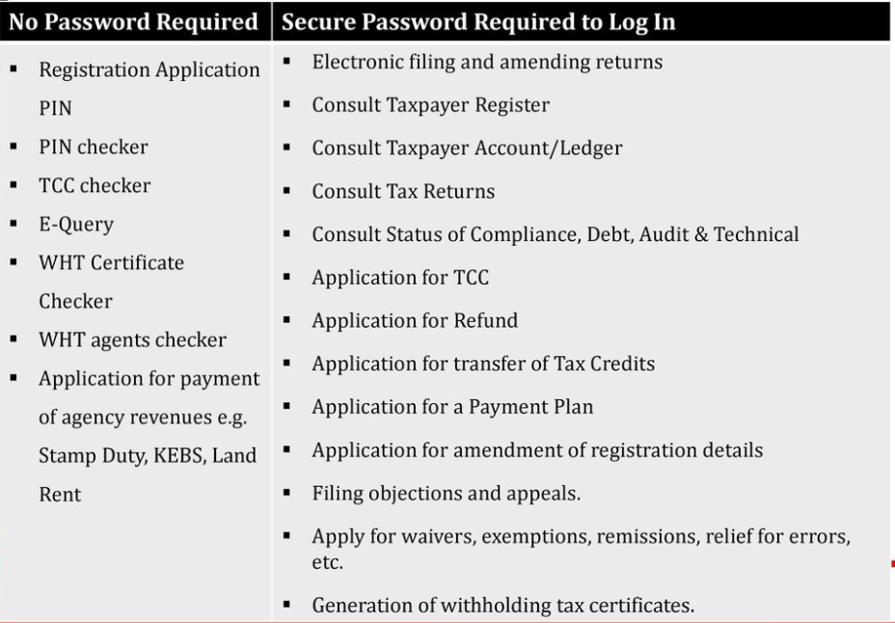
TAX ADMINISTRATION MANAGEMENT INFORMATION SYSTEM (TAMIS)
Excerpt of data control protocol for the Kenya Revenue Tax Authority ITAX
Benefits of TAMIS Adoption
Enabling self-services to minimize administrative burden and cost.
Lower compliance cost for taxpayers and increased convenience of compliance.
Improved operational efficiency and compliance monitoring.
Integrated view on taxpayer information and tax liabilities.
Real-time access to query and analyse taxpayer records for the purpose of assessment or recovery of tax liabilities.
Improved data integrity through system audit processes, data control and access protocols (See excerpt on KRTA ITAX to the right).
Integration of multiple service delivery channels with the various modules e.g. Dedicated IGR bank payment gateway with payment module.
Integration of a unique identification number generation function.
API integration to enable information exchanges with other partner agencies. tax agency and other key stakeholders such as the finance ministry, banks, and other.
Source: Moses Wachana (2016), Kenya Revenue Tax Authority Integrated Tax Management System (ITAX)
8

Slide 9
TAX ADMINISTRATION MANAGEMENT INFORMATION SYSTEM(TAMIS)
Common Errors/Issues
Procurement
Error
Deployment
Error
Change Management Issues
Adoption of wrong procurement approach.
Inexperienced solution provider.
Procurement of non-scalable solution.
Weak contract with no clear delimitation of data ownership, security, privacy clauses, expected deliverables and milestones.
Inadequate requirement gathering.
Poor business process integration.
Customization errors.
Mismatch with needs assessment
Resistance to change.
Poor ICT capacity/infrastructure to support state-wide adoption between SIRS HQ and field/area offices.
Lack of standard processes.
9

Slide 10
TYPES OF TAMIS SOLUTIONS
Custom-Developed
Commercial-Off-the Shelf
This is a TAMIS solution specifically designed for a tax authority to service its desired need.
Common features :
Customization according to specific requirements.
Transfer of specialized domain knowledge already built into any existing legacy systems.
Deployment time is longer due to software development phase.
Well-suited for division-wide or fragmented applications
Difficulty in practicing version control and guarantying availblilty of update patches to address bugs.
Often requires longer on-site presence for set up.
Module uptake is scalable.
This is a standardized TAMIS solution provided by commercial package producers, with already developed and designed modules to service basic taxpayer management functions. The provider upon purchase by the client only needs to domesticate desired functions/modules to serve the need of the client. Other specific customization that could follow include language, colour scheme/appearance, logo, key output messages, data/information output format, API integration, etc.
Common features include:
Robust, field-tested software.
No need to redevelop an existing application/module.
Easier migration to integrated solutions.
Shorter deployment timeline.
Module uptake is scalable.
Customisation to client requirement is limited to available domestication offer. However, at a separate cost, the solution providers can programme out of scope functions into the solution on demand by the client.
10
Source: World Bank. Guidance Notes on e-Government Practices—ISG. Make or Buy Decision Factors: World Bank Experience and Guidance Note for Treasury Management System.

Slide 11
DEPLOYMENT APPROACHES
On-premise
The solution provider delivers an on-site IT infrastructure to host the solution, which is managed by the client with agreed support from the provider (often negotiated).
Common features:
Costs associated with managing and maintaining all the solution entails can run exponentially higher than a cloud computing environment.
On-premise setup requires in-house server hardware, software licenses, integration capabilities, and IT employees on hand to support and manage potential issues that may arise.
Longer deployment timeline.
There is no reliance on external factors such as the internet to access your servers.
Upscaling with IT development requires physical upgrade of IT infrastructure/hardware.
Cloud (SaaS/PaaS/IaaS)
The solution provider delivers an off-site solution usually web and cloud based. The actual physical IT infrastructure is housed offsite with the solution provider.
Common features:
Allows organizations to pay on “as-needed basis” and effectively scale up or down depending on overall usage, user requirements, and the growth of the organisation.
Update or upgrade patches can be communicated remotely for download and installation by the client.
There are no capital expenses, data can be backed up regularly, and organizations only have to pay for the resources they use.
Can be deployed in a matter of hours or days as it is done via the internet, whereby there is no need for a physical server to be in place.
11

Slide 12
INTEGRATION OPPORTUNITIES FOR TAMIS IN NIGERIA
FIRS
Customs
Informal Sector (POS)
Banks
FRSC
Opportunities for integration are limitless but require persuasion, negotiation and selling a win-win case.
Other Private Sector Entities
Other
MDAs
(FG&SG)
NIBBS (BVN)
VIO
NIMC (NIN)
NEPC
PEF
CBN
Land Ministry/GIS
12

Slide 13
KEY MESSAGES FOR TAX AUTHORITIES
Assess your automation needs.
Depending on resources, scalability desired and the variation of your tax processes from the basic taxpayer management functions, evaluate which fits – COTS or Custom-developed solution.
Employ a competitive procurement process.
Ensure a strong contract is put together that secures the SIRS’s right of ownership, security and privacy of taxpayer data and information that will be recorded or processed through the solution.
Establish standard processes that support the business processes to guide deployment/TAMIS domestication.
Ensure system requirements gathering and business process mapping is conducted to avoid deployment error.
Institute a change management programme and protocol:
Sensitize all stakeholders on the new system (internal and external as may be applicable).
Procure for and equip all SIRS offices (HQ, field and area offices) with the necessary ICT infrastructure to operate the TAMIS optimally.
Train users on the functions, troubleshooting and maintenance of the TAMIS to avoid protracted contracting of the solution providers or maintenance cost.
Train the SIRS staff on embedded integrations with external agencies.
13

Slide 14
Contact Us for Support
Nigeria Governors’ Forum (NGF)
Olanrewaju Ajogbasile
Mobile:+234-908-341-1461
Email: oajogbasile@ngf.org.ng
Solomon Affun
Mobile: +234-809-945-5800
Email: saffun@ngf.org.ng
Zubaida Abiola
Mobile: +234-811-553-1997
Email: zabiola@ngf.org.ng

