Slide 1
Nigeria Governors’ Forum (NGF) Technology and Tax Event
April 2021
Digital Transformation Journey of the
Mauritius Revenue Authority
Soobhash Sonah
Director, Information Systems Department
19th April 2021

Slide 2
Agenda
General Strategy
SAP ERP with TRM - ITAS
eServices - efiling
ePayment
Mobile App - MRAEasy
Projects in the pipeline

Slide 3
General Strategy
Innovation coupled with agility and flexibility
Self reliance – in house ICT capacity building
Continuous improvement - process-wise and technology-wise
Legal framework support – especially for electronic transactions
Strategic partners (service providers, banks, Telco) – 3rd party info
Robust, reliable and secure service to tax payers
Public awareness and involvement (Communication)
Win-for-All formula (Taxpayer, MRA, Government, Partners)

Slide 4
Phase wise implementation
ERP – SAP –TRM
Integrated Tax Administration Solution
eServices Platform
(Provide portfolio of eServices to Internal/external stakeholder)
Authentication, efiling, ePayment, Notifications, etc
eFiling
45 taxtypes
99%
ePayment
85%
Mobile Applications
MRAEasy
Info Highway
Third Party Info

Slide 5
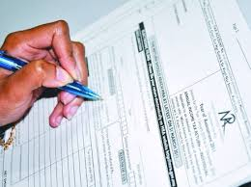
Tax Administration Challenges
Return not filed
3.Reminder
1.Register
2.File Tax Return
Return filed
5.Refund
ITAS (SAP TRM) connects the entire tax & revenue management lifecycle process
4.Process Tax Return
6.E-Payment
8.Assessment
Selection of cases
7.Tax Audit

Slide 6
Integrated Tax Administration Solution (ITAS)
In 2010, ITAS went live on SAP – ERP with the Tax Revenue Management module. Today we have over 45 tax types on ITAS.
Robust, reliable, scalable, flexible, audit trail, monitoring mechanism
Workflow – approval process automation – No printing and no signing necessary
Business Rules Engine(BRF+) built-in to cater for business logic mainly on returns
SAP Business Warehouse, SAP Business Objects were configured for reporting purposes with a view to offload the ECC system.
Portal for both the tax officer and for the tax payer, thus allowing externalising services to stakeholders, ➔ eServices
In 2017/2018, ITAS underwent a major technical Upgrade to S/4 HANA 1610 – in-memory technology – much faster user response
In 2021, ITAS was upgraded to latest release S/4 HANA 2020, with CRM (branded as Customer experience) with many standard role-based FIORI apps delivered for immediate use.

Slide 7
eServices – Taxpayer’s Portal
E-filing of tax returns using eservices platform/ TP portal
Introduced e-filing of income tax returns in 2008
- 99% of e-filing in 2020
- pre-filled tax returns
- user Authentication and OTP for greater security
- e-filing thru smart applications (tablets, I-Phones, I-Pads)
- draft returns can be saved before final return is submitted
Other eServices available:
Collection of social contributions at MRA
Payment of benefits – Negative Income Tax, Special Allowance
E-objection application
eNotification – SMS gateway, email
E-Complaint management system
Application for Tax Residence Certificate (TRC)
Online facility for reporting FATCA, CRS and CbC files from Financial Institutions

Slide 8
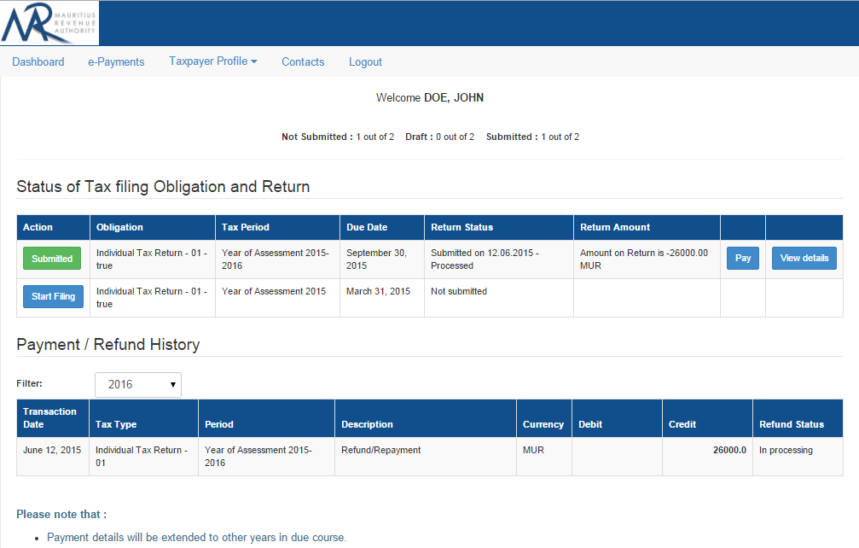
Taxpayer’s portal
10/7/16
Notes:
8
8

Slide 9
E-payment facilities
Reduced several ePayment channels to only a few efficient ones.
Payment modes available at MRA :
Incoming Payment
Direct Debit
Credit card (for individual taxpayers)
Outgoing Payment
Electronic Fund Transfer (same system as Direct Debit)
The Direct Debit facility becoming increasingly popular as :
Secure and hassle free mode of payment
No registration for individuals
One time registration for organisations
Minimal cost per transaction irrespective of amount
Easy reconciliation

Slide 10
Direct Debit Payment Flow
File Tax Return and make payment using MRA’s mobile app or web applications
MRA E-Services
Payment Module
Prepare payment instructions
Taxpayer
MRA receives payment feedback
Receive payment status
Treat payment feedback from commercial banks
Successful/dishonoured payments
Send payment feedback to MRA
Execute payment instructions
Debit beneficiaries accounts
Central Bank of Mauritius captures & treats payment instructions
Sends payment instructions to commercial banks
Taxpaer
Notify taxpayers of payment status

Slide 11
Third-party information
Generic Format
(Inscriptions, Purchase of Food and Beverages, etc…)
Medical Insurance
Master Data
Housing Loan
Tax Obligations
VAT Details
(Supplier and Customer)
Tax Returns
Building Permits
Immovable Properties
(Acquired and Sold)
Customs Imports & Exports
Goods and Services
(Purchases and Sales)
Audits
Registered Motor Vehicles
(National Transport Authority)
Assessments
Return of Employees
Accounting
Tax Deduction at Source
(on Bank Interest)
Tax Deduction at Source
(on Services)
11

Slide 12
Info Highway
Automatic exchange of information
Platform implemented by the Government of Mauritius for sharing of information electronically among public sector agencies
Live and Real-time access to third party info
Publisher to share and Subscriber to consume
Live validation of returns – Data accurate right at source
There are three ways of accessing namely through
Portal
Web Services
Bulk extraction by SFTP
10/7/16
Notes:
12
12

Slide 13
Evolution of IT Systems
Impact on Laws and Legislations
2014
I-Recruitment - Taleo Cloud Solution
E-Filing of Personal Income Tax - Mobile
VAT Lucky Draw - Website, SMS, Mobile App
Payment by POS and Credit/Debit card
2006
Consolidation of Three Tax Legacy Systems
2007
Oracle Financial and Human Resources Management System Implementation
Efiling: Personal Income Tax
2015
E-Objection
FATCA Registration and Reporting
Adhoc Exchange of Info with other Tax Authorities
Time Attendance System Implementation at MRA Headquarter
2016
MRA Taxpayer Portal
Payment Facility – DIRECT Debit - BOM
Complaint Management System
2008
Oracle Self Service
2009
2017
MRA Easy MOBILE App
Integration of ITAS & Govt Infohighway
CRS
Integrated Tax Administration Solution Phase I - VAT, TDS, PAYE, Rum & Liquor, Gaming and Betting
2010
2018
Social Contributions (including filing of joint PACO)
Major Upgrade of ITAS to S/4 HANA
Integrated Tax Administration Solution Phase II - Income Tax
Tax Return Scanning Solution
2011
2019
Country By Country Reporting
2012
Payment by ATM
Prefilling of Returns on MRA E-Services
PRGF and Contribution Sociale Generalisee
COVID Assistance Schemes such as GWAS, SEAS, COVID Solidarity fund
E-Payment of Excise license, Rum and Liquor
SAP Business Objects for Advanced Reporting
Paperless Office: SAP Record Mgt System
QR codes for tagging & tracking of assets
Mobile Payment
Transfer of Horsre Racing Central Server to MRA
2020
2013
2021
Installation of Behavioural Insight
Schemes such as Financial Assistance to SME, Special Allowance to EOE

Slide 14
Mobile Development - MRAEasy
In the year 2016, MRA introduced MRAEasy, a Mobile application for the filing of returns:
allow employers in Mauritius to file and pay their employees’ Pay-As-You-Earn (PAYE) as well as Contributions (CSG and National Solidarity fund) on a monthly basis.
Allow individual taxpayers file their Annual Income Tax return
To ease the employers’ filing, the MRAeasy App
prefills ALL the employees’ details for the employer
The employer may then add additional employees and/or modify an existing employee’s details.
The employer can browse throughout the app without internet connection.
An internet connection is required only when the user is logging in, submitting a return and effecting a payment.

Slide 15
COVID-19 Government Initiatives
Lockdown from 19th Mar -30 Apr 2020 AND Mar 10 2021-now
Government came up with several Assistance schemes to help the residents of Mauritius during confinement
Wage Assistance Scheme – Paid the employers so they can pay their employees during the lockdown
17,000 employers affecting 300,000 employees
Self-Employed Assistance scheme – Paid directly to the self-employed upon application
211,000 self-employed amounting
eApplication developed in a week and payment were done through ePayment platform through the central bank
Bandwidth management specially during peak hours
All eServices were up during confinement

Slide 16
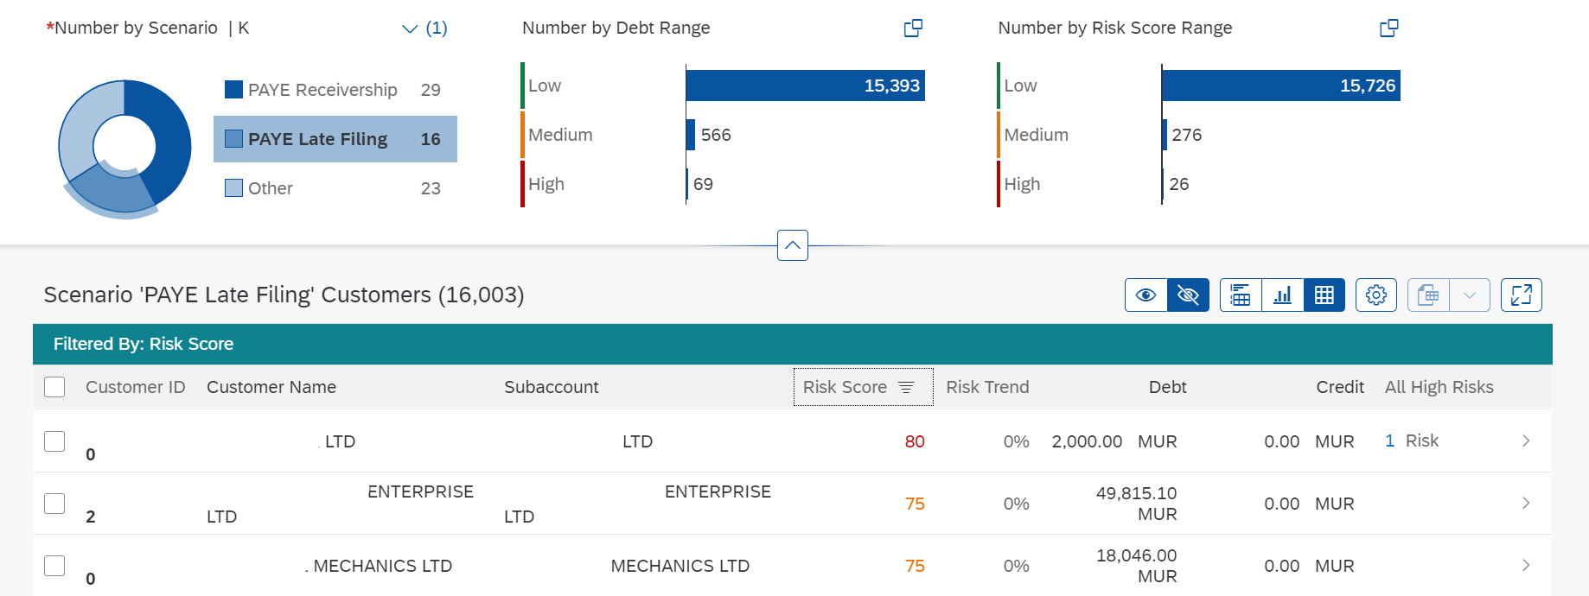
Other projects –
SAP Behavioral Insights
Uses Machine Learning to predict scores for taxpayers with respect to specific risks like Late Payment and Late Submission.
Enables us to be proactive in dealing with risky taxpayers like late payers and late filers so as to enhance compliance and collection.
Status: Product Installed and configured. Training of end users to be planned and Operation to be defined.

Slide 17
Currently in pipeline -eInvoicing and Fiscalisation
Impact on Laws and Legislations
Tax Agency E-invoicing System
Buyer
Supplier
2. TA provides fiscalised receipt or invoice
5. TA provides details of fiscalised receipt/invoice
4. Buyer checks validity of fiscalised receipt/invoice with TA
1. Supplier sends invoice to Tax Agency (TA) for fiscalisation
3. Supplier sends fiscalised receipt or invoice to Buyer
6. Buyer makes payment for fiscalised receipt/invoice

