Slide 1

BRIEF ON FUEL SUBSIDY

Slide 2
Key facts about subsidy
1.
2.
3.
4.
In 2012, The landing cost of a litre of PMS is estimated at N104/litre based on a crude oil price of US$90pb
Under the current downstream sector structure, prices are not determined by demand and supply.
Pump price of PMS is fixed at N65 per litre by Government.
The landing cost of a litre of PMS is about N123/litre based on an average crude oil price of US$113.98pb
To this, add the cost of distribution, bridging and Profit margins of N15.49/litre.
This results in effective cost of N138.49/litre.
To this, add the cost of distribution, bridging and Profit margins of N15.49/litre.
This results in effective cost of N119.49/litre.

Slide 3
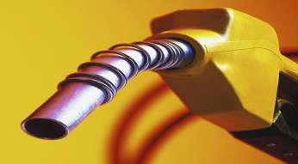
What is fuel subsidy?
1.
Paid, by government, to keep prices below free market.
2.
Causes distortions that result in huge economic costs such as rent-seeking behavior and smuggling etc
3.
Amount of Subsidy = difference between the consumer pump price of fuel vs. the total cost of producing or importing
4.
The price of petrol = N65 per litre but actual cost of supply = N138.49 per litre;
And projected at N119.49/litre in 2012.
6.
Presently, only petrol and kerosene enjoy government subsidy. Diesel has already been successfully deregulated.
5.
This means that currently for every one litre of petrol purchased at the official price of N65 Government contributes N73.49

Slide 4
    Deregulation of the downstream sector
    (Benefits of deregulation)
1. Implies limited intervention by government
2. Allows for better regulation & transparency
3. Allows for free operation activities in the sector.
4. Attracts new investors into the market. Increase competition and promote overall higher productivity.
5. Reduces scarcity: by ensuring adequate supply of petroleum products.
6.Similar Success story to the telecommunication sector.

Slide 5
Why remove Subsidy? (1)
It is a major fiscal and financial burden on the nation:
(i) From 2006 to 2011, about N3.7 trillion was spent on subsidy.
(ii) In 2011, N1.348tr was spent between January and October and it is expected to reach N1.436tr by the end of the year.
(iii) This represents 30% of total FGN Expenditure, 118% of the capital budget; 4.18% of GDP.
The large increase observed in 2011 is a result of:
(i) Increased crude oil price from US$81.25pb to US$113.98pb
(ii) Exchange rate movements
(iii) Larger Volume consumed (about 35 million litres per day)
(iv) N150bn of Kerosene carried over from 2009 and 2010
Year | Average Crude Oil Price (US$ pb) | TOTAL Subsidy | Year on year Growth Rate
2006 | 67.03 | 261.11 | -
2007 | 74.68 | 278.86 | 7%
2008 | 101.78 | 630.57 | 126%
2009 | 63.02 | 463.59 | -26%
2010 | 81.25 | 672.84 | 45%
2011 (Jan - Oct) | 113.98 | 1,348.20 | 100%
TOTAL |  | 3,655.17 | -

Slide 6
Why remove Subsidy? (2)
Decrease smuggling activities particularly to neighboring countries
Reduce fraud and rent seeking behavior in the sector
Present level of Subsidy is not sustainable!!!
Does not reach intended beneficiaries
Benefits mostly the rich
Lack of Investment Incentives
20 refinery licenses already issued to private individuals/companies since 2000
None has built a refinery yet because with the current market structure, investors cannot even cover their costs
Revenue can be used for many other pressing social and infrastructural development projects in sectors like health, education, power supply and roads.

Slide 7
Who Benefits from Subsidy?
The Rich & Middle Class
- A motorcycle owner uses about 20 litres/week compared to 60 l for a small car owner
- Others take buses, taxis & okodas and their subsidy level is low
Neighboring Countries
Smugglers
Normal profit accruing to Independent Marketers

Slide 8
Subsidy and FGN Budget
    A substantial amount of money is expended on subsidy
    This could be invested in capital projects and used to reduce deficit and domestic borrowing which adds to our debt.
    In 2011 FGN borrowed N852bn to finance its deficit.

Slide 9
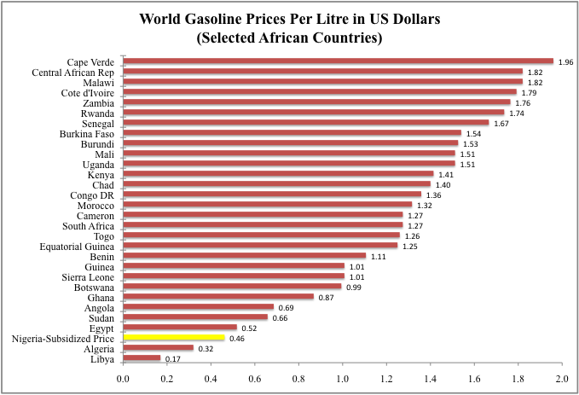
How Nigeria Compares with Other African Countries
    Petrol price in Nigeria ranks low in Africa...
    Nigerian Estimate based on crude oil price of US$113.98pb

Slide 10
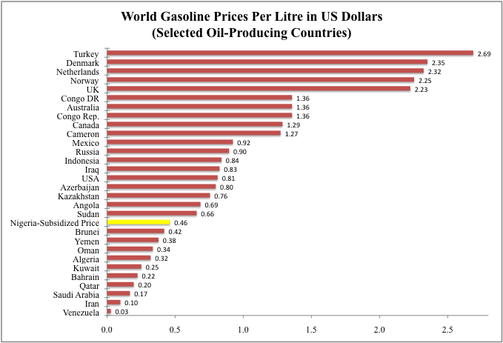
How Nigeria Compares with Other Oil Producing Countries (3)
    PMS price is below international average
    Unsubsidised Estimate based on crude oil price of US$113.98pb

Slide 11
How Nigeria Compares with Other Oil Producing Countries (1)
    Nigeria is poor compared to other oil producing countries
N/S | Country | Population (millions) | Crude Oil Reserves (barrels per person) | Oil Revenue (US$ per person) | Average GDP per person (2006-2010 in USD) | Human Development Index | Price Per Litre (in US Dollars)
1 | Kuwait | 2.82 | 35,993 | 29,239 | 35,516 | 0.76 | 0.25
2 | Qatar | 1.71 | 15,150 | 30,161 | 68,080 | 0.82 | 0.2
3 | Saudi Arabia | 27.14 | 9,746 | 12,116 | 15,839 | 0.77 | 0.17
4 | Venezuela | 29.46 | 7,168 | 2,756 | 9,544 | 0.73 | 0.03
5 | Iraq | 32.11 | 3,581 | 2,517 | 2,197 | 0.57 | 0.83
6 | Iran | 75.88 | 1,806 | 1,840 | 4,559 | 0.71 | 0.10
7 | Norway | 4.97 | 1,340 | 14,145 | 81,616 | 0.94 | 2.25
8 | Angola | 19.6 | 689 | 3,101 | 3,817 | 0.48 | 0.69
9 | Congo Rep. | 4.14 | 469 | 2,317 | 2,721 | 0.53 | 1.36
10 | Algeria | 36.2 | 337 | 1,638 | 4,125 | 0.70 | 0.32
11 | Nigeria | 167.05 | 223 | 472 | 1,203 | 0.45 | 0.46
12 | Sudan | 30.89 | 217 | 521 | 1,338 | 0.41 | 0.66
13 | Yemen | 23.83 | 112 | 364 | 1,079 | 0.46 | 0.38
14 | USA | 312.69 | 99 | 789 | 46,071 | 0.91 | 0.81
15 | UK | 62.3 | 46 | 706 | 40,304 | 0.86 | 2.23
16 | Indonesia | 237.64 | 18 | 137 | 2,228 | 0.61 | 0.84
17 | Cameroon | 19.4 | 10 | 109 | 1,102 | 0.48 | 1.27

Slide 12
How Nigeria Compares with Other Oil Producing Countries (2)
    Compared to other oil producing countries, Nigeria has a significantly lower GDP per capita; substantially less oil revenue per capita and greater social challenges:
      Total crude production of approximately 2.5 million barrels per day. Therefore Nigeria has a significantly lower GDP per capita
      Nigeria's GDP per capita is around $1,200 per year with over 167 million in population
    Low level of human development indicates :
      That our spending priorities MUST differ from those of more developed oil producers
      And address a large number of unmet needs through judicious use of resources flowing from deregulation.

Slide 13
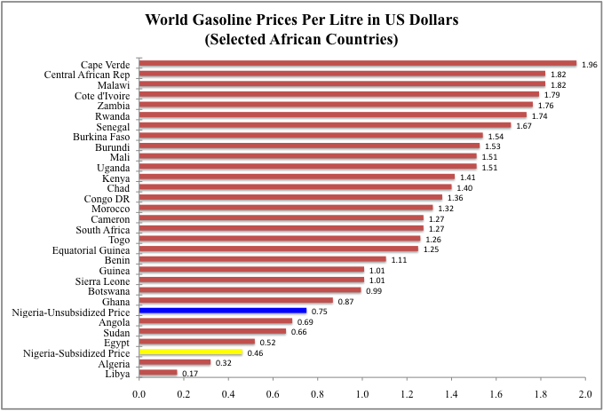
Where will Nigeria stand after Subsidy Removal? (1)
    Within Africa...
    Unsubsidised Estimate based on crude oil price of US$90pb

Slide 14
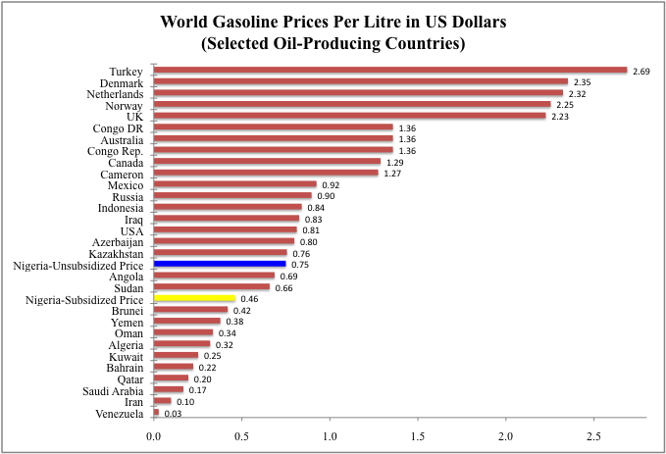
Where will Nigeria stand after Subsidy Removal? (2)
    Internationally...
    Unsubsidised Estimate based on crude oil price of US$90pb

Slide 15
How will FGN use the freed resources from subsidy removal? (1)
SUbsidy Reinvestment and Empowerment Programme (SURE Programme)
FGN developed this program
Social Safety Net Programs to help poorest households to cope with impact of price increase
Maternal and child health services,
Designed to invest the freed resources in social safety nets and infrastructure
Encapsulates all the proposed palliative programmes
Public works/youth employment programme
Urban mass transit scheme, and
Vocational training schemes

Slide 16
How will FGN use the freed resources from subsidy removal? (2)
    High profile infrastructure projects across the country in sectors such as:
Infrastructure
Roads and Rails
Infrastructure
Water Resources
Infrastructure
Power
Infrastructure
Refineries
(With Private Sector)
    To ensure sustainability and delivery of these projects:
      Structures have been developed to guarantee adequate oversight, accountability, and implementation of the various projects.
      High powered committee of eminent Nigerians to monitor revenue proceeds and proper implementation:
      Members with proven integrity from Nigerian Youth, Women groups and Civil Society Organisations.

Slide 17
Who will benefit from the subsidy removal?
The Nigerian Public at large
Youth through:
- Public works programme
- Training schemes
- Refineries creating jobs
- ICT projects
Urban Mass Transit Users
Women and their Children through:
- Maternal and Child health services
Traders and Inter-city Commuters through improved roads and railways system
Farmers through improved irrigation and water conservation systems

Slide 18
End Notes:
The current subsidy on petroleum products is the difference between landing cost and pump price fixed by government
Subsidy does not get to the poor. The middle and upper classes are the real beneficiaries
It is clearly unsustainable! Subsidy in 2011 alone so far is over N1.3tr; which is higher than our capital budget.
Evidence shows that the price of fuel in Nigeria is below both the African and International average!
Nigeria with its large population and small oil base is comparatively poor compared to other oil producers
Therefore:
  We must rethink our approach to managing our scarce resources to provide services to Nigerians.
  We will be better off using the amount spent on subsidy to target poorer groups and big infrastructure projects
To ensure effectiveness, efficiency and delivery a high profile committee will monitor implementation and use of the amount saved

Slide 19


