Slide 1
UPDATE ON IMPLEMENTATION OF THE BASIC HEALTH CARE PROVISION FUND (BHCPF) by Dr. Osagie Ehanire Honourable Minister of Health National Economic Council Meeting
FEDERAL MINISTRY OF HEALTH
21st January, 2021

Slide 2
Background
The Basic Health Care Provision Fund (BHCPF) is enshrined in the National Health Act 2014, as an irrevocable testament to Nigeria’s commitment to achieving Universal Health Coverage.
Its implementation started with a Presidential launch in January 2019 following which N55.1 Billion was made available from the 2018 statutory allocation.
The implementation of the Fund was suspended in January 2020 following observations by the Health Committees of the National Assembly that some portions of the earlier developed 2018 Operations Manual for the implementation of the Fund were not in compliance with the National Health Act.

Slide 3
Overview of the Fund
In accordance with the National Health Act, the BHCPF is derived from three Sources:
(a) An annual grant from the Federal Government of Nigeria of not less than one per cent (1%) of its Consolidated Revenue Fund (CRF)
(b) Grants by international donor partners
(c) Funds from any other sources, inclusive of the private sector.
The overall objective of the BHCPF is to ensure the provision of a Basic Minimum Package of Health Services (BMPHS) to all Nigerians, strengthen the Primary Health Care (PHC) system and provide emergency medical treatment.
Notes:
Key amidst complains from the Implementing organizations was the fact that the BHCPF was threatening the sustainability of the SSHIA which depends on premium paid by citizens.

Slide 4
The Basic Health Care Fund is premised on four key levers that address the drivers of poor health outcomes in Nigeria
SCHEME LEVERS
Levers
Description
Dedicated
funding
mechanism
Additional fiscal space: 1% of the Consolidated Revenue Fund (CRF) is statutorily allocated to health
Funding expected to be channelled towards delivery of primary care services
Demand and
supply side
financing
Strategic purchasing of a minimum package of health services
Investments in the building blocks of the health system in a manner that improves the quality of care
Strong
coordination
Roles for government at federal, state, LGA and community levels
Organized delivery of health care services
Robust
governance and
accountability
framework
Clearly established lines of accountability
Funds to address critical needs
Robust data and performance frameworks for continuous evaluation

Slide 5
Governance and Operational framework for BHCPF
Reporting and Feedback
Honourable Minister of Health
[MOC]
Programmatic and financial
NPHCDA
NHIS
NEMTC
Gateways Forum
Hon Commissioner of Health [soc]
SPHCB/A
SSHIA
SEMTC (TSA)
LGA Chairman
[LGA PHC Advisory Comm]
Gateways Forum
LGHA
WDC
PHC
The Gateways Forum is the periodic meeting of the 3 Gateways to ensure synergy, resolve operational conflict and to facilitate common public communication and messaging.

Slide 6
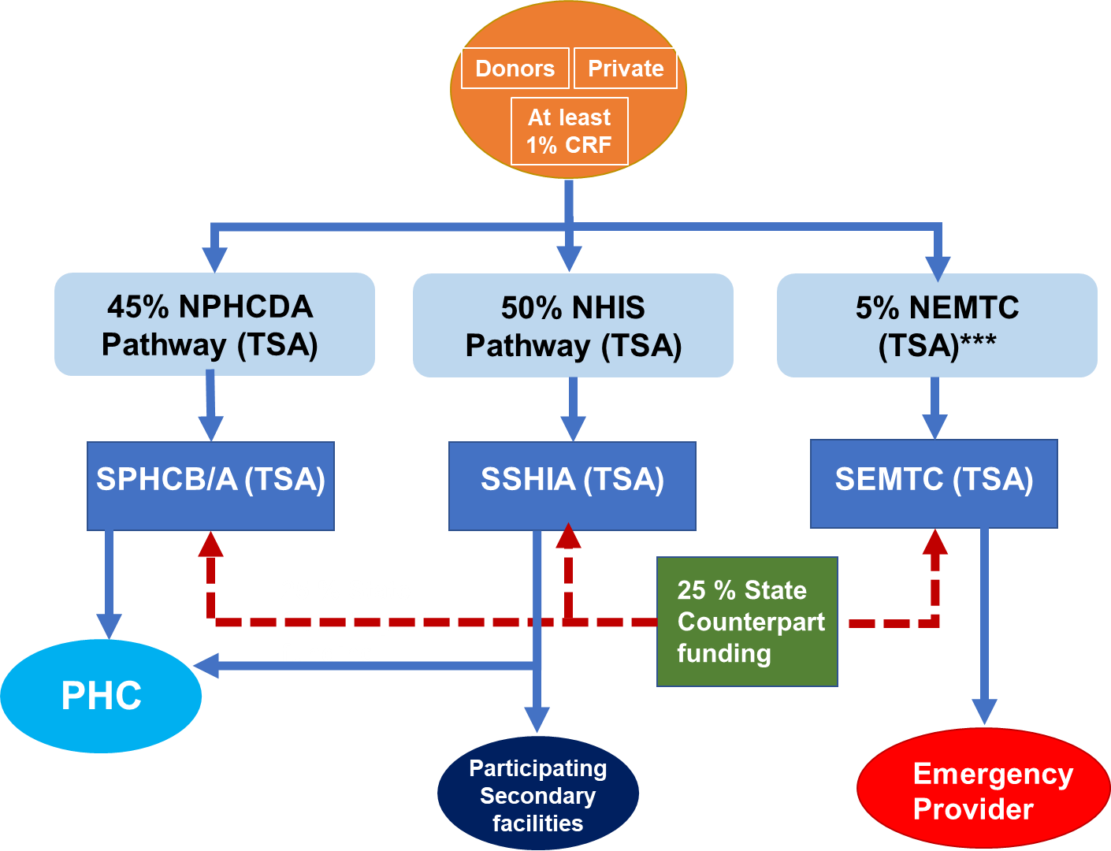
Financial Arrangement for BHCPF
At least 1% CRF
Donors
Partners
HRH and Infrastructure
25% to be remitted by states as funding or prorated as new or scaled-up investments in HR, Infrastructure and Equipment
Financial management to be based on FGN Public Financial Regulations
Notes:
The 25% counterpart funding from states and LGAs would be paid to the State TSA and constitute 100% of funding available to the state (i.e. National 75%, State 25%)

Slide 7
Accountability
The HMH and the States HCs will maintain leadership and oversight over the BHCPF
The use of TSA is expected to enhance transparency as it can be viewed across all level by authorized persons.
Financial and programmatic reports are due quarterly and reviewed in line with the governance and operational structure of the BHCPF
An Accountability Framework is incorporated in the Guideline and reporting at all levels would contain sections reflecting actions taken based on the framework.
Oversight committee and gateways to routinely make public press releases on funding and implementation status.
Regular supervision, monitoring and quality assessment at all operational levels and by the MOC.
Regular audits to be done by the office of the Auditor General; and financially contributing Donors and Partners may also commission audits.
Notes:
Key defaults are non remittal of funds to beneficiaries and misuse of funds. Sanctions for the NPHCDA Gateway include: Warning, Reports to State Governors, withholding of Funds, suspension of State from Gateway and reporting to financial crime institutions etc. For the national level sanctions may be applied by the HMH.

Slide 8
Payment and Implementation Gateways
Disbursing 50% of the BHCPF through the National Health Insurance Scheme (NHIS) via a pathway to be called the NHIS Gateway, for the provision of BMPHS to citizens in eligible primary and secondary health care facilities.
Disbursement of 45% of BHCPF through the National Primary Health Care Development Agency (NPHCDA Gateway) for the provision of essential drugs, vaccines and consumables for eligible primary health care facilities (20%), the provision and maintenance of facilities, laboratory, equipment and transport for eligible primary healthcare facilities (15%) and the development of Human Resources for Primary Health Care (10%)
Utilization of 5% for the provision of Emergency Medical Treatment (EMT Gateway) through the National Emergency Medical Treatment Committee.

Slide 9
Updates on the Implementation of the Fund
Funds have been disbursed to all the states and the FCT for both the NPHCDA and NHIS Gateways
Of the N55.1bn appropriated in 2018, 50% was released (N27.55b) in addition to donor funds
There were no disbursements in 2019 and 2020 to the BHCPF
For 2021, the FMB&NP allocated N35billion
Notes:
Key amidst complains from the Implementing organizations was the fact that the BHCPF was threatening the sustainability of the SSHIA which depends on premium paid by citizens.

Slide 10
NHIS Gateway Operations
NHIS responsible for implementing the ‘NHIS Gateway’ i.e. 50% of the BHCPF
The fund shall be used to purchase the Basic Minimum Package of Health Services (BMPHS) for all Nigerians.
BMPHS which covers the entire spectrum of care (preventive, promotive, curative and rehabilitative) has been upgraded to also include elements of emergency care at both primary and secondary levels.
Purchase of PHC services will be via CAPITATION based on total enrollees; while for secondary care payments would be based on FEE-FOR-SERVICE MECHANISMS
Funds have been disbursed to all 36 states for the NHIS Gateway

Slide 11
Benefit Package
Primary Level Care
General consultation with prescribed drugs
Health education for prevention of diseases
Primary care Surgery
Primary Care Mental Health
HIV/AIDS/Sexual Transmitted Diseases
Primary care Paediatrics
Primary Care Internal Medicine
Primary Care Maternal, Neonatal & Child Care
Primary Care Emergency Services
Basic Laboratory Services
Secondary Level Care
Consultation with prescribed drugs
Emergencies outside the usual residence
Admission
Treatment and procedures that cannot be handled at primary level but covered by BMPHS.
Treatment of opportunistic infections as defined in the HIV Treatment Protocol
Paediatric conditions
Internal Medicine (Adult)
Obstetric & Gynaecology
Surgery
Laboratory Services
Referral

Slide 12
Target Beneficiaries
All Nigerians
Emphasis will be on the poorest of the poor and other vulnerable groups
Targeting options include
Use of National Social Register
State level targeting
Beneficiaries’ data must be captured in NHIS/SSHIA database in approved format to ensure authenticity of enrolees
All enrolment will be validated using National Identification Number (NIN)

Slide 13
States enrolling for BHCPF as at 18th January, 2021
S/N | States
1 | Kaduna
2 | Kano
3 | Niger
4 | Sokoto
5 | Kwara
6 | Nasarawa
7 | Yobe
S/N | States
8 | Cross River
9 | Anambra
10 | Ebonyi
11 | Abia
12 | Kogi
13 | FCT
14 | Ogun

Slide 14
NPHCDA Gateway Operations
NPHCDA responsible for implementing the ‘NPHCDA Gateway’ i.e. 45% of the BHCPF
The NPHCDA through the Gateway shall support states, SPHCBs and LGHAs to ensure at least one functional PHC in every political ward across the country; prioritizing Public PHCs in rural areas.
Proposal from SPHCB/A for funding would follow a bottom top approach:
Summation of cost of Business Plans from PHCs submitted through the LGAs,
Costing of the states human resource needs (prioritizing SBAs and CHIPs),
cost of systematic intervention in infrastructure and equipment for PHC etc.
NPHCDA shall make quarterly disbursements to states based on annual Workplans submitted by state, within state assigned funding envelopes.
NPHCDA would provide technical support to states, monitor, verify, conduct/oversee surveys and coordinate stakeholders' interventions relating to the Gateway nationwide.
PHC to operate with some level of autonomy to spend funds received from the SPHCB/A in implementing their business plans.
Notes:
Funding to states is currently determined by applying the human development index (HDI) and population to available resources.

Slide 15
Status of Baseline Assessment of BHCPF Facilities in States
Baseline assessment of facilities
Field Assessment of PHC Facilities, and Data Analysis Completed in 27 States:
Abia, Adamawa, Anambra, Bauchi, Bayelsa, Benue, Delta, Ebonyi, Edo, Ekiti, FCT, Imo, Jigawa, Kaduna, Kano, Katsina, Kebbi, Kwara, Nasarawa, Niger, Ogun, Osun, Oyo, Plateau, Sokoto, Yobe and Zamfara
Field Assessment Completed, but Data Analysis ongoing in 8 States
Kogi , Borno, Gombe, Lagos, Taraba, Cross River, Ondo and Enugu
2 states are yet to conduct their baseline
Akwa Ibom, and Rivers
Total States
Completed
Ongoing
Yet to commence
The baseline assessment is a state based & funded activity to determine the baseline condition of selected PHCs and track improvement across 10 thematic areas including infrastructure, staffing etc.

Slide 16
Status of Capacity Building of Health Workers on BHCPF
Capacity building of health workers
Training of Facility health workers’ training has been completed in 25 States at 31st December, 2020
Abia, Anambra, Bauchi, Bayelsa, Delta, Ebonyi, Ekiti, FCT, Jigawa, Kaduna, Katsina, Kebbi, Nasarawa, Niger, Ogun, Osun, Oyo, Yobe, Kano, Kwara, Benue, Adamawa, Gombe Imo and Zamfara
Trainings are ongoing 7 States
Sokoto, Edo, Ondo, Borno, Taraba, and Plateau
Capacity building is yet to commence in 6 States: Kogi, Akwa Ibom, Cross River, Enugu, Lagos, and Rivers
Challenges include late commencement of preceding process i.e., baseline, lack of funding and other state level challenges, including the COVID pandemic.
So far, the following has been trained:
BHCPF state trainers: 1353
HWs: 10,766
WDCs: 10,730
Total States
Completed
Ongoing
Yet to commence
The Capacity building is for the state’s health workers and Ward Development Committee (WDC) members on how to manage the BHCPF programme and DFF
This is a state funded activity

Slide 17
Verification of states
To be eligible for verification, states must have completed Capacity Building
Verification exercises ensure that all the selected PHC facilities meet the minimum requirements to receive DFF and provide quality services
Requirements include functional bank account, trained HRH, fair infrastructural etc.
PHCs with challenges must be addressed by the state prior to receipt of DFF funding
Of the 22 state verified:
9 States have commenced disbursement to 1,691 authorized PHCs,
13 states expected to disburse to 2,250 PHCs by end of January, 2021
Remaining 3 states (Adamawa, Gombe & Imo) out of 25 eligible have been scheduled for end of January, 2020
Total eligible
Total verified
Scheduled

Slide 18
A total of 1,691 health facilities across 9 states have received the funds
# of Wards
# of HFs that received funds
Abia
Ebonyi
FCT
Osun
Anambra
Delta
Niger
Nasarawa
Kaduna
A total of 9 states have commenced disbursements to PHCs based on meeting all readiness criteria and authorization by the NPHCDA
The other health facilities that were not cleared to receive funds due to infrastructural and human resources deficiencies
The states have made written commitments to address these deficiencies as soon as possible

Slide 19
All the funds totaling NGN 13.2 Billion received by the NPHCDA Gateway have been disbursed to 36 states and the FCT (based on Year 2018 allocation and release)
Total funds received by the NPHCDA (NBillion)
Disbursements to States and PHCs
13.2
States have commenced disbursement to PHCs
States have received Gateway funds, but have not commenced disbursement to PHCs
11.8
Kaduna
Niger
FCT
Nasarawa
Osun
1.4
Delta
Ebonyi
Total received from BHCPF by NPHCDA
1% CRF
GFF from World bank
Anambra
Abia
Of the 36 states and FCT that have received funds, 19 have been authorized to disburse funds to the eligible PHCs, while 9 states have commenced disbursements to PHCs (Abia, Anambra, Delta, Ebonyi, FCT, Nasarawa, Niger, Kaduna and Osun)
The 10 remaining states are to be authorized to disburse to PHCs this January, having just completed their verification process

Slide 20
EMT Gateway Operations
National Health Act states that 5% of Basic Health Care Provision Fund shall be used for Emergency Medical Treatment (EMT) to be administered by a committee appointed by the National Council on Health: The National Emergency Medical Treatment Committee (NEMTC)
NEMTC would operate through SEMTCs, working in synergy with any existing State level Emergency Agencies.
Core focus of the EMT Gateway would be the establishment and operationalization of a National Ambulance Service; and enabling capacity for emergency response at individual/client level inclusive of public health emergencies.

Slide 21
NATIONAL EMERGENCY MEDICAL SERVICES AND AMBULANCE SYSTEM (NEMSAS)
112
112

Slide 22
FIXING EMERGENCY MEDICAL SERVICES
A huge proportion of these mortalities present as emergency medical conditions
Fixing the emergency medical services will potentially save about 25% of annual mortalities and 50% annual morbidities
112

Slide 23
EXISTING EMERGENCY MEDICAL SERVICES
1.
Segmented, no national coordination
2.
No national 3 digit number, 112, 911, 999, 111
3.
No national governance struture
4.
No shared facilities between states
5.
No nation-wide data
112

Slide 24
THE NEMSAS APPROACH
01
06
Nationally coordinated, with provision of governance and guidelines
All disease conditions resulting in emergencies catered for
02
07
Integrated software, communication and monitoring & evaluation components
Guaranteed payment to providers
03
08
State based
Payments for services provided
04
09
Use of existing ambulance services and emergency healthcare facilities
No prepayments required from patients
05
10
Strong public-private partnership
Enhanced community and citizen emergency medical services awareness
112

Slide 25
BASIC BUILDING BLOCKS
01.
02.
Current Health System and Disease Burden
Governance and Institutional Leadership
03.
Information and Communication
Technology
04.
Human Resource and Training
05.
06.
Emergency Care Equipment
Provider Accreditation
07.
08.
Monitoring and Evaluation
Branding and Publicity
09.
Finance
10.
User Reimbursement
112

Slide 26
PROVIDERS
New/Exisitng Providers
Emergency Ambulance Services
Acute Care Centres
Hub and Spoke Method
Ongoing Re-evaluation of all
Providers
Payment as per agreed work based tariff using existing mechanisms
Use of Nearest Appropriate Ambulance
and Acute Care Centre
112

Slide 27
MAIN STEPS FOR NEMSAS SERVICES
On-scene & in-transport
treatment
SOS Request
01
02
03
04
05
Incident
Dispatch
Hospital Admission
112

Slide 28
FINANCE
Seed money from 5% Basic Health Care Provision Fund (BHCPF)
Funds raised will be used to pay for poor people.
Huge expansion of healthcare fiscal space envisaged.
Funds to be raised from donors including corporate organisations and private citizens.
Huge economic impact
Reinbursement by individuals who can afford care.
**No Payment at the point of treatment
112

Slide 29
IMPLEMENTATION
Phased
Gradual geographical spread to all states
Gradual inclusion of road ambulances to include air, and water.
Utilize local resources
Utilize and strenghten existing medical services
112

Slide 30
EXPECTED GAINS OF NEMSAS
Reduce mortality by half
1
Provide jobs
2
Create research and training opportunities
3
Promote medical education
4
Promote research
5
Improve private – public collaboration
6
Provide room for citizen participation
7
Hallmark achievement of the administration
8
112

Slide 31
CHALLENGES
Many States have not been able to access their TSA Accounts and this has slowed down implementation
Reluctance of States to Meet the 25% Counterpart funding as required by law
Relative slow pace of implementation in some states as a result of Non-completion of prerequisite activities (i.e. baseline assessment, capacity building) which are state funded activities and COVID-19 pandemic related challenges in 2020
Non release of 2019 and 2020 Allocation for adequate funding of the gateways

