Slide 1
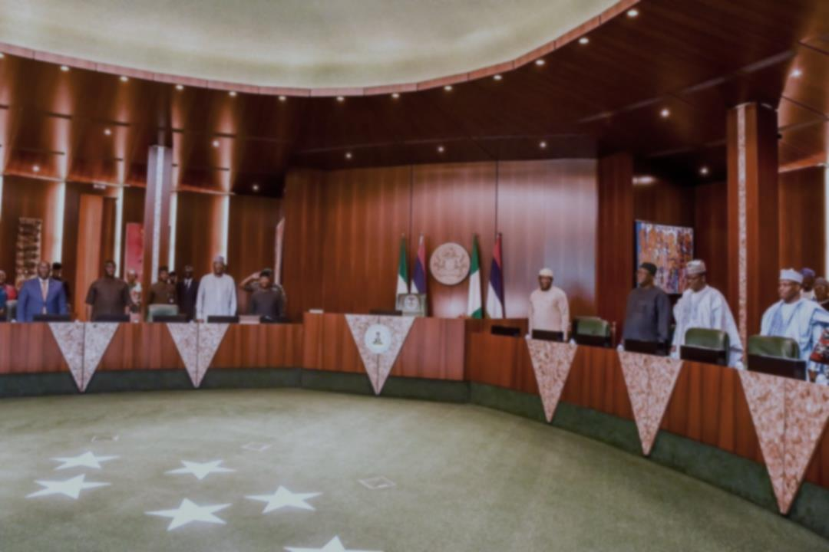
National Economic Council
2020 Resolutions Report
January 2021

Slide 2
Introduction
The National Economic Council held a total of Ten (10) Council meetings and One(1) Emergency meeting in the year 2020
A total of Twenty-Eight (28) resolutions were passed across Four (4) key thematic areas
Thematic Area |  | Number of Resolutions
Investing in People | HCD | 2
 | COVID-19 | 9
 | Public Engagement | 3
Fiscal Stability |  | 6
Infrastructure |  | 3
Environmental Sustainability |  | 2
Others |  | 3
Total Resolutions Made |  | 28
The Resolutions/Decisions made have been arranged according to Thematic Areas and documented in the following slides for review
It is hoped that the review of these Resolutions/ Decisions of Council will ensure proper follow-up, implementation and achievement of targeted Policy objectives.

Slide 3
Key Action Points for States
No | Thematic Area | Actions Required
1 | Nutrition | Mandate relevant States Structures with responsibility to interface and collaborate with the National Technical Committee on Nutrition
2 | Fiscal Stability (Economic Sustainability Plan) | States to collaborate with the Economic Sustainability Committee for effective implementation of the Plan. Implementation monitoring should be sustained
3 | Human Capital Development (HCD) | States Scorecard to be presented at the February 2021 NEC Meeting States to constitute their Human Capital development Councils States to provide information to enable the World Bank conduct a Public Expenditure Review as a prerequisite under the Human Capital Index (HCI) program of the World bank
4 | COVID-19 Response | Task force to ensure compliance Spot checks and enforcement of COVID 19 protocols to be sustained Expand Number of testing centres Public enlightenment to be sustained
5 | Growth of MSMEs and Job Creation | Expand Land banks in each State earmarked for investment in agriculture and agro-processing Develop and roll out a digitalized and transparent land acquisition system for all Land holdings Set up a one Stop Shop for entry in Agriculture Aggregation of all laws governing taxes Centralization of all tax collection in the State Issuance of Tax identification numbers for all Companies
6 | Generation Unlimited/ Co-creating solutions with Youths as Agents of Change | States to express interest based on: Youth population Deprivation index Internet connectivity Effective Right of way for Broadband penetration Existing Infrastructure and Relevant State programes Private Sector Engagement

Slide 4
NEC 2020 Resolutions/Decisions: Investing in People (HCD)
No | Resolutions (Meeting Ref) | Task Owners | Update | Further Actions Required
1 | Council resolved that individual States should invest on nutrition and put in place a structure to deal with the various challenges (NEC 01/2020/101ST MEETING) | Council Members Technical Committee on Nutrition | The Vice President has set up a Technical Committee to interface with all relevant Parties that have a role in improving child nutrition nationwide. | Mandate relevant States Structures with responsibility to interface and collaborate with the Technical Committee on Nutrition
2 | The Chairman of Council implored the World Bank representative for assistance in working with the HCD CWG to identify the specific indices that needed improvement so that the States can be advised appropriately (NEC 07/2020/107TH MEETING) | CWG HCD Coordinator | The Core Working Group on Human Capital Development is working with the World Bank to harmonize the indices used to assess human development on a global perspective Many States of the Federation are yet to constitute their Human Capital Development Councils, a basic requirement to accelerating HCD at State levels | States Scorecard to be presented at the February 2021 NEC Meeting States to constitute their Human Capital development Councils States to provide information to enable the World Bank conduct a Public Expenditure Review as a prerequisite under the Human Capital Index (HCI) program of the World Bank

Slide 5
NEC 2020 Resolutions/Decisions: Investing in People (COVID-19 RESPONSE)
No | Resolutions (Meeting Ref) | Task Owners | Update | Further Actions Required
1 | Council gave approval to work with the World Bank on the CAREs Program and urged the World Bank to look into the observations made. (NEC 04/2020/104TH MEETING) | The World Bank Group Federal Ministry of Finance, Budget and National Planning | The Board of the World Bank has Approved the CAREs Programme for implementation | Steering and Technical Committee to work on modalities to activate the Program.
2 | Council set up a Sub-Committee that would interface/liaise with the Presidential Task Force on COVID-19 on the modalities and process of lifting the national lockdown as well as re-opening of the economy. The following States Governors were nominated to serve on the Committee: Delta, Lagos, Kano, Anambra, Bauchi, Plateau and the Hon. Minister of FCT. The Committee is to be chaired by His Excellency, Senator (Dr.) Ifeanyi Okowa, Governor of Delta State. (NEC 04/2020/104TH MEETING) | Dr. Ifeanyi Okowa, Governor of Delta State. (chairman) Other Members: Governors of Lagos, Kano, Anambra, Bauchi, and Plateau States, as well as the Minister of FCT. | The Committee has met 17 times and has been briefing Council regularly
3 | The Chairman directed that NCDC should deal with the specific issues raised by the Taraba and Gombe States without generalizing them, while the Council took note of other issues. (NEC 05/2020/105TH MEETING) | Ad-Hoc Committee interfacing with Presidential task force on COVID-19 Taraba and Gombe States | The work is on-going

Slide 6
NEC 2020 Resolutions/Decisions: Investing in People (COVID-19 RESPONSE)
No | Resolutions (Meeting Ref) | Task Owners | Update | Further Actions Required
4 | Council directed the Committee to hold further discussion with PTF to resolve the conflicting directives on the re-opening of schools for JSS3 and SSS3 candidates. (NEC 05/2020/105TH MEETING) |  | Ad-Hoc Committee interfacing with Presidential task force on COVID-19 | Action already taken
5 | States were advised to study the guidelines provided by the Federal Ministry of Education on reopening of schools and the new normal in the Nation’s Education Sector. (NEC 07/2020/107TH MEETING) | Council members | The Federal Ministry of Education provided a Guideline to States on the reopening of Schools. It was published on the Ministry’s website. A task force was set up to go round to monitor compliance on the guidelines at the Federal level. | Task force to ensure compliance
6 | The Chairman of Council advised the State Governments to ensure that citizens adhere to all the safety measures of the Covid-19 (NEC 07/2020/107TH MEETING | Council members |  | Spot checks and enforcement to be sustained

Slide 7
NEC 2020 Resolutions/Decisions: Investing in People (COVID-19 RESPONSE)
No | Resolutions (Meeting Ref) | Task Owners | Update | Further Actions Required
7 | Council took note and directed the SGF and the PTF to work out the processes towards ensuring that the addresses and directories of testing centres are available online. Council also promised to follow up with the Hon. Minister of Finance, Budget and National Planning on the balance of fund for the procurement of Molecular Laboratory equipment. (NEC 10/2020/110TH MEETING) | SGF PTF NCDC Fed Ministry of Finance, Budget and National Planning | List of testing Centers available online on NCDC website | Expand Number of testing centres
8 | Council nominated additional Members to work with the Ad-Hoc Committee interfacing with PTF to come up with feasible suggestions to address resurgence of Covid-19: The new members included the following; Governor of Kaduna and Ogun States; Minister of Youth and Sports Development; and Minister of Information and Culture. (NEC 11/2020/111TH MEETING) | Members of Ad-Hoc Committee: Governors of Kaduna and Ogun States; Minister of Youth and Sports and Information and Culture. | The work of the Committee is ongoing Committee is implementing continuous Education of people Enforcement of Covid 19 protocols There has been extension of reopening of schools in some States | Public enlightenment to be sustained Enforcement of COVID-19 protocols to be sustained

Slide 8
NEC 2020 Resolutions/Decisions: Investing in People (PUBLIC ENGAGEMENT)
No | Resolutions (Meeting Ref) | Task Owners | Update | Further Actions Required
1 | Council set up a NEC Ad-Hoc Committee on Public Engagement to engage Youths, representatives of the Civil Society Organizations, religious and traditional leaders on employment and social safety net programmes. The Committee which is chaired by the Vice President, has as members the Governors of Sokoto (NW), Borno (NE), Niger (NC), Ondo (SW), Ebonyi (SE) and Delta (SS) States; The Committee is to commence work immediately. (NEC 09/2020/109TH MEETING) | The Vice President (Chairman of Council) Other members included: Governors of Sokoto (NW), Borno (NE), Niger (NC), Ondo (SW), Ebonyi (SE) Delta (SS) States | The implementation Framework has been circulated to States. The Secretariat of the NEC Adhoc Committee in the Office of the Vice President has developed a Concept Note on the issue and is partnering with some Youth Groups to develop an engagement Strategy
2 | Council took note and directed the NEC Secretariat to schedule a meeting of the Ad-Hoc Committee on Public Engagement as soon as possible and the Committee to come up with an Action Plan. (NEC 10/2020/110TH MEETING) | NEC Secretariat | The committee has met three times. | Further meeting to agree on the steps for the engagement
3 | Council took note and agreed that the youth conferences would commence as soon as the details of the Terms of Reference for State and National Conferences have been developed and agreed upon by Council. (NEC 11/2020/111TH MEETING) | Council Members Technical Team | The Secretariat of the NEC Adhoc Committee in the Office of the Vice President has developed a Concept Note on the issue and is partnering with some Youth Groups to develop an engagement Strategy Council agreed that the Youth conference should be focused on job creation

Slide 9
NEC 2020 Resolutions/Decisions: Fiscal Stability
No | Resolutions (Meeting Ref) | Task Owners | Update | Further Actions Required
1 | Council set up a Committee to coordinate the various measures by the States and Federal Government to address the socio-economic challenge of Covid-19 and its impact on the economy. The Committee to be chaired by the Vice President and Chairman of Council has Governors of Kaduna, Edo, Kebbi, Nassarawa, Ogun, Jigawa, Ebonyi and Ekiti States as members. Others members include the Honourable Ministers of Finance, Agriculture, Health, Governor of CBN, GMD NNPC and DG, NCDC. Council strongly recommends to relevant authorities and stakeholders to consider placing a ban on public gathering in order to contain and stem the spread of the coronavirus (COVID-19) in Nigeria. (NEC 03/2020/103RD MEETING) | The Vice President (Chairman of Council) Governors of Kaduna, Edo, Kebbi, Nasarawa, Ogun, Jigawa, Ebonyi and Ekiti States. The Ministers of Finance, Agriculture, and Health. The Governor of CBN, GMD of the NNPC and the DG, NCDC. | Report of the Committee was produced and presented to NEC A National Economic Sustainability Plan has been developed to cushion the negative impact on the resources of Government and support people who may have experienced job/income losses Various levels of restrictions were imposed across the Country to curb the spread of Covid -19 | States to collaborate with the Economic Sustainability Committee for effective implementation of the Plan
2 | The Chairman of Council directed the ESP Committee to work with NGF Committee led by the Kaduna State Governor to ensure that the ESP was a National Implementation Plan and should be implemented as quickly as possible. (NEC 04/2020/104TH MEETING) | Minister of Finance and ESP Committee Members Kaduna State Governor And the NGF Committee. | The Committee harmonized the ESP with inputs from States | Implementation monitoring should be sustained

Slide 10
NEC 2020 Resolutions/Decisions: Fiscal Stability
No | Resolutions (Meeting Ref) | Task Owners | Update | Further Actions Required
3 | The Chairman noted that the consensus view of Council is the need for one exchange rate and this view should be communicated to the Governor of the Central Bank of Nigeria for necessary action. (NEC 05/2020/105TH MEETING) | Minister of Finance Governor of the Central Bank.
4 | Council noted the prayers in the Memorandum regarding the Budget Estimates for the NEC Secretariat and other Related Activities for the Year 2020 and granted approval accordingly (NEC 05/2020/105TH MEETING) | Federal Ministry of Finance, Budget and National Planning | Approval is being implemented

Slide 11
NEC 2020 Resolutions/Decisions: Fiscal Stability
No | Resolutions (Meeting Ref) | Task Owners | Update | Further Actions Required
5 | The Chairman requested for the formal submission of the Report for appropriate consideration of the ESP Committee. Responding, the Governor of Kaduna State assured that the Report would be forwarded to the Council through the Nigeria Governors’ Forum (NGF) Secretariat. DECISION Council took note (NEC 05/2020/105TH MEETING) | Minister of Finance and ESP Committee Members Kaduna State Governor And the NGF Committee | The Economic Sustainability Plan is being implemented. The MSME Survival Fund activated Solar homes program initiated Rapid Response Register opened The Social Housing Initiative launched. Almost 5m farmers registered under the Agriculture for food and jobs Program is being implemented In collaboration with CBN and Federal Ministry of Finance, Budget and National Planning. Initiatives to ensure delivery of inputs to farmers for dry season farming is also being undertaken.

Slide 12
NEC 2020 Resolutions/Decisions: Fiscal Stability
No | Resolutions (Meeting Ref) | Task Owners | Update | Further Actions Required
6 | Council took note and directed that all additional comments to the Bill should be forwarded as quickly as possible to enable such inputs be included in the draft Finance Bill. The prayers were also approved as requested. (NEC 10/2020/110TH MEETING) | Federal Ministry of Finance, Budget and National Planning | 2020 Finance Bill already signed into Law by Mr. President.

Slide 13
NEC 2020 Resolutions/Decisions: Infrastructure
No | Resolutions (Meeting Ref) | Task Owners | Update | Further Actions Required
1 | Council was to await the consideration of the President on the matter of the Electricity Power Distribution Companies (DISCOs) (NEC 03/2020/103RD MEETING) | Governor of Kaduna State Other Members of the Ad-Hoc Committee | White Paper issued on the matter by Mr. President | Council to commission and submit report on forensic audit of ownership structure of Electricity distribution companies
2 | That the Report of the Committee was presented, adopted and approved by Council at its meeting in March, 2020. That efforts were ongoing to get the Committee members to sign-off the Report but the process was disrupted with the outbreak of corona-virus That the Report of the Committee had been forwarded to the Presidential Coordination Working Group, chaired by the Vice President which is coordinating the various Initiatives in the power sector. (NEC 04/2020/104TH MEETING) | Governor of Kaduna State Other Members of the Ad-Hoc Committee | White Paper issued on the matter by Mr. President | Council to commission and submit report on forensic audit of ownership structure of Electricity distribution companies
3 | The Council welcomed the suggestion made by the NGF Chairman and Governor of Ekiti State and resolved that an initial consultation should be scheduled between the NGF Chairman and the HMoWH. While taking note of all the other concerns raised. The Chairman of Council also directed the NGF Chairman to revert the outcome of the consultation to NEC for further deliberations. (NEC 06/2020/106TH MEETING) | Governor Fayemi, chairman of NGF Minster of Works and Housing.

Slide 14
NEC 2020 Resolutions/Decisions: Environmental Stability
No | Resolutions (Meeting Ref) | Task Owners | Update | Further Actions Required
1 | The Chairman while seeking for lasting solutions to the issue of dredging, noted the need for all hands to be on decks towards addressing the recurring annual flooding in the country. The Council however, took note of all the issues raised. (NEC 06/2020/106TH MEETING) | Federal Ministry of Environment | Minister of Environment briefed Council at December NEC meeting on measures being undertaken to address flooding by Rivers Niger and Benue and also seek alternative funding for the project | Alternative project funding arrangement to be pursued
2 | The Chairman of Council promised to discuss the issue of dredging with Mr. President before further action can be taken. (NEC 07/2020/107TH MEETING) | The Vice President (Chairman of Council) | Council awaiting Mr Presidents directives

Slide 15
NEC 2020 Resolutions/Decisions: Others
No | Resolutions (Meeting Ref) | Task Owners | Update | Further Actions Required
1 | Council resolved that the Chairman of the NGF with two (2) other Governors should meet with the Secretary to the Government of the Federation (SGF), HMFBNP and the Inspector General of Police (IGP) to coordinate and ensure proper planning and utilization of the Funds when released On the request for financial support to the States and FCT in the fight against insecurity, the Chairman of the Council directed the Governor of Ekiti State to bring up a Memo for his consideration and onward transmission to Mr. President. (NEC 06/2020/106TH MEETING) | Governor Fayemi, Chairman of NGF. | The meeting held and the Community Policing initiative is being implemented in line with the proposals presented by the IGP to the Governors. The matter before the Committee is yet to be concluded. | Further interactions needed to agree modalities
2 | Council took note of the highlights in Roman Numerals i – v of the Memorandum for Consideration and Approval of the NRRS II (2021 - 2030) and approved for implementation. (NEC 10/2020/110TH MEETING) |  | Implementation has commenced
3 | Council took note of the Prayers on roman numerals i – vi of the Memorandum on 2020 Budget Estimates of FAAC meetings and approved the proposed FAAC Budget for Year 2020. (NEC 10/2020/110TH MEETING) |  | Implementation has commenced

