Slide 1
“TAPPING THE REVENUE POTENTIAL OF STATES ”
“Speaking Points at the Induction for New & Returning Governors”
Tunde Fowler
Executive Chairman, Federal Inland Revenue Service (FIRS)
Chairman, Joint Tax Board (JTB)
Chairman, African Tax Administration Forum (ATAF)
1st Vice Chairman, United Nations International Tax Experts Committee
April 30, 2019

Slide 2
Outline
Introduction
Tax As A Major Enabler Of IGR
Taxes and Levies collected by Federal, State and Local Governments
Revenue Generation Challenges To National Development
VAT In Nigeria To Harness Greater Potential
VAT Automation- Other Strategies
Importance of Taxation for National & State Development
Factors Necessitating Autonomy-Benefits of Autonomy
State Performance: 2015-2018
Recommendation To States Boards & Conclusion

Slide 3
Introduction
State Governments across the nation need money to finance their expenditure, which includes infrastructure and social services.
There are two major ways for states to finance its expenditure – through taxation and borrowing.
Generally, taxation is deemed preferable to borrowing as debt has to be repaid usually with interest and other debt servicing obligations which can sometimes create additional burden on Government.
In addition, taxation does not have the same limitations as borrowing as a means of financing expenditure.
Putting in place, effective strategies and policies to enhance revenue generation is pivotal for state’s financial autonomy.

Slide 4
Tax as a Major Enabler of Internally Generated Revenue
This is where citizens, as taxpayers, come in. Ideally, voluntary compliance by the taxpayer will ensure that revenue is made available for improving on the provision of social amenities and services.
Taxation places a higher burden of accountability on government, while providing taxpayers with a greater stake in governance. At its core, taxation is a social contract between Government and taxpayers.
Where citizens play such a significant role in raising revenue, Government will similarly have a strong motivation to account for revenues collected and their utilization.
In actualizing its mandate, revenue authorities must ensure that every effort is made to see that the emerging issues of tax administration does not hamper all stakeholders (Government, FIRS and Taxpayers)from meeting their respective obligations.

Slide 5
Taxes and Levies collected by Federal, State and Local Governments
Federal Government: Below are a list of various taxes & levies at the federal government level
WHT – Withholding Tax
CGT – Capital Gains Tax
CIT – Company Income Tax
PAYE/PIT – Pay As You Earn/ Personal Income Tax
Stamp Duties
PPT – Petroleum Profit Tax
EDT – Education Tax
NITDA Levy – Technology Levy

Slide 6
Taxes and Levies collected by Federal, State and Local Governments
State Government:
Naming of street registration fees in the State Capital
Right of Occupancy fees on lands owned by the State Government in urban areas of the State
Personal Income Tax in respect of (Pay-As-You-Earn (PAYE) and Direct Taxation (Self-Assessment)
Withholding tax (individuals only)
Capital gains tax (individuals only)
Stamp duties on instruments executed by individuals
Pools betting and lotteries, gaming and casino taxes
Road taxes
Business premises registration fee

Slide 7
Taxes and Levies collected by Federal, State and Local Governments
Local Governments:
Market taxes and levies excluding any market where State finance is involved.
Motor Park levies.
Radio and television license fees (other than radio and television transmitter).
Vehicle radio license fees (to be imposed by the Local Government of the State in which the car is registered).
Wrong parking charges.
Public convenience, sewage and refuse disposal fees.
Shops and kiosks rates.
Tenement rates.
Slaughter slab fees
Marriage, birth and death registration fees.
Naming of street registration fee, excluding any street in the State Capital.
Right of Occupancy fees on lands in rural areas, excluding those collectable by the Federal and State Governments.

Slide 8
Revenue Generation Challenges To National Development
Tax Evasion and Avoidance Strategy (Transfer Pricing and Base Erosion & Profit Sharing)
Poor Inter Agency Collaboration with revenue stakeholders
Poor or absence of record keeping by businesses.
Operations outside the formally regulated monetary economy
Lack of patriotism and positive tax culture
Predominantly cash-based transactions
Non-Remittance of taxes and Diversion of Revenue/Sharp Practices.

Slide 9
VAT In Nigeria To Harness Greater Potential
VAT, a tax levied on goods and services consumed.
Revenue generated from VAT is shared among the three tiers of government.
Federal Government takes 15% of VAT collections, while the state get 50% and local governments share 35% .
If State Governments play an important role in ensuring taxes levied from all goods and services are properly remitted, it would be beneficial to them as it means more money for infrastructural and economical developments

Slide 10
VAT Automation
On behalf of Nigeria, FIRS collected 1.108trn in 2018, which surpassed that of 2016 (828.19bn) and 2017 (972.30bn) since 2015. Based on the sharing formula in place the growth in VAT benefits all tiers of government.
13.95%
17.4%
VAT Increase from 2016-2018 = 33.78%

Slide 11
e-Stamp Duty
E-Stamp duties collection is on a steady increase. In 2018, the FIRS collected 15.66bn. The above collected this year has already surpassed that of 2017 (10.9bn), 2016 (5.6bn). This is an indicator of an improvement of the earning potential of the nation.
96.6%
Stamp Duty Increase from 2016-2018 = 179.6%

Slide 12
Other Automation Strategies
Auto VAT Collection
Automation of VAT collection in key sectors which will facilitate reduction in compliance cost in the long term.
Government Information Financial Management Information System(GIFMIS)
GIFMIS is an interface linking FIRS to the OAGF for real-time exchange of information and data.
State Offices of Accountant General Platform (SAG)
Automating the deduction at source and remittance of VAT and WHT from State governments contract payments. This also increases revenue shared to state by the federal government.
e-Stamp Duty
Easier payment for taxpayers
Integration with CAC-reduced stamp duty payments from 3days- just a few hours.
Automation of stamp duty levied transactions from the comfort of your home or office
It can be accessed at http://stampduty.gov.ng

Slide 13
Other Automation Strategies
Voluntary Assets and Income Declaration (VAIDS)
VAIDS was initiated by the Federal Ministry of Finance and the FIRS received over 5122 applications under the Scheme
The Scheme resulted into voluntary asset declaration of over N92billion liability with over N61.6billion paid so far by companies
Qualified applicants will benefit from waiver of penalty and interest, and exemption from tax audit/investigation
e-Receipt
An electronic notification will be automatically sent to the taxpayer’s email and/or phone with in 24 hours after payment and verification
e-TCC
Taxpayers can request for and print TCC for their respective tax payment from the comfort of their homes and offices.

Slide 14
Importance of Taxation for National & State Development
Good governance ensures that the tax collected is used in a way that benefits the country's citizens in form of:
Health
Education
Infrastructural Development
Housing
Transportation
Others

Slide 15
Factors Necessitating Autonomy
Lack of required facilities for effective collection of tax revenue.
Low remuneration/morale and Lack of skills comparable to those of taxpayers.
Under assessments, Arbitrary assessments and Non-assessments.
Non-Remittance of taxes and Diversion of Revenue/Sharp Practices.
Inconsistencies in the application of enforcement standards.
Loss of Revenue due to the State Government.

Slide 16
Lagos State Budget Size VS IGR 1999 - 2013
In spite of the relocation of the Federal Capital, Lagos State remains Nigeria’s and indeed ECOWAS and Sub-Saharan Africa’s economic and commercial hub.
Lagos experiences major challenges faced by mega cities the world over which include urban transportation, safety of lives and properties, affordable and qualitative Education, Provision of Health facilities, Portable drinking water, Beautiful environment etc.
With a growing population and concentration of national industrial activities, Lagos State needed substantial investment in socio- economic infrastructure which required the need to increase its internally generated revenue
16

Slide 17
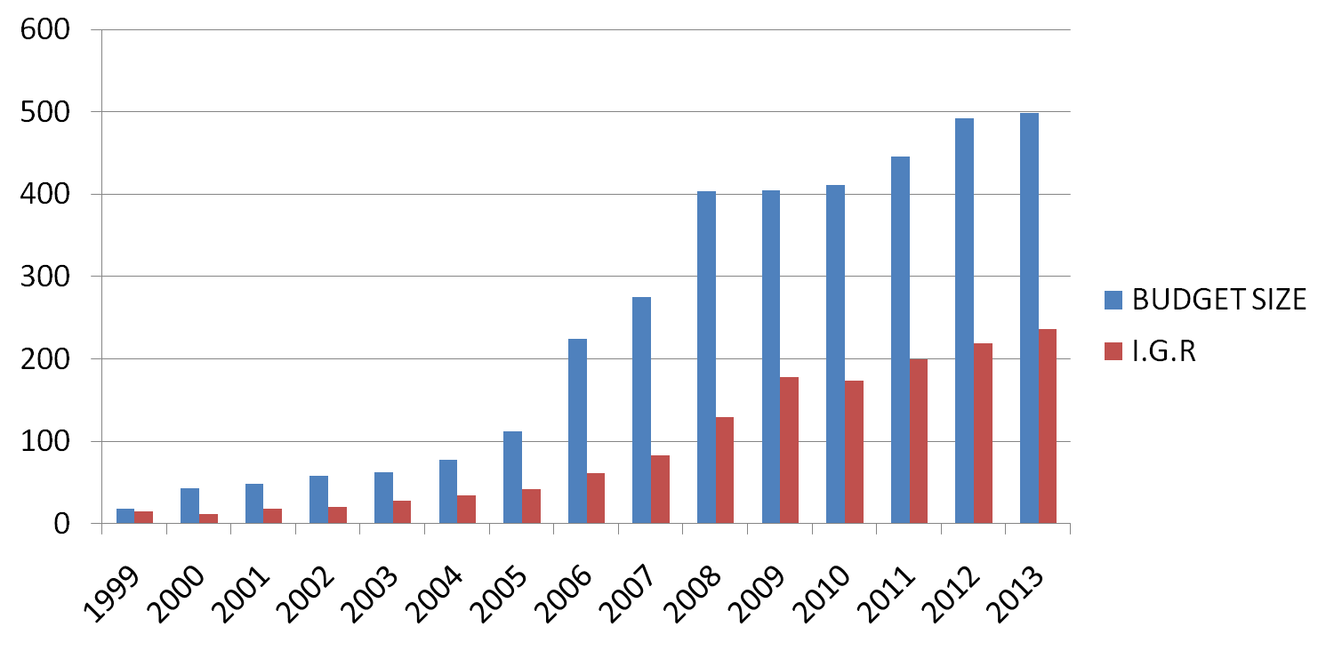
Lagos State Budget Size VS IGR 1999 - 2013
 | 1999 | 2000 | 2001 | 2002 | 2003 | 2004 | 2005 | 2006 | 2007 | 2008 | 2009 | 2010 | 2011 | 2012 | 2013
BUDGET SIZE | 17.884 | 42.942 | 48.915 | 58.235 | 62.653 | 77.407 | 112.729 | 224.232 | 274.762 | 403.401 | 405.00 | 411.571 | 445.18 | 491.94 | 499.00
I.G.R | 14.636 | 11.607 | 17.885 | 20.776 | 27.537 | 33.998 | 42.283 | 61.684 | 83.02 | 129.563 | 178.1 | 173.447 | 199.948 | 219.32 | 236.195

Slide 18
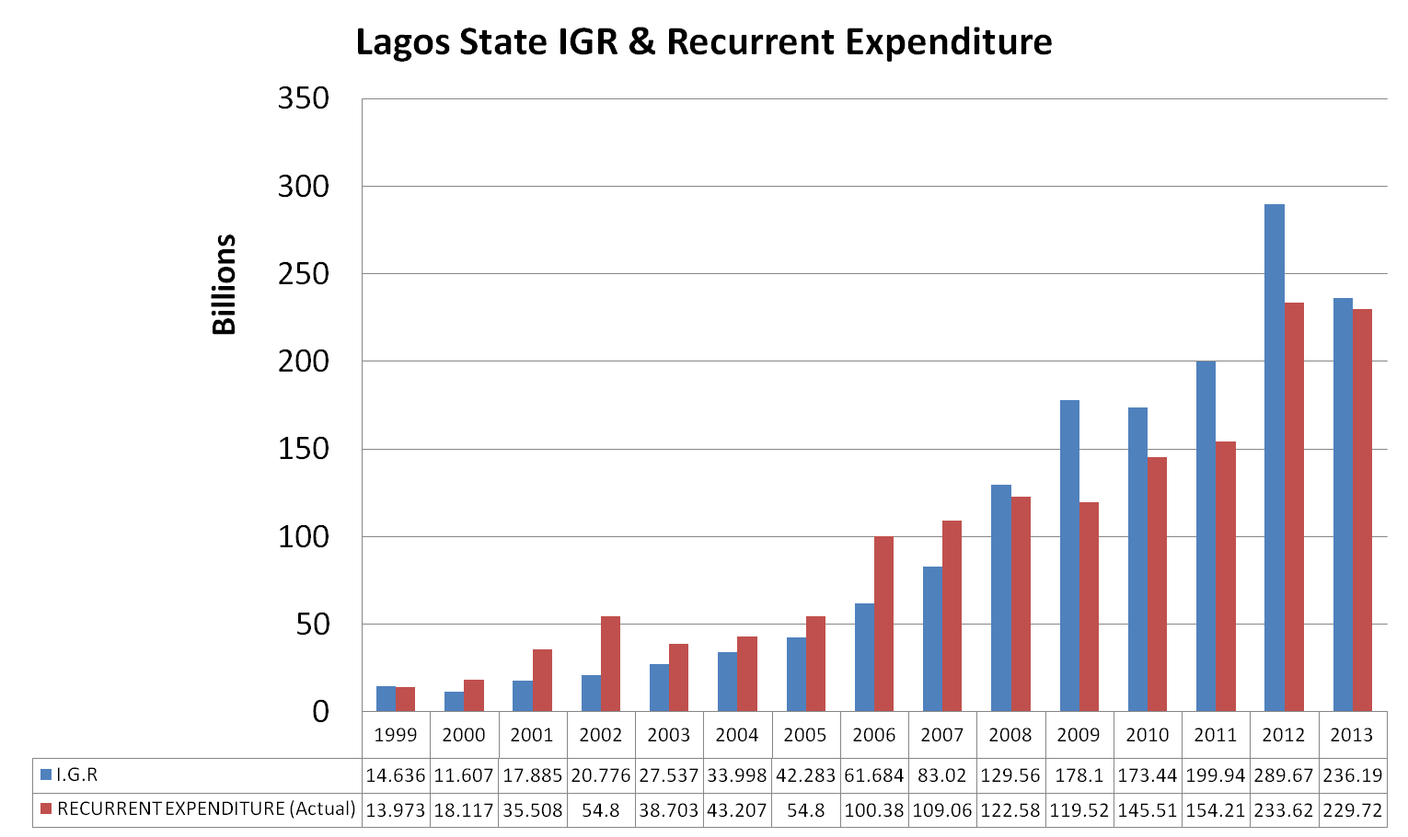
Lagos State IGR V Recurrent Expenditure

Slide 19
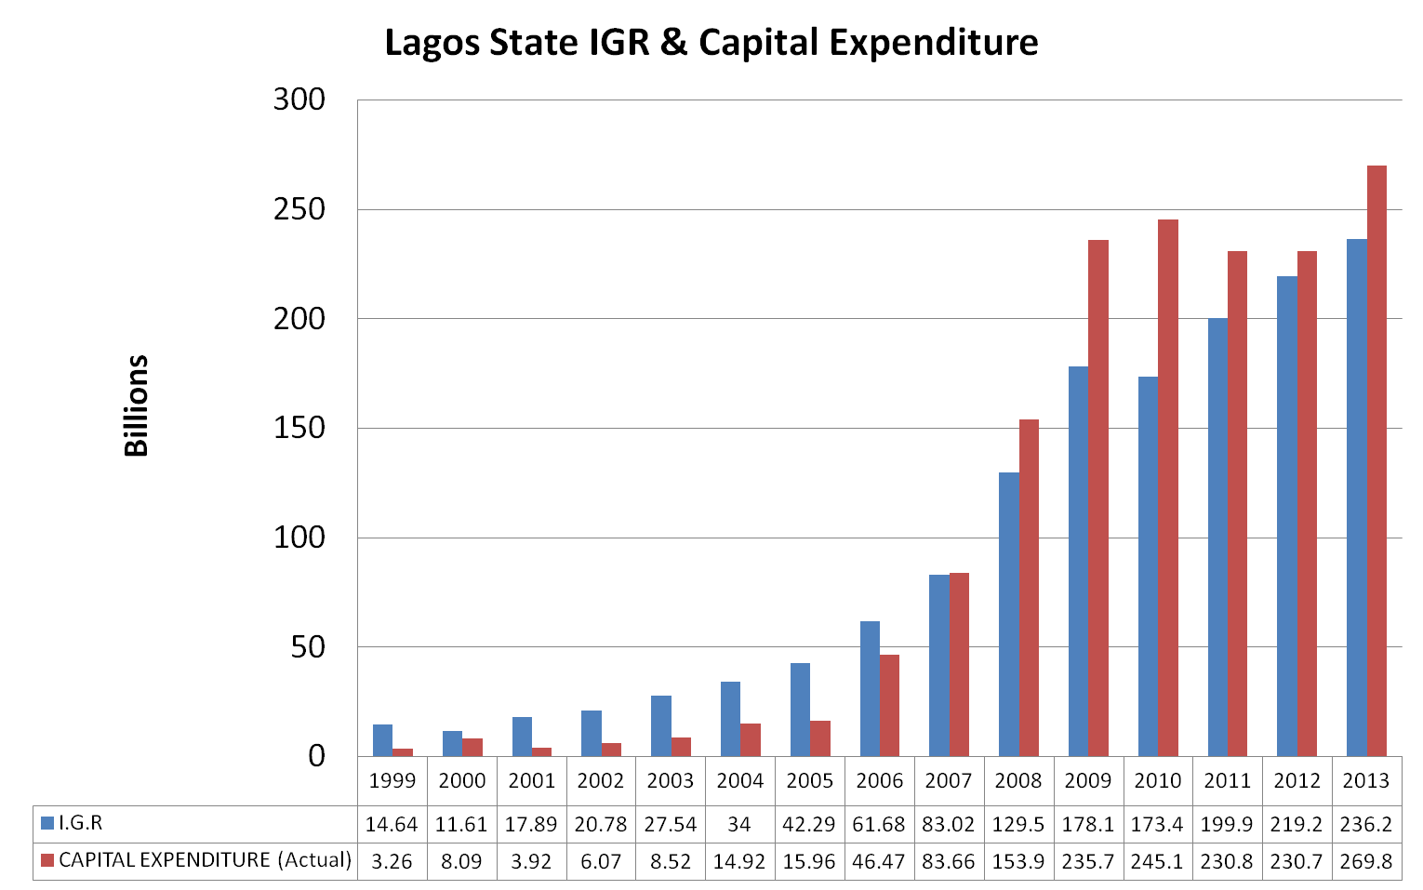
Lagos State IGR V Capital Expenditure

Slide 20
Benefits of Autonomy
A wider taxpayer base
Increased rate of voluntary compliance.
Accurate and timely payment of taxes
Increase in Internally Generated Revenue.
Less dependent on Federal Allocation

Slide 21
Autonomous States
S/N | STATE | YEAR OF AUTONOMY
1 | Lagos | 2007
2 | Bauchi | 2009
3 | Edo | 2012
4 | Kano | 2013
5 | Benue | 2014
6 | Kwara | 2015
7 | Kaduna | 2016
8 | Akwa Ibom | 2016
9 | Zamfara | 2016
10 | Kogi | 2017
11 | Gombe | 2018
12 | Ondo | 2019

Slide 22
STATE PERFORMANCE (Autonomous Vs Non-Autonomous States)
HIGHEST PERFORMING STATES(WITH AUTOMOMY) 3 YEAR AVERAGE
S/N | State | 2016 | 2017 | 2018 | % Increase 2016-2018
 |  | (N billion) | (N billion) | (N billion)
1 | Lagos | 302.425 | 333.967 | 382.181 | 26.37
2 | Kano | 30.959 | 42.418 | 44.107 | 42.47
3 | Edo | 23.041 | 25.342 | 28.425 | 23.37
4 | Kaduna | 17.051 | 26.53 | 29.446 | 72.69
5 | Akwa Ibom | 14.973 | 15.956 | 24.21 | 61.69

Slide 23
STATE PERFORMANCE (Autonomous Vs Non-Autonomous States)
LOWEST PERFORMING STATES (WITHOUT AUTONOMY) 3 YEAR AVERAGE
S/N | State | 2016 | 2017 | 2018 | % Increase 2016-2018
 |  | (N billion) | (N billion) | (N billion)
1 | Ekiti | 2.991 | 4.967 | 6.465 | 116.15
2 | Borno | 2.675 | 4.983 | 6.524 | 143.89
3 | Kebbi | 3.132 | 4.393 | 4.881 | 55.84
4 | Ebonyi | 4.342 | 5.102 | 5.562 | 28.10
5 | Yobe | 3.24 | 3.598 | 4.382 | 35.25
The lowest performing states have the capacity to be among the top performing states.
Autonomy will boost revenue collection for state development and reduce dependency on federal allocation.

Slide 24
3 Year States Performance To IGR
S/N | State | 2016 (N billion) | 2017 (N billion) | 2018 (N billion)
1 | Lagos | 302.425 | 333.967 | 382.181
2 | Rivers | 85.287 | 89.484 | 112.780
3 | Ogun | 72.981 | 74.835 | 84.554
4 | Delta | 44.057 | 51.888 | 58.439
5 | Kano | 30.959 | 42.418 | 44.107
6 | Edo | 23.041 | 25.342 | 28.425
7 | Oyo | 18.879 | 22.448 | 24.635
8 | Kaduna | 17.051 | 26.530 | 29.446
9 | Enugu | 14.235 | 22.039 | 22.145
10 | Akwa Ibom | 14.973 | 15.956 | 24.210
11 | Anambra | 16.787 | 17.365 | 19.305
12 | Cross River | 14.776 | 18.104 | 17.552
13 | Kwara | 17.253 | 19.637 | 23.046
14 | Abia | 12.694 | 14.917 | 14.834
15 | Ondo* | 8.684 | 10.927 | 24.788
16 | Benue | 9.556 | 12.399 | 11.215
17 | Bayelsa | 7.905 | 12.523 | 13.636
18 | Osun | 8.884 | 11.731 | 10.381
19 | Kogi | 9.569 | 11.244 | 19.311
20 | Plateau | 9.191 | 10.788 | 12.726
21 | Sokoto | 4.545 | 9.018 | 18.762
22 | Bauchi | 8.677 | 4.369 | 9.690
23 | Niger | 5.881 | 6.517 | 10.432
24 | Imo | 5.871 | 6.850 | 14.884
25 | Katsina | 5.545 | 6.029 | 6.961
26 | Adamawa | 5.788 | 6.201 | 6.204
27 | Taraba | 5.895 | 5.764 | 5.968
28 | Jigawa | 3.535 | 6.650 | 9.246
29 | Nasarawa | 3.402 | 6.174 | 7.566
30 | Zamfara | 4.777 | 6.023 | 8.206
31 | Gombe | 2.941 | 5.272 | 7.343
32 | Ekiti | 2.991 | 4.967 | 6.465
33 | Borno | 2.675 | 4.983 | 6.524
34 | Kebbi | 3.132 | 4.393 | 4.881
35 | Ebonyi | 4.342 | 5.102 | 5.562
36 | Yobe | 3.240 | 3.598 | 4.382
 | TOTAL | 812.443 | 936.471 | 1,176.431
Internally Generated
Revenue increase
from 2016-2018 = 44.8%

Slide 25
Recommendation To State Revenue Boards
Revenue Administration Law for State Internal Revenue Service granting it full financial and administrative autonomy.
Establishment and operationalization of single dedicated IGR account where all government revenue collectable shall be paid.
Automation of all revenue administration process.
Aggressive Taxpayer enlightenment program to sensitize taxpayers.

Slide 26
Conclusion
Federal and State boards of internal revenue authorities need to focus on closing current gaps in the revenue collection system, while also identifying new/ untapped sources of revenue
Tax revenue is a more sustainable source of revenue with advantages over other sources of Government revenue.
Creating the right environment to maximize the latent potential in the Nigerian economy, especially within the tax system is important so that tax revenue can truly become the major source of Government revenue
FIRS will always be available to partner with any State Government or Government agency on any initiatives that will be of benefit to the tax administration system.

Slide 27
Thank You

