Slide 1
STRATEGIC COMMUNICATIONS

Slide 2
Opening Thoughts
“Social Media has become the main source of news online. With more than 2.4billion internet users, nearly 64.5 percent receive breaking news from Facebook, Twitter, YouTube, Snapchat and Instagram instead of traditional media… The Survey found 57 percent increase in traffic to news sites referred from social media”
- Nicole Martin, Forbes, Nov. 30, 2018

Slide 3
Strategic Communications
Pivotal
Leveraging
The Social Media
The Digital World
Digital Platforms
Proactive
Professional

Slide 4
Strategic Communications Plan
At the core of an Effective Strategic Communication Plan are four key elements:
Situational Knowledge
Goal Setting
Communication Competence
Delivery Tools

Slide 5
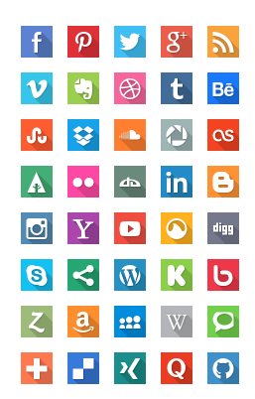
Strategic Communication Plan – Social Media
Key Elements:
Inclusiveness
Provide Information
Feedback mechanisms
Speed of Information Share
Control the Narrative
©Graphburger.com

Slide 6
Press vs. Public Relations
The line is very thin
Everyone is now a journalist
Everyone is now a PR Consultant – Web. 2.0 Social Media Platforms enables information dissemination
To Harness the Power of the Internet for PR and Strategic Communications:
Develop a reputable site for Government
Have Twitter Handles for government and the Governor
Assemble Professionals – content developers and professional journalists.

Slide 7
Controlling the Narrative
Decide on Goals
Develop a Plan
Embed the levels of media in the Process
Design Information Flow
Identify a Focal Person
Build a Media Back-End

Slide 8
Controlling the Narrative (2)
Decide early-on the
Platforms to USE
Platforms to MONITOR
Media Management
Media Team
Beyond the Information Commissioner and CPS

Slide 9
THANK YOU

