Slide 1
Smarter Government —
the Data, the Map, & the Method
Nigeria Governors’ Forum
Abuja, Nigeria
April 29 — May 1, 2019
Governor Martin O’Malley
Democrat
Maryland 2007–2015
Notes:
Thank you...
It is a humbling and great honor to be here at ESRI's User Confernce with all you.
Together, all of you assembled here, just might represent the most important collection of human skills and talents necessary for making progress in these challenging times.
For you in this room have the technical and intellectual skills necessary to connect, to synthesize, and to makes sense of the forces and challenges ahead.
Your power, as individuals and as a group, could well hold the key to bringing forward a new era of human progress at the most critical time of human history on our planet.
I believe our Earth is a progressing biological system.
A system that reaches cognition and understanding in all of us, in human beings.
In our time -- aided by new information and communication technologies -- that evolution is reaching a hyper consciousness: the shared consciousness of the entire planet.
Together, we face big challenges.
Providing jobs, opportunity, food and water for a growing population.
Confronting health and security threats.
Arresting climate change.
None of these challenges can be successfully met and overcome without governments that work.
And yet, creativity and imagination are not often the first words we associate wth government.
Together, we need to change that reality.
And change it quickly.

Slide 2
The ability to model, measure, and map our built and our natural environment - in real-time - in ways all can see....

Slide 3
The ability to manage dynamic systems — regardless of scale — in order to achieve better results for individual people.

Slide 4
In this new way of governing,...
collaboration is the new competition.

Slide 5
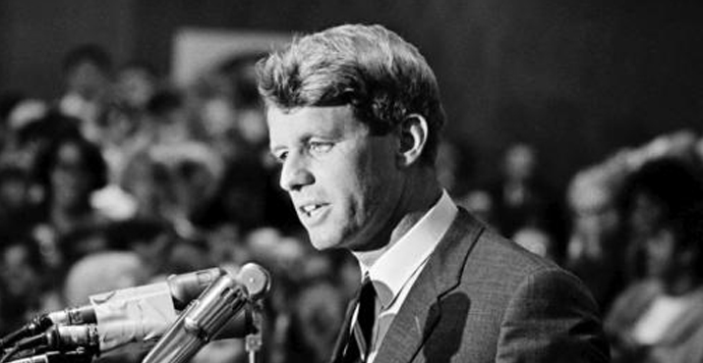
“It is from the numberless diverse acts of courage and belief that human history is shaped. Each time a man stands up for others, or strikes out against injustice, he sends forth a tiny ripple of hope.”
– Robert Kennedy

Slide 6
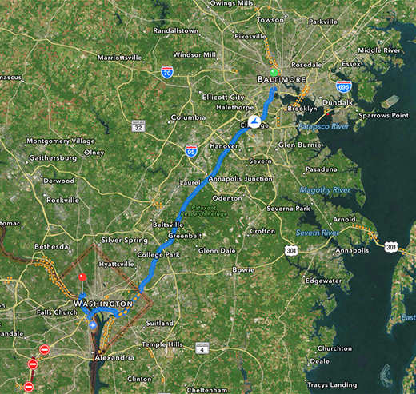
Belief Space and the Internet of Things

Slide 7
Entrepreneurial
Performance Measured
Interactive
COLLABORATIVE
A new way of
leadership
Notes:
This is the new way of governing. It's not about excuses. It's not about moving left or right; it's about moving forward. It's about getting things done.
A New Way of Governing is Emerging You and I find ourselves living in a moment "between times." A hinge of history. The old ways of governing -- ideology, bureaucracy, hierarchy -- are fading away. A new way of governing is emerging. It calls for a new way of leadership at every level.

Slide 8
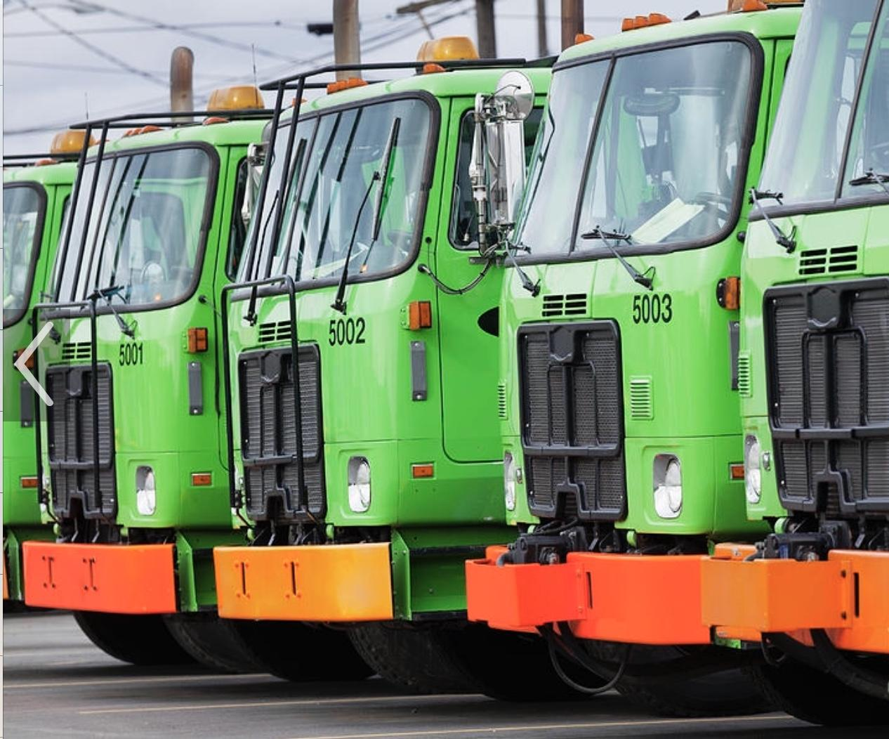
?

Slide 9
Old Tenets of City Government
If the Mayor really wants to know, we can find out. But we’ll have to pull all of our people off their other jobs. And it will take weeks.

Slide 10
Old Tenets of City Government
If the Mayor really wants to know, we can find out. But we’ll have to pull all of our people off their other jobs. And it will take weeks.
We’ll get to that as soon as we can, but it will take a few months because our budget was cut last year.

Slide 11
Old Tenets of City Government
If the Mayor really wants to know, we can find out. But we’ll have to pull all of our people off their other jobs. And it will take weeks.
We’ll get to that as soon as we can, but it will take a few months because our budget was cut last year.
That wouldn’t work, here, because: a) This is the way we’ve always done it; b) We’re already doing that; or c) We tried that once and it didn’t work.

Slide 12
Old Tenets of City Government
If the Mayor really wants to know, we can find out. But we’ll have to pull all of our people off their other jobs. And it will take weeks.
We’ll get to that as soon as we can, but it will take a few months because our budget was cut last year.
That wouldn’t work here because: a) This is the way we’ve always done it; b) We’re already doing that; or c) We tried that once and it didn’t work.
I hope everyone forgets about this question before next year’s annual budget hearing...

Slide 13
CitiStat Tenets
Accurate and timely intelligence shared by all
Rapid deployment of resources
Effective tactics and strategies
Relentless follow-up and assessment

Slide 14
The Changing Nature of Leadership
Transforming organizations
AUTHORITY
TRUTH
Shared Understanding
Notes:
This new way of leadership is fundamentally entrepreneurial. It is collaborative; it is relentlessly performance measured.
It operates by way of common platforms -- essentially, the Internet and geographic information systems -- systems that, for the first time, make this work open and visible to all.
I created this slide on the screen when teaching "business in government" classes last Spring at the Johns Hopkins Carey School of Business.
There was time -- just ten to fifteen years ago -- when the best place for a connected leader was to sit high atop the pyramid of command and control.
The rule of that bygone day was the rule of "because I said so."
Today, in the Age of Information, the most important place for an effective leader to be is in the collaborative center of the latest emerging truth.
In this age where information can be mapped and shared by all in an instant, the new rule is the authority of "because I can show you it works?"
This new way of governing has quietly taken root, now, in cities and towns all across the United States. It is steadily radiating out and up from cities, to states, and hopefully one day soon to our national government.
And that is why your skills, your abilities, your insights and your power are so very important and needed today,...
You might recall this next slide from earlier today.

Slide 15
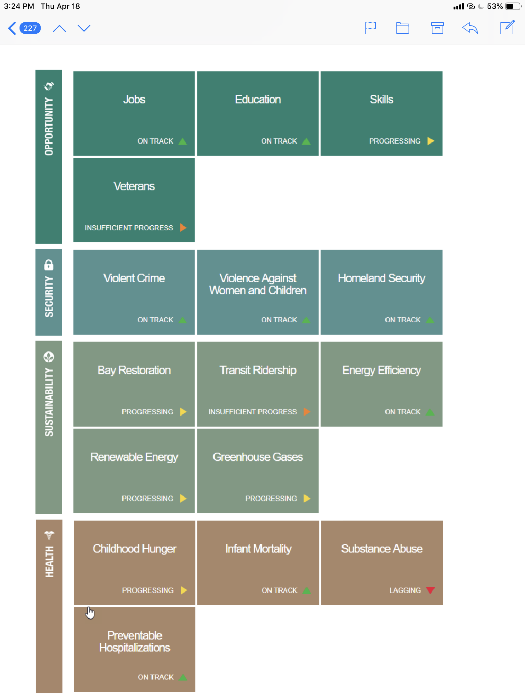
Strategic Goals with
Public Deadlines

Slide 16
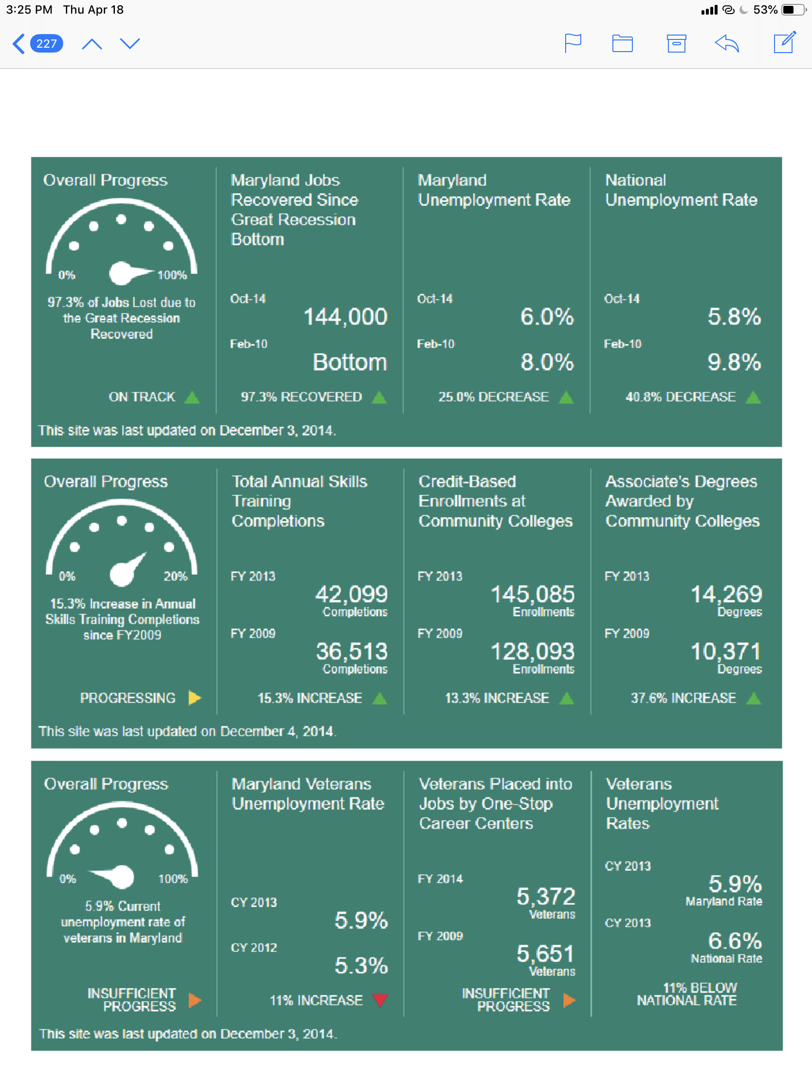
Public Facing
Dashboards

Slide 17
But, here’s the thing,...
None of this works unless the leader insists — and drives — a repeating cadence of collaboration and follow-up.

Slide 18
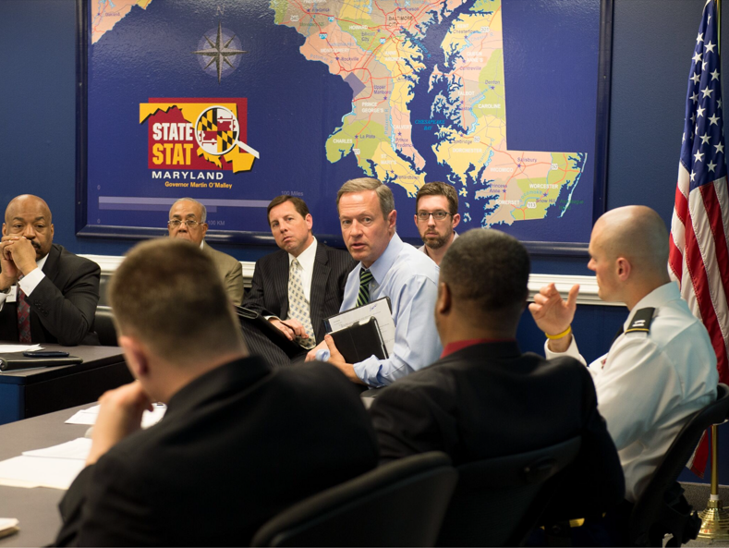
Repeating Cadence of Collaboration

Slide 19
Improving Public Safety

Slide 20
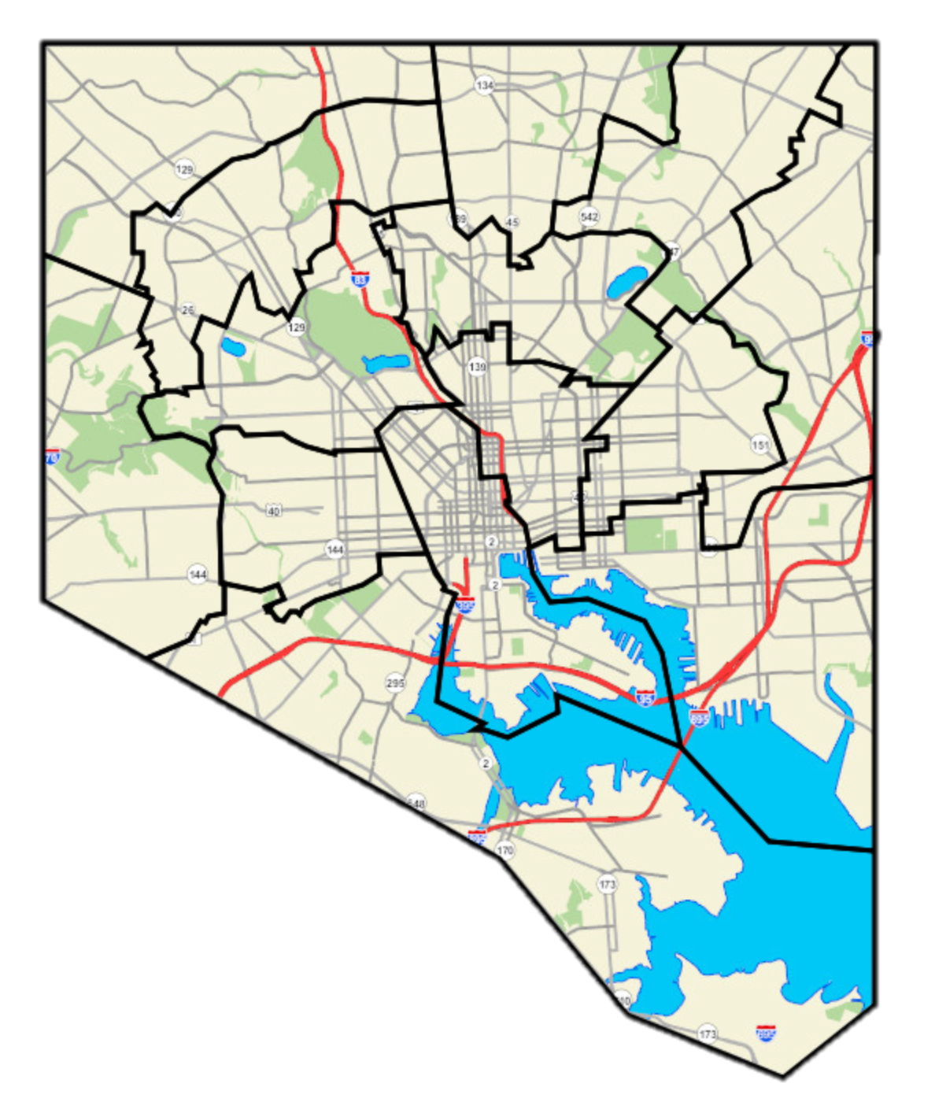
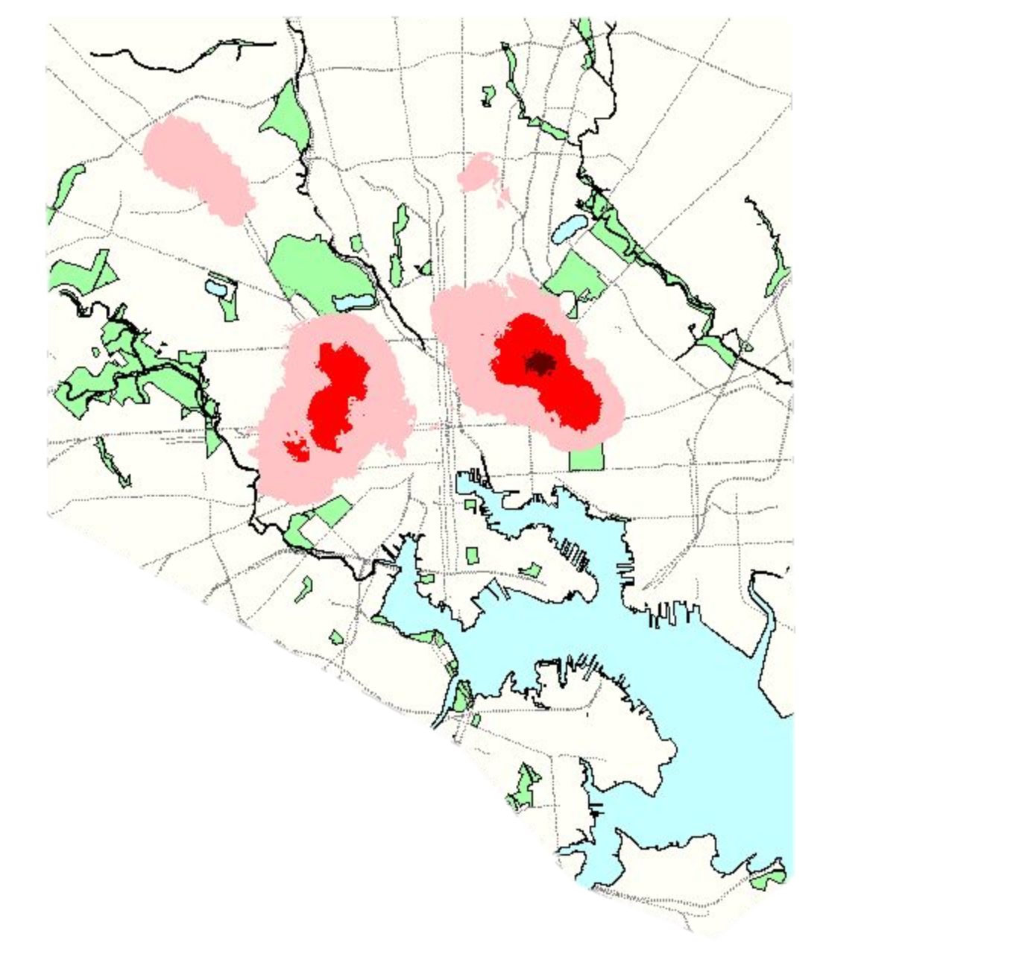
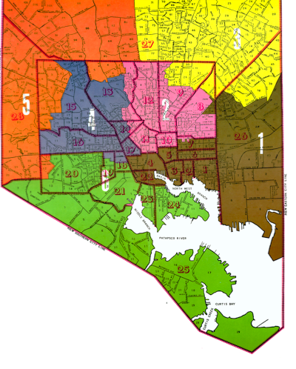
We deployed police to where crime was actually happening…
OR
200 Police thru COPS
=
Notes:
When President Clinton at the beginning of our Administration helped Baltimore with the ability to put 200 additional police officers on our streets, we had a big decision to make. Where to send them? We could deploy them equally to each of the six council districts. If we wanted to be real political, we could deploy them to the districts with the highest numbers of primary voters. If we wanted to be real, real political, we could deploy them to districts where the greatest number of people voted for us,...

Slide 21
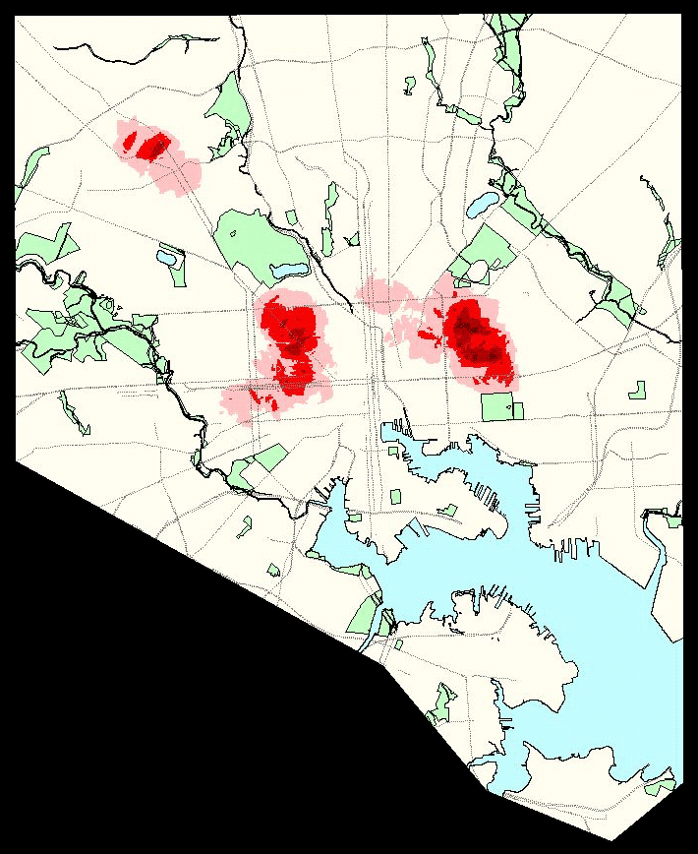
Baltimore City Homicides and Shootings
1999

Slide 22
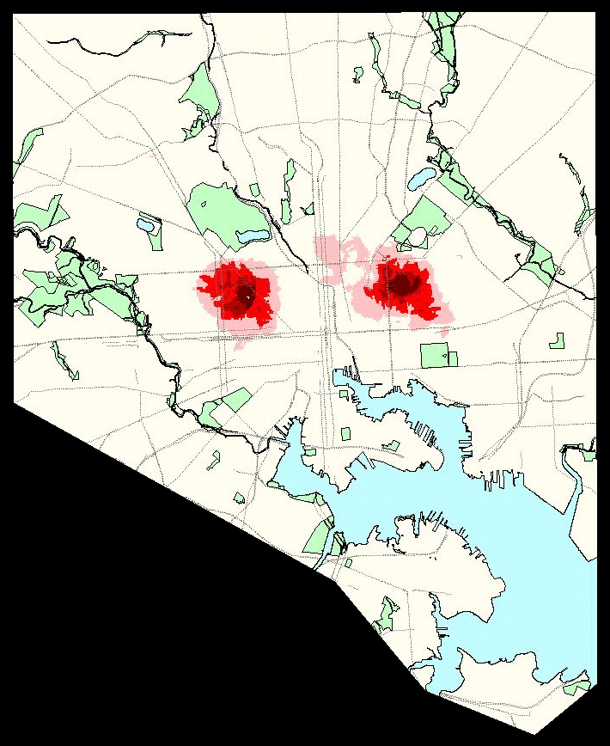
Baltimore City Homicides and Shootings
2000

Slide 23
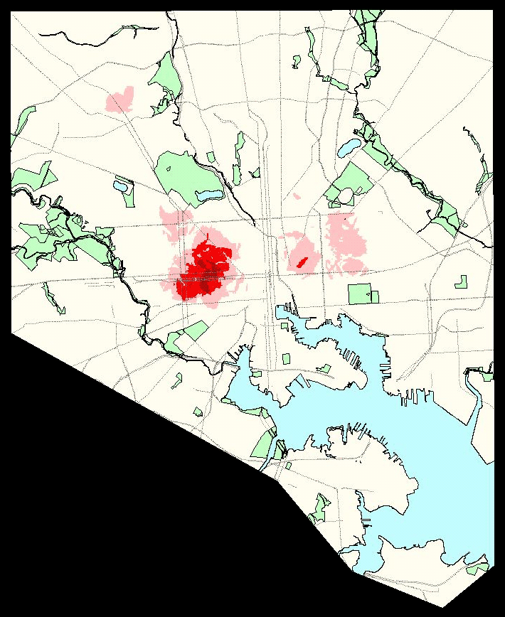
Baltimore City Homicides and Shootings
2001

Slide 24
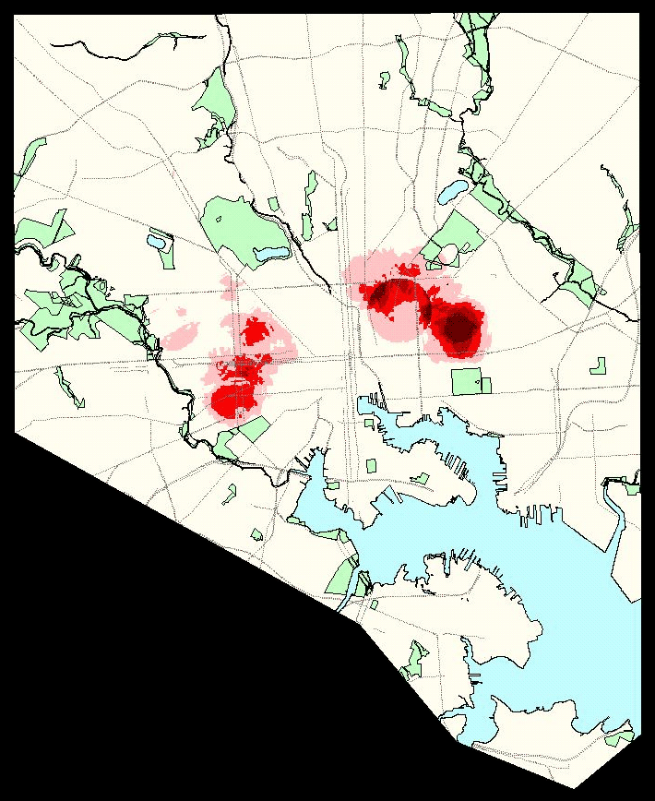
Baltimore City Homicides and Shootings
2002

Slide 25
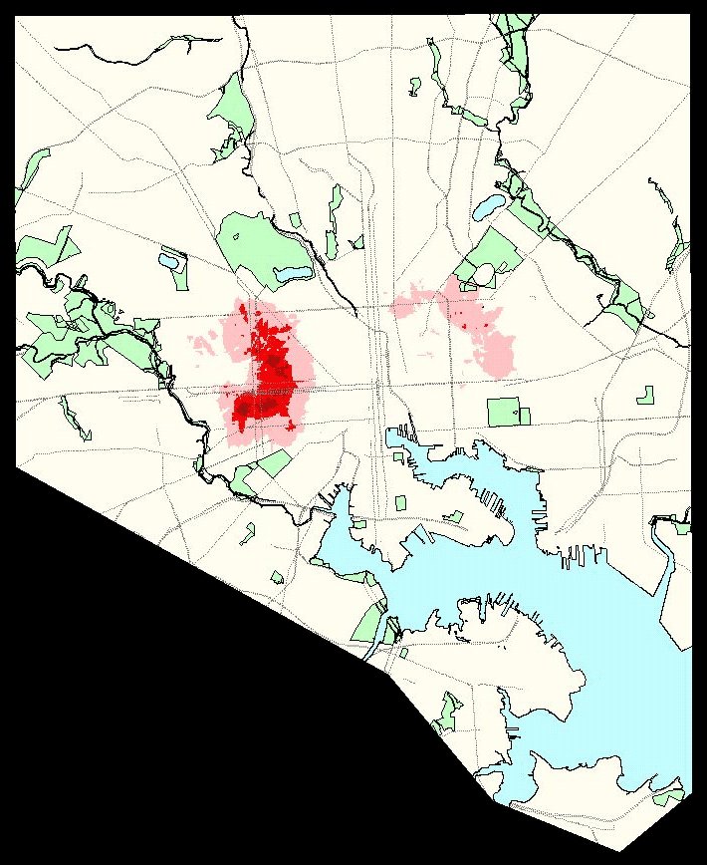
Baltimore City Homicides and Shootings
2003

Slide 26
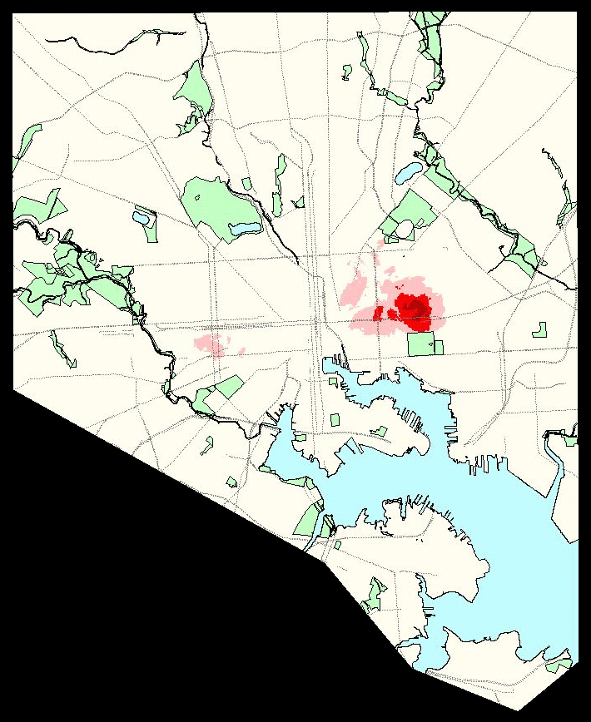
Baltimore City Homicides and Shootings
2004

Slide 27
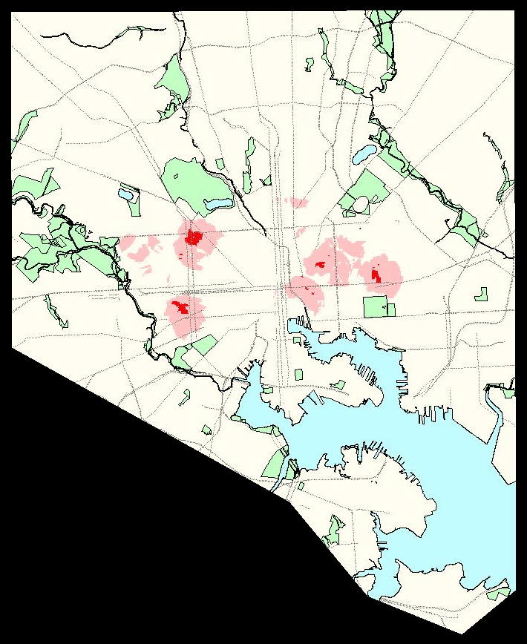
Baltimore City Homicides and Shootings
2005

Slide 28
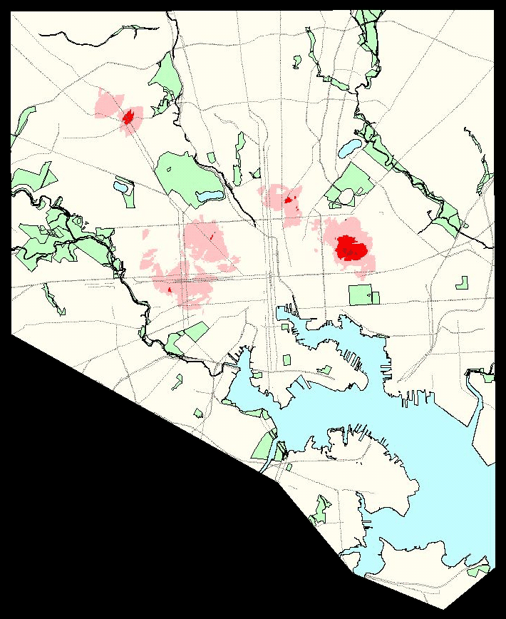
Baltimore City Homicides and Shootings
2006

Slide 29
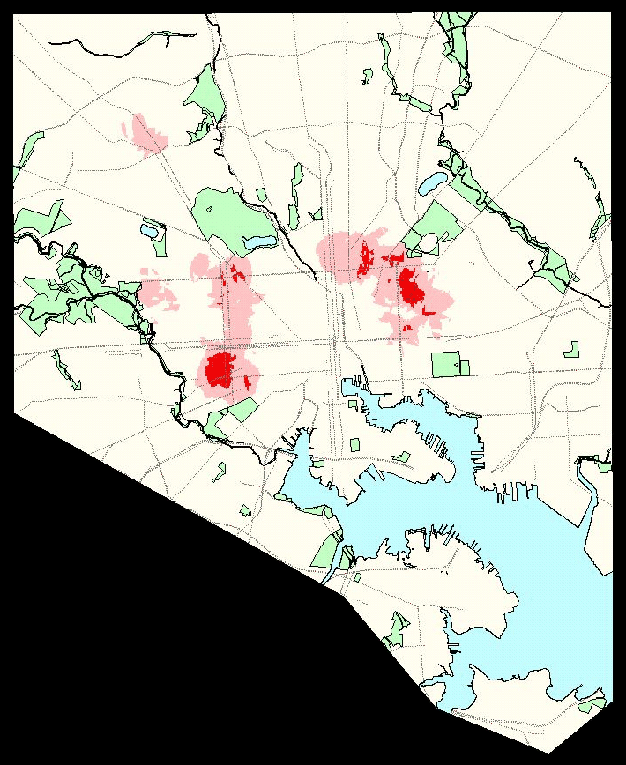
Baltimore City Homicides and Shootings
2007

Slide 30
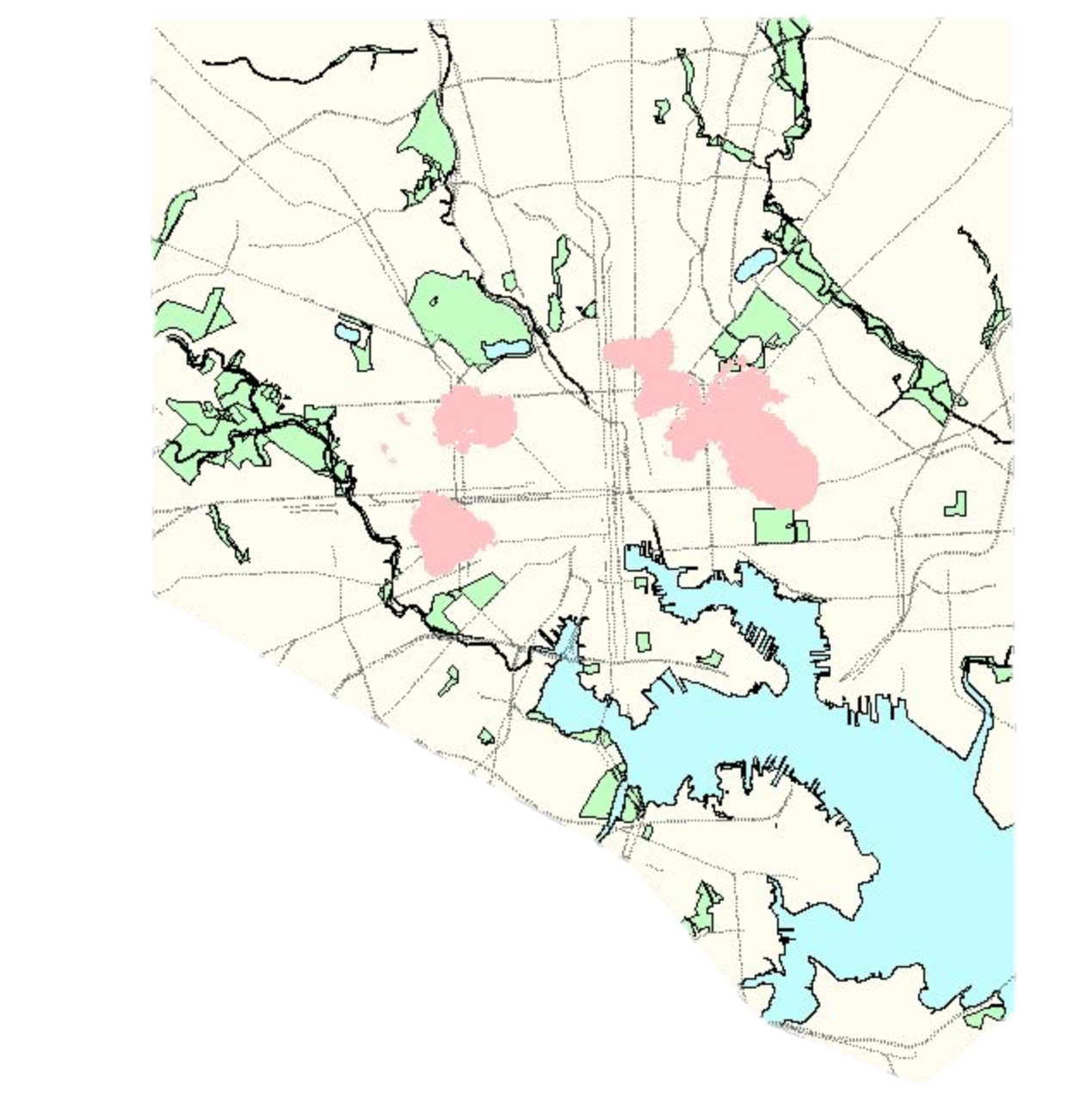
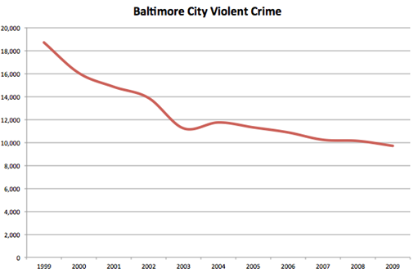
Managing by politics and excuses….
...giving way to managing for better results
Results: From 2000 – 2009
Baltimore Achieved the Biggest Reduction in Part One Crime of any Major City in America
Notes:
Or, we could deploy them to these hotspot kidneys of death where the greatest numbers of our citizens were being shot, mugged, or robbed. We chose to send these 200 police officers to where the greatest amount of violent crime was happening. We repeated the process every day and every week. Over the next ten years Baltimore went on to achieve the biggest reduction in Part One crime of any major city in America.
Story III This new way of governing is not just for Cities.
When I was elected governor of Maryland in 2006 we took this new way of getting things done to state government and dubbed it, "Statestat."
slide 9 –single animated slide will start with no map and add 4 maps one on each click
True story.

Slide 31
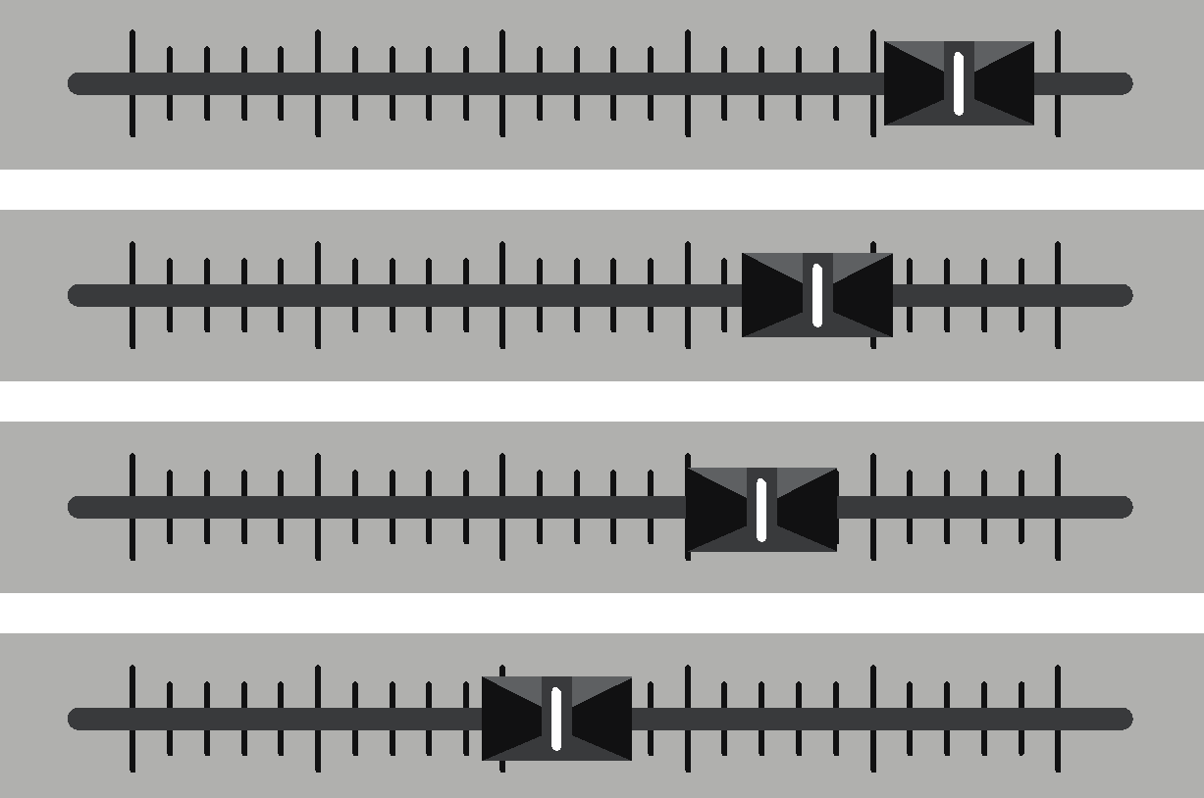
Data-driven Decision Making
LAPD’s data-driven crime fighting evolution
Stove-piped
Intuition based
Query based
Map-Making
2012
Shared by All
Evidence based
Alert based
Analytics
2017

Slide 32
Repairing Roads and Bridges

Slide 33
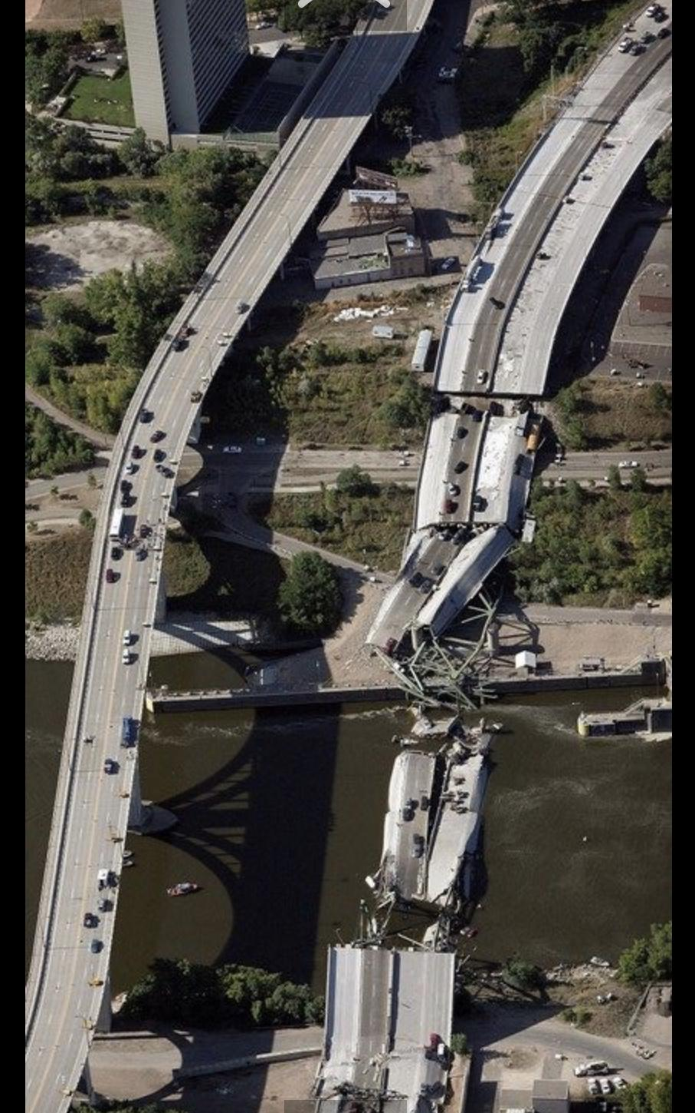
Minnesota’s I-35w Bridge Collapse
Evening Rush Hour
August 1, 2007

Slide 34
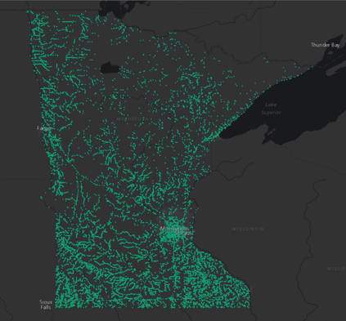
A New Way of Governing is Emerging
Focused on results; driven by “what works?”
All Bridges

Slide 35
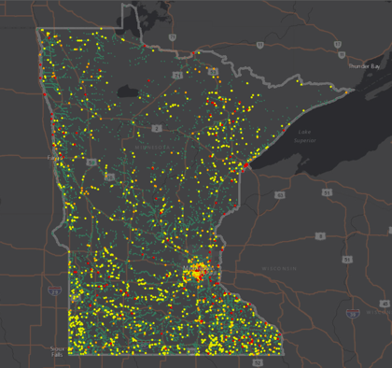
A New Way of Governing is Emerging
Focused on results; driven by “what works?”
All Bridges
Bridge Conditions

Slide 36
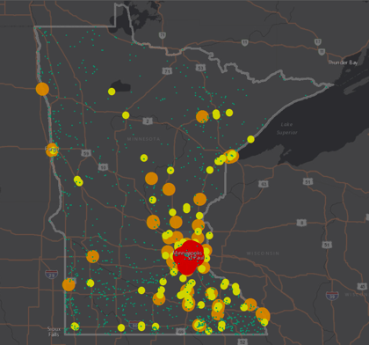
A New Way of Governing is Emerging
Focused on results; driven by “what works?”
All Bridges
Bridge Conditions
Traffic Volume

Slide 37
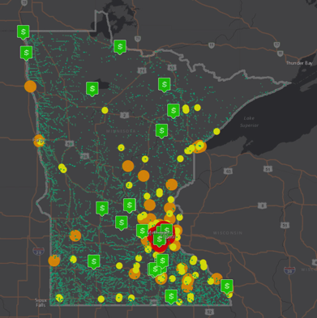
A New Way of Governing is Emerging
Focused on results; driven by “what works?”
All Bridges
Bridge Conditions
Traffic Volume
Bridge Investments

Slide 38
Clean Water

Slide 39
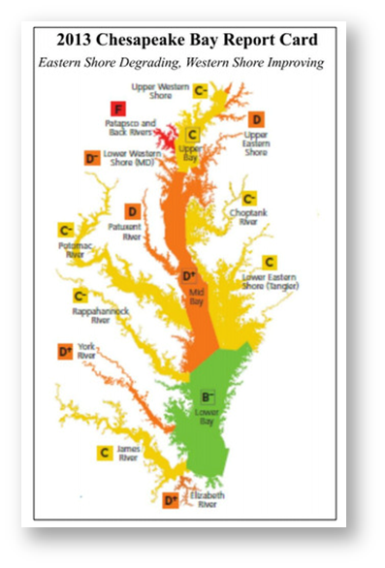
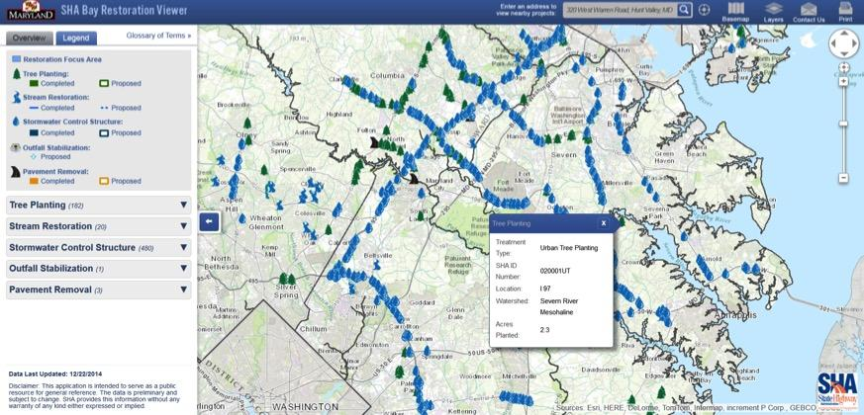
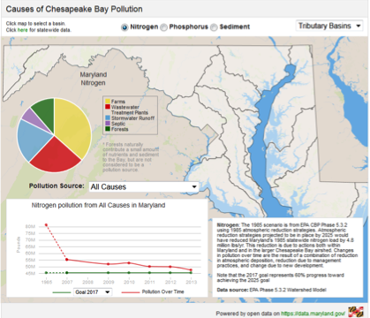
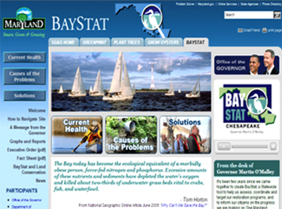
Predictive Analytics
Restoring the health of the bay
Notes:
Clean water is a human right.
To restore the health of the Chesapeake Bay we created Baystat -- a common platform for identifying the mostly non-point sources of pollution that flow into the rivers and streams of the Chesapeake Bay: agriculture, storm-water runoff, septic systems, and sewage treatment plants.
We set two year milestones for taking measureable actions on actual lands and places to improve the health of our waters. Upgrades to water treatment plants, 400,000 acres of winter cover crops, hundreds of acres of planted stream buffers -- to reduce the pollution flows from nitrogen, phosphorous, and sediment levels by 14, 15 and 18 percent respectively.
All six states in the Bay watershed now follow this performance management regimen. The Federal EPA now monitors multi-state effor through its platform, ChesapeakeStat. The fish, the oysters, and the Bay grasses monitor our efforts in their own ways.
Did we meet every goal?
No we did not meet every goal.
If we met every goal we probably weren't setting our sights sufficiently high.
But by always pursuing our goals, we always made progress.
Final example. More land has been consumed by development in my home state of Maryland over the last 35 years than in the first 350 years of our existence as a state.
We therefore have one of the biggest ecological footprints of any state in the nation. To preserve our essential remaining natural lands and open space, we created the common platform of, The Maryland Greenprint. With Greenprint we are able to target our land preservation dollars and other efforts to protect the most ecologically valuable parcels of land in our state -- parcels that expand forested stream buffers,.. parcels that extend contiguous habitat corridors,...parcels that protect the health of our waters. Thanks to GIS and the Internet, every citizen can see how,...why,...and where.
Place matters. What if Greenprints were in use in every state across our entire country to better guide development and conservation decisions?
Imagine the benefits for future generations if we had a national Greenprint, and citizens could see,... could understand,... and thereby care enough to take better actions to preserve or restore the natural systems of vitally important lands on this American continent?

Slide 40
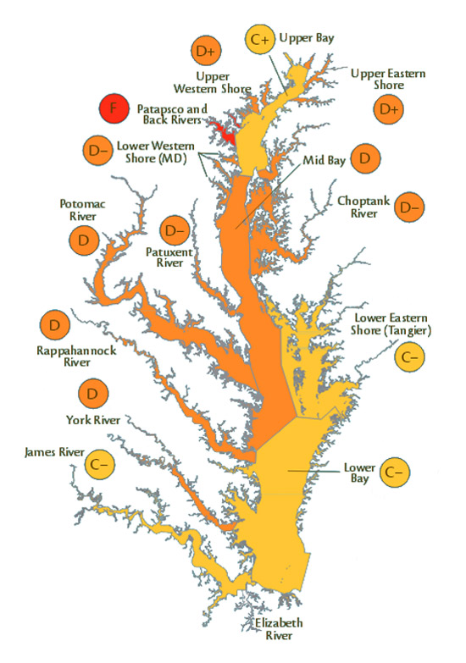
2006
Chesapeake
Bay Health
Report Card
D+
39

Slide 41
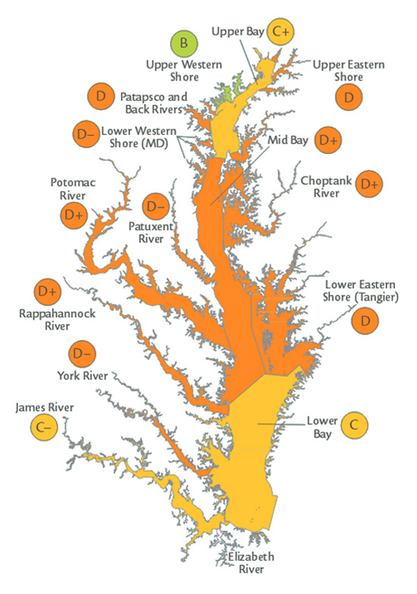
2007
Chesapeake
Bay Health
Report Card
C-
40

Slide 42
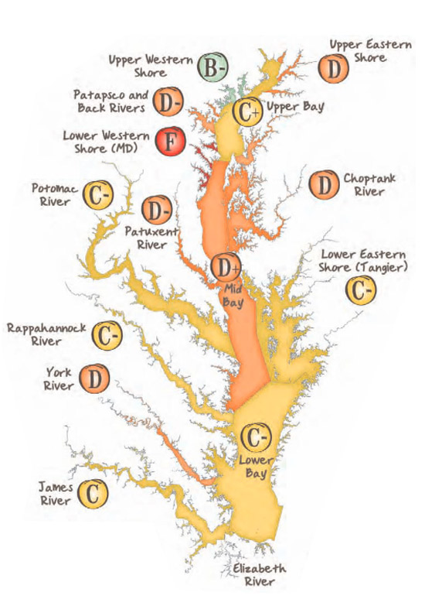
2008
Chesapeake
Bay Health
Report Card
C-
43

Slide 43
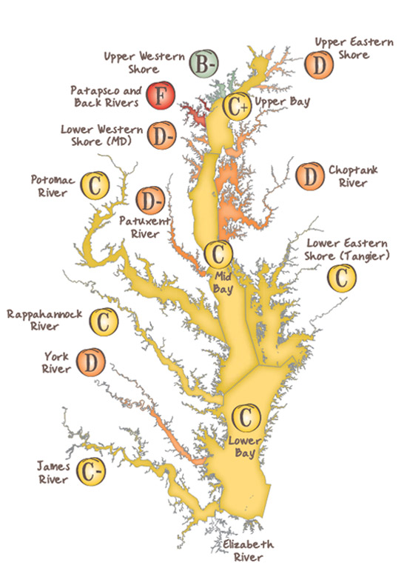
2009
Chesapeake
Bay Health
Report Card
C
46

Slide 44
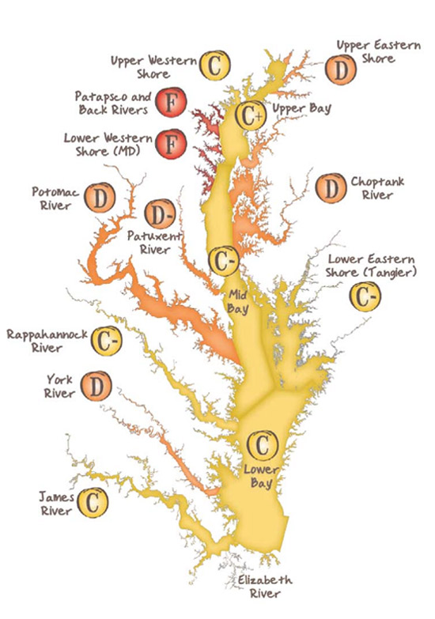
2010
Chesapeake
Bay Health
Report Card
C-
42

Slide 45
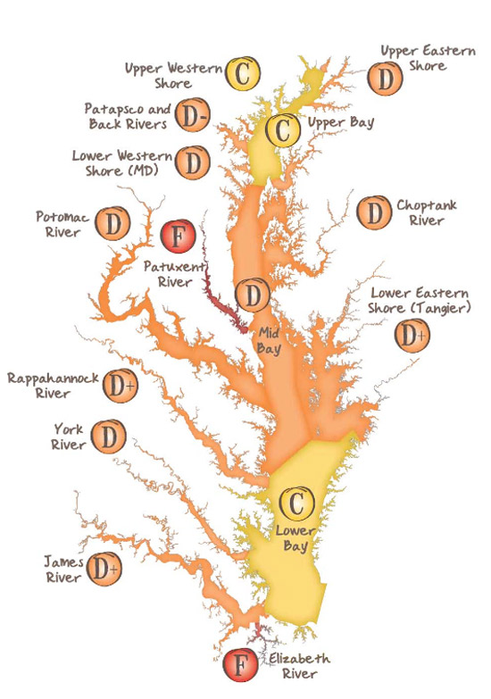
2011
Chesapeake
Bay Health
Report Card
D+
38

Slide 46
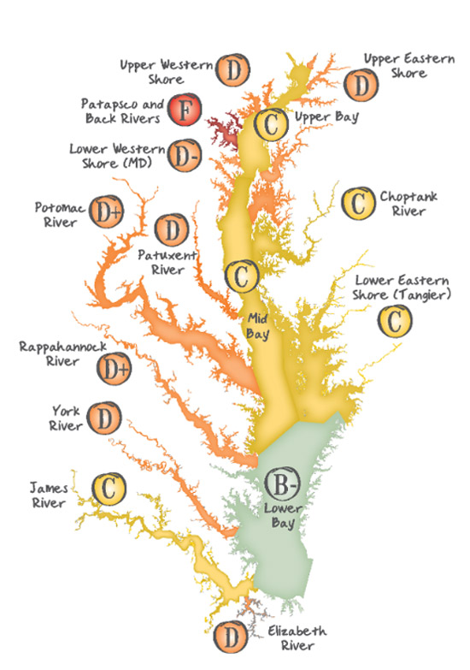
2012
Chesapeake
Bay Health
Report Card
C
47

Slide 47
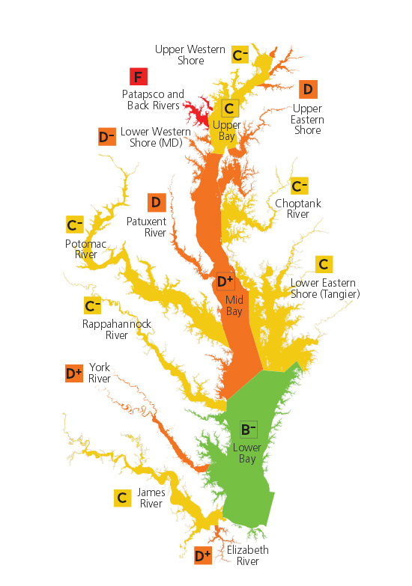
2013
Chesapeake
Bay Health
Report Card
C
45

Slide 48
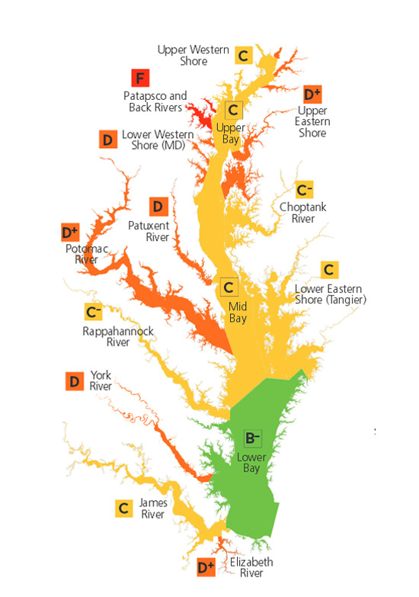
2014
Chesapeake
Bay Health
Report Card
C
50

Slide 49
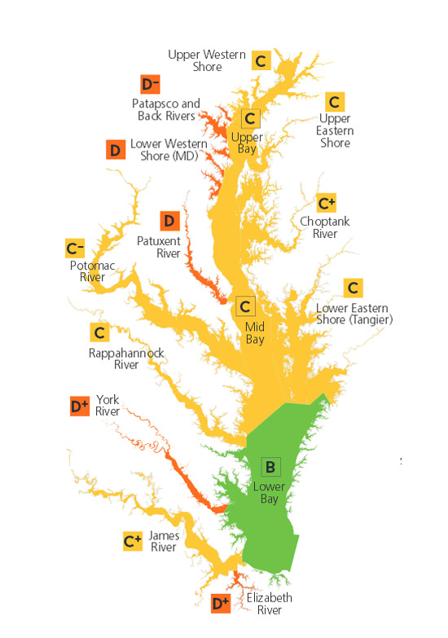
2015
Chesapeake
Bay Health
Report Card
C
53

Slide 50
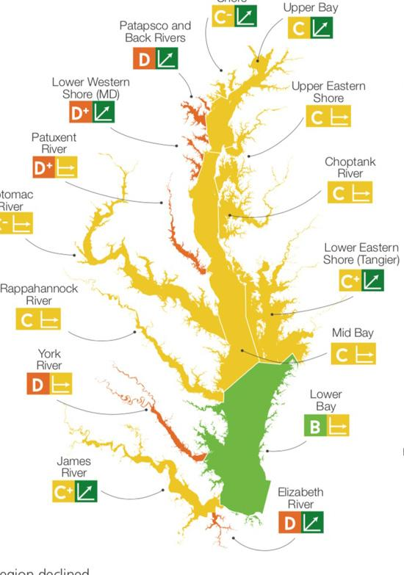
2016
Chesapeake
Bay Health
Report Card
C

Slide 51
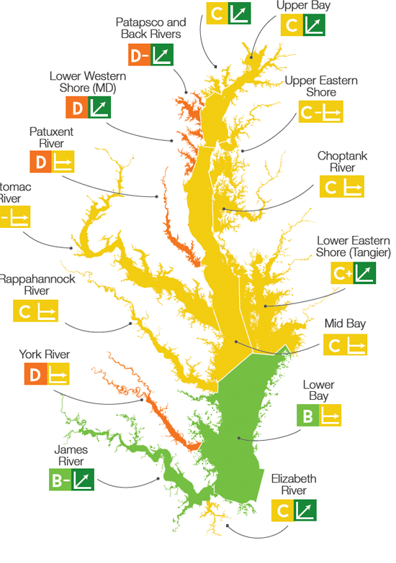
2017
Chesapeake
Bay Health
Report Card
C

Slide 52
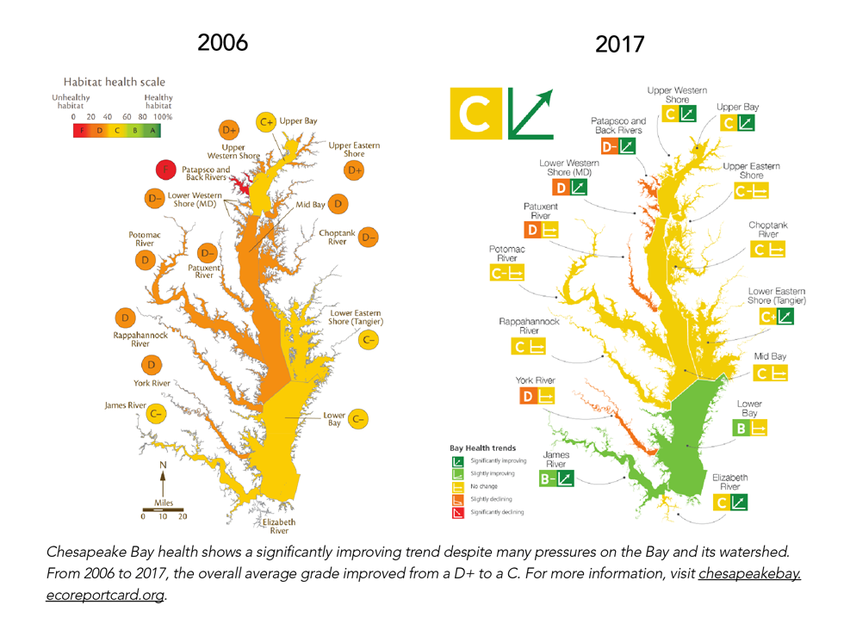

Slide 53
So,...
Embrace a radical commitment to openness and transparency.
Measure Performance to lift up your leaders.
Have the courage to set Public Goals with Deadlines.

Slide 54
Start, and don’t stop.

Slide 55
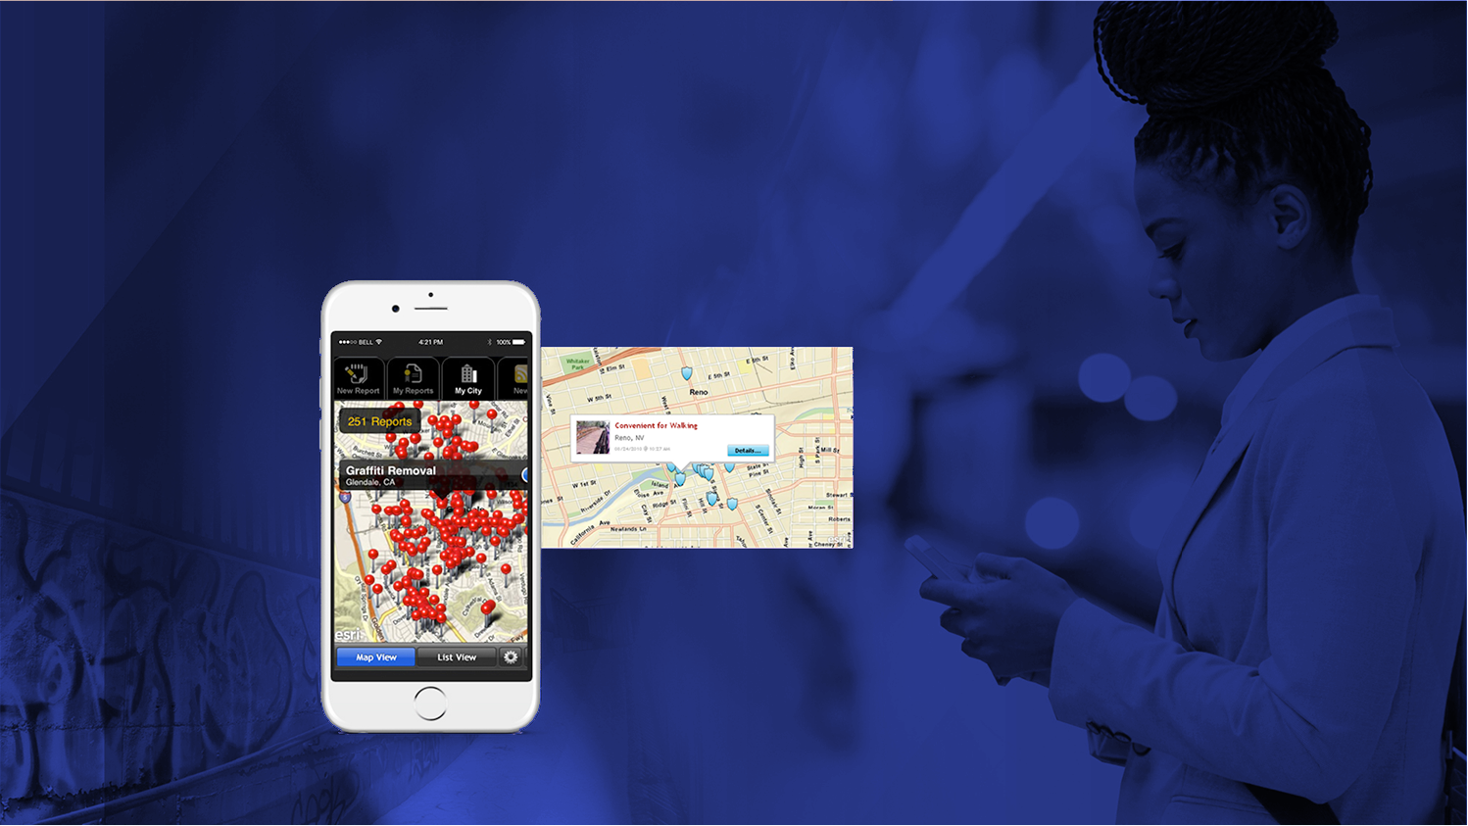
Getting things done
Citizens Affecting Real Change

