Slide 1
Nigeria Governors’ Forum
Economic Management:
State Government Imperatives 2019/21
Presented by Bismarck Rewane
CEO, Financial Derivatives Company Ltd.
April 30^{th,} 2019

Slide 2
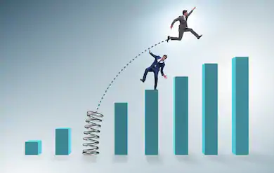
Outline
Historical Perspective to Economic Management in Nigeria
Regional Performance of Macroeconomic Indicators
Policy Scorecard – Cause, Effect and Impact
Simulated Scenario Analysis
Observations, Prescriptions and Expected Outcomes

Slide 3
Historical Perspective to Economic Management in Nigeria

Slide 4
What is Economic Management
It is the administration of the resources, finances, income, and expenditure of a community or business enterprise through optimal resource allocation

Slide 5
Fiscal Economic Management
At the state level, fiscal economic management focuses on resource allocation based on the dictates of equity and efficiency (social impact and outcome)
Taking into consideration the social and environmental impact in decision making
Opposed to private sector, where profit maximization and shareholders wealth accretion are paramount

Slide 6
Fiscal Economic Management
Fiscal economic management involves the administration of state’s sources and uses of funds (Balance Sheet) given resource constraints and other priorities
Revenue
Oil Revenue
Loans (deficit)
Expenditure
Capital Exp.
Statutory Transfers
Non-oil Revenue
Recurrent Exp.
Debt Service
Debt Repayment
Revenue
IGR
Capital Receipts
Expenditure
Capital Exp.
Federal Transfers
Recurrent Exp.
Debt Service
Debt Repayment
Loans (deficit)

Slide 7
True Federalism Through Restructuring
Federalism is a form of government
A variant of democratic political arrangement
Self-governing provinces or states under a central federal government
Like the United States
Compared to Confederations – voluntary associations of independent states – to secure some common purpose
Like the former USSR

Slide 8
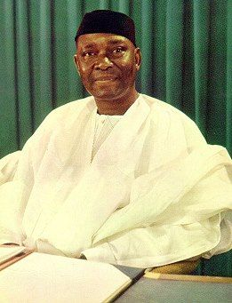
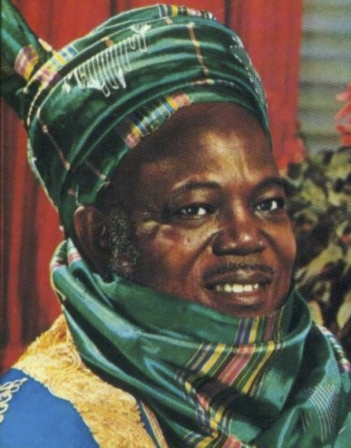
Evolution of Federalism in Nigeria
Federalism is an evolving phenomenon
Failed federalism gave way to coups, followed by civil war
Coups (Military Unitarianism) are not necessarily a rejection of federalism and self determination
Yearning for regional protection led to civil war
Supreme commander gave way to Commander-in-Chief
4 regions split into 12 to 19 to 36+1
Federalism account sharing formula changed

Slide 9
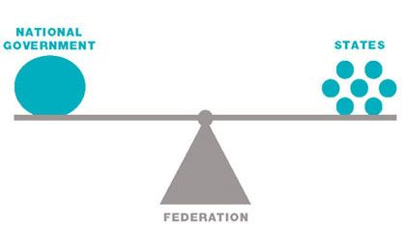
Evolution of Federalism in Nigeria
Accommodating the non-resource rich and recognised derivation and environmental challenges
The narrative is now changing
From sharing the cake to baking the cake
Empirical evidence is slowing and validating certain trends

Slide 10
State Economic Management, Resource Allocation and Prosperity Juxtaposed

Slide 11
Resource Rich States Afflicted
Almost all high revenue receiving states afflicted by resource curse
With unemployment higher than national unemployment rate of 23.1% (Q3’18)
Although, unemployment rate and opportunity within states might dispel this
Lagos state remains an outlier – due to resource optimization

Slide 12
Correlation between Unemployment and FAAC
Highest FAAC Recipient – High Misery Index
Above national misery index of 54.52 points

Slide 13
Efficient Fiscal Management as a State Differentiator
Profligacy vs. Prudence
Expenditure items to total expenditure evaluates individual states’ priorities
States’ spend on education and health (capital items) yet to translate to better living standard
Expense Item to Total Budget*
State | Wage Bill (%) | Overheads (%)** | Capital Expenditure (%)
Lagos | 10.7 | 22.4 | 66.8
Akwa-Ibom | 8.2 | 25.1 | 66.7
Bayelsa | 15.1 | 35.3 | 49.5
Kano | 24 | 9.8 | 66.2
Edo | 21.2 | 23.8 | 55
Delta | 23.2 | 24.5 | 52.3
* - 2018 Budget Estimates
** - Including debt service costs

Slide 14
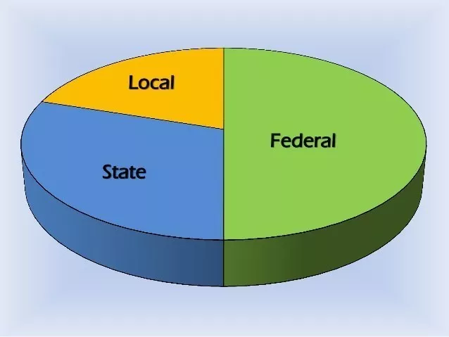
Sharing Formula across Tiers
Economic management starts at the federal level
FAAC sharing formula
FG – 52.68%
States – 26.72%
LGs –20.6 %

Slide 15
FAAC Reflective of Volatile Oil Prices
In the last 5 years the average FAAC shared has fluctuated with oil prices
Negative correlation between the two variables
Pick up in crude oil prices buoyed FAAC

Slide 16
Fiscal Deficit to Total Revenue
Analysis show an inverse relationship between IGR and fiscal deficit
Widening fiscal deficit continues to weigh on capital expenditure
Due to debt burden

Slide 17
State debt to Total Revenue
States with the highest debt to total revenue ratio recorded relatively high rate of unemployment
Osun state was an outlier
 | States | Unemployment (%)
1st | Osun | 10.1
2nd | Ekiti | 20.2
3rd | Cross River | 30.6
4th | Plateau | 29.8
5th | Zamfara | 18

Slide 18
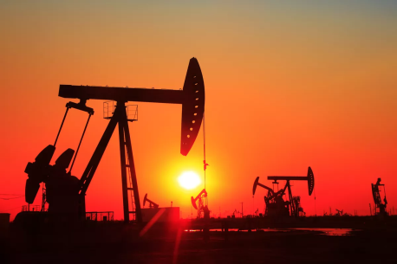
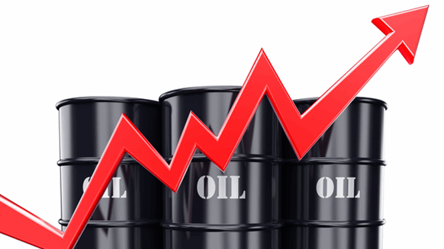
Resilience to Shocks Remain Weak
Very few states can withstand the impact of internal and external volatilities
Internal shocks –
Dip in oil production
Insecurity from insurgence or communal clashes
External shocks –
Plunge in commodity prices (oil, gas, agric. commodities)
Global protectionism and policy tightening
Emphasizes the need to diversify revenue sources

Slide 19
State Resilience to Shocks Index Top 3 States
Lagos
Kano
Enugu
What is common to these states?
IGR-to-Total Revenue > 25% - Less reliant on FAAC
Capex-to-Budget > 40% - investment in infrastructure
Revenue can adequately cover state’s recurrent expenditure
More resilient to an oil price shock

Slide 20
Regional Performance of Macroeconomic Indicators

Slide 21
Variables of Interest
GDP Growth
Inflation
Unemployment
Debt – External & Domestic
Internally generated revenue & FAAC
Ease of doing business

Slide 22
Proxies of Interest
Branches of Banks in state
Aggregate consumption
WAEC/JAMB candidates and score
Passenger traffic

Slide 23
Macroeconomic Indicators
Source: NBS, FDC Think Tank
Average | North Central | North East | North West | South South | South East | South West
Inflation (Mar’19) | 11.5 | 12.31 | 12.13 | 10.75 | 11.32 | 11.54
Unemployment Q3’18 | 23.34 | 25.12 | 23.29 | 31.3 | 24,08 | 14.3
Underemployment Q3’18 | 22.89 | 22.77 | 28.49 | 19.2 | 18.74 | 13.95
Internally Generated Revenue (Q3’18) (N’bn) | 4.48 | 1.63 | 3.96 | 9.37 | 3.42 | 20.42
Debt (2018) (N’bn) | 90.46 | 67.17 | 61.95 | 172.98 | 61.98 | 172.62
Ease of doing business (2018) | 57.4 (3rd) | 57.8 (2nd) | 61.03 (1st) | 53.86 (5th) | 53.32 (6th) | 55.82 (4th)

Slide 24
What the GDP tells us (Sector Performance)
Real GDP expanded by 2.38% in Q4’18
From 1.81% in Q3’18
FY’18: 1.93%

Slide 25
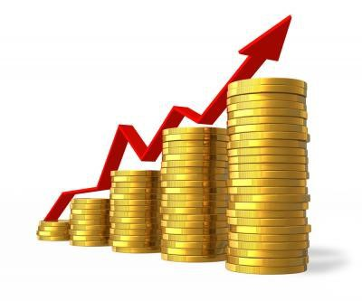
Inflation
The Fisher Effect:
r = i – $π$
The higher the inflation, the lower the real interest rate
To keep rates attractive, nominal interest rate has to rise
Higher debt service payment
Source: NBS, FDC Think Tank
Real interest rate
Inflation
Nominal interest rate

Slide 26
Internally Generated Revenue
Top five states
States | (% of total revenue) | H1’18 IGR (N’bn) | Capex to budget (%) 2018
Lagos | 73.72 | 166.98 | 67
Ogun | 66.57 | 37.42 | 65
Kano | 34.72 | 21.21 | 66
Cross River | 34.58 | 17.13 | 70
Rivers | 34.48 | 85.01 | 75
Bottom five states
States | (% of total revenue) | H1’18 IGR (N’bn) | Capex to budget (%) 2018
Yobe | 6.67 | 1.80 | 65
Akwa Ibom | 7.37 | 7.98 | 54
Bayelsa | 7.51 | 6.26 | N/A
Borno | 7.66 | 2.49 | N/A
Kebbi | 7.81 | 2.2 | N/A
High level of commercialization drives IGR in Lagos State
Accounts for 31% of bank branches
Most states remain largely dependent on FAAC disbursement
Source: NBS, FDC Think Tank

Slide 27
Internally Generated Revenue – Looking beyond rhetorics
Improve tax collection efficiencies
Increase the ease of doing business
Finance infrastructural needs
A key enabler of business and investor confidence
To drive higher tax revenue
Make significant investments in companies
To increase dividend income
Partner with private sector in various sectors such as manufacturing, agriculture and tourism
Link future borrowing to sustainable projects

Slide 28
Unemployment Rate – High at 23.1% in Q4’18
Nigeria unemployment rate jumps to 23.1% in Q4’18 due to:
Low incentives to attract investors
Lack of employable skills
High number of university graduates

Slide 29
Misery Index
Source: NBS, FDC Think Tank
Top five states with the lowest misery index
States | Misery Index (%)
Taraba | 25.07
Ogun | 28.41
Osun | 28.87
Oyo | 30.59
Ekiti | 36.53
Misery Index is the summation of:
Inflation
Unemployment
Underemployment
Nigeria’s misery index now 54.45%
Bottom five states with the highest misery index
States | Misery Index (%)
Jigawa | 69.03
Kaduna | 64.24
Yobe | 63.66
Rivers | 62.84
Nassarawa | 58.92

Slide 30
Domestic Debt Profile
Source: NBS, FDC Think Tank
Domestic Debt (N’bn)
Highest |  | Lowest
Lagos | 530.24 | Yobe | 27.77
Delta | 228.81 | Katsina | 30.85
Rivers | 225.59 | Anambra | 33.49
Akwa-Ibom | 198.66 | Jigawa | 35.16
Cross River | 167.96 | Sokoto | 38.60
States with highest domestic debt are:
Oil producing states
States with highest unemployment rate
States with highest share of FAAC
Reflection of fiscal mismanagement

Slide 31
External Debt Profile
Source: DMO, FDC Think Tank
External Debt ($’mn)
Highest |  | Lowest
Lagos | 1,426.43 | Taraba | 21.61
Edo | 276.25 | Borno | 21.62
Kaduna | 227.25 | Yobe | 27.49
Cross River | 188.77 | Kogi | 31.58
Bauchi | 133.93 | FCT | 31.85
North Central and North East has the lowest external debt stock
Reflective in low IGR
And high misery index

Slide 32
Jamb Application
Source: NBS, FDC Think Tank
States | Top five Applicants (‘000) | Admitted | % of capex to total expenditure
Imo | 93 | 29 | 70
Oyo | 87 | 29 | 55
Osun | 86 | 28 | 52
Ogun | 80 | 26 | 58
Delta | 80 | 23 | 46
South West recorded the highest number of Jamb applicants and admitted

Slide 33
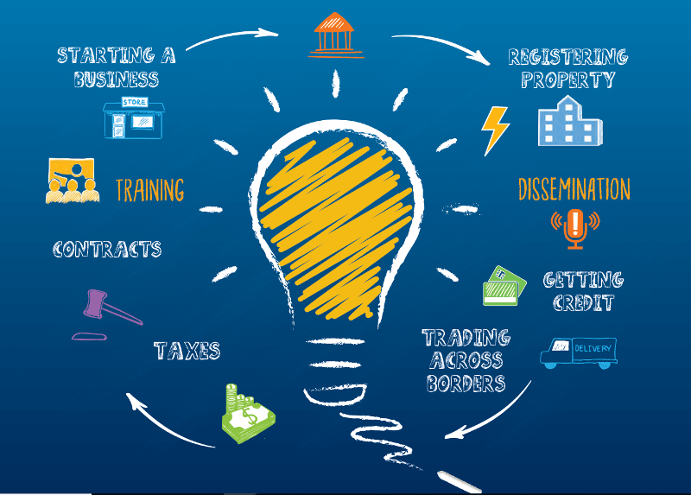
Ease of Doing Business – World bank
World bank Doing Business report is measured based on:
Starting a business
Dealing with construction permits
Registering property
Enforcing contracts
According to the report, it is easier to:
Start a business in Abuja and Lagos
Get a construction permit in Niger and Kano
Register property in Kaduna and Zamfara
Enforce a contract in Kaduna and Bauchi
Source: World Bank, FDC Think Tank

Slide 34
Ease of Doing Business - Problems that remain
Lack of proper infrastructure
Low internet penetration
Challenges for local entrepreneurs
Accessibility of local building regulations remain weak
As well as quality control after construction

Slide 35
Ease of Doing Business – Way Forward
Improve the quality of infrastructure
To increase efficiency
Adopt online tax registration and payment
Increase awareness of availability
Make the construction permit process more transparent
Simplify the structure of the building permit fees

Slide 36
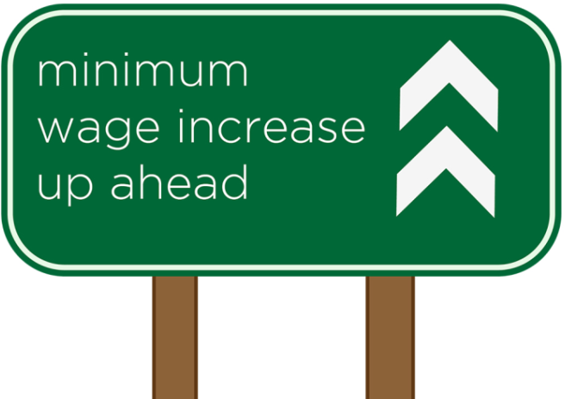
New Minimum Wage Funding & Consequential Impact
States civil service account for about 1.9 million workers
States get 85% of VAT, as well as other statutory allocations
In addition to IGR
Personnel expenses of most states exceed IGR
So, there is either –
An expense problem Or A revenue problem
For social reasons, head count rationalization may be farfetched
But labour optimization will help boost productivity

Slide 37
Need to Augment Revenue Sources
As at 2017, only 7 states generate IGR in excess of 30% of their total revenue
10 states had debt profiles exceeding their statutory revenue by more than 200%
19 states exceed theirs by more than 100%

Slide 38
Bridging the Funding Gap
IGR remains key to the funding of the new minimum wage
Funding through the statutory allocation (FAAC) is unsustainable
Though, increase in VAT may provide temporary succour
Complemented by improved tax administration
Other measures include –
Privatization - Partially sell equity across SOEs
Liberalization – Private sector-led projects
Commercialization - Rental income from idle assets
Concessions - Fees from long term leasing of assets

Slide 39
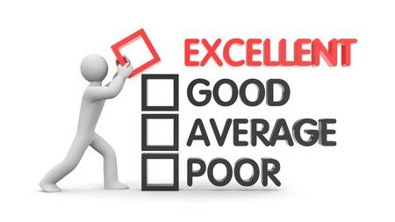
Policy Scorecard

Slide 40
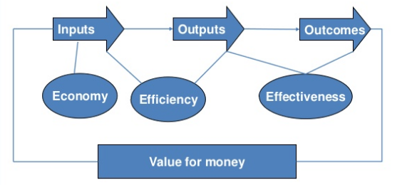
Value for Money 3-Tripod Evaluation
Project evaluation and appraisal should be based on these conditions

Slide 41
How To Effectively Measure Performance
Under social accounting, the non-financial metrics are paramount
More emphasis on social outcomes and impact (effectiveness)
As opposed to resource maximization (efficiency)
Financial Measures
Revenue Generation Capacity
Debt Service-to-Revenue
Non-Financial Measures
Social Metrics
Education
Effective Healthcare
Quality of Life

Slide 42
Alignment with Federal Government Priorities
Complementing federal government initiatives
Key to fully exploit synergies
Especially big-ticket projects
Which have high social and environmental impact
For instance, provision of rural housing upon the completion of connecting railway lines
Will help decongest urban centres
Improving the quality of life in both centres (urban and rural)

Slide 43
Alignment with Federal Government Priorities
Adopting a procyclical policy against the federal government’s fiscal consolidation
Will put a strain on limited financial resources
Widen the funding gap at the state level
Exacerbating debt service burden/cost

Slide 44
Focus on Areas of Competitive Strength
The 3Es framework emphasize the need to be internally efficient
Leverage resources (land, labour, capital)

Slide 45
Simulated Scenario Analysis

Slide 46
Best Case
Assumptions
Oil Price: $60pb - $70pb
Oil production: 1.65mbpd – 1.75mbpd
Exports of $60bn, imports of $45bn
Tax-to-GDP – 15%
Investment-to-GDP – 20%
Debt service-to-Revenue – 35%
Impact
GDP Growth (%) | 3.5-4.5
Inflation (%) | 12.5
Money Supply Growth (%) | 17
Net FDI ($’bn) | 6
External Reserves ($’bn) | 50
Exchange Rate (N/$, IEFX) | 345
Fiscal deficit (N’trn) | 2
Policy Adjustments Required
Investment-friendly policy to deepen investment flows

Slide 47
Worst Case
Assumptions
Oil Price: $40pb - $45pb
Oil production: 1.1mbpd – 1.2mbpd
Exports of $35bn, imports of $38bn
Tax-to-GDP – 4%
Investment-to-GDP – 11%
Debt service-to-Revenue – 75%
Impact
GDP Growth (%) | -1.99
Inflation (%) | 17.2
Money Supply Growth (%) | -1.65
Net FDI ($’bn) | -2.8
External Reserves ($’bn) | 21
Exchange Rate (N/$, IEFX) | 410-430
Fiscal deficit (N’trn) | 4-5
Policy Adjustments Required
Look inwards to resuscitate ailing sectors
Leverage competitive advantage through economies of scale

Slide 48
Observation, Prescription and Expected Outcomes

Slide 49
Summary
Both FGN and all states have run at deficit in the last 2 decades
Deficits are not a bad thing if there is unemployment and economic slowdown Revenue generation capacity of a state is a function of business confidence
There is a direct relationship between investment in education and living standard - but these investments must be deliberate
Emphasizing the need to provide adequate infrastructure

Slide 50
Prescription and Key Takeaways
States cannot afford to do nothing and expect results
All projects need to be appraised based on the value for money 3-tripod test (3 Es)
Deliberate attempts need to be made to strengthen the commercial viability of states
Through IGR, while relying less on FAAC
This will kick start the momentum towards sustainable fiscal responsibility

