Slide 1
Partnership for Learning for All in Nigeria (PLANE)

Slide 2
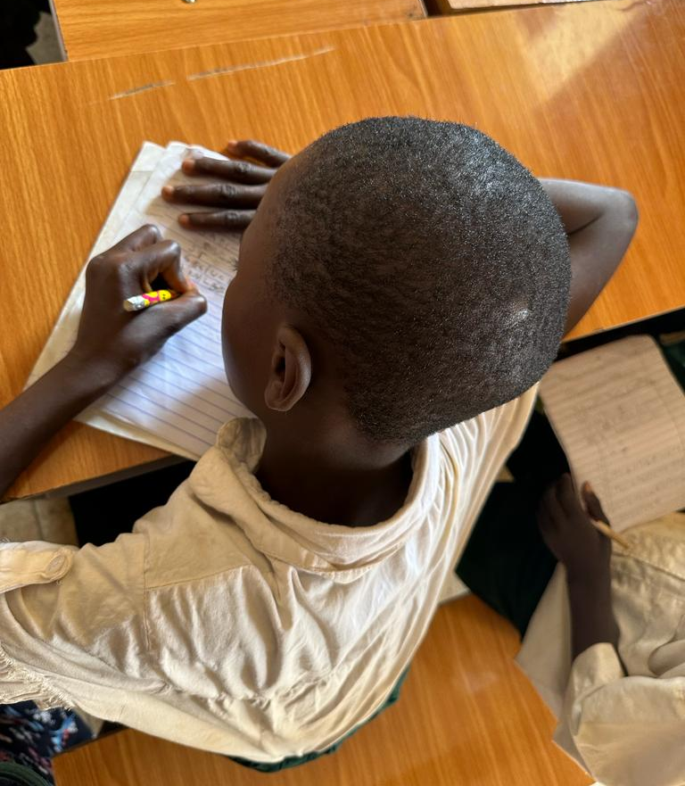
WHO WE ARE
The PLANE Programme is a seven year Education Programme in Nigeria that is funded by the UK Government.
The programmes goals are to:
Improve foundational skills (reading, writing and maths) for children
Invest in a more inclusive and effective education system in Nigeria
Increased use of data and evidence generation
to realise the Government of Nigeria’s commitment to drive sustainable improvements in learning outcomes for Nigeria’s children
The.

Slide 3
PLANE IN NIGERIA

Slide 4
PLANE IN NIGERIA
The PLANE programme works with federal and state leaders, legislators, education providers and parents across Abuja, Jigawa, Kaduna, Kano, Borno, Yobe, the South-East and the South-West.
PLANE works on basic education across state and non-state education systems with a focus on marginalised groups, especially girls. It contributes towards real, transformational change, driving progress in the learning environment and supporting improvements in how education is managed and delivered. It will lead to more children going to school, staying in school and learning more.
IMPROVED
EDUCATIONAL
SYSTEMS
MARGINALISED
CONFLICT AFFECTED
CHILDREN

Slide 5
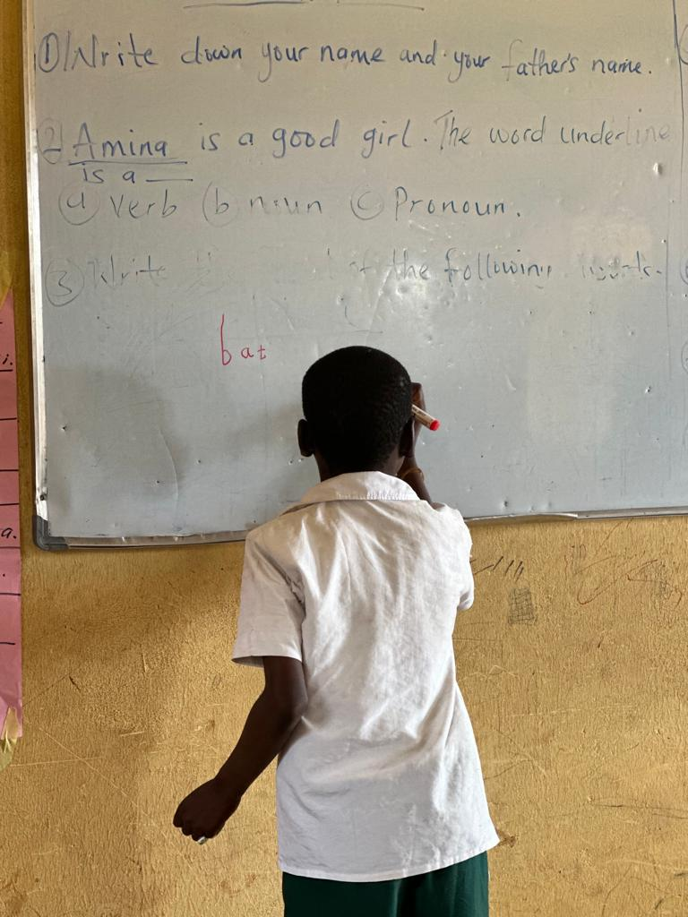
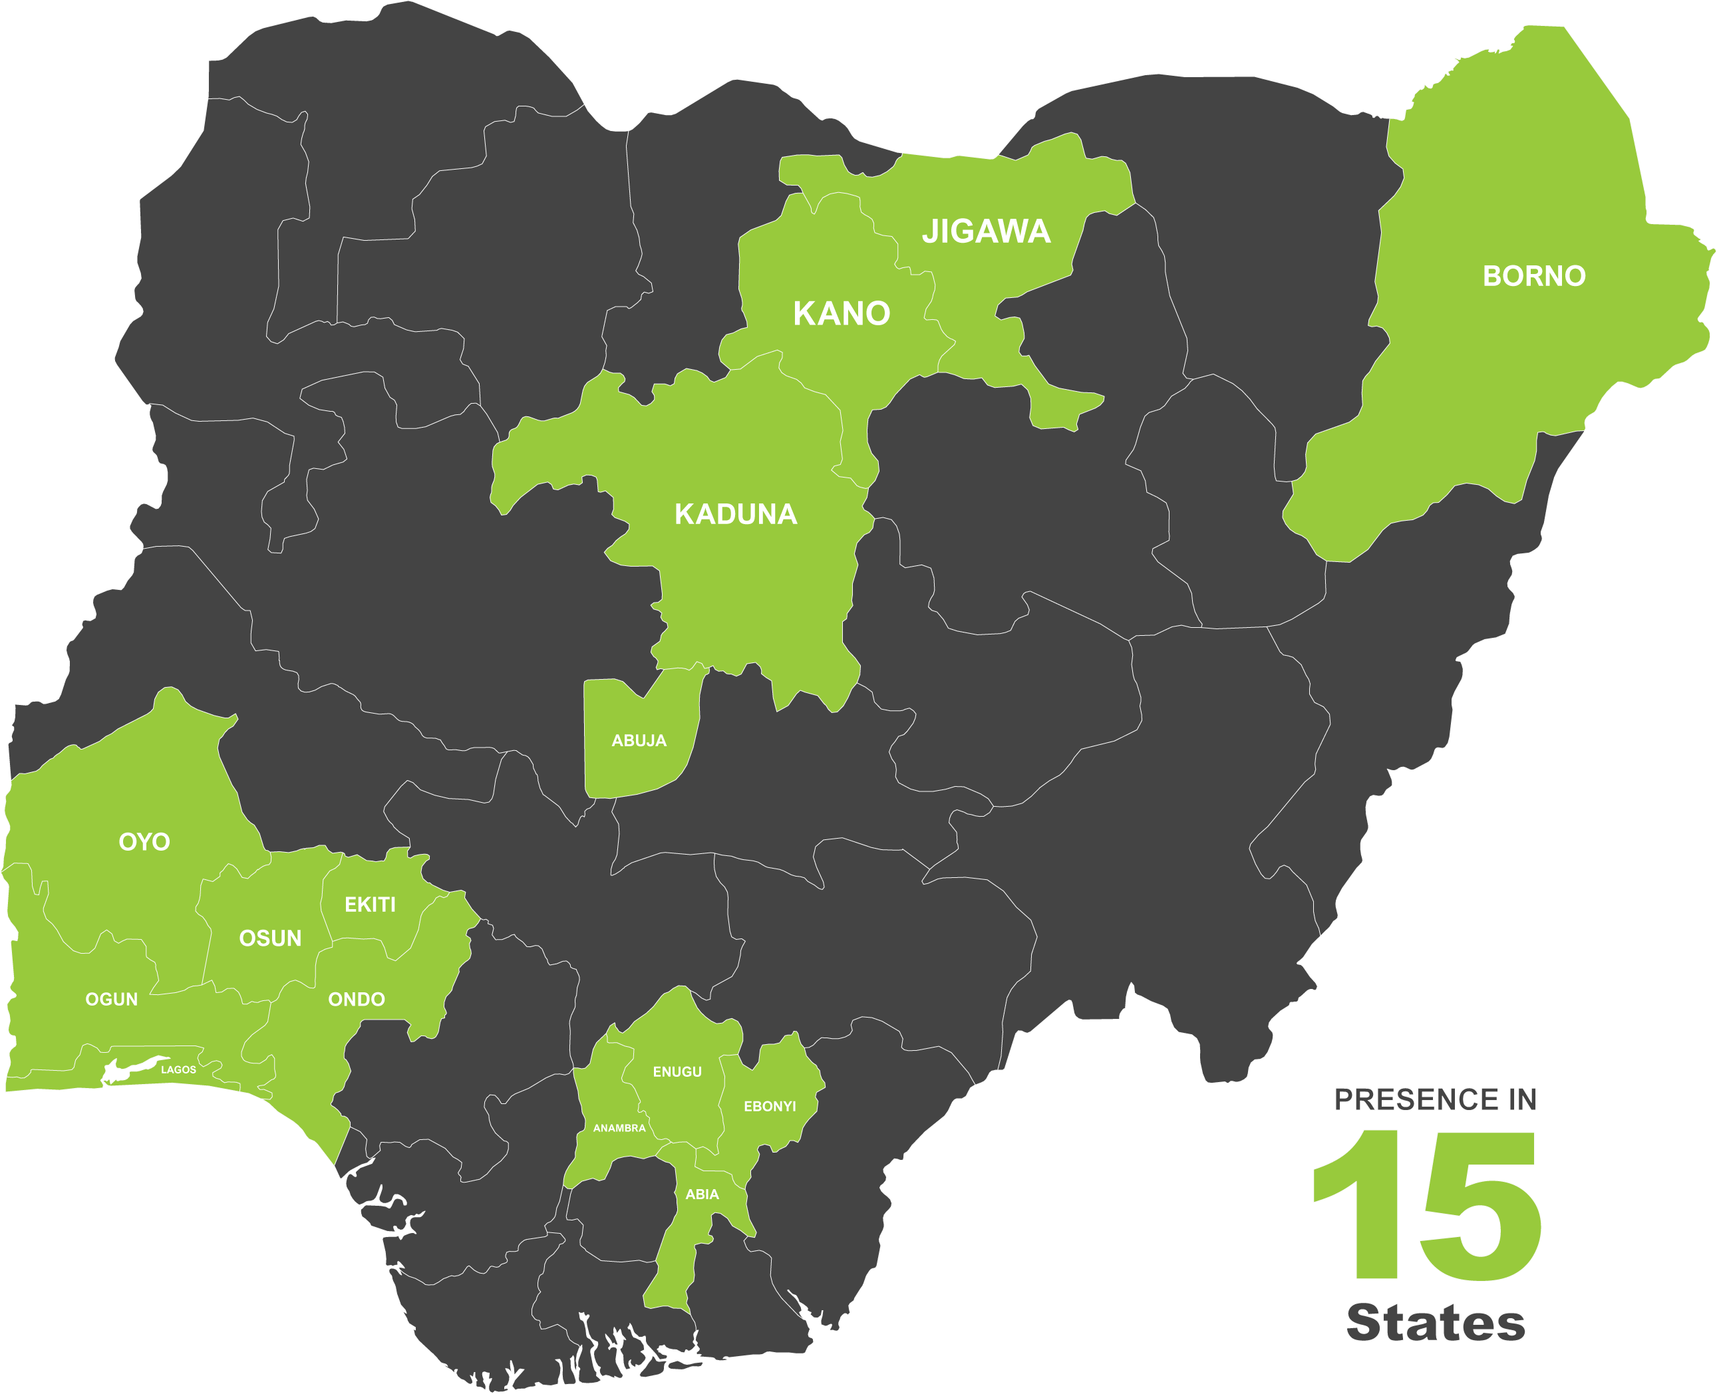
PLANE STATE PRESENCE IN NIGERIA

Slide 6
PLANE OPERATIONAL WINDOWs

Slide 7
PLANE OPERATIONAL WINDOWS
Window 1
Getting the Foundations Right
Strengthened Learning &
Teaching Systems
Increased use of
Data and Evidence
Improved
Governance
Window 2
Education in
Emergencies
Creating access
To Foundational
Learning
Conflict Affected
Children
Supporting Recovery
Systems
Window 3
Community Support to
Learning
Strengthened Learning & Teaching Systems

Slide 8
PLANE OPERATIONAL WINDOWS
Window 1
Getting the Foundations Right
Strengthened Learning &
Teaching Systems
Improved
Governance
Increased use of
Data and Evidence
Focused on strengthening education systems through better teaching and learning, improved governance for state and non-state education delivery, and increased use of data and evidence.

Slide 9
PLANE OPERATIONAL WINDOWS
Window 2
Education in Emergencies
Creating access
To Foundational
Learning
Conflict Affected
Children
Supporting Recovery
Systems
Focused on creating access to foundational learning for marginalised, conflict affected children and supporting the recovery of systems to enable their continued access and retention.

Slide 10
PLANE OPERATIONAL WINDOWS
Window 3
Community Support to Learning
Strengthened Learning & Teaching Systems
Focused on building community support for inclusive learning for all children, especially the most marginalised children through advocacy and behavioural adaptation.

Slide 11
Foundational Learning
In Year 1, the PLANE Programme reached:
9,385 teachers and 554,648 learners with foundational learning and accelerated learning materials.
Foundational Learning (FL) teachers and head teachers received a combination of materials based on their subject area and grade level:
FL teachers received 16,842 teacher guides
16,748 learner books
6,599 read-aloud anthologies
3,930 posters
Over 348,035 P1 and P2 pupils from 1,937 FL schools received Hausa literacy and mathematics books.

Slide 12
Foundational Learning
Strengthening Teachers English Proficiency (STEP) course established.
The course provided support to government-led ongoing teacher capacity building for 1,176 teachers
This was a twenty week course
It was completed across seven LGAs
The overall result showing that 70% of the participants who scored above the pass mark of 50% can deliver classes in English Language after completing the course.
Teachers showed improvements in teacher practices, including session planning, lesson delivery, pupil progression, and use of instructional materials.
.

Slide 13
Safeguarding
PLANE supported state governments to develop materials as required by the National Policy on Safety, Security, and Violence-Free Schools (NPSSVFS) and the Safe Schools Declaration (SSD). This included:
State-approved safeguarding guidelines;
Safeguarding action plans for schools;
Self-assessment tool to gauge progress against the plan;
Code of conduct for teachers;
Safeguarding incidents template to appropriately document issues and suspected violations; and
School and community referral pathway to address incidents.
Schools have a designated safeguarding lead as the first point of contact for safeguarding concerns at the school.
2,487 schools across the Kano, Kaduna and Jigawa States now equipped with comprehensive action plans and guidelines for safeguarding
.

Slide 14
Improved Governance of the State and Non-State Systems
Promoting inclusive education through policy reforms:
Girls’ Education Policy
Teacher Policy
National Policy of Safety, Security and Violence-Free Schools (NPSSVS)
Strengthening transparent budget processes
Improving teacher recruitment
Improving non-state school registration through a socio-demographic survey and pilot graded assessment. Survey carried out in 1,134 unregistered schools to understand and enhance learning environments, access to financial resources, and parent information

Slide 15
Use of Evidence and Effective Communications
An evidence-based approach is the foundation of PLANE’s approach to working with government and other stakeholders.
The PLANE programme will:
Promote the use of evidence in all policy development and programming.
During Year 1, PLANE released six evidence products, each of which was supported by formal and informal engagement of key audiences to improve their understanding of the data and identify how it can inform their work.
The reports were:
(1) The PLANE Baseline Assessment Report;
(2) An in-depth Assessment on Teachers’ Recruitment and Deployment;
(3) Graded Assessment of Private and IQTE schools;
(4) A Sociodemographic Survey of Non-state Schools,
(5) The Gender Equality and Social Inclusion Scan; and
(6) A review of the Nigeria Education Management Information System (NEMIS).

Slide 16
Summary of Overall Foundational Learning Outcomes for Y1 (combined P2, P4 and P6)
Results measured at beginning and end-of-year assessments in a representative sample of learners in P2, P4 and P6.
Pupils were tested using the Early Grade Reading Assessment (EGRA) and Early Grade Math Assessment (EGMA).
 | Kaduna | Jigawa | Kano* | Combined states
Pupils in P2, P4 & P6 who increased a level in literacy | 43.8% | 25.3% | 33.1% | 36.4%
Pupils in P2, P4 & P6 who increased a level in math | 55.0% | 34.4% | 44.2% | 47.1%

Slide 17
Key challenges
Inherent capacity of states to absorb support and deliver education reform is very limited
State financial resources are insufficient and not always well-spent
Increasing domestic costs and the devaluation of the Naira continue to prevent teachers and learners from attending school
Ongoing political change in some locations risks further undermining progress and distracts from addressing education and other basic priorities

Slide 18
Partnership for Learning
for All in Nigeria
Thank You

