Slide 1
Following the Money: Reporting Budgets & Procurement
Dayo Aiyetan
Executive Director
International Centre for Investigative Reporting, ICIR

Slide 2
Training Objectives
Provide an Understanding of the budgeting process.
Provide an understanding of redflag in the budgeting processes
Show where to get information about budgets
Provide an understanding of essential sections the Public Procurement Act 2007
Investigating Procurement/Contract Fraud
Case Study

Slide 3
Budgets and budgeting Processes
Section 82 of the 1999 Constitution (as amended) authorises the National Assembly to make laws for the spending of public funds.
The federal budget is captured in the yarly Appropriation Act.
By law, no penny can be spent by any arm of government or any Ministry, Department of Agency (MDA) outside what is budgeted in the Appropriation Act.
The law also allows for the National Assembly to approve a supplementary budget to meet exegencies.

Slide 4
The Budgeting Process
FMoF and Budget Office come up with economic plan – part of this is the MTEF (Medium Term Expenditure Framework)
Proposal submission by MDAs & GOEs (Government Owned Entreprises)
Presentation of Budget estimates to Presidency/FEC Approval
President presents Budget to National Assembly
Approval of Budget by NASS
Implementation of Budget/allocation and release of funds/contracts/procurement.

Slide 5
Red Flags to Watch out for in Budgets
Skewed funds appropriation – particularly favouring principal officers eg https://www.icirnigeria.org/how-nass-leadership-hijacked-2022-supplementary-budget/
Frivolous expenditure – yacht purchase, N15 billion - https://www.premiumtimesng.com/news/top-news/647592-despite-economic-crisis-wike-proposes-n15bn-for-vps-new-residence.html
Budget padding – how do you know about budget padding?
Inconsistency or irrelevance to agency mandate – many constituency projects
Incomplete, inadequate of fuzzy information

Slide 6
https://www.icirnigeria.org/ghost-contractors-rogue-lawmaker-and-abandoned-projects-threaten-education-in-kano-public-schools/
https://www.icirnigeria.org/how-sokoto-govt-breached-extant-laws-awarded-multi-million-naira-contracts-to-company-owned-by-state-officials/

Slide 7
Where to get Budget Infomation
The Appropriation Act (Budget)
Budgit
PLAC (Policy and Advocacy Centre)
NASS website ??????

Slide 8
Public Procurement
Public procurement is the use of public funds by for the delivery of public goods and services
Involves a series of related activities starting with needs assessment to the contract award, to the payment, M & E, contract management and certificate of completion
Section 2 of the 1999 Constitution (as amended) spells out the primary function of government as the security and welfare of citizens. Procurement plays a central role in government meeting this responsibility.
Procurement accounts for 60% to 65% of government spending as shown in the yearly budget
According to the ICPC, 60% looting of our public funds comes from contract and procurement processes
60% of Illicit Financial Flows (IFFs) from Africa are from commercial transactions such as contracts – The Thabo Mbeki report on IFFs

Slide 9
Government Procurement Activities
Construction work – roads, bridges, schools, hospitals, constituency and other projects
Other
infrastructure projects – rail, dams, ports etc
Supplies – office, equipment, medical, books, food (School feeding Program) etc
Military hadware - arms and ammunitions

Slide 10
Understanding the Public Procurement Act
The Legal Frame work
The Public Procuement Act 2002
Lays out procurement processes, procedures and approving authorities – Sects 16 to 52
Establishes the Bureau of Public Procurement (BPP) – Sect 3 (Section 5 spells out the responsibilities of the Bureau)
Vests BPP with powers to regulate and supervise procurement activities of MDAs.
Prescribes offences and penalties

Slide 11
Legal Framework contd
Sub National Level
A total of 18 states have enacted Public Procurement laws - Adamawa, Anambra, Bauchi, Bayelsa, Delta ,Ebonyi, Ekiti, Enugu, Imo, Jigawa, Kaduna, Kebbi, Kwara, Lagos , Niger, Ondo, Osun, and Rivers
Some 26 states not have open contracting portals

Slide 12
Procurment Cycle
Infograph by Kehinde Ogunyale

Slide 13
Procurement Stages
Pre Bidding
Needs Assessment & Evaluation
Market surveys/ In-House Estimates
Procurement Planning
Provision of funding
Selecting procurement method
Preparation of Bid Documents

Slide 14
Procurement Stages
Bidding Stage
Advertisement
Collection, Submission & Opening of Bids
Evaluation of Bids
Writing the Evaluation Report
Approval /”No Objection”

Slide 15
Procurement Stages
Post Bidding
Award and Signing of Contract
Contract Administration/ Management
Project Commissioning
Monitoring & Evaluation
Project Closure

Slide 16
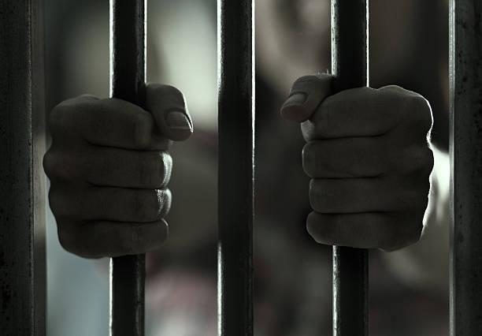
Investigating Procurements: Infractions to watch out for
Section 58 of the PPA 2007 spells out offences under the Act and offenders are liable to between 5 to 10 years imprisonment, with no option of fine.
Debarment from public procurement for five years
Dismissal from public service
Fine equal to 25 % of procurement sum

Slide 17
Infractions to the law
Bid rigging
Influencing procurement process
Procurement fraud
Contract splitting to avoid monetary threshholds
Altering procurement documents to influence bid outcomes
Conflict of interest

Slide 18
Other Infractions
If a company does not meet any of these requirement
CAC registration
Submission of NSITF Compliance certificate
Submission of ITF compliance certificatePENCOM compliance certificate
Company Tax clearance Certificate

Slide 19
Investigating procurements: Red Flags
Bid rigging – Limited competition, submission of consistently high bids, winner subcontracts to losing bidder, same mathematical and spelling errors, identical bids, same format.
Procurement irrelevant to MDA’s mandate or work
Or More focus on purchase or irrelevant, ancillary or accessory items e.g. MoH focus on printing
Contract splitting – multiple contracts below a certain threshold
Conflict of Interest

Slide 20
Red flags contd
Excessive urgency.
Repetitive use of one contractor in a competitive field
Competitors uncharacteristically refrain from bidding on contracts
Poor description of line item in budget or in reporting
Bid patterns : too close, too high, round numbers, identical margins or percentages
Persistent and unjustified high prices from all bidders compared to local markets (Indicates price fixing agreement)
Bid from fake companies to give impression of competition

Slide 21
Red flags contd
Bid winner subcontracts job to bid loser or a company that didn’t bid

