Slide 1
Development and Solution Reporting
What you need to know
December 6, 2023

Slide 2
Introduction: Overview of Development and Solution Reporting
Today, most news media outfits underreport stories about development issues.
Thus, it is necessary to raise awareness about various programmes and issues, as well as report on solutions that are working in society.

Slide 3
What is Development Reporting?
Development reporting means reporting on development – related issues.
It involves the systematic tracking, documentation, and communication of progress, achievements, and challenges during the various stages of a project or process.

Slide 4
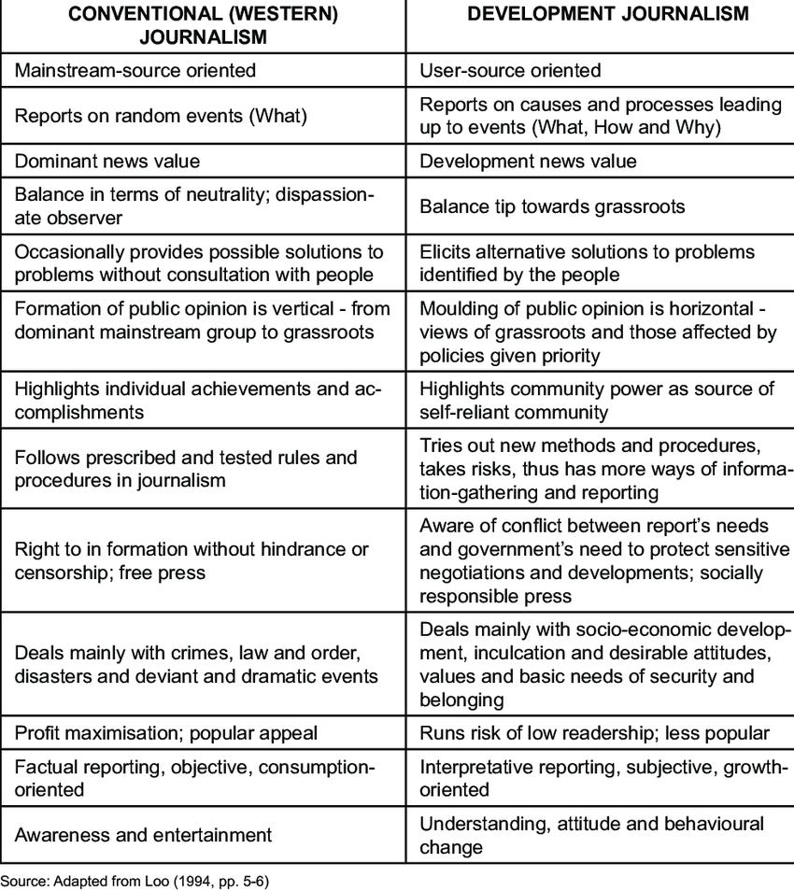
How Development Reporting differs from regular journalism

Slide 5
Origin of development reporting
It originated post-World War II in the post-colonial era when newly independent, developing countries sensed a lack of global media interest in their development programs.
These nations embraced development reporting as a form of positive journalism, aiming to spotlight their developmental initiatives.

Slide 6
Purpose of development reporting
To make people aware of development projects and their many repercussions.
To encourage active public participation in development programmes.
To give a voice to marginalized communities.

Slide 7
Some sources of development stories
‌Journals‌
Press releases from government ministries that are associated with development work such as rural development, environment, social welfare, education, agriculture and even science and technology
National and International NGOs‌
Seminars and Conferences

Slide 8
Development reporting - things to know
Development reporting includes the measurement of:
Key performance indicators (KPIs)
Milestones, and
Other relevant metrics to provide insights into the developmental aspects of a project or initiative.

Slide 9
Some common key metrics and indicators include:
Economic Indicators such as GDP growth and employment rates.
Social Indicators such as infant mortality and healthcare access.
Environment-based indicators such as carbon emissions and biodiversity preservation.
Such metrics collectively provide a comprehensive overview of a country's development progress and areas that may require attention.

Slide 10
Some Challenges facing Development reporting
Low professional journalistic standards
Lack of financial resources
Inadequate work technical skills
Fragmented legal frameworks
‌Risk of low patronage
The need to beat deadlines

Slide 11
Ethics that can help a development reporter
A development reporter:
Cannot and should not ignore the ideology behind any development programme. It always helps in understanding the purpose of the programme.‌
Should always present both positive and negative facts before the public and authorities.

Slide 12
What is Solution Reporting?
It is a type of reporting that focuses on the identification, implementation, and evaluation of strategies or interventions to address problems or challenges.
It encompasses the documentation of the entire problem-solving process, from understanding the issue to implementing and assessing the effectiveness of solutions.

Slide 13
What is Solution Reporting? (Cont.d)
Effective solution reporting enables the society to learn from experiences and refine their approaches to problem-solving.
Solutions journalism is not Public Relations; it is examining a response, not promoting it.

Slide 14
Four pillars of solution reporting
Response
Outcome
Evidence and
Insight

Slide 15
pillars of solution reporting: response
pillars of solution reporting: response
The “response” pillar answers the question, "what action steps are being taken to address the problem?

Slide 16
pillars of solution reporting: outcome
The “outcome” pillar answers the question, "What has changed before and after the action steps were taken?”

Slide 17
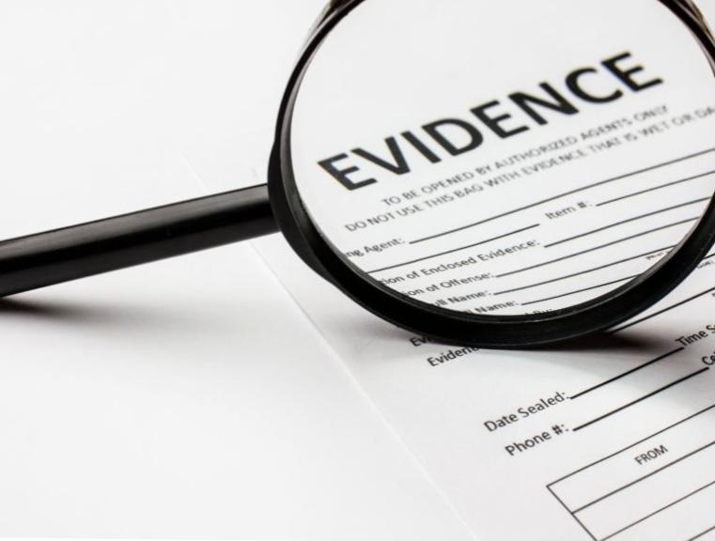
pillars of solution reporting: evidence
The "evidence" pillar answers the question, "What concrete revelations from the outcomes back up other findings on the subject?"
Text

Slide 18
pillars of solution reporting: insight
The “insight" pillar provides responses to questions such as: What is not working correctly? Which successes can be promoted? What is still relevant? And what can inform future interventions?

Slide 19
Solution reporting – things to know
A good solution report/story should respond to one or more of the aforementioned pillars. Therefore, the reporter must:
Understand the Problem
Know the solutions being implemented, and
Find out the effectiveness of each solution

Slide 20
Solution reporting – things to know (cont.D)
Also note that:
Collaborative story development enhances collective impact.
Diverse perspectives enrich potential story angles.
Increased evidence collection and broader reach amplify awareness of potential solutions.

Slide 21
Integration of Development and Solution Reporting – things to note
Collaborative Storytelling: Combining the expertise of development and solution reporters allows for more comprehensive narratives.
Holistic Perspective: Combining development and solution reporting provides a holistic view, capturing challenges, progress, and potential resolutions in a balanced manner.

Slide 22
Integration of Development and Solution Reporting – things to note (cont.d)
Data-Driven Insights: Integration enables the incorporation of data-driven insights, fostering evidence-based reporting on developmental issues and proposed solutions.
Engagement with Stakeholders: Integration involves engaging with various stakeholders, from communities to experts, fostering a deeper understanding of issues and potential remedies.

Slide 23
Integration of Development and Solution Reporting – things to note (cont.d)
Impact Measurement: Integration facilitates a more nuanced approach to measuring the impact of development initiatives and the effectiveness of proposed solutions.
Enhanced Public Awareness: By seamlessly integrating these reporting approaches, journalists contribute to increased public awareness and understanding of both challenges and positive developments.

Slide 24
Best Practices in development and solution reporting
Effective Communication
Data Accuracy and Transparency
Continuous Improvement

Slide 25
Some Evolving Reporting Strategies in development and solution reporting
Interactive Multimedia Storytelling
Community-Centric Reporting
Data Journalism Integration
Crowdsourced Reporting

Slide 26
Conclusion
Development reporting deals with the broader progress of a project, while solution reporting specifically addresses the process of solving problems within that project.
Both types of reporting contribute to informed decision-making and continuous improvement in various domains, such as business, research, and project management.

Slide 28
Thank you for listening!!!

Slide 29
References
‌Dunham, R. The four pillars of solutions journalism – and the benefits of collaboration. International Journalists' Network. Retrieved from https://www.globalbusinessjournalism.com/post/the-four-pillars-of-solutions-journalism-and-the-benefits-of-collaboration#:~:text=Solutions%20journalism%20relies%20on%20four,%2C%20outcome%2C%20evidence%20and%20insights‌
Hurst, D. (2016). Insights that matter. Web Analytics and Measurement. Image with the word, “insight”. https://www.google.com/search?q=insight&client=ms-android-xiaomi-rvo3&sca_esv=588395872&tbm=isch&prmd=inv&sxsrf=AM9HkKkW3FSIpVnEDK1vN9GtlMfxanRLgA:1701875673226&source=lnms&sa=X&ved=2ahUKEwivhNH3jPuCAxXHZ0EAHQAaBMYQ_AUoAXoECAIQAQ&biw=357&bih=669&dpr=3.02#imgrc=zwBfvtINWrwZDM&imgdii=pwsfh_zsx4iC6M
Image with the words, “any questions?”https://images.app.goo.gl/bwoJRsGFaz3n5PAw6
Ivanič, P. (2018). Covering migration; tools and resources for quality migration coverage. Press conference at Nairobi University, Kenya. Retrieved from https://coveringmigration.com/learning_pages/what-is-development-journalism/‌
Kumari, A. (2023). Development and Rural Reporting. Newswriters. Retrieved from https://newswriters.in/2023/07/14/development-and-rural-reporting/#:~:text=The%20sole%20purpose%20of%20development,positive%20as%20well%20as%20negative.
‌Mkhitarian, J. (2022). Admissible vs. Inadmissible Evidence: What You Need to Know. Image with the word, "evidence". New Mexico Criminal Law Offices. https://newmexicocriminallaw.com/admissible-vs-inadmissible-evidence-what-you-need-to-know/
‌Narayan, V., V. (2016). Reporting development in journalism. SlideShare. Retrieved from https://www.slideshare.net/VINEETHNARAYANV/reporting-development-in-journalism‌

Slide 30
References (cont.d)
OpenAI. (2023). "Development and Solution Reporting: What you need to know." ChatGPT. https://chat.openai.com/share/b5b0193b-89f7-4bda-a08a-01134515382a‌
OpenAI. (2023). "Development Metrics and Indicators." ChatGPT. https://chat.openai.com/share/413d4bb8-fe10-4081-9fd0-e8062312b215‌
OpenAI. (2023). “Dev. Reporting: tracking progress.” ChatGPT. https://chat.openai.com/share/0836643b-17ad-4fe5-812b-a821118a3325
Robie, D. (2013). ‘Four Worlds’ news values revisited: A deliberative journalism paradigm for Pacific media. Pacific Journalism Review Vol. 19(1):84-110. Retrieved from https://www.researchgate.net/publication/283607601_'Four_Worlds'_news_values_revisited_A_deliberative_journalism_paradigm_for_Pacific_media‌
Sutrisno. (2023). Perbedaan Response dan Respond. Image with the word, "Response". Kepoindonesia. https://www.kepoindonesia.id/?m=1‌
Talabi, F. (2013). The Challenges of Development Journalism in Nigeria. Journal of Social Sciences (COES&RJ-JSS) 2(1) DOI:10.25255/jss.2013.2.1.35.40. Retrieved from https://www.researchgate.net/publication/254955067_The_Challenges_of_Development_Journalism_in_Nigeria‌
Unlock:OKR. (n.d). Outcomes over Output: Why do OKRs Matter? Image of "outcome". https://images.app.goo.gl/U2uuX4Ab3t3LEMNu8

