Slide 1
Enhancing Top Team Effectiveness of Health Leaders across Nigeria’s 36 States and the FCT
Presentation to State Health Commissioners
November 03, 2023

Slide 2
Background
The Nigeria Governors Forum (NGF) Health Secretariat collaborated in late 2022 with the Nigeria Health Commissioners' Forum (NHCF) to enhance the effectiveness of state health leadership teams
This collaboration was deemed necessary to optimize the synergy among the state health MDAs towards achieving desired outcomes driven by their respective leaderships
The NGF engaged Solina Health to implement this project which aimed to understand challenges of the state health leadership teams, develop solutions, and kickstart these solutions to improve their effectiveness
This document describes the implementation progress thus far and the next steps to be taken
Source: Team Analysis

Slide 3



Content
  Project Overview
  Diagnostics report
  Plan for follow up support
  Prayers

Slide 4






The Top Team Effectiveness project set out to achieve 2 main objectives
INTRODUCTION
Objectives of the project
Use known team effectiveness models to understand the current structural, political, interpersonal and contextual challenges affecting the effectiveness of the state health leadership teams
Understand the barriers
1
Co-create a framework for establishing and maintaining top team effectiveness
Develop potential solutions and kickstart the implementation of these solutions towards improving the effectiveness of the state health management teams
Co-create solutions
2
We adapted the GRPI¹ and Lencioni² models for team development to assess the components of the effectiveness of the top leadership team
SOURCE: 1. The GRPI model – an approach for team development S Raue, SH Tang, C Welland 2013; 2. The Five Dysfunctions of a Team Patrick M. Lencioni 2007; Team analysis

Slide 5




The project was designed to be implemented in four phases
APPROACH
xxx
Details on next slide
Phases
1
2
3
4
Rapid Diagnostic
Solutions
Co-Creation
TTE
Retreat
Documentation and tracking
Key Activities
Reviewed available academic literature
Developed interview guides and workshop tools
    Interviewed 3 - 4 health team managers per state and analyzed findings
Conducted a solution co-creation workshop to:
Review the findings from the interviews
Identify potential root causes and solutions to the identified gaps
Align on the plan for the general retreat
Conducted retreat with three representatives per state:
Introduced the participants to TTE
Developed plans for improving the TTE based on the diagnostic findings
Develop a simple tracker for the NHCF and continuously track the commitments from the retreat
    Conduct execution support to a few states for six months
    Update tool kit to include lessons learned from execution support
Key Activities
Outputs
Interview guides and workshop tools
Draft diagnostic report including key barriers to top team effectiveness
A draft team effectiveness improvement toolkit
Finalized diagnostic report
State baseline assessment
State top team improvement plans
National communique
Final team effectiveness improvement toolkit
Commitment tracker
Project close out report
The first three phases of the project have been concluded, while the documentation and tracking phase was put on hold due to the general elections and attendant changes in government across many states earlier in the year
SOURCE: Solina team analysis

Slide 6

A three step methodology was used to obtain relevant output for the TTE implementation
APPROACH
Rapid diagnostics
Solutions co-creation
TTE retreat
26 HCHs
33 ES SPHCDA
32 ES SHIA
12 other leaders
4 HCHs
4 ES SPHCDA
3 ES SHIA
25 HCHs,
31 ES SPHCDA
31 ES SHIA
Who
Final diagnostic report
State-specific recommendations
TTE solutions toolkit
Commitment Tracker
Overall output
Interviewed at least one health leader from all 36 states + FCT to understand their state’s current realities on the GRPI team effectiveness focus areas and determine their gaps
Held a day session with a select sample of state leaders to review the diagnostic findings, improve the insights, identify the probable root causes of all gaps and recommend potential solutions
Conducted a 2-day retreat with leaders from 35 states¹ to socialize the assessment findings and support each state to develop state-specific plans for improving team effectiveness
How
1. Rivers state had no representative at the retreat
SOURCE: Solina team analysis

Slide 7
Content
  Project Overview
  Diagnostics report
  Plan for follow up meetings
  Prayers

Slide 8

We summarized the findings from the diagnostics along 4 focus areas of the GRPI model
Goals
The majority of states reported clearly documented goals but there appeared to be a gap in having a shared understanding and application across states
Roles
Roles are documented in most states but they were instances of varying interpretation which in some instances affected interactions. In some cases, suboptimal coordination and collaboration was attributed to this.
Overlapping roles existed in some states but could be helpful or harmful, depending mostly on interpersonal relationships of agency leaders.
Processes
Respondents from some states provided discordant answers to processes in their states; suggesting gaps in communication and alignment between them.
Interpersonal relationship
Conflict resolution is mostly through informal processes and channels. Those states where top teams have cordial working and interpersonal relationships record minimal conflict and resolve them easily
Most states have not been able to conduct leadership retreats mostly due to unavailability of funds for the retreats
Source: Team analysis

Slide 9

The state teams developed solutions around three domains to address their respective gaps during the co-creation workshop and retreat
1
Strengthen coordination and communication between the MDAs
There were specific solutions proffered for each state across the 3 domains
All the state teams at the retreat received a tailored intervention plan that contained their specific gaps, proffered solutions and state-specific intervention plans
These documents will be reshared with the commissioners
The NGF has developed a dashboard to track state’s progress with implementing the retreat output and intervention plans
2
Build capacity of top team to understand their roles and on relevant soft skills
3
Institute a mutual accountability system for monitoring, analyzing, and improving the performance among the health MDAs
SOURCE: KII with MDAs, Solina team analysis, Co-Creation workshop

Slide 10
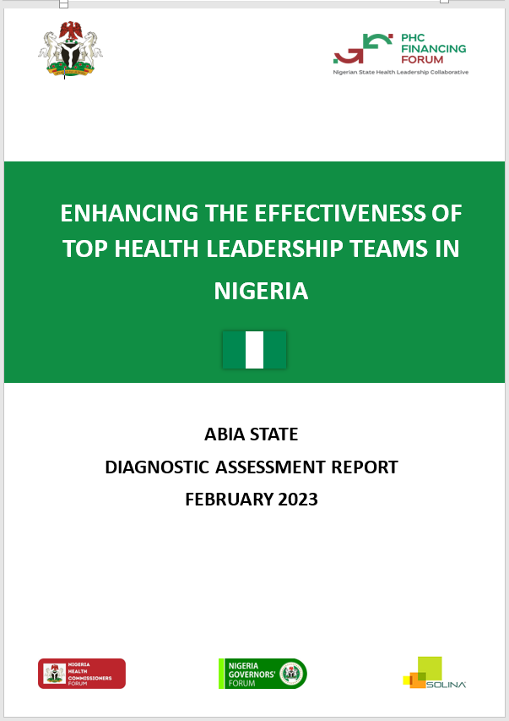
The team developed and shared tailored reports with each state team
Objective
To provide detailed findings from the diagnostic assessment of the state top health leadership team and the proposed solutions developed by some members of this team.
Cover page of a state’s report
Content
Assessment methodology
State-specific findings
State improvement plan
State team MBTI learning
Expected use of the state report
Expectations from the HCHs
Discuss the findings from the assessment and align on the immediate next steps.
Implement and track the interventions
Discuss other interventions not covered in this report and plan accordingly
SOURCE: KII with MDAs, Solina team analysis, Co-Creation workshop

Slide 11
Content
  Project Overview
  Diagnostics report
  Plan for follow up support
  Prayers

Slide 12
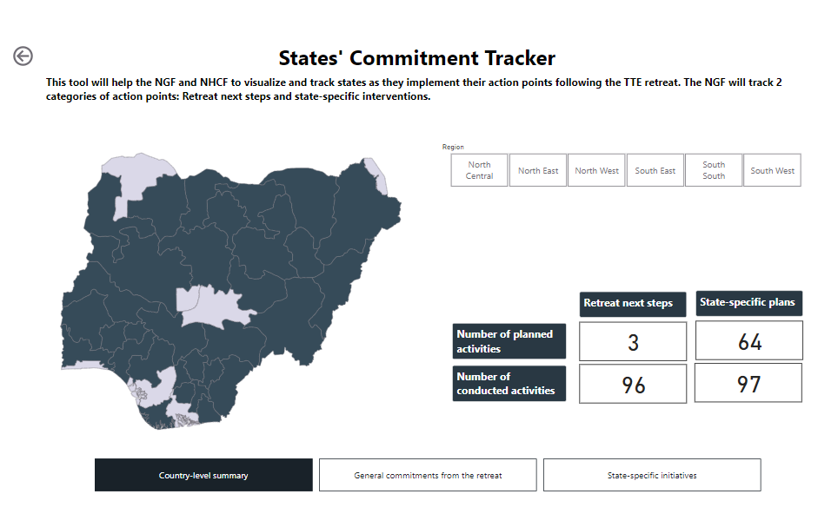
We developed a dashboard to guide the NGF and States’ commissioners in tracking the plans from the retreat workshop and visualize implementation progress
How to access the TTE Dashboard
The TTE dashboard can be accessed using the Microsoft Power Bi application at the following link
https://app.powerbi.com/view?r=eyJrIjoiY2UwZjNkNzYtYzg2OC00OTA5LWE4ZTQtN2FkMzVmYzlhNjQ5IiwidCI6ImNkMWMxYTAyLWUxNWUtNGE2NS1iNWJiLTllMjFhNWFmN2NlOSIsImMiOjl9
How to update the TTE Dashboard
The dashboard is updated using a Google sheet accessible to each state
https://docs.google.com/spreadsheets/d/1AeKASZ4-tgiqhK99RjwNdkJdo96x3Y4Vl8Ds9BbRXns/edit#gid=46133342
How frequently should the dashboard be updated
The NGF Health Secretariat will provide assistance to states experiencing difficulty in accessing and utilizing the dashboard
Monthly, to enable state’s track their implementation progress and course correct where applicable
SOURCE: TTE dashboard

Slide 13





Anambra, Edo, Ekiti, Gombe, Kogi, and Zamfara state were selected for the implementation support
STATES’ SELECTION
SOKOTO
KATSINA
YOBE
6
JIGAWA
ZAMFARA
States will be supported to implement their team effectiveness improvement plans
KEBBI
KANO
BORNO
KADUNA
BAUCHI
GOMBE
NIGER
KWARA
ADAMAWA
FCT
PLATEAU
States were selected using a 3-step analysis approach
OYO
NASARAWA
1
Geopolitical zoning
TARABA
EKITI
All 32 States were grouped into their geopolitical zones
OSUN
KOGI
BENUE
OGUN
ONDO
EDO
ENUGU
LAGOS
EBONYI
CROSS
RIVER
Assessment
ANAMBRA
2
Scores were assigned to each state based on the level of their participation in the project and the probability of a continuity of government
DELTA
IMO
ABIA
RIVERS
AKWA IBOM
BAYELSA
3
Selection
The NGF will follow up with these states to schedule the implementation support visits
The state with the highest score in each geopolitical zone was selected for the implementation support
SOURCE: Solina team analysis, https://en.wikipedia.org/wiki/List_of_state_governors_of_Nigeria

Slide 14
Content
  Project Overview
  Diagnostics report
  Plan for follow up support
  Prayers

Slide 15

Our prayers to the Commissioners
All states
All states
Call a meeting to review the state’s plan and discuss the approach to implementing the interventions
Identify an appropriate forum to leverage for routinely reviewing the progress and output of your state health team routinely
Assign a focal person to routinely update the dashboard for your state
Review the dashboard during the NHCF meetings
Implementation support states
Provide dates for the visit to your state to commence implementation support
Provide dates for the visit to your state to commence implementation support
SOURCE: Solina team analysis

Slide 16
Backup

Slide 17
We found that a majority of the states reported gaps in overlap of roles, clarity of reporting lines and existence of team engagement fora
Trend in perceived status of the 36 states and the FCT
No perceived gaps
Perceived gaps
Inadequate sample size
Bauchi
Benue
Gombe
Kano
Rivers
Zamfara
Akwa-Ibom
Niger
Ogun
Delta
Kaduna
Lagos
Ebonyi
Jigawa
Yobe
Enugu
Imo
Katsina
Oyo
Nasarawa
Osun
Abia
Adamawa
Anambra
Bayelsa
Borno
Crossriver
Edo
Ekiti
FCT
Kebbi
Kogi
Kwara
Ondo
Plateau
Sokoto
Focus
Metrics
Taraba
Goal
Documented vision & mission
Understanding of vision & mission
Aligned priorities
Role
Clearly documented roles
Roles overlap
Process
Documented processes
Clear reporting line
Inter-personal commun-ication
interagency coord. platform
Health leadership meetings/fora
Gaps were assessed as areas where there was no harmony in the response from all the respondents in a state
Many states reported roles overlap due to incursion in the duties of MDAs by other MDAs. While these incursions are sometimes minor and informally resolved, it could be a cause of major friction if there is no clear coordination by the HCH of activities performed by all MDAs
The gaps in existence of health leadership engagement forums were a result of undefined platforms for meeting, interaction and information sharing
SOURCE: KII with MDAs, Solina team analysis

Slide 18
As many as ten states had respondents who could not describe the SMoH’s vision and mission
ASSESSMENT FINDINGS: GOALS
Understanding of the SMoH’s vision and mission statement
Understanding of vision and mission statement by geopolitical zones (N = states)
Understanding of vision and mission statement by respondent role/agency (N = Respondents)
All can provide an explanation
Not all can provide an explanation
Can provide some explanation
Can provide no explanation
37
33
32
26
1
7
7
10
27
2
6
6
5
1
2
2
1
Total
NC
NW
NE
SS
SW
SE
HCH
SPHCDA
SHIA
4th person
Some respondents from 8 states that previously mentioned that they have documented vision/mission statements could not provide an explanation of the vision
There were disparities in the responses from interviewees from 10 states. This disparity in the understanding of the vision and mission across the categories of respondents further suggests a possible communication gap between the SMoH and health agencies
SOURCE: KII with MDAs, Solina team analysis, Analysis is based on perceived responses from state respondents

Slide 19
Fourteen states had at least one respondent reporting the presence of overlap
ASSESSMENT FINDINGS: ROLES
Overlaps in the delineation of roles across MDAs
Presence of overlap in roles by geopolitical zones (N = States)
Presence of overlap in roles by respondent’s roles (N = Respondents)
There is no role overlap
There is role overlap
No role overlap
There is role overlap
Complementary role overlap
37
Complementary role overlap was recorded as no role overlap
33
30
26
7
7
6
6
6
10
1
1
0
5
23
2
Total
NC
NW
NE
SS
SW
SE
HCH
SPHCDA
SHIA
4th person
The interviewees noted that a deficient understanding of agencies’ roles and responsibilities is the major reason for overlaps despite the operational guidelines and policies being appropriately documented
However, in some cases, respondents saw the overlap as complementary because they facilitated synergy and cross-learning within the health workforce. This is an opportunity that can be identified and utilized in all states
SOURCE: KII with MDAs, Solina team analysis, Analysis is based on perceived responses from state respondents

Slide 20
Only sixteen states confirmed that they report to/through the SMoH
ASSESSMENT FINDINGS: PROCESSES
Clear documented reporting structures between the MDAs and SMoH in the state
Reporting structures between MDAs and SMoH by geopolitical zones (N = States)
Reporting structures between MDAs and SMoH as reported by respondents (N = Respondents)
All agencies report to/through the SMoH
Through/To the HCH
Unclear reporting structure
Not all agencies report to/through the SMoH
Independent of the HCH
Not applicable
37
34
1
31
25
1
1
9
3
7
6
7
6
6
25
10
16
5
20
2
2
2
2
Total
NC
NE
NW
SE
SS
SW
HCH
SPHCDA
SHIA
4th person
The laws setting up the agencies in some states does not require them to report to/through the SMoH
It is recommended that a structured reporting line to/through the SMoH be considered across all agencies to improve collaboration in attaining the state’s health goals
SOURCE: KII with MDAs, Solina team analysis, Analysis is based on perceived responses from state respondents

Slide 21
Only fourteen states confirmed the conduct of leadership meetings or retreats to build the interpersonal relationships within the team
ASSESSMENT FINDINGS: INTER-PERSONAL RELATIONSHIP
Existence of any semi-formal gathering to foster stronger interpersonal relationships within the team e.g. retreats
Existence of an informal engagement platform by geopolitical zones (N = States)
Existence of an informal engagement platform by respondents’ roles (N = Respondents)
All agree that the state has
Not all agree that the state has
Yes
No
I don’t know
37
33
1
30
26
2
10
7
6
7
5
6
6
2
14
1
1
Total
NC
NE
NW
SE
SS
SW
HCH
SPHCDA
SHIA
4th person
Some interviewees mentioned the use of group features on social messaging platforms (e.g WhatsApp) and leveraging other partner-funded events to hold semiformal meetings
All states need to make deliberate efforts to hold semi-formal gathering to foster interpersonal relationship within the team . For instance, states can include retreats as part of their annual operation plan or leverage other state activities such as AOP development or other donor funded activities for their retreats
SOURCE: KII with MDAs, Solina team analysis, Analysis is based on perceived responses from state respondents

Slide 22



FOLLOW UP SUPPORT
Each state will be supported to achieve four key objectives
Focus
Details
Objectives
Establish a shared understanding of the TTE support plan among the state’s top health team
Review the progress of the state’s improvement plan
Review the progress of the state’s improvement plan
Conclude the state support initiative
1
Proposed date
2
January 2024
Requirements
Communicate a convenient date for the meeting with the state’s top health team
Designate a state liaison preferably the Permanent Secretary or the MDA Head to facilitate communication with the support team
3
The activities to be carried out in each state are not limited to the above and are subject to change depending on the specific need of each state
Support visits will be structured around the communicated timelines based on the State’s top health team availability
Source: Team analysis

Slide 23

Proposed 6-month support plan to selected states
Key activities
Jan
Feb
Mar
Apr
May
Jun
Jul
Responsible
1
Inform selected states for support and
secure their commitment for the planned activities
15/01/2024 - 18/01/2024
NGF
2
Learn of progress made by states in
implementing next steps from the retreat
22/01/2024 - 26/01/2024
Solina
3
Support state to implement any pending retreat next step
29/01/2024 - 16/02/2024
Solina
4
Support the state to schedule and plan the first visit
19/02/2024 - 21/02/2024
Solina
5
Continue virtual support for specific agreed activities
across the state
Solina
26/02/2024 - 28/06/2024
6
Support the state to schedule and plan the second
and third visits (where necessary)
07/07/2024 - 19/07/2024
Solina
SOURCE: Solina team analysis

Slide 24
Solution Domain 1: Strengthen coordination and communication between the MDAs (1/2)
Challenges
Root Causes
Proposed Solutions
Difference in understanding of the vision and mission of the SMoH
a
Suboptimal coordination and communication between the SMoH and other health MDAs to ensure collective buy-in on the SMoH’s vision and mission
Set-up a system/platform comprising the HCH and all MDA heads to coordinate and ensure the alignment and buy-in of the health MDAs on the SMoH’s vision and mission
Set-up a system to develop/routinely review the vision and mission of the health system, and communicate state’s health priorities to all the MDAs
Derailment of MDAs’ priorities from the state’s health priorities
b
Conflicting guidance from the national level and interference from development partners
  National and development partners sometimes bypass the SMoH and/or agency heads in their communication with agencies and/or program officers
Establish/leverage existing platforms to routinely discuss and align the SMoH’s and agencies’ priorities, including latest development from National and proposals from development partners
NHCF and NGF to help flag state concerns to the national bodies and emphasize the need to channel all communications to the MDAs, through the SMoH
SOURCE: KII with MDAs, Solina team analysis, Co-Creation workshop, TTE retreat

Slide 25
Solution Domain 1: Strengthen coordination and communication between the MDAs (2/2)
Challenges
Root Causes
Proposed Solutions
Role overlaps across MDAs
c
Ambiguous statements in some MDA policies which indicate broad responsibility scope hereby leading to unclear roles between MDAs and potential misinterpretation
  In some instances, an MDA intentionally exploits these ambiguous policies to perform the roles due to delays in service delivery by the originally assigned MDA
Review existing laws/policies to clearly define roles for each MDAs and also correct any possible role overlaps between the MDAs and encourage systems strengthening
  NGF and NHCF to consider engaging FMoH to provide a framework/guide for the review of the MDAs’ policies
  Institute a system for joint problem solving led by the HCH to address challenges on encroachment of roles and create opportunities for synergy
Non-existence of routine retreats to foster interpersonal relationships within the team
d
No budget for retreat in state’s annual plan
Include retreats/similar semi-formal events in the ministry’s annual plan or budget
Leverage existing funded meetings/fora (e.g. AOP development/review workshops) for team retreats to foster stronger interpersonal relationships
SOURCE: KII with MDAs, Solina team analysis, Co-Creation workshop, TTE retreat

Slide 26
Solution Domain 2: Build capacity of top team to understand their roles and on relevant soft skills
Challenges
Root Causes
Proposed Solutions
Insufficient understanding of the existing structures/
systems guiding the operations of the MDAs
a
No clear system in place for the onboarding/orientation of new CEOs and other key personnel in health MDAs and no clear provision for continuous professional development of health leaders
Establish a system to adequately onboard all new CEOs and other key personnel in health MDAs on the State’s health vision and mission and priorities
NGF and NHCF to develop a standard onboarding pack for all MDAs
Onboarding process is to span across a feasible period of time
Develop and disseminate a well laid out job description to guide the operations of all MDAs across all levels (directors, etc.)
Develop a framework and curriculum for continuous training of old and new health CEOs situated at the office of the DPRS SMoH
Non alignment of the state’s health priorities with political leaders’ health manifesto
b
Suboptimal communication/advocacy of the health sector priorities by the health team to political leadership
Build the capacity of the health leaders to adequately engage the political leadership on the priorities of the state’s health sector
SOURCE: KII with MDAs, Solina team analysis, Co-Creation workshop, TTE retreat

Slide 27
Solution Domain 3: Institute a mutual accountability system for improving the performance among the health MDAs
Challenges
Root Causes
Proposed Solutions
Top health leaders are not aware of activities in other health MDAs and are thus unable to hold each other accountable
Variable structures for reporting or engagement between health sector MDAs and the SMoH across states. For example;
  Use of parallel oversight and steering committees as accountability platforms for individual projects/programs
  Political affiliations which encourage direct informal engagement of health CEOs with political leadership
Set up a system to jointly develop annual state plans and review the priorities of the MDAs periodically
Ensure the SMoH is adequately represented in all project monitoring and supervisory teams/activities
SOURCE: KII with MDAs, Solina team analysis, Co-Creation workshop, TTE retreat

Slide 28




Participants engaged in 5 key sessions to achieve the expected output
Session
Session Description
Output
1
An overview of the TTE assessment scope, methodology and the major findings across the country was presented to the participants
All participants had a shared understanding of the TTE diagnostic findings
Presentation of findings
2
Proposed recommendations from the Solutions Co-Creation Workshop were displayed at different locations at the venue
Participants took turns in groups to visit the gallery stands which displayed the gaps, root causes, and solutions to the identified challenges across the GRPI team effectiveness model
They shared their thoughts on the identified gaps and provided suggestions on the proposed solutions
An updated list of gaps, root causes and solutions to the identified challenges across the GRPI team effectiveness model
Gallery walk and discussion
3
Panel Session
Top leaders in the health space shared their experiences, challenges faced, and mitigation strategies adopted to resolve these challenges
Participants gained more knowledge on steps to take in addressing some of the challenges they face in their various fields
4
Personality assessment
Participants were introduced to the concept of personality types and how it can impact the functionality of a team
Each participant also took the Myers-Briggs Type Indicator (MBTI) personality test
Participants had a better understanding of how the personality of individuals can affect their team
Participants got their MBTI personality type
5
State findings review and intervention plan
Participants converge in their state groups to review and validate their states’ findings from the diagnostic
They also developed high-level implementation plans for each of the interventions they identified for resolving their challenges
Participants gained more knowledge on steps to take in addressing some of the challenges they face in their various fields
SOURCE: KII with MDAs, Solina team analysis, Co-Creation workshop

Slide 29
35 (95% of 37) states confirmed the existence of a documented vision and mission for the SMoH
ASSESSMENT FINDINGS: GOALS
Existence of vision and mission statement
Existence of vision and mission statement by geopolitical zones (N = states)
Existence of vision and mission statement by respondent role/agency ( N = respondents)
All agree that they have
Not all agree that they have
We have
We don’t have
I don’t know
37
33
32
7
1
6
35
1
26
31
31
10
9
Total
NC
NW
NE
SS
SW
SE
HCH
SPHCDA
SHIA
4th person
In 2 states, the responses of the HCH differed from the agency head. This suggests a communication gap among the stakeholders or possibly, no shared understanding of the state’s vision of mission for health across the MDAs
Some states have gone further to disseminate their vision and mission on their websites and displaying them in their offices. Other states will benefit from this practice to increase team members’ consciousness of the state’s vision and mission
SOURCE: KII with MDAs, Solina team analysis, Analysis is based on perceived responses from state respondents

Slide 30
32 (86% of 37) states agreed that the priorities of their SMoH and agencies were aligned
ASSESSMENT FINDINGS: GOALS
Aligned priorities between the SMoH and the agencies
Alignment between priorities of SMoH and agencies by geopolitical zone (N = States)
Alignment between priorities of SMoH and agencies by respondent’s role (N = Respondents)
All agree that priorities align
Not all agree that priorities align
Priorities align
Priorities do not align/unclear
37
33
32
1
26
0
7
6
6
32
1
1
5
10
1
1
Total
NC
NW
NE
SS
SW
SE
HCH
SPHCDA
SHIA
4th person
Non-alignment of priorities are largely due to poor coordination between the SMoH and the agencies
Respective states’ top health teams will benefit from holding routine joint coordination meetings to review their health goals. This will also ensure shared understanding of the goals, while improving respective MDA-level responsibility & alignment with these goals
SOURCE: KII with MDAs, Solina team analysis, Analysis is based on perceived responses from state respondents

Slide 31
33 (89% of 37) states confirmed that the roles and organisational structure of the health MDAs are clearly documented
ASSESSMENT FINDINGS: ROLES
Clearly documented roles and organisational structure
Clear documentation of roles and organisational structure of MDAs by geopolitical zone (N = States)
Clear documentation of roles and organisational structure of MDAs by role (N = Respondents)
37
All have
Not all have
33
Yes
No
Unclear
1
32
26
1
7
1
6
6
32
30
10
33
1
1
5
23
1
1
Total
NC
NW
NE
SS
SW
SE
HCH
SPHCDA
SHIA
4th person
Most health MDAs have their roles and organisational structure clearly documented in their establishing laws and operational guidelines
All states will benefit from ensuring current and new team leaders are well briefed on the documented roles and organisational structure of their respective MDAs
SOURCE: KII with MDAs, Solina team analysis, Analysis is based on perceived responses from state respondents

Slide 32
30 (81% of 37) states reported the existence of clear processes for all routine activities
ASSESSMENT FINDINGS: PROCESSES
Clear processes for all routine activities
Existence of clear processes for all activities by geopolitical zones (N = States)
Existence of clear processes for all activities by respondents (N = Respondents
Clear processes for all routine activities
Defined processes for all activities
No clear processes for all routine activities
Defined processes for some activities
No defined processes / unclear
37
Having defined processes for only some activities was recorded as a gap in the existence of clear processes for all activities
33
32
1
2
1
26
2
7
30
31
10
30
1
6
6
5
24
1
1
Total
NC
NW
NE
SS
SW
SE
HCH
SPHCDA
SHIA
4th person
States were assessed for all routine planning, budgeting, implementing and monitoring activities. These processes are documented in the operational guidelines in some states; and laws/policies setting up the MDAs in other states
There were disparities in the responses from the interviewees in 3 states on the availability of defined processes for all their state’s activities. This may indicate some capacity gap with the onboarding process of some CEOs who did not have previous context of the MDA laws
SOURCE: KII with MDAs, Solina team analysis, Analysis is based on perceived responses from state respondents

Slide 33
6 (16% of 37) states do not have a formal platform for convening top health teams
ASSESSMENT FINDINGS: INTER-PERSONAL RELATIONSHIP
Existence of a formal platform that brings together the heads of the health MDAs
Existence of a formal engagement platform by geopolitical zones (N = States)
Existence of a formal engagement platform by respondents’ roles (N = Respondents
All agree that they have
Not all agree that they have
Yes
No
I don’t know
37
33
32
1
1
26
7
6
6
30
29
31
1
1
5
1
Total
NC
NW
NE
SS
SW
SE
HCH
SPHCDA
SHIA
4th person
Most inter-agency meetings are conducted monthly or quarterly with a clearly documented terms of reference for the participant, meeting agenda and action points
However, some respondents shared that the meetings have not been frequent due to conflicting priorities. In light of this, some states leverage informal platforms such as WhatsApp groups for ongoing conversations
SOURCE: KII with MDAs, Solina team analysis, Analysis is based on perceived responses from state respondents

Slide 34
Incursion of roles was the most reported cause of conflicts, and most states have no defined process for resolving conflicts
ASSESMENT FINDINGS: MANAGING CONFLICTS
Based on the responses from the respondents, some of the causes of conflicts within and across health MDAs are
Approach or system for conflict resolution within and across health MDAs
Incursion of roles
Poor communication/misunderstanding
Adhoc/informal arrangement
By top management committee
Funding issues
External interference
By conflict resolution committee
Unclear from responses
By HCH or MDA leads
The state should institute an accountability framework that will facilitate responsibilities and synergy among health MDAs; heads
While leveraging existing inter-agency coordination and other funded platforms to bring the MDAs’ heads together, conflicting issues should be addressed with reference to established laws and policies
SOURCE: KII with MDAs, Solina team analysis, Analysis is based on perceived responses from state respondents

