Slide 1
NGF and its work in Health
3rd November, 2023

Slide 2
Background
The Nigeria Governors Forum is a non-partisan platform of all the 36 Executive Governors in Nigeria to promote collaboration, good governance and sustainable development.
Meets at least once a month
Has a Secretariat which is the technical and administrative arm of the Forum that helps to set the agenda and priorities of the Forum
Secretariat through evidence, guided the NGF to identify 4 priorities in health
UHC; Health Security, Immunization and Nutrition

Slide 3
About the Health Team
The health unit of the NGF Secretariat is responsible for coordinating all health-related interventions being championed by the Secretariat.
To be the leading go-to resource and learning hub for catalyzing subnational health development and contributing to health SDGs.
To keep the NGF informed and up to date on health priorities and promote evidence-based decision-making & actions, accountability, and learning for better health outcomes at the subnational level.

Slide 4
Health Team Members
Dr Ahmad Abdulwahab
Senior Health Advisor
Dr Chinekwu Oreh
Health Specialist
Dr Avuwa Oteri
Immunization Advisor
Maryam Yahaya
Program officer
Marvellous Olatunji
MEAL Officer/Focal person for NHCF
Adeolu Adegbemile
Nutrition Policy Analyst
Chidinma Ezenwa
Nutrition Policy Advisor
Abdulrasak Are
Dr Fatima Kumo
Intern
Polio Focal point

Slide 5
About the Health Team
What We Do
We leverage our convening powers to support States to achieve their health goals through
Evidence Generation
High-Level Advocacy
Resource Mobilization
Accountability
Partnerships
Capacity Building
We also engage with other key stakeholders at the federal level.

Slide 6
About the Health Team
How we Work
Collate and Analyze Data to Generate Evidence
Presentations
Monthly Health Presentations/Teleconference Meetings
Scorecards
PHCUOR
Nutrition
UHC
Peer learning
Best Practice
Feedback
Interface with state MDAs
Experience sharing meetings with state actors
State visits
Experience sharing
Use of champions
DMA
Partnership
Federal MDAS
Development partners
Evidence-based Decision and Better Health Outcomes

Slide 7
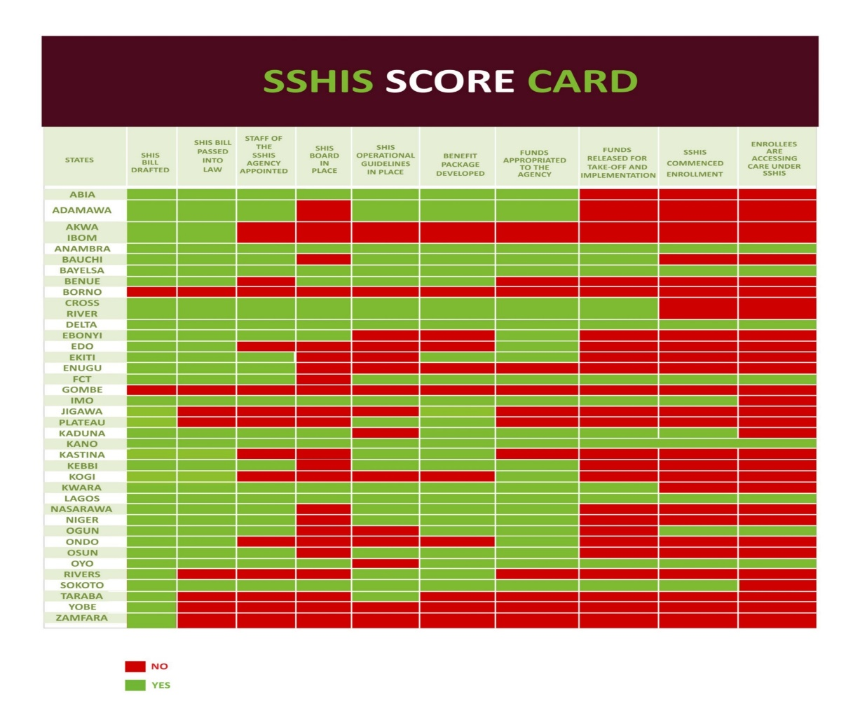
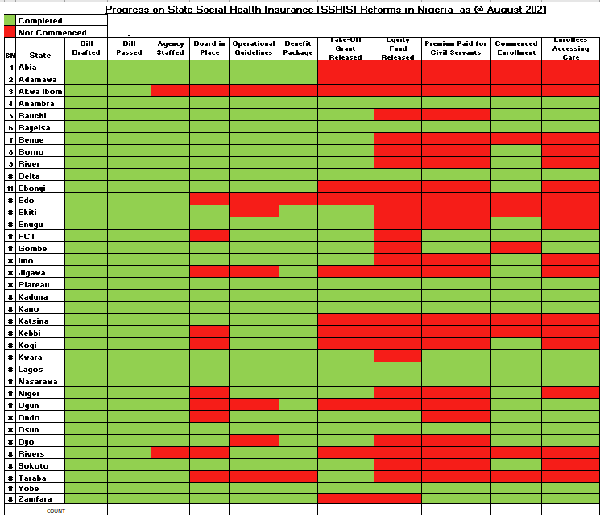
Results
State Social health Insurance Scheme
35 States and the FCT have established a SSHIS, the remaining State (Rivers) have passed the bill but are yet to take off
26 States have commenced enrolment of beneficiaries while 18 States have started accessing care
About 7 million persons enrolled
The Osun Case for SSHIS:
Problem: Osun State had difficulties kicking off the state health insurance scheme because take off grant had not been released.
Action: The State health team presented the SSHIS scorecard to the NGF with calls to action the Governors
Result: The state governor approved the release of the take-off grant. Osun SSHIS is currently running smoothly.
23
11
34
August, 2021
July, 2019
26

Slide 8
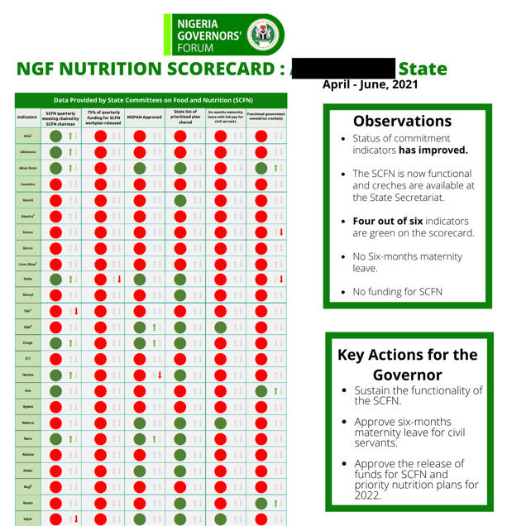
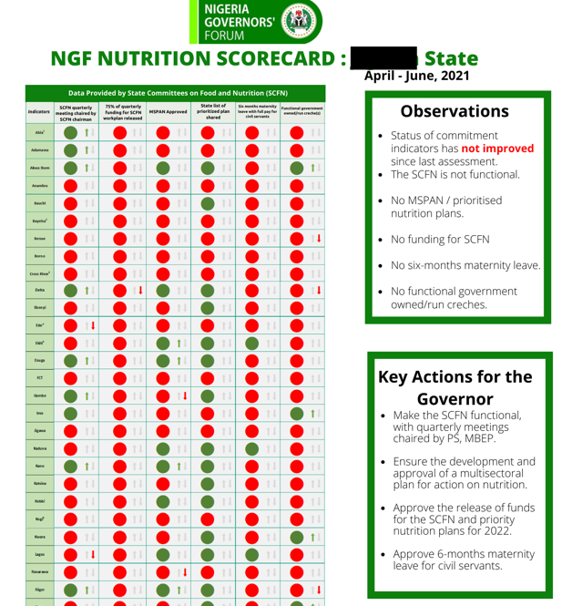
Results
The Nutrition Scorecard Features:
Scorecard: Colour-coded; indicators selected for key commitment areas. Governors see how at one glance, how their states perform when compared to other states.
State specific observations: The State progress on commitments is clear stated in the observation box. Note that the state with no improvement was clearly stated.
Call to Action: State specific calls to action are clearly stated.
Nutrition
18 additional States have created multi sectoral coordination mechanism for Nutrition i.e. States Committee on Food and Nutrition
17 additional States have recorded improvements in at least one commitment area for strengthening Nutrition.
National Council on Nutrition adopted and upscaled scorecard to National Nutrition Scorecard

Slide 9
Current Partnerships
Bill & Melinda Gates Foundation:
Use of Data by NGF for Prioritization, Decision Making and Accountability
BMGF/UNICEF/NPHCDA:
PHC Leadership Challenge
GAVI
Support for Sub-National Engagement on Routine Immunization and COVID-19 Response
UNICEF
Nutrition
Results for Development:
Nutrition financing

Slide 10
Our Requests
Share relevant documents with the secretariat
Bills and Laws; Reports, Manuals and guidelines
Review State Health Profiles and share feedback
NGF Executive Summary: call for contributions
Support consultants sent to document best practices
Zipline and HEFEMAA ongoing
Other States to share best practices

Slide 11
Thank you

