Slide 1


OGIDI
PILOT PROJECT

Slide 2
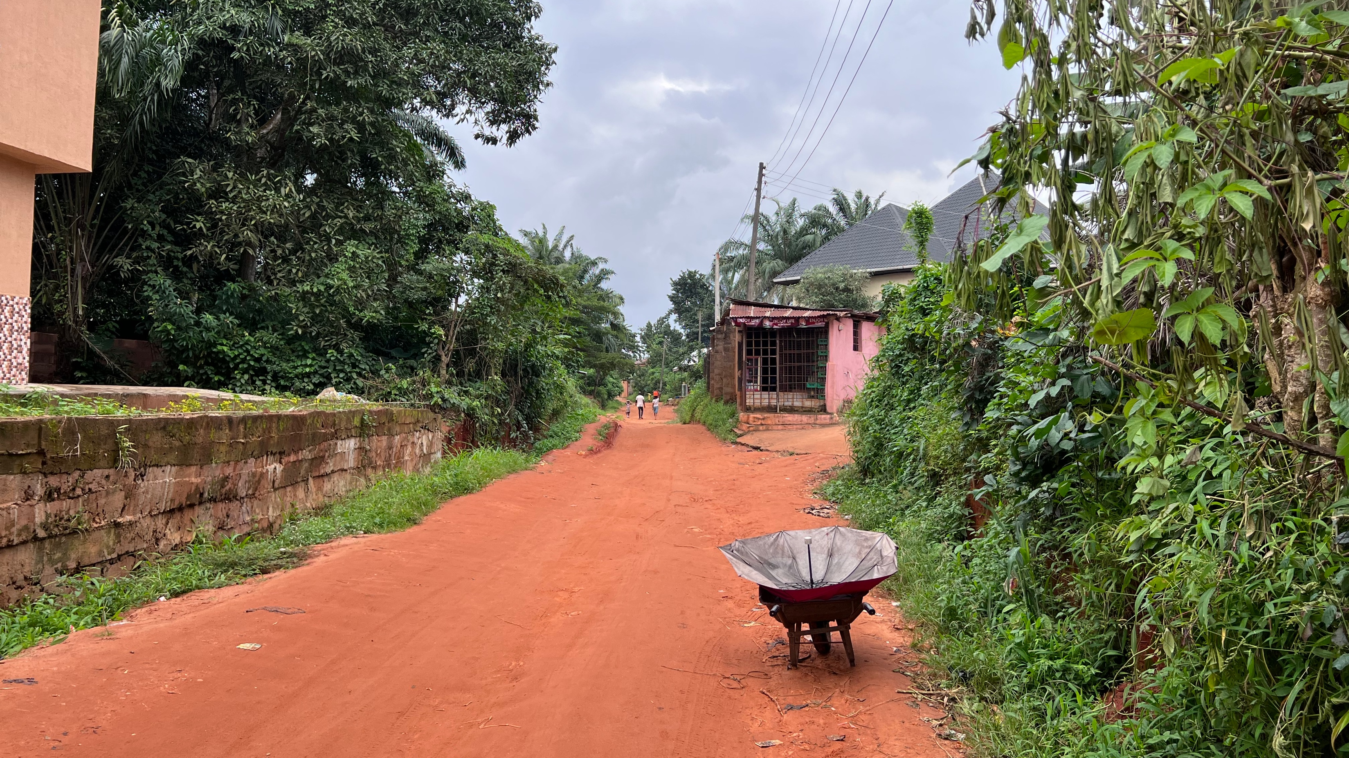







Odida Ogidi before the pilot
A typical Nigerian village of 1,500 residents, with school, health centre and small business activity
Inequitable billing
Supply confusion
Irregular supply times
Estimated billing
Reliance on generators
3-4 hours of power a day
Lack of faith that power supplied would be paid for

Slide 3
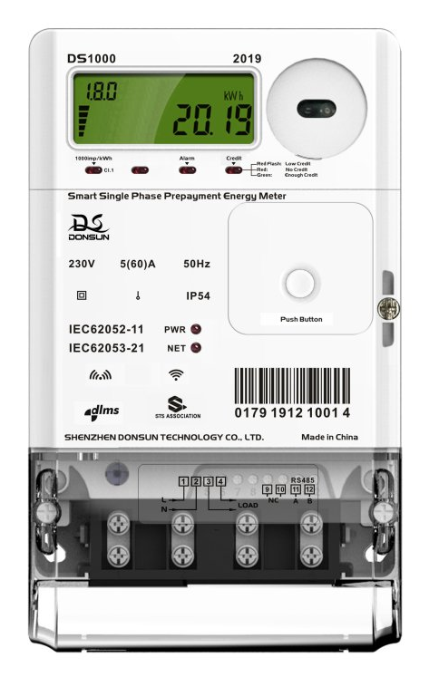


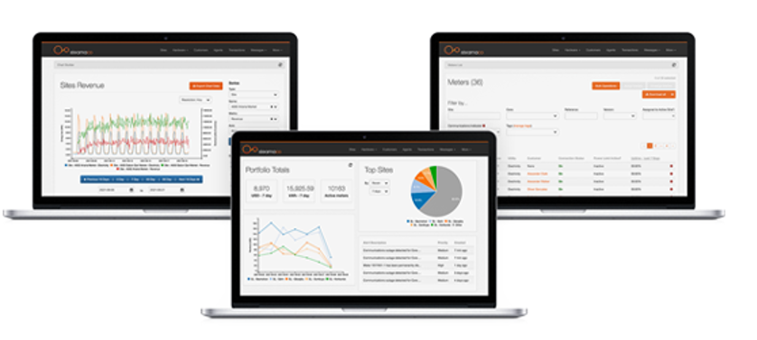


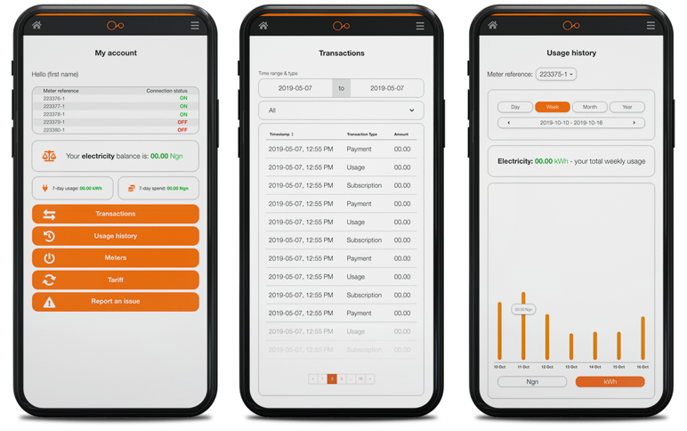
SteamaCo solution.
300 smart meters + AI – a first of its kind in Nigeria
+
165% increased availability of power - 4 to 11.2 hrs
150% increase in revenue for the DisCo
Improved security, productivity and quality of life
By providing increased power - backed by revenue assurance, everyone wins

Slide 4




Across the board increases in site performance: power supplied, Collection Efficiency, and revenue generated.
2.6x increase
(4 hrs to 11.2 hours)
Hours power supplied
60% increase
(40% to 100%)
Collection Efficiency
150% increase
(Naira 2.1m to Naira 4.0m)
Revenue

Slide 5
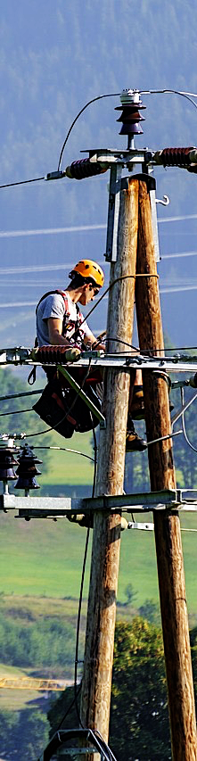
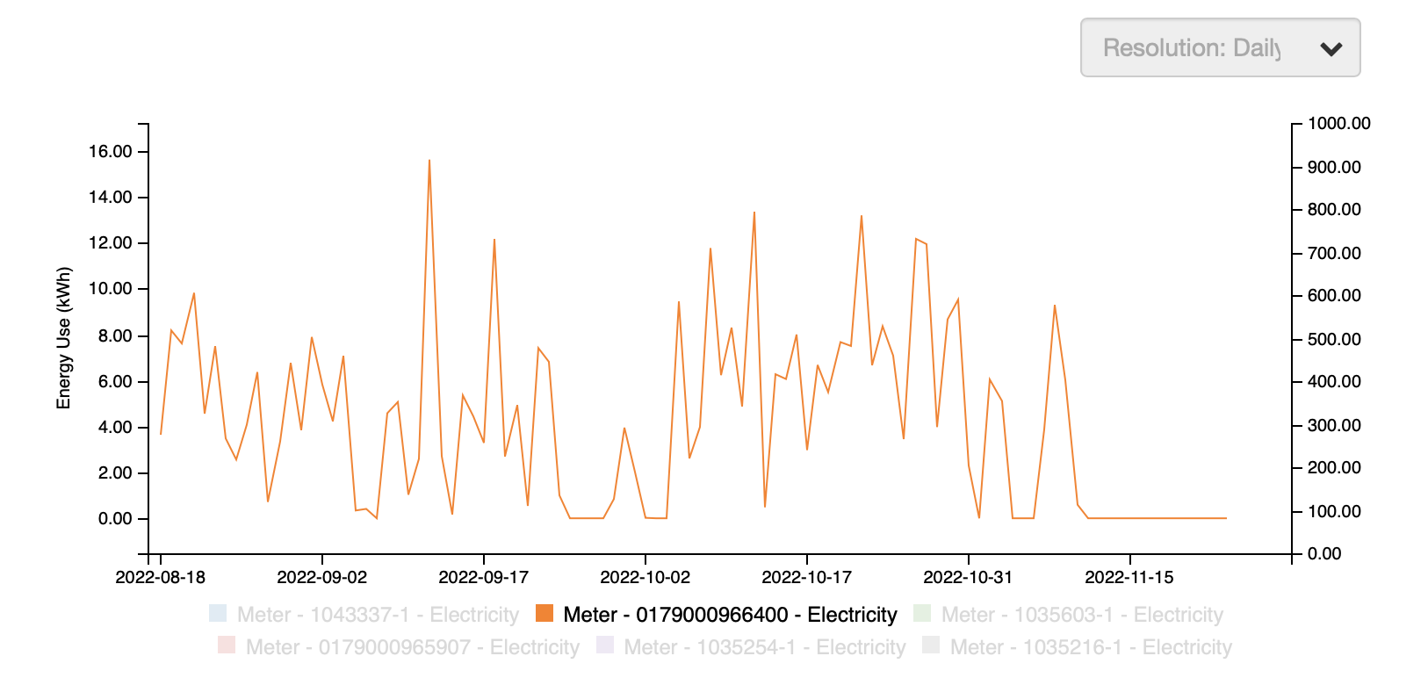
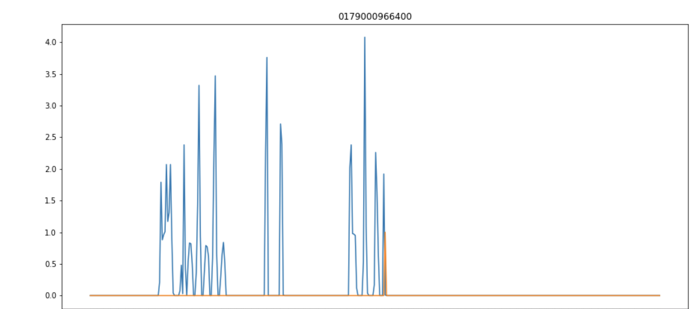
Backed by ATC&C Loss Detection.
Full bypass
75%
Detection
Partial bypass
58%
Illegal connection
67%
Avg. time to detection
2 days
Time saving to detection
98% reduction

Slide 6







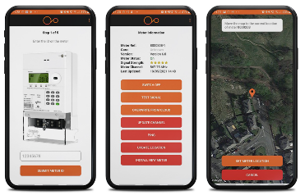
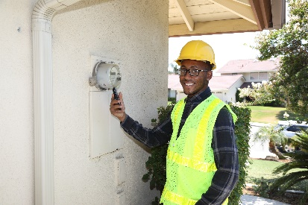




The impact of the Ogidi Pilot
Win Win - EEDC revenues up over 150% + consumers receive and pay for the power they need
Simple user-interface
EEDC: More Revenue
Change: Economic and citizen impact of increased power
POC: Pilot the efficacy of AI theft detection, learn fast & improve detection
Alerting: proactive maintenance and customer service
Managed workflows
Ukpaka: More Visibility
Visibility: complete accountability on power usage and payments
Field-force management: improved efficiency of field service trips; Ukpaka
Connectivity: More communities are asking to be connected to the SteamaCo IoT platform
Visibility on usage & costs
Customer confidence
Protection: NMMP investment protection for DisCos
Scalability: Measure revenue growth when increased power distribution
Trusted: better customer service through improved communication and guaranteed supply

Slide 7

Thank You!

