Slide 1
Navigating
THE TERRAIN AND SETTING PRIORITIES
HE Dr Zainab Shinkafi-Bagudu
First lady Kebbi State
Founder Medicaid cancer Foundation
Director Union for International Cancer Control

Slide 2
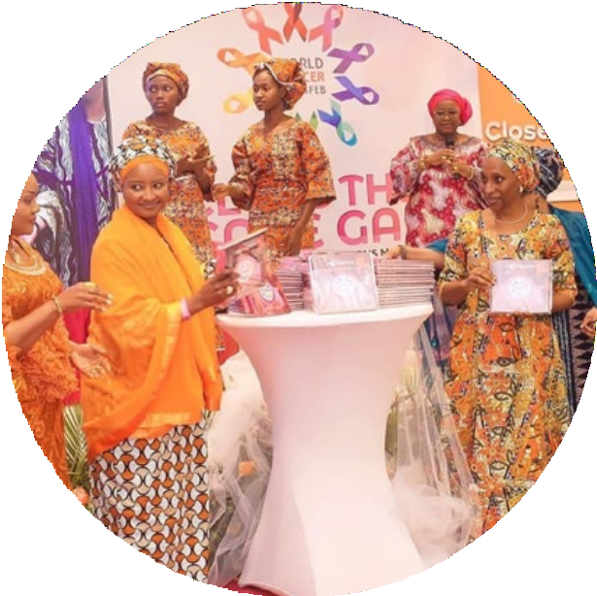
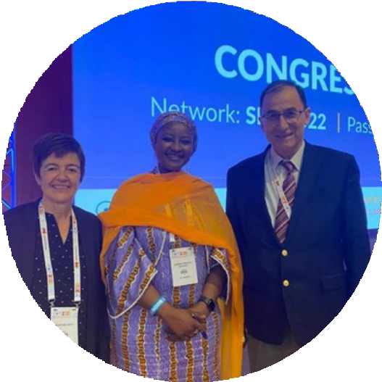
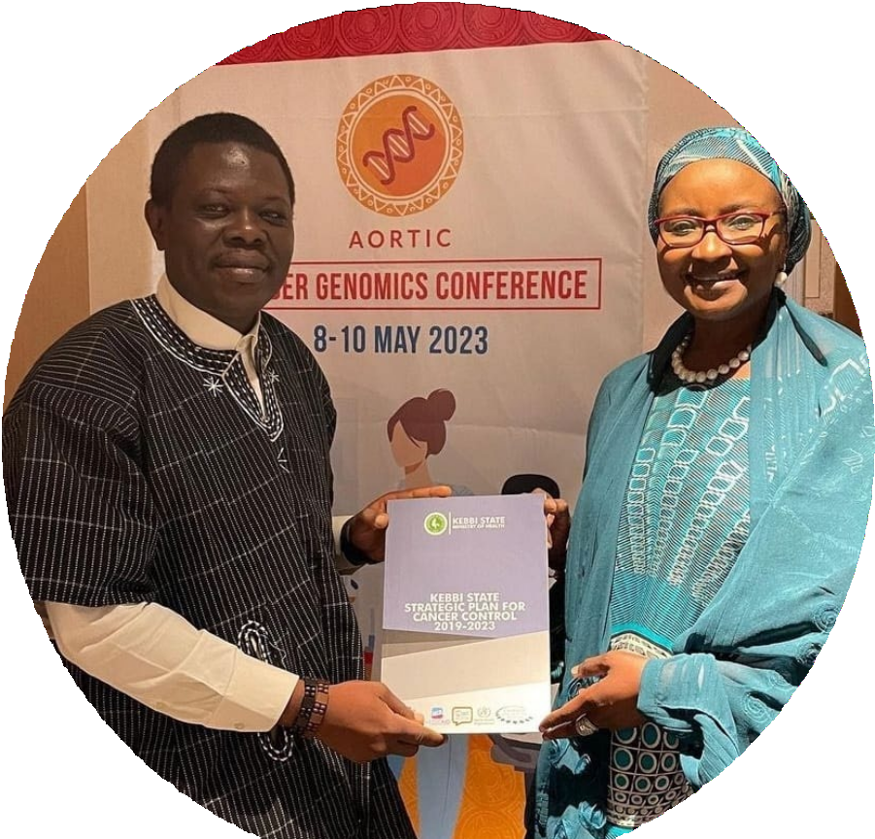
CHALLENGES OF TRANSITIONING
TO NEW ROLES AS FIRST LADY
“
Embracing my new role as First Lady
was overwhelming, but I decided to
take time to understand my new
responsibilities and develop a unique vision for my role in the State.

Slide 3
COMPLEMENTING ROLES OF GOVERNORS

Slide 4
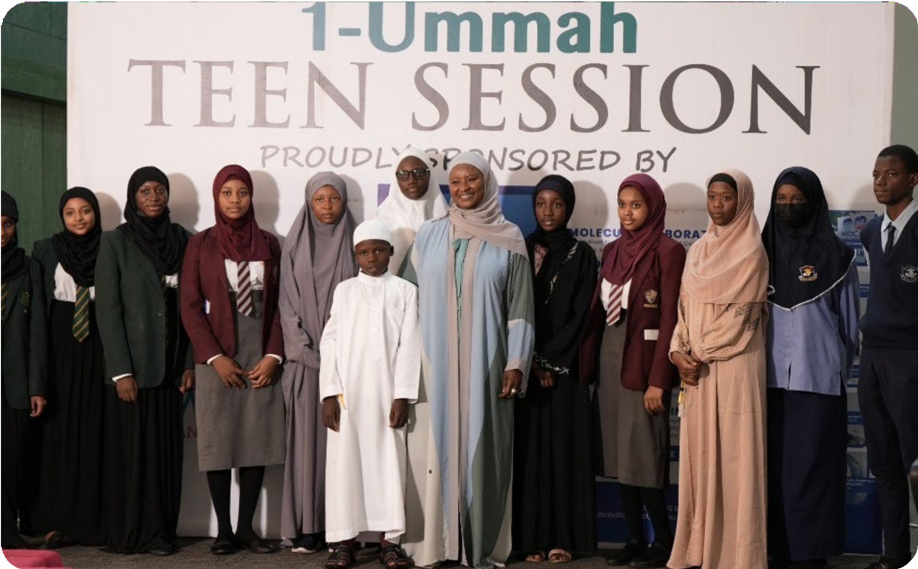
Understand Challenges Confronting Women, Girls and Children in Nigeria:
Looking at the facts to choose your path.

Slide 5
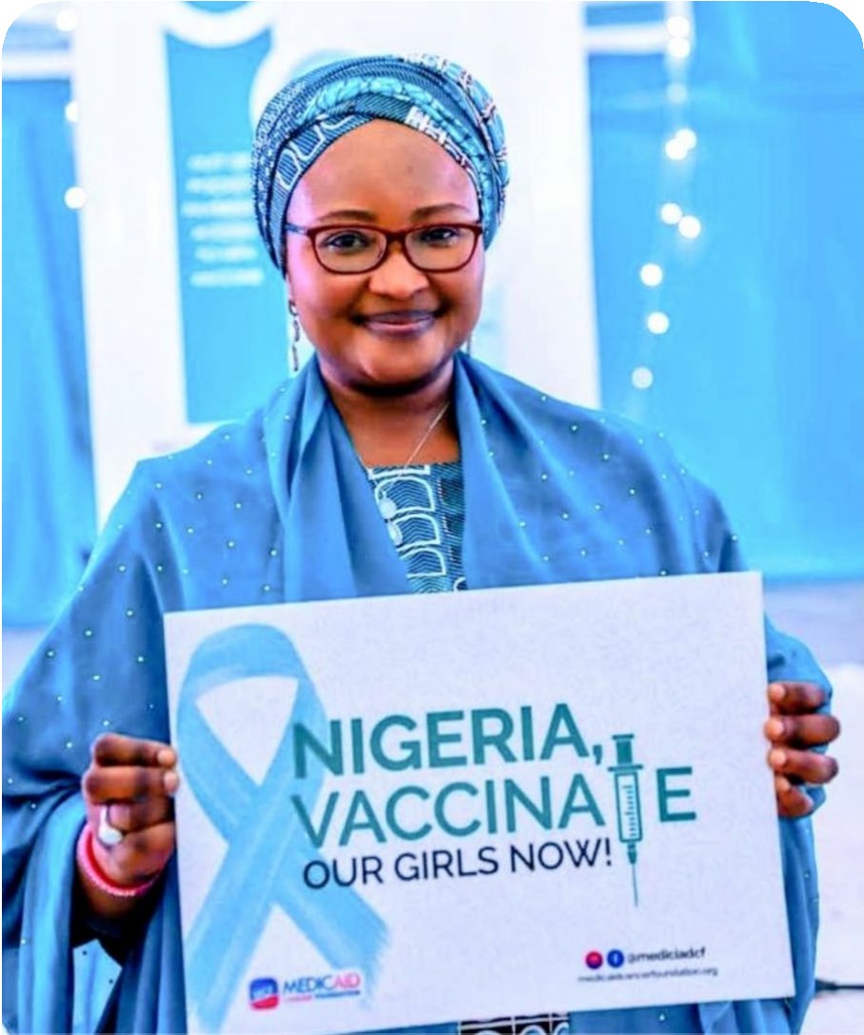
50 MILLION
WOMEN
60 MILLION
WOMEN
aged 15 years and older are at risk of developing cervical cancer.
of childbearing age
(between 15 and 49 years of age)
suffer a disproportionately high level of health issues.

Slide 6
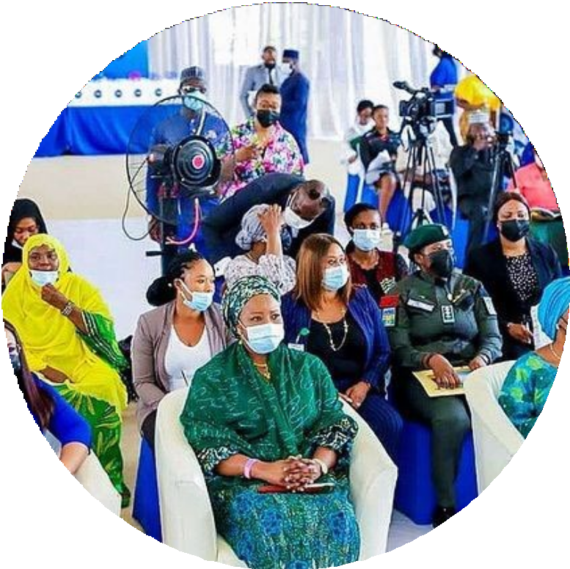
64.4% FEMALES
HAD DEPRESSION
Of the over 50 million workforce in Nigeria,
are in the informal sector and less than 1 million women
are employed in the formal sector.
18 MILLION WOMEN
when compared to 35.6%
in a study of ambulant patients attending outpatient clinics in South-eastern Nigeria

Slide 7
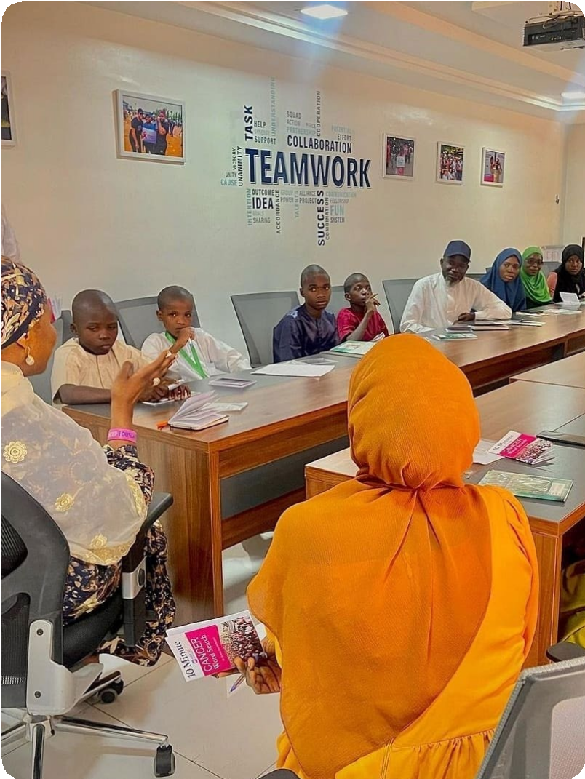
A study in 2017 revealed that enrolment in Nigerian universities was 43.1% and 56.9% for Female and Male respectively.
Of the total number of children not in school worldwide,
.
20% OF THEM LIVE IN NIGERIA

Slide 8
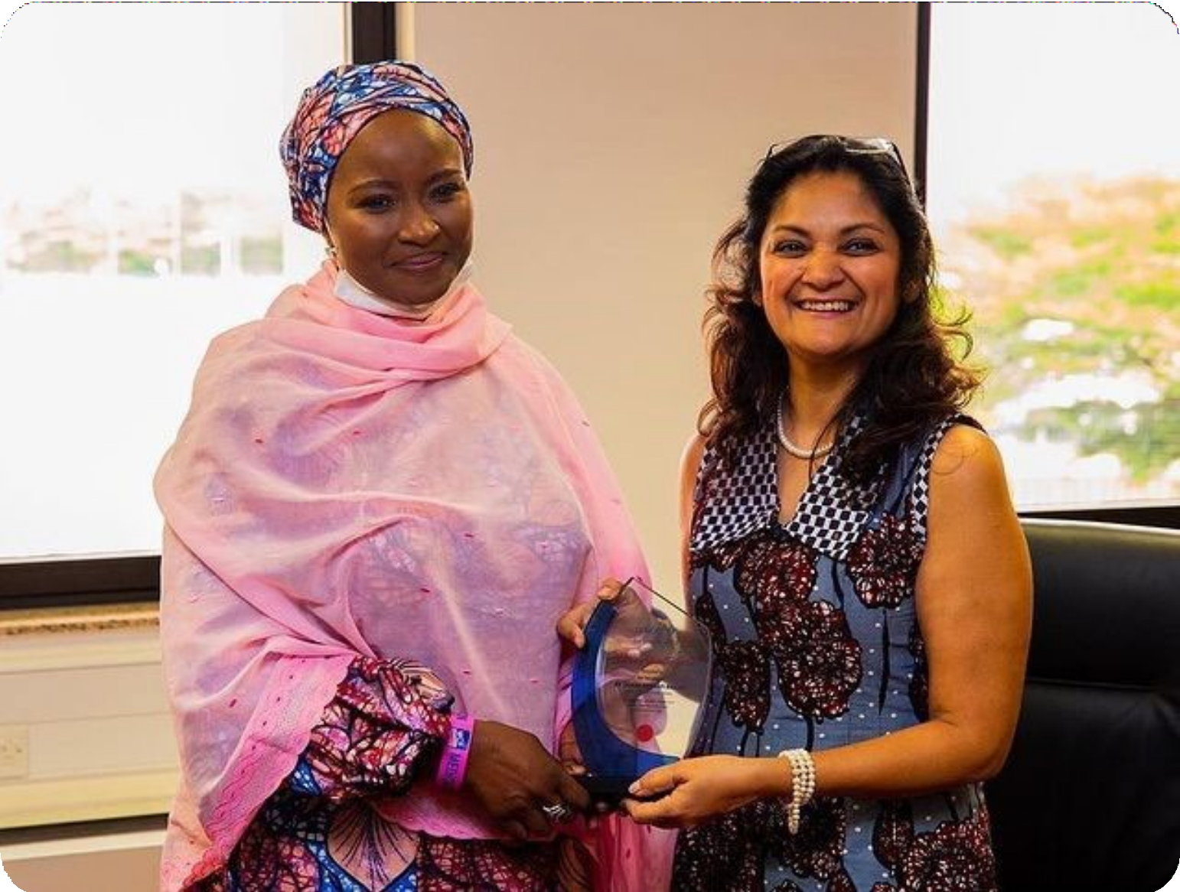
Understanding the Policy Issues within the State that affect women, children and girls [both locally and nationally] and understand where your strength lies.

Slide 9
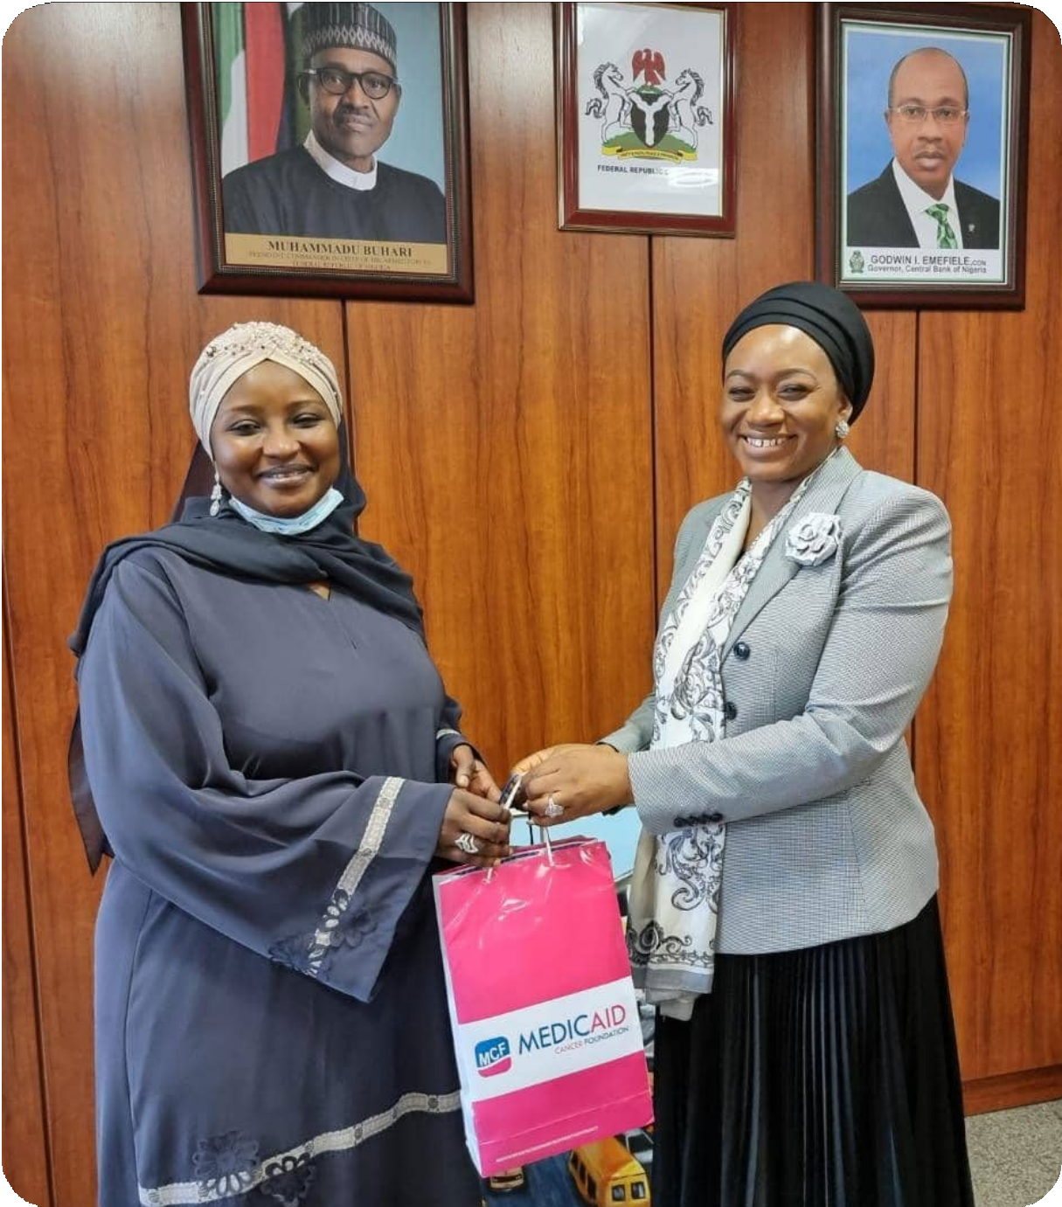
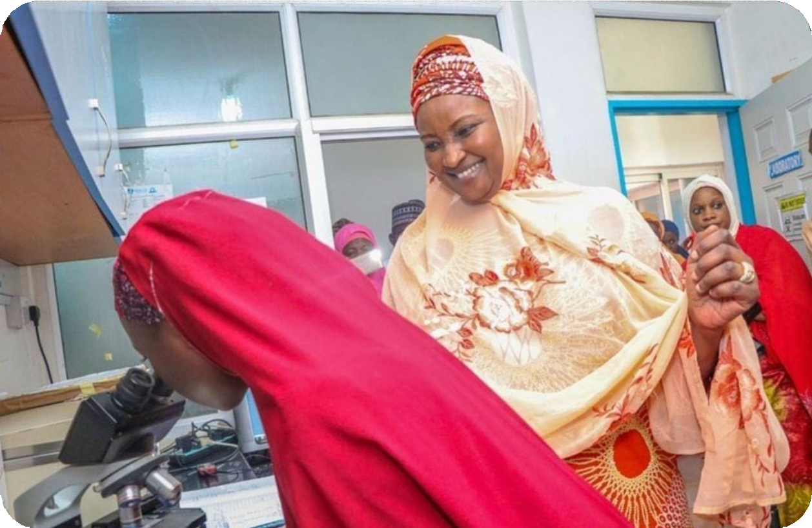
Girl Child Education Advocacy
Advocating for vaccination grants from cbn

Slide 10
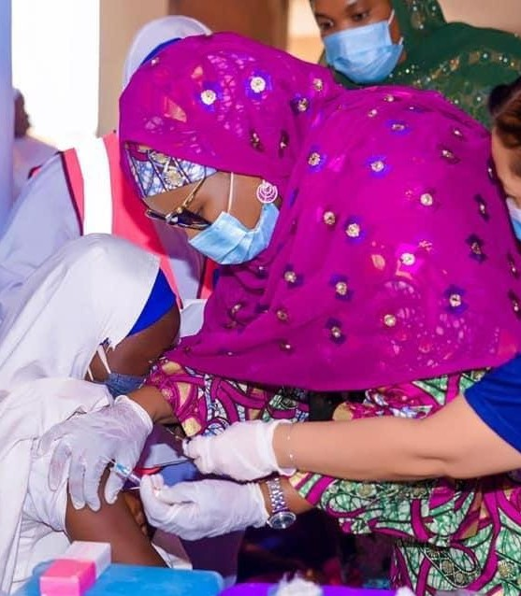
742 WOMEN
were Trained on Self Breast Exams
EXAMPLE IN HEALTHCARE:
397 WOMEN
Screened on Cervical Cancer
407 STUDENTS
Reached during Cancer Advocacy
100 SCHOOLS
Benefited from the HPV Program.

Slide 11
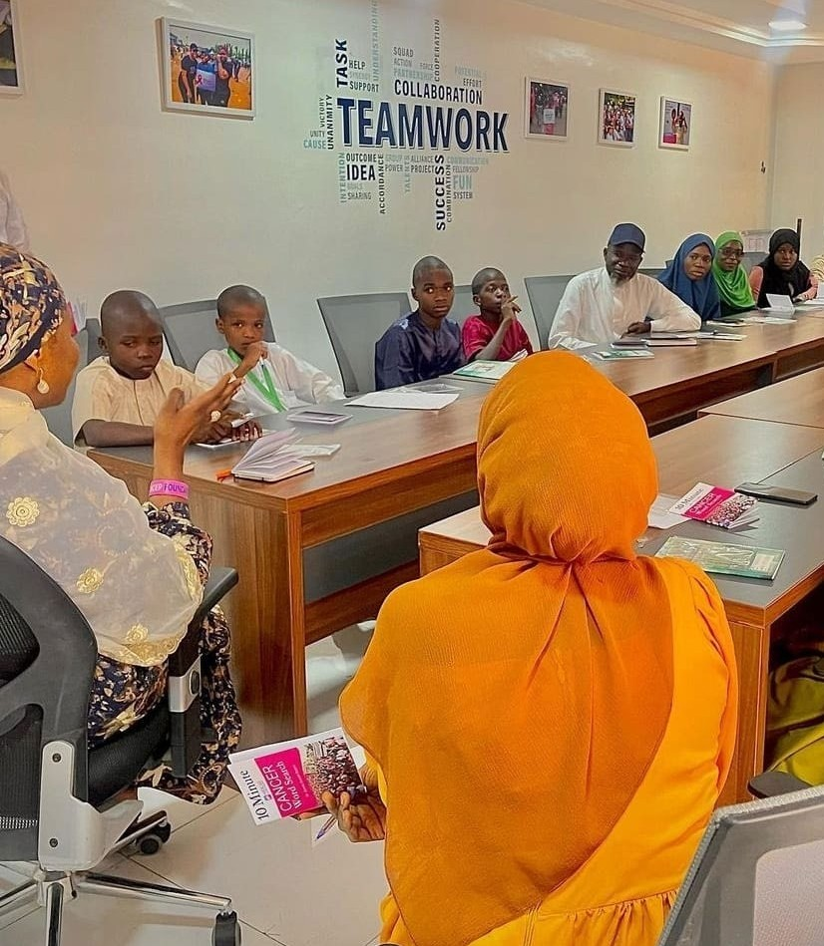
EXAMPLE IN EDUCATION:
As I focused on education,
I ensured to circle back to my core on re-emphasizing on cancer and the importance of prevention from an early age in life.

Slide 12
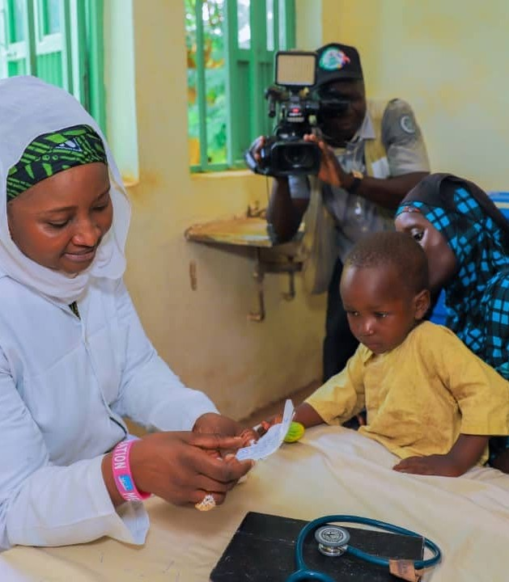
CHILD PROTECTIVE SERVICES:
We pioneered policies focused on Child Protection Services as an essential framework to safeguard the well-being of vulnerable children in our communities.

Slide 13
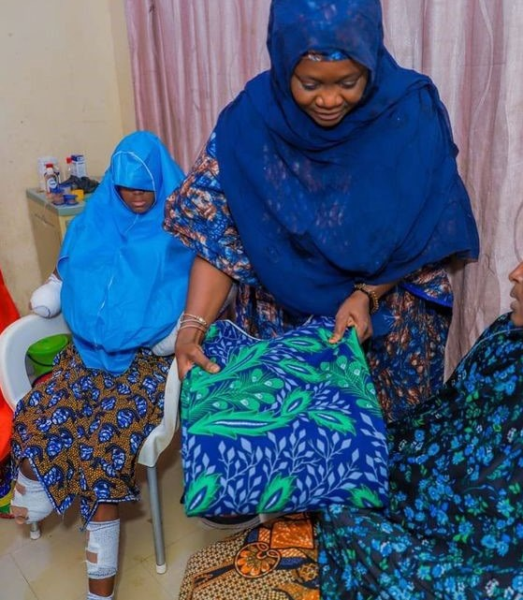
ON GENDER-BASED VIOLENCE (GBV):
In Kebbi State, we have launched several campaigns to raise awareness about GBV, providing support services
for survivors and working with community leaders to change attitudes and beliefs that perpetuate violence against women.

Slide 14
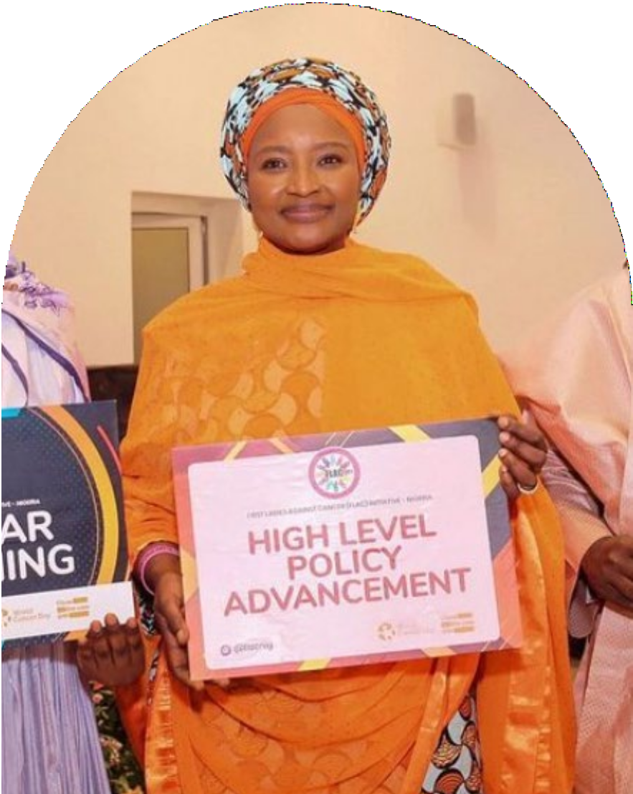
SUMMARY OF MY PERSONAL STRATEGIES
Find your core and start from where you are. For me, I looked at areas I have training, passion and worked on over the years. I decided to make that my core mission without my new status and added two more issues I am passionate about and can make a difference in.
Secondly, I sought out mentors and support networks, attended workshops and local, global conferences, and immerse in the issues I care about most. In my experience, this has been invaluable in helping me define my priorities and set the stage for a successful tenure as first lady.

Slide 15
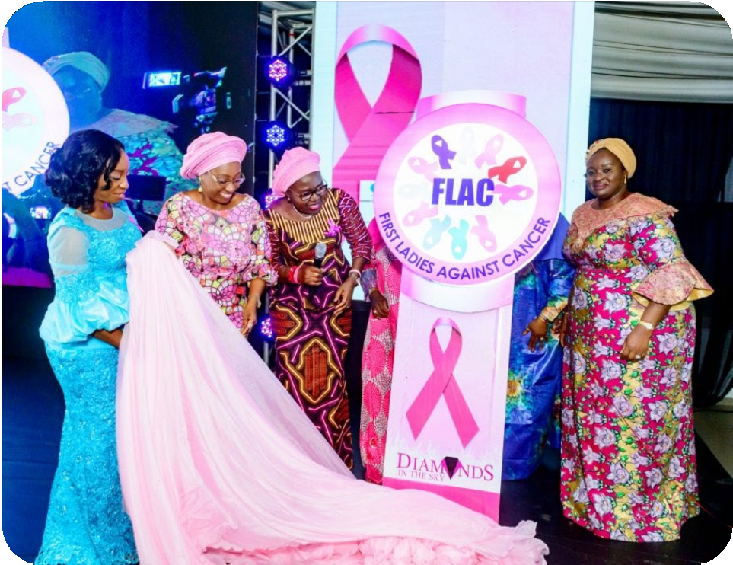
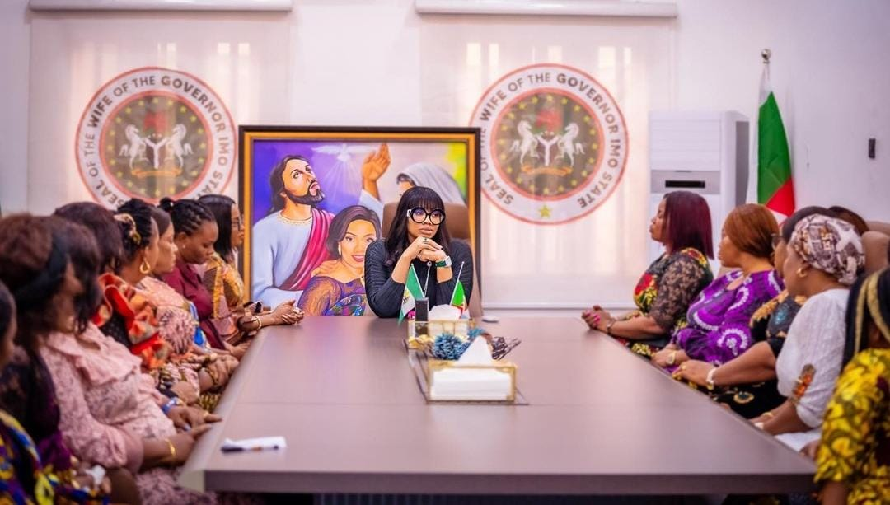
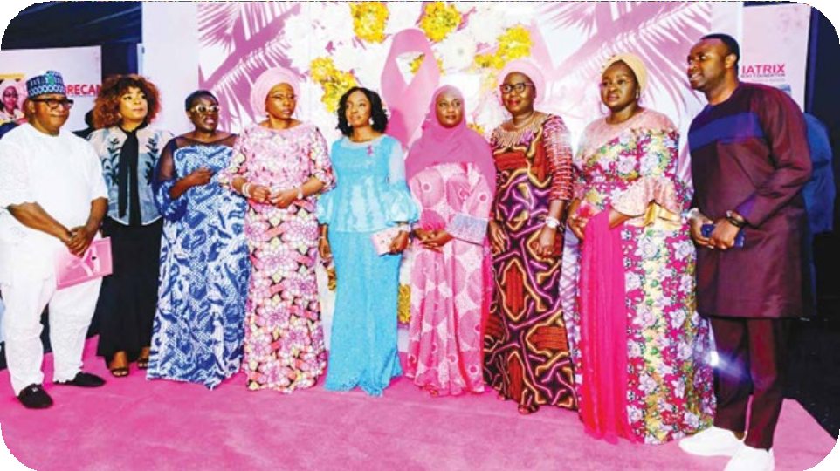
Chairperson of FLAC. FLAC drives advocacy to increase awareness, access to cancer care, and influence policy di- rection in Nigeria with the co- llective aim of reducing the cancer burden in the country.

Slide 16
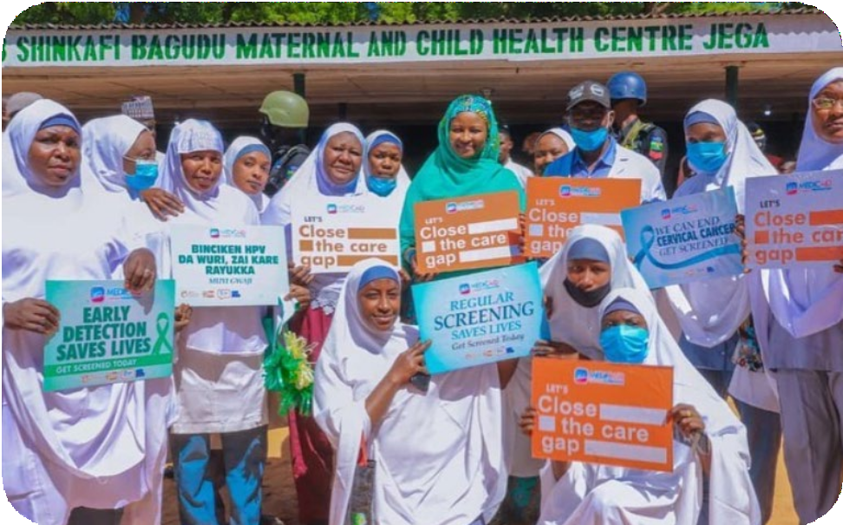
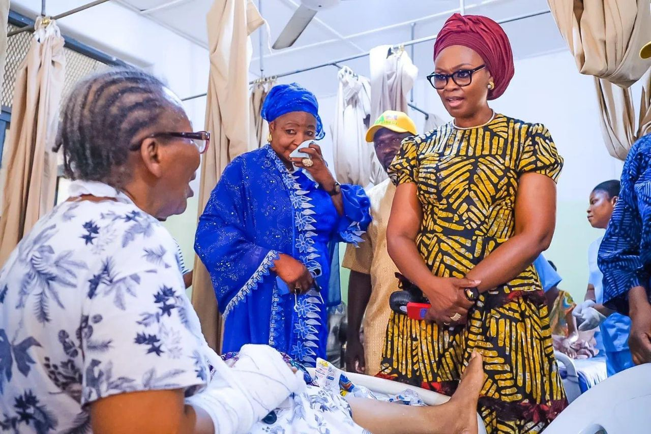
PREPARING FOR THE TRANSITION BACK TO CIVILIAN LIFE
Finally, it is essential to recognize that our time as first ladies will eventually come to an end. It is crucial to prepare for the transition back to civilian life by creating a strong foundation and structure, building lasting networks, and cultivating a legacy that will continue to impact our communities long after our tenure is over.
For me, my work at Medicaid continues, whether in office or out of office, saving lives from the preventable but deadly cancer.

Slide 17
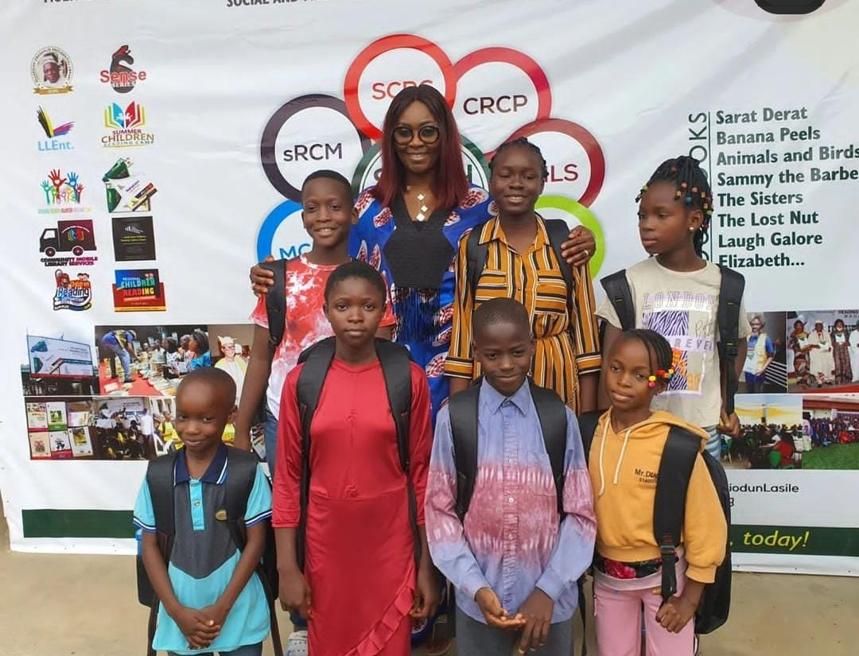
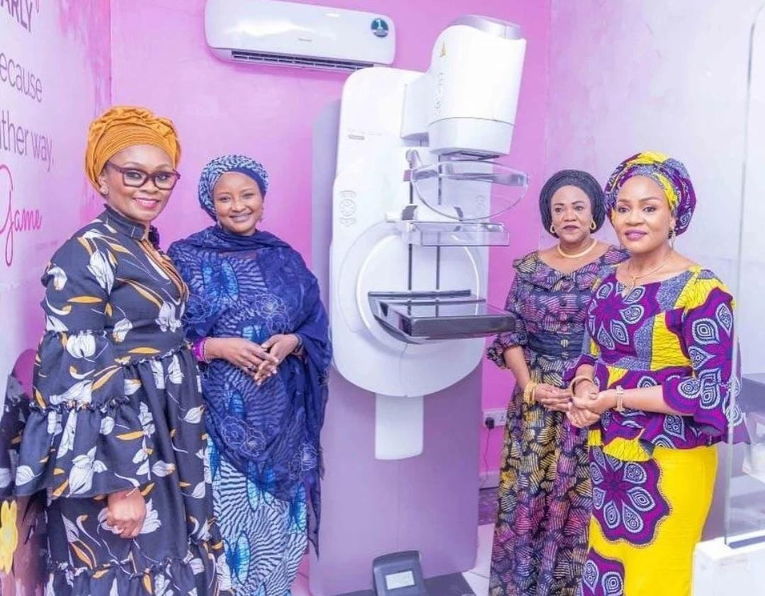
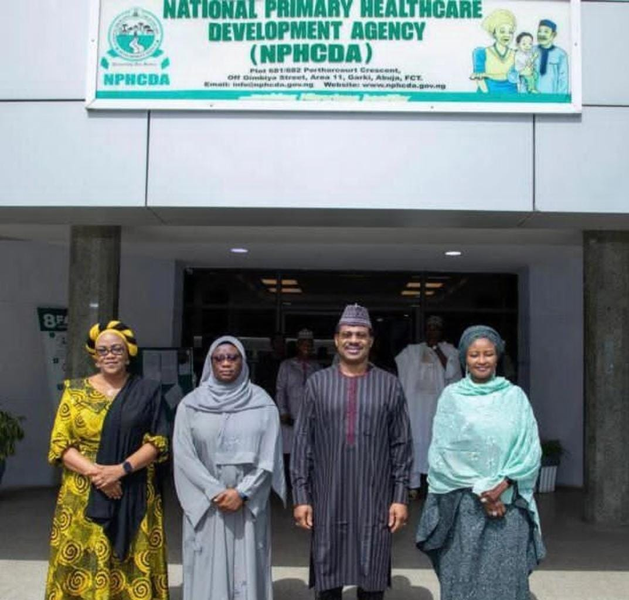
PHOTO GALLERY

Slide 18
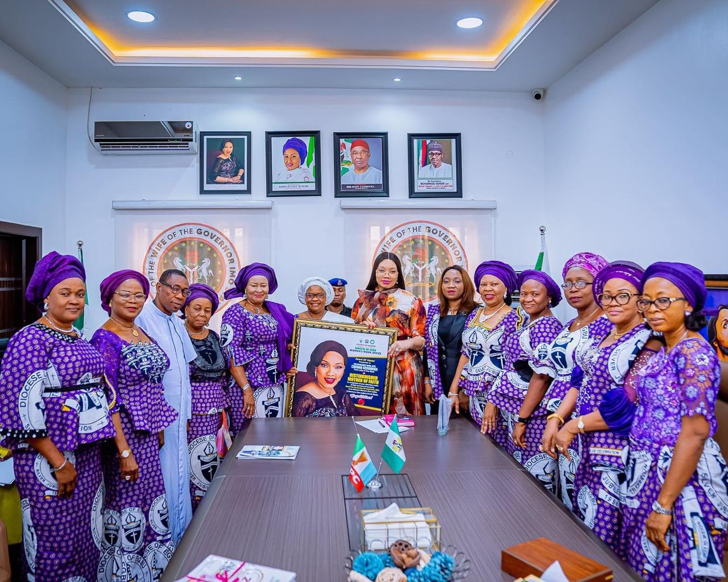
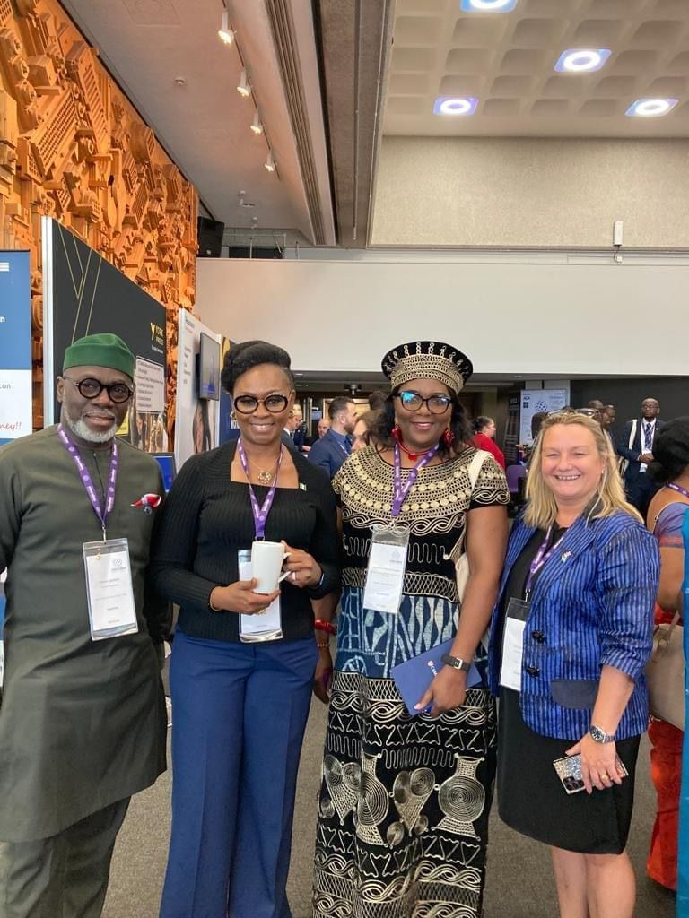
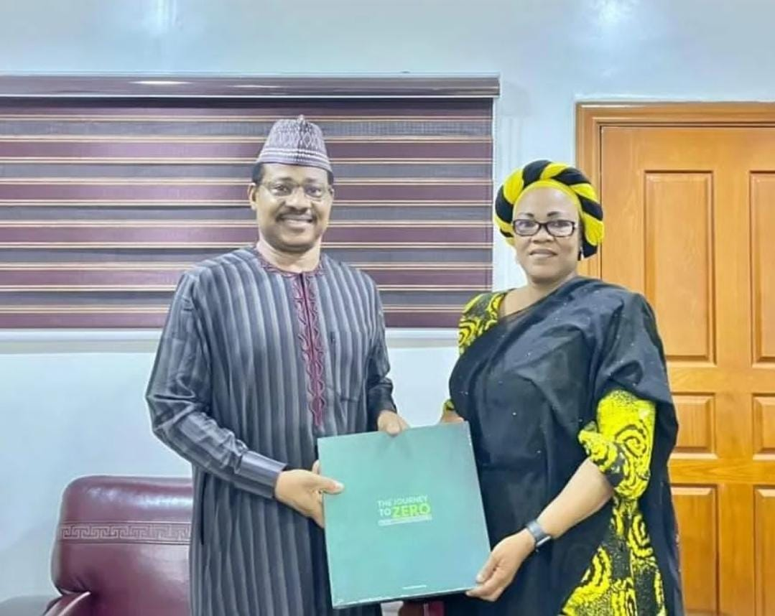

Slide 19
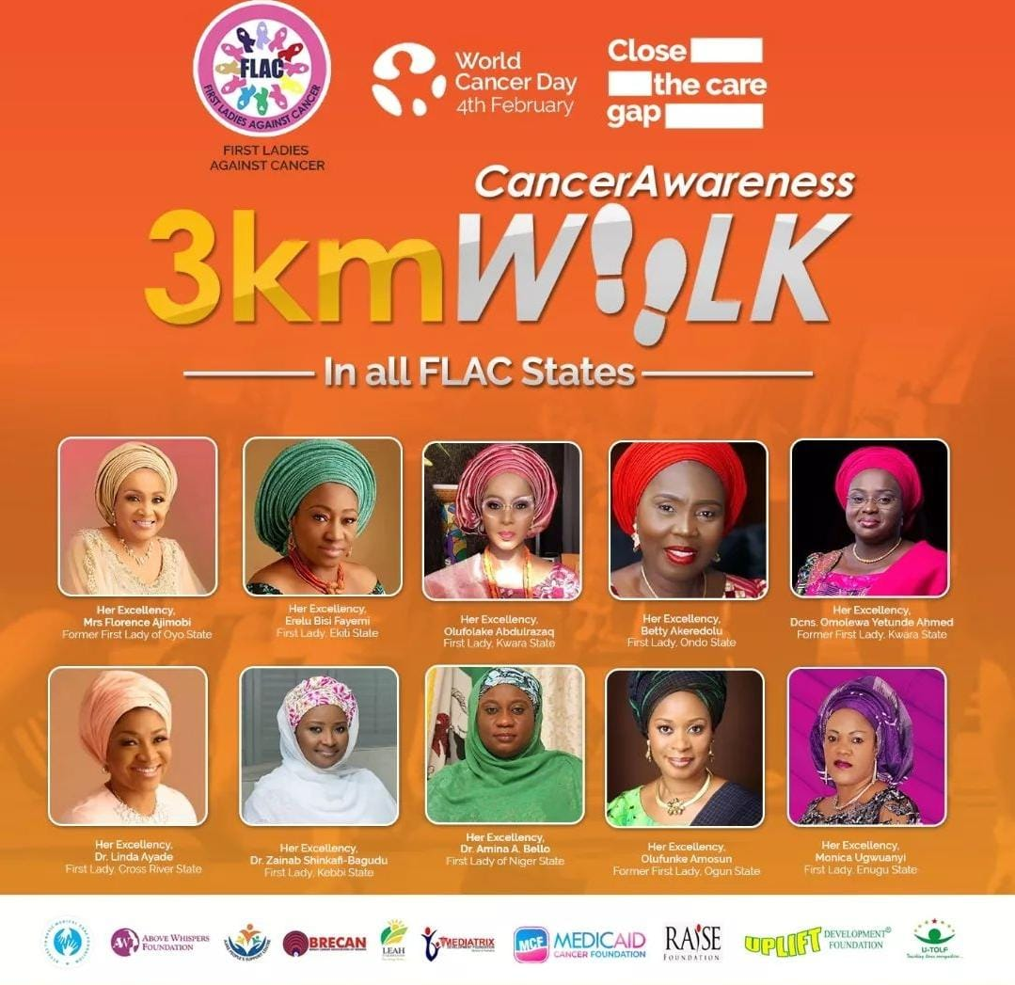
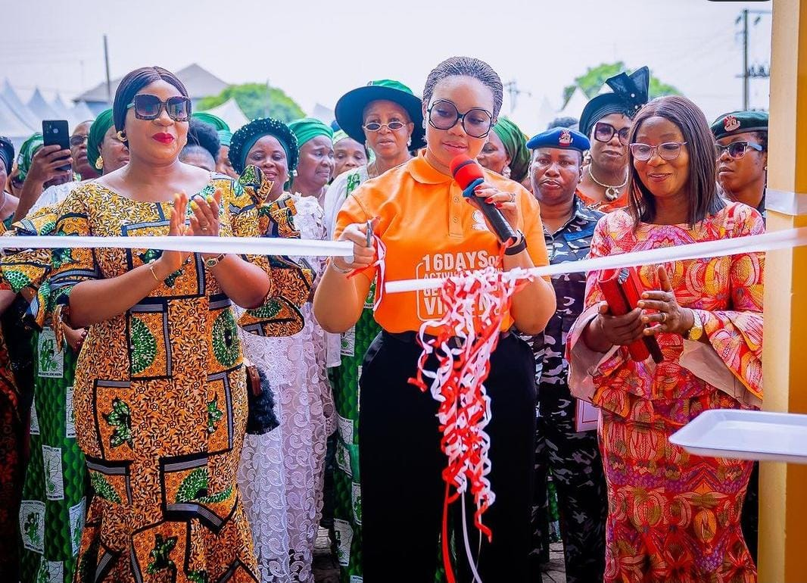
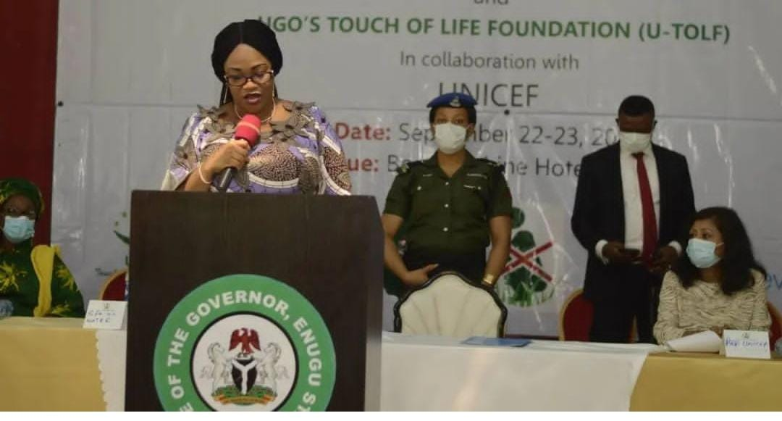

Slide 20
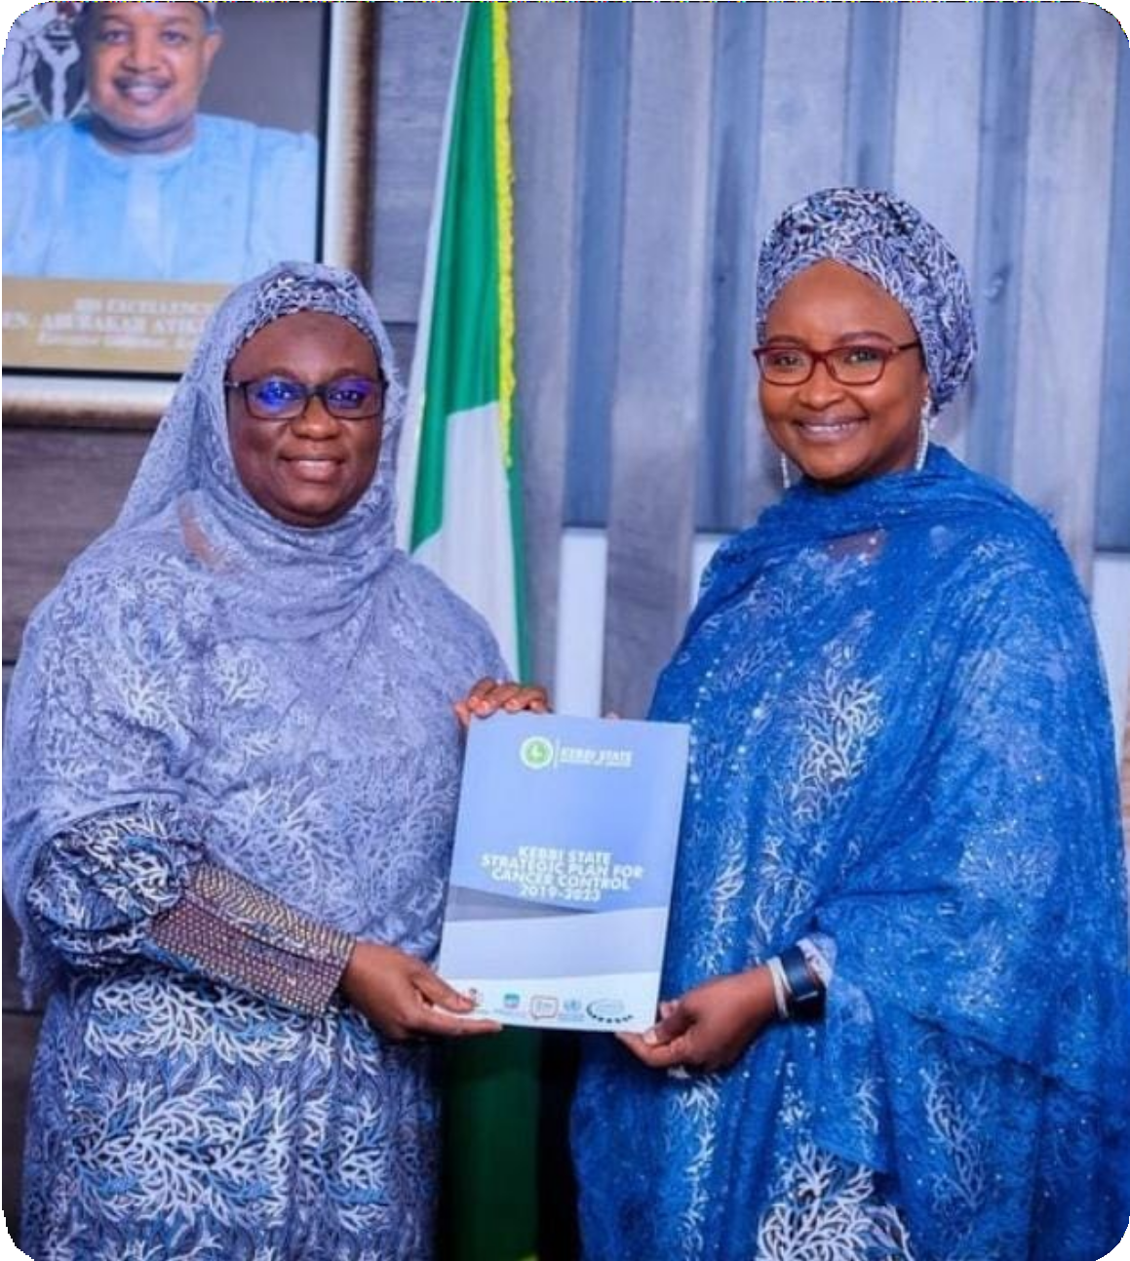
As First Ladies, we have a unique opportunity to make a lasting impact in our states and in Nige- ria. By choosing the issues that matter to our people and to us, complementing the roles of our Governors, transitioning effectively to our new roles, advocating for the rights of women and girls, implementing impactful strategies, and preparing for the future, we can truly navigate the terrain and set priorities that will bring about positive change to our respective states and to our dear nation.
Good Luck!

