Slide 1
SFTAS Update on DLR 6.2: E-Procurement Deployment and CONTRACT AWARD Publication in Open Contracting Data Standard (OCDS) FORMAT
Date: 23rd March 2022
NIGERIA GOVERNORS’ FORUM (NGF)
STATES FISCAL TRANSPARENCY, ACCOUNTABILITY AND SUSTAINABILITY(SFTAS) TECHNICAL ASSISTANCE PROJECT
Presented by:
Olanrewaju Ajogbasile
Senior Programme Manager,
NGF HelpDesk
oajogbasile@ngf.org.ng
+2349083411461

Slide 2
BACKGROUND
16 States (Akwa Ibom, Bayelsa, Borno, Edo, Ekiti, Gombe, Jigawa, Kano, Kaduna, Kebbi, Kogi, Niger, Ondo, Sokoto, Yobe and Zamfara State) signed a common Framework Agreement and Contract in 2020 with European Dynamics (an E-Government Solution Vendor) to deliver an E-Procurement Software as a Service (SaaS) solution to assist States implement reforms required to meet Disbursement Linked Result (DLR) 6.2.
Related disbursement to DLR 6.2 for 2020 – 2021 Annual Performance Assessment (APA) years if achieved is est. $1m – $3.5m.
European Dynamics’ contract is valued at est. $303,500 (exclusive of taxes) per State covering supply, installation and recurrent subscription cost for 12 quarters.

Slide 3
E_PROCUREMENT (SAAS) FRAMEWORK AGREEMENT PROJECT COST AND RELATED DLI 6.2 DISBURSEMENTS
PAYMENT TO VENDOR vs. EXPECTED DISBURSEMENT FROM DLR 6.2
PAYMENT TO VENDOR (EUROPEAN DYNAMICS) |  | EXPECTED DISBURSEMENT FROM DLR 6.2 (2020 APA) | EXPECTED DISBURSEMENT FROM DLR 6.2 (2021 APA)
Payment Milestones | Amount | Expected Cash Inflow from DLR 6.2 (2020 APA) | Expected Cash Inflow from DLR 6.2 (2021 APA)
A. Supply and Installation Cost | US$96,500 | 6.2 Basic Target: Framework contract for e-Procurement signed by 31st December 2020 AND Publish contract award information above a threshold set out in the State’s procurement law/regulation on a monthly basis in OCDS format on the state website or online portal if available. 6.2 Stretch Target: Implement e-Procurement in at least 3 MDAs (incl. Education, Health and Public Works) and publish all contract award information in OCDS format on the online portal for the 3 MDAs AND For those MDAs without e-procurement: Publish contract award information above a threshold set out in the State’s procurement law/regulation on a monthly basis in OCDS format on the state website or online portal if available. Basic Target: $1m per State Stretch Target: $1.5m per State | 6.2 Target: No later than June 30, 2022, implement e-procurement in at least 4 MDAs (incl. Education, Health and Public Works) publish all contract award information in OCDS format on the online portal for the 4 MDAs. System must Go-Live by 31st December 2021. AND For those MDAs without e-procurement: Publish contract award information above a threshold set out in the State’s procurement law/regulation on a monthly basis in OCDS format on the state website or online portal if available. Target: $2m per State
Ai. Operational Acceptance Test (OAT) Plan | US$28,950.00 | i. DLR 6.2 Basic Target Framework contract for e-Procurement signed by 31 December 2020 AND Publish contract award information above a threshold set out in the State’s procurement law/regulation on a monthly basis in OCDS format on the state website or online portal if available. (deadline Dec 2020) = $1,000,000 ii. DLR 6.2: Implement e-procurement in at least 4 MDAs (incl. Education, Health and Public Works) and publish all contract award information in OCDS format on the online portal for the 4 MDAs AND For those MDAs without e-procurement: Publish contract award information above a threshold set out in the State’s procurement law/regulation on a monthly basis in OCDS format on the state website or online portal if available (deadline Dec 2021) = $2,000,000 DLI 6.1 Total = $3,000,000
Aii. Operational Acceptance Test (OAT) Report | US$48,250.00
Aiii. Training Report | US$19,300.00
B. Recurrent Costs | US$207,000
Bi. 1st Quarterly Subscription | US$17,250.00
Bii. 2nd Quarterly Subscription | US$17,250.00 | N.B: Disbursements are only due after the respective APAs have been conducted.
Biii. Future Quarterly Subscriptions (10 Quarters) | US$172,500.00
D= Grand Total (A+B) [Exclusive of all Taxes] | US$303,500.00

Slide 4
Progress towards DLR 6.2 (2021) - $ 2 million
Framework Agreement States’ Progress towards DLR 6.2 as at 21st March 2022
State | Kaduna | Edo | Jigawa | Niger | Akwa Ibom | Kogi | Borno | Gombe | Kano | Ondo | Zamfara | Kebbi | Sokoto | Yobe | Ekiti | Bayelsa
Go-Live Status | Live | Live | Live | Live | Live | Live | Live | Live | Live | Live | Live | Live | Live | Live | Live | Live
E_GP Adoption
OCDS Compliance
LEGEND | INDICATORS
 | GO-Live Status Live E-GP Adoption State is on track OCDS Compliance State has OCDS Data published for year 2021 in required format
 | E-GP Adoption Marginally behind plans Some of MDAs are yet to publish Procurement plan(s) State is yet to initiate e_Procurement process in pilot MDAs OCDS Compliance Some OCDS data field are empty
 | GO-Live Status Not Live E-GP Adoption High risk that the State may likely miss out in achieving the DLI requirements due to poor user adoption and stakeholder engagement – Require immediate intervention. OCDS Compliance OCDS portal not active No OCDS data available for 2021

Slide 5
Progress towards DLR 6.2 (2021) - $ 2 million
Non - Framework Agreement States’ Progress towards DLR 6.2 as at 21st March 2022
State | Delta | Abia | Ebonyi | Lagos | Adamawa | Benue | Ogun | Bauchi | Anambra | Plateau | Cross River | Imo | Osun | Oyo | Enugu | Nasarawa
Go-Live Status | Live | Live | Live | Live | Live | Live | Live | Live | Live | Live | Live | Live | Live | Live | Live | Live
E_GP Adoption
OCDS Compliance
LEGEND | INDICATORS
 | GO-Live Status Live E-GP Adoption State is on track OCDS Compliance State has OCDS Data published for year 2021 in required format
 | E-GP Adoption Marginally behind plans Some of MDAs are yet to publish Procurement plan(s) State is yet to initiate e_Procurement process in pilot MDAs OCDS Compliance Some OCDS data field are empty
 | GO-Live Status Not Live E-GP Adoption High risk that the State may likely miss out in achieving the DLI requirements due to poor user adoption and stakeholder engagement – Require immediate intervention. OCDS Compliance OCDS portal not active No OCDS data available for 2021

Slide 6
SLOW E_PROCUREMENT SYSTEM ADOPTION AND PUBLICATION IN OPEN CONTRACTING DATA STANDARDS (OCDS)
Akwa Ibom State is the only Framework Agreement/Contract (FA/FC) State behind on E-GP system adoption and is at high risk of not meeting the DLR requirements. However, another 6 FA/FC States (Borno, Gombe, Kebbi, Sokoto, Ekiti and Bayelsa State) are behind on OCDS compliance requirements. Their OCDS portals are either not active or OCDS data for 2021 not published.
Bauchi, Delta, Abia, Lagos, Anambra, Plateau, Imo, Enugu and Nasarawa State are the Non-FA/FC States (out of 16 States) behind on E-GP adoption. Bauchi State is particularly at high risk of not meeting the DLR requirements.
Imo and Bauchi State are the only Non-FA/FC States (out of 16 States) behind on OCDS compliance requirements. Their OCDS portals are either not active or OCDS data for 2021 not published.
NGF in collaboration with Ernst & Young (EY) and the World Bank will continue to review States procurement plans and transaction implementation strategies to advise on remedial actions to achieve compliance.
NGF in collaboration with EY and the World Bank will continue to provide technical review as well as advisory support to States on OCDS.
A top-down directive from the State Governors mandating e_procurement system adoption in at least 4 MDAs (incl. Education, Health and Public Works) and monthly publication of contract awards’ information in OCDS format by all MDAs will greatly assist.

Slide 7
PAYMENT DEFAULT AND POSSIBLE DISCONTINUATION OF SERVICE
14 of the 16 Framework Agreement/Contract (FA/FC) States except Jigawa and Kebbi State are behind on milestone payments and owing between $17,000 - $138,000 each. Unpaid invoices by the 14 FA/FC States amounts to more than $1.2 million in total.
European Dynamics has written to States repeatedly on the unpaid invoices and has begun charging interest on delayed payments.
This if unaddressed could lead to the vendor discontinuing service which will jeopardise the chance of concerned States in meeting the revised DLR timeline of June FY2022.
The vendor has written to all States regarding the outstanding payment invoices due and has also escalated the matter to the World Bank requesting their intervention to deduct at source, the sums owed from future disbursement to States on the SFTAS programme. While this will be the most convenient option given the FX issues faced by the concerned States in meeting their payment obligation. However, the deduction at source will require the sign-off of the States concerned.

Slide 8
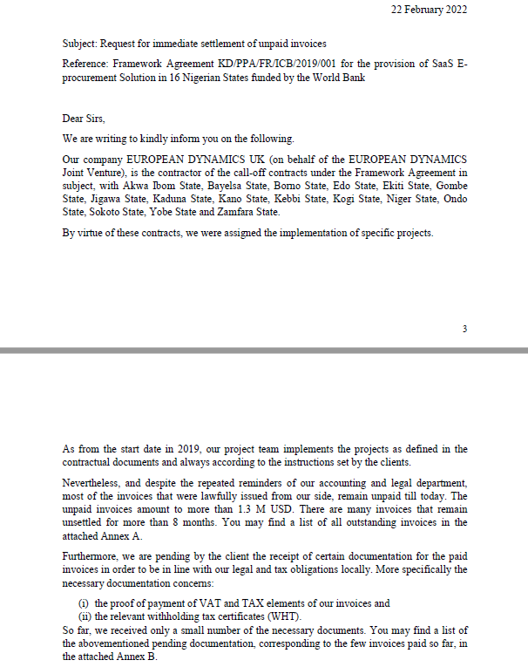
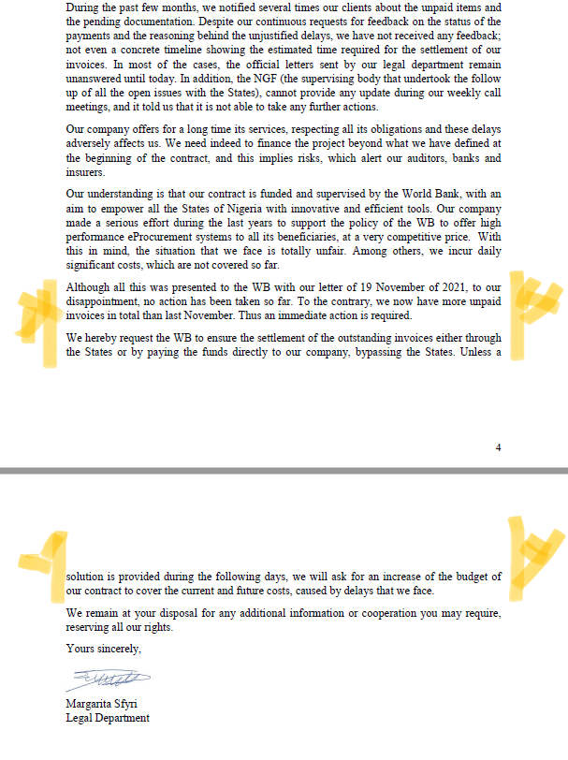
LETTER WRITTEN BY EUROPEAN DYNAMICS TO THE WORLD BANK ON 22ND FEBRUARY 2022
Distribution of Total Outstanding Payment by States as of 23/03/22
S/N | State | Amount
1. | Akwa Ibom | $131, 155: 41
2. | Bayelsa | $67, 600: 66
3. | Borno | $113, 884: 96
4. | Edo | $17, 273: 61
5. | Ekiti | $116, 925: 15
6. | Gombe | $17, 250: 00
7. | Kaduna | $138, 084: 42
8. | Kano | $84, 847:35
9. | Kogi | $113, 869: 92
10. | Niger | $102, 161: 35
11. | Sokoto | $48, 287: 98
12. | Ondo | $113, 750:00
13. | Yobe | $113, 836: 05
14. | Zamfara | $96, 535: 42

Slide 9
DISTRIBUTION OF SPECIFIC UNPAID INVOICES BY STATES
Nigerian State | Invoice Number | Invoice Date | Net Amount ($) | Months Due
AKWA IBOM | 16/2021 | 31-May-21 | 28,950.00 | 8.50
AKWA IBOM | 17/2021 | 31-May-21 | 48,250.00 | 8.50
AKWA IBOM | 36/2021 | 21-Jul-21 | 19,300.00 | 7.00
AKWA IBOM | 86/2021 | 25-Nov-21 | 155.41 | 3.00
AKWA IBOM | 93/2021 | 25-Nov-21 | 17,250.00 | 3.00
AKWA IBOM | 14/2022 | 15-Feb-22 | 17,250.00 | 0.05
BAYELSA | 87/2021 | 25-Nov-21 | 50.66 | 3.00
BAYELSA | 103/2021 | 9-Dec-21 | 48,250.00 | 2.50
BAYELSA | 104/2021 | 9-Dec-21 | 19,300.00 | 2.50
BORNO | 15/2021 | 26-May-21 | 28,950.00 | 9.00
BORNO | 27/2021 | 23-Jun-21 | 48,250.00 | 8.00
BORNO | 57/2021 | 9-Sep-21 | 19,300.00 | 5.50
BORNO | 88/2021 | 25-Nov-21 | 134.96 | 3.00
BORNO | 109/2021 | 20-Dec-21 | 17,250.00 | 2.00
EDO | 95/2021 | 29-Nov-21 | 23.61 | 3.00
EDO | 02/2022 | 26-Jan-22 | 17,250.00 | 1.00
EKITI | 37/2021 | 29-Jul-21 | 28,950.00 | 6.50
EKITI | 59/2021 | 9-Sep-21 | 48,250.00 | 5.50
EKITI | 64/2021 | 11-Oct-21 | 19,300.00 | 4.50
EKITI | 96/2021 | 29-Nov-21 | 50.15 | 3.00
EKITI | 11/2022 | 11-Feb-22 | 20,375.00 | 0.50
GOMBE | 05/2022 | 3-Feb-22 | 17,250.00 | 0.50
KADUNA | 32/2021 | 8-Jul-21 | 69,000.00 | 7.50
KADUNA | 97/2021 | 29-Nov-21 | 84.42 | 2.50
KADUNA | 123/2021 | 31-Dec-21 | 69,000.00 | 1.50
KANO | 39/2021 | 4-Aug-21 | 48,250.00 | 6.50
KANO | 60/2021 | 27-Sep-21 | 19,300.00 | 5.00
KANO | 98/2021 | 29-Nov-21 | 47.35 | 2.50
KANO | 06/2021 | 3-Feb-22 | 17,250.00 | 0.50

Slide 10
DISTRIBUTION OF SPECIFIC UNPAID INVOICES BY STATES
Nigerian State | Invoice Number | Invoice Date | Net Amount ($) | Months Due
KOGI | 20/2021 | 31-May-21 | 28,950.00 | 8.50
KOGI | 28/2021 | 23-Jun-21 | 48,250.00 | 8.00
KOGI | 58/2021 | 9-Sep-21 | 19,300.00 | 5.50
KOGI | 90/2021 | 25-Nov-21 | 119.92 | 3.00
KOGI | 110/2021 | 20-Dec-21 | 17,250.00 | 2.00
NIGER | 14/2021 | 25-May-21 | 48,250.00 | 9.00
NIGER | 33/2021 | 12-Jul-21 | 19,300.00 | 7.00
NIGER | 91/2021 | 25-Nov-21 | 111.35 | 3.00
NIGER | 92/2021 | 25-Nov-21 | 17,250.00 | 3.00
NIGER | 13/2022 | 15-Feb-22 | 17,250.00 | 0.00
ONDO | 62/2021 | 27-Sep-21 | 28,950.00 | 5.00
ONDO | 63/2021 | 27-Sep-21 | 48,250.00 | 5.00
ONDO | 66/2021 | 11-Oct-21 | 19,300.00 | 4.00
ONDO | 12/2022 | 11-Feb-22 | 17,250.00 | 0.50
SOKOTO | 29/2021 | 30-Jun-21 | 28,950.00 | 7.50
SOKOTO | 94/2021 | 25-Nov-21 | 19,300.00 | 3.00
SOKOTO | 99/2021 | 29-Nov-21 | 37.98 | 2.50
YOBE | 34/2021 | 21-Jul-21 | 28,950.00 | 7.00
YOBE | 38/2021 | 29-Jul-21 | 48,250.00 | 6.50
YOBE | 56/2021 | 9-Sep-21 | 19,300.00 | 5.50
YOBE | 100/2021 | 29-Nov-21 | 86.05 | 3.00
YOBE | 04/2022 | 3-Feb-22 | 17,250.00 | 0.50
ZAMFARA | 30/2021 | 30-Jun-21 | 28,950.00 | 7.50
ZAMFARA | 101/2021 | 29-Nov-21 | 35.42 | 3.00
ZAMFARA | 105/2021 | 9-Dec-2021 | 48,250.00 | 2.50
ZAMFARA | 106/2021 | 9-Dec-2021 | 19,300.00 | 2.50

Slide 11
THANK YOU

