Slide 1
Data requirements for sustainable development goals monitoring AND REPORTING - RESULTS OF THE SDGs INDICATOR MAPPING
By
Dr. Yemi Kale
Statistician General of the Federation

Slide 2
Outline of Presentation
The Sustainable Development Goals (SDGs)
The Role of the Statistical System in SDG Implementation
Importance of Monitoring and Reporting the SDGs
Monitoring and Reporting of SDG Implementation
Reporting of SDGs in Nigeria
Challenges
Conclusion

Slide 3
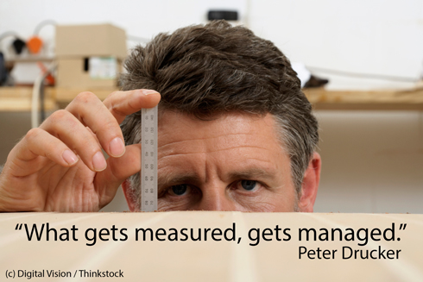
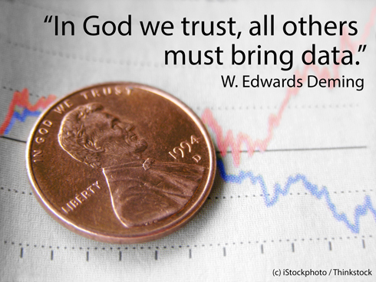

INTRODUCTION…
These quotations are pointers to
the key role and importance of data/statistics
Notes:
Permit me the opportunity of briefly recalling with a few quotes on the importance of Statistics means to us…

Slide 4





Development efforts are often hampered by poor or non-existent data. While attempts are being made to address this, much more needs to be done to improve official data by developing countries themselves, particularly as new development goals are set for the post-2015 period. – Bono
Notes:
This is a quote by the renowned Development Activist and UN Ambassador Bono, highlighting the importance of data to the SDG process.

Slide 5


The Sustainable Development Goals (SDGs)
Notes:
O what is he SDGS about? The SDGS is th successor global development program hat replaced the MDGs. In September 2015, heads of state adopted the Agenda 2030 for sustainable development. This agenda charts out a universal holistic framework to help set the world on a path towards sustainable development, by addressing economic development, social inclusion, environmental sustainability, and good governance. This vision, which was endorsed by 189 nations in New York in September 2015 is expected to guide nations, International Organizations, the Private Sector, Civil Society and governments in all countries and at all levels in the shared pursuit of a healthier world and a better tomorrow.

Slide 6

The Sustainable Development Goals (SDGs)
17 Goals
169 Targets
231 Indicators
Notes:
So what does the SDGS entail? At the global level, the SDGs has 17 Goals and 169 specific targets to achieve these 17 goals. The attainment or otherwise of these Goals and targets under the 2030 agenda will be monitored using a set of global indicators. The global indicator framework, with 231 indicators was developed by the Inter Agency and Expert Group on SDG Indicators (IAEA-SDGs), and have been adopted by the UN Statistical Commission of which our own NBS played a key role.
The 17 goals give a vision of the kind of world we want by the year 2030. The 169 targets tell us how we get to the goals, while the indicators tell us if or when we meet the targets. The 17 goals are -
End poverty in all its forms everywhere
End hunger, achieve food security and improved nutrition and promote sustainable agriculture
Ensure healthy lives and promote well-being for all at all ages
Ensure inclusive and equitable quality education and promote lifelong learning opportunities for all
Achieve gender equality and empower all women and girls
Ensure availability and sustainable management of water and sanitation for all
Ensure access to affordable, reliable, sustainable and modern energy for all
Promote sustained, inclusive and sustainable economic growth, full and productive employment and decent work for all
Build resilient infrastructure, promote inclusive and sustainable industrialization and foster innovation
Reduce inequality within and among countries
Make cities and human settlements inclusive, safe, resilient and sustainable
Ensure sustainable consumption and production patterns
Take urgent action to combat climate change and its impacts
Conserve and sustainably use the oceans, seas and marine resources for sustainable development
Protect, restore and promote sustainable use of terrestrial ecosystems, sustainably manage forests, combat desertification, and halt and reverse land degradation and halt biodiversity loss
Promote peaceful and inclusive societies for sustainable development, provide access to justice for all and build effective, accountable and inclusive institutions at all levels
Strengthen the means of implementation and revitalize the global partnership for sustainable development

Slide 7

The Role of the Statistical System in SDG Implementation
The role of the statistical system is to produce the 231 indicators required for monitoring of the SDGs.
Notes:
As the authoritative source of official statistics in Nigeria, the primary role of NBS and indeed the statistical system in the SDG implementation is to generate the 231 statistical indicators required to track progress towards the attainment of the 17 goals and 169 targets.
Each country will also develop their own national indicators to assist in monitoring progress made on the goals and targets, whish is what we are in the process of doing.
We started early by developing our strategy to first of all get the baseline data across the 231 indicators and subsequently ensuring we keep them updated, monitored and tracked as we go along. Some of these 231 indicators will be collected via the system of administrative statistics while some will be collected via major surveys including MICS, HNLSS, Smart Nutrition Surveys etc The methodology and pre testing work for some of these major survey have ben ongoing for a while now and some like MICS are ongoing as we speak. WRT SASs we have attached staff to the major MDAs in question and are in the process of training them on what t collect and how and in what format.
But why is monitoring important? Why are we taking all these steps very quickly? Ill explain this by going back to the previous MDGS program

Slide 8
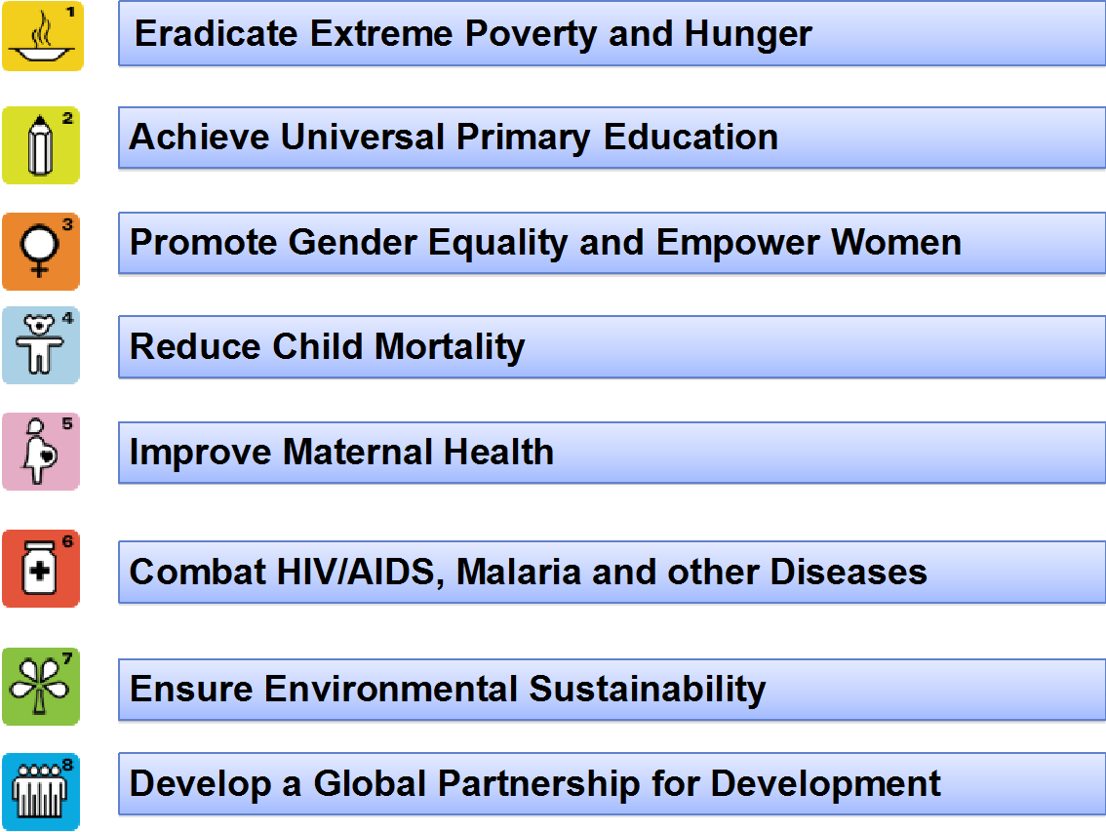

Nigeria’s Experience in Reporting MDGs Implementation
Notes:
For Us to effectively play our role as the official source of data for the monitoring of the goals, it is very important that we look back on our experience in the Millennium Development Goals and what lessons we can learn from it.
The experience from the MDGs implementation in Nigeria points to critical challenges posed by lack of comprehensive, up-to-date and harmonized data for monitoring progress and success recorded for some of the goals and target.
As a matter of fact, there was no comprehensive data production strategy for monitoring of the MDGs from the onset. In fact baseline was collected 5 years after it began and only checked again towards the last three years. In between huge financial resources was poured into the MDGS. Were they successful? We will never no because we started tracking late. Even when we started tracking we saw some states were doing better than others in one goal or another but we continued treating each state and each goal like each state was progressing the same way at d same pace. Eg not every state has a problem of fertilizer in agric. So state a is doing well in education and bad in health and state b is the reverse but instead of devoting more of its mdg resources in state 1 to health and not education since its issue was health we just maintained the same allocation.
Another challenge with mdgs apart from not having a data strategy which we now have with sdgs is that the roles and responsibility for who produces what was not properly outlined, no appropriate methodologies for computation of indicators were established and the commensurate funding for data production lacking.
Duplication and discrepancies in reported numbers. Inconsistent data sources.
This resulted in serious difficulties and challenges midway through implementation of the MDGs process, most especially in ascertaining Nigeria’s status in the process.
We are desperately committed not to repeat all this errors this time with the sdgs.

Slide 9
Notes:
This are just some of the results of the mdgs computed by nbs but towards the end of the program like I mentioned earlier.

Slide 11
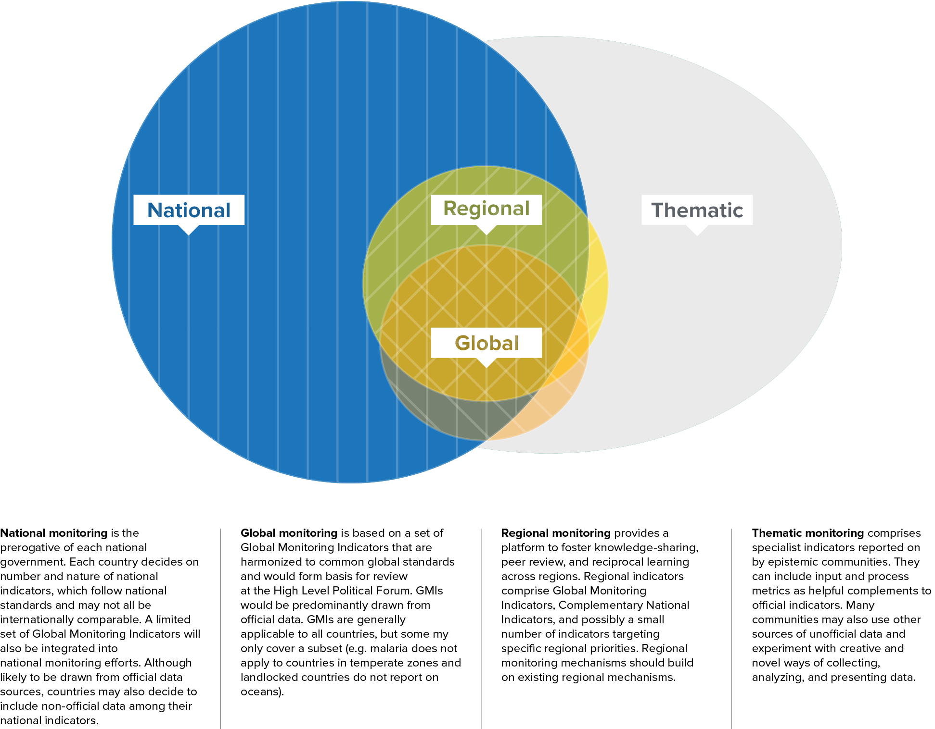
Monitoring and Reporting of SDG Implementation
Notes:
There are 4 levels of Reporting for the Monitoring of the Implementation the SDGs
Firstly at the National reporting
National reporting is the most significant level of reporting and relies heavily on the work of National Statistical Office. Given the breadth of the SDG agenda and to foster broad, multi-stakeholder participation in national reporting, the reporting is not limited to the NSO only but to the entire statistical system which comprises of both producers and users of data. National ownership at all levels of the SDG framework is critical, and national reporting must respond to national priorities and needs. For this reason, each country is expected to pursue its own set of national indicators. Such a set of indicators may consist of the Global Reporting Indicators used to support the global monitoring framework and Complementary National Indicators that address each country’s specific challenges, priorities, and preferences.
Secondly we have the Global Reporting
This is based on a set of Global Monitoring Indicators already agreed and adopted at the UN Statistical Commission. It is a vital complement to national monitoring and reporting. Global monitoring will ensure global coordination, support strategies to manage global public goods, and indicate which countries and thematic areas are in need of greatest assistance. A global dialogue on progress will also encourage knowledge-sharing and reciprocal learning. To this end, a set of Global Reporting Indicators for the SDGs is required. The majority of Global Reporting Indicators will be derived from NSOs, drawing on official data sources such as censuses, civil registration and vital statistics, and household surveys, but some may be prepared by specialist agencies, for example where no suitable, comparable official data exists. To ensure comparability, Global Reporting Indicators must be harmonized across countries.
Regional monitoring
Regional monitoring will have an important role in fostering knowledge sharing, reciprocal learning, and peer review. It will also promote shared accountability for regional challenges and opportunities, such as shared watersheds, regional conflicts, or regional infrastructure. Where possible, this monitoring should build on existing regional mechanisms, such as the Regional Economic Commissions or the Africa Peer Review Mechanism.
Thematic Reporting
To achieve the SDGs, complex challenges must be addressed across a broad range of sectors. Lessons learned in one country, for instance in health, education, agriculture, or infrastructure design, can inform progress in other countries. Similarly, implementation challenges and technology gaps are often common across countries, so it will be important that each major epistemic community is mobilized in support of the SDGs. This in turn will require thematic reporting on progress and implementation challenges.
Thematic communities – often under the leadership of specialized international organizations – can develop specialist indicators for monitoring and accountability that are tracked in countries across the globe. Often these indicators include input and process metrics that are helpful complements to official indicators, which tend to be more outcome-focused.

Slide 12



Why is Monitoring the Implementation of SDGs Important?
Monitoring serves 2 Broad purposes
  Management Tool - to assist in resource allocation.
  Reporting/Accountability Tool - to measure progress and help ensure the accountability.
Notes:
Its very important to highlight the importance and need for monitoring before we move ahead.
Monitoring the Implementation of the SDGs is not only essential for the achievement of the goals but is an integral part of the SDG framework. There is no possible way in which we can categorically affirm that we have met any of the goals without having a robust monitoring framework of which the Indicators form the backbone. A sound monitoring process for the SDGs will serve 2 main purposes –
To Serve as a Management Tool – to help inform policy, design programs and allocate resources.
To also serve as a Report Card/Accountability Tool - to measure progress towards sustainable development and help ensure the accountability of all stakeholders for achieving the SDGs.

Slide 13
Example of SDG Monitoring as a Management Tool
SDG Targets | Indicator | Current Status | 2030 Target
3.1 By 2030, reduce the global maternal mortality ratio to less than 70 per 100,000 live births | 3.1.1 Maternal deaths per 100,000 live births | 243 (per 100,000) | 70 per (100,000)
 | 3.1.2 Proportion of births attended by skilled health personnel | 58.60% | 100%
3.2 By 2030, end preventable deaths of newborns and children under 5 years of age, with all countries aiming to reduce neonatal mortality to at least as low as 12 per 1,000 live births and under-5 mortality to at least as low as 25 per 1,000 live births | 3.2.1 Under-5 mortality rate (deaths per 1,000 live births) | 89 per (1000) | 12 per (1000)
 | 3.2.2 Neonatal mortality rate (deaths per 1,000 live births) | 58 per (1000) | 25 per (1000)
Source: MDG Performance Tracking Survey 2014
Notes:
To illustrate this lets take one of the goals as an example of using the SDGs monitoring as a management tool
GOAL 3 of the SDG is to “Ensure healthy lives and promote well-being for all at all ages”. Target 3.1 of this goal talks about reducing the global maternal mortality ratio to less than 70 per 100,000 live births by 2030, while Target 3.2 talks about ending preventable deaths of new-borns and children under 5 years of age, with all countries aiming to reduce neonatal mortality to at least as low as 12 per 1,000 live births and under-5 mortality to at least as low as 25 per 1,000 live birth. For each of the targets, you have associated indicators by which we should be able to tell if the target has been met. Looking at the associated indicators for targets 3.1 and 3.2 here, it immediately gives us an indication of where we are now for each target as against where we want to be by 2030. Using this information, the health ministry in designing its programs can use this data to guide how it allocates resources to its different programs, from this information it will seem more resources might me needed in Maternal Mortality Prevention programs than Neonatal Mortality Prevention programs, as the MMR is much further from the 2030 target than NMR is from its 2030 target. This is how data is used to diagnose problems, allocate resources to d particular problem and monitor progress.

Slide 14
Example of SDG Monitoring as a reporting/accountability Tool
SDG Targets | Indicator | Current Status | 2030 Target
1.1 By 2030, eradicate extreme poverty for all people everywhere, currently measured as people living on less than $1.25 a day | 1.1.1 Proportion of the population below the international poverty line, disaggregated by sex, age group, employment status and geographical location (urban/rural) | 42.2% (Extreme Poverty Rate) | 0%
1.2 By 2030, reduce at least by half the proportion of men, women and children of all ages living in poverty in all its dimensions according to national definitions | 1.2.1 Proportion of the population living below the national poverty line, disaggregated by sex and age group | 62.60% | 31.30%
Notes:
Lets use another eg to illustrate sdgs monitoring but this time as a reporting tool.
As a Reporting/Accountability tool, the monitoring process can be used by the general public to hold government to promises made and can also be used by governments to appraise themselves.
Using Goal 1 for illustration here, which seeks to End poverty in all its forms everywhere in the world, the targets here is to eradicate extreme poverty and reduce by half the proportion of the population living below the national poverty line. At the launch of the SDGs in 2015, nation states including Nigeria effectively made a commitment to this targets, so for governments to know if they are on track on not, the monitoring process, using appropriate data gives a clear indication and help government to stay on track.
So we can see the critical role of data and monitoring in the SDG implementation process, its not a after process or afterthought but an integral part of the SDG implementation.

Slide 15


Planning for the SDGs monitoring in Nigeria
Several activities and consultations already carried out while some are on-going.
Notes:
In order to ensure that we put ourselves in the best possible position for the commencement of the SDGs, as the coordinator of the statistical system, we have already carried out Several activities aimed at improving our coordination, data collection, management and dissemination processes in preparation to usher in the new sustainable development framework as defined by SDGs. Through increased collaboration, openness and engagement with critical stakeholders, including other government agencies, business associations, academia and the media, we have produced a Indicator Production Framework.
The primary objective and goal of the Indicator Framework is for better efficiency and Coordination in the data production process.
This framework is comprehensive and well-defined, covering both at the federal and state levels.
Each Federal MDA statistics units and State Bureau of Statistics will have their roles and responsibility clearly defined and stated out. Each will know what is expected of them and very importantly the timelines expected from them. This will help avoid duplication of outputs across agencies as well as wasted resources doing the same thing. It will also prevent inconsistency in figures generated, it will also enhance the quality of the data and cut cost across the board.
Previously, each ministry / sector would want to undertake its own sectoral survey, independent of the statistics office and without consideration for how its data relates to other sectors and would apply whatever method suited them in a complicated and disorganised manner.

Slide 16
Production of the SDGs Baseline Indicators
Data Production Systems
3
SAS
2
NISH
NISE
System of Administrative Statistics
National Integrated Survey of Household using
National Integrated Survey of Establishment using
Compendium of Statistical Terms
EA/Hu. Frame & Maps
Directory of Industries & Businesses
Notes:
Before I talk about the specific statistical activities we have carried out, it is important to talk about the different data production systems in NBS.
National Integrated Survey of Households (NISH) – this is framework under which we conduct household based surveys. This is a very robust and comprehensive framework with over 860 thousand housing Units grouped by Enumeration Areas covering the entire country. It is from here that we select sample to conduct are routine Employment Survey, Living Standard Surveys, Health and Nutrition Surveys and the likes.
National Integrated Survey of Establishment (NISE) – This is the framework under which we conduct establishment based surveys, this framework contains a list of over 800 thousand registered businesses. This is the framework from where we conduct establishment based surveys.
System of Administrative Statistics (SAS) – SAS is our system of collecting administrative data from line MDAs and State Statistical Agencies. Under this system we collect information that MDAs collect routinely during the course of their work, such as enrolment rate in schools, government financial statistics, number of reporting crimes or accidents etc.

Slide 17
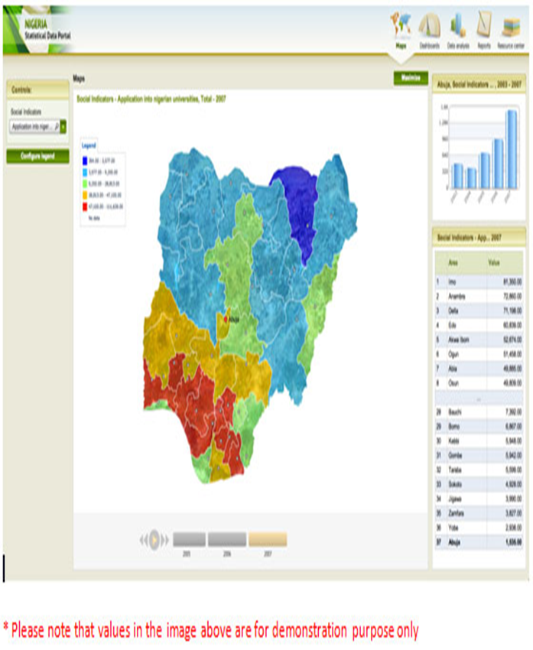
Data Mapping Exercise
Objective – to identify the various goals, target and associated indicators, data sources, frequency of production and disaggregation.
Status - Done
Notes:
One of the major exercises carried out in preparation for this process was a Data Mapping Exercise.
A comprehensive Data Mapping exercise was completed last year, listing all 231 proposed indicators and the data sources ie the specific data production activity and the MDA we would partner with to collect the required indicator either through administrative means or through a Survey.
This exercise was carried out in collaboration with the states and federal MDAs, So each agency has a fair idea of what is expected of them and the frequency in which they are expected to provide the information.

Slide 18
GOALS | TARGET | INDICATORS | MDAs | DATA PRODUCTION ACTIVITY | FREQUENCY
GOAL 1 | 1.1 By 2030, eradicate extreme poverty for all people everywhere, currently measured as people living on less than $1.25 a day | 1.1.1 Proportion of population below the international poverty line, by sex, age, employment status and geographical location (urban/rural) | NBS | National Living Standard Survey/General Household Survey | 5yrs Interval/Annually
End poverty in all its forms everywhere in the world | 1.2 By 2030, reduce at least by half the proportion of men, women and children of all ages living in poverty in all its dimensions according to national definitions | 1.2.1 Proportion of population living below the national poverty line, by sex and age | NBS | National Living Standard Survey/General | 5yrs Interval
 |  | 1.2.2 Proportion of men, women and children of all ages living in poverty in all its dimensions according to national definitions | NBS | General Household Survey | Annually
 | 1.3 Implement nationally appropriate social protection system, including minimum objectives to achieve for all, including floors, and ensure that by 2030 achieve substantial coverage of the poor and the vulnerable | 1.3.1 Proportion of population covered by social protection floors/systems, by sex, distinguishing children, unemployed persons, older persons, persons with disabilities, pregnant women, new-borns, work-injury victims and the poor and the vulnerable | NBS | General Household Survey | Annually
Notes:
This is a snapshot of the Output from the Data Mapping Exercise, this snapshot shows Goal 1, its target and related indicators. It also shows the Agency who’s primary responsibility it is to produce the indicator, in this case NBS. It also shows the particular data production activity from where the indicators will emanate from, which is the National Living Standard Survey in this case, and also the frequency in which the exercise will be carried out.
So for all the 231 indicators, we have identified the system of data production, the relevant MDA in charge and the specific data production activity as well as the frequency of production.

Slide 19
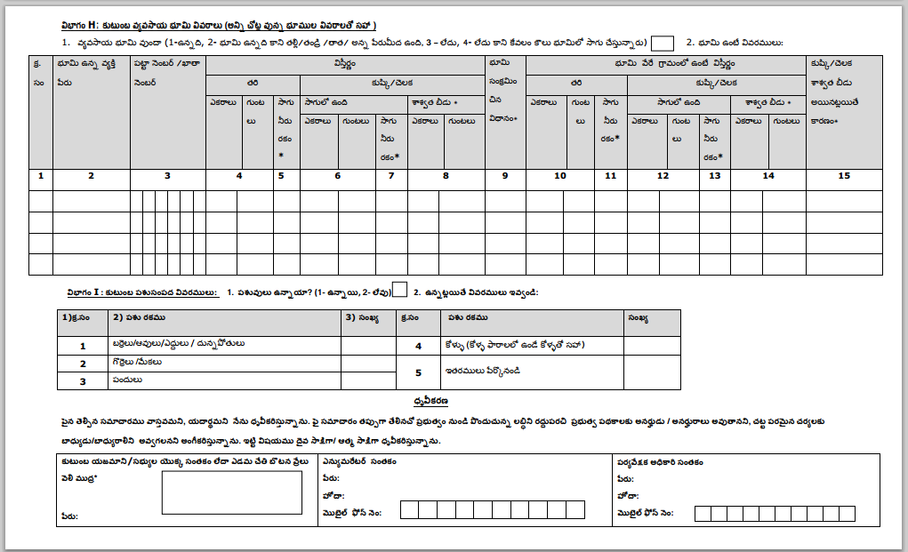

Development of a Data COLLECTION INSTRUMENTS AND Manual
Objective – to define each indicator on the list and produce an instrument for collecting the information
Status – On-going
Notes:
Another exercise that has been started is the process of developing data collection instruments and manuals. This process is almost completed.
Under this process, we are developing data collection templates for each MDA that is expected to provide information as well as a manual explaining each question in the template and how it is to be completed.

Slide 20

Capacity Building (Federal MDAs & State ssas)
Objective – to develop the human capacity within the statistical system to produce the indicators in a reliable and timely manner.
Status – On-going
Notes:
The initial process of building staff capacity has already commenced and is on-going. The aim here is to adequately equip the Staff of NBS, Federal MDAs statisitics unit and State Statistics agencies with the requisite skills for producing the indicators relevant to their organisations. The process has started in-house and will then move to federal MDAs and then to the States.
Staff are being trained on how to collect and compute the indicators relevant to their agencies. This will be a very extensive process to ensure the quality of the final data.

Slide 21


Development of Sdgs Data bond and responsibility framework
Notes:
We also adopted an SDG data bond and responsibility framework.
The objective of this exercise is to get every MDA involved in the Monitoring Process to commit to their responsibility in the process. Each will be expected to sign a bond which stipulates in details what their specific responsibilities are in terms of the data they are meant to produce. Its simply a way of getting high level buy-in into the monitoring process.

Slide 22
SOME Data Production activities for the SDGs Baseline Indicators
NISH
  National Living Standard Survey
  Multiple Indicator Cluster Survey
  Agricultural Survey
  Labour Force Survey
  Demographic and Health Survey
NISE
  Enterprise/Economic Survey
  National Accounts
  Consumer Price Index (CPI)
SAS
Education Management Information Systems
Civil Registration And Vital Statistics (CRVS)
Management Information Systems For Health
Government Operations Statistics
Trade Statistics - Volume & Value Import/Export
Statistics Of International Trade In Services And Tourism (SITS)
Procurement Data (Spending/Expenditure))
National Budget
Notes:
What has been done to collect the baseline indicators so far?
These are some of the data production activities from which most of the indicators for the SDGs will be generated. Each of these activities will produce indicators that will be used in the monitoring of the SDGs. Each of these activities will be carried out under one of the 3 data production frameworks we have (NISH, NISE and SAS). For Example, the National Living Standard Survey will provide indicators such as Headline Poverty Rate, Extreme Poverty Rate amongst others. Some have been completed. Others are ongoing and the preparatory stages for the remaining are also ongoing

Slide 23

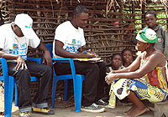
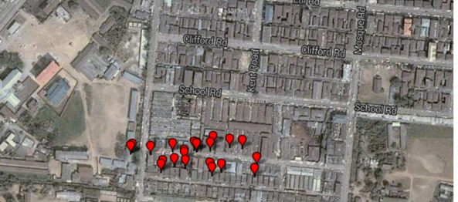
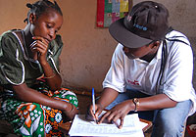
On-going data Production for sdGs monitoring
multiple INDICATOR cluster Survey
Notes:
One example of a major project that would produce a lot of the needed indicators that is ongoing is the MICS
MICS is an international household survey programme developed by UNICEF, it provides up-to-date information on the situation of Women and Children as well as men.
This is nationwide survey, sampling over 33,000 Households across the country. The type of information to be generated from this exercise are-
Mortality
Reproductive Health
Nutrition
Child Health
Water and Sanitation
Literacy and Education
Child Protection
Child Development
HIV/AIDS and Sexual Behaviour
Access to Mass Media and Use of ICT
Subjective Well-being
The survey is presently at the Training Stage, which lasts for a month, after that, data collection in the field will commence and last for 3 months. Due to the use of electronic means for data collection as well as other efficiency methods adopted, we hope to have preliminary results by December this year, which will be a record time as data processing usually takes up to 6 months. This exercise will provide over 25 percent of the SDG baseline indicators and a lot more information on which government can use in planning and designing programs and interventions.

Slide 24



Use of Non-Traditional Data Sources
Use of alternative data sources such as
  Mobile Telecommunication Data
  Employment Records
  Crowd-sourced Prices Data
Notes:
In addition to these conventional sources of data, we are also taking advantage of ICT and the recent data revolution to take advantage of non-traditional sources of data i.e Big Data.
There is an enormous wealth of information out there and we see an opportunity to exploit this data to complement and fill existing data gaps within the system. We have already started this process in NBS, through collaborations with Jobberman, we already produce a Quarterly Online Recruitment Report to complement our Job Creation Survey.
We are also in the process of developing an online platform with a mobile application for collecting real time market price information, when completed this will be a rich addition to the monthly CPI data and can serve both government and businesses alike in making investment decisions.
Our data is increasingly collected using CAPI devices which enables us to collect coordinates of the locations the data was collected and to take images during interviews and record those interviews for play back later in case there is need to verify some information earlier taken.

Slide 25


Statistical Advocacy
High level advocacy targeted at policy makers at the federal and state levels.
Notes:
Finally we have advocacy
High level advocacy for the monitoring of the goals is needed. Policy makers at all levels have to understand the importance of indicators to the monitoring process and should commit the needed resources to the production of the indicators.

Slide 26

Potential challenges
Coordination
Financing
Human Capacity
Notes:
Unlike the MDGs the SDGs encourages and promotes the need for public, private and civil society partnerships in the implementation and monitoring of the SDGs. In light of this, the coordination of all partners in the monitoring process is a huge and daunting task as is a potential challenge. Partners in all sectors must acknowledge and respect the coordinating mandate and authority of the relevant agencies in this process for the overall success of it.
Financing is also a potential challenge. The reality is that data production is not cheap and data is no longer an option but a necessity, hence we must invest heavily to produce the needed information. Without the data, we are hunting or fishing in the dark. Just to give an idea, South Africa is investing about 5 billion dollars ($4,995,833,838) into SDG data production annually over the next 15 years. So we need to be investing seriously in data production. This compares to just UD 45,000 devoted to the exercise at the federal level and I doubt any individual state budgeted more so we really need to fund this activity properly.
Finally we have Human Capacity challenges – while it has improved over the years, particularly at the federal level, more still needs to be done, mainly at the state and local government levels.

Slide 27
Conclusion
This is a very ambitious task on our hands
NBS remains committed and will deliver on its mandate concerning the SDGs
Continuous support from government and partners is very critical to the success.
Notes:
In conclusion, The SDGs in itself is a very ambitious task and the monitoring of it even more so, considering the resource (human and financial) required. However I believe that we have no other choice than to meet the onerous task set before us. We at NBS at not perturbed by this challenge, we remain committed to delivering on our mandate as a statistical office. We are confident that with the continued operational and institutional and with improved financial support from our government and our partners, NBS can successfully carry out its’ functions as relates to the SDGs and also continue to remain a model statistical agency for other African countries.

Slide 28


THANK YOU FOR YOUR ATTENTION
NATIONAL BUREAU OF STATISTICS
Plot 762, Independence Avenue,
Central Business District,
Abuja.
Email: ykale@nigerianstat.gov.ng
feedback@nigerianstat.gov.ng
Website :www.nigerianstat.gov.ng
www.facebook.com/nigerianstatistics
“@nigerianstat”

