Slide 1
Forging Effective Links Between Agricultural and Industrial Sectors for Enhanced implementation of the SDGs
Chuma Ezedinma PhD
UNIDO
Regional Office Nigeria
August 2016

Slide 2

17 Goals
169 Targets to be achieved by 2030

Slide 3

Together for a sustainable future
The 5 Ps

Slide 4
The 4 C’s
Competition
Conformity
Connection
Coordination
The Real Sector
Agriculture
Manufacturing
Mining
Environment
The Enablers
Infrastructure
Skills
Finance
Invest Climate
.......etc

Slide 5
The importance of Industry
In developing countries, barely 30 per cent of agricultural production undergoes industrial processing. In high-income countries, 98 per cent is processed. This suggests that there are great opportunities for developing countries in agribusiness
Manufacturing is an important employer, accounting for around 470 million jobs worldwide in 2009 – or around 16 per cent of the world’s workforce of 2.9 billion. In 2013, it is estimated that there were more than half a billion jobs in manufacturing
Industrialization’s job multiplication effect has a positive impact on society. Every one job in manufacturing creates 2.2 jobs in other sectors
Small and medium-sized enterprises that engage in industrial processing and manufacturing are the most critical for the early stages of industrialization and are typically the largest job creators. They make up over 90 per cent of business worldwide and account for between 50-60 per cent of employment
Least developed countries have immense potential for industrialization in food and beverages (agro-industry), and textiles and garments, with good prospects for sustained employment generation and higher productivity
Middle-income countries can benefit from entering the basic and fabricated metals industries, which offer a range of products facing rapidly growing international demand

Slide 6
Competition: Adding value to commodities
public support
:
policies
,
institutions
,
infrastructures
pre
-
production
:
the
agricultural
post
-
harvest
post manufacturing
the market
resource
production
processing
Machinery & Equipments
resource efficient
Land Preparation
,
packaging
clean technology
eco
-
design
Pesticides
Planting
skills
local markets
fertilizers
finance
supplementation
Weeding
machinery
rural energy
quality control
marketing
international
and food safety
markets
Harvesting
water
organization
:
pollution
management
clusters
,
consortia
containment
business development services

Slide 7
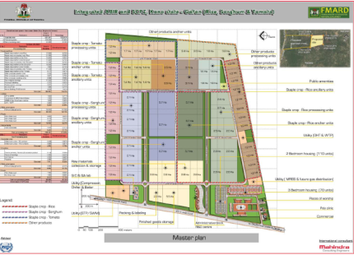
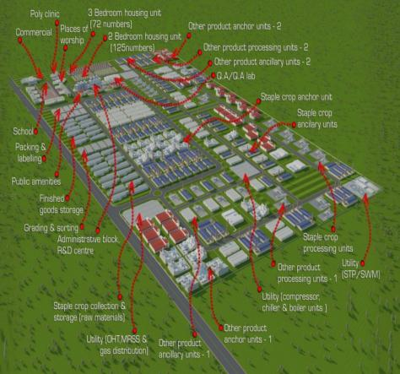
Industrial Clusters: From Comparative Advantage to Competitive Advantage
72%
56%
55%
53%
45%
39%
28%
24%
19%
5%
Infrastructure
Financing
Securing Supplies
Policy & Regulatory Environment
Human Capital
Governance
Information & Communication
Land
Government Coordination
Competitive Environment
Supply side constraints in Agro industrial development
Addresses challenges to Industrialization simultaneously

Slide 8
Infrastructure is key to Industrialization & Competitiveness
Rail connectivity
Highway strengthening
Road connectivity
Air & Sea Port connectivity
External water supply source linkages
External power linkages
External infrastructure connects the IZ with the outside world providing forward and backward linkages necessary for the operations.
The government’s resources and capacities are limited and need to be used strategically

Slide 9
SDG 9 recognizes Infrastructure as critical
For many African countries, particularly the lower-income countries, the existent constraints regarding infrastructure affect firm productivity by around 40 per cent
Inadequate infrastructure leads to a lack of access to markets, jobs, information and training, creating a major barrier to doing business
Quality infrastructure is positively related to the achievement of social, economic and political goals
Basic infrastructure like railways, roads, information and communication technologies, sanitation, electrical power and water remains scarce in many developing countries
2.5 billion people worldwide lack access to basic sanitation and almost 800 million people lack access to water, many hundreds of millions of them in Sub Saharan Africa and South Asia
About 2.6 billion people in the developing world are facing difficulties in accessing electricity full time

Slide 10
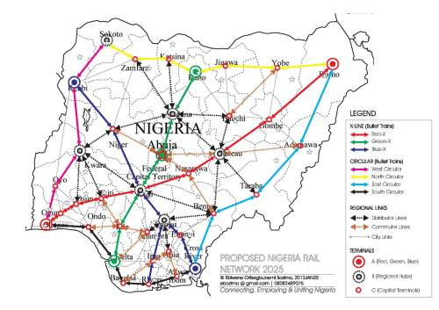

Slide 11
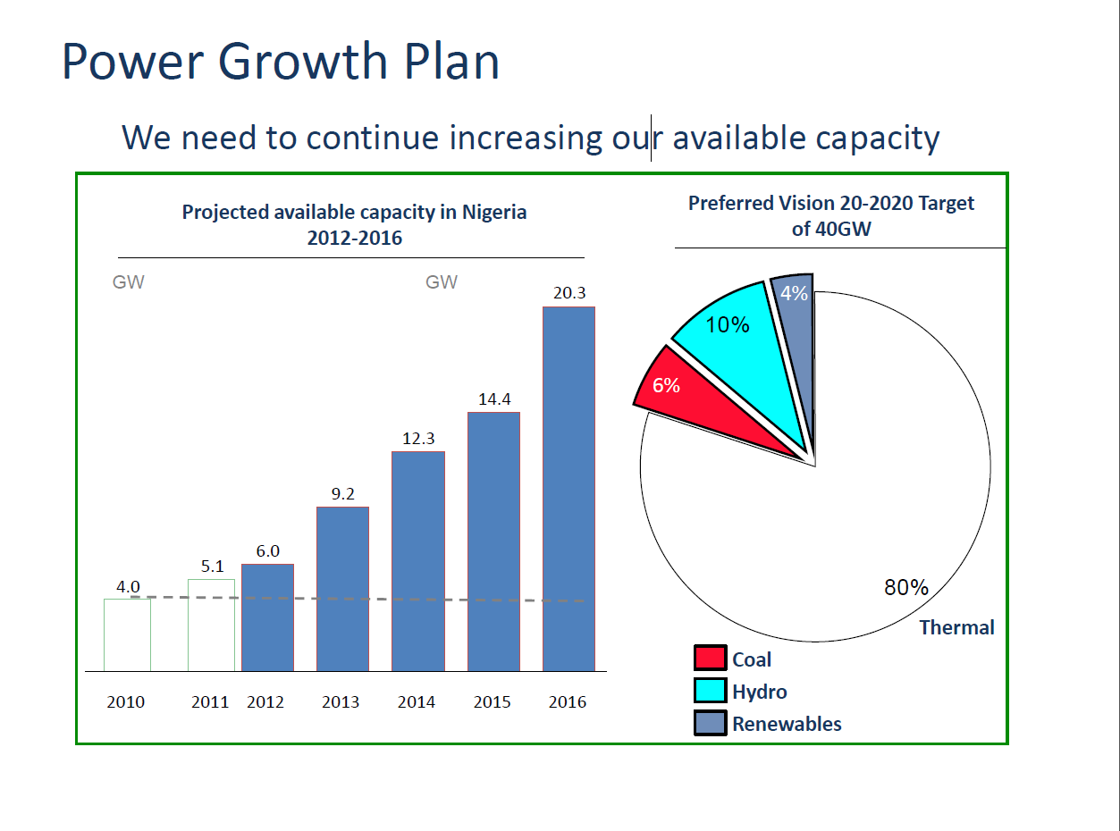

Slide 12
Improve on the Ease of doing business in Nigeria
Ease of Doing Business indicators
Starting a Business
Dealing with Construction Permits
Getting Electricity
Registering Property
Getting Credit
Protecting Investors
Paying Taxes
Trading Across Borders
Enforcing Contracts
Resolving Insolvency

Slide 13
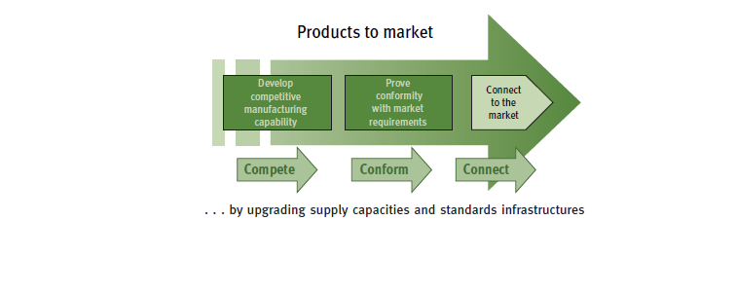
The Other C’s: Conform and Connect for Value

Slide 14
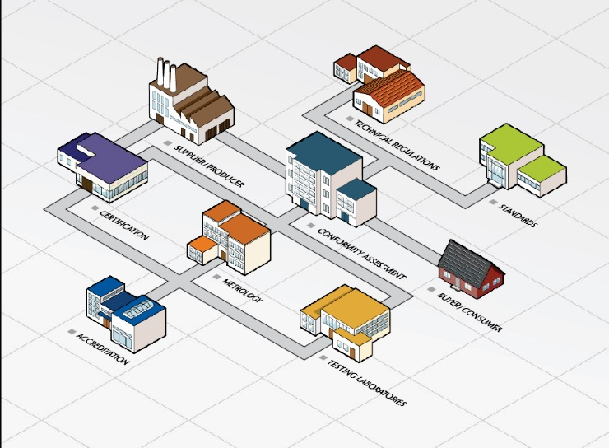
Building Trade Capacity: Support in 5 Key areas
COMPONENT ONE: Assistance with the promulgation of a National Quality Policy (NQP) and improvements in ensuing legislation for the NQI
COMPONENT TWO: Establishment of a National Accreditation Body (NAB) and Capacity development for accreditation auditors
COMPONENT THREE: Development of a National Metrology Institute (NMI)
COMPONENT FOUR: Improvement of Organised Private sector in the NQI through its capacity to create and support conformity assessment bodies (CAB)
COMPONENT FIVE: Enhancement of the consumer protection role on quality issues as well as increased capacities of consumer associations to lift up the quality offer/culture of Nigerian enterprises.
C1
C4
C1
C3
C5
C2
C4

Slide 15






Link to INTERNATIONAL WTO Agencies
Metrology
Certification
National
Quality
Infrastructure
Testing
Standardization
Accreditation
CODEX
15

Slide 16
Coordination
1). Providing infrastructure & industrial clusters involves support and services under the scope of several MDAs (e.g., energy, transportation, communication, environment, science and technology etc.) and a very close inter ministerial coordination is required
With respect to coordination, there are, basically, two main problems to be avoided:
  inter-governmental agency rivalry, which is a result of lack of coordination and even opposition between government agencies; and
  inefficient decision-making processes, which is due to the fact that multiple reporting structures and reporting layers are expected to lead to inefficiencies and delays in the process of implementation.
(2). Support at the highest level of Government - NEMT
(3). Monitor and evaluate progress actively - MBNP

Slide 17

Coordination is Ownership
“Private sector led, Government enabled”
  Develop enabling environment & framework - (policies, finance, land, incentives)
  Provide connectivity to critical national public infrastructure such as land, roads, and energy
  Regulatory Framework
  Finance public goods
  Invest in modern industrial processing, associated production & technology
  Invest in on-site infrastructure and services
  Provide sustainable site management
  communities
  Build capacity and technical expertise
  FDI/FPI
Local & International Private Sector Players
Develop-ment Partners
Federal, State, Local Govts.
  Financing and service support
  Develop market linkages
  Capacity building
Industrial upgrading and diversification needs to:
– Address externalities
– Solve coordination problems
Need for a facilitating state –Justin Lin

Slide 18
Conclusion: The SDG 9 Targets
Develop quality, reliable, sustainable and resilient infrastructure, including regional and transborder infrastructure, to support economic development and human well-being, with a focus on affordable and equitable access for all
Promote inclusive and sustainable industrialization and, by 2030, significantly raise industry’s share of employment and gross domestic product, in line with national circumstances, and double its share in least developed countries
Increase the access of small-scale industrial and other enterprises, in particular in developing countries, to financial services, including affordable credit, and their integration into value chains and markets
By 2030, upgrade infrastructure and retrofit industries to make them sustainable, with increased resource-use efficiency and greater adoption of clean and environmentally sound technologies and industrial processes, with all countries taking action in accordance with their respective capabilities
Enhance scientific research, upgrade the technological capabilities of industrial sectors in all countries, in particular developing countries, including, by 2030, encouraging innovation and substantially increasing the number of research and development workers per 1 million people and public and private research and development spending
Facilitate sustainable and resilient infrastructure development in developing countries through enhanced financial, technological and technical support to African countries, least developed countries, landlocked developing countries and small island developing States
Support domestic technology development, research and innovation in developing countries, including by ensuring a conducive policy environment for, inter alia, industrial diversification and value addition to commodities
Significantly increase access to information and communications technology and strive to provide universal and affordable access to the Internet in least developed countries by 2020

Slide 19
Thank You

