Slide 1
NGF HEALTH PRIORITY AGENDA
2018

Slide 2
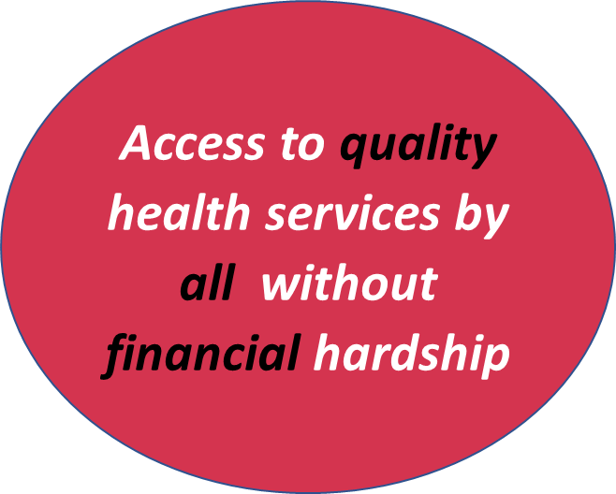
The 3 Priority Areas
POLIO ERADICATION INITIATIVE
Ensure Nigeria is declared polio free by 2019
NUTRITION
Make progress towards Global Nutrition Targets 2025
….because health is a human right

Slide 3
Priority Areas
1. UHC: Components & Benefits
FUNCTIONAL FACILITIES
UNIVERSAL HEALTH COVERAGE
IMPROVED HEALTH OUTCOMES
ECONOMIC GROWTH
EDUCATIONAL GAIN
WOMEN EMPOWERMENT
POVERTY ALLEVIATIION
FINANCIAL PROTECTION
Essential Medicines
Emphasis on Women, Adolescents and Children

Slide 4
Priority Areas …
2. Polio Eradication Initiative
3. Nutrition
Political commitment and leadership towards PEI
National and Subnational Immunization Plus Days
Routine Immunization
Surveillance
Political commitment and leadership towards nutrition
Domestic Resource Mobilization for Nutrition

Slide 5
Updates on Health
UHC
Akwa Ibom, Bayelsa and Edo State are yet to establish their PHC Boards
BHCPF yet to be implemented by FGN
Polio
Nigeria 17 months Polio free 19 more months to go!
Sustained commitment needed.
Disease oubreaks
Lassa Fever (Ebonyi, Ondo, Edo, Bauchi, Kogi)
Meningitis (Kaduna, Katsina, Sokoto and Zamfara)
Cholera (Kano)
Measles (several states)

Slide 6
Keys Requests to the NGF
UHC
Advocate to FGN for the inclusion of BHCPF in the 2018 budget
Creation of SPHCB in Akwa Ibom, Bayelsa and Edo States
Establishment for social health insurance schemes in all states
Establishment of sustainable drugs supply schemes in all states
Polio
Sustain dedication to the Abuja Commitment on polio

Slide 7
Thank you for Listening

