Slide 1
NGF HEALTH UPDATE
19th January 2022

Slide 2
Universal Health Coverage
Basic Health Provision Fund
FMOH disbursed 2021/2022 BHCPF funds to the gateways (NHIS and NPHCDA) in December 2021
NHIS and NPHCDA has disbursed to all the 36 states in January 2022, except for the top up for Abia, Niger and Osun for the NHIS gateway
The funds is from the 2021 budget but will be used for 2022
Subsequent disbursements of funds will be based on retirement of the 2021/2022 funds
States will also be required to make provision for 25% counterpart contribution in the 2023 budget

Slide 3
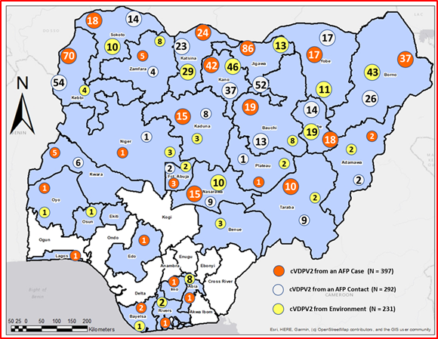
Polio Eradication
Wild Polio Virus cases remain ZERO in Nigeria
However, number of Circulating Mutant Polio Virus is on the increase in many States in Nigeria
920 cases of CMPV2 recorded from Jan – Dec 2021 with 767 occurring in the second half of 2021
Increase due to low levels of routine immunization coverage and environmental factors
Distribution of CMPV2
Polio Eradication

Slide 4
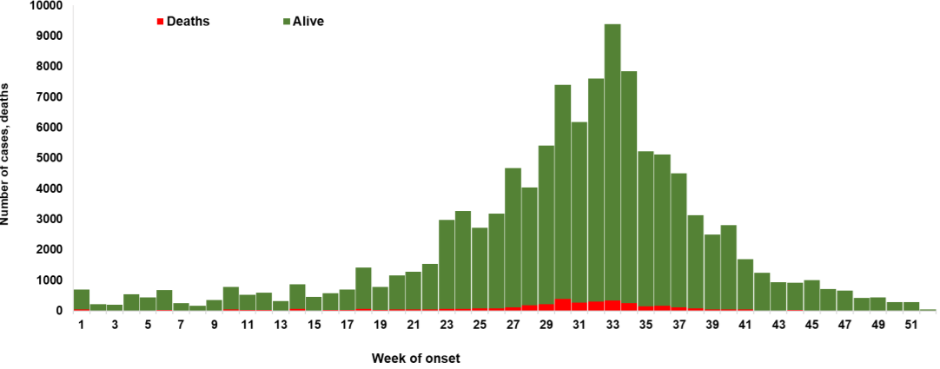
Health Security
Cases of COVID19 and Cholera are generally on the decline in the past few weeks
COVID19 (2020 to date)
Confirmed Cases 251,178
Active Cases 23,439
Discharged cases 224,629
Deaths 3,110
Cholera (2021)
Suspected Cases 111,062
Deaths 3,604
84% drop in new cases last week of 2021

Slide 5
Health Security …
COVID 19 Preparedness and Response project (COPREP)
A total of $132.5M will be disbursed to States for general COVID 19 response ($56.5M) and Vaccines Distribution ($76M)
Requirements for accessing the fund have been sent to States
The issue on the fragmentation of the fund flow raised by the States is yet to be resolved
A meeting between the HCH and the WB team is being proposed for next week to iron out all outstanding concerns.

Slide 6
Nutrition
Nutrition
Nutrition remains a priority of the NGF and a critical development issue for the nation.
A national priority list of interventions for year 2022 has been developed and shared with all the States
The Vice President, His Excellency, Prof Yemi Osinbajo has requested the NGF to:
facilitate the adaption of the priority lists by the States
facilitate the release of funds by State Governors to implement priority nutrition interventions in their respective states

Slide 7
2022 Outlook
Formal sector enrolment into the SSHIS in all States
Establishment/Functionality of State Drugs management agency
Accountability of the BHCPF
Release of Equity funds
PHC Challenge fund
Functionality of the SCFN
Implementation of 2022 priority list of Nutrition interventions
System strengthening of States Emergency preparedness and response
Strengthening capacity of Epidemiological Unit
Functionality of State Task Force on PHC and Immunization
Deepening partnership with federal MDAs and existing partners
Exploring new partnerships with donor agencies

Slide 8
Required Actions By Governors
POLIO:
Reactivate the functionality of the State Task Force on PHC (includes immunization) headed by the respective deputy Governors
NGF secretariat to facilitate a virtual meeting between the deputy Governors and NPHCDA
Health Security
Continue mobilization for vaccination and promote adherence to non pharmaceutical intervention
Release HCH for the proposed meeting with WB on CoPREP
Nutrition
Release funds for implementation of the 2022 priority lists for Nutrition

Slide 9
Thank you for Listening

