Slide 1
Distinct Dedication to Delivery
GMD’s Brief to NEC
Mele K. Kyari
GMD NNPC
October 27, 2021
…Drive to Global Excellence

Slide 2
2021-YTD Crude Oil Prices Trend ($/bbl) and Other Market Developments
86
National Budget benchmark
Oil prices came under pressure as OPEC unexpectedly trimmed its world oil demand growth forecast for 2021
Also, China, the world’s biggest crude importer, releases data showing that import fell by 15%
West African crude differentials remained under pressure due to competitive light sweet regional crudes and delivered U.S. crude.

Slide 3
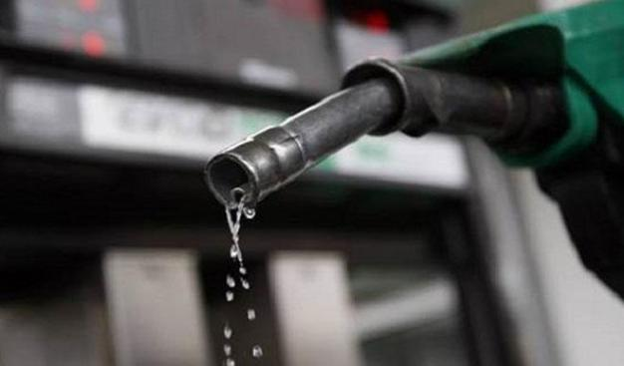
Gasoline Prices Trend
Nov 2020 - 2021YTD PMS Price Movement
At US$85 crude oil, 60m litres daily consumption and N411/1$ FX, PMS under recovery per litre will be N140/litre
Daily PMS under recovery will be N8.4billion
Using I&E FX rate unit under recovery will be N158/litre and N9.5billion daily
Annual PMS under recovery range between N3.07-N3.46 Trillion

Slide 4
Gasoline Prices Trend
Nov 2020 - 2021YTD PMS Price Movement
At US$85 crude oil, 60m litres daily consumption and N570/1$ FX, PMS under recovery per litre will be N232/litre
Daily PMS under recovery will be N14billion
Annual PMS under recovery will escalate to N5 Trillion

Slide 5
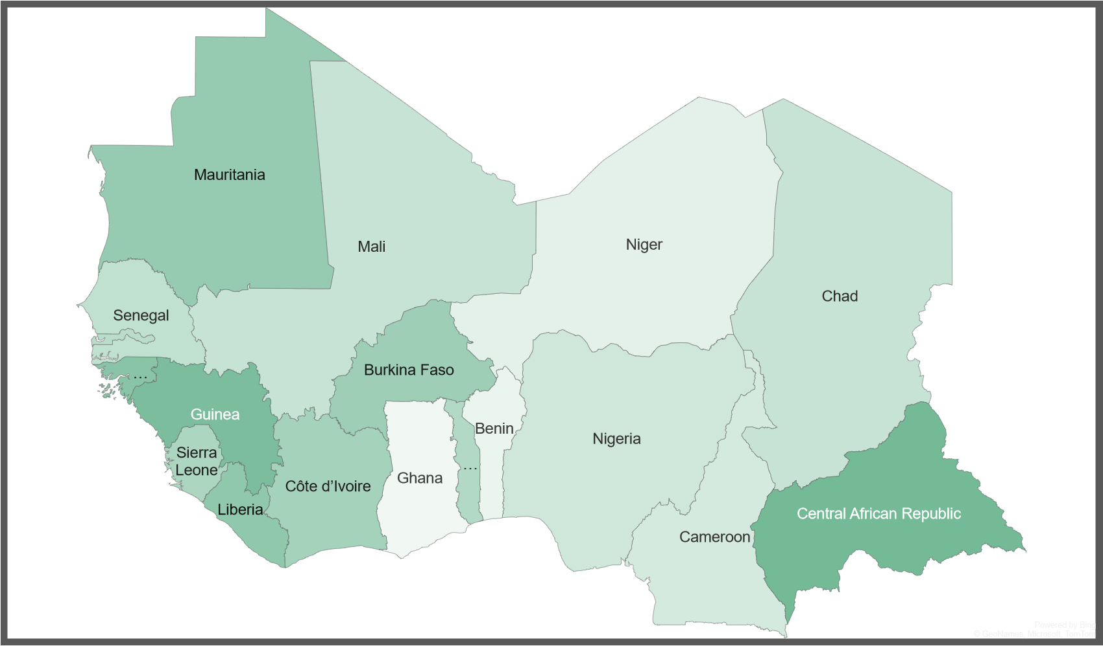
Gasoline Price Across Some West Africa Countries (Naira Per Litre)
486
493
562
446
375
422
302
446
162
388
870
366
377
318
450
Togo
457
www.globalpetrolprices.com as at October 2021
Referenced FX Rate: N411.23/USD

Slide 6
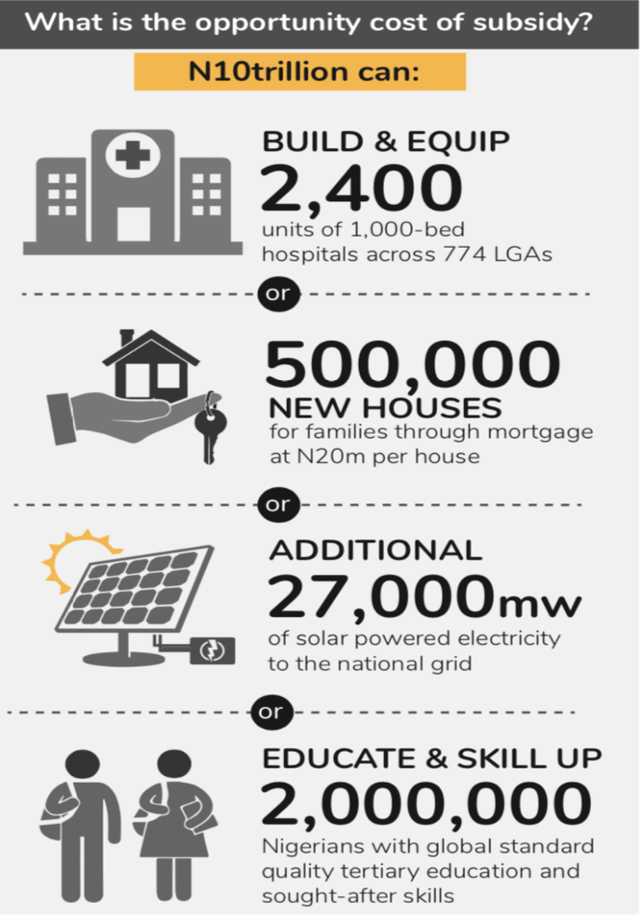
What Deregulation Can Deliver to NIgerians
12 Trillion Naira in 4years
At US$80 crude oil, 60m litres daily consumption and N411/1$ FX, PMS under recovery per litre will be N138/litre
Daily PMS under recovery will be N8.3billion
Annual PMS under recovery will escalate to 3 Trillion Naira
Road Construction
Well Equipped 120 Beds Tertiary Health Centres
7,500KM
Every Year
37 Every Year
@ N400,000,000.00/Km
@ N82 Billion/ Hospital

Slide 7
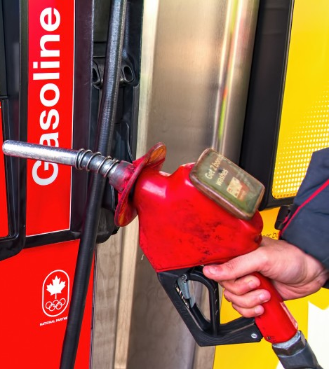
Switching to Alternative Fuels
Customers Perception on Safety
No exposure to global prices, only to change in Dom Gas pricing of ~ $2.5
Affordability
Availability
N320
N160
N323
Fuel Efficiency
LPG Assumptions:
- Delivered price of N7,600/12kg
- 1 Kg to litre
Switching Cost
Market players will require investment to trade across products portfolio

Slide 8
Thank you

