Slide 1
COVID-19 VACCINATION IN AKWA IBOM STATE
The Road so far
PROF. AUGUSTINE VINCENT UMOH
HON. COMMISSIONER FOR HEALTH
AKWA IBOM STATE
2nd SEPTEMBER, 2021

Slide 2
Covid-19 – a raging pandemic
Akwa Ibom State recorded it’s first cases o April 1st 2020
(five of them at once!)
Covid-19 vaccines to the rescue

Slide 3
41,134
1st dose administered
Key Updates
25,032
2nd dose administered as at 09.07.2021
6903 vials (about 69,030 doses) of Astra Zeneca Vaccine received by the State on the
10th of March, 2021
First dose was given at a State flag-off on the
16th of March, 2021
22,298
Males vaccinated
18,836
Females vaccinated

Slide 4
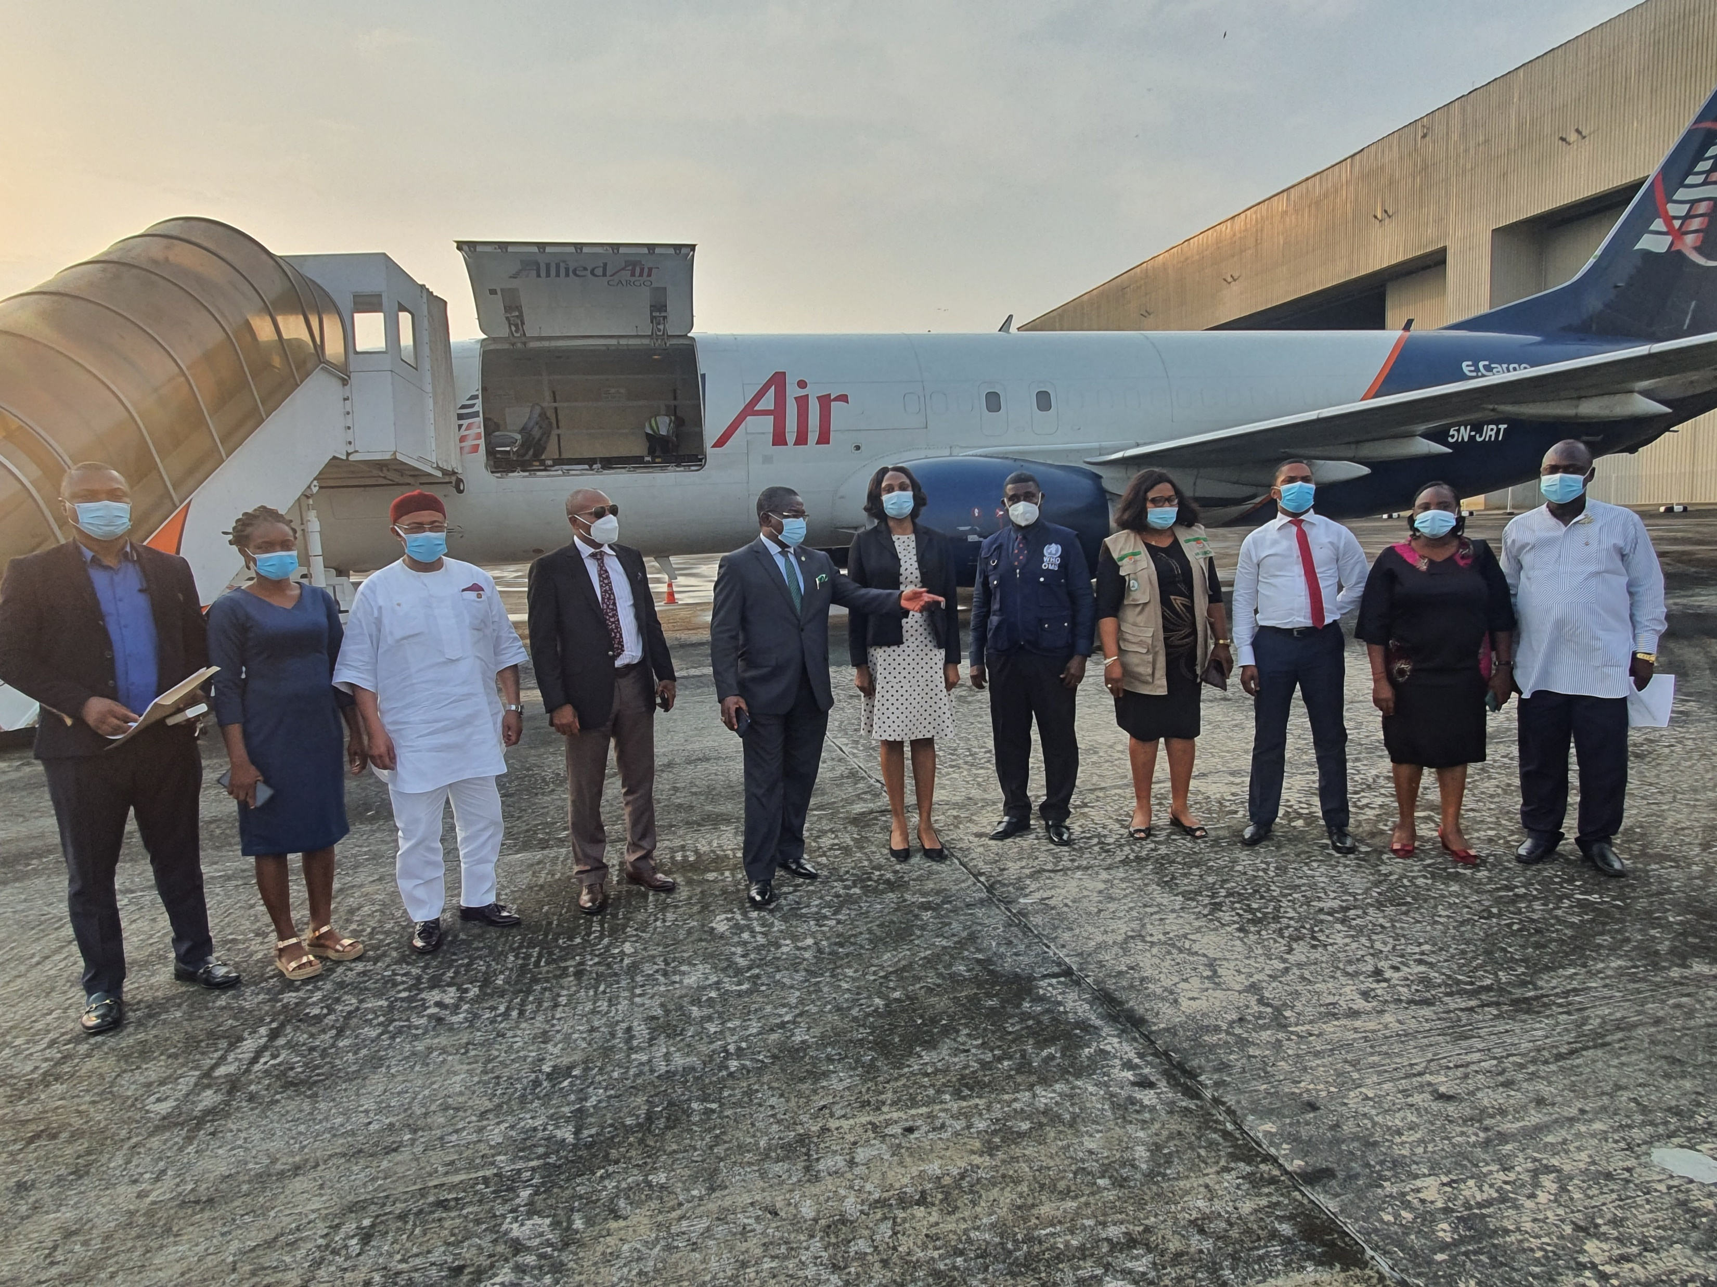
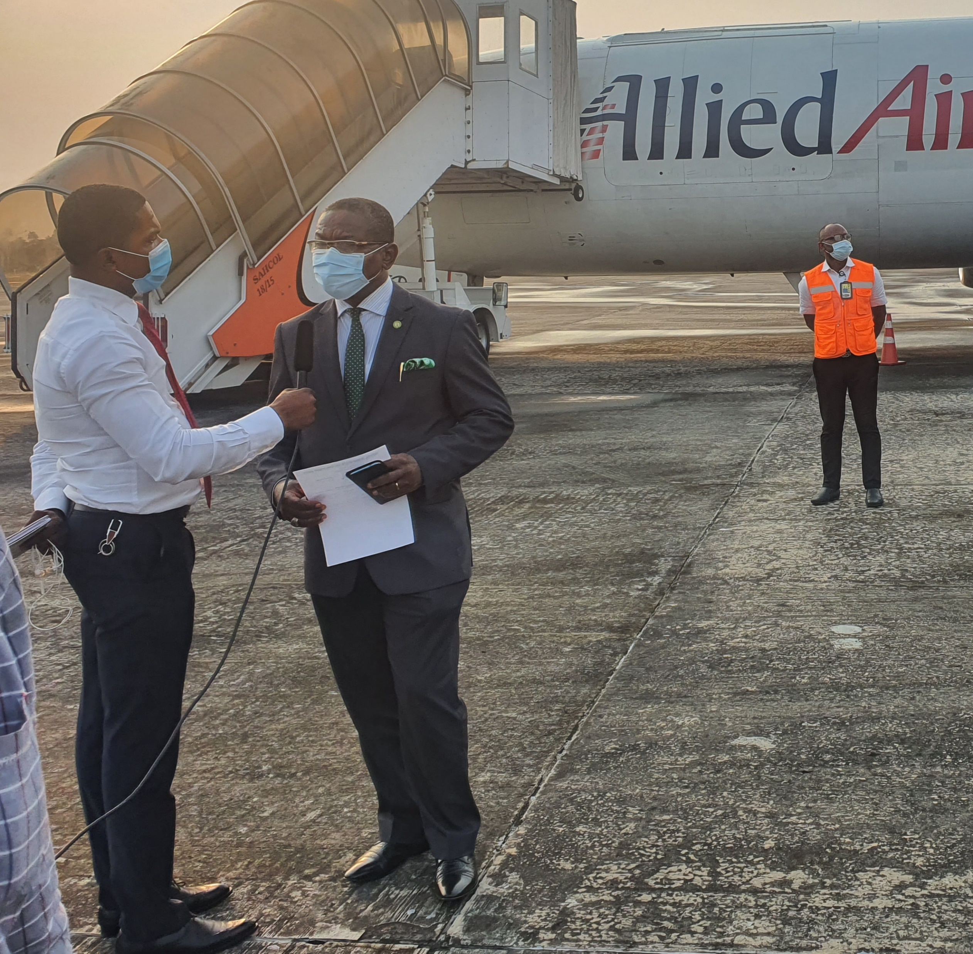
We received the AstraZeneca Vaccines

Slide 5
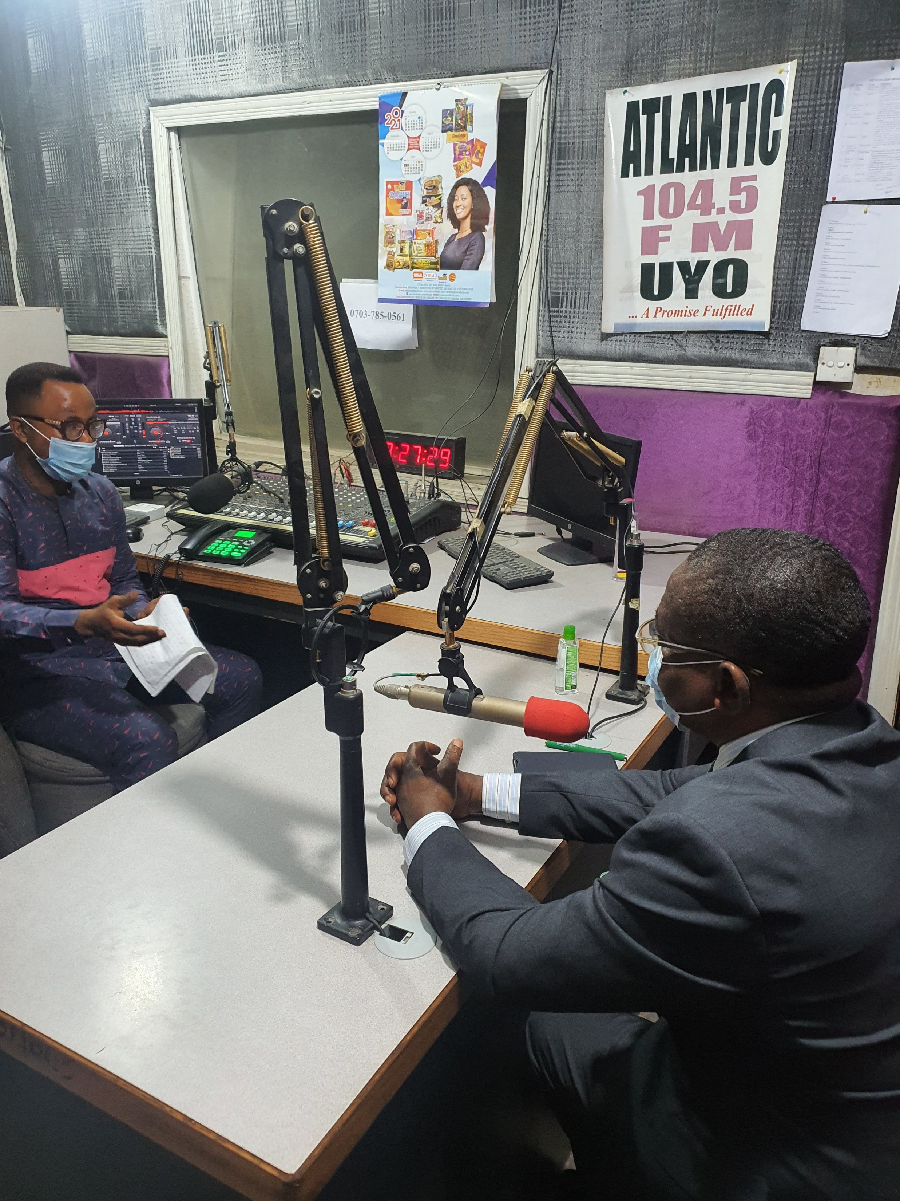
We announced it to the world

Slide 6
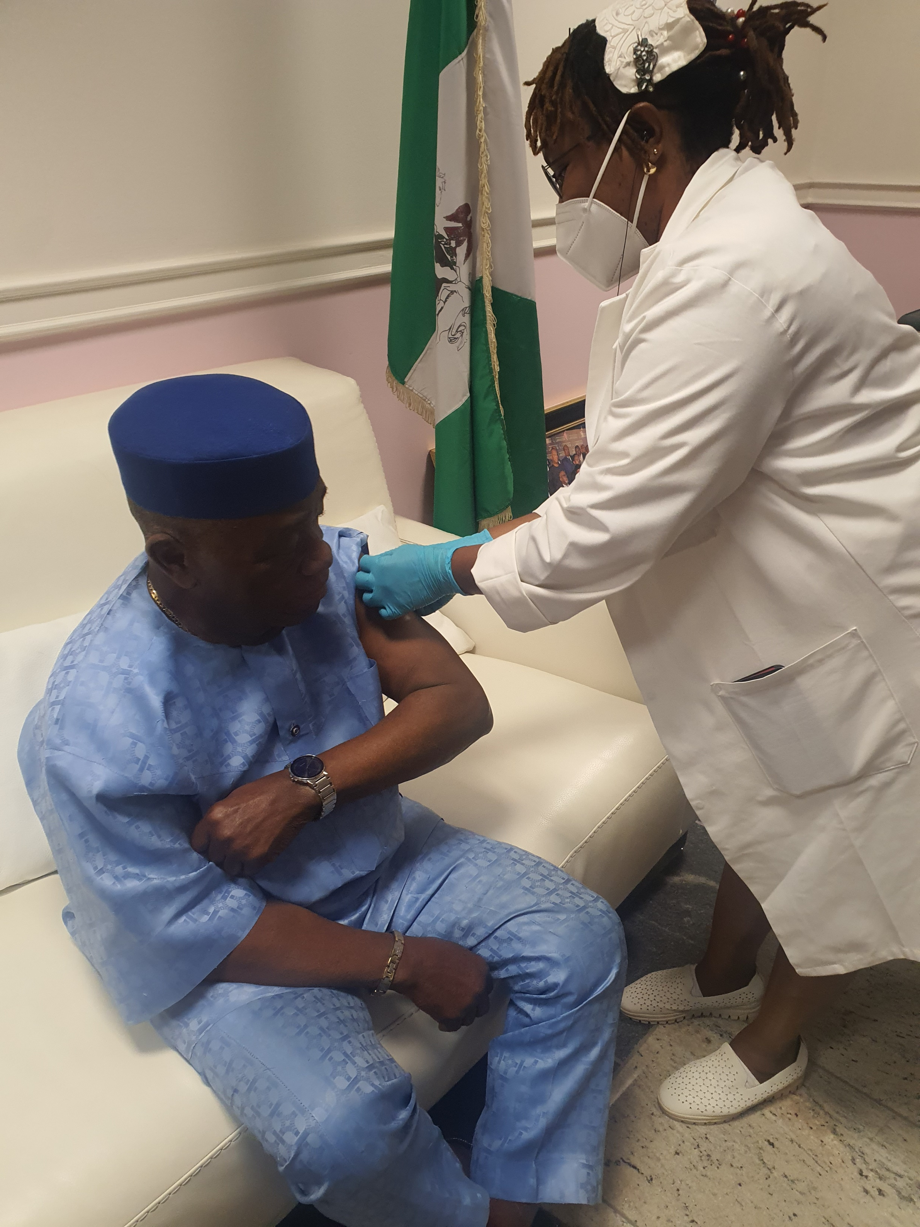
We led by example!

Slide 7
9,358 (30%)
1st dose administered as at 31St of August, 2021
Key Updates
4,524 vials (about 63,336 doses) of Moderna Vaccine received by the State on the
18th of August, 2021
Moderna
First dose was given on the 25th of August, 2021
4,936
Males vaccinated
4,422
Females vaccinated

Slide 8
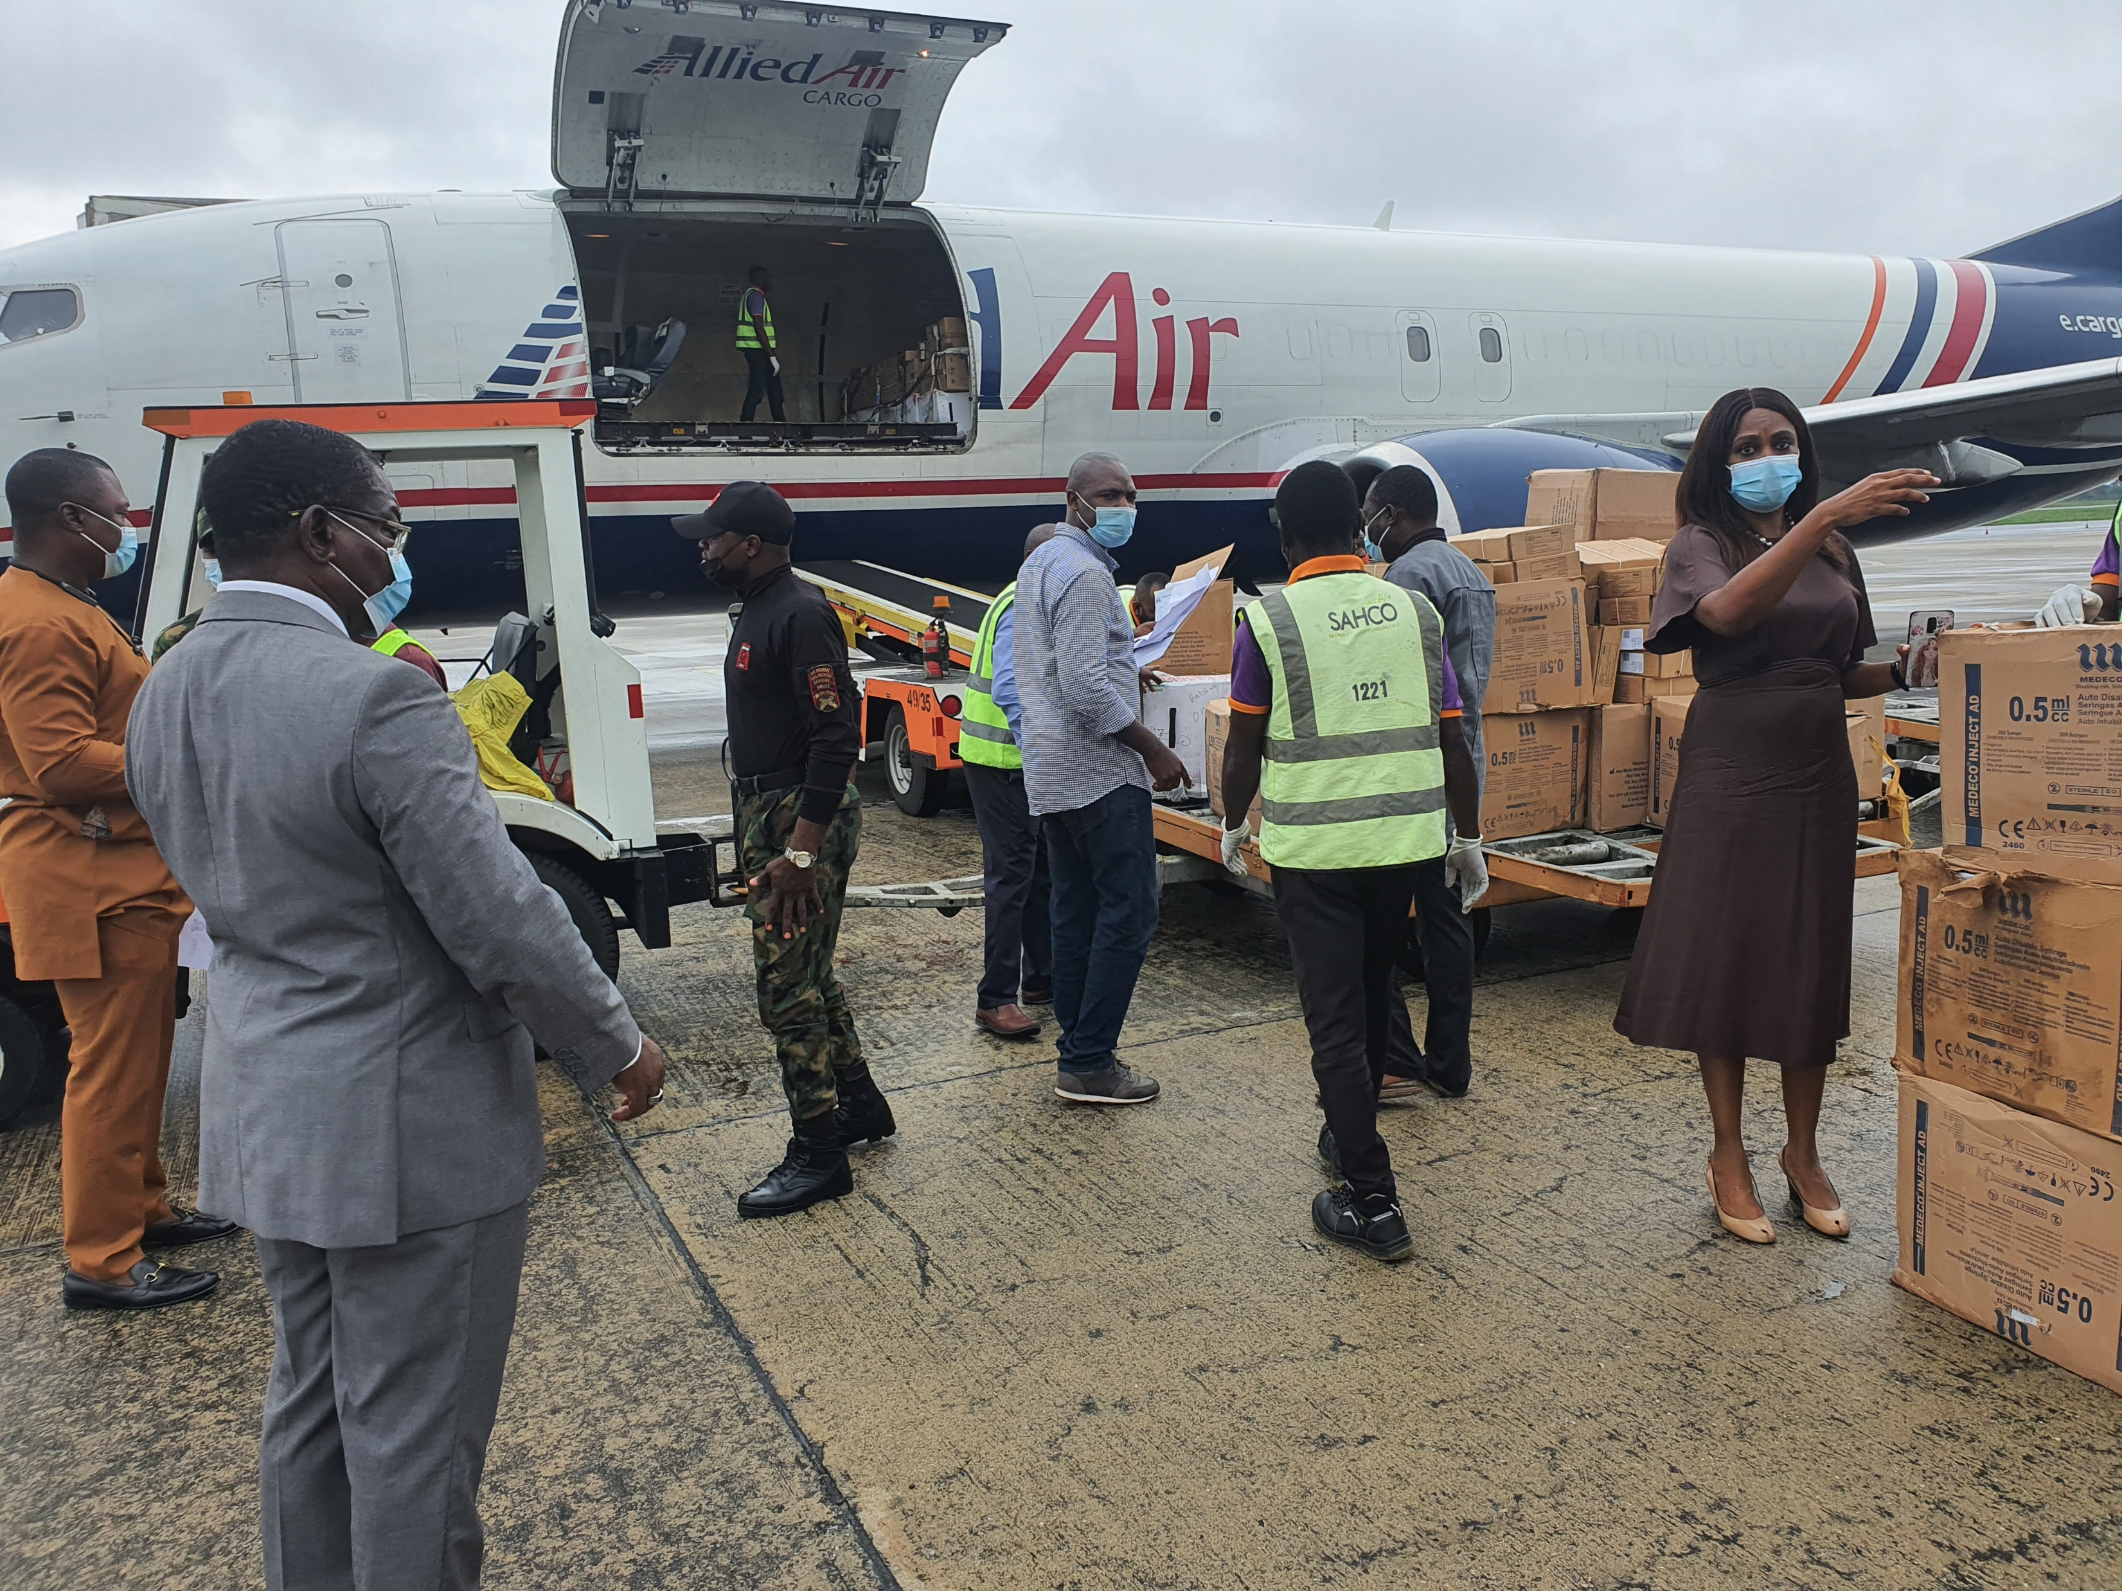
We received Moderna Vaccine too

Slide 9
Key Updates Continued
1096 vials (about 10,960 doses) of additional Astra Zeneca Vaccine received by the State on the
28th of August, 2021

Slide 10
Other Key Indicators
Key Updates
Serious AEFIs for 1st Phase: 1
Non serious AEFIs for 1st Phase: 185
Serious AEFIs for 2nd Phase @ 31st August, 2021: 0
Non serious AEFIs for 2nd Phase @ 31st August, 2021: 27

Slide 11
CHALLENGES
Key Challenges
Poor risk perception by members of the public
Fear of stigmatization
Inadequate IEC Materials
Low acceptability of vaccine
Inadequate social mobilization activities
Late release of logistics funds
Late and non-payment of allowances to personnel

Slide 12
Next Steps
Key Updates – Way forward
Continuous capacity building of health workers on Immunization Service Delivery
Increase and improve community-ownership for immunization
Sustain Community engagement and public sensitization
Increase awareness creation for vaccination
Engage with NPHCDA for prompt release of funds for logistics and personnel allowances

Slide 13
Next Steps
Key Updates – Way forward
Continuous capacity building of health workers on Immunization Service Delivery
Increase and improve community-ownership for immunization
Sustain Community engagement and public sensitization
Increase awareness creation for vaccination
Engage with NPHCDA for prompt release of funds for logistics and personnel allowances

Slide 14
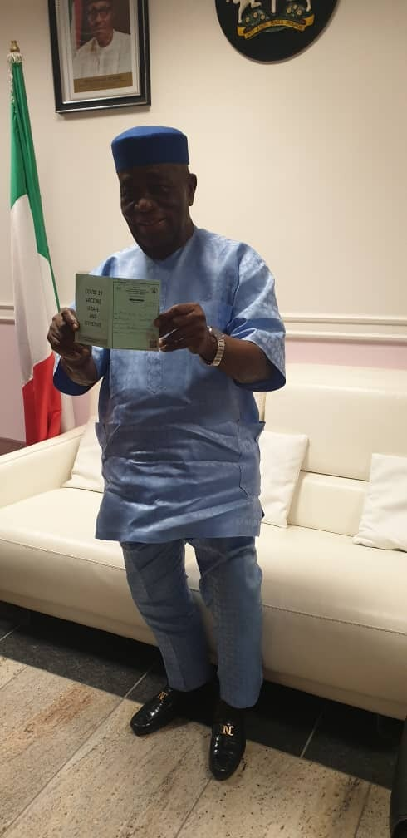

Slide 15
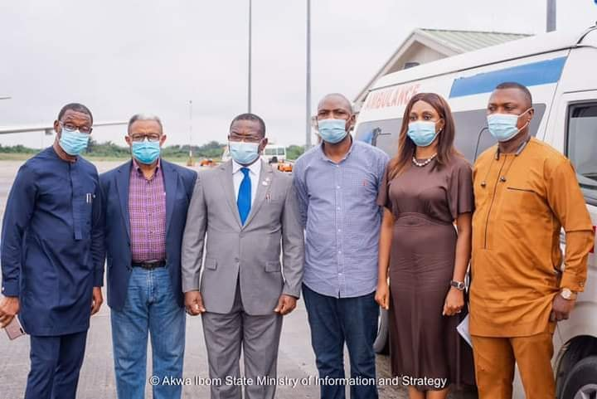
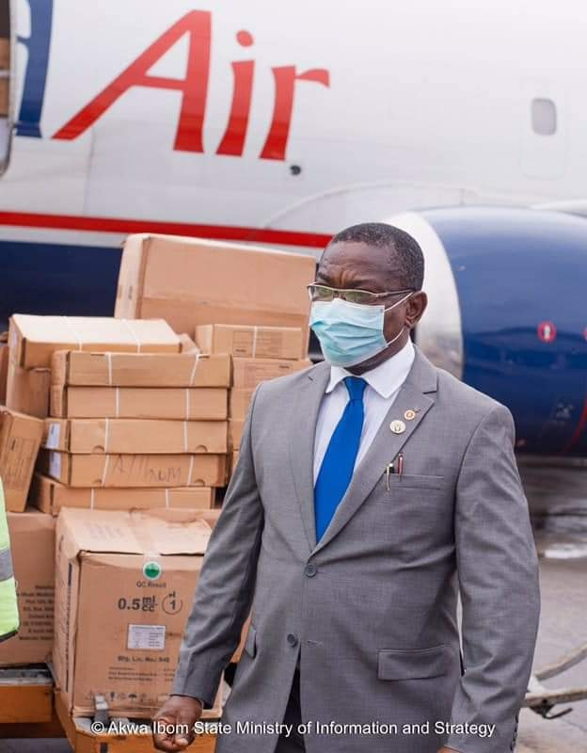

Slide 16
Sosongo
(Thank you)

